Slide 1
Developing Apps for Office and SharePoint using “Napa” and Visual Studio 2012
Jim Nakashima
Saurabh Bhatia
3-019

Slide 2
Agenda
The new Cloud App Model
Apps for Office
Apps for SharePoint
Publishing
Lots of demos along the way!

Slide 3
The new Cloud App Model

Slide 4
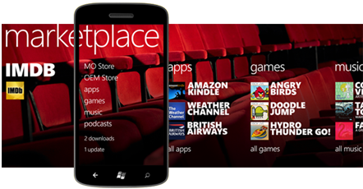
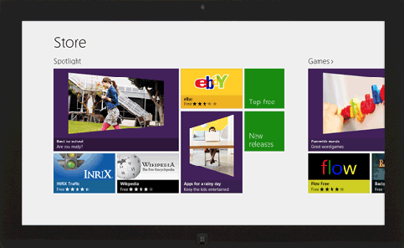
Apps for Office and SharePoint?
Bring the concept & value of apps on devices to Office & SharePoint
Store
Reach a billion Office users
Easy to find, try, buy and share
Corporate app catalog
Manage internal apps
Govern Store apps

Slide 5
Overview of the App Model
Unified and Cloud Ready
Works on-premises and in O365
Smooth lifecycle, built in monitoring, telemetry and isolation
Web-standards based
Embraces web technologies including HTML, JavaScript REST/ODATA, Oauth
End User Driven Experience
Launch the Office Store right from Office & SharePoint

Slide 6
Apps for Office

Slide 7
App Shapes for Office
Task Pane
App adjacent to the document
Content
App in the body of the document
Mail
Inline Pane on an email or appointment item

Slide 8
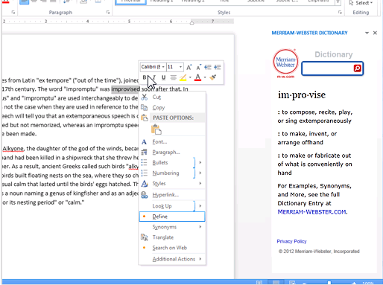
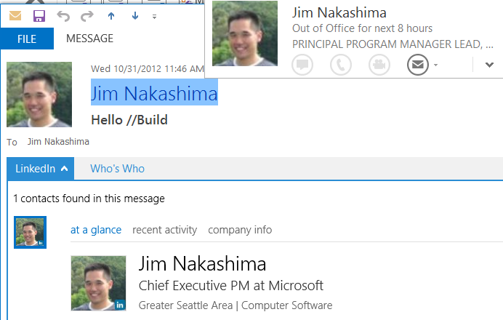
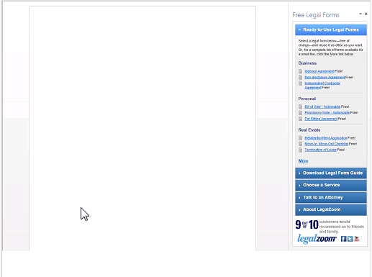
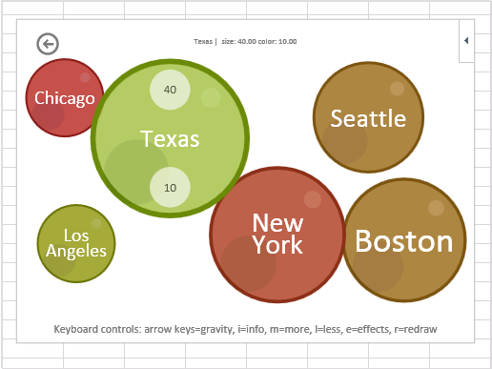
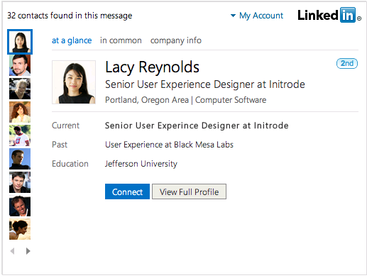
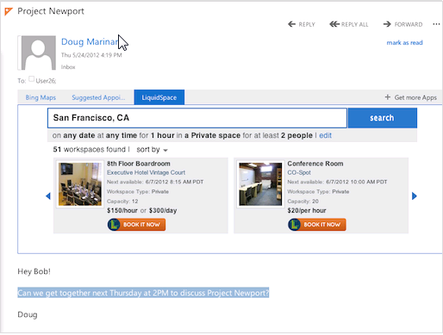
Example Apps for Office

Slide 9
Anatomy of an app for Office

Slide 10
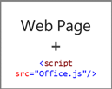
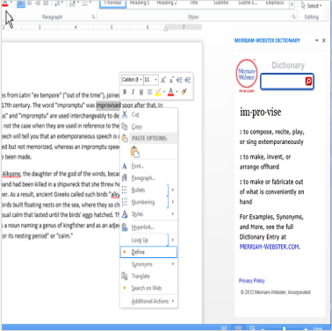
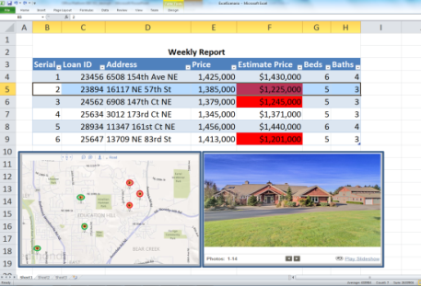
Anatomy of an app for Office
Web Server: Azure, IIS, LAMP, etc…
Office Store
SharePoint App Catalog
Office applications

Slide 11
Demo: Getting Started with “Napa”
Saurabh Bhatia

Slide 12
Bubbles Project
http://aka.ms/ndl3fe

Slide 13
Demo: Medal Tracker app
Jim Nakashima

Slide 14
Apps for SharePoint

Slide 15
App Shapes for SharePoint
Full page
Implement complete app experiences to satisfy business scenarios
Parts
Create app parts that can interact with the SharePoint experience
UI Command extensions
Add new commands to the ribbon and item menus

Slide 16
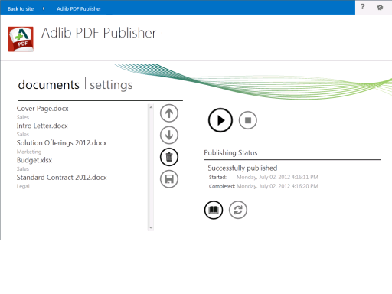
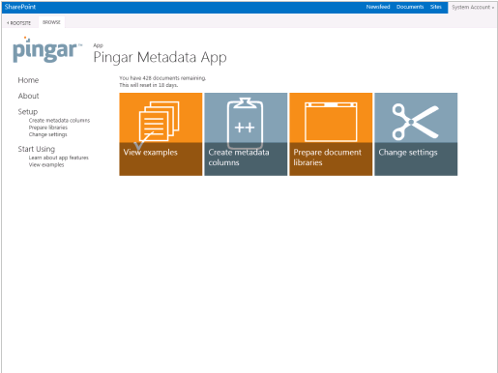
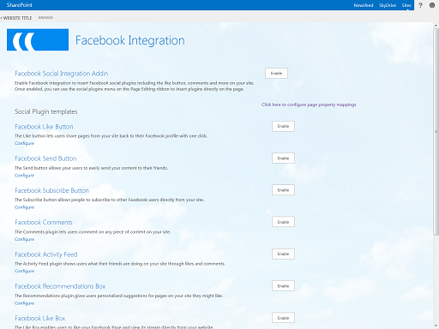
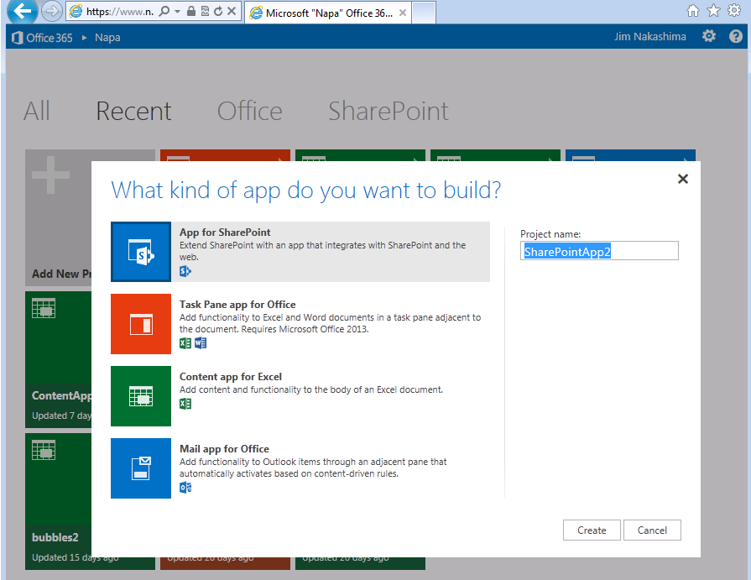
Example apps for SharePoint

Slide 17
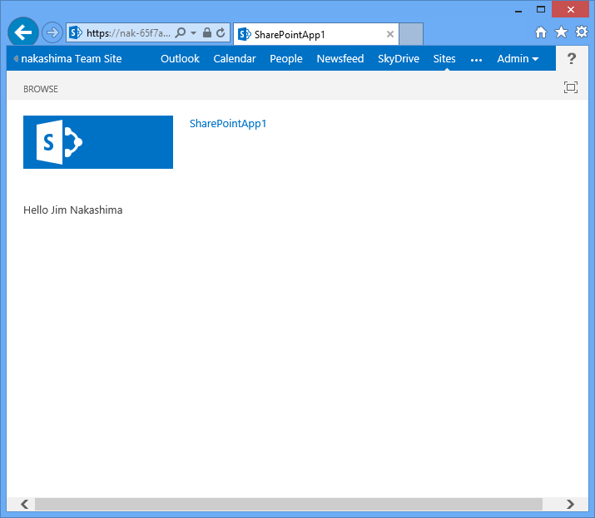
Anatomy of an app for SharePoint
Office Store
SharePoint App Catalog
SharePoint
Web Server: Azure, IIS, LAMP, etc…
Manifest
Content
Web Content
Web Browser

Slide 18
Demo: Building an app for SharePoint
Saurabh Bhatia

Slide 19
Flickr Project
http://aka.ms/p1bfye

Slide 20
Napa and Visual Studio
Napa is complementary to Visual Studio
Get started in Napa, continue in Visual Studio
Made it very easy to move to Visual Studio when you want to. For example:
Debugger
Support additional deployment topologies (i.e. server code)
ALM tools (SCC, Work Items, Profiler, etc.)
Additional SharePoint items (BCS, Workflow, etc.)

Slide 21
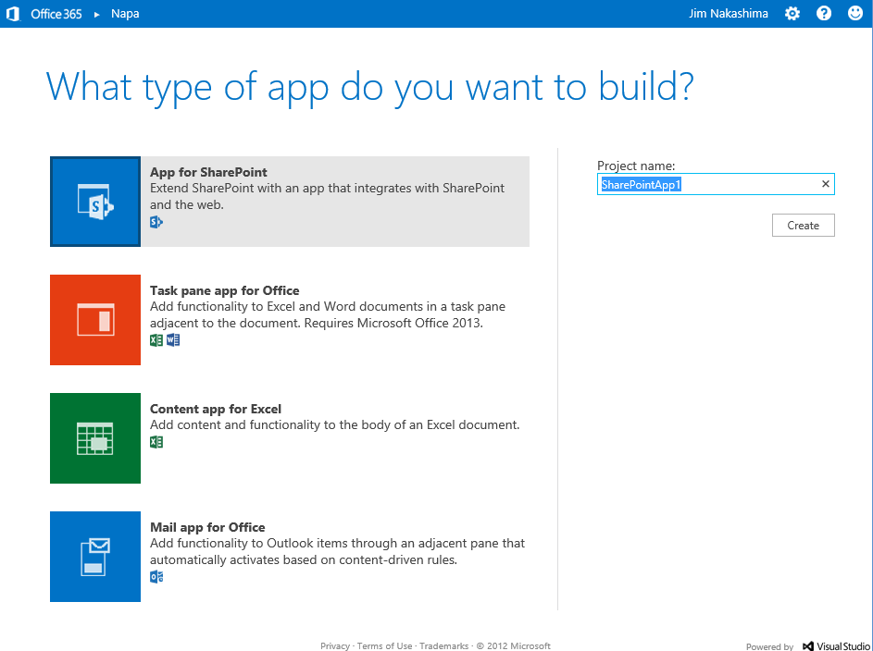
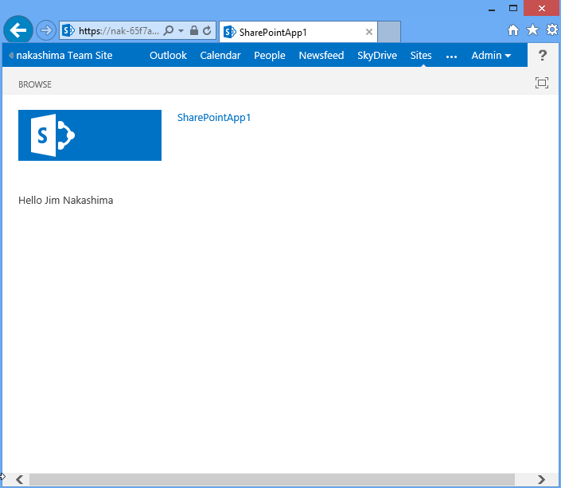
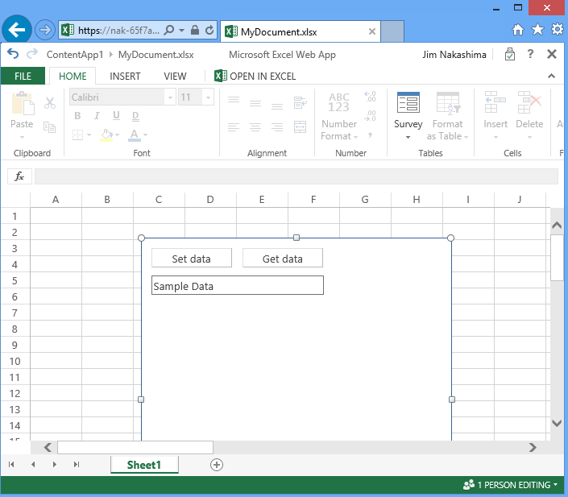
Napa is an app for SharePoint
Windows Azure
Office Store
Install the Napa app
SharePoint Developer Site
Side load SharePointApp1
JS
CSS
HTML
ASPX
App for SharePoint
Document
SharePointApp1
App for Office

Slide 22
Publishing

Slide 23
From Developer to End User
Office and SharePoint
Dev center
submission
Office Store
Integrated
Office Store
End users
TRIAL/ PURCHASE
Developer
TRIAL/ PURCHASE
Direct
Vendor/
IT projects
SharePoint
App Catalog
IT admin

Slide 24
Recap: Anatomy of an app for SharePoint
Office Store
SharePoint App Catalog
SharePoint
Web Server: Azure, IIS, LAMP, etc…
Manifest
Content
Web Content
Web Browser

Slide 25
Recap: Anatomy of an app for SharePoint
Office Store
SharePoint App Catalog
SharePoint
Azure Web Site managed by SharePoint
Manifest
Content
Web Content
Web Browser

Slide 26
Demo: SharePoint + Windows Azure
Saurabh Bhatia

Slide 27
Summary
Value of apps comes to Office Apps are easy to build
Web standards based
First class developer tools
Apps are easy to deploy and maintain
Built in monitoring, to track usage
Built in app lifecycle management
Office Store

Slide 28
Participate in Design Research
Participate in Microsoft Developer Division design research
Influence future design decisions
Get Microsoft software/hardware
Enroll with Kelly here today, or enroll online at http://aka.ms/yijoye

Slide 29
Office & SharePoint Resources
http://dev.office.com
http://blogs.msdn.com/b/officeapps
Please submit sessions evals on the Build Windows 8 App
or at http://aka.ms/BuildSessions

