Slide 1
Advanced Windows Azure: Infrastructure as a service (IaaS)
Michael Washam @MWashamMS
Senior Technical Evangelist
Session 3-026

Slide 2
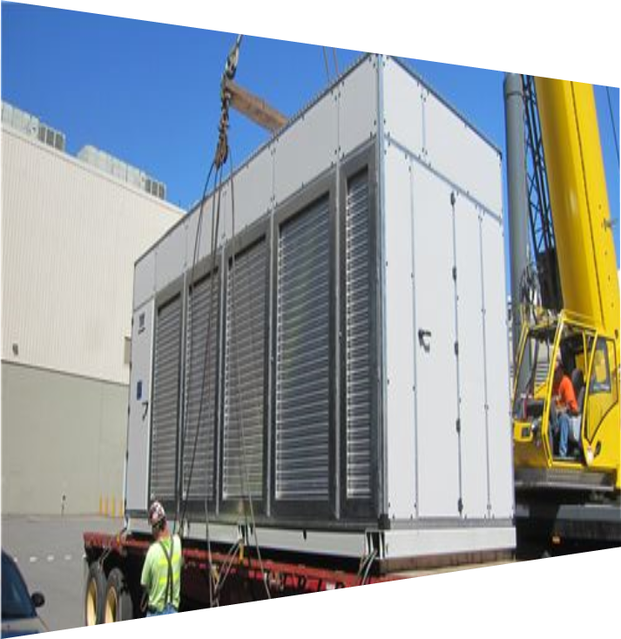
Agenda
Saving time and money with automation
Building a virtual machine library
Designing for scale and availability

Slide 3
Saving time & money with automation
Service management API (REST)
Power Shell Cmdlets
Cross platform CLI

Slide 4
Windows Azure service management API
REST based - https://management.core.windows.net
X509 certificate authentication
Calls are asynchronous (poll for result status)
Versioned – Set through HTTP header
"x-ms-version", "2012-03-01"

Slide 5
Service model glossary
Cloud service=Hosted service
Virtual machine=PersistentVMRole

Slide 6
Anatomy of a virtual machine
Cloud Service (Hosted Service)
ServiceName (myservice.cloudapp.net)
AffinityGroup Location
Deployments (Production, Staging)
PersistentVMRole (s)
Role Name=VMName
Role Type=PersistentVMRole
ConfigurationSets
NetworkConfigurationSet
WindowsProvisioningConfigurationSet
LinuxProvisioningConfigurationSet
OSVirtualHardDisk
DataVirtualHardDisks
RoleSize=ExtraSmall, Small, Medium, Large, ExtraLarge
(Data Center)
Deployment
Slot (Always Production for PersistentVMRole)
DeploymentName
RoleList
DnsServers
VirtualNetworkName
DnsServer
Name
Address
Virtual Network is Defined at the Deployment Level

Slide 7
Network configuration
PersistentVMRole
Role Name=VMName
Role Type=PersistentVMRole
ConfigurationSets
NetworkConfigurationSet
WindowsProvisioningConfigurationSet
LinuxProvisioningConfigurationSet
OSVirtualHardDisk
DataVirtualHardDisks
RoleSize=ExtraSmall, Small, Medium, Large, ExtraLarge
NetworkConfigurationSet
InputEndpoints
SubnetNames
InputEndpoint
LocalPort
Name
Port
Protocol
LoadBalancedEndpointSetName
LoadBalancerProbe
Path
Port
Protocol

Slide 8
Provisioning configuration
WindowsProvisioningConfigurationSet
ComputerName
AdminPassword
ResetPasswordOnFirstLogin
EnableAutomaticUpdates
TimeZone
StoredCertificateSettings
DomainJoin
PersistentVMRole
Role Name=VMName
Role Type=PersistentVMRole
ConfigurationSets
NetworkConfigurationSet
WindowsProvisioningConfigurationSet
LinuxProvisioningConfigurationSet
OSVirtualHardDisk
DataVirtualHardDisks
RoleSize=ExtraSmall, Small, Medium, Large, ExtraLarge
LinuxProvisioningConfigurationSet
HostName
UserName
UserPassword
DisableSshPasswordAuthentication
SSH

Slide 9
Storage
PersistentVMRole
Role Name=VMName
Role Type=PersistentVMRole
ConfigurationSets
NetworkConfigurationSet
WindowsProvisioningConfigurationSet
LinuxProvisioningConfigurationSet
OSVirtualHardDisk
DataVirtualHardDisks
RoleSize=ExtraSmall, Small, Medium, Large, ExtraLarge
OSVirtualHardDisk
HostCaching
DiskLabel
DiskName
MediaLink
SourceImageName
DataVirtualHardDisks
HostCaching
DiskLabel
DiskName
Lun
LogicalDiskSizeInGB
MediaLink

Slide 10
Creating a virtual machine
POST - https://management.core.windows.net/<subscription-id>/services/hostedservices/<service-name>/deployments
<Deployment xmlns:i="http://www.w3.org/2001/XMLSchema-instance" xmlns="http://schemas.microsoft.com/windowsazure">
<Name>testsmapi1</Name>
<DeploymentSlot>Production</DeploymentSlot>
<Label>testsmapi1</Label>
<RoleList>
<Role i:type="PersistentVMRole">
….
</Role>
</RoleList>
</Deployment>
First VM created with Create Deployment API
Deployment
PersistentVMRole
POST - https://management.core.windows.net/<subscription-id>/services/hostedservices/ deployments/<deployment-name>/roles
<PersistentVMRole xmlns:i="http://www.w3.org/2001/XMLSchema-instance" xmlns="http://schemas.microsoft.com/windowsazure">
<RoleName>myvm1</RoleName>
<RoleType>PersistentVMRole</RoleType>
….
</PersistentVMRole>
Additional VMs in the same deployment created with Add Role API
PersistentVMRole

Slide 11
Updating a virtual machine
GET - https://management.core.windows.net/<sub-id>/services/hostedservices/<service-name>/deployments/<deployment-name>/roles/<role-name>
Returns XML Representation of the Virtual Machine
PersistentVMRole
PUT - https://management.core.windows.net/<sub-id>/services/hostedservices/<service-name>/deployments/<deployment-name>/roles/<role-name>
<PersistentVMRole xmlns:i="http://www.w3.org/2001/XMLSchema-instance" xmlns="http://schemas.microsoft.com/windowsazure">
<RoleName>myvm1</RoleName>
<RoleType>PersistentVMRole</RoleType>
….
</PersistentVMRole>
Modify (add endpoints, disk changes etc..) and PUT changes
PersistentVMRole

Slide 12
Other operations
Capture | Save Virtual Machine as a re-usable image
Delete | Deletes the Virtual Machine (not the disks)
Download RDP File | Generates an RDP File for the VM
Start, Shutdown and Restart

Slide 13
Virtual machine automation with the Service Management API
Demo

Slide 14
Automating with Script
Automation
Query, Manage and Configure Virtual Machines across multiple subscriptions, cloud services and storage accounts.
Provision Fully Configured Virtual Machines
Storage and Networking Configured
Domain Joined (PowerShell)
From non-Windows Clients (Cross Platform CLI)
Virtual Networking
Completely Configure Virtual Networks from a Script (PowerShell)

Slide 15
Getting started with the PowerShell Cmdlets
Download from http://www.windowsazure.com/en-us/manage/downloads
Import-Module Azure
Get-AzurePublishSettingsFile
Import-AzurePublishSettings File
Get-AzureVM

Slide 16
Getting started with the Cross Platform CLI
Install node.js from http://nodejs.org
npm install azure –g
azure account download
azure account import
azure vm list

Slide 17
Automation with the Windows Azure PowerShell Cmdlets and the Cross Platform CLI tools
Demo

Slide 18
Building a virtual machine library
Using the capture feature to save customized images

Slide 19
Building a virtual machine library
Use pre-configured virtual machines to save time and reduce costs
Install custom agents for management and advanced deployment

Slide 20
Using capture to create an image
Blob Storage
Identical/similar deployment instances using common OS image as start
Platform Image
Boot
VM
Blob Storage
Customize
Generalize
Capture
Capture VM Saves Customized Image to Your Image Library

Slide 21
Configuring startup tasks
Allow the ability to run a Script when the virtual machine boots
Enable remote PowerShell
Configure roles and install features
Download and execute other Scripts or software

Slide 22
Bootstrapping a virtual machine
Demo

Slide 23
Designing for scale and availability
Using availability sets and the load balancer to achieve both

Slide 24
Availability and load balanced sets
Availability sets
Distributes your VMs on separate physical hardware
Tells the fabric controller in what order to update virtual machines (rolling upgrades)
99.95% SLA
Load balanced sets
Distribute traffic in round robin based on port and protocol

Slide 25
End to end highly available solution
Redundancy at every level
Database
SQL-AVSET
Web Server
IIS-AVSET
Internet
Mirroring
LB
Web Server
Database

Slide 26
HTTP load balancer custom probes
Load balancer polls every 15 seconds
Receives other than 200 OK (HTTP)
Traffic stops until 200 Received
Continues polling
Cloud Service
HTTP 500
Web1
/healthcheck.aspx
Traffic
Probe
LB
PORT 80
Web2
/healthcheck.aspx
Traffic
Probe
Traffic
Web3
/healthcheck.aspx
Probe

Slide 27
Using HTTP health probes with the load balancer
Demo

Slide 28
TCP load balancer custom probes
Load balancer polls every 15 seconds
Looks for ACK on socket connect
Traffic stops until ACK received
Continues polling
Cloud Service
SQL1
1433
Traffic
Probe
LB
PORT 1433
SQL2
1433
Traffic
Probe
Traffic
SQL3
1433
Probe

Slide 29
Using TCP health probes with the load balancer
Demo

Slide 30
Wrapping up
You just saw…
How to save time and money with automation
Build a virtual machine library with capture
Use custom probes for scale and availability
For more information:
Follow me on Twitter @MWashamMS
PowerShell Examples: michaelwasham.com
Don’t forget to fill out the eval ☺

Slide 31
Related sessions
Session 2-011
Introduction to Windows Azure Infrastructure as a Service - Mark Russinovich
10/31 1:45PM – 2:45PM
(right before this session) ☺

Slide 32
Resources
Follow us on Twitter @WindowsAzure
Get Started: www.windowsazure.com/build
Please submit session evals on the Build Windows 8 App or at http://aka.ms/BuildSessions

