Slide 1
SQL, noSQL, BigData, Tables,
Blobs and more…
What’s a developer to do?
David Campbell
Technical Fellow

Slide 2
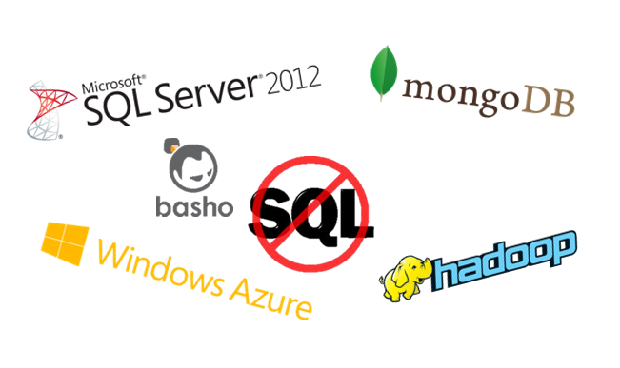
Overview
Describe the Landscape & How to Decide
Explain “Big Data”
Map/Reduce Drill-Down
Answer Questions
Audience Participation…

Slide 3
Life Was Simple
“Forms Over Data”

Slide 4




Not anymore…
Device / Cloud
Multi-dimensional Experiences
Social Integration
Rapid Evolution
Volatile Scale

Slide 5






The Result
A Storage Zoo…

Slide 6
What do Developers Want?
Rapid Development and Evolution
    Persistence Ignorance
    Schema Evolution / Dynamic Schema
Friction Free Scaling
    O(1) Management Scale
    Partition Ignorance
    HA & Resilience
Maximize Return on Available Data
    Audience Analytics
    Recommendations
?

Slide 7
A Conceptual Model
How do we make sense of this?
Data Model
Consistency Model
Cluster Model
Query Model
View Model

Slide 8
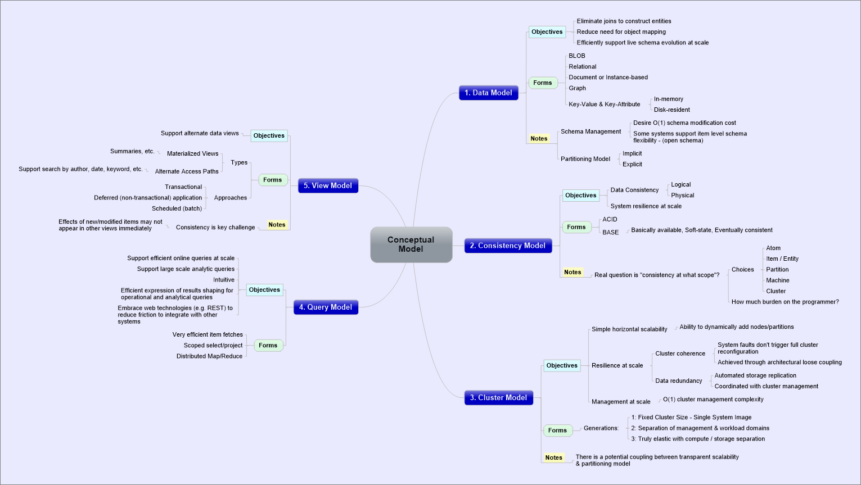
It’s Simple – Really!

Slide 9
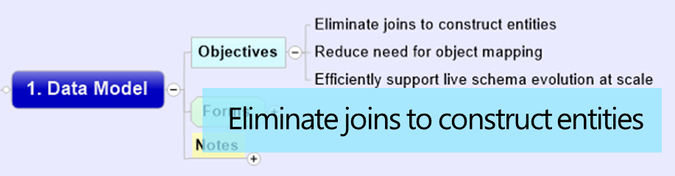
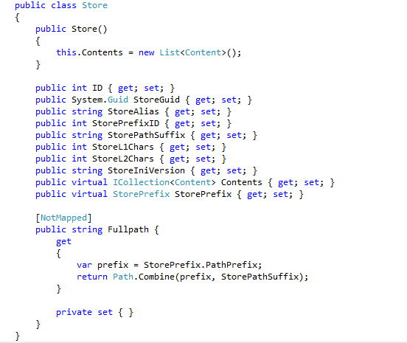
Smart Choice = Separation & Composition
Entity Framework
Code First
Migrations

Slide 10
The Cost of Consistency
Machine
Rack
Data Center
Internet
Database
Cost~{friction, performance, availability,…}
Database
Attribute
Entity
Shard
Data Model Level ----
System Implementation Level ----

Slide 11

SQL Azure DB Federations
Root
ACID consistency within members
(shards)
Eventual consistency across members
M1
M2
M3
M4
M5

Slide 12
Takeaway: How to Choose
Conceptual Model Drives Smart Choices
You can mix and match – baby & bathwater, etc.
TNSTAAFL
You are now smarter than most bloggers on this topic!

Slide 13
Azure Offerings
Azure Blob Storage
  Elastic Inexpensive storage
Azure Tables
  Elastic Key/Attribute storage
Azure Caching
  Elastic Key/Object cache
Azure SQL Database
  Elastic RDBMS with sharding capabilities

Slide 14
Explaining “Big Data”

Slide 15
Top Level Value Flow
What is “Big Data”
really about?
Awash in “Ambient Data”
  Free to acquire
  Cheap to store
“Information Production”
  Turns Ambient Data into Information
Insight Generation
  Turns Information into Insights & Actions
Ambient Data
Information Production
Insights & Actions

Slide 16
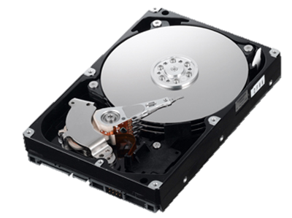
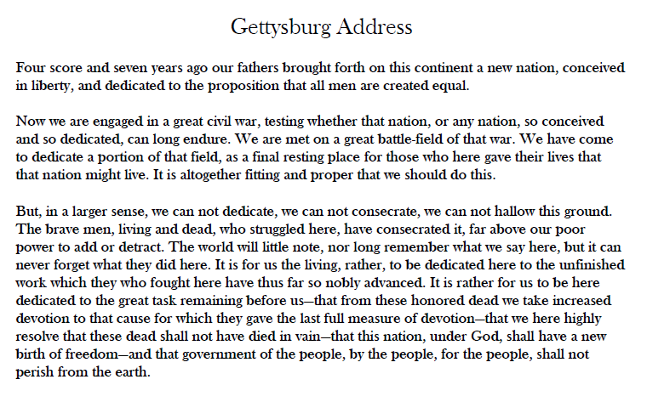

Data Acquisition Cost → $0
$1.10
$0.00
$1,000
$1,000,000,000
From: $1B/TB To: ~$0/TB

Slide 17
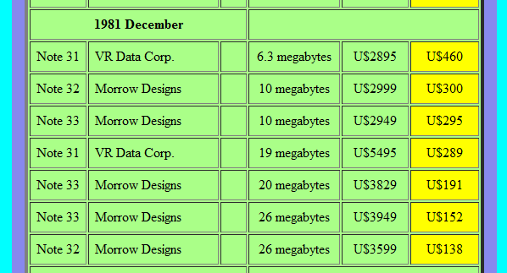
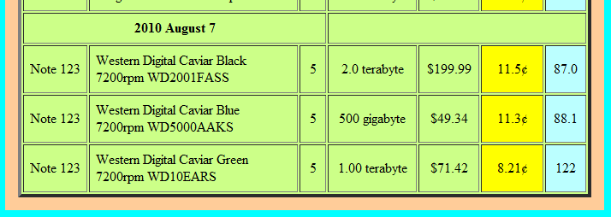
Data Storage Cost → $0
$December 1981 - $660M/TB
August 2010 - $100/TB
From: $660,000,000/TB To: $100/TB in 30 years
Source: http://www.littletechshoppe.com/ns1625/winchest.html

Slide 18
The Big Dataflow…
Traditional Systems
  Data Warehouses / Marts
  Cubes
  …
Source
Source
Source
Digital Shoebox
Source
Information
Production
Source
Source
Source
Source
Source
Emergent Systems
  Deep data mining
  Machine Learning
  Near real-time prediction
  …

Slide 19
Standard Data Analytics Lifecycle
Build a physical model
Answer the question
Build a logical model
Collect the data
Load the data
Question
Tune
Time →
Often weeks to months

Slide 20
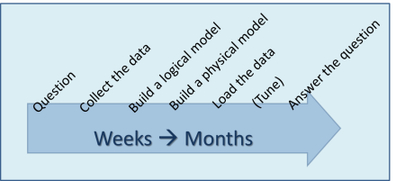
Lifecycle of a Question
Validation
Question
Different Question
Worth asking again?
Not interesting
Make it repeatable
Bring it to production

Slide 21
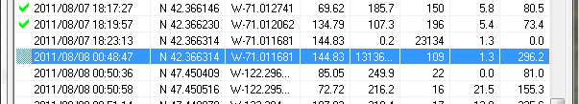
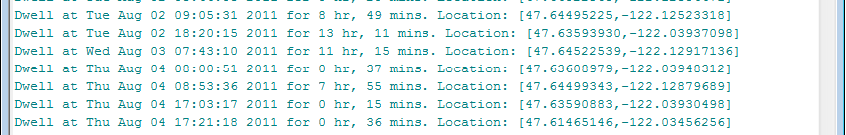
Personal Example - GPS
T₃
Tree of transforms and filters
Cleansing often happens in transformed
domain
  E.g. Where I slept each night…
Can produce higher level information
  [DwellAtHome],[RouteToWork],
  [DwellAtWork] = ‘Commute to work’
Using higher level information:
  Commute duration ← f(leavingTime)
T₂
Source
T₁
T₄
T₅

Slide 22
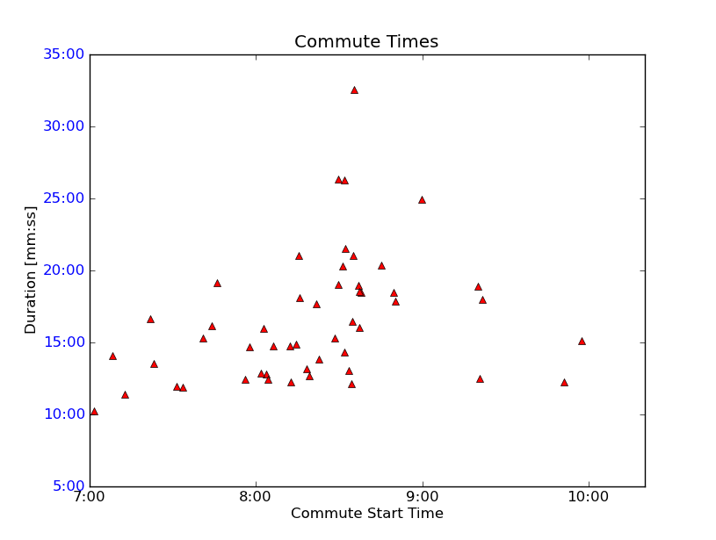
Commute Time as f(leaveTime)

Slide 23
Event & State Correlation
Dwell geolocation
+
2011-06-10 06:18:26, 2011-06-10 06:16:18, 0.04
2011-06-10 06:21:18, 2011-06-09 08:27:50, 21.89
2011-06-10 06:24:37, 2011-06-09 07:43:58, 22.68
2011-06-10 06:26:48, None, 0.00
2011-06-10 06:29:37, 2011-06-09 06:53:34, 23.60
2011-06-10 06:34:41, 2011-06-09 12:00:25, 18.57
2011-06-10 06:39:52, 2011-06-09 17:44:54, 12.92
2011-06-10 06:43:18, 2011-06-09 14:28:49, 16.24
Outlook statistics
=
How much email do I send from home vs. at work?

Slide 24
Map / Reduce Systems
What’s the deal with Hadoop and other Map/Reduce systems?
Developer Friendly Information Production Machine
Simple to Understand
Simple to Develop For
Inherently Scalable

Slide 25
EYNTK about MapReduce on One Slide
Map
Reduce
Map
1
2
3
4
5
Map
Reduce
Map
MapReduce framework splits input up into groups of data
MapReduce framework calls your Map function – Map(input)
  Your Map function processes input and returns 0 or more (key,value) pairs
MapReduce framework collates keys (“Shuffle”)
MapReduce framework calls your Reduce function – Reduce(key, []values)
  Your Reduce function processes values and returns a result
MapReduce framework writes your result to the filesystem

Slide 26
HDInsight
Hadoop on Windows {Azure, Server, Laptop}
Hortonworks HDP distribution
.NET Map/Reduce API
Linq to Hive

Slide 27
Let’s Look at Some Code…

