Slide 1
Developing Big Data Analytics Applications with JavaScript and .NET for Windows Azure and Windows
Matt Winkler (@mwinkle)
Principal Program Manager
3-038

Slide 2
What is big?

Slide 3
Image courtesy of CERN

Slide 4
The Large Hadron Collider produces 1 PB/sec

Slide 5
But, I don’t have a Large Hadron Collider

Slide 6
But you do have…
Sensors
Clicks
Logs
Transactional records
Call centers
Medical transcriptions
Images
Documents
Signals from social media
Simulations

Slide 7
Systems like Hadoop evolved to extract value from this data, shaped at the
intersection of physics and economics

Slide 8
Redundant, distributed, scalable storage
Easily distribute the computation

Slide 9
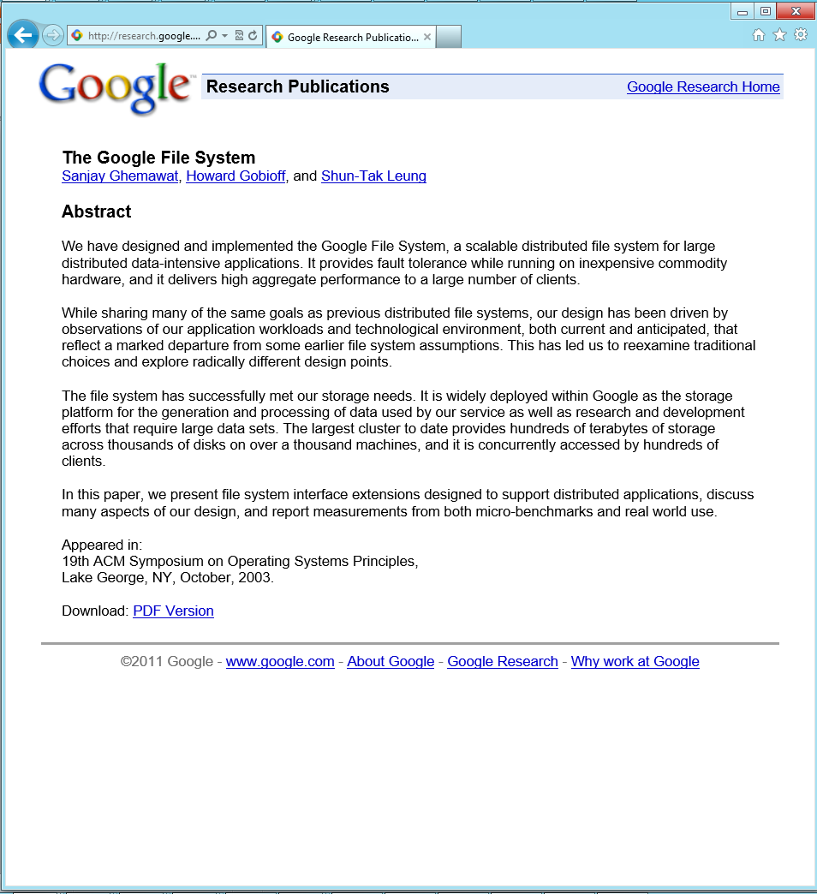
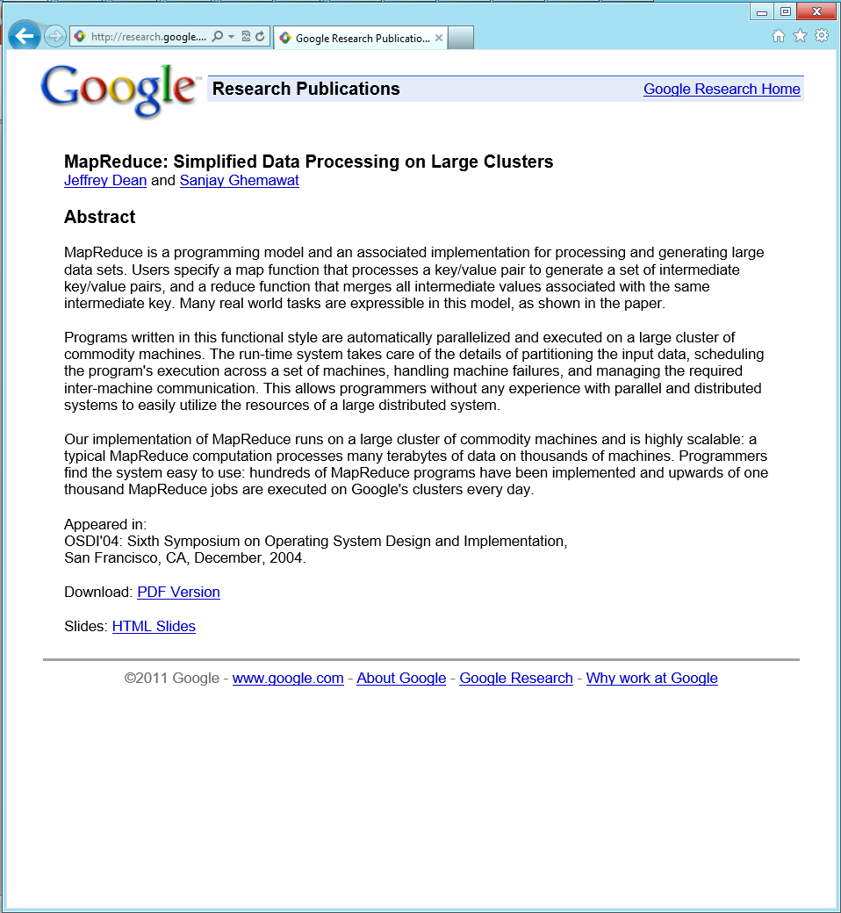
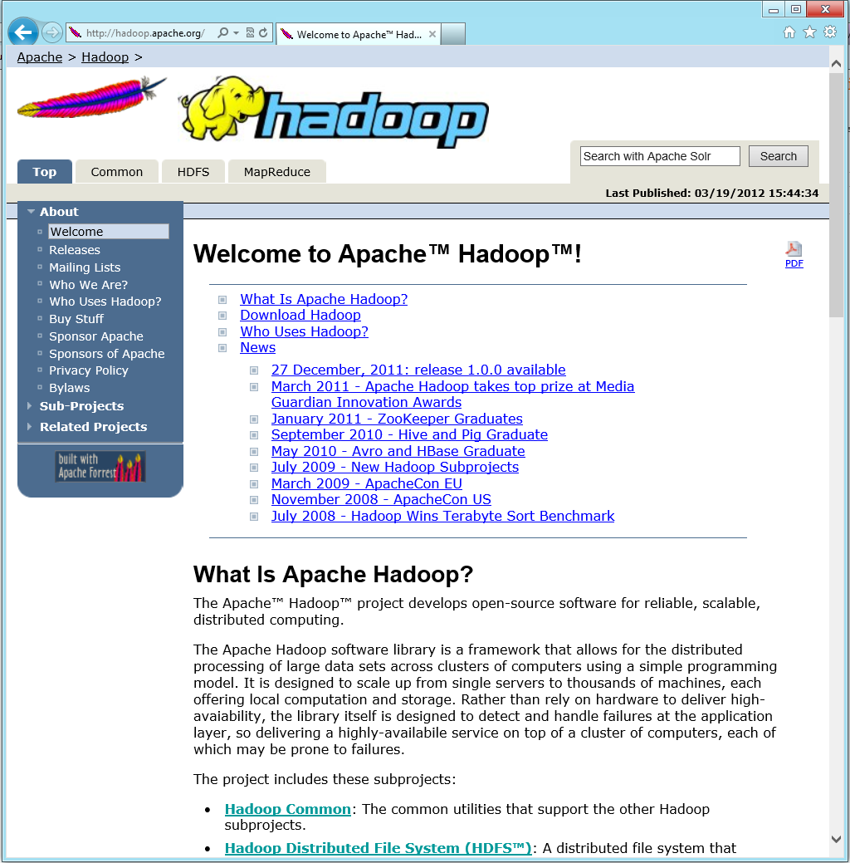
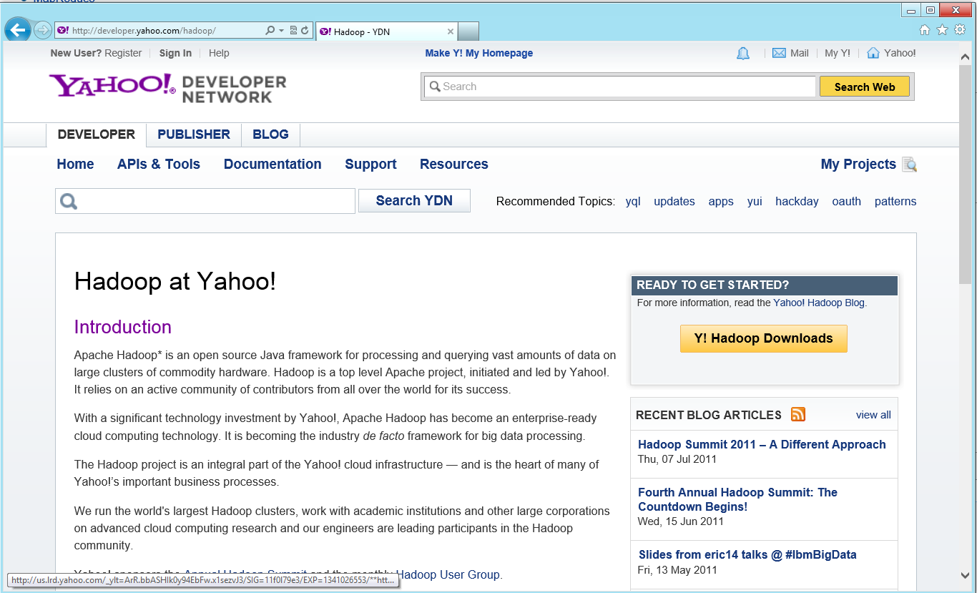

Slide 10
Getting Started with HDInsight on Azure and Windows

Slide 11
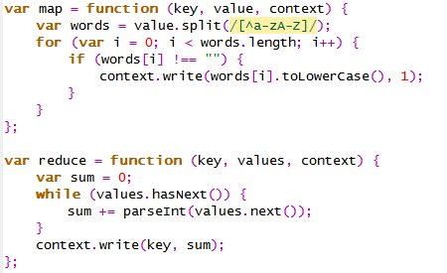
Introduction to Map/Reduce
In Practice, WordCount
Functionally
Map f(k1,v1) ➔ list(k2,v2)
The quick brown fox jumps over the lazy dog
Reduce f(k2, list(v2)) ➔ (k2, v3)
Map
In Code
(the,1) (quick,1), (brown,1), (fox,1), (jumps,2) (over,1), (the,1),(lazy,1),(dog,1)
Shuffle
(the,(1,1)) (quick,1), (brown,1), (fox,1),(jumps,1) (over,1),(lazy,1),(dog,1)
Reduce
(the,2) (quick,1), (brown,1), (fox,1), (jumps,1),(over,1), (lazy,1),(dog,1)
Then, scale to TB/PB of data over 10’s, 100’s or 1000’s of nodes

Slide 12
Map/Reduce in JavaScript

Slide 13
Map/Reduce in .NET

Slide 14
What’s After Wordcount?
Reverse indexing
Distributed data cleansing
Data transformation
Machine learning algorithms
Traditional analytics
Predictive analytics
Recommended Reading: Data-Intensive Text Processing with MapReduce

Slide 15
Hive, Like SQL, Just Bigger
You write
Hive Compiles
Hadoop Executes
SELECT
airlinelocal.Origin,
airlinelocal.Dest,
airlinelocal.Carrier,
AVG(averagearrivaldelay –
airlinelocal.ArrDelayMinutes)
as AvgDiffFromAverage
FROM
airlinelocal
JOIN
reallybadroutes
ON
(airlinelocal.Origin = reallybadroutes.Origin AND
airlinelocal.Dest = reallybadroutes.Dest)
GROUP BY
airlinelocal.Origin,
airlinelocal.Dest,
airlinelocal.Carrier
ORDER By
AvgDiffFromAverage DESC
Hive M/R Filter
Hive M/R Join
Hive M/R Aggregate
Hive M/R Order

Slide 16
Hive LINQ To Hive

Slide 17
Easy to get started Write Hadoop jobs in the language of your choice Use your tools to process big data

Slide 18
Resources
Microsoft Big Data
Azure HDInsight
.NET SDK For Hadoop
Please submit session evals on the Build Windows 8 App or at http://aka.ms/BuildSessions

Slide 19
Resources
Follow us on Twitter @WindowsAzure
Get Started: www.windowsazure.com/build
Please submit session evals on the Build Windows 8 App or at http://aka.ms/BuildSessions

Slide 21
Appendix beyond this

