Slide 1
Windows Phone 8 Native C/C++ Game Development
Sam George
Principal Group Program Manager
Windows Phone
3-046

Slide 2
Windows Phone 8 game platform goals
Support Existing Games (XNA)
Reduce the Cost to Target Windows Phone
Enable Cutting Edge Performance
Make it Easy to Make Money

Slide 3
So, how did we do?

Slide 4
Reduce the cost to target Windows Phone
C++ Code Portability
Reuse your own C++ code
Use open source C++ libraries
Cocos2D, SharpDx
Competitive Middleware Support
Used by over 50% of games
Havok, Unity, FMOD, Scaleform, Wwise, Marmalade
Windows 8 Aligned Game Platform
Direct3D app supported Windows 8 and Windows Phone 8
Large shared API set

Slide 5
Enable cutting edge performance
New Expansive C++ API Surface
Graphics - Direct3D 11.1
Audio - XAudio2 / WASAPI / IMFMediaEngine
Video - IMFMediaEngine
Networking
All critical subsystems games need
File system, threading, input, sensors and more

Slide 6
Make it easy to make money
In-app purchasing
Consumables: gold coins, poker chips
Durables: additional game levels
7.X Light Up
New global marketplace support
191 countries
50 languages
MO billing, international credit cards, PayPal, local options

Slide 7
Native games
Demo

Slide 8
Ross O'Dwyer Head of Developer Support

Slide 9
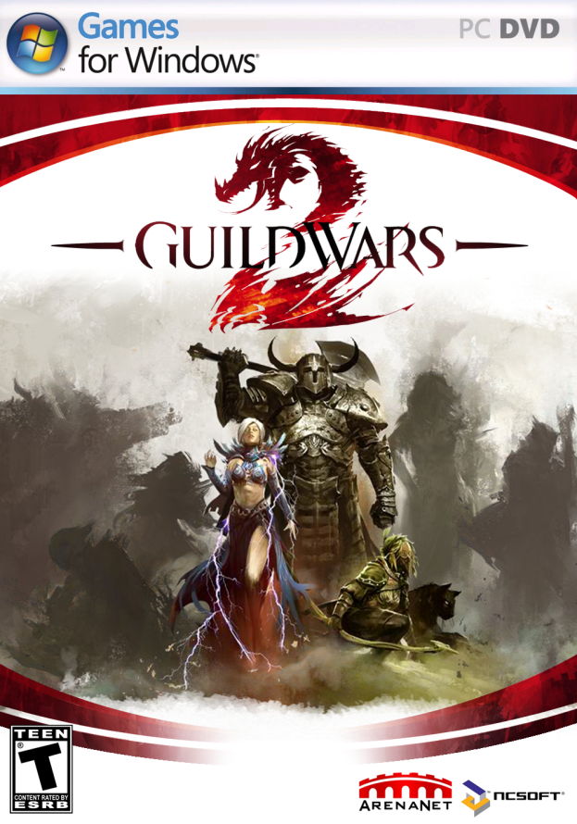
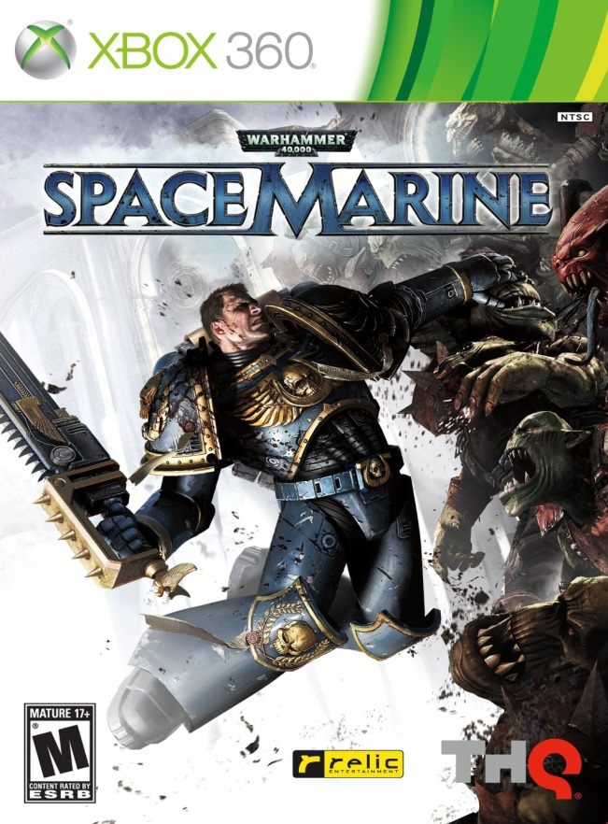
Havok-powered titles

Slide 10
App models & APIs

Slide 11
Windows Phone 8 App Models
Direct3D App
C++
XAML App
C# / VB
Direct3D
Interop
C++
Reuse
Windows Phone 8 API Set
Graphics
Audio
Media
Common
.NET FX
File System
Networking
Input
CoreCLR
Commerce
Base Types
Sensors

Slide 12
Direct3D App Model
C++ Only
Access to the new Windows Phone 8 API surface
Windows Runtime APIs, COM and Win32 style APIs
Reuse your C++ code
Statically linked or a dll
Supports activation and app lifecycle
CoreApplication, CoreWindow, CoreDispatcher

Slide 13
Direct3D app
Demo

Slide 14
Windows Phone 8 app models
Direct3D App
C++
XAML App
C# / VB
Direct3D
Interop
C++
Reuse
Windows Phone 8 API Set
Graphics
Audio
Media
Common
.NET FX
File System
Networking
Input
CoreCLR
Commerce
Base Types
Sensors

Slide 15
XAML App Model
XAML App Model extended
C++ Code Reuse
Your own or other C++ libraries
Call COM / Win32 style APIs from within Windows Runtime Components
Full access to the new Windows 8 shared API surface
Windows Phone Runtime APIs, COM and Win32 style APIs
Direct3D Composition
Render into a XAML scene from C++/Direct3D
New elements

Slide 16
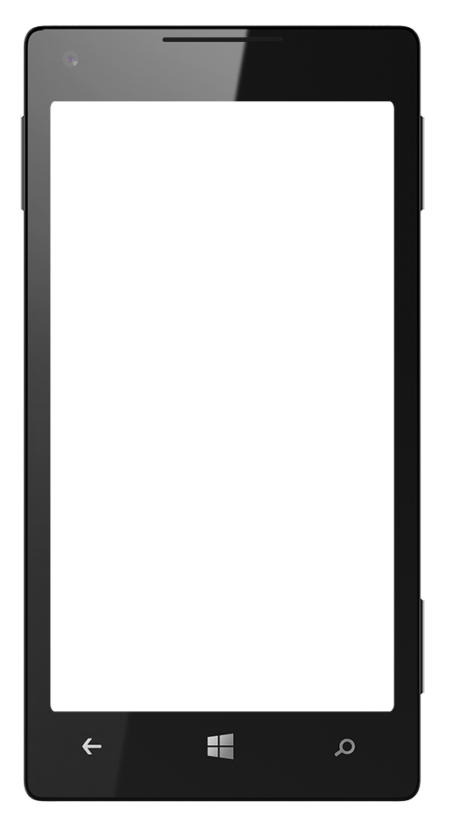
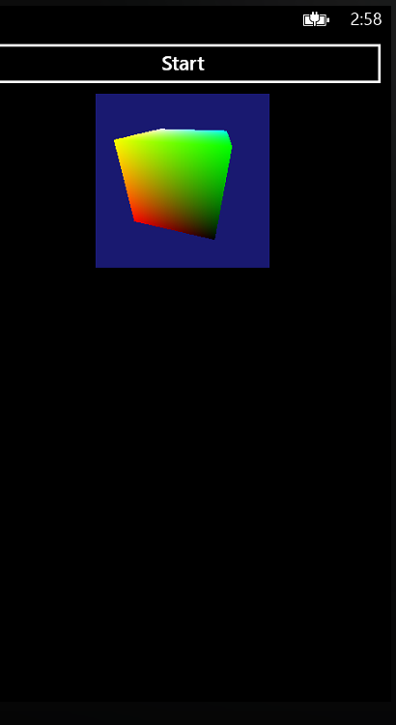
DrawingSurface
Place anywhere
Draw to it from C++/Direct3D
Composited automatically with other XAML elements
Uses a Direct3D Swap Chain
<StackPanel>
<Button Content="Start"/>
<DrawingSurface Height="200“ Width="200"/>
</StackPanel>

Slide 17
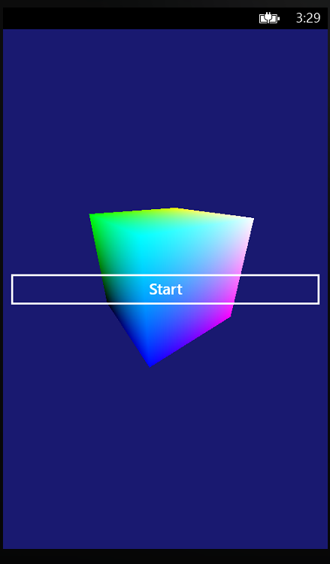
DrawingSurfaceBackgroundGrid
Must be the root element of a page
You render to the background from C++/Direct3D
Does not use a Direct3D Swap Chain
Performs better
Grid children are rendered on top
<DrawingSurfaceBackgroundGrid>
<StackPanel VerticalAlignment="Center">
<Button Content="Start"/>
</StackPanel>
</DrawingSurfaceBackgroundGrid>

Slide 18
XAML and Direct3D
Demo

Slide 19
Choosing Between XAML & Direct3D App
XAML App
You need access to Live Tiles, Notifications, Background Agents, XAML UI, etc
Direct3D App
You need the absolute best performance
You don’t need what the XAML App gives you
How hard is it to switch?
It is very straightforward

Slide 20
New Windows Phone 8 APIs

Slide 21
Input & Sensors
Windows Runtime APIs
Input
PointerPressed, PointerMoved, PointerReleased
KeyDown, KeyUp, CharacterRecieved, Show/Hide Onscreen Keyboard
Windows.Devices.Sensors
Accelerometer
Gyrometer
Orientation
Compass
Inclinometer
Supports Polling and Events

Slide 22
Input
Demo

Slide 23
Graphics
API
Direct3D 11.1
Hardware capabilities
Feature level 9.3
Subset of Windows 8
No Windows Imaging Component (WIC)
No Direct2D or DWrite
Removed legacy features
No GDI
No D3DX
No fixed function
No runtime shader compilation
Use DirectXTex
(http://codeplex.com/directxtex)
Use DirectX Tool Kit
(http://codeplex.com/directxtk)
Use Visual Studio

Slide 24
Feature Level 9.3
Included
Shader model 4_0_level_9_3
Similar to vs_2_a and ps_2_b (2.0 turned up to 11)
Long pixel shaders (512 instructions)
Dynamic flow control
Gradient instructions
Max texture size = 4096
Conditional non-pow-2 textures
BC1-BC3 texture compression
Floating point textures
Multiple rendertargets
Hardware instancing
Occlusion queries
Separate alpha blend
Not Included
Geometry shaders
Hull/domain shaders
DirectCompute
Resource arrays
BC4–BC7 compression
Vertex texture fetch

Slide 25
Shaders
Demo

Slide 26
Audio Support
Sound effects
Looping, 3D positioning, DSP effects, etc
Many at once
In-memory PCM or ADPCM data
Background music
One at a time
Compressed (MP3, WMA)
Asynchronously streamed from the filesystem or URI
Raw PCM streams
Render & capture
Low level API
XAudio2
IMFMediaEngine
WASAPI

Slide 27
Audio in the Game World
Enemies
Explosion
Weapon fire
Alarm
Teammates
Player

Slide 28
XAudio2 Audio Graph Architecture
Player’s Weapon
Memory Buffer(s)
Source Voice
Effect
Chain
Nearby Alarm
Final mix to output stream
Enemies Behind Box
Obstruction submix
Memory Buffer(s)
Source Voice
WASAPI Output
Mastering Voice
Effect
Chain
Memory Buffer(s)
Source Voice
Effect
Chain
Submix Voice
Effect
Chain
Memory Buffer(s)
Source Voice

Slide 29
Background music: IMFMediaEngine
COM based
Initialize and set source
Source can be URI or IMFByteStream
Control playback
Play, Pause, Stop
Loop, Seek

Slide 30
Background Music
Demo

Slide 31
Video Cut Scene Support - IMFMediaEngine
Initialize and set source
Control playback
Render video
Game retrieves video frame and renders video frame on the texture of an object in the game
Game uses OnVideoStreamTick to find out whether a new video frame is ready
Game uses TransferVideoFrame to copy video frame to DXGI surface
OS can render RGB / NV12 formats

Slide 32
Networking
Covered extensively in Networking talk
StreamSocket/StreamSocketListener
TCP Sockets with SSL Support
DatagramSocket
UDP Sockets
PeerFinder
Bluetooth & NFC
Supports App->Device and App->App
XmlHttpWebRequest2
C++ HTTP Support
WinSock

Slide 33
File System
Windows Runtime APIs
StorageFile, StorageFolder, ApplicationData
Supports “ms-appx” & “ms-appdata” loading URI
Win32 Style APIs
CopyFile2, CreateDirectoryW, CreateFile2, DeleteFileW, FindClose, FindFirstFileExW, FindNextFileW, FlushFileBuffers, GetDiskFreeSpaceExW, GetFileAttributesExW, GetFileInformationByHandleEx, GetOverlappedResultEx, LockFileEx, MoveFileExW, ReadFile, RemoveDirectoryW, SetEndOfFile, SetFileAttributesW, SetFileInformationByHandle, SetFilePointerEx, UnlockFileEx, WriteFile

Slide 34
Launchers and Choosers
Windows Runtime APIs
Launch Marketplace Details Page
Launch Application Review Page
Launch Marketplace Search
Launch Browser
Launch Connection Settings
Launch Email Compose
Sharing: Social Networks, Email, SMS
Choose Photo
Other Windows Phone L&C not supported… yet

Slide 35
Visual Studio 2012

Slide 36
Visual Studio 2012
New Templates For C++ Apps & Components
Direct3D App
Direct3D with XAML App
Windows Phone Runtime Components
DLLs and Static Libraries
Command line tools
Build/deploy/debug
CPU Profiling
C++ or C#
ETL based profiling
Tools for game assets
Mesh viewer
Texture editor
HLSL editor

Slide 37
Questions and Answers
Other Windows Phone 8 Development Talks
Tuesday 10/30
04:00 – 0:500 | How to Leverage your code across WP8 and Windows 8 | 92 Nexus/Normandy
04:00 – 0:500 | WP8 XAML Application Development | 92 Magellan
05:45 – 06:45 | WP8 In App Purchase & Developer Center | 92 Nexus/Normandy
Wednesday 10/31
11:15 – 12:15 | WP8 Critical Dev Practices | 92 Magellan
01:45 – 02:45 | WP8 Networking, Bluetooth, NFC | 92 Nexus/Normandy
03:30 – 04:30 | WP8 Making Money with your Application | 92 Magellan
05:15 – 06:15 | WP8 HTML5/IE10 for Developers | 92 Magellan
Thursday 11/1
08:30 - 09:30 | WP8 Maps, Location & Background | 92 Magellan
10:15 – 11:15 | WP8 Performance & Optimization | 92 Magellan
12:00 – 01:00 | WP8 Photo & Lens Apps | 92 Magellan
02:30 – 03:30 | How to Leverage your code across WP8 and Win 8 | 33 McKinley
02:30 – 03:30 | WP8 Tiles, Lock and Notifications | 92 Magellan
04:15 – 0:515 | WP8 Native C/C++ Game Development | 33 McKinley
04:15 – 05:15 | WP8 Using C++ in your Applications | 92 Magellan
Friday 11/2
08:30 – 09:30 | WP8 Using C++ in your Applications | 33 McKinley
08:30 – 09:30 | WP8 Using the Speech API | 92 Magellan
10:15 – 11:15 | WP8 Wallet and Deals | 92 Magellan
12:45 – 01:45 | WP8 App to App Communication | 92 Magellan
02:30 – 03:30 | WP8 Enterprise Development | 92 Magellan

