Slide 1
Xbox LIVE on Windows 8 Deep dive
Brian Tyler
Principal Development Lead
3-056

Slide 2
What am I going to talk about?
These are the voyages of the Xbox LIVE on Windows 8 SDK. Its mission, to find the longest names possible for products and features.
Xbox LIVE
What’s in the SDK?
Architecture
Demos!
Questions

Slide 3
Xbox LIVE Services
RESTful services
JSON payloads
Single authentication model
Enable gameplay across screens
Windows 8
Xbox 360
Windows Phone

Slide 4
What’s in the SDK?
Integration with Windows 8
Windows Runtime APIs: C++, .NET, and JavaScript
Tiles and toasts with Windows notification service
Sign-in and commerce UI

Slide 5
What’s in the SDK?
Windows Runtime projections for mainline scenarios
Profile and avatar
Friends and game invites
Achievements and leaderboards
Async matchmaking and multiplayer
DLC commerce and management
Title-managed storage

Slide 6
What’s in the SDK?
Downloadable Content (DLC)
Durable and consumable
In-app commerce
Background download
Offline support
Grant and display achievements
Leaderboard updates
Profile information
Durable DLC

Slide 7
What’s in the SDK?
Title-managed storage
Global R/O configuration storage with A/B testing
Per user R/W general storage
Async matchmaking and multiplayer
Invites and turns, even when players are offline
Cloud state management

Slide 8
What’s in the SDK?
Server side authentication
Microsoft account (AuthN)
Xbox Secure Token service (AuthZ)
Federated identity for your game server
Server side proof-of-purchase

Slide 9
Using the SDK projections
Demo

Slide 10
Getting the profile
task<UserProfile^> getProfile(user->GetProfileAsync());
getProfile.then([=] (task<UserProfile^> getProfileTask)
{
try
{
UserProfile^ userProfile = getProfileTask.get();
auto name = userProfile->Name;
auto gamerscore = userProfile->Gamerscore;
}
catch(Exception^ ex)
{
ErrorOccurred(ex->HResult);
}
});

Slide 11
Drilling-in: Architecture

Slide 12
Architectural layers
Games
Xbox game apps
Clients
SKD samples
SKD frameworks
SKD docks
Xbox LIVE SDK
Xbox LIVE service
Profile
Friends
Achievements
Strongly typed APIs
Leaderboards
Async multiplayer
PDLC
Tile storage
Microsoft.Xbox.dif
Foundation
ServiceClient
UserIdentity
PushNotification Channel/Manager
OS Platform
IXMLHTTPRequest2
JSON Parsing

Slide 13
First things last – authentication
You know that I know that you know that I suspect who you are…
First you need to sign-in!
One call, many returns
UI but always asynchronous

Slide 14
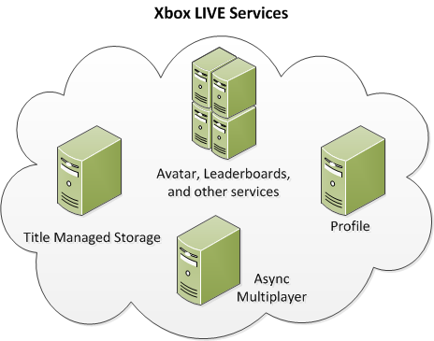
Authentication process
Security Token Service
(XSTS)
Trust
XSTS Token
Get XSTS Token
MSA
Game
REST/JSON
XSTS token
RPS ticket
3. Send XSTS Token to access services
Authenticate (prove your identity)

Slide 15
Signing-in
Demo

Slide 16
Triggering sign-in
task<UserIdentity^> signIn(XboxLIVEService::SignInAsync());
signIn.then([=] (task<UserIdentity^> signInTask)
{
try
{
UserIdentity^ identity = signInTask.get();
}
catch(Exception^ ex)
{
ErrorOccurred(ex->HResult);
}
});

Slide 17
But what if I have my own game server?
XSTS supports federated token scenarios
Xbox LIVE Services: Entertainment powered by the cloud
GDC 2012 Martin Sleeman, Xbox LIVE Services

Slide 18
Federated authentication process
Security Token Service
(XSTS)
Trust
XSTS Token
Your cloud service
Get XSTS Token (for your cloud service)
Policy enforcement
Services
Services
MSA
Game
REST/JSON
XSTS token
RPS ticket
3. Send XSTS Token to access services
Authenticate (prove your identity)

Slide 19
In-app DLC
Key stages of stuff
What stuff have I bought?
What stuff can I buy?
Buy some stuff
Download some stuff
Use stuff that I bought

Slide 20
Show your stuff for sale
I want your money.
Find and display the latest offers
We provide the data, you provide the sparkle
Xbox Games app also provides a portal for purchase

Slide 21
Enumeration
Demo

Slide 22
Buy some stuff
Give me!
One call is all it takes
Like sign-in, the trick is in handling the result
In-app experience but can fail over to Xbox Games for some conditions

Slide 23
Commerce
Demo

Slide 24
Capital expenditures – Durable DLC
The classic love story of gamer meets map pack.
We return validated receipts, even when offline
Download the content and run
Remember purchases can be made outside of this machine or the game

Slide 25
Spare change – Consumable DLC
What is today’s exchange rate from Euros to Minesweeper doubloons?
Similar to durables, but with a built-in ATM feature
Consumption can’t be securely validated offline so no built-in offline support
But you can track if it makes sense for you

Slide 26
Consumption
Demo

Slide 27
Keeping in touch
WNS provides push notifications to Windows clients
Xbox LIVE Services integrates into WNS to deliver events
Deliver game invites
“Your turn”, nudges
Results in toasts and tile updates

Slide 28
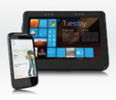
WNS + Xbox LIVE
Friend
WNS
Push notification
Create channel
Send message
on channel
You
DB
XBL Services
Register channel
Invite friend

Slide 29
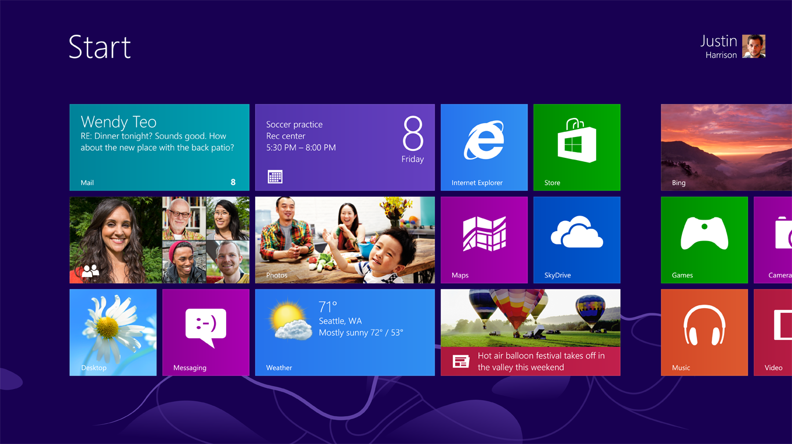

Slide 30
Questions?

