Slide 1
Building world-ready Windows Store apps
Ben Riga
Sr. Technical Evangelist, Windows 8
http://about.me/ben.riga
3-104

Slide 2
What we’ll cover in this session
Localization
Language resolution
Globalization
Translation

Slide 3
Unprecedented reach and opportunity
Store in:
Apps in:
Developers from:
Payouts:
230+
countries
100+
languages
120+
markets
80+
currencies

Slide 4
What does world-readiness mean?
To the user
Content in my language
Data formatted correctly for my culture (dates, times, currency, etc.)
Text input just works
To the developer
Code base identical across all languages
Separate the code from any UI text that must be translated
Supports linguistic and cultural needs of all users

Slide 5
What’s new in Windows 8?
User provides list of preferred languages
Windows intelligently does the right thing
A client-side resource-management system for HTML/JavaScript No need to call a server every time you want a string
The same resource-management system supports all languages C#, C++, JavaScript, Visual Basic
You don’t have to manually manage images for DPI or high-contrast changes
New tooling to help manage translations

Slide 6
3 parts to building world-ready apps
Localization
Globalization
Translation
(Testing)

Slide 7
Localization

Slide 8
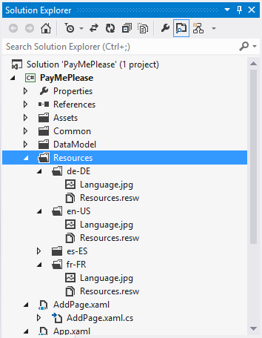
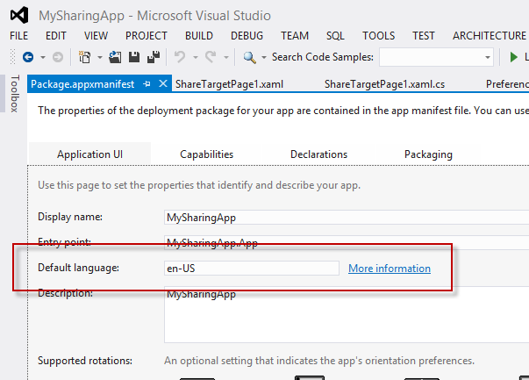
Localizing an app
Separate your resources
Set a default language

Slide 9
File-based resource management
Useful for images, media, HTML, CSS, etc.
Expensive to translate, so avoid if possible
Steps (HTML or XAML):
Create alternate file assets for different languages and DPI
Use simple file / folder naming conventions
Ensure that your elements are tagged correctly

Slide 10
Naming resources using qualifiers
Naming convention:
foldername/qualifiername-value_qualifiername-value/filename.qualifiername-value_qualifiername-value.ext
Images/en-US/homeregion-USA/logo.scale-100_contrast-white.png
becomes:
Images/logo

Slide 11
Localizing a string
Useful for hard-coded strings in code
Steps:
Move strings from markup to resource file (resJSON or ResW)
Use ResourceLoader.getString() to retrieve the resource by name

Slide 12
Managing and retrieving strings in markup
HTML or XAML
Steps
Move strings from markup to resource file
In XAML:
Add x:Uid attribute to elements
In HTML:
WinJS.Resources.processAll
Mark resource references using data-win-res attribute

Slide 13
Localizing your app’s presence in the system
Your app content is also represented in the Windows Store, on the Start screen, in search, and in your app’s splash screen
You start by localizing your app manifest
Steps:
Add strings to resource file
Add references to the app manifest using ms-resource URI scheme

Slide 14
File-based resource management Retrieving a string Managing localized strings in markup The app manifest
Demo

Slide 15
Finding the right language

Slide 16
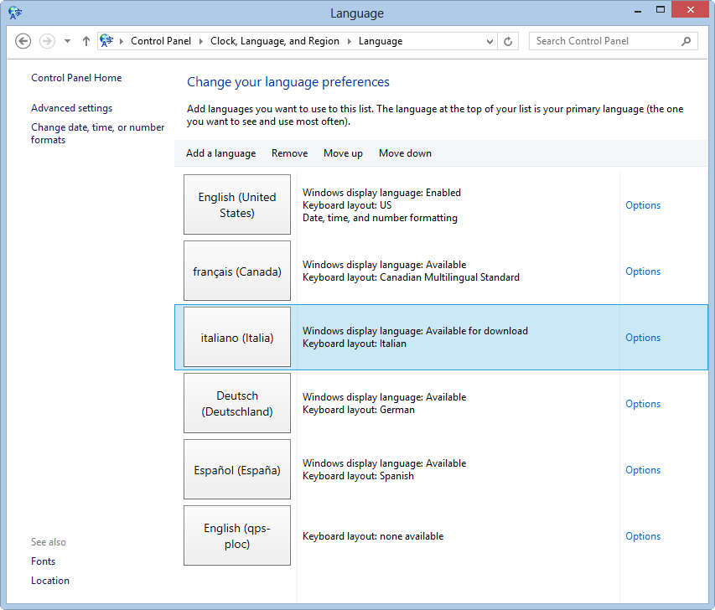
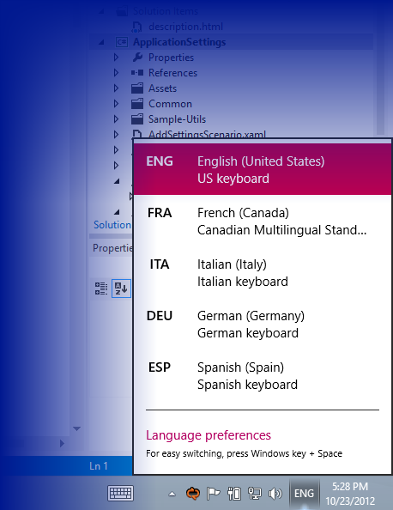
Users specify all their language preferences

Slide 17
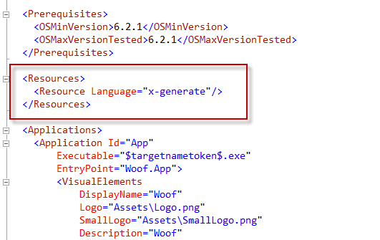
Apps specify list of localizations
Typically Visual Studio will extract from the resources (in the app manifest)
Languages listed are the languages displayed to users in the Windows Store

Slide 18
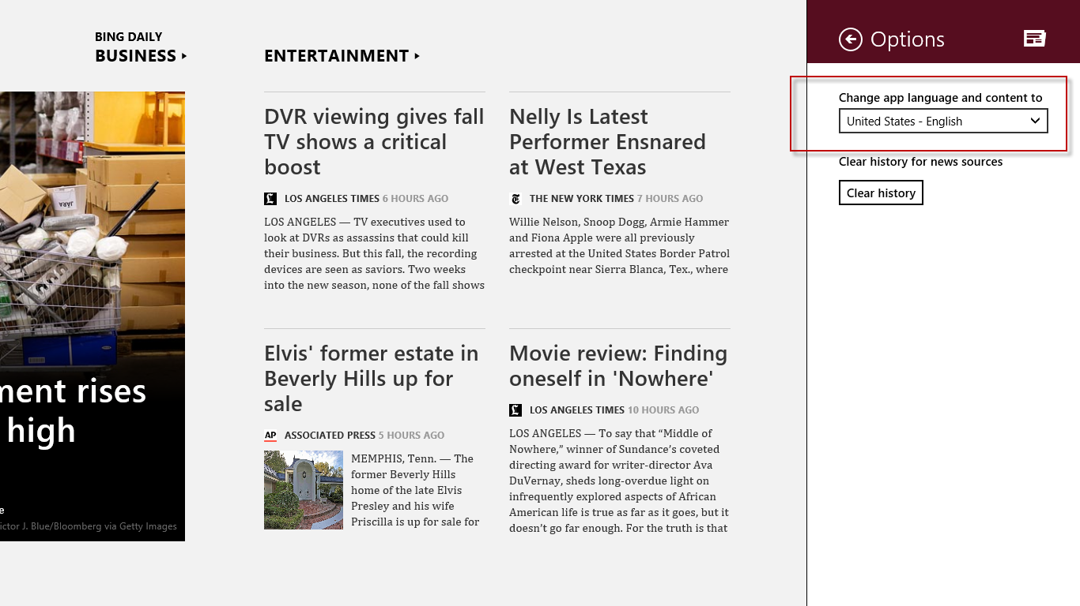
Developers can also allow users to override
Effectively overrides the top language of the list
Persistent & expensive
Requires app to reload
Not for transient changes (e.g., logging)
Windows.Globalization.ApplicationLanguages.primaryLanguageOverride

Slide 19
Windows intelligently matches
App-supported languages | User language preferences | App's primary language override | App languages | What the user sees in the app
English (GB) (default) German (Germany) | English (GB) | none | English (GB) | UI: English (GB) Dates/times/numbers: English (GB)
German (Germany) (default) French (France) Italian (Italy) | French (Austria) | none | French (Austria) | UI: French (France) (fallback from French (Austria)) Dates/times/numbers: French (Austria)
English (US) (default) French (France) English (UK) | English (Canada) French (Canada) | none | English (Canada) French (Canada) | UI: English (US) (fallback from English (Canada)) Dates/times/numbers: English (Canada)

Slide 20
Windows intelligently matches - default
App-supported languages | User language preferences | App's primary language override | App languages | What the user sees in the app
Spanish (Spain) (default) Spanish (Mexico) Spanish (Latin America) Portuguese (Brazil) | English (US) | none | Spanish (Spain) | UI: Spanish (Spain) Uses default because no fallback is available for English Dates/times/numbers: Spanish (Spain)

Slide 21
Windows intelligently matches - partial
App-supported languages | User language preferences | App's primary language override | App languages | What the user sees in the app
Spanish (Spain) (default) Catalan (partial) French (France) | Catalan French (France) | none | Catalan French (France) | UI: Mostly Catalan and some French (France) because not all the strings are in Catalan Dates/times/numbers: Catalan

Slide 22
Windows intelligently matches - override
App-supported languages | User language preferences | App's primary language override | App languages | What the user sees in the app
English (UK) (default) French (France) German (Germany) | German (Germany) English (UK) | English (UK) (chosen by user in app's UI) | English (UK) German (Germany) | UI: English (UK) (language override) Dates/times/numbers: English (UK)

Slide 23
User and app languages
User-declared languages
Windows.System.UserProfile.GlobalizationPreferences.Languages()
App-declared languages
Windows.Globalization.ApplicationLanguages.ManifestLanguages()
Resolved languages
Windows.Globalization.ApplicationLanguages.Languages()

Slide 24
Globalization

Slide 25
Globalization
Numbers / currency
Date / time
Collation
Calendar

Slide 26
Number formatting and parsing
Windows.Globalization.NumberFormatting
DecimalFormatter
PercentFormatter
PermilleFormatter
CurrencyFormatter

Slide 27
Date/Time Formatting
Windows.Globalization.DateTimeFormatting
DateTimeFormatter
Windows.Globalization
Calendar

Slide 28
Formatting dates/times/numbers
Demo

Slide 29
Translation

Slide 30
Translation
Various options
DIY
Microsoft Language Portal (with Microsoft product glossaries)
http://www.microsoft.com/Language/en-US/Default.aspx
Multilingual App Toolkit
Crowdsourcing
Professional third-party services

Slide 31
Multilingual App Toolkit
Integration with Visual Studio IDE add and manage translation files
Pseudo language engine (Language: qps-ploc) for in-house testing of localized apps
Translation file export & import roundtrip send and receive resources to friends, family, or a translator for review
XLIFF lightweight editor localization UI for editing translated strings translation suggestions from Microsoft Translator

Slide 32
Multilingual App Toolkit
Demo

Slide 33
Using Microsoft Translator
For custom workflows
Microsoft Translator APIs (Translate( ), Detect( ), Speak())
Crowdsource to improve translations – collaborative translation features of the API (AddTranslation, GetTranslation)
Bonus: Use the same API to add translation functionality to your application, to provide a truly global experience
http://www.MicrosoftTranslator.com/dev/

Slide 34
Resources

Slide 35
Sessions
Building world-ready Windows Store apps
3-103 (HTML/CSS/JavaScript)
3-104 (XAML)

Slide 36
Samples
Application resources and localization sample
Date and time formatting sample
Number formatting and parsing sample
All links here:
http://bit.ly/BenRiga-Build2012

Slide 37
Sites
Multilingual App Toolkit for Visual Studio
Microsoft Translator Developer Site
Microsoft Language Portal
All links here:
http://bit.ly/BenRiga-Build2012

Slide 38
Q&A
Ben Riga
Sr. Technical Evangelist, Windows 8
http://about.me/ben.riga

Slide 39
Resources
Develop: http://msdn.microsoft.com/en-US/windows/apps/br229512
Design: http://design.windows.com/
Samples: http://code.msdn.microsoft.com/windowsapps/Windows-8-Modern-Style-App-Samples
Videos: http://channel9.msdn.com/Windows
Please submit session evals by using the Build Windows 8 app
or at http://aka.ms/BuildSessions

