Slide 1
Key technologies for advanced media applications
Mike Downey
Principal Evangelist, Media Platform Evangelism
3-117

Slide 2
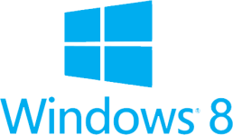
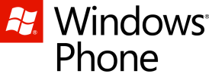
Microsoft Media Platform
Private cloud
Public cloud
Clients
Frameworks
Microsoft® Media Platform
Player
Framework
Windows Azure Media Services
Microsoft® Media Platform
Video
Editor
Microsoft® Media Platform
Microsoft®
PlayReady®
Content
Manager
Porting
Kit

Slide 3
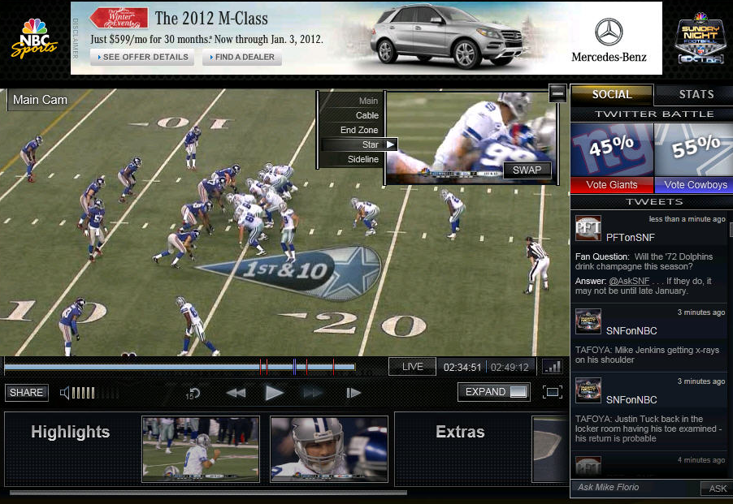
Advertising
Captions
Multi-Cam
Analytics
Robustness
Adaptive Bitrate
Markers
Live
DRM
Playlists

Slide 4
Streaming media to Windows 8

Slide 5
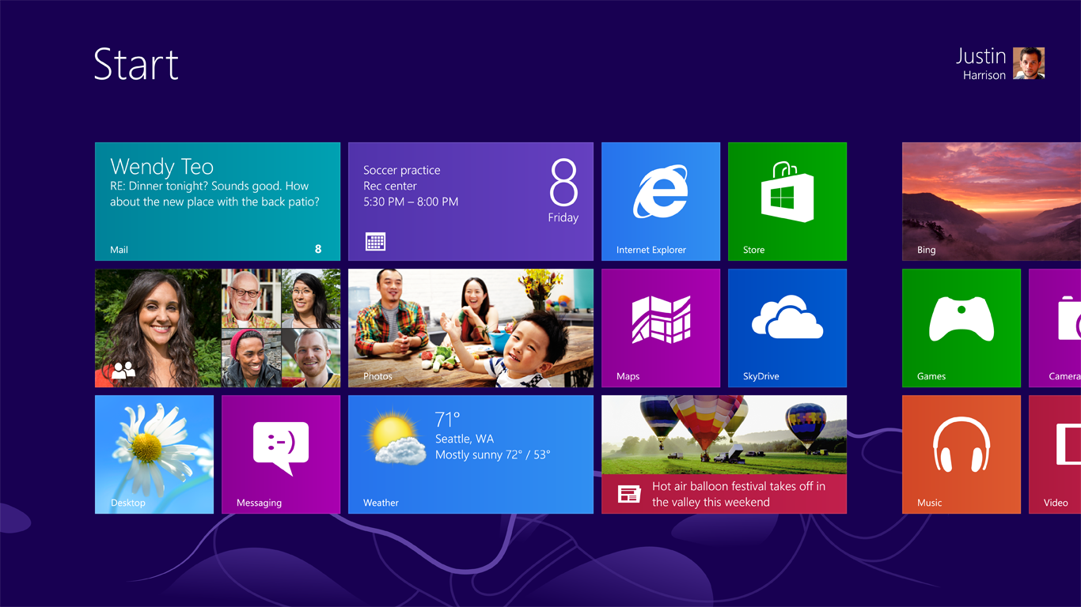

Slide 6
IE10 on the
Desktop on
Windows RT
IE10 on the
Desktop
IE10

Slide 8
Demo: Bridging to desktop & apps

Slide 10
Demo: Windows 8 Media App Example

Slide 11
Elements of a video player
<video>
MediaElement
MF Extensions & WinRT Components
Player framework
Basic playback
Progressive download
Local playback
Streaming
(Live & VoD)
Codecs
PlayReady/DRM
Video effects
Extensibility
Captioning
Advertising
Error/Retry logic
UI/Styling
Playlist Management

Slide 12
Demo: <video>

Slide 13
Going beyond <video>…

Slide 14
Windows 8 media pipeline
Windows Store app
<audio src=“…”>
<video src=“…”>
MediaElement
Windows Runtime (WinRT)
Playback/Preview
Capture
Transcode
Streaming
Extensibility
Protection
MediaControl
Media Foundation
Audio/Video Source
Video Decoder
Video Encoder
Video Effect 1
Video Effect 2
Audio/Video Sink
Audio Decoder
Audio Encoder
Audio Effect 1
Audio Effect 2
DirectX
Windows Audio Session API (WASAPI)

Slide 15
Smooth Streaming SDK for Windows 8
Adaptive bitrate streaming over HTTP
Live and Video-on-Demand
Proven at scale with events like Olympics, SNF
Based on MP4 format
No licensing fee
Supported on Windows, Windows Phone, Xbox, Silverlight, iOS, TV, Set-top boxes, etc
On-ramp to MPEG-DASH and UltraViolet

Slide 16
PlayReady SDK for Windows 8
PlayReady fully supported
Playback, License operations, Domain operations, Metering
Free developer SDK for Windows Store apps
Integrated with Visual Studio 2012
Download from Visual Studio Gallery
New capabilities only available to Windows Store apps
Per app / per user license store
License deletion

Slide 17
How do I implement all of this?

Slide 18
Microsoft Media Platform: Player Framework

Slide 19
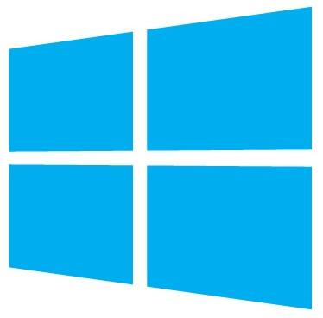

Slide 20
Cross-platform, open source
Adaptive-bitrate heuristics
Rich DVR-style playback
Ad integration
Closed captions
Error-handling and retry logic
Playlist management
UI customization
Plugin model
3-D video
Media analytics
PlayTo

Slide 21
Player Framework for Windows 8

Slide 22
Windows 8 PF architecture
HTML5 App
XAML App
Player Framework for HTML5
Player Framework for XAML
Player Framework Plugins
Captions
Advertising
Tracking
Playlist
Error Handler
ControlStrip
Adaptive
WinRT Shared Components (C#)
Adaptive Manager
VAST Handler MAST Scheduler
VMAP Scheduler
VPAID Player
FreeWheel Scheduler
Smooth Streaming SDK

Slide 23
Demo: Player Framework

Slide 24
Advanced features

Slide 25
Video advertising

Slide 26
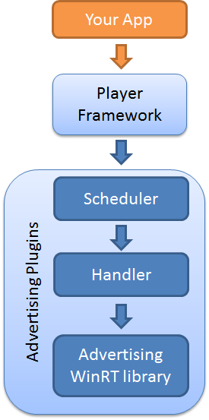
Video advertising support
Ad scheduling
VMAP, MAST, FreeWheel
Types of scheduled ads
Prerolls, midrolls, postrolls
Ad formats
VAST, Simple clips, Custom
Ad types & VPAID
Linear, Non-linear, Companion

Slide 27
Closed captioning

Slide 28
Closed captioning support
Providing closed captioning is increasingly important around the world
FCC requirement
Captioning is more than just text
TTML
WebVTT (JS-only)
Other standards considered for the future
SMPTE-TT, 607/708, New TTML Lite spec

Slide 29
Extensibility

Slide 30
Extensibility
Player Framework extensibility originally architected using MEF in Silverlight
This architecture has been simplified for Windows 8
All major features designed as plugins
Windows is also extensible
Streaming, codecs, content protection all provided via Media Foundation extensions
Richard Fricks’ session

Slide 31
MPEG-DASH

Slide 32
MPEG-DASH
Framework standard requiring additional application profiles to create complete interoperability standards
Specifies media description and segment formats to enable efficient and high-quality delivery of media over the Internet
Media Presentation Description (MPD) format based on XML
Segment format defines syntax and semantics of HTTP responses
Profiles
ISOBMFF (fMP4)
M2TS

Slide 33
Demo: MPEG DASH Client

Slide 34
Sample app

Slide 35
Recap
Internet Explorer 10
Windows 8 for advanced scenarios
Smooth Streaming
PlayReady
Extensibility
Player Framework for Windows 8
MPEG-DASH

Slide 36
Download the player framework and sample app http://playerframework.codeplex.com

Slide 37
Resources
Develop: http://msdn.microsoft.com/en-US/windows/apps/br229512
Design: http://design.windows.com/
Samples: http://code.msdn.microsoft.com/windowsapps/Windows-8-Modern-Style-App-Samples
Videos: http://channel9.msdn.com/Windows
Please submit session evals by using the Build Windows 8 app
or at http://aka.ms/BuildSessions

