Slide 1
Key technologies for shopping apps
Santhosh Panchap & Can Comertoglu
Microsoft Corporation
3-119

Slide 2
Agenda
Discuss and demonstrate specific features of shopping apps including
General architectural decisions
Optimizing virtualized result sets
The communication model between web and app (auth, services)
Payment methods
Other Windows features to consider that enhance the shopping experience
You’ll leave with
Knowledge and code to address unique shopping app challenges

Slide 3
Shopping app: key features
Displaying and navigating large result sets
User authentication / secure credential storage
Payment
Sharing a wish list
User notification of “specials”
Printing receipts
App discoverability from website

Slide 4
Web Services and component reuse reduces time to develop and improves Site/App consistency.

Slide 5
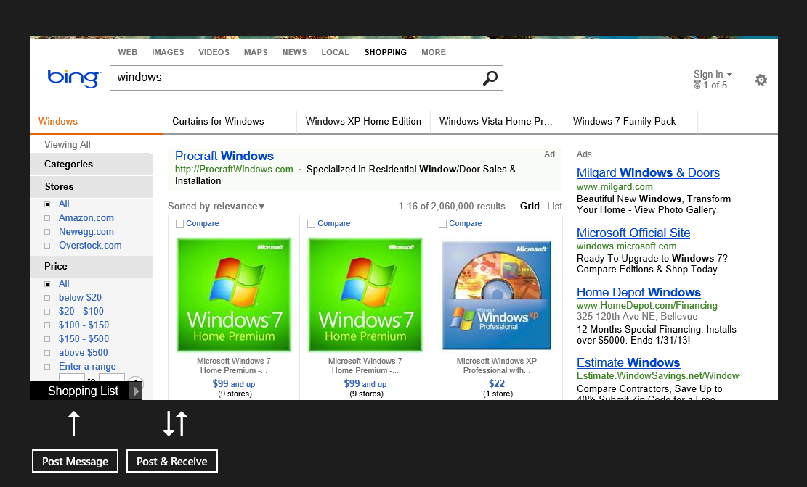
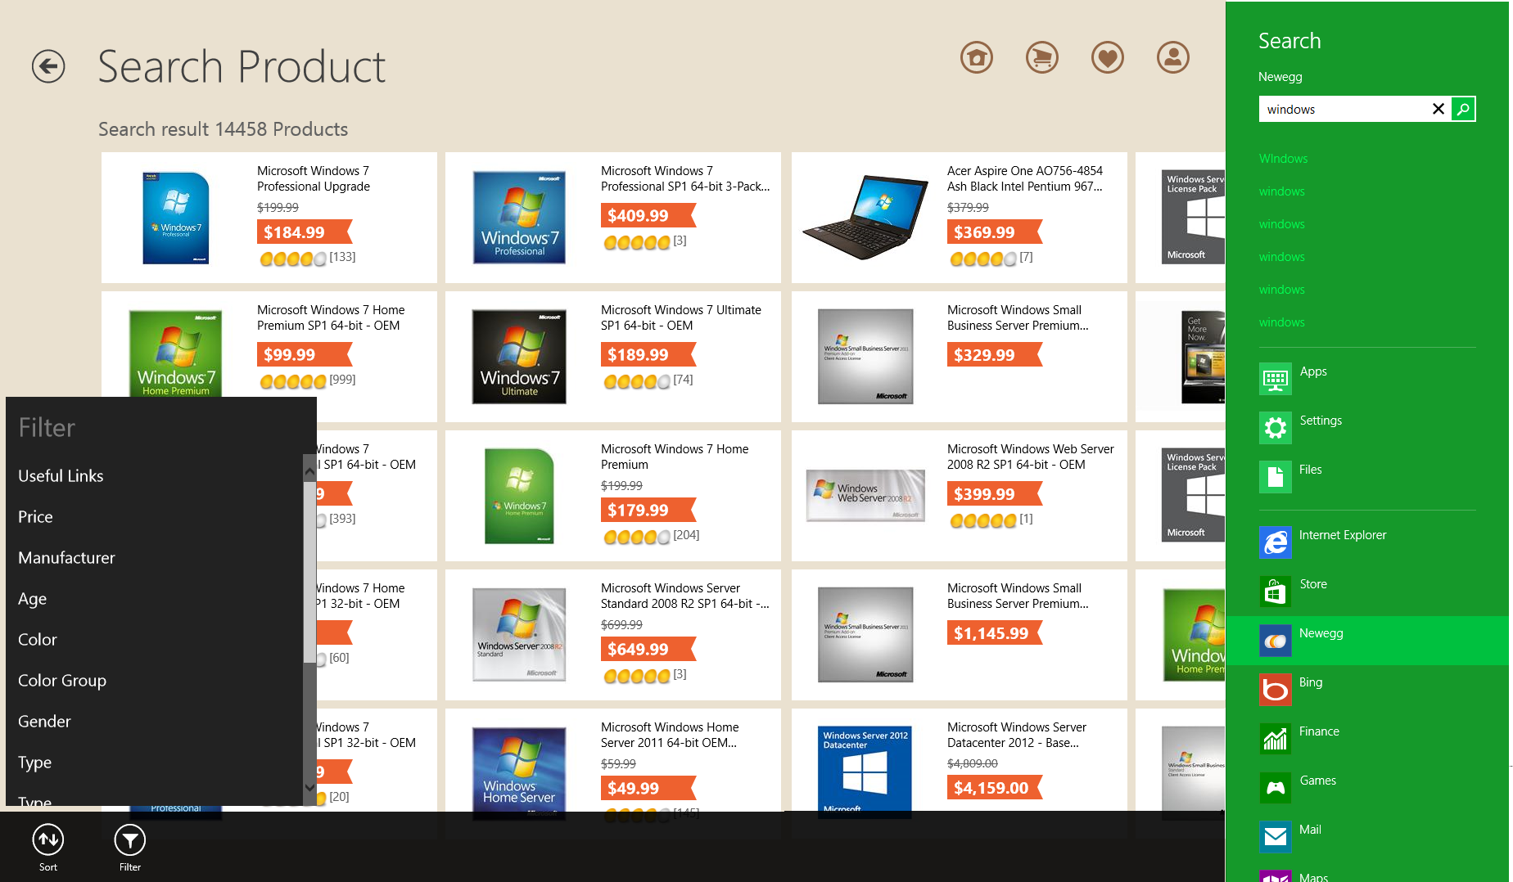
Model comparison
Web hosting in app
Creating a Windows Store app with web assets

Slide 6
Website hosting : not a good design for feature rich apps
Webpages already have commanding navigation and other Windows 8 built-in features
Messages can be sent and received, but communication often requires changes to the website
app ->web ->app
User interaction within the webpage cannot be determined and must be constantly communicated through a callback, so the app can synchronize accordingly with the hosted content.
Commands
Search
Navigation
Layout (vertical)

Slide 7
Demo: using WebView (iFrame)

Slide 8
Relevant code
Declaring the iFrame in XAML
<WebView x:Name="webViewHost" Margin="189,113,0,0" Width="1030" HorizontalAlignment="Left" VerticalAlignment="Top" Height="503" Source="http://www.bing.com/shopping/search?q=windows&amp;FORM=L8SP10" />
Updating the source dynamically
webViewHost.Source = new Uri("http://www.bing.com/rewards/tou");
Invoking script on the web page
webViewHost.InvokeScript("CountAndListen", null);

Slide 9
Store app model
Why native?
Great UI controls with built-in support for key Windows UX experiences
Content first design
Unnecessary and confusing web navigation and commanding chrome removed
User model consistency
Brand integration into Windows

Slide 10
Store app: utilizing web assets
App UX guidelines are easily adhered to as the app is written specifically for the Windows experience
Intrinsic controls provide touch first experiences
App is focused on content, which is virtualized, fast, and fluid.
The app communicates with Windows instead of
app->web -> app->Windows -> app->web
Web resources are retrieved via XHR against existing web services
Commands
Search
Navigation
Layout (horizontal)

Slide 11
Recommendation
Don’t use Webview or iFrame for primary experience
“The intent of WebView (iFrame) is to incorporate web content into an app context, and not to provide a browsing experience within the app. The Windows Store policy specifically disallows the latter, because such content won't generally go into snap view well, or necessarily respond to touch input consistently, thereby giving a sub-standard user experience.”
Do use the standard app templates, Windows Controls and Commands, and Windows contracts such as Search, Share and Settings to create your experience.

Slide 12
A great application experience provides for a content first, fast and responsive, fluid user experience.

Slide 13
Load, Store and display large sets of Data
Users generated search results often yield long lists
Keep the UI thread responsive : Use async
Use UI virtualization to create only visible items
Keep item templates simple
Load subsets
Model filtering appropriately

Slide 14
Demo : List virtualization using web content

Slide 15
Declarative template
<div data-win-control="SdkSample.ScenarioOutput">
<div id="itemTemplate" data-win-control="WinJS.Binding.Template">
<div class="itemTempl">
<img data-win-bind="src: thumbnail" alt="Databound image" />
<div class="content" data-win-bind="innerText: title"></div>
</div>
</div>
<div id="listview1" data-win-control="WinJS.UI.ListView"
data-win-options="{
selectionMode: 'none',
tapBehavior: 'none',
swipeBehavior: 'none',
layout: { type: WinJS.UI.GridLayout } }">
</div>
</div>

Slide 16
Simple renderer
// wait for the itemPromise to complete to access the data
return itemPromise.then(function (item) {
// root element for the item
var element = document.createElement("div");
element.className = "itemTempl";
// using innerHTML is usually faster than creating the DOM with createElement & appendChild
element.innerHTML = "<img src='" + item.data.thumbnail + "' alt='Databound image' /><div class='content'>" + item.data.title + "</div>";
return element;

Slide 17
Function template with recycling
…
// specifies a promise that will be completed when rendering is complete
// itemPromise will complete when the data is available
renderComplete: itemPromise.then(function (item) {
// mutate the element to include the data
if (!label) {
label = element.querySelector(".content");
img = element.querySelector("img");
}
label.innerText = item.data.title;
img.src = item.data.thumbnail;
img.style.visibility = "visible";
…

Slide 18
During authorization, user credentials must be secured.

Slide 19
Introducing the Web Authentication Broker

Slide 20
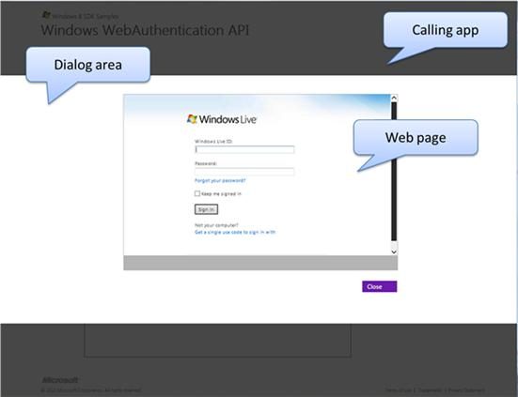
Web Authentication Broker
The Web Authentication Broker enables
Website hosting in an isolated container within an app.
Secure user credential gathering and authorization that is isolated from the app.
Single sign-on with online providers (OAuth and OpenID).

Slide 21
Web Authentication Broker components
App container 1
Medium
App container 2
Application
Runtime broker
Web Auth Host

Slide 22
Web Authentication Broker flow
An app invokes the Web AuthBroker async providing website and redirect URI
The broker creates a system modal dialog and selects a separate, dedicated app container
The broker starts the Web Auth Host and attaches it to the system modal dialog
The Web Auth host navigates to the request URI. (login page).
As the user interacts with the online provider website by clicking links or submitting information, the host checks each URI for a match with a callback URI provided by the app before navigating to it.
If a match is found, the host ends the navigation and signals the broker.
The broker takes down the dialog box, clears any persisted cookies created by the host from the app container, and returns the protocol data back to the application.

Slide 23
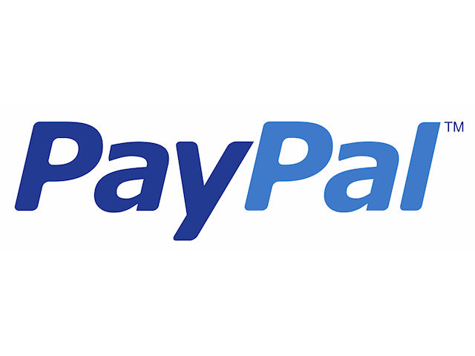

Slide 24
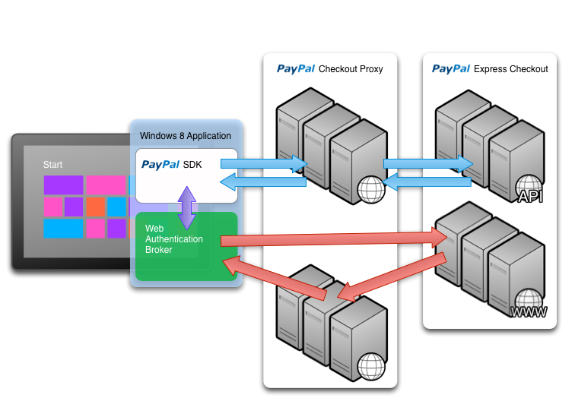

Slide 25
Demo : PayPal

Slide 26
Windows provides features that significantly enhance the shopping experience.

Slide 27
Live tiles are ambient notifications that draw users back to your app

Slide 28
Demo : live tile update with web image

Slide 29
Push Notification
Windows 8
Cloud Service
Request Channel URI.
Notification Client Platform asks WNS for a notification channel. WNS returns a Channel URI.
Channel URI provided to your App
Your App registers with your Cloud Service
Your Service notifies WNS by executing POST on Channel URI
WNS receives and routes notification to the appropriate device
App
(4)
(5)
(1)
(3)
Notification
Client Platform
Windows Push Notification Service
(6)
(2)

Slide 30
Sharing is a powerful way to increase engagement and drive user acquisition.

Slide 31
Demo : sharing

Slide 32
Sharing across Applications
Source App
Share Broker
Target App
User selects “Share”, active app is sent DataRequested event
On installation, registers as Share Target through manifest declaration
Registers DataRequested event handler with the Data Transfer Manager
Filters list of Target Apps and Quick Links
Activated for Sharing
User selects Target App or Quick Link
Receives event and fills DataPackage in event handler
Process DataPackage contents
Activate Target App as kind ShareTarget
DataPackage lives in Source application
Records QuickLink if Target App returned one
Reports Complete

Slide 33
Sharing details - source
// initializing code
DataTransferManager dataTransferManager = DataTransferManager.GetForCurrentView();
dataTransferManager.DataRequested += new TypedEventHandler<DataTransferManager, DataRequestedEventArgs>(this.DataRequested);
// registered function
private void DataRequested(DataTransferManager sender, DataRequestedEventArgs e)
{
DataRequest request = e.Request;
{
DataPackage requestData = String;
request.Properties.Title = String;
request.Properties.Description = String; // The description is optional.
request.SetUri(Uri);
}
}

Slide 34
Sharing details - target
…
if (eventObject.detail.kind === Windows.ApplicationModel.Activation.ActivationKind.shareTarget) {
// Code to handle activation goes here. }
…
ShareOperation shareOperation = (ShareOperation)e.Parameter;
await Task.Factory.StartNew(async () =>
{
// Retrieve the data package properties.
String sharedDataTitle = shareOperation.Data.Properties.Title;
String sharedDataDescription = shareOperation.Data.Properties.Description;
String sharedThumbnailStreamRef = shareOperation.Data.Properties.Thumbnail;
…
}

Slide 35
Printing

Slide 36
Demo: printing

Slide 37
Printing
…
// Add an event handler, which creates preview pages.
printDocument.Paginate += CreatePrintPreviewPages;
// Add an event handler, which provides a specified preview page.
printDocument.GetPreviewPage += GetPrintPreviewPage;
// Add an event handler, which provides all final print pages.
printDocument.AddPages += AddPrintPages;
// Create a PrintManager and add a handler for printing initialization.
PrintManager printMan = PrintManager.GetForCurrentView();
printMan.PrintTaskRequested += PrintTaskRequested;

Slide 38
Wrap up
Consider your architecture carefully
Speed and responsiveness counts
Security is critical for your users and your brand
Windows features bring your app to life!

Slide 39
Related sessions
“Guidance for shopping apps”. Speaker: Mark Hopkins
“Shopping app case studies”. Speaker: Mark Hopkins
“Deep Dive on WinJS ListView”. Speaker: Mike Mastrangelo

Slide 40
Q&A

Slide 41
Resources
Develop: http://msdn.microsoft.com/en-US/windows/apps/br229512
Design: http://design.windows.com/
Samples: http://code.msdn.microsoft.com/windowsapps/Windows-8-Modern-Style-App-Samples
Videos: http://channel9.msdn.com/Windows
Please submit session evals by using the Build Windows 8 app
or at http://aka.ms/BuildSessions

