Slide 1
XAML list controls
Terry Adams
XAML Controls Development Lead
3-131

Slide 2
Agenda
Windows 8 personality
List scenarios for Windows 8
Overview of list controls
Advanced features

Slide 3
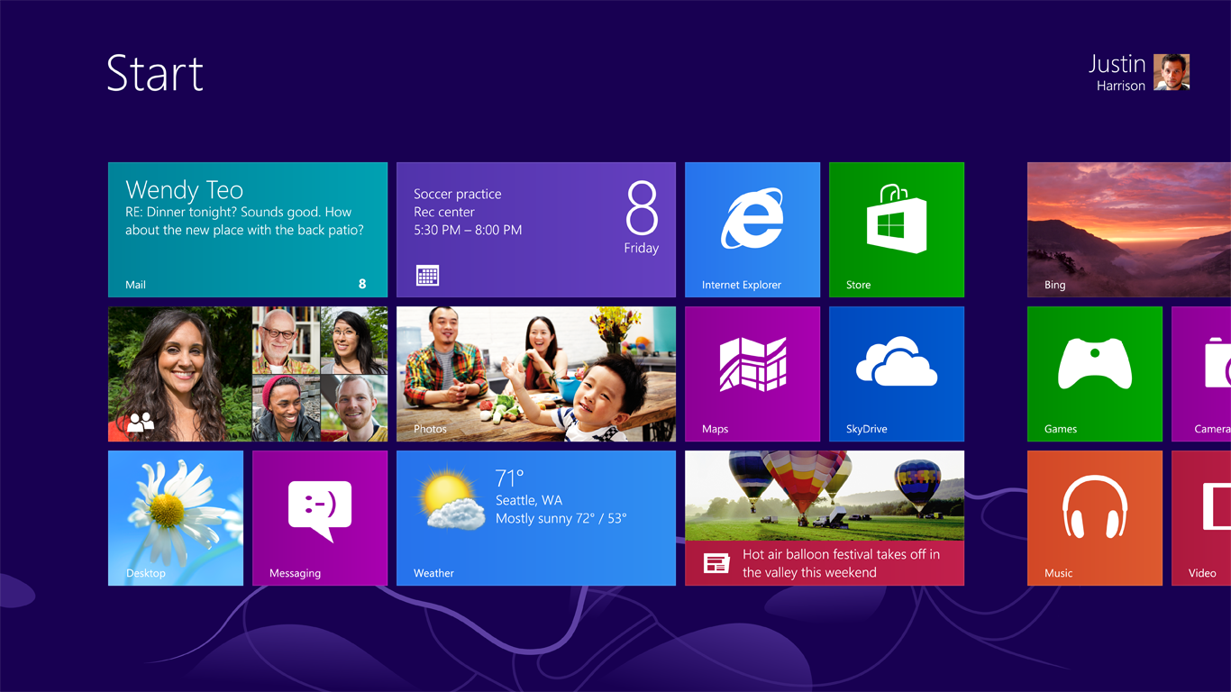

Slide 4
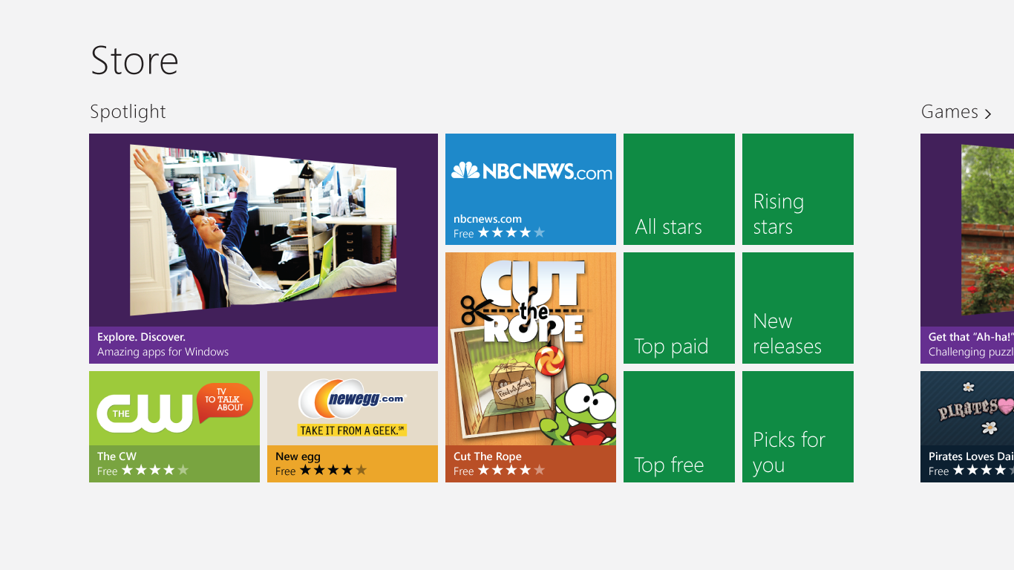

Slide 6
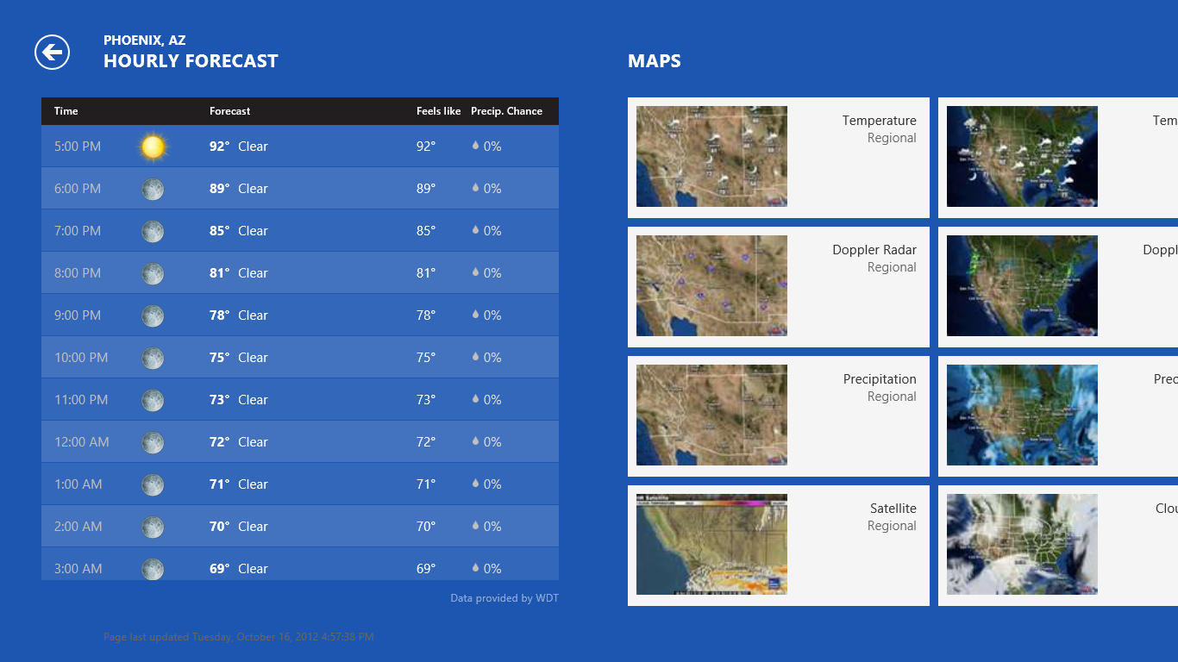
Need ListView Picture

Slide 8
List scenarios for Windows 8
Displaying a list or grid of items
Single or multiple selection
Reordering items in a list or grid
Drag-and-drop functionality
Grouping
Navigating large lists of items
Viewing items one at a time

Slide 9
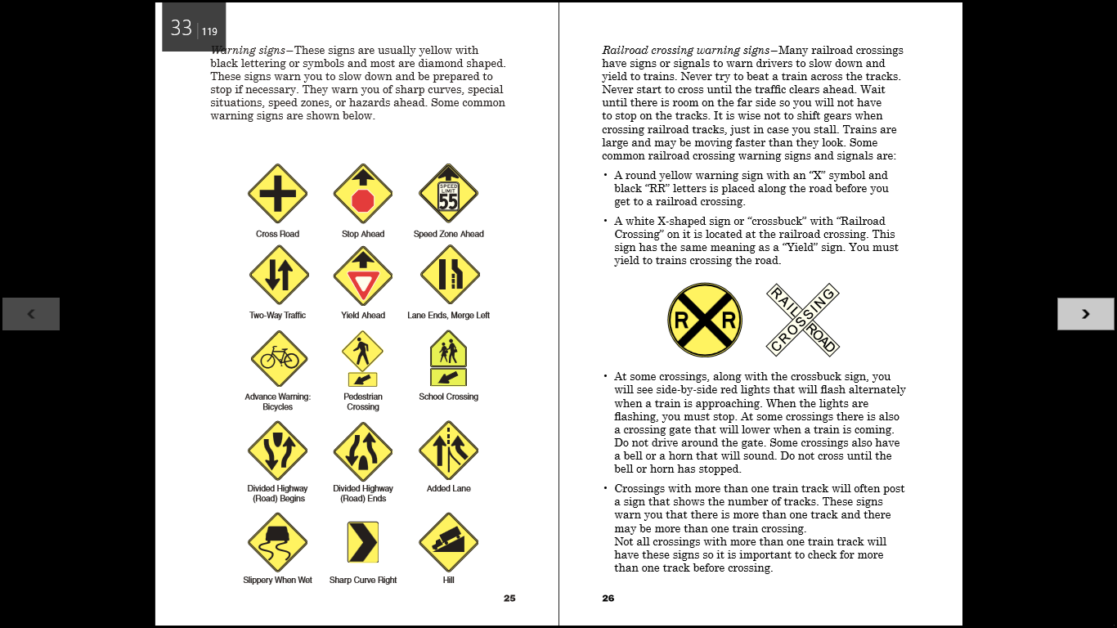

Slide 10
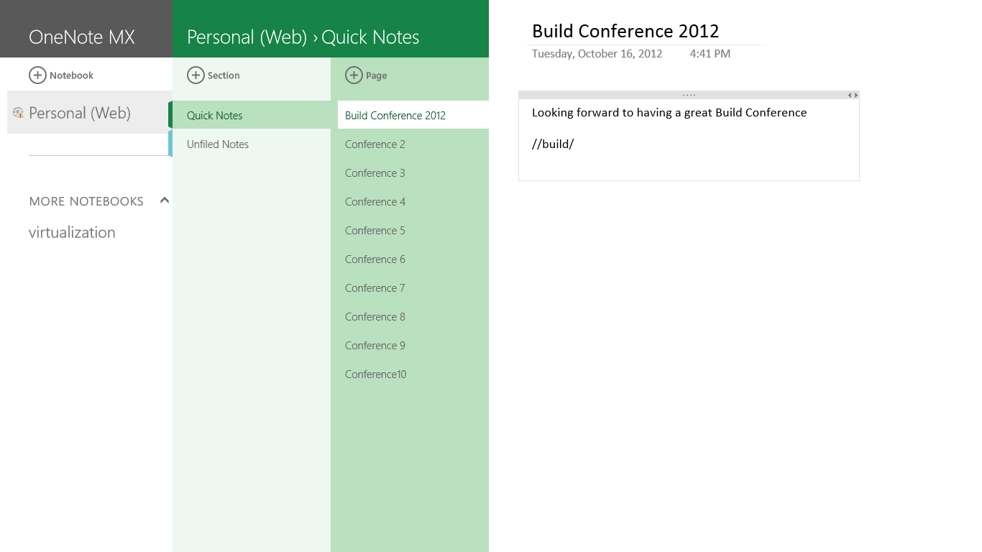

Slide 12
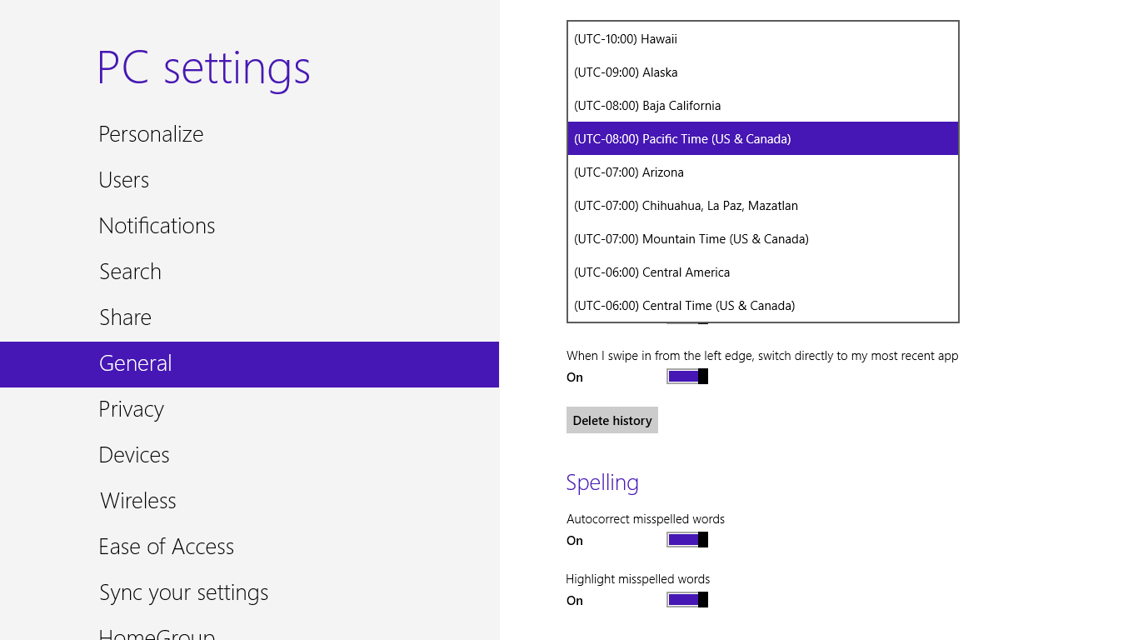

Slide 13
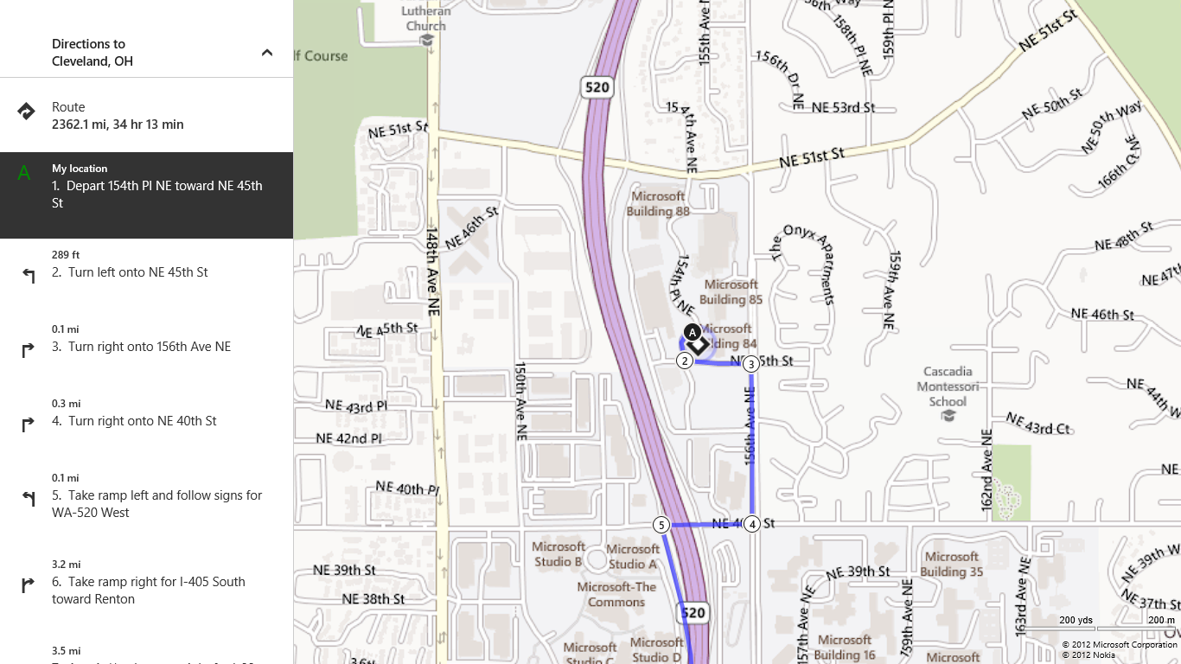

Slide 14
Creating a GridView app
Adding a GridView
Adding a header

Slide 15
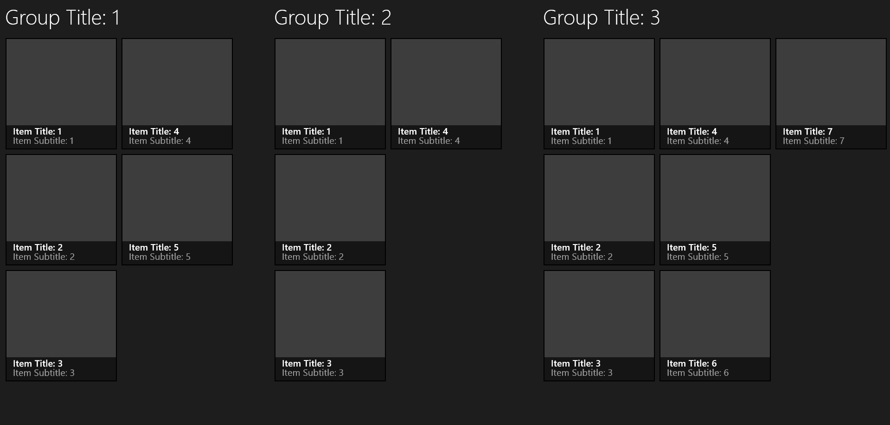
Grouping

Slide 16
Templating and styling groups - Layout <GridView.ItemsPanel/>
Panel for top-level groups

Slide 17
Templating and styling groups - Layout <GridView.GroupStyle.Panel/>
Panel for group items

Slide 18
Templating and styling groups - Header <GridView.GroupStyle.HeaderTemplate/>
Template for group headers

Slide 19
Templating and styling groups – Group item <GridView.GroupStyle.ContainerStyle/>
Template for group item
ContentPresenter
ItemsControl

Slide 20
Adding grouping
Setting up group panels
Adding a header

Slide 21
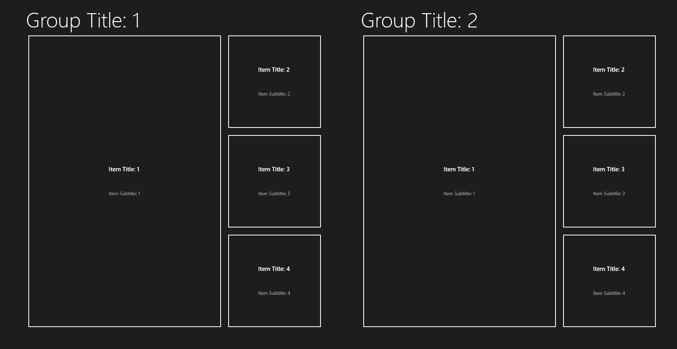
Variable-Sized Items
1x1
1x1
3x2
1x1
3x2
1x1
1x1
1x1

Slide 22
Adding items of varying sizes
Demo

Slide 23
Semantic Zoom
What is Semantic Zoom?

Slide 24
Adding Semantic Zoom
Demo

Slide 26
Resources
Develop: http://msdn.microsoft.com/en-US/windows/apps/br229512
Design: http://design.windows.com/
Samples: http://code.msdn.microsoft.com/windowsapps/Windows-8-Modern-Style-App-Samples
Videos: http://channel9.msdn.com/Windows
Please submit session evals by using the Build Windows 8 app
or at http://aka.ms/BuildSessions

