Slide 1
50 Performance Tricks to Make your HTML5 apps and sites Faster
Jatinder Mann
Internet Explorer Program Manager
3-132

Slide 2
Windows 8
Windows Store Apps
Desktop Apps
View
XAML
HTML / CSS
HTML
JavaScript
Model Controller
C
C++
C#
VB
JavaScript
(Chakra)
C
C++
C#
VB
WinRT APIs
System Services
Communication
& Data
Graphics & Media
Devices & Printing
Application Model
Internet Explorer
Win32
.NET / SL
Core
Windows Core OS Services

Slide 3
Windows 8
Windows Store Apps
Desktop Apps
View
XAML
HTML / CSS
HTML
JavaScript
Model Controller
C
C++
C#
VB
JavaScript
(Chakra)
C
C++
C#
VB
WinRT APIs
System Services
Communication
& Data
Graphics & Media
Devices & Printing
Application Model
Internet Explorer
Win32
.NET / SL
Core
Windows Core OS Services

Slide 4
Windows 8
Windows Store Apps
Desktop Apps
View
XAML
HTML / CSS
HTML
JavaScript
Model Controller
C
C++
C#
VB
JavaScript
(Chakra)
C
C++
C#
VB
WinRT APIs
System Services
Communication
& Data
Graphics & Media
Devices & Printing
Application Model
Internet Explorer
Win32
.NET / SL
Core
Windows Core OS Services

Slide 5
Windows 8
Windows Store Apps
Desktop Apps
View
XAML
HTML / CSS
HTML
JavaScript
Model Controller
C
C++
C#
VB
JavaScript
(Chakra)
C
C++
C#
VB
WinRT APIs
System Services
Communication
& Data
Graphics & Media
Devices & Printing
Application Model
Internet Explorer
Win32
.NET / SL
Core
Windows Core OS Services

Slide 6
You’ll leave with…
Understanding of what makes a site/app fast.
Specific things to improve your performance today.

Slide 7
300

Slide 8
200

Slide 9
How much do you know about performance?

Slide 15
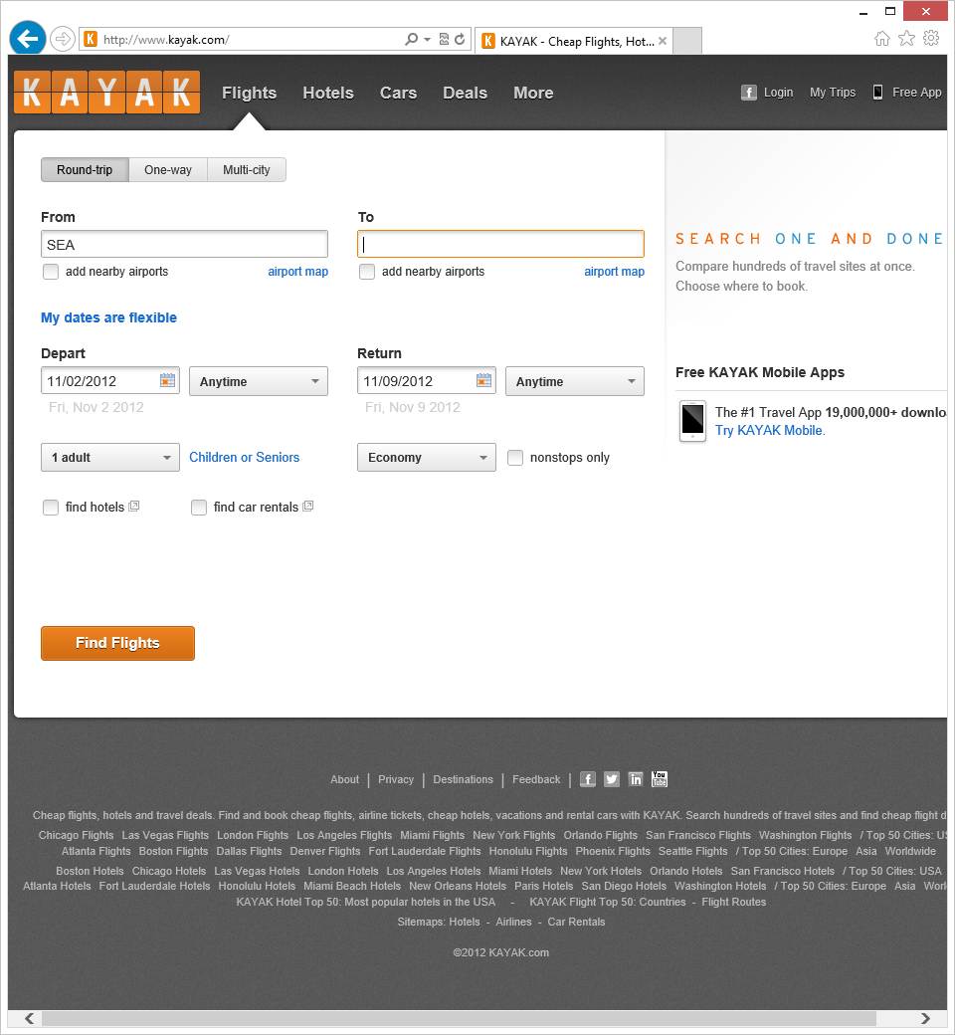

Slide 19
 | Total Size (k) | Number Elements | CSS Rules | Image Files | Script Lines (F) | Script Libraries
Site #1 | 3,697 | 1,504 | 1,392 | 41 | 77,768
Site #2 | 2,278 | 1,100 | 5,325 | 29 | 39,183
Site #3 | 1,061 | 2,673 | 1,105 | 66 | 12,643
Site #4 | 1,812 | 4,252 | 1,672 | 12 | 10,284
Site #5 | 1,372 | 900 | 3,902 | 6 | 38,269
jQuery
YUI
Prototype
ExtJS
Scriptaculous
Other

Slide 20
 | Total Size (k) | Number Elements | CSS Rules | Image Files | Script Lines (F) | Script Libraries
Site #1 | 3,697 | 1,504 | 1,392 | 41 | 77,768
Site #2 | 2,278 | 1,100 | 5,325 | 29 | 39,183
Site #3 | 1,061 | 2,673 | 1,105 | 66 | 12,643
Site #4 | 1,812 | 4,252 | 1,672 | 12 | 10,284
Site #5 | 1,372 | 900 | 3,902 | 6 | 38,269
jQuery
YUI
Prototype
ExtJS
Scriptaculous
Other

Slide 21
 | Total Size (k) | Number Elements | CSS Rules | Image Files | Script Lines (F) | Script Libraries
Site #1 | 3,697 | 1,504 | 1,392 | 41 | 77,768
Site #2 | 2,278 | 1,100 | 5,325 | 29 | 39,183
Site #3 | 1,061 | 2,673 | 1,105 | 66 | 12,643
Site #4 | 1,812 | 4,252 | 1,672 | 12 | 10,284
Site #5 | 1,372 | 900 | 3,902 | 6 | 38,269
jQuery
YUI
Prototype
ExtJS
Scriptaculous
Other

Slide 22
 | Total Size (k) | Number Elements | CSS Rules | Image Files | Script Lines (F) | Script Libraries
Site #1 | 3,697 | 1,504 | 1,392 | 41 | 77,768
Site #2 | 2,278 | 1,100 | 5,325 | 29 | 39,183
Site #3 | 1,061 | 2,673 | 1,105 | 66 | 12,643
Site #4 | 1,812 | 4,252 | 1,672 | 12 | 10,284
Site #5 | 1,372 | 900 | 3,902 | 6 | 38,269
jQuery
YUI
Prototype
ExtJS
Scriptaculous
Other

Slide 23
 | Total Size (k) | Number Elements | CSS Rules | Image Files | Script Lines (F) | Script Libraries
Site #1 | 3,697 | 1,504 | 1,392 | 41 | 77,768
Site #2 | 2,278 | 1,100 | 5,325 | 29 | 39,183
Site #3 | 1,061 | 2,673 | 1,105 | 66 | 12,643
Site #4 | 1,812 | 4,252 | 1,672 | 12 | 10,284
Site #5 | 1,372 | 900 | 3,902 | 6 | 38,269
jQuery
YUI
Prototype
ExtJS
Scriptaculous
Other

Slide 24
 | Total Size (k) | Number Elements | CSS Rules | Image Files | Script Lines (F) | Script Libraries
Site #1 | 3,697 | 1,504 | 1,392 | 41 | 77,768
Site #2 | 2,278 | 1,100 | 5,325 | 29 | 39,183
Site #3 | 1,061 | 2,673 | 1,105 | 66 | 12,643
Site #4 | 1,812 | 4,252 | 1,672 | 12 | 10,284
Site #5 | 1,372 | 900 | 3,902 | 6 | 38,269
jQuery
YUI
Prototype
ExtJS
Scriptaculous
Other

Slide 25
 | Total Size (k) | Number Elements | CSS Rules | Image Files | Script Lines (F) | Script Libraries
Site #1 | 3,697 | 1,504 | 1,392 | 41 | 77,768
Site #2 | 2,278 | 1,100 | 5,325 | 29 | 39,183
Site #3 | 1,061 | 2,673 | 1,105 | 66 | 12,643
Site #4 | 1,812 | 4,252 | 1,672 | 12 | 10,284
Site #5 | 1,372 | 900 | 3,902 | 6 | 38,269
jQuery
YUI
Prototype
ExtJS
Scriptaculous
Other

Slide 26
Which is the fastest website?

Slide 27
 | Total Size (k) | Number Elements | CSS Rules | Image Files | Script Lines (F) | Script Libraries
Site #1 | 3,697 | 1,504 | 1,392 | 41 | 77,768
Site #2 | 2,278 | 1,100 | 5,325 | 29 | 39,183
Site #3 | 1,061 | 2,673 | 1,105 | 66 | 12,643
Site #4 | 1,812 | 4,252 | 1,672 | 12 | 10,284
Site #5 | 1,372 | 900 | 3,902 | 6 | 38,269
jQuery
YUI
Prototype
ExtJS
Scriptaculous
Other

Slide 28
 | Total Size (k) | Number Elements | CSS Rules | Image Files | Script Lines (F) | Script Libraries
Site #1 | 3,697 | 1,504 | 1,392 | 41 | 77,768
Site #2 | 2,278 | 1,100 | 5,325 | 29 | 39,183
Site #3 | 1,061 | 2,673 | 1,105 | 66 | 12,643
Site #4 | 1,812 | 4,252 | 1,672 | 12 | 10,284
Site #5 | 1,372 | 900 | 3,902 | 6 | 38,269
jQuery
YUI
Prototype
ExtJS
Scriptaculous
Other

Slide 29
Which is the slowest website?

Slide 30
 | Total Size (k) | Number Elements | CSS Rules | Image Files | Script Lines (F) | Script Libraries
Site #1 | 3,697 | 1,504 | 1,392 | 41 | 77,768
Site #2 | 2,278 | 1,100 | 5,325 | 29 | 39,183
Site #3 | 1,061 | 2,673 | 1,105 | 66 | 12,643
Site #4 | 1,812 | 4,252 | 1,672 | 12 | 10,284
Site #5 | 1,372 | 900 | 3,902 | 6 | 38,269
jQuery
YUI
Prototype
ExtJS
Scriptaculous
Other

Slide 31
 | Total Size (k) | Number Elements | CSS Rules | Image Files | Script Lines (F) | Script Libraries
Site #1 | 3,697 | 1,504 | 1,392 | 41 | 77,768
Site #2 | 2,278 | 1,100 | 5,325 | 29 | 39,183
Site #3 | 1,061 | 2,673 | 1,105 | 66 | 12,643
Site #4 | 1,812 | 4,252 | 1,672 | 12 | 10,284
Site #5 | 1,372 | 900 | 3,902 | 6 | 38,269
jQuery
YUI
Prototype
ExtJS
Scriptaculous
Other

Slide 32
What is web performance?

Slide 33
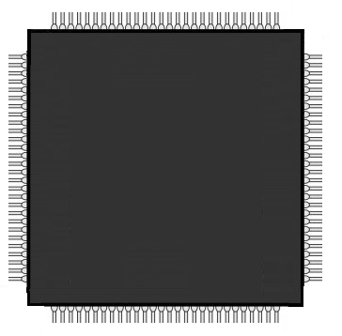
GPU
Core 1
Core 2
Core 3
Core 4

Slide 34
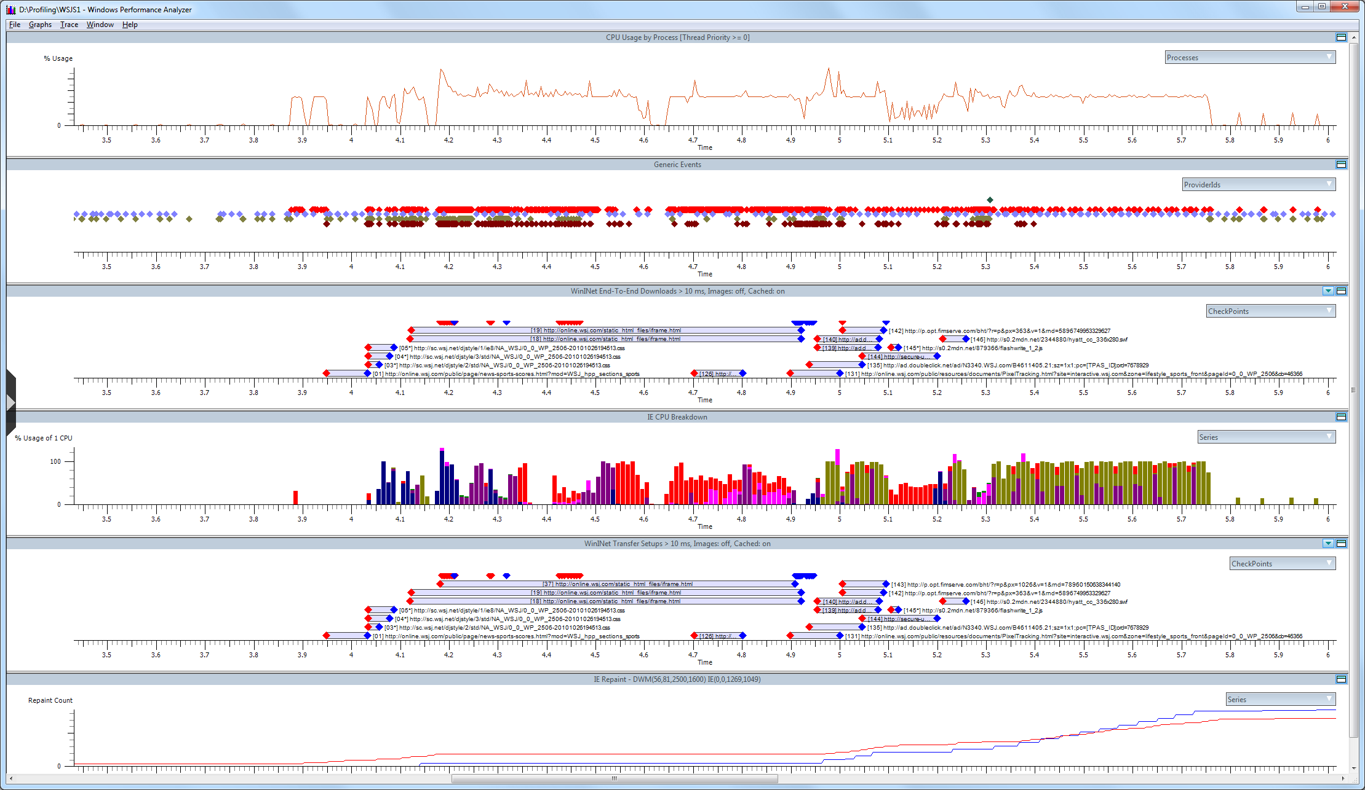
Windows Performance Toolkit: http://msdn.microsoft.com/en-us/performance/default.aspx
Measuring Browser Performance: http://blogs.msdn.com/b/ie/archive/2010/06/21/measuring-browser-performance-with-the-windows-performance-tools.aspx?utm_medium=Twitter&utm_source=Shared

Slide 35
CPU
Activity
Initial Document
Requested
Waiting For
Initial Document
Processing
Initial Document

Slide 36
CPU
Activity
Waiting For
Sub-Downloads
Processing
Content

Slide 37
CPU
Activity
Processing
Content
Waiting For
XHR
Processing
Content (again)
Page Displayed
To Screen
Page Finished
Loading
Page Updates
Screen

Slide 38
CPU
Activity
Time to Glass (1.14 seconds)
Elapsed Page Load Time (1.81 seconds)
CPU Time (1.39 seconds)
Idle CPU Time (0.42 seconds)

Slide 39
CPU
Activity
Time to Glass (1.14 seconds)
Elapsed Page Load Time (1.81 seconds)
CPU Time (1.39 seconds)
Idle CPU Time (0.42 seconds)

Slide 40
Where does the CPU time go?

Slide 41
Networking
HTML
CSS
Collections
JavaScript
Marshalling
DOM
Formatting
Block Building
Layout
Rendering

Slide 42
Networking
HTML
CSS
Collections
JavaScript
Marshalling
DOM
Formatting
Block Building
Layout
Rendering

Slide 43
Networking
HTML
CSS
Collections
JavaScript
Marshalling
DOM
Formatting
Block Building
Layout
Rendering

Slide 44
Networking
HTML
CSS
Collections
JavaScript
Marshalling
DOM
Formatting
Block Building
Layout
Rendering

Slide 45
Networking
HTML
CSS
Collections
JavaScript
Marshalling
DOM
Formatting
Block Building
Layout
Rendering

Slide 46
Networking
HTML
CSS
Collections
JavaScript
Marshalling
DOM
Formatting
Block Building
Layout
Rendering

Slide 47
Networking
HTML
CSS
Collections
JavaScript
Marshalling
DOM
Formatting
Block Building
Layout
Rendering

Slide 48
Networking
HTML
CSS
Collections
JavaScript
Marshalling
DOM
Formatting
Block Building
Layout
Rendering

Slide 49
Networking
HTML
CSS
Collections
JavaScript
Marshalling
DOM
Formatting
Block Building
Layout
Rendering

Slide 50
Networking
HTML
CSS
Collections
JavaScript
Marshalling
DOM
Formatting
Block Building
Layout
Rendering

Slide 51
Networking
HTML
CSS
Collections
JavaScript
Marshalling
DOM
Formatting
Block Building
Layout
Rendering

Slide 52
Networking
HTML
CSS
Collections
JavaScript
Marshalling
DOM
Formatting
Block Building
Layout
Rendering

Slide 53
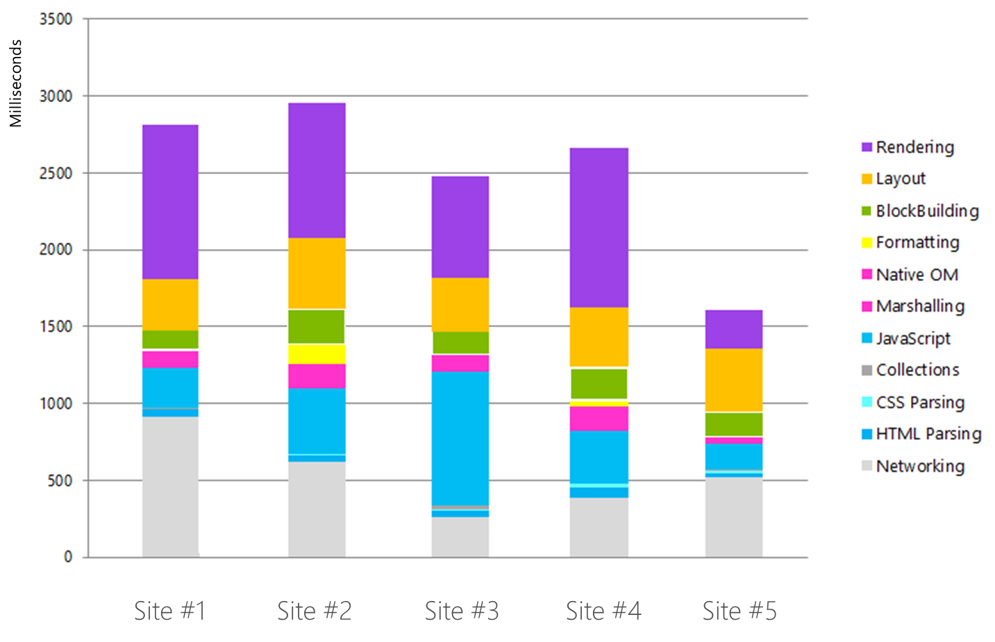

Slide 56
50 Performance Tricks

Slide 57
Six Principles to Remember
Quickly Respond to Network Requests
Minimize Bytes Downloaded
Efficiently Structure Markup
Optimize Media Usage
Write Fast JavaScript
Know What Your Application is Doing

Slide 58
Principle #1: Quickly Respond to Network Requests

Slide 59
Avoid 3xx Redirection Quickly Respond to Network Requests

Slide 60
Avoid 3xx Redirection Quickly Respond to Network Requests
Request
GET / HTTP/1.1
Host: www.news.com

Slide 61
Avoid 3xx Redirection Quickly Respond to Network Requests
Request
GET / HTTP/1.1
Host: www.news.com
Response
HTTP/1.1 303 See Other
Location: http://homepage.news.com/

Slide 62
Avoid 3xx Redirection Quickly Respond to Network Requests
63%
of top 1000 websites
worldwide contain 3xx redirect

Slide 63
Avoid Meta Refresh Tag Quickly Respond to Network Requests
<meta http-equiv="refresh" content="url=http://news.com/"/>

Slide 64
Avoid Meta Refresh Tag Quickly Respond to Network Requests
14%
of worldwide URL’s contain meta-refresh

Slide 65
Minimize Server Time for Requests Quickly Respond to Network Requests
Web Application
Web
Server

Slide 66
Minimize Server Time for Requests Quickly Respond to Network Requests
User
Database
Web Application
Web
Server

Slide 67
Minimize Server Time for Requests Quickly Respond to Network Requests
User
Database
Web Application
Web
Server
Business
Information

Slide 68
Minimize Server Time for Requests Quickly Respond to Network Requests
User
Database
Web Application
Web
Server
Business
Information

Slide 69
Use Content Distribution Networks (CDN’s) Quickly Respond to Network Requests

Slide 70
Use Content Distribution Networks (CDN’s) Quickly Respond to Network Requests

Slide 71
Use Content Distribution Networks (CDN’s) Quickly Respond to Network Requests

Slide 72
Use Content Distribution Networks (CDN’s) Quickly Respond to Network Requests

Slide 73
Use Content Distribution Networks (CDN’s) Quickly Respond to Network Requests

Slide 74
Maximize Concurrent Connections Quickly Respond to Network Requests
Domain
Web Application

Slide 75
Maximize Concurrent Connections Quickly Respond to Network Requests
Domain
Web Application

Slide 76
Maximize Concurrent Connections Quickly Respond to Network Requests
Domain
Web Application
Domain

Slide 77
Reuse Connections Quickly Respond to Network Requests
HTTP Response
HTTP/1.1 200 OK
Content-Type: application/javascript
Content-Length: 230848
Connection: close

Slide 78
Reuse Connections Quickly Respond to Network Requests
HTTP Response
HTTP/1.1 200 OK
Content-Type: application/javascript
Content-Length: 230848
Connection: close

Slide 79
Know Your Servers Quickly Respond to Network Requests
Domain
Web Application
?

Slide 80
Understand Your Network Timing
Quickly Respond to Network Requests
Unload
Redirect
App Cache
DNS
TCP
Request
Response
Processing
onLoad

Slide 81
Principle #2: Minimize Bytes Downloaded

Slide 82
Download Fewer Resources and Bytes Minimize Bytes Downloaded
777k
average number of bytes downloaded

Slide 83
Download Fewer Resources and Bytes Minimize Bytes Downloaded

Slide 84
GZIP Compress Network Traffic Minimize Bytes Downloaded
Request
GET / HTTP/1.1
Accept: */*
Accept-Language: en-us
UA-CPU: x86
Accept-Encoding: gzip, deflate
Host: www.live.com
Response
HTTP/1.1 200 OK
Content-Length: 3479
Expires: -1
Date: Sun, 14 Mar 2010 21:30:46 GMT
Pragma: no-cache
Content-Encoding: gzip

Slide 85
GZIP Compress Network Traffic Minimize Bytes Downloaded
Request
GET / HTTP/1.1
Accept: */*
Accept-Language: en-us
UA-CPU: x86
Accept-Encoding: gzip, deflate
Host: www.live.com
Response
HTTP/1.1 200 OK
Content-Length: 3479
Expires: -1
Date: Sun, 14 Mar 2010 21:30:46 GMT
Pragma: no-cache
Content-Encoding: gzip

Slide 86
GZIP Compress Network Traffic Minimize Bytes Downloaded
Request
GET / HTTP/1.1
Accept: */*
Accept-Language: en-us
UA-CPU: x86
Accept-Encoding: gzip, deflate
Host: www.live.com
Response
HTTP/1.1 200 OK
Content-Length: 3479
Expires: -1
Date: Sun, 14 Mar 2010 21:30:46 GMT
Pragma: no-cache
Content-Encoding: gzip

Slide 87
Persist App Resources Locally in Package Minimize Bytes Downloaded
Domain
Web Application
Package

Slide 88
Persist App Resources Locally in Package Minimize Bytes Downloaded
Domain
Web Application
Package

Slide 89
Cache Dynamic Resources in App Cache Minimize Bytes Downloaded
Domain
Web Application
HTML5 App Cache

Slide 90
Cache Dynamic Resources in App Cache Minimize Bytes Downloaded
Domain
Web Application
HTML5 App Cache

Slide 91
Cache Dynamic Resources in App Cache Minimize Bytes Downloaded
Domain
Web Application
HTML5 App Cache

Slide 92
Cache Dynamic Resources in App Cache Minimize Bytes Downloaded
Domain
Web Application
v2
HTML5 App Cache

Slide 93
Provide Cacheable Content Minimize Bytes Downloaded
Request
GET /images/banner.jpg HTTP/1.1
Host: www.microsoft.com
Response
HTTP/1.1 200 OK
Content-Type: image/jpeg
Expires: Fri, 20 Apr 2011 00:00:00 GMT

Slide 94
Provide Cacheable Content Minimize Bytes Downloaded
Request
GET /images/banner.jpg HTTP/1.1
Host: www.microsoft.com
Response
HTTP/1.1 200 OK
Content-Type: image/jpeg
Expires: Fri, 20 Apr 2011 00:00:00 GMT

Slide 95
Send Conditional Requests Minimize Bytes Downloaded
Request
GET /images/banner.jpg HTTP/1.1
Host: www.microsoft.com
If-Modified-Since:
Sun, 10 Apr 2011 21:30:46 GMT
Response
HTTP/1.1 304 Not Modified
Content-Type: image/jpeg
Last-Modified:
Sun, 1 Mar 2011 21:30:46 GMT

Slide 96
Send Conditional Requests Minimize Bytes Downloaded
Request
GET /images/banner.jpg HTTP/1.1
Host: www.microsoft.com
If-Modified-Since:
Sun, 10 Apr 2011 21:30:46 GMT
Response
HTTP/1.1 304 Not Modified
Content-Type: image/jpeg
Last-Modified:
Sun, 1 Mar 2011 21:30:46 GMT

Slide 97
Send Conditional Requests Minimize Bytes Downloaded
Request
GET /images/banner.jpg HTTP/1.1
Host: www.microsoft.com
If-Modified-Since:
Sun, 10 Apr 2011 21:30:46 GMT
Response
HTTP/1.1 304 Not Modified
Content-Type: image/jpeg
Last-Modified:
Sun, 1 Mar 2011 21:30:46 GMT

Slide 98
Cache Data Requests Minimize Bytes Downloaded
jQuery Data Request
jQuery.ajax({
url: url,
dataType: 'json',
data: data,
success: callback
});
Cached jQuery Data Request
jQuery.ajax({
url: url,
dataType: 'json',
data: data,
cache: true,
success: callback
});
Notes:
© 2012 Microsoft Corporation. All rights reserved. Microsoft, Windows, and other product names are or may be registered trademarks and/or trademarks in the U.S. and/or other countries.
The information herein is for informational purposes only and represents the current view of Microsoft Corporation as of the date of this presentation. Because Microsoft must respond to changing market conditions, it should not be interpreted to be a commitment on the part of Microsoft, and Microsoft cannot guarantee the accuracy of any information provided after the date of this presentation. MICROSOFT MAKES NO WARRANTIES, EXPRESS, IMPLIED OR STATUTORY, AS TO THE INFORMATION IN THIS PRESENTATION.

Slide 99
Cache Data Requests Minimize Bytes Downloaded
jQuery Data Request
jQuery.ajax({
url: url,
dataType: 'json',
data: data,
success: callback
});
Cached jQuery Data Request
jQuery.ajax({
url: url,
dataType: 'json',
data: data,
cache: true,
success: callback
});

Slide 100
Standardize File Capitalization Convention Minimize Bytes Downloaded
Lower Case
<img src="icon.png" />
Title Case
<img src="Icon.png" />
Careless Developer
<img src="ICon.png" />

Slide 101
Standardize File Capitalization Convention Minimize Bytes Downloaded
Lower Case
<img src="icon.png" />
Title Case
<img src="Icon.png" />
Careless Developer
<img src="ICon.png" />

Slide 102
Standardize File Capitalization Convention Minimize Bytes Downloaded
Lower Case
<img src="icon.png" />
Title Case
<img src="Icon.png" />
Careless Developer
<img src="ICon.png" />

Slide 103
Standardize File Capitalization Convention Minimize Bytes Downloaded
Lower Case
<img src="icon.png" />
Title Case
<img src="Icon.png" />
Careless Developer
<img src="ICon.png" />

Slide 104
Principle #3: Efficiently Structure Markup

Slide 105
Load Pages in Latest Browser Mode (HTML5) Efficiently Structure Markup
Quirks Mode (Legacy IE)
IE7 Standards Mode
IE8 Standards Mode
IE9 Standards Mode (HTML5)
IE10 Standards Mode (HTML5)

Slide 106
Load Pages in Latest Browser Mode (HTML5) Efficiently Structure Markup
Quirks Mode (Legacy IE)
IE7 Standards Mode
IE8 Standards Mode
IE9 Standards Mode (HTML5)
IE10 Standards Mode (HTML5)

Slide 107
Use HTTP Header to Specify Legacy IE Modes Efficiently Structure Markup
Page Meta Tag
<meta http-equiv="X-UA-Compatible" content="IE=EmulateIE7">
HTTP Header
HTTP/1.1 200 OK
Date: Sun, 14 Mar 2010 21:30:46 GMT
X-UA-Compatible: IE=EmulateIE7

Slide 108
Use HTTP Header to Specify Legacy IE Modes Efficiently Structure Markup
Page Meta Tag
<meta http-equiv="X-UA-Compatible" content="IE=EmulateIE7">
HTTP Header
HTTP/1.1 200 OK
Date: Sun, 14 Mar 2010 21:30:46 GMT
X-UA-Compatible: IE=EmulateIE7

Slide 109
Use HTTP Header to Specify Legacy IE Modes Efficiently Structure Markup
Page Meta Tag
<meta http-equiv="X-UA-Compatible" content="IE=EmulateIE7">
HTTP Header
HTTP/1.1 200 OK
Date: Sun, 14 Mar 2010 21:30:46 GMT
X-UA-Compatible: IE=EmulateIE7

Slide 110
Link Style Sheets at Top of Page Efficiently Structure Markup
<html>
<head>
<title>Test</title>
<link rel="stylesheet" type="text/css"href="class.css" />
</head>
<body>
…
…
…
</body>
</html>

Slide 111
Link Style Sheets at Top of Page Efficiently Structure Markup
<html>
<head>
<title>Test</title>
<link rel="stylesheet" type="text/css" href="class.css" />
</head>
<body>
…
…
…
</body>
</html>

Slide 112
Never Link Style Sheets at Bottom of Page Efficiently Structure Markup
<html>
<head>
<title>Test</title>
</head>
<body>
…
…
…
</body>
<link rel="stylesheet" type="text/css" href="styles.css"/>
</html>

Slide 113
Never Link Style Sheets at Bottom of Page Efficiently Structure Markup
<html>
<head>
<title>Test</title>
</head>
<body>
…
…
…
</body>
<link rel="stylesheet" type="text/css" href="styles.css"/>
</html>

Slide 114
Avoid Using @import for Hierarchical Styles Efficiently Structure Markup
@import url(/stylesheets/one.css);
@import url(/stylesheets/two.css);
MyHeading
{
color: red;
font-family: 'New Century Schoolbook', serif;
background: white;
}

Slide 115
Avoid Using @import for Hierarchical Styles Efficiently Structure Markup
@import url(/stylesheets/one.css);
@import url(/stylesheets/two.css);
MyHeading
{
color: red;
font-family: 'New Century Schoolbook', serif;
background: white;
}

Slide 116
Avoid Embedded and Inline Styles Efficiently Structure Markup
<html>
<head>
<title>Test</title>
</head>
<body>
<style>
.item { color:#009900;}
</style>
<div class=‘item’>MyItem</div>
</body>
</html>

Slide 117
Avoid Embedded and Inline Styles Efficiently Structure Markup
<html>
<head>
<title>Test</title>
</head>
<body>
<style>
.item { color:#009900;}
</style>
<div class=‘item’>MyItem</div>
</body>
</html>
Notes:
© 2012 Microsoft Corporation. All rights reserved. Microsoft, Windows, and other product names are or may be registered trademarks and/or trademarks in the U.S. and/or other countries.
The information herein is for informational purposes only and represents the current view of Microsoft Corporation as of the date of this presentation. Because Microsoft must respond to changing market conditions, it should not be interpreted to be a commitment on the part of Microsoft, and Microsoft cannot guarantee the accuracy of any information provided after the date of this presentation. MICROSOFT MAKES NO WARRANTIES, EXPRESS, IMPLIED OR STATUTORY, AS TO THE INFORMATION IN THIS PRESENTATION.

Slide 118
Only Include Necessary Styles Efficiently Structure Markup
/* These styles are for the home page. */
HomePage
{
color: red;
}
/* These styles are for the content page. */
ContentPage
{
color: green;
}

Slide 119
Only Include Necessary Styles Efficiently Structure Markup
/* These styles are for the home page. */
HomePage
{
color: red;
}
/* These styles are for the content page. */
ContentPage
{
color: green;
}

Slide 120
Only Include Necessary Styles Efficiently Structure Markup
/* These styles are for the home page. */
HomePage
{
color: red;
}
/* These styles are for the content page. */
ContentPage
{
color: green;
}

Slide 121
Always Link JavaScript at End of File Efficiently Structure Markup
<html>
<head>
<title>Test</title>
</head>
<body>
…
…
…
<script src="myscript.js" … ></script>
</body>
</html>
Notes:
© 2012 Microsoft Corporation. All rights reserved. Microsoft, Windows, and other product names are or may be registered trademarks and/or trademarks in the U.S. and/or other countries.
The information herein is for informational purposes only and represents the current view of Microsoft Corporation as of the date of this presentation. Because Microsoft must respond to changing market conditions, it should not be interpreted to be a commitment on the part of Microsoft, and Microsoft cannot guarantee the accuracy of any information provided after the date of this presentation. MICROSOFT MAKES NO WARRANTIES, EXPRESS, IMPLIED OR STATUTORY, AS TO THE INFORMATION IN THIS PRESENTATION.

Slide 122
Always Link JavaScript at End of File Efficiently Structure Markup
<html>
<head>
<title>Test</title>
</head>
<body>
…
…
…
<script src="myscript.js" … ></script>
</body>
</html>

Slide 123
Avoid Linking JavaScript In Head Efficiently Structure Markup
<html>
<head>
<title>Test</title>
<script src="myscript.js" … ></script>
</head>
<body>
…
…
…
</body>
</html>

Slide 124
Avoid Linking JavaScript In Head Efficiently Structure Markup
<html>
<head>
<title>Test</title>
<script src="myscript.js" … ></script>
</head>
<body>
…
…
…
</body>
</html>

Slide 125
Avoid Inline JavaScript Efficiently Structure Markup
<html>
<head>
<script type="text/javascript"> function helloWorld() { alert('Hello World!') ; }
</script>
</head>
<body>
…
</body>
</html>
Notes:
© 2012 Microsoft Corporation. All rights reserved. Microsoft, Windows, and other product names are or may be registered trademarks and/or trademarks in the U.S. and/or other countries.
The information herein is for informational purposes only and represents the current view of Microsoft Corporation as of the date of this presentation. Because Microsoft must respond to changing market conditions, it should not be interpreted to be a commitment on the part of Microsoft, and Microsoft cannot guarantee the accuracy of any information provided after the date of this presentation. MICROSOFT MAKES NO WARRANTIES, EXPRESS, IMPLIED OR STATUTORY, AS TO THE INFORMATION IN THIS PRESENTATION.

Slide 126
Avoid Inline JavaScript Efficiently Structure Markup
<html>
<head>
<script type="text/javascript"> function helloWorld() { alert('Hello World!') ; }
</script>
</head>
<body>
…
</body>
</html>

Slide 127
Use the Defer Tag When Head Only Option Efficiently Structure Markup
<html>
<head>
<title>Test</title>
<script src="myscript.js" defer="defer"></script>
</head>
<body>
…
…
…
</body>
</html>

Slide 128
Use the Defer Tag When Head Only Option Efficiently Structure Markup
<html>
<head>
<title>Test</title>
<script src="myscript.js" defer="defer"></script>
</head>
<body>
…
…
…
</body>
</html>

Slide 129
Asynchronously Download Script Efficiently Structure Markup
<html>
<head>
<title>Test</title>
</head>
<body>
…
…
…
<script async src="myscript.js"></script>
</body>
</html>

Slide 130
Asynchronously Download Script Efficiently Structure Markup
<html>
<head>
<title>Test</title>
</head>
<body>
…
…
…
<script async src="myscript.js"></script>
</body>
</html>

Slide 131
Remove Duplicate Code Efficiently Structure Markup
<html>
<head>
<title>Test</title>
</head>
<body>
…
<script src="jquery.js" … ></script>
<script src="myscript.js" … ></script>
<script src="navigation.js" … ></script>
<script src="jquery.js" … ></script>
</body>
</html>

Slide 132
Remove Duplicate Code Efficiently Structure Markup
<html>
<head>
<title>Test</title>
</head>
<body>
…
<script src="jquery.js" … ></script>
<script src="myscript.js" … ></script>
<script src="navigation.js" … ></script>
<script src="jquery.js" … ></script>
</body>
</html>

Slide 133
Remove Duplicate Code Efficiently Structure Markup
52%
of the pages on the web
have duplicate code

Slide 134
Standardize on a Single Framework Efficiently Structure Markup
<script src="jquery.js" … ></script>
<script src="prototype.js" … ></script>
<script src="dojo.js" … ></script>
<script src="animater.js" … ></script>
<script src="extjs.js" … ></script>
<script src="yahooui.js" … ></script>
<script src="mochikit.js" … ></script>
<script src="lightbox.js" … ></script>
<script src="jslibs.js" … ></script>
<script src=“gsel.js" … ></script>
…

Slide 135
Don’t Include Script To Be Cool Efficiently Structure Markup
<script src="facebookconnect.js" … ></script>
<script src="facebooklike.js" … ></script>
<script src="facebookstats.js" … ></script>
<script src="tweetmeme.js" … ></script>
<script src="tweeter.js" … ></script>
<script src="tweetingly.js" … ></script>
<script src="googleanalytics.js" … ></script>
<script src="doubleclick.js" … ></script>
<script src="monitor.js" … ></script>
<script src="digg.js" … ></script>
…
Notes:
© 2012 Microsoft Corporation. All rights reserved. Microsoft, Windows, and other product names are or may be registered trademarks and/or trademarks in the U.S. and/or other countries.
The information herein is for informational purposes only and represents the current view of Microsoft Corporation as of the date of this presentation. Because Microsoft must respond to changing market conditions, it should not be interpreted to be a commitment on the part of Microsoft, and Microsoft cannot guarantee the accuracy of any information provided after the date of this presentation. MICROSOFT MAKES NO WARRANTIES, EXPRESS, IMPLIED OR STATUTORY, AS TO THE INFORMATION IN THIS PRESENTATION.

Slide 136
Principle #4: Optimize Media Usage

Slide 137
Minimize Number of Images Optimize Media Usage

Slide 138
Minimize Number of Images Optimize Media Usage
58
average number of media resources on the top 100,000 web sites

Slide 139
Avoid Death by 1,000 Images Optimize Media Usage

Slide 140
Avoid Death by 1,000 Images Optimize Media Usage
<img src="twitter.png" width="40" height="40" />
<img src="facebook.png" width="40" height="40" />
<img src="linkedin.png" width="40" height="40" />
<img src="slashdot.png" width="40" height="40" />
<img src="digg.png" width="40" height="40" />
<img src="livemocha.png" width="40" height="40" />
<img src="last.png" width="40" height="40" />
<img src="meetin.png" width="40" height="40" />
<img src="eharmony.png" width="40" height="40" />
<img src="mog.png" width="40" height="40" />
<img src="myspace.png" width="40" height="40" />
<img src="nexopia.png" width="40" height="40" />
…

Slide 141
Use Image Sprites Optimize Media Usage
Scenario #1 – Multiple Files
Scenario #2 - Image Sprite
40px
40px
40px
40px
40px
40px
240px
40px
40px
40px
6 Images
6 Connections
96k Download
1 Image
1 Connection
21k Download

Slide 142
Create Your Sprites by Hand Optimize Media Usage
289px
700px
Notes:
© 2012 Microsoft Corporation. All rights reserved. Microsoft, Windows, and other product names are or may be registered trademarks and/or trademarks in the U.S. and/or other countries.
The information herein is for informational purposes only and represents the current view of Microsoft Corporation as of the date of this presentation. Because Microsoft must respond to changing market conditions, it should not be interpreted to be a commitment on the part of Microsoft, and Microsoft cannot guarantee the accuracy of any information provided after the date of this presentation. MICROSOFT MAKES NO WARRANTIES, EXPRESS, IMPLIED OR STATUTORY, AS TO THE INFORMATION IN THIS PRESENTATION.

Slide 143
Create Your Sprites by Hand Optimize Media Usage
289px
700px

Slide 144
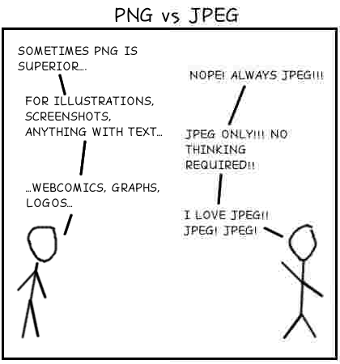
Image Formats: PNG, JPEG, JPEG-XR Optimize Media Usage
PNG (Default)
Website Elements, Logos
JPEG
Photographs
JPEG-XR
High Resolution Photographs
Don’t Get Distracted
GIF, TIFF, BMP, WebP, etc.

Slide 145
Use Native Image Resolutions Optimize Media Usage
<html>
<head>
<title>Test</title>
</head>
<body>
…
<!-- logo.gif dimensions: 500 x 400 -->
<img src="logo.png" width="50" height="40" />
…
</body>
</html>

Slide 146
Use Native Image Resolutions Optimize Media Usage
<html>
<head>
<title>Test</title>
</head>
<body>
…
<!-- logo.gif dimensions: 500 x 400 -->
<img src="logo.png" width="50" height="40" />
…
</body>
</html>

Slide 147
Use Native Image Resolutions Optimize Media Usage
<html>
<head>
<title>Test</title>
</head>
<body>
…
<!-- logo.gif dimensions: 500 x 400 -->
<img src="logo.png" width="50" height="40" />
…
</body>
</html>

Slide 148
Replace Images with CSS3 Gradients Optimize Media Usage
-ms-gradient(linear, 50% 50%, 0% 34%, from(#666666), to(#666666), color-stop(.3,#333333))
-webkit-gradient(linear, 50% 50%, 0% 34%, from(#666666), to(#666666), color-stop(.3,#333333))
-moz-gradient(linear, 50% 50%, 0% 34%, from(#666666), to(#666666), color-stop(.3,#333333))

Slide 149
Replace Images with CSS3 Border Radius Optimize Media Usage
border-radius:18px;
-webkit-border-radius: 100px;
-moz-border-radius: 100px;

Slide 150
Leverage CSS3 Transforms
Optimize Media Usage
Element
Move
Rotate
Skew
-ms-transform: translate(75px, 100px) scaleY(.75) skewY(10deg);
-webkit-transform: translate(75px, 100px) scaleY(.75) skewY(10deg);
-moz-transform: translate(75px, 100px) scaleY(.75) skewY(10deg);
-o-transform: translate(75px, 100px) scaleY(.75) skewY(10deg);

Slide 151
Use DataURI’s for Small Single View Images Optimize Media Usage
<html>
<head>
<title>Test</title>
</head>
<body>
<img src=
"data:image/png;base64
iVBORw0KGgoAAAANSUhEUgAAAAUAAAAFCAYAAACNbyblA"
alt="Red dot" />
</body>
</html>

Slide 152
Use DataURI’s for Small Single View Images Optimize Media Usage
<html>
<head>
<title>Test</title>
</head>
<body>
<img src=
"data:image/png;base64
iVBORw0KGgoAAAANSUhEUgAAAAUAAAAFCAYAAACNbyblA"
alt="Red dot" />
</body>
</html>

Slide 153
Use DataURI’s for Small Single View Images Optimize Media Usage
<html>
<head>
<title>Test</title>
</head>
<body>
<img src=
"data:image/png;base64
iVBORw0KGgoAAAANSUhEUgAAAAUAAAAFCAYAAACNbyblA"
alt="Red dot" />
</body>
</html>

Slide 154
Use DataURI’s for Small Single View Images Optimize Media Usage
<html>
<head>
<title>Test</title>
</head>
<body>
<img src=
"data:image/png;base64
iVBORw0KGgoAAAANSUhEUgAAAAUAAAAFCAYAAACNbyblA"
alt="Red dot" />
</body>
</html>
Notes:
© 2012 Microsoft Corporation. All rights reserved. Microsoft, Windows, and other product names are or may be registered trademarks and/or trademarks in the U.S. and/or other countries.
The information herein is for informational purposes only and represents the current view of Microsoft Corporation as of the date of this presentation. Because Microsoft must respond to changing market conditions, it should not be interpreted to be a commitment on the part of Microsoft, and Microsoft cannot guarantee the accuracy of any information provided after the date of this presentation. MICROSOFT MAKES NO WARRANTIES, EXPRESS, IMPLIED OR STATUTORY, AS TO THE INFORMATION IN THIS PRESENTATION.

Slide 155
Avoid Complex SVG Paths Optimize Media Usage
<path fill-rule="evenodd" clip-rule="evenodd" fill="#FFFFFF" d="M106.093,87.369c-0.666,1.132-2.11,1.485-3.775,1.618 C102.856,87.902,104.848,86.851,106.093,87.369z"/>
<path fill-rule="evenodd" clip-rule="evenodd" fill="#FFFFFF" d="M159.485,91.414c1.025,0.007,0.982,1.404-0.27,1.079C159.101,91.929,159.4,91.779,159.485,91.414z"/>
<path fill-rule="evenodd" clip-rule="evenodd" fill="#FFFFFF" d="M254.404,91.414c0.906-0.277,0.42,0.839,0.54,1.348c-0.348,0.372-1.172,0.267-1.888,0.27C253.441,92.429,253.922,91.92,254.404,91.414z"/>
<path fill-rule="evenodd" clip-rule="evenodd" fill="#FFFFFF" d="M262.764,93.302c-1.355,0.098-2.027-0.489-2.157-1.618 C261.263,91.362,262.884,91.992,262.764,93.302z"/>
<path fill-rule="evenodd" clip-rule="evenodd" fill="#FFFFFF" d="M211.26,94.38c0.563,0.76-0.738,1.458-1.888,1.348 C209.436,94.714,210.478,94.677,211.26,94.38z"/>
<path fill-rule="evenodd" clip-rule="evenodd" fill="#FFFFFF" d="M119.306,94.65c1.248,0.461-0.088,1.505-0.27,2.1z"/>
<path fill-rule="evenodd" clip-rule="evenodd" fill="#FFFFFF" d="M112.564,98.695c0.27,0,0.54,0,0.809,0 c-0.004,0.985-0.767,1.211-1.079,1.888C111.456,100.068,112.716,99.412,112.564,98.695z"/>
<path fill-rule="evenodd" clip-rule="evenodd" fill="#FFFFFF" d="M271.663,101.122c0.906-0.277,0.42,0.839,0.539,1.349C271.612,102.431,271.623,101.791,271.663,101.122z"/>
<path fill-rule="evenodd" clip-rule="evenodd" fill="#FFFFFF" d="M107.711,103.009c-0.065,0.475-0.464,0.615-1.079,0.54C106.697,103.074,107.096,102.934,107.711,103.009z"/>
<path fill-rule="evenodd" clip-rule="evenodd" d="M111.756,103.009c0.731,0.406-0.429,1.164-0.54,1.618C110.33,104.066,111.671,103.49,111.756,103.009z"/>
<path fill-rule="evenodd" clip-rule="evenodd" fill="#FFFFFF" d="M265.73,103.549c0.099,1.285-3.022,2.717-2.696,0.27C264.271,104.086,264.709,102.663,265.73,103.549z"/>
<path fill-rule="evenodd" clip-rule="evenodd" fill="#FFFFFF" d="M270.854,104.627c-0.645,1.915,0.101,3.066,0.81,4.314c-1.951,0.552-1.228-3.769-3.506-3.775C267.546,102.422,270.47,103.358,270.854,104.627z"/>
<path fill-rule="evenodd" clip-rule="evenodd" fill="#FFFFFF" d="M167.036,103.818c0.516,0.113,1.161,0.098,1.079,0.809c-0.313-0.044-0.48,0.06-0.54,0.27C167.213,104.72,167.073,104.321,167.036,103.818z"/>
<path fill-rule="evenodd" clip-rule="evenodd" d="M159.755,105.437c0.27,0,0.539,0,0.809,0c0,0.27,0,0.539,0,0.809 C159.976,106.294,159.706,106.024,159.755,105.437z"/>
<path fill-rule="evenodd" clip-rule="evenodd" fill="#FFFFFF" d="M217.462,105.706c0.629,0,1.258,0,1.888,0 C219.664,106.86,217.146,106.86,217.462,105.706z"/>
<path fill-rule="evenodd" clip-rule="evenodd" fill="#FFFFFF" d="M267.079,106.785c0.705-0.076,1.159,0.099,1.078,0.809 C267.452,107.669,266.997,107.495,267.079,106.785z"/>
<path fill-rule="evenodd" clip-rule="evenodd" fill="#FFFFFF" d="M254.675,107.054c2.004,0.692,2.529,2.863,3.505,4.584 C256.177,112.02,255.477,108.771,254.675,107.054z"/>
<path fill-rule="evenodd" clip-rule="evenodd" fill="#FFFFFF" d="M269.775,109.481c0.594,0.215,1.076,0.542,1"/>
<path fill-rule="evenodd" clip-rule="evenodd" fill="#FFFFFF" d="M167.036,110.29c0.047,0.44-1.764,0.544-1.348-0.27 C166.164,109.52,166.475,110.138,167.036,110.29z"/>
<path fill-rule="evenodd" clip-rule="evenodd" fill="#FFFFFF" d="M258.18,112.447c0.759,0.051,1.149,0.469,1.079,1.349 C258.5,113.745,258.109,113.327,258.18,112.447z"/>
<path fill-rule="evenodd" clip-rule="evenodd" fill="#FFFFFF" d="M264.922,115.953c-1.202-0.596-1.809-1.788-2.428-2.966 C264.305,111.344,264.101,114.976,264.922,115.953z"/>
<path fill-rule="evenodd" clip-rule="evenodd" d="M107.98,113.256c-0.559,1.509-1.884,2.25-2.966,3.236 C104.806,115.29,106.567,113.735,107.98,113.256z"/>
<path fill-rule="evenodd" clip-rule="evenodd" fill="#FFFFFF" d="M255.214,113.796c1.357-0.542,1.554,2.396,2.157,3.505 C255.953,116.832,255.691,115.205,255.214,113.796z"/>
<path fill-rule="evenodd" clip-rule="evenodd" fill="#FFFFFF" d="1.888,0.809C262.972,119.431,261.089,118.257,261.146,115.144z"/>
<path fill-rule="evenodd" clip-rule="evenodd" fill="#FFFFFF" d="M265.73,117.032c0.711-0.082,0.695,0.563,0.809,1.079 C265.828,118.192,265.844,117.547,265.73,117.032z"/>
<path fill-rule="evenodd" clip-rule="evenodd" fill="#FFFFFF" d="M228.248,119.728C228.5,120.993,226.991,120.206,228.248,119.728 L228.248,119.728z"/>

Slide 156
Video: User Preview Images Optimize Media Usage

Slide 157
Minimize Media Plugin Usage Optimize Media Usage

Slide 158
Proactively Download Future Media Optimize Media Usage

Slide 159
Principle #5: Write Fast JavaScript

Slide 160
Stick to Integer Math Write Fast JavaScript
C, C++, C# (Static Language)
static int DoMath(int value) {
int result = 0;
for (int i = 0; i < 10000; i++) {
for (int j = 0; j < 10000; j++) {
result = i + j + value;
}
}
return result;
}
JavaScript (Dynamic Language)
function DoMath(value) {
for (var i = 0; i < 10000; i++) {
for (var j = 0; j < 10000; j++) {
var result = i + j + value;
}
}
return result;
}

Slide 161
Stick to Integer Math Write Fast JavaScript
C++
JavaScript
DoMath(999);
40ms
200ms (~5x)
DoMath(999/2);
40ms
1600ms (~40x)

Slide 162
Stick to Integer Math Write Fast JavaScript
Pointer
Type Tag
0x005e22a0
01
Value
449.4999999………
Pointer
0x005e4148
Type Tag
02
Value
“Hello World”

Slide 163
Stick to Integer Math Write Fast JavaScript
DoMath(Math.floor(999 / 2));
var b = Math.ceil((p[i].r + p[i].g + p[i].b) / 3);

Slide 164
Stick to Integer Math Write Fast JavaScript
DoMath(Math.floor(999 / 2));
var b = Math.ceil((p[i].r + p[i].g + p[i].b) / 3);

Slide 165
Stick to Integer Math Write Fast JavaScript
DoMath(Math.floor(999 / 2));
var b = Math.ceil((p[i].r + p[i].g + p[i].b) / 3);

Slide 166
Minify Your JavaScript Write Fast Loading JavaScript

Slide 167
Minify Your JavaScript Write Fast Loading JavaScript
Initial (66 Characters)
function Sum(number1, number2) {
return (number1 + number2);
}

Slide 168
Minify Your JavaScript Write Fast Loading JavaScript
Initial (66 Characters)
function Sum(number1, number2) {
return (number1 + number2);
}
Characters Removed (54 Characters)
function Sum(number1,number2){return number1+number2;}

Slide 169
Minify Your JavaScript Write Fast Loading JavaScript
Initial (66 Characters)
function Sum(number1, number2) {
return (number1 + number2);
}
Characters Removed (54 Characters)
function Sum(number1,number2){return number1+number2;}
Compacted (30 Characters)
function Sum(a,b){return a+b;}
Notes:
© 2012 Microsoft Corporation. All rights reserved. Microsoft, Windows, and other product names are or may be registered trademarks and/or trademarks in the U.S. and/or other countries.
The information herein is for informational purposes only and represents the current view of Microsoft Corporation as of the date of this presentation. Because Microsoft must respond to changing market conditions, it should not be interpreted to be a commitment on the part of Microsoft, and Microsoft cannot guarantee the accuracy of any information provided after the date of this presentation. MICROSOFT MAKES NO WARRANTIES, EXPRESS, IMPLIED OR STATUTORY, AS TO THE INFORMATION IN THIS PRESENTATION.

Slide 170
Initialize JavaScript on Demand Write Fast Loading JavaScript
var userTileScriptsLoaded = false;
function CustomizeUserTile()
{
if (userTileScriptsLoaded == false)
{
var head = document.getElementsByTagName("head")[0];
script = document.createElement('script');
script.type = 'text/javascript';
script.src = 'upload.js';
head.appendChild(script);
}
}

Slide 171
Initialize JavaScript on Demand Write Fast Loading JavaScript
var userTileScriptsLoaded = false;
function CustomizeUserTile()
{
if (userTileScriptsLoaded == false)
{
var head = document.getElementsByTagName("head")[0];
script = document.createElement('script');
script.type = 'text/javascript';
script.src = 'upload.js';
head.appendChild(script);
}
}

Slide 172
Initialize JavaScript on Demand Write Fast Loading JavaScript
var userTileScriptsLoaded = false;
function CustomizeUserTile()
{
if (userTileScriptsLoaded == false)
{
var head = document.getElementsByTagName("head")[0];
script = document.createElement('script');
script.type = 'text/javascript';
script.src = 'upload.js';
head.appendChild(script);
}
}

Slide 173
Initialize JavaScript on Demand Write Fast Loading JavaScript
var userTileScriptsLoaded = false;
function CustomizeUserTile()
{
if (userTileScriptsLoaded == false)
{
var head = document.getElementsByTagName("head")[0];
script = document.createElement('script');
script.type = 'text/javascript';
script.src = 'upload.js';
head.appendChild(script);
}
}

Slide 174
Initialize JavaScript on Demand Write Fast Loading JavaScript
var userTileScriptsLoaded = false;
function CustomizeUserTile()
{
if (userTileScriptsLoaded == false)
{
var head = document.getElementsByTagName("head")[0];
script = document.createElement('script');
script.type = 'text/javascript';
script.src = 'upload.js';
head.appendChild(script);
}
}
Notes:
© 2012 Microsoft Corporation. All rights reserved. Microsoft, Windows, and other product names are or may be registered trademarks and/or trademarks in the U.S. and/or other countries.
The information herein is for informational purposes only and represents the current view of Microsoft Corporation as of the date of this presentation. Because Microsoft must respond to changing market conditions, it should not be interpreted to be a commitment on the part of Microsoft, and Microsoft cannot guarantee the accuracy of any information provided after the date of this presentation. MICROSOFT MAKES NO WARRANTIES, EXPRESS, IMPLIED OR STATUTORY, AS TO THE INFORMATION IN THIS PRESENTATION.

Slide 175
Minimize DOM Interactions Use DOM Efficiently
function CalculateSum() {
var leftSide = document.body.all.lSide.value;
var rightSide = document.body.all.rSide.value;
document.body.all.result.value = leftSide + rightSide;
}

Slide 176
Minimize DOM Interactions Use DOM Efficiently
function CalculateSum() {
var leftSide = document.body.all.lSide.value;
var rightSide = document.body.all.rSide.value;
document.body.all.result.value = leftSide + rightSide;
}

Slide 177
Minimize DOM Interactions Use DOM Efficiently
function CalculateSum() {
var leftSide = document.body.all.lSide.value;
var rightSide = document.body.all.rSide.value;
document.body.all.result.value = leftSide + rightSide;
}

Slide 178
Minimize DOM Interactions Use DOM Efficiently
function CalculateSum() {
var leftSide = document.body.all.lSide.value;
var rightSide = document.body.all.rSide.value;
document.body.all.result.value = leftSide + rightSide;
}
Notes:
© 2012 Microsoft Corporation. All rights reserved. Microsoft, Windows, and other product names are or may be registered trademarks and/or trademarks in the U.S. and/or other countries.
The information herein is for informational purposes only and represents the current view of Microsoft Corporation as of the date of this presentation. Because Microsoft must respond to changing market conditions, it should not be interpreted to be a commitment on the part of Microsoft, and Microsoft cannot guarantee the accuracy of any information provided after the date of this presentation. MICROSOFT MAKES NO WARRANTIES, EXPRESS, IMPLIED OR STATUTORY, AS TO THE INFORMATION IN THIS PRESENTATION.

Slide 179
Minimize DOM Interactions Use DOM Efficiently
function CalculateSum() {
var leftSide = document.body.all.lSide.value;
var rightSide = document.body.all.rSide.value;
document.body.all.result.value = leftSide + rightSide;
}

Slide 180
Minimize DOM Interactions Use DOM Efficiently
function CalculateSum() {
var leftSide = document.body.all.lSide.value;
var rightSide = document.body.all.rSide.value;
document.body.all.result.value = leftSide + rightSide;
}

Slide 181
Minimize DOM Interactions Use DOM Efficiently
function CalculateSum() {
var leftSide = document.body.all.lSide.value;
var rightSide = document.body.all.rSide.value;
document.body.all.result.value = leftSide + rightSide;
}

Slide 182
Minimize DOM Interactions Use DOM Efficiently
function CalculateSum() {
var leftSide = document.body.all.lSide.value;
var rightSide = document.body.all.rSide.value;
document.body.all.result.value = leftSide + rightSide;
}

Slide 183
Minimize DOM Interactions Use DOM Efficiently
function CalculateSum() {
var leftSide = document.body.all.lSide.value;
var rightSide = document.body.all.rSide.value;
document.body.all.result.value = leftSide + rightSide;
}
15 lookups
Notes:
© 2012 Microsoft Corporation. All rights reserved. Microsoft, Windows, and other product names are or may be registered trademarks and/or trademarks in the U.S. and/or other countries.
The information herein is for informational purposes only and represents the current view of Microsoft Corporation as of the date of this presentation. Because Microsoft must respond to changing market conditions, it should not be interpreted to be a commitment on the part of Microsoft, and Microsoft cannot guarantee the accuracy of any information provided after the date of this presentation. MICROSOFT MAKES NO WARRANTIES, EXPRESS, IMPLIED OR STATUTORY, AS TO THE INFORMATION IN THIS PRESENTATION.

Slide 184
Built in DOM Methods Always More Efficient Use DOM Efficiently
function LoopChildren(elm) {
var node = elm.firstChild;
while (node != null) {
node = node.nextSibling;
}
}

Slide 185
Built in DOM Methods Always More Efficient Use DOM Efficiently
function LoopChildren(elm) {
var node = elm.firstChild;
while (node != null) {
node = node.nextSibling;
}
}
Notes:
© 2012 Microsoft Corporation. All rights reserved. Microsoft, Windows, and other product names are or may be registered trademarks and/or trademarks in the U.S. and/or other countries.
The information herein is for informational purposes only and represents the current view of Microsoft Corporation as of the date of this presentation. Because Microsoft must respond to changing market conditions, it should not be interpreted to be a commitment on the part of Microsoft, and Microsoft cannot guarantee the accuracy of any information provided after the date of this presentation. MICROSOFT MAKES NO WARRANTIES, EXPRESS, IMPLIED OR STATUTORY, AS TO THE INFORMATION IN THIS PRESENTATION.

Slide 186
Built in DOM Methods Always More Efficient Use DOM Efficiently
function LoopChildren(elm) {
var node = elm.firstChild;
while (node != null) {
node = node.nextSibling;
}
}

Slide 187
Use Selectors API for Collection Access Use DOM Efficiently
function doValidation() {
var reqs = document.querySelectorAll(".required");
var missingRequiredField = false;
for (var i = 0; i < reqs.length; i++) {
if (reqs[i].value == "")
missingRequiredField = true;
}
}

Slide 188
Use Selectors API for Collection Access Use DOM Efficiently
function doValidation() {
var reqs = document.querySelectorAll(".required");
var missingRequiredField = false;
for (var i = 0; i < reqs.length; i++) {
if (reqs[i].value == "")
missingRequiredField = true;
}
}

Slide 189
User .innerHTML to Construct Your Page Use DOM Efficiently
function InsertUsername()
{
document.getElementById('user').innerHTML = userName;
}

Slide 190
User .innerHTML to Construct Your Page Use DOM Efficiently
function InsertUsername()
{
document.getElementById('user').innerHTML = userName;
}

Slide 191
Batch Markup Changes Use DOM Efficiently
function BuildUI() {
var elm = document.getElementById('ui');
var contents = BuildTitle() + BuildBody() + BuildFooter();
elm.innerHTML = contents;
}

Slide 192
Batch Markup Changes Use DOM Efficiently
function BuildUI() {
var elm = document.getElementById('ui');
var contents = BuildTitle() + BuildBody() + BuildFooter();
elm.innerHTML = contents;
}

Slide 193
Batch Markup Changes Use DOM Efficiently
function BuildUI() {
var elm = document.getElementById('ui');
var contents = BuildTitle() + BuildBody() + BuildFooter();
elm.innerHTML = contents;
}

Slide 194
Batch Markup Changes Use DOM Efficiently
function BuildUI() {
var elm = document.getElementById('ui');
var contents = BuildTitle() + BuildBody() + BuildFooter();
elm.innerHTML = contents;
}

Slide 195
Maintain a Small and Healthy DOM Use DOM Efficiently
Document
HTML
Body
Element
Element
Element
Element
Element
Element
Element
Element
Element

Slide 196
JSON Always Faster than XML for Data
XML Representation
<!DOCTYPE glossary PUBLIC "DocBook V3.1">
<glossary><title>example glossary</title>
<GlossDiv><title>S</title>
<GlossList>
<GlossEntry ID="SGML" SortAs="SGML">
<GlossTerm>Markup Language</GlossTerm>
<Acronym>SGML</Acronym>
<Abbrev>ISO 8879:1986</Abbrev>
<GlossDef>
<para>meta-markup language</para>
<GlossSeeAlso OtherTerm="GML">
<GlossSeeAlso OtherTerm="XML">
</GlossDef>
<GlossSee OtherTerm="markup">
</GlossEntry>
</GlossList>
</GlossDiv>
</glossary>
JSON Representation
"glossary":{
"title": "example glossary", "GlossDiv":{
"title": "S", "GlossList": {
"GlossEntry": {
"ID": "SGML",
"SortAs": "SGML",
"GlossTerm": "Markup Language",
"Acronym": "SGML",
"Abbrev": "ISO 8879:1986",
"GlossDef": {
"para": "meta-markup language",
"GlossSeeAlso": ["GML", "XML"] },
"GlossSee": "markup" }
}
}
}
}

Slide 197
Use Native JSON Methods Write Fast JavaScript
Native JSON Methods
var jsObjStringParsed = JSON.parse(jsObjString);
var jsObjStringBack = JSON.stringify(jsObjStringParsed);

Slide 198
Use Regular Expressions Sparingly Write Fast JavaScript
var foo = ^(?:\$\s*)?(?:(?:\d{0,3}(?:[, ]\d{0,3})*(?:\s*\$)\\;

Slide 199
Principle #6: Know What Your Application is Doing

Slide 200
Understand JavaScript Timers Know What Your Application is Doing
setTimeout
setTimeout(callback, ms);
setInterval
var test = setInterval(callback, ms); clearInterval(test);
n
n
n
n
n
n

Slide 201
Combine Application Timers Know What Your Application is Doing
6
6
6
6
6
6
6
6
6
6
6
10
10
10
10
10
10
50

Slide 202
Align Timers to the Display Frame (16.7) Know What Your Application is Doing
16.7
16.7
16.7
setInterval(renderLoop, 16.7);
setInterval(renderLoop, 33.4);

Slide 203
Use requestAnimationFrame for Animations Know What Your Application is Doing
16.7
16.7
16.7
window.requestAnimationFrame(renderLoop);

Slide 204
Know When Your App is Visible Know What Your Application is Doing
Page Visibility API
document.hidden (property)
Visibilitychange (event)

Slide 205
Six Principles to Remember
Quickly Respond to Network Requests
Minimize Bytes Downloaded
Efficiently Structure Markup
Optimize Media Usage
Write Fast JavaScript
Know What Your Application is Doing

Slide 206
Windows Performance Toolkit: http://msdn.microsoft.com/en-us/performance/default.aspx
Measuring Browser Performance: http://blogs.msdn.com/b/ie/archive/2010/06/21/measuring-browser-performance-with-the-windows-performance-tools.aspx?utm_medium=Twitter&utm_source=Shared

Slide 207
GPU
Core 1
Core 2
Core 3
Core 4

Slide 208
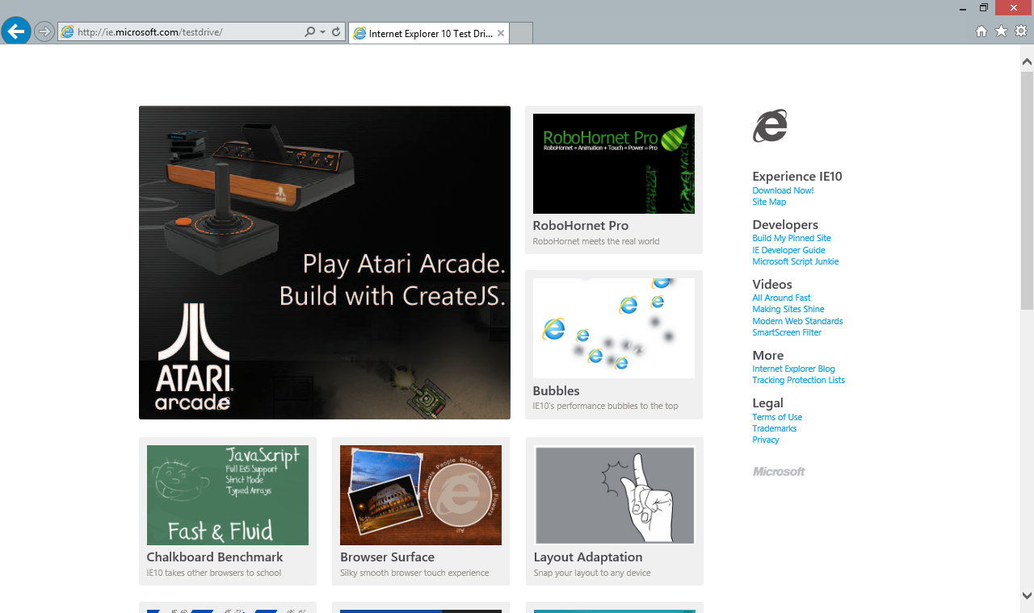

Slide 209
?

Slide 210
«««««

Slide 211
Resources
Develop: http://msdn.microsoft.com/en-US/windows/apps/br229512
Design: http://design.windows.com/
Samples: http://code.msdn.microsoft.com/windowsapps/Windows-8-Modern-Style-App-Samples
Videos: http://channel9.msdn.com/Windows
Please submit session evals by using the Build Windows 8 app
or at http://aka.ms/BuildSessions

