Slide 1
Don’t break the web
Rey Bango & Tyson Matanich
Microsoft Developer Awesomeness

Slide 2

somegeekintn.com

Slide 3
National Electrical Manufacturers Association

Slide 4
W3C
Ecma International
IETF

Slide 5


Slide 6
JavaScript

Slide 7
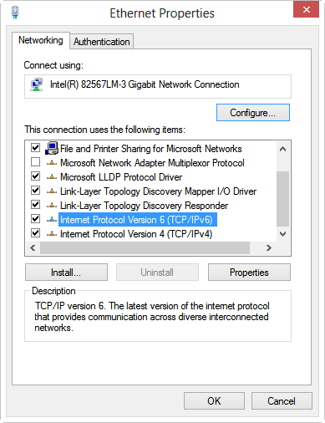

Slide 8
Stable & emerging

Slide 9
Stable standards
  There were no recent additions or changes and no renaming or major changes are expected
Supported by at least two browsers other than Internet Explorer 10
Interoperable across all these browsers for the features’ core use cases
Already used on the Web, including in their unprefixed form
Reached Candidate Recommendation or are likely to become Candidate Recommendations

Slide 10
Emerging standards
Allow the specification to evolve
    Without prefixes, web content written for the earliest implementation(s) could constrain the editor(s) and make useful additions or changes difficult or even impossible.
Segregate experimental implementations
    The bugs or choice of draft version of a particular browser have no impact on other browsers.
Style sheet documentation
    The vendor-specific dependencies of a style sheet are explicitly documented.

Slide 11
Emerging standards
Designated by vendor prefixes
Each vendor has its own prefix
  Styles
    -ms- (Microsoft)
    -moz- (Mozilla)
    -webkit- (Webkit-based browsers like Chrome & Safari)
    -o- (Opera)
  Example:
    display: -ms-flexbox;
    display: -webkit-flexbox;

Slide 12
Emerging standards
  Platform APIs
    window.requestAnimationFrame()
      window.mozRequestAnimationFrame()
      window.webkitRequestAnimationFrame()
      window.msRequestAnimationFrame()

Slide 13
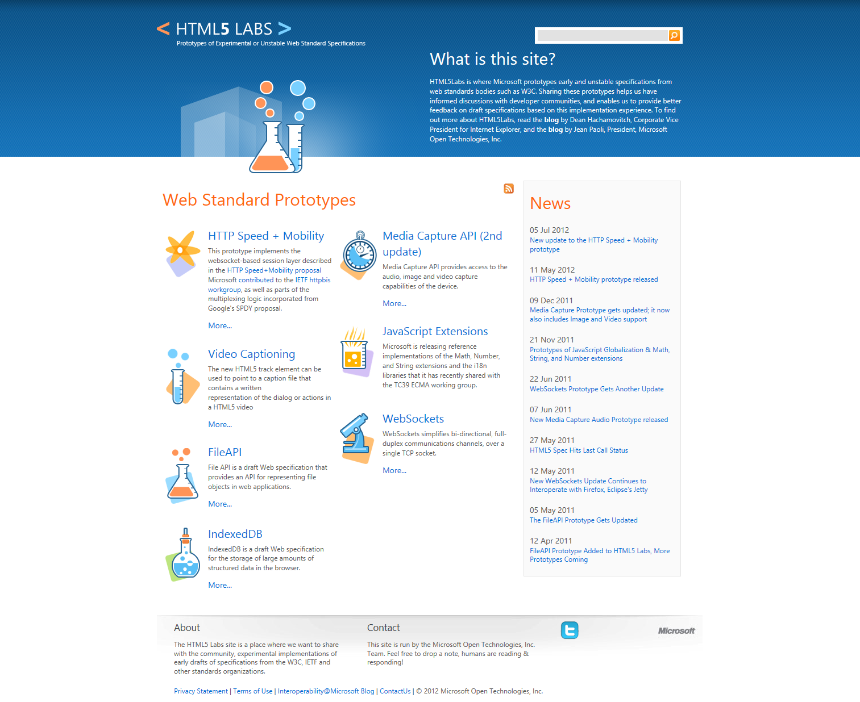

Slide 14
Features you can depend on

Slide 15
Minimize breaking changes

Slide 16
Specs change
CSS Gradients
    Introduced in 2008
    Working Draft in 2009
background: -webkit-linear-gradient(left, yellow, red);
background: -moz-linear-gradient(left, yellow, red);
background: -o-linear-gradient(left, yellow, red);
background: -ms-linear-gradient(left, yellow, red);
Candidate Recommendation in 2012
background: linear-gradient(to right, yellow, red);

Slide 17
Specs need time to bake
Examples
  Websocket
    2010: Security flaw forced Mozilla & Opera to back out support
  WebGL
    2011: Security flaw identified that could allow low-level exploits due to access to graphics drivers & hardware
    CERT issued a warning on this recommending users disable WebGL

Slide 18
Browser vendors generally
drop their prefix when the
corresponding specification
reaches the Candidate Recommendation stage.

Slide 19
-webkit-transform: rotate(30deg);
-moz-transform: rotate(30deg);
-ms-transform: rotate(30deg);
-o-transform: rotate(30deg);
transform: rotate(30deg);

Slide 20
-webkit-transform: rotate(30deg);

Slide 21
-webkit-box-reflect:…;
Proprietary, NOT standard

Slide 22
“Best viewed in…..”

Slide 23
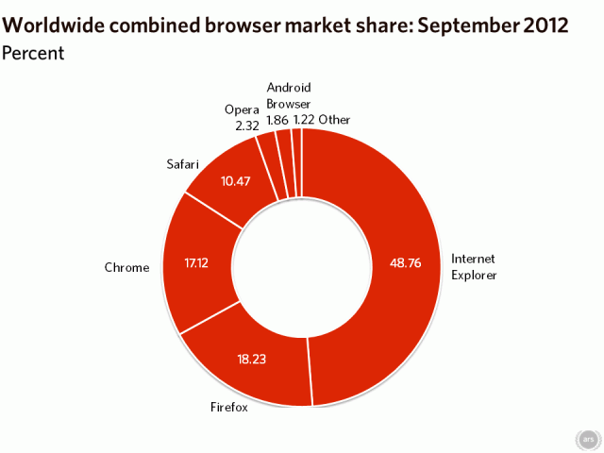
Stats via Ars Technica

Slide 24
Think cross-browser!

Slide 25
-webkit-transform: rotate(30deg);
-moz-transform: rotate(30deg);
-ms-transform: rotate(30deg);
-o-transform: rotate(30deg);
transform: rotate(30deg);

Slide 26
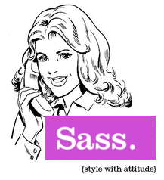



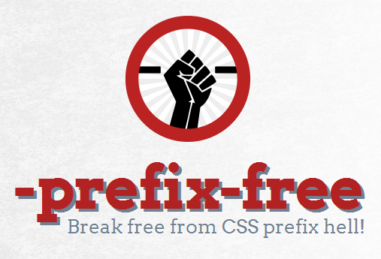

Slide 27
Is it a standard?
“box-shadow” site:w3.org
“box-reflect” site:w3.org

Slide 28
Browser fragmentation

Slide 29
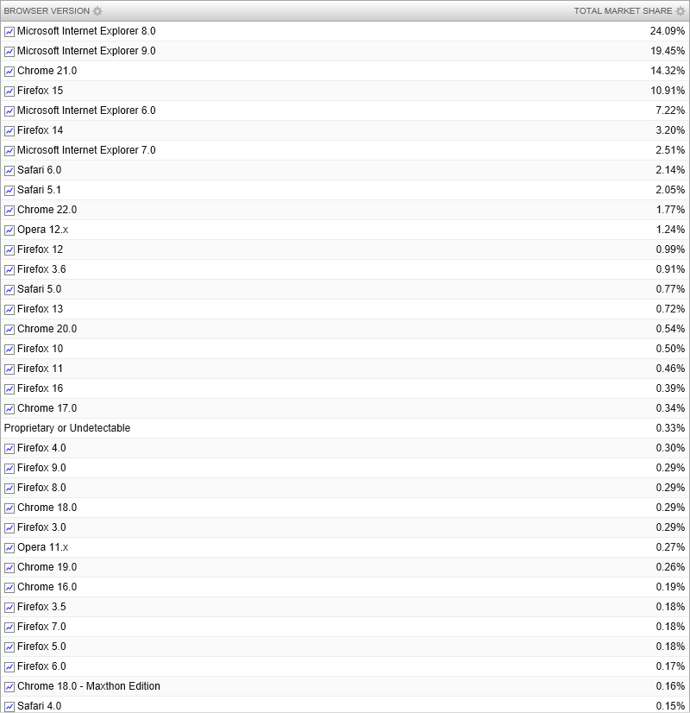

Slide 30
Fragmentation
Varying Levels of Support
  Across browsers
  Across browser versions
  New versions released constantly
Browser detection doesn’t work
  Fixes based on assumptions
  Full-time job tracking changes

Slide 31
Solutions?

Slide 32
Feature detection

Slide 33
Feature detection
Act based on what browsers support, not their versions
Check for the feature you want to use
    Object
    Method
    Property
    Behavior
  Dynamically load custom code to mimic missing features
  Detect for standards-based features first
    Browsers often support both standards and legacy
    Standards are your most stable ground to build upon

Slide 34
Why not check for a browser?

Slide 35
Bad
// If not IE then use addEventListener…
if (navigator.userAgent.indexOf("MSIE") == -1) {
window.addEventListener( “load”, popMessage, false );
} else if (window.attachEvent) {
window.attachEvent( “onload”, popMessage);
}

Slide 36
Good
if (window.addEventListener) {
window.addEventListener( “load”, popMessage, false );
} else if (window.attachEvent) {
window.attachEvent( “onload”, popMessage);
}

Slide 37
What happens when feature detection looks like this?

Slide 38
Yuck!
function(){
var
sheet, bool,
head = docHead || docElement,
style = document.createElement("style"),
impl = document.implementation || { hasFeature: function() { return false; } };
style.type = 'text/css';
head.insertBefore(style, head.firstChild);
sheet = style.sheet || style.styleSheet;
var supportAtRule = impl.hasFeature('CSS2', '') ?
function(rule) {
if (!(sheet && rule)) return false;
var result = false;
try {
sheet.insertRule(rule, 0);
result = (/src/i).test(sheet.cssRules[0].cssText);
sheet.deleteRule(sheet.cssRules.length - 1);
} catch(e) { }
return result;
} :
function(rule) {
if (!(sheet && rule)) return false;
sheet.cssText = rule;
return sheet.cssText.length !== 0 && (/src/i).test(sheet.cssText) &&
sheet.cssText
.replace(/\r+|\n+/g, '')
.indexOf(rule.split(' ')[0]) === 0;
};
bool = supportAtRule('@font-face { font-family: "font"; src: url(data:,); }');
head.removeChild(style);
return bool;
};

Slide 39


Slide 40
  Best feature detection support
  Detects:
    All major HTML5 features
    All major CSS3 features
  Includes HTML5Shim for semantic tag support
  Widespread adoption
    Twitter, National Football League, Burger King, and many more…
  Constantly updated

Slide 41
  1,031 Responses
    jQuery: 89%
    Modernizr: 51%
    Git: 47%
    HTML5 Boilerplate: 43%
    Sass: 25%
    LESS: 23%
    Compass:18%
Widely used

Slide 42
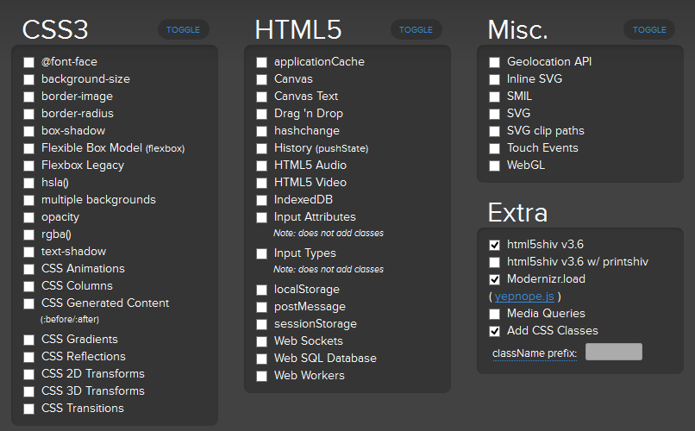

Slide 43
Test for
@font-face

Slide 44
You can do this
function(){
var
sheet, bool,
head = docHead || docElement,
style = document.createElement("style"),
impl = document.implementation || { hasFeature: function() { return false; } };
style.type = 'text/css';
head.insertBefore(style, head.firstChild);
sheet = style.sheet || style.styleSheet;
var supportAtRule = impl.hasFeature('CSS2', '') ?
function(rule) {
if (!(sheet && rule)) return false;
var result = false;
try {
sheet.insertRule(rule, 0);
result = (/src/i).test(sheet.cssRules[0].cssText);
sheet.deleteRule(sheet.cssRules.length - 1);
} catch(e) { }
return result;
} :
function(rule) {
if (!(sheet && rule)) return false;
sheet.cssText = rule;
return sheet.cssText.length !== 0 && (/src/i).test(sheet.cssText) &&
sheet.cssText
.replace(/\r+|\n+/g, '')
.indexOf(rule.split(' ')[0]) === 0;
};
bool = supportAtRule('@font-face { font-family: "font"; src: url(data:,); }');
head.removeChild(style);
return bool;
};

Slide 45
Or this…
if (Modernizr.fontface){
…
}

Slide 46
Polyfills & shims

Slide 47
Polyfills & shims
  What are they?
    Typically JavaScript, HTML, & CSS code
  What do they do?
    Provides the technology that you, the developer, expect the browser to provide natively
    Provides support for missing features
  When do you use them?
    Use them to fall back gracefully or mimic functionality

Slide 48
What’s the difference?
  Polyfill
    Replicates the real, standard feature API
    You can develop for the future
  Shims
    Provides own API to a missing feature
    Doesn’t adhere to a specification but fills the gap
    Generally provides more features

Slide 49
  Stylesheet:
  article {
    -webkit-border-radius:10px;
    -moz-border-radius:10px;
    -ms-border-radius:10px;
    -o-border-radius:10px;
    border-radius:10px;
  }
  JavaScript code for non-modern browser:
  if (!Modernizr.borderradius) {
  // Load a shim to mimic the rounded corners...
  $.getScript("js/jquery.corner.js", function () {
  $("article").corner();
  });
  }

Slide 50
Consider this
  Considerations
    You need to vet the code
      Does it work as expected?
      Cross-browser?
    You may need to support it in the future
      Developer abandons work
      Do you have the skills to maintain it?
    API Consistency
      Will you need to rewrite your code later?

Slide 51
Takeaway
  Focus on STABLE standards
    Specs can change and you want to be ready
    Experimentation is perfectly fine
  Cross-browser matters
    Do you want to go back to the “Best Viewed in” days?
    Detect for standards first
    Use Modernizr – http://modernizr.com

Slide 52
Takeaway
  Polyfills and shims
    Opt for code that mimics a standard API to avoid a rewrite
    You may have to support the code going forward
  Test your sites across all major browsers
    Lots of options for all operating systems
    Browserstack.com stands out for ease of use and availability

Slide 53
Microsoft.com

Slide 54
There is no standard screen resolution

Slide 55
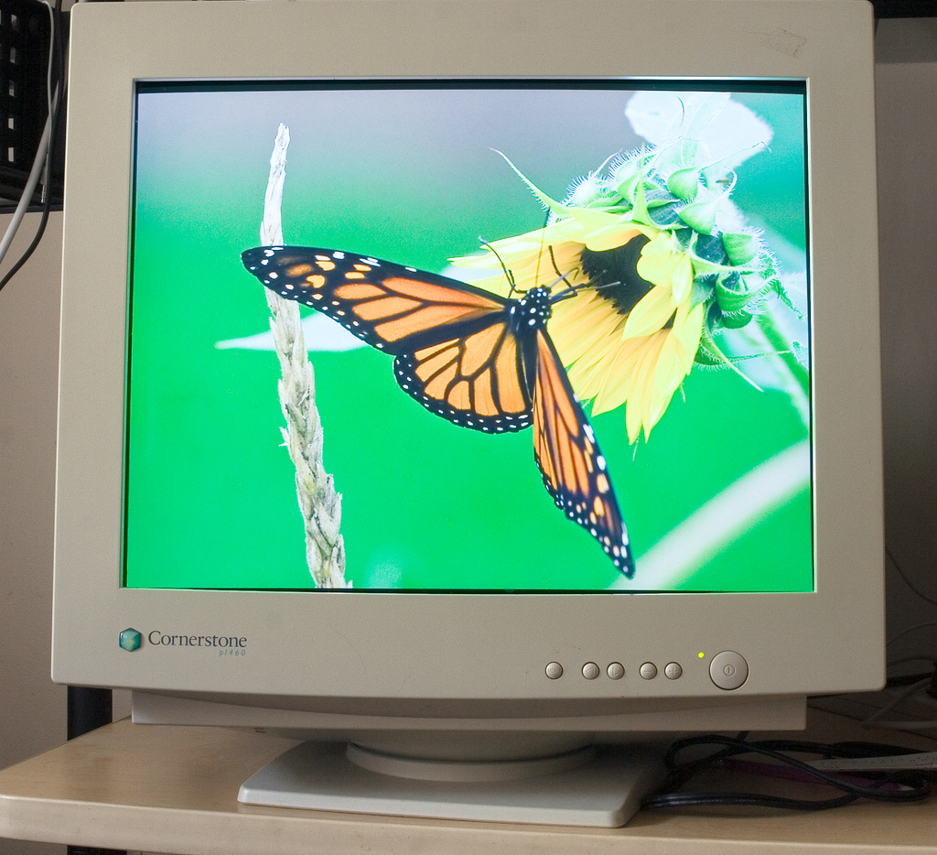
This is not the standard
image by Nic’s events’

Slide 56

More modern,
but not the standard
image by Hire London

Slide 57
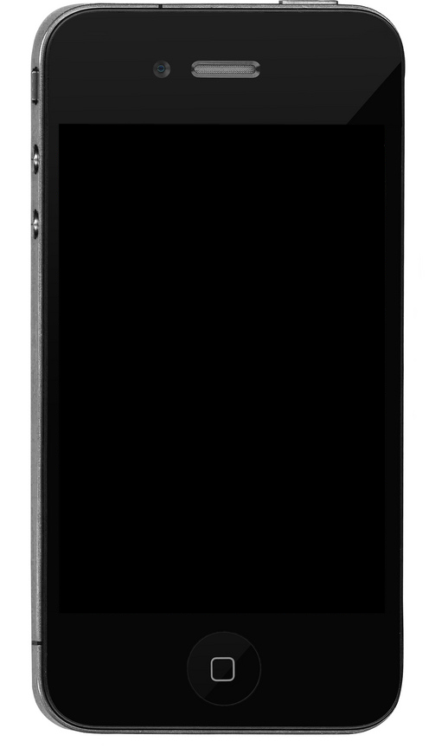
Smaller,
but not the standard
image by Randolf Jorberg

Slide 58
Separate web sites
Lets build one site for “normal” computers and another one for phones.
The “normal” site can be ____px wide and the mobile one can be ____px wide.

Slide 59
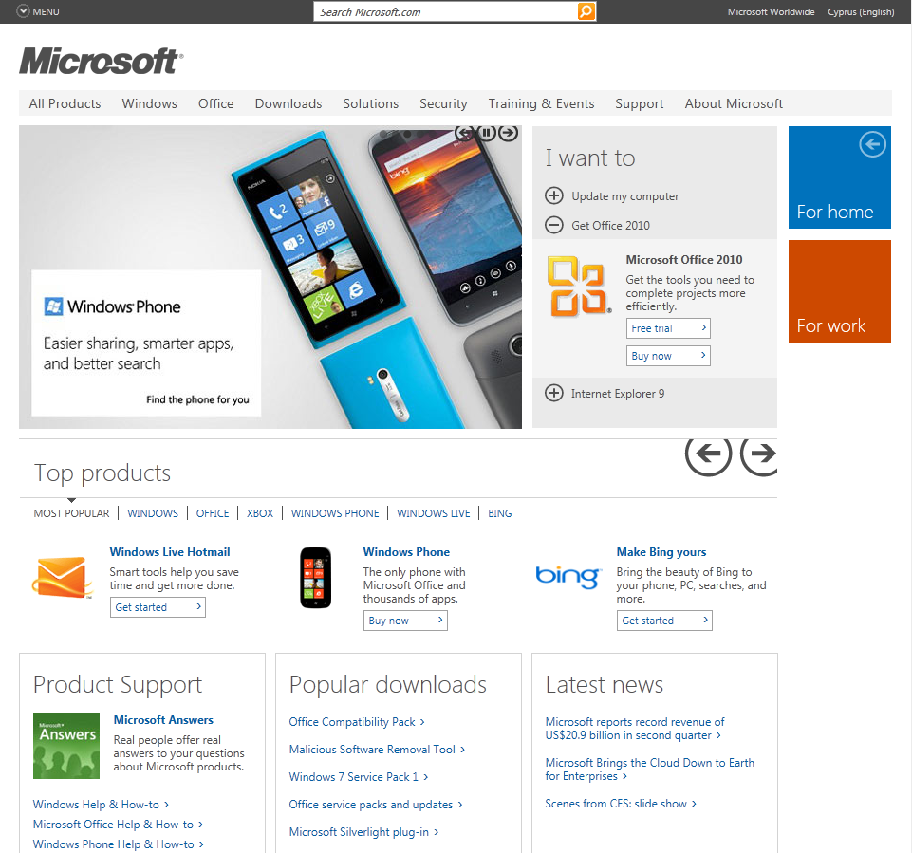
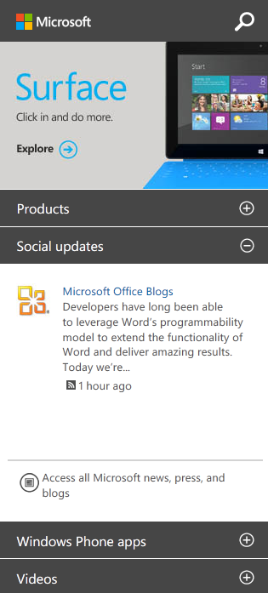
Previous Microsoft.com
Old “normal” site and mobile site
www.microsoft.com
m.microsoft.com

Slide 60
Responsive web design
Responsive designs should not just be fluid but also be thoughtful
  Any screen / browser size
  Fluid layout
  Same markup
  Same CSS
  Same URL

Slide 61
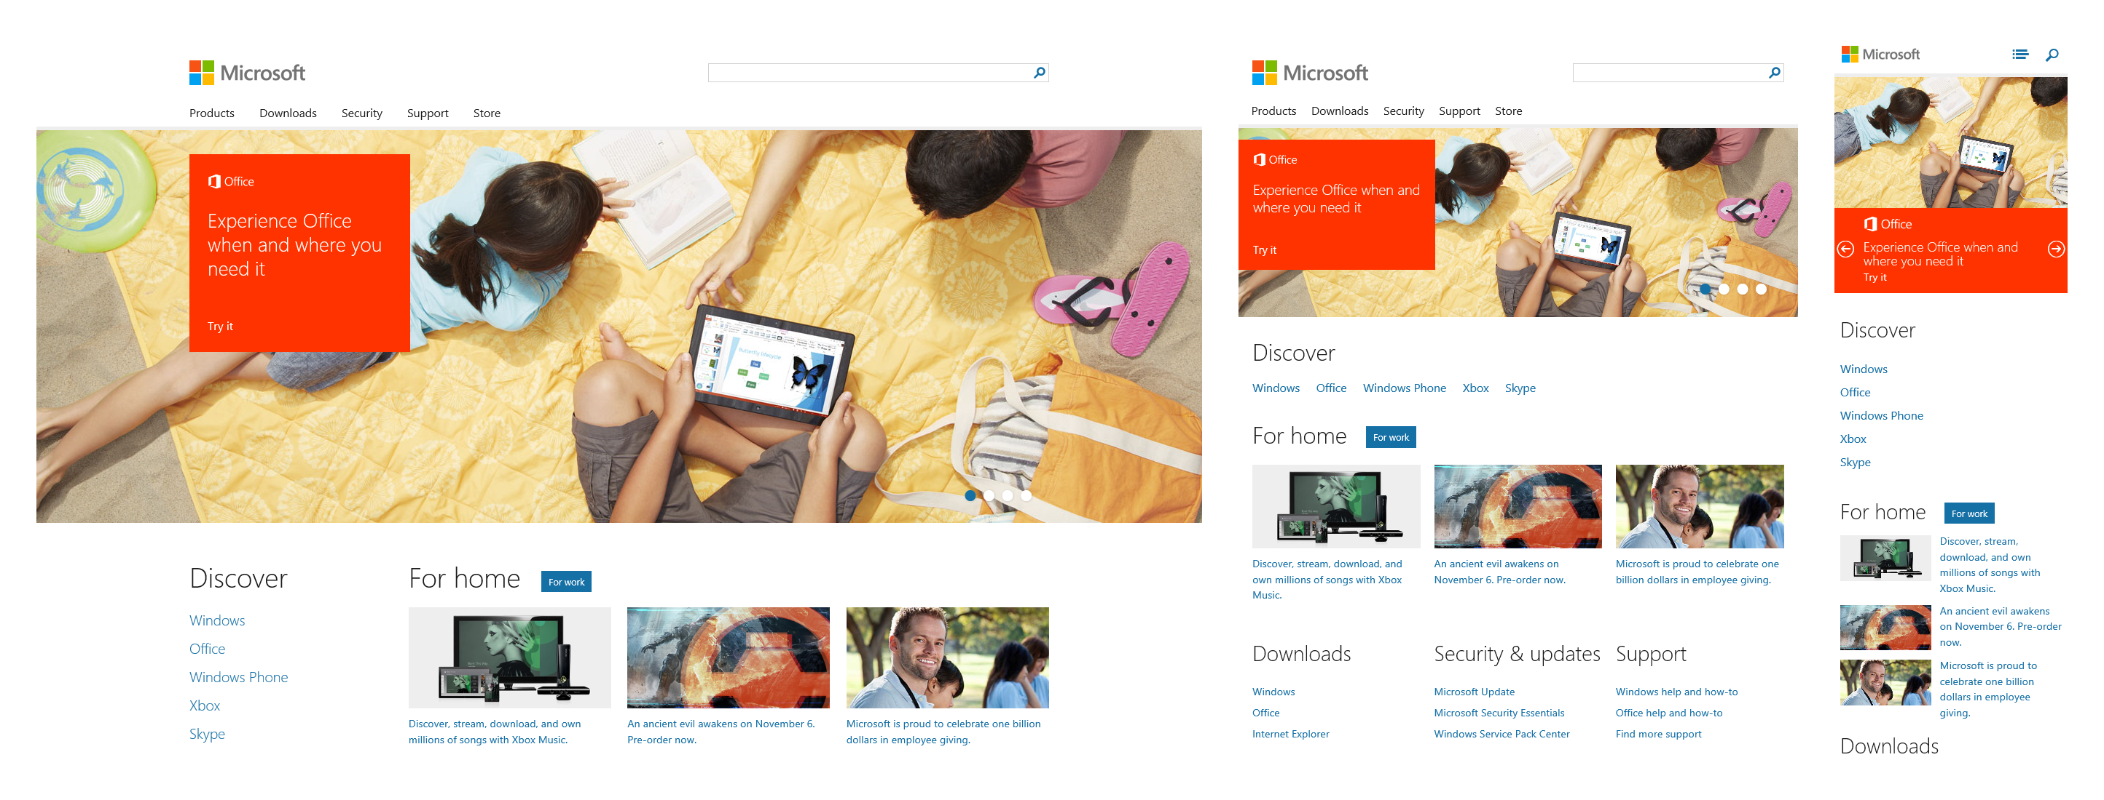
New Microsoft.com

Slide 62
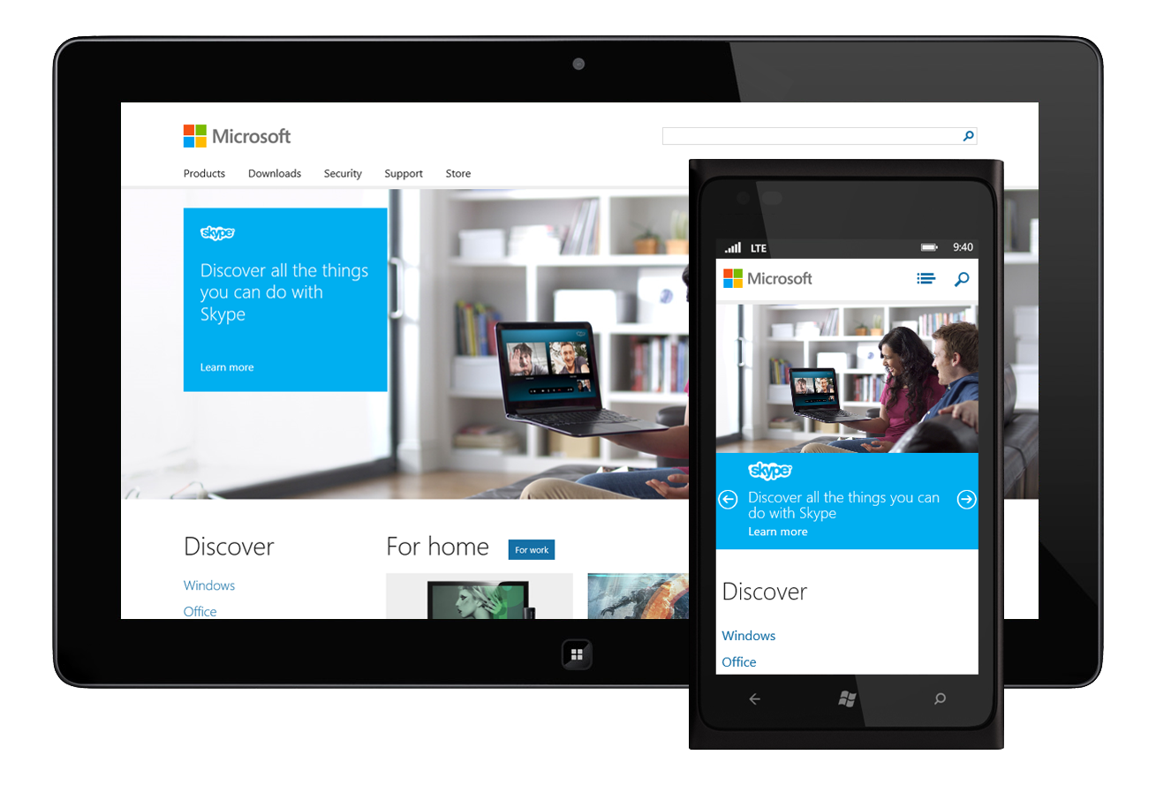
Viewport
It was almost ok to forget about 800 x 600 and now any size goes

Slide 63
Viewport
<!-- Not a standard -->
<meta name="viewport"
content="width=device-width, initial-scale=1.0" />
/* W3C Working Draft */
@-ms-viewport { width: device-width; }
@-o-viewport { width: device-width; }
@viewport { width: device-width; }

Slide 64
Media queries
“…media queries optimize the design for different viewing contexts…” - Ethan Marcotte
@media screen and (min-width: 680px) {
body {
font-size: 0.8em;
}
}

Slide 65
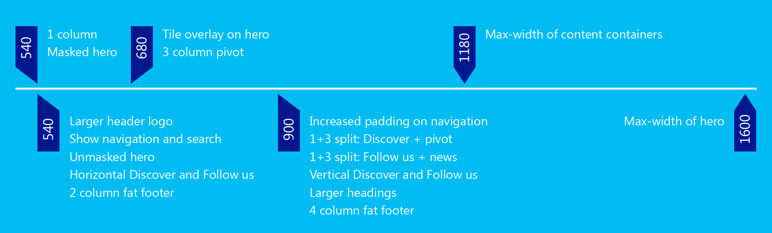
Breakpoint timeline

Slide 66
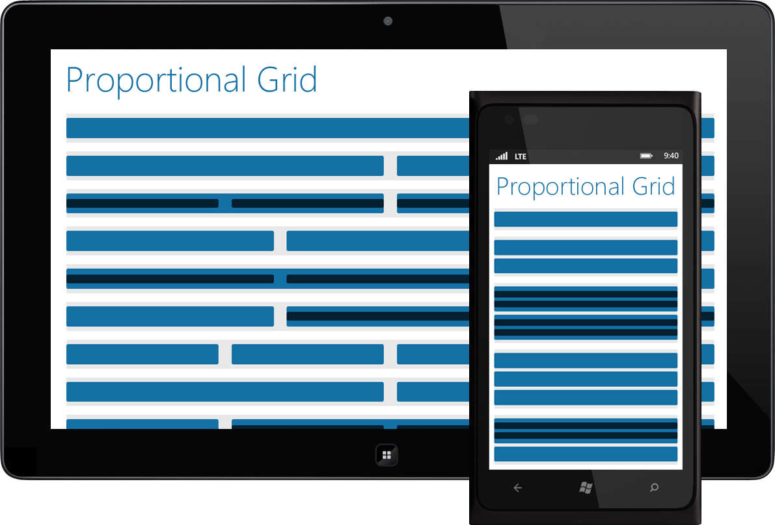
Proportional grid
Sizing content into full width, halves, thirds, and quarters

Slide 67

Cross-browser support
Simple?

Slide 68


Build for your users
IE 10
IE 9
IE 8
IE 7
IE 6
IE Mobile 10
IE Mobile 9
IE Mobile 8
Xbox
PC
PC
PC
PC
Mac
iPhone
iPad
Tablet
Phone
Kindle Fire
…not quite so simple
we test on 25+ browser, OS, device combinations

Slide 69
Older browsers
Older browsers don’t support media queries
  Use a JavaScript library to add support
  Lock the layout to specific width

Slide 70
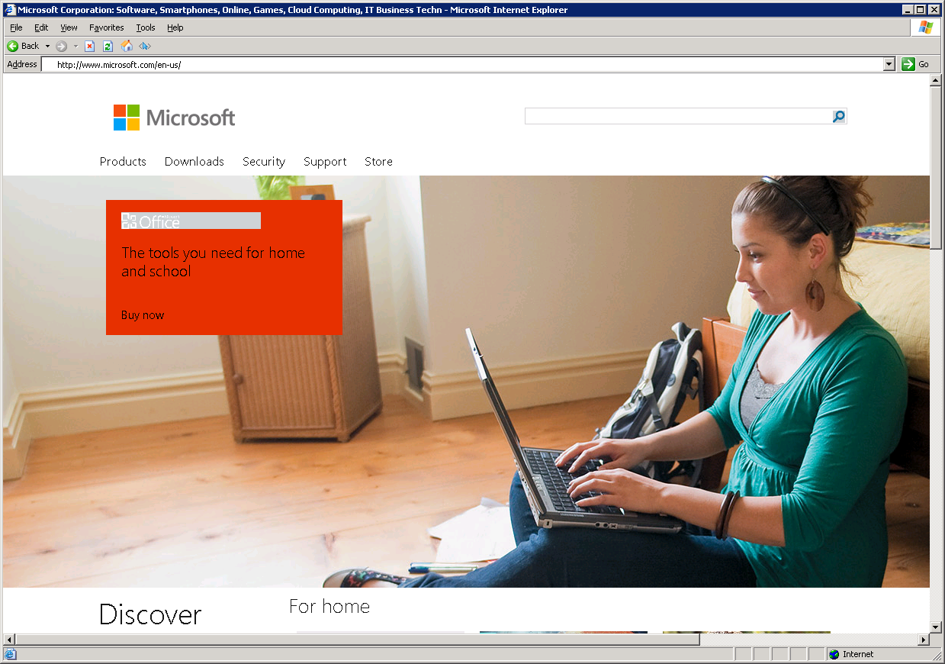
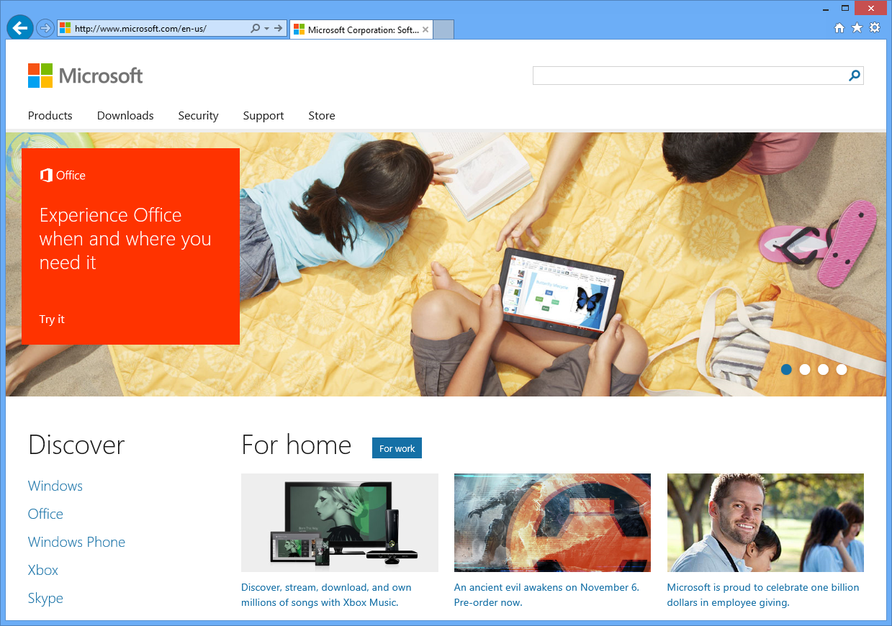
Decide whether different is ok
IE 6
IE 10

Slide 71
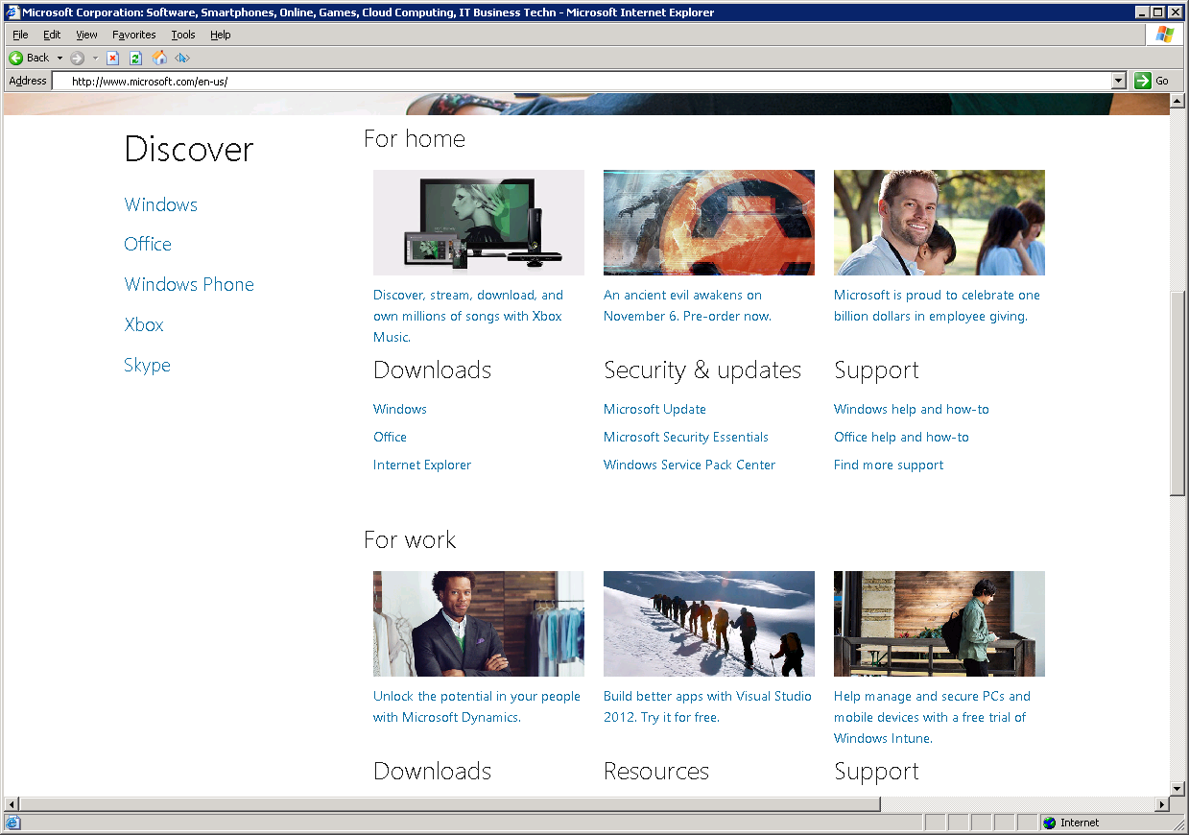
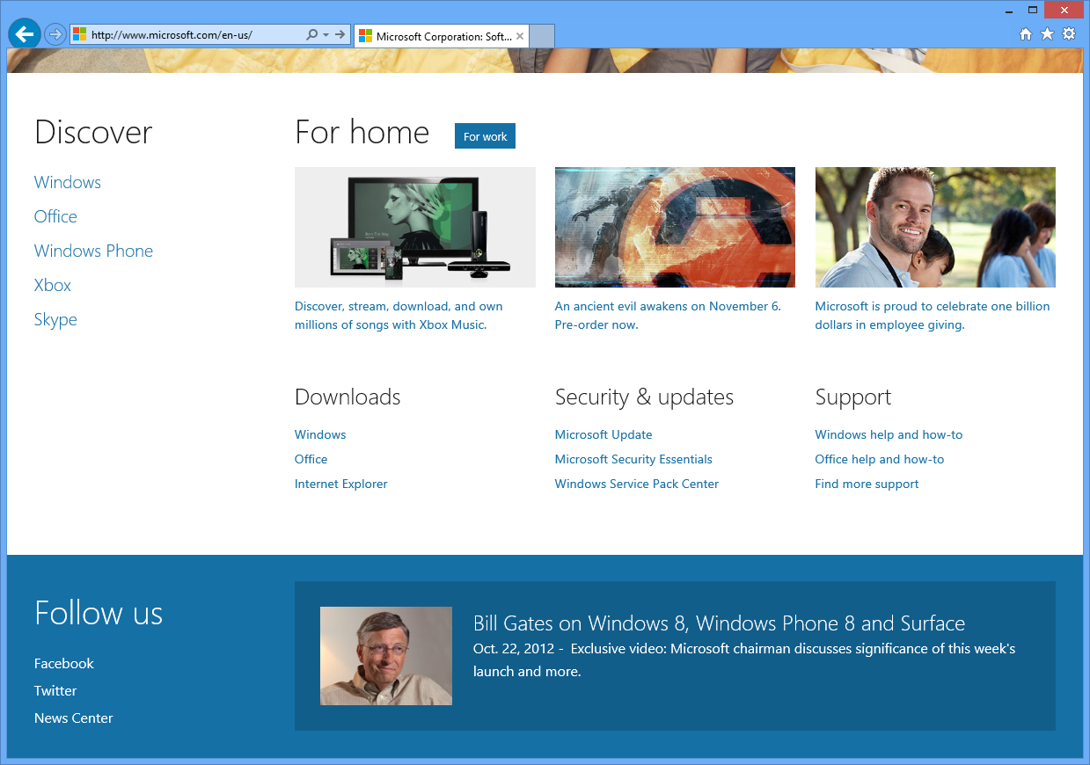
Pixel perfect isn't always required
IE 6
IE 10

Slide 72
User-agent vs. feature detection
Use the right tool for the job
  User-agent detection requires maintenance
  Feature detection is future friendly
  Sometimes user-agent detection is required

Slide 73
User-agent detection
We have to update lists of regular expressions as new browsers are released
When we use it
  Content targeting
  Legacy browser support
  Video
  Local web fonts

Slide 74
Feature detection
Doesn’t require ongoing maintenance
When we use it
  Events
  CSS3 Animations
  Video
  Web fonts

Slide 75
HD images
Not all users have fast, unlimited bandwidth
  Quality vs. file size
  Useful when displaying text in images or logos

Slide 76


Microsoft logo
1x on iPad = 861 bytes
2x on iPad = 1.5 KB

Slide 77
Microsoft logo unresolved
<div data-picture data-alt="Microsoft">
<div data-src="lg-1x.png"></div>
<div data-src="lg-2x.png" data-media="(min-device-pixel-ratio: 2.0)"></div>
<div data-src="sm-1x.png" data-media="(max-width: 539px)"></div>
<div data-src="sm-2x.png" data-media="(max-width: 539px) and
(min-device-pixel-ratio: 2.0)"></div>
<noscript><img src="lg-1x.png" alt="Microsoft" /></noscript>
</div>

Slide 78
Microsoft logo resolved
<div data-picture data-alt="Microsoft" data-resolved="true">
<div data-src="lg-1x.png"></div>
<div data-src="lg-2x.png" data-media="(min-device-pixel-ratio: 2.0)"></div>
<div data-src="sm-1x.png" data-media="(max-width: 539px)"></div>
<div data-src="sm-2x.png" data-media="(max-width: 539px) and
(min-device-pixel-ratio: 2.0)"></div>
<noscript><img src="lg-1x.png" alt="Microsoft" /></noscript>
<img alt="Microsoft" src="lg-2x.png" data-source-index="1" />
</div>

Slide 79
Hero image unresolved
<div data-picture data-alt="Alt text" data-disable-swap-below data-defer>
<div data-src="1600x540.jpg"></div>
<div data-src="1024x346.jpg" data-media="(max-device-pixel-width:1024px)"></div>
<div data-src="600x203.jpg" data-media="(max-device-pixel-width:600px)"></div>
<div data-src="480x162.jpg" data-media="(max-device-pixel-width:480px)"></div>
<noscript><img src="1600x540.jpg" alt="Alt text" /></noscript>
</div>

Slide 80
Hero image resolved
<div data-picture data-alt="Alt text" data-disable-swap-below data-defer
data-resolved="true">
<div data-src="1600x540.jpg"></div>
<div data-src="1024x346.jpg" data-media="(max-device-pixel-width:1024px)"></div>
<div data-src="600x203.jpg" data-media="(max-device-pixel-width:600px)"></div>
<div data-src="480x162.jpg" data-media="(max-device-pixel-width:480px)"></div>
<noscript><img src="1600x540.jpg" alt="Alt text" /></noscript>
<img alt="Alt text" src="1600x540.jpg" data-source-index="0" />
</div>

Slide 81
Web fonts
“Type design is going to change a lot as we do less for print and more specifically for the screen” - Jeff Veen
  Basic support in all major browsers - even IE 6
  Graceful degradation to local fonts *
  Be careful of file sizes
  Create font packs with only required characters
  Some locales require too many glyphs

Slide 82


Web fonts on Microsoft.com
Segoe UI Light
Segoe UI
Tahoma

Slide 83
Defining the web font
@font-face {
font-family: 'wf_SegoeUI';
src: url('font.eot');
src: local('Segoe UI'), local('Segoe'), local('Segoe WP'),
url('font.eot?#iefix') format('embedded-opentype'),
url('font.woff') format('woff'),
url(font.ttf') format('truetype'),
url('font.svg#web') format('svg');
font-weight: normal;
font-style: normal;
}

Slide 84
Using the web font
body {
font-family: 'wf_SegoeUI', 'Segoe UI', 'Segoe', 'Segoe WP',
'Tahoma', 'Verdana', 'Arial', 'sans-serif';
}

Slide 85
Icon fonts
Can increase clarity and decrease page weight
  Pros
  Vector – no need for 2x images
  Can change color with CSS
  Fewer HTTP requests – similar to image spriting
  Cons
  Doesn't work in all browsers

Slide 86
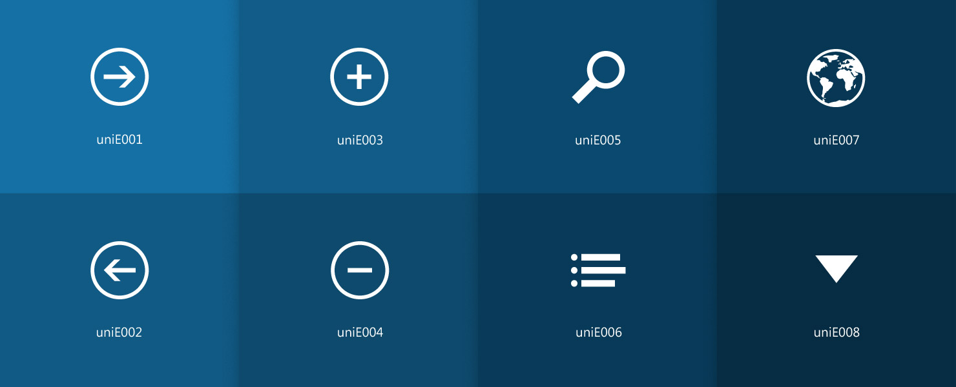
Icon font used on Microsoft.com
Eight vector graphics combined into one font file

Slide 87
Defining the icon font
@font-face {
font-family: 'MSHPIconsRegular';
src: url('icons.eot');
src: url('icons.eot?#iefix') format('embedded-opentype'),
url('icons.woff') format('woff'),
url('icons.ttf') format('truetype'),
url('icons.svg#web') format('svg');
font-weight: normal;
font-style: normal;
}

Slide 88

Using the icon font
.icon-menu, .icon-search {
font-family: 'MSHPIconsRegular';
color: #1570A6;
}
.fontface .icon-menu:after {
content: '\e003';
}
.fontface .icon-search:after {
content: '\e004';
}

Slide 89
Backward compatibility for icon fonts
.nofontface .icon-menu, .nofontface .icon-search {
background-position: center center;
background-repeat: no-repeat;
height:16px;
width:16px;
}
.nofontface .icon-menu {
background-image: url('menu.png');
}
.nofontface .icon-search {
background-image: url('search.png');
}

Slide 90
Considerations when going responsive
“Is responsive web design right for my web site?”
  Thoughtfully consider
  Breakpoint timeline
  Grid system
  CMS integration
  Image sizes
  Browser support
  Test plans
  Be all in

Slide 91


