Slide 1
Powering your apps with Microsoft accounts
Shelly Guo
Software Development Lead
3-138

Slide 2
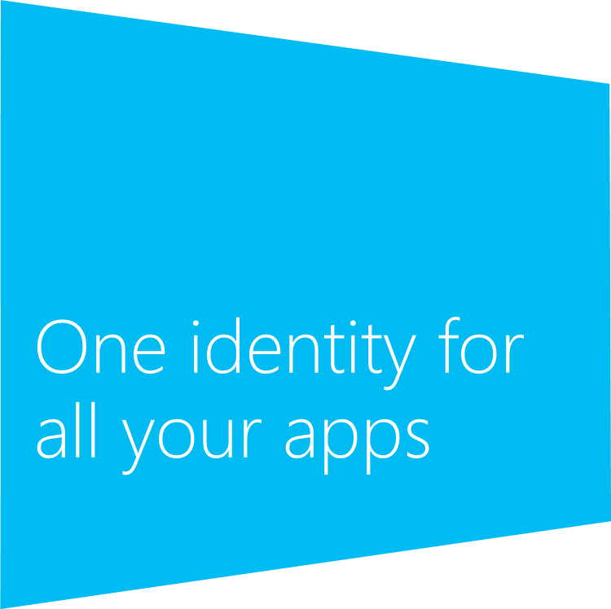
Agenda
Why use the Microsoft account service?
How to integrate the Microsoft account service into your app
How to connect your websites’ sign-in with users’ Microsoft accounts

Slide 3
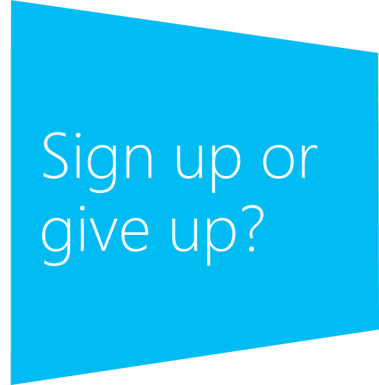
The “easy sign-in” paradox
One size does not fit all
Personalization increases satisfaction
Personalization increases engagement and loyalty
Users dislike signing up for websites and apps
Requiring sign up leads to a high drop rate
Users forget passwords

Slide 4
Your users sign in to Windows 8 with a Microsoft account once and then get a personalized experience in apps and websites

Slide 5
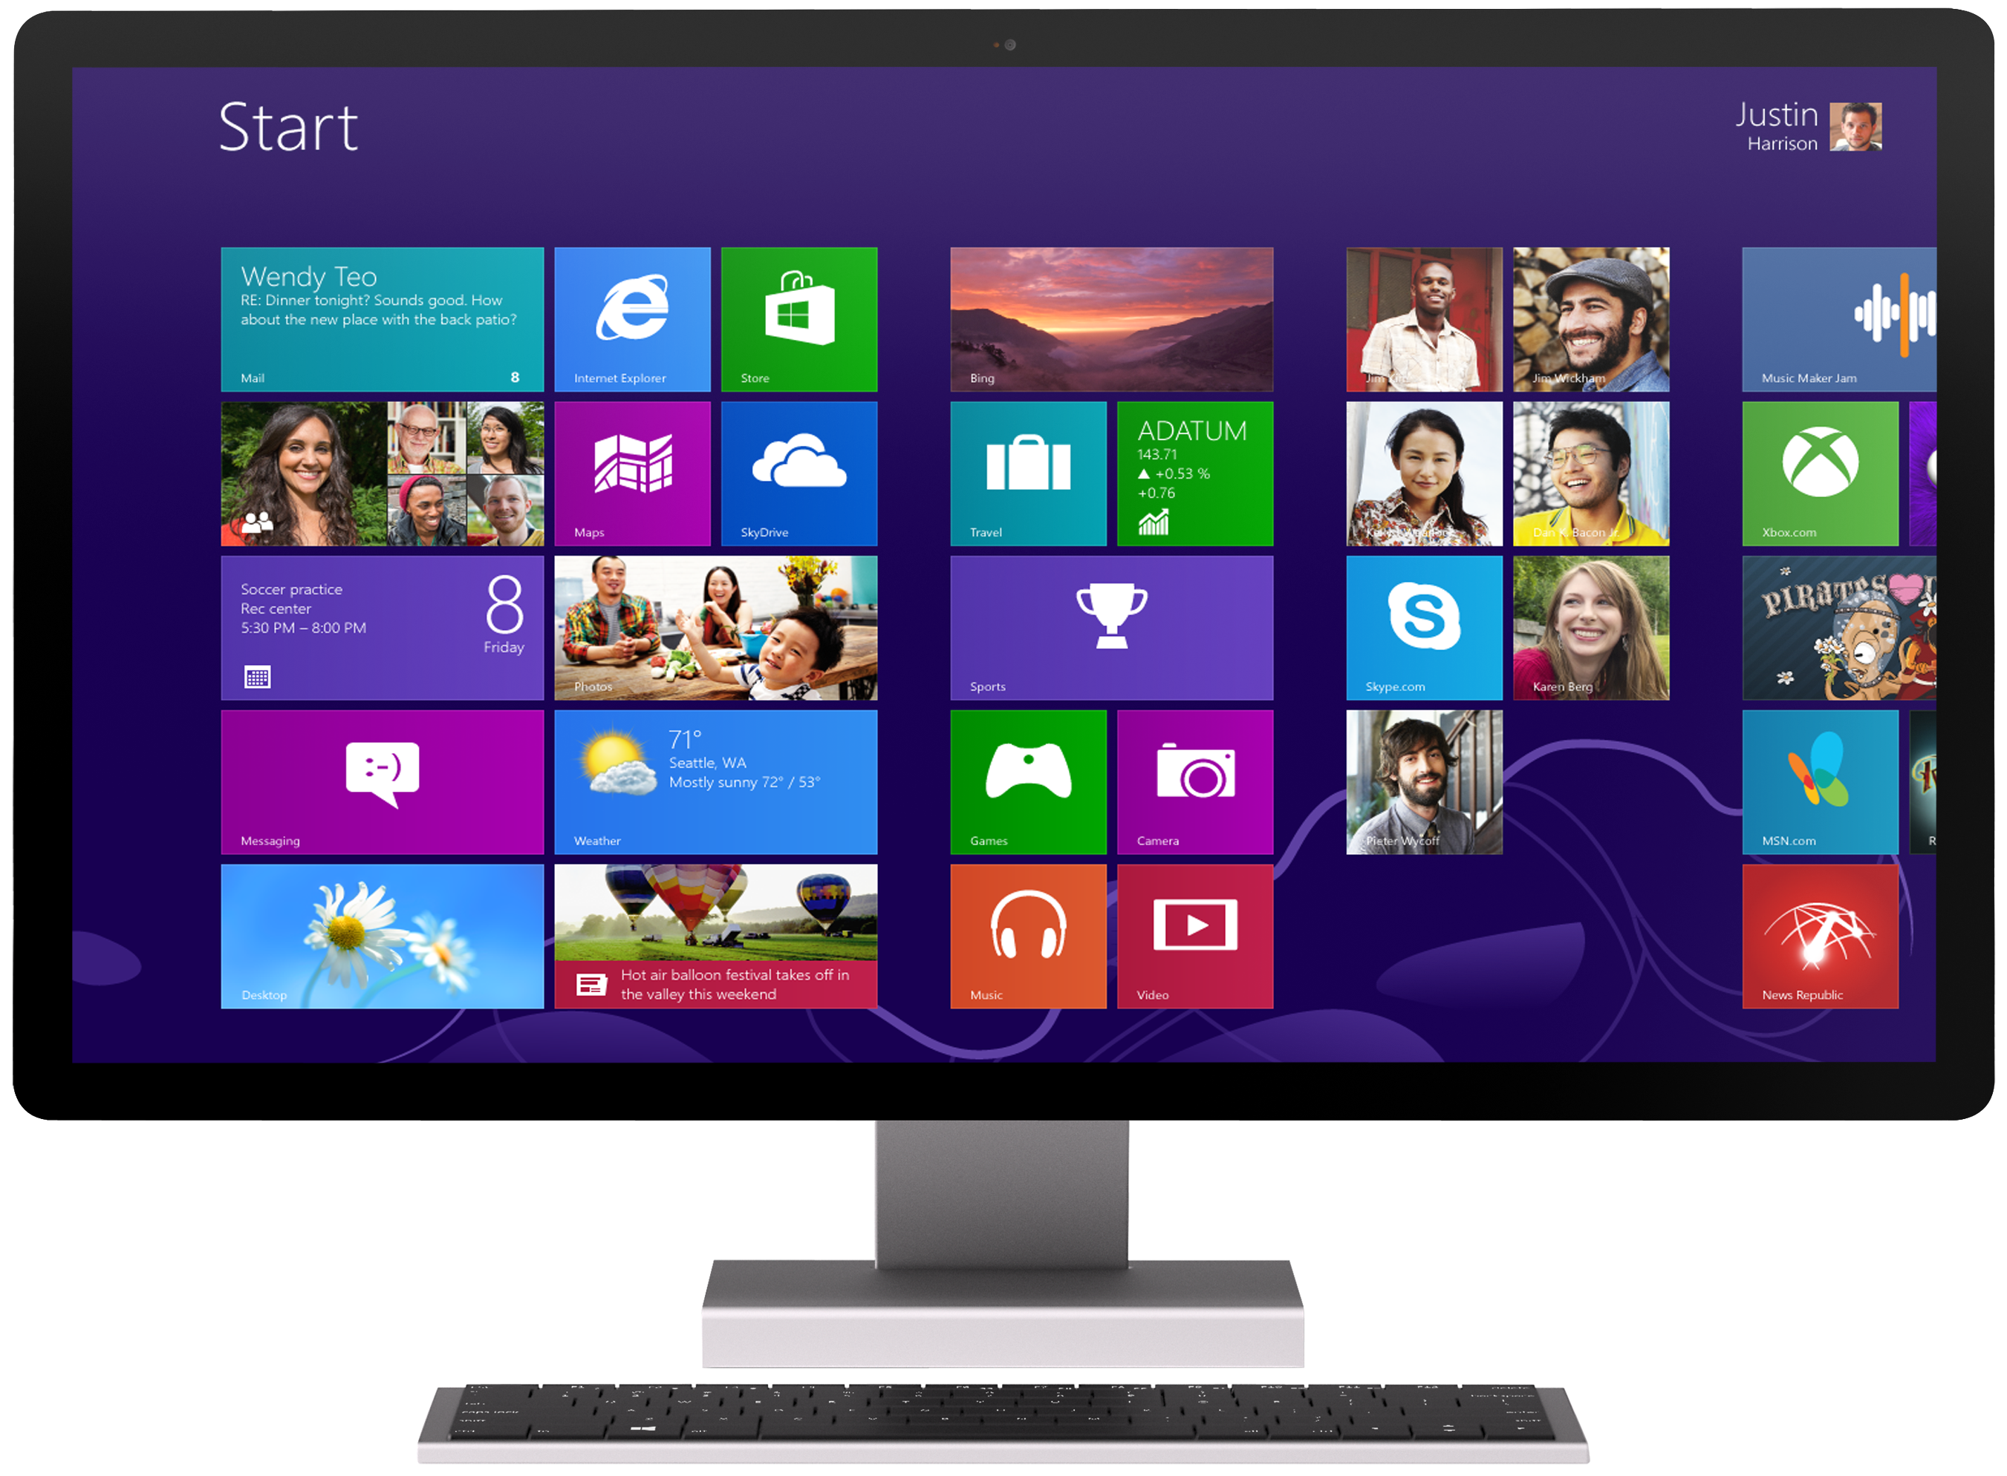
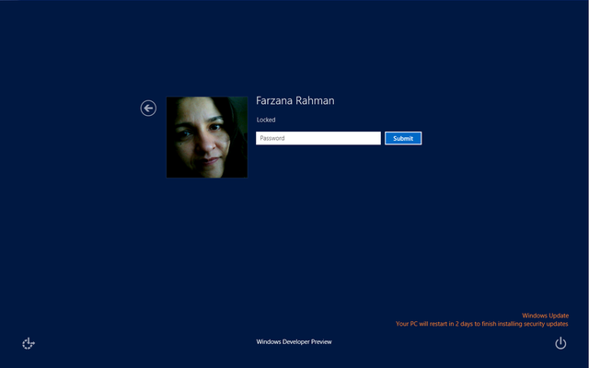
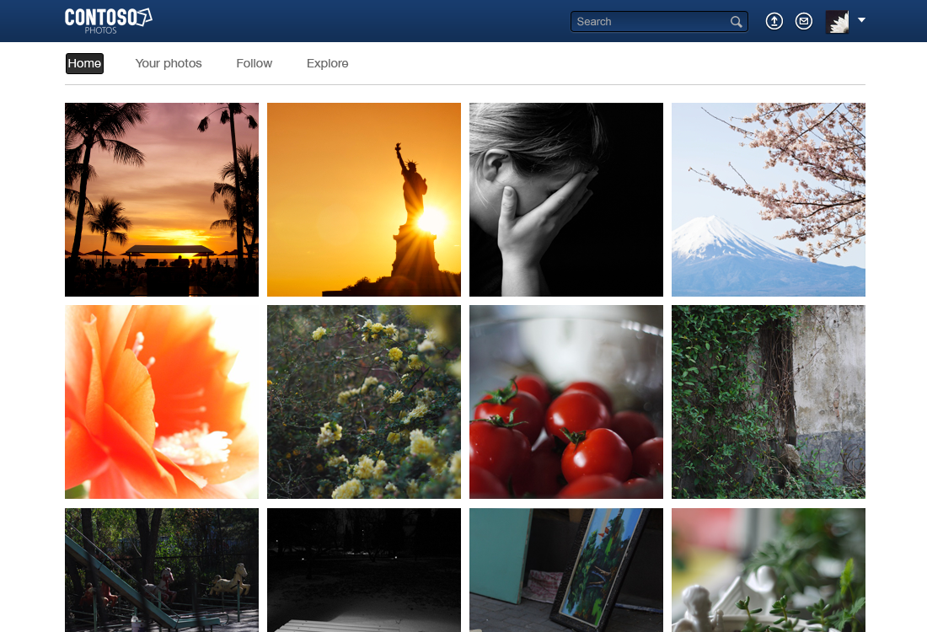
Single sign-on with the Microsoft account service
1
User signs-in to Windows 8
2
User is signed-in to your app
3
User is signed-in to your website

Slide 6
The benefits of using Microsoft accounts
Seamless sign-in for your app and website
We’ve built it so you don’t have to
Apps and websites with existing identity systems can
Bootstrap sign-up with user information
Instantly personalize the experience for Windows users

Slide 7
After the user signs in with a Microsoft account, you can
Build continuous client experiences using Windows roaming settings
Example scenarios
Continue watching a movie where you left off
Keep track of stocks added in a finance app
Open the most recently viewed documents in your app
Access the user’s SkyDrive, profile, and social network using the Live SDK
Example scenarios
Open a file stored in SkyDrive
Connect with a user’s contacts and friends
Store app data and access it from Windows Phone, Xbox, and other cross-platform apps

Slide 8
How do you do it?

Slide 9
The Live SDK provides APIs that help apps and websites to easily integrate with Microsoft accounts and Windows services
Protocols
OAuth 2.0
Live Connect REST API
Client SDKs
Windows 8, Windows Phone, .NET
Other mobile platforms

Slide 10
Sign-in with the Live SDK – C#
async override void Initialize()
{
string[] scopes = new string[] { "wl.signin", "wl.basic" };
var authClient = new LiveAuthClient();
var loginResult = await this.authClient.InitializeAsync(new List<string>(scopes));
if (loginResult.Status == LiveConnectSessionStatus.Connected)
{
var connectClient = new LiveConnectClient(loginResult.Session);
var operationResult = await connectClient.GetAsync("me");
dynamic json = operationResult.Result;
this.tbMe.Text = json.first_name + " " + json.last_name;
}
else
{
loginResult = await this.authClient.LoginAsync(new List<string>(scopes));
}
}

Slide 11
Sign-in for JavaScript developers
WL.init();
WL.login({ "scope": “wl.signin wl.basic" }).then(
function (response) {
showUserData();
},
function (response) {
log("Could not connect, status = " + response.status);
}
);
function showUserData() {
WL.api({ path: "/me", method: "GET" }).then(
function (response) {
log(JSON.stringify(response).replace(/,/g, "\n"));
},
function (response) {
log("API call failed: " + JSON.stringify(response.error).replace(/,/g, "\n"));
}
);
}

Slide 12
Add single sign-on and personalization to your Windows Store app
Demo

Slide 13
Integrate Microsoft accounts with your existing identity system
Contoso.com
4
App server can also obtain user information directly from Microsoft
3
App server decrypts the authentication token and stores the user ID along with other user information
2
App sends the authentication token to app server
1
User signs-in using Microsoft account

Slide 14
Working with the authentication token
What is the authentication token?
A token generated using the standard JSON Web Token protocol It can be used to verify the identity of the user
How is it used on the server?
You can obtain a unique user ID by decrypting the authentication token, using your app secret

Slide 15
Extract the user ID from the authentication token
String GetUserId(string authenticationToken)
{
var authClient = new LiveAuthClient(appId, appSecret, redirectUrl);
string userId = authClient.GetUserId(authenticationToken);
return userId;
}

Slide 16
Sign-in to your site using the Live SDK
async void Initialize()
{
var authClient = new LiveAuthClient(appId, appSecret, redirectUrl);
var loginResult = await this.authClient.InitializeWebSessionAsync(this.HttpContext);
if (loginResult.Status == LiveConnectSessionStatus.Connected)
{
var connectClient = new LiveConnectClient(loginResult.Session);
var getResult = await connectClient.GetAsync("me");
var jsonResult = getResult.Result as dynamic;
this.model.UserName = jsonResult.first_name + " " + jsonResult.last_name;
this.model.Favorites = this.GetFavorites(loginResult.Session.AuthenticationToken);
}
else
{
this.model.LoginUrl = this.authClient.GetLoginUrl(new List<string>(scopes));
}
}

Slide 17
Integrate the Microsoft account service with your website
Demo

Slide 18
Key takeaways
You can use the Live SDK to add single sign-on and personalization to your Windows Store apps
You can connect a user’s Microsoft account to his or her account in your own identity system by using the authentication token
You can use the Live SDK on your website to authenticate users and retrieve user data through the REST API service

Slide 19
Related sessions
3-139 The developer’s guide to the SkyDrive API

Slide 20
Resources
Live developer portal http://dev.live.com
Interactive SDK http://isdk.dev.live.com
Live SDK source code and samples http://www.github.com/liveservices
Please submit session evals on the Build Windows 8 App or at http://aka.ms/BuildSessions

Slide 21
Resources
Develop: http://msdn.microsoft.com/en-US/windows/apps/br229512
Design: http://design.windows.com/
Samples: http://code.msdn.microsoft.com/windowsapps/Windows-8-Modern-Style-App-Samples
Videos: http://channel9.msdn.com/Windows
Please submit session evals by using the Build Windows 8 app
or at http://aka.ms/BuildSessions

Slide 22
Questions?

