Slide 1
Touchscreen and stylus and mouse, oh my!
Jeff Burtoft
HTML5 Evangelist, Windows Evangelism
@boyofgreen
3-140

Slide 2
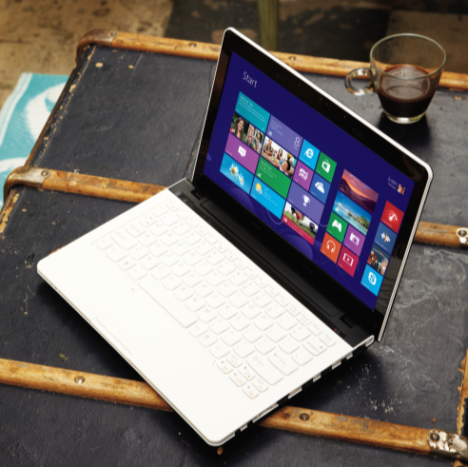
Agenda
Built in benefits
Gestures and pointers
Input specific interactions
Beyond traditional inputs
Integrating all together

Slide 3
Built in benefits

Slide 4
App-level controls all include mouse alternatives for free: ListView, AppBar, select control, semantic zoom, etc.

Slide 5
Design for touch, get mouse for free

Slide 6
JavaScript
document.addEventListener('MSPointerMove', moveTouchPoint, false);

Slide 7
C# / XAML
<Canvas PointerMoved="moveTouchPoint">

Slide 8
Gestures and pointers

Slide 9
Gestures range from simple interactions like tapping, to more complicated manipulations like zooming, panning, and rotating.
MSGesture – HTML5/JavaScript
Static gesture events
msgesturehold
msgesturetap
Manipulation gesture events
msgesturechange
msgestureend
msgesturestart
msinertiastart

Slide 10
Gestures range from simple interactions like tapping, to more complicated manipulations like zooming, panning, and rotating.
Gesture – XAML
Static gesture events
Tapped
DoubleTapped
RightTapped
Holding
Manipulation gesture events: For multi-touch interactions such as pinching, and interactions that use inertia, you use the manipulation events.

Slide 11
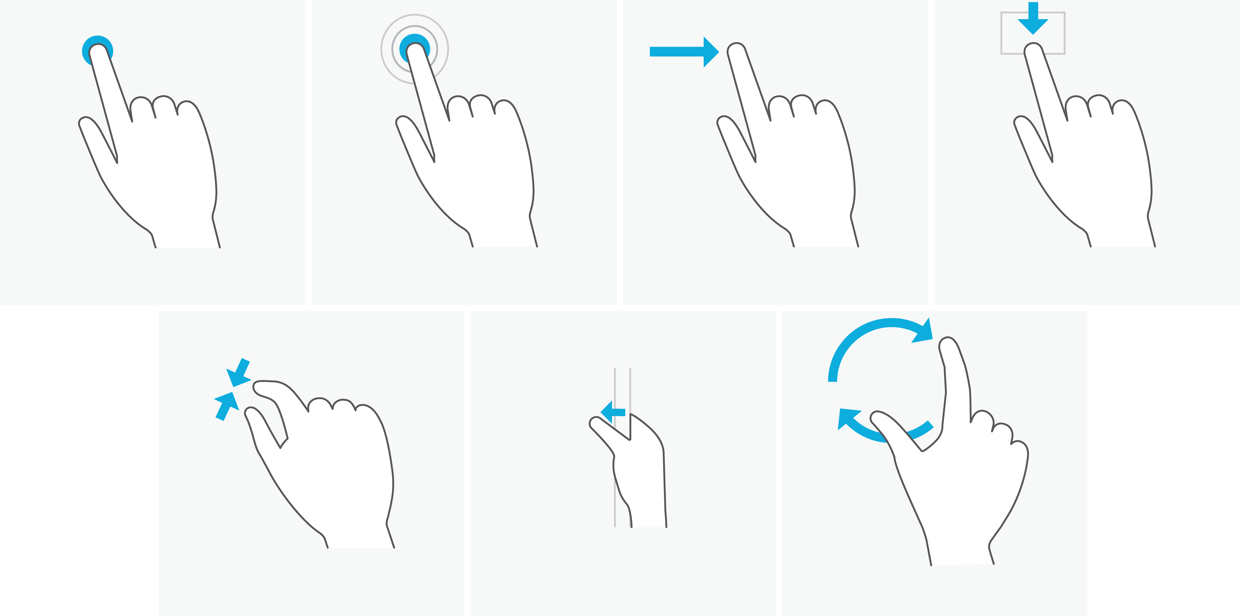
Windows 8 touch language
Press and hold to learn
Tap for primary action
Slide to drag
Swipe to select
Swipe from edge for
app and system UI
Pinch to zoom
Rotate to rotate

Slide 12
Changes to gesture model
Multiple concurrent gestures: create a multi-gesture UX (for example, a multi-slider control, such as an audio equalizer).
Explicit control over what elements are targeted by gestures, and over which active touch contacts feed into each gesture.
Handle touch and gesture events independently of each other
Event returns transformation data in a form that allows you to easily consume it to manipulate content in response to gestures

Slide 13
Pointer events provide a unified and streamlined way to get mouse, touch, and pen data.
Pointer – XAML
PointerPressed
PointerReleased
PointerMoved
PointerExited
PointerEntered
PointerCanceled

Slide 14
Pointer events provide a unified and streamlined way to get mouse, touch, and pen data.
MSPointer – HTML5/JavaScript
MSPointerDown
MSPointerMove
MSPointerUp
MSPointerOver
MSPointerOut
MSPointerCancel
MSPointerHover

Slide 15
Event object for pointer Each touch point creates separate event object
Touch 1
event
width
height
target
etc
Touch 2
event
width
height
target
etc
Touch 3
event
width
height
target
etc

Slide 16
http://www.w3.org/Submission/2012/SUBM-pointer-events-20120907/

Slide 17
For HTML5/JavaScript, a familiar upgrade to click event model: MSPointer events support touch, mouse, and pen

Slide 18
For XAML, a touch, mouse or pen on the screen are converted to an equivalent Windows Runtime pointer event, such as PointerPressed

Slide 19
Demo: pointers and gesture

Slide 20
/*set up new gesture */
var newGesture = new MSGesture();
console.log(newGesture);
newGesture.target = canvas;
function paint(event) {
if (event.type == "MSPointerDown") { //MSPointer will halt all your gestures if you don't skip it
newGesture.addPointer(event.pointerId);
return;
}
canvas.addEventListener("MSGestureStart", paint, false);
canvas.addEventListener("MSGestureEnd", paint, false);
canvas.addEventListener("MSGestureChange", paint, false);
canvas.addEventListener("MSInertiaStart", paint, false);
canvas.addEventListener("MSGestureTap", paint, false);
canvas.addEventListener("MSGestureHold", paint, false);
canvas.addEventListener("MSPointerDown", paint, false);
JavaScript

Slide 21
canvas.addEventListener("MSPointerMove", function(event){ paint(ctx, event) }, false);
function paint(ctx,event) {
ctx.fillRect(event.offsetX, event.offsetY, event.width + 2, event.height + 2);
//set readings on screen
buildMeter(event);
};
JavaScript

Slide 22
XAML:
<Canvas x:Name="pointerCanvas" PointerMoved="onPointerMoved" PointerPressed="onPointerPressed" PointerReleased="onPointerReleased" Background="#00000000" />
C#:
private Dictionary<uint, PointerPoint> _points = new Dictionary<uint, PointerPoint>();
private void onPointerPressed(object sender, PointerRoutedEventArgs e) { if(e.Pointer.IsInContact){ var point = e.GetCurrentPoint(pointerCanvas); _points.Add(e.Pointer.PointerId, e.GetCurrentPoint(pointerCanvas)); }
}
private void onPointerReleased(object sender, PointerRoutedEventArgs e){ if (_points.ContainsKey(e.Pointer.PointerId)) _points.Remove(e.Pointer.PointerId); }
C# / XAML

Slide 23
C# / XAML
C#:
private void onPointerMoved(object sender, PointerRoutedEventArgs e){ if (e.Pointer.IsInContact){ var point = e.GetCurrentPoint(pointerCanvas); if (_points.ContainsKey(e.Pointer.PointerId)){
var prev = _points[e.Pointer.PointerId]; Line line = new Line(); line.X1 = prev.Position.X; line.Y1 = prev.Position.Y; line.X2 = point.Position.X; line.Y2 = point.Position.Y; line.Stroke = new SolidColorBrush(Colors.Azure); line.StrokeThickness = 8.0; line.StrokeStartLineCap = line.StrokeEndLineCap = PenLineCap.Round; pointerCanvas.Children.Add(line); } _points[e.Pointer.PointerId] = point; } }

Slide 24
Input specific interactions

Slide 25
Target specific pointer types with “type” attribute within Pointer event object

Slide 26
JavaScript
var paint = function(event){
if (event.pointerType === event.MSPOINTER_TYPE_PEN){
...
}
};
canvas.addEventListener("MSPointerMove", paint }, false);

Slide 27
C# / XAML
XAML:
<Canvas x:Name="pointerCanvas"
PointerMoved="onPointerMoved"
Background="#00000000" />
C#:
private void onPointerMoved(object sender, PointerRoutedEventArgs e){
if(e.Pointer.PointerDeviceType == Windows.Devices.Input.PointerDeviceType.Pen){
...
}
}

Slide 28
CSS attributes that target touch: CSS zoom, CSS snap

Slide 29
CSS
.myContainer {
width: 400px;
height: 325px;
overflow-x: scroll;
-ms-scroll-snap-type: mandatory;
-ms-scroll-snap-points-x: snapInterval(0px, 405px);
}

Slide 30
CSS
.zoomItContainer {
-ms-content-zooming: zoom;
overflow: scroll;
}

Slide 31
Customize the user experience
Use Windows Runtime platform to provide deeper levels of data
full touch interaction
mouse devices with alternate buttons
pen devices with barrel buttons and eraser tips.
Access interaction APIs for input data
Windows.UI.Core
Windows.UI.Input
Windows.Devices.Input

Slide 32
Beyond traditional inputs

Slide 33
Sensors and devices
Accelerometer
Camera
Microphone
GPS
Light sensor
Xbox controller
Etc.

Slide 34
JavaScript
accelerometer = Windows.Devices.Sensors.Accelerometer.getDefault();
if (accelerometer) {
// Set the reportInterval to enable the sensor events
accelerometer.reportInterval = reportInterval;
accelerometer.addEventListener("readingchanged", onDataChanged);
accelerometer.addEventListener("shaken", onShaken);
}
function onDataChanged(e) {
var reading = e.reading;
document.getElementById("eventOutputX").innerHTML = reading.accelerationX.toFixed(2);
document.getElementById("eventOutputY").innerHTML = reading.accelerationY.toFixed(2);
document.getElementById("eventOutputZ").innerHTML = reading.accelerationZ.toFixed(2);
}

Slide 35
JavaScript
accelerometer = Windows.Devices.Sensors.Accelerometer.getDefault();
var cameraCaptureUI = new Windows.Media.Capture.CameraCaptureUI();
var mediaCapture = new Windows.Media.Capture.MediaCapture();
loc = new Windows.Devices.Geolocation.Geolocator();
var lightSensor = Windows.Devices.Sensors.LightSensor;

Slide 36
Demo: Xbox controller in Windows 8 app

Slide 37
#pragma once
namespace GameController
{
public value struct State
{
uint32 controllerId;
uint32 packetNumber;
bool connected;
bool a;
bool b;
SHORT LeftThumbY;
SHORT RightThumbX;
SHORT RightThumbY;
};
C++

Slide 38
public ref class Controller sealed
{
~Controller();
uint32 m_index;
bool m_isControllerConnected; // Do we have a controller connected
XINPUT_CAPABILITIES m_xinputCaps; // Capabilites of the controller
XINPUT_STATE m_xinputState; // The current state of the controller
uint64 m_lastEnumTime; // Last connection was checked
public:
Controller(uint32 index);
void SetState(uint16 leftSpeed, uint16 rightSpeed);
State GetState();
};
C++

Slide 39
JavaScript
controller = new GameController.Controller(0);
if (controller.getState().connected == true) {
var state = controller.getState();
}
var a = state.a;
var b = state.b;
var left = state.dpad_left;
var right = state.dpad_right;
var down = state.dpad_down;

Slide 40
Integrating it all: Never mind the bullets

Slide 41
Recap

Slide 42
“Design for touch get mouse for free” is more like “Code for pointer or gestures, get touch and default mouse and pen behaviors for free”

Slide 43
Use gesture events to get easy access to the Windows 8 touch language Use pointer events to code for touch, mouse, and pen in a unified way Some interactions require different experiences for different input devices

Slide 44
Expand beyond traditional inputs, but always have a fallback for devices that don’t support them Windows 8 makes it easy for developers to cater to user’s input devices, and provide a unique experience through a variety of simultaneously supported inputs.

Slide 45
Resources
Develop: http://msdn.microsoft.com/en-US/windows/apps/br229512
Design: http://design.windows.com/
Samples: http://code.msdn.microsoft.com/windowsapps/Windows-8-Modern-Style-App-Samples
Videos: http://channel9.msdn.com/Windows
Please submit session evals by using the Build Windows 8 app
or at http://aka.ms/BuildSessions

