Slide 2
Building games for Windows
Kam VedBrat
Group Program Manager
2-047

Slide 3
Games on Windows
What we’ve seen
How to make your game successful
Advances in Windows 8.1 for games

Slide 4
Games: year-over-year revenue growth
#1 entertainment revenue growth category
Source: PWC, MSFT Estimates

Slide 5
Games: annual consumer spend
$12B
#1 entertainment revenue growth category
$12B consumer PC gaming spend
Source: NPD, GFK, IDG, Public Financial Disclosures, MSFT Estimates

Slide 6
Games: world-wide audience
#1 entertainment revenue growth category
$12B consumer PC gaming spend
Over 1 billion people play world-wide
Source: NPD, GFK, IDG, Public Financial Disclosures, MSFT Estimates

Slide 7
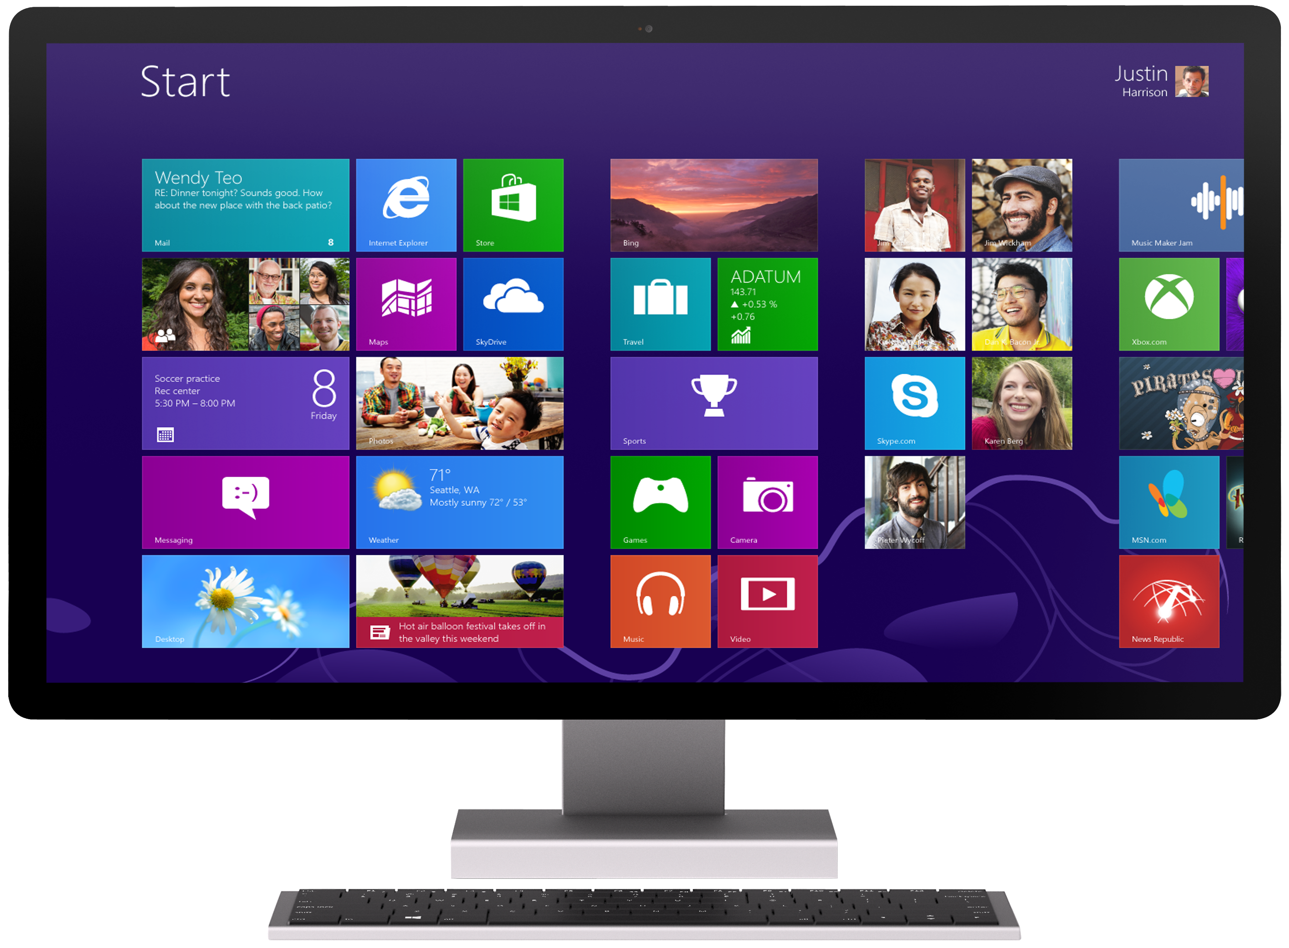
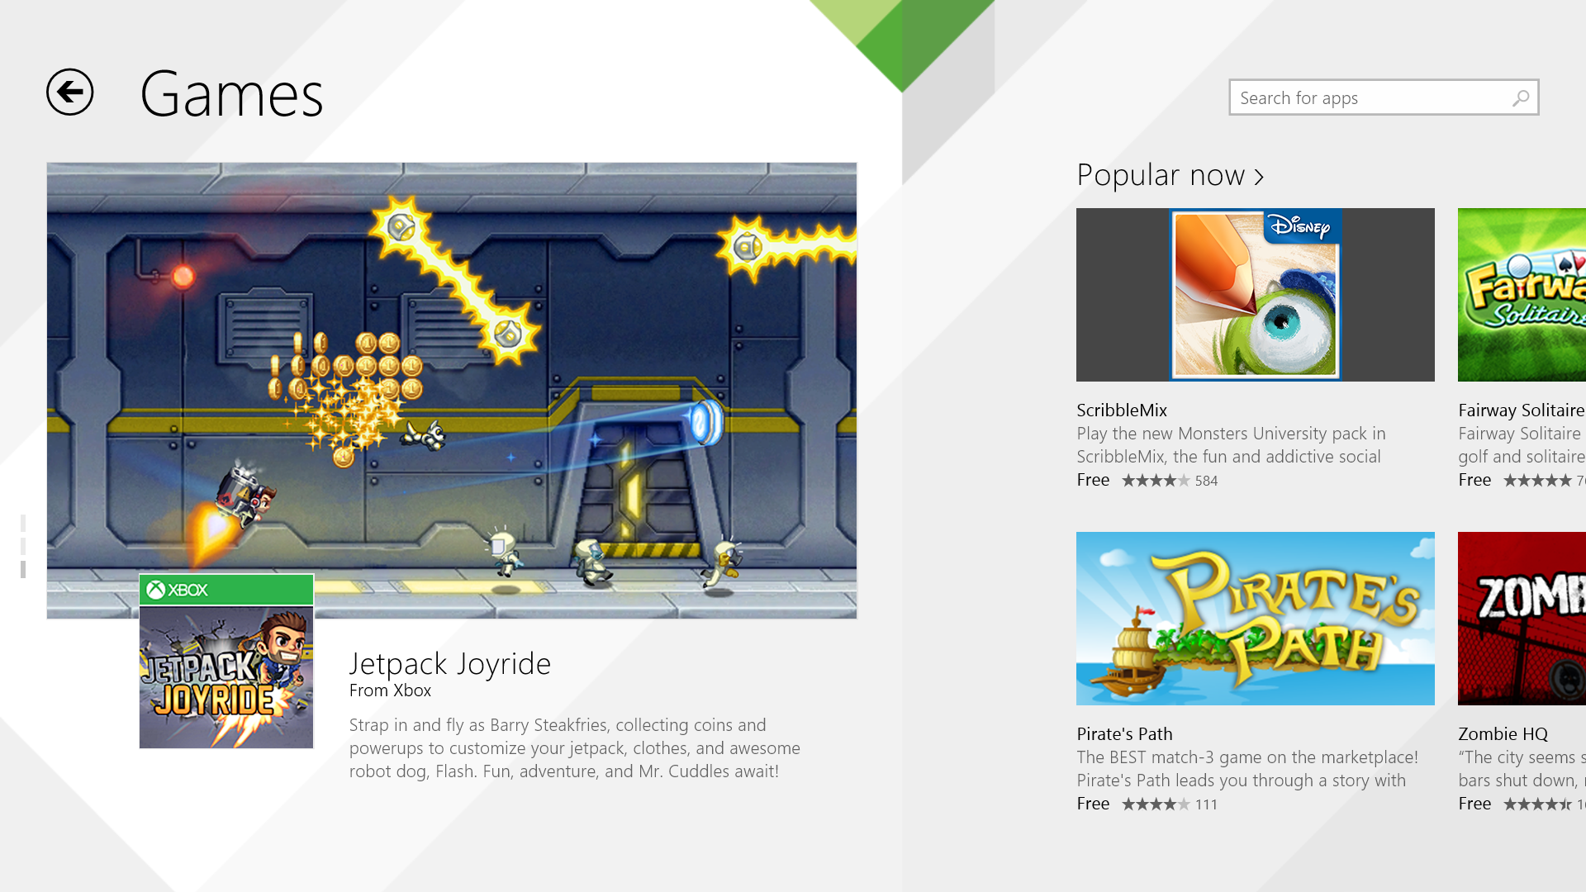
Windows Store Games
Games lead top paid
Games lead top free

Slide 8
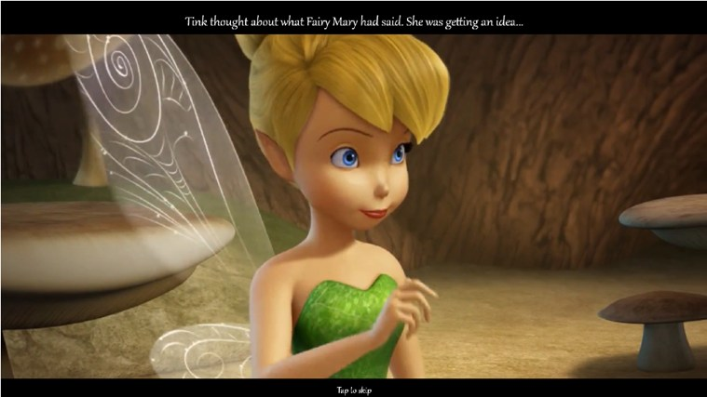
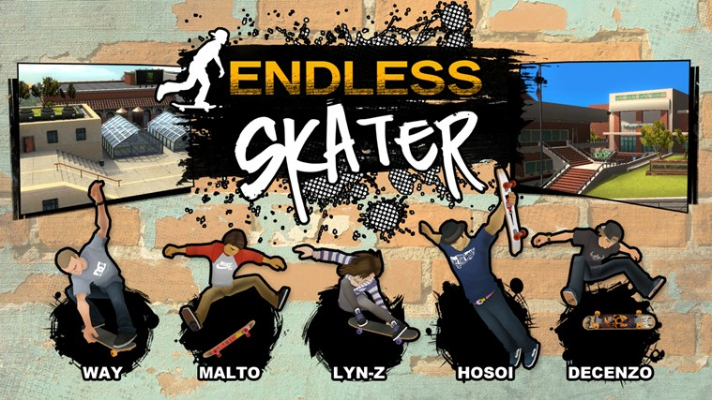
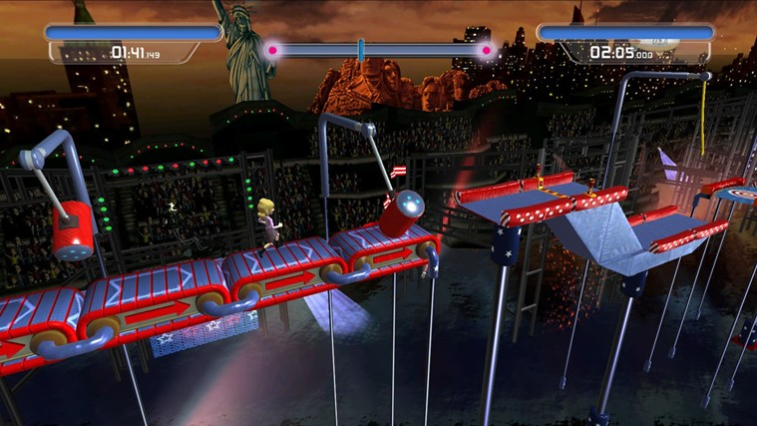
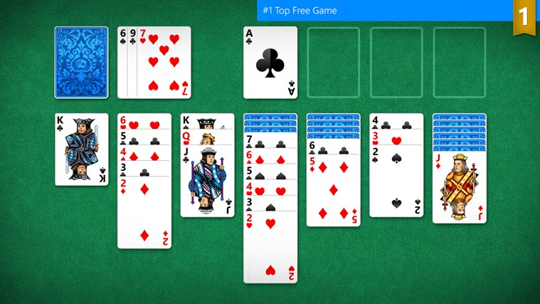
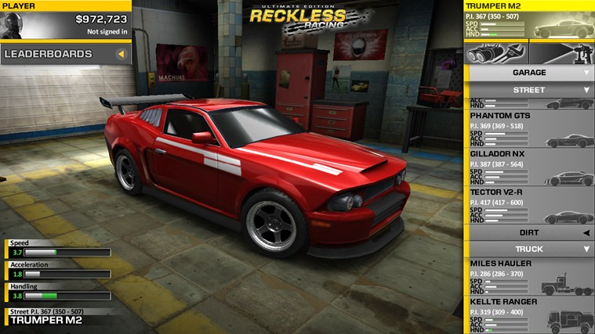
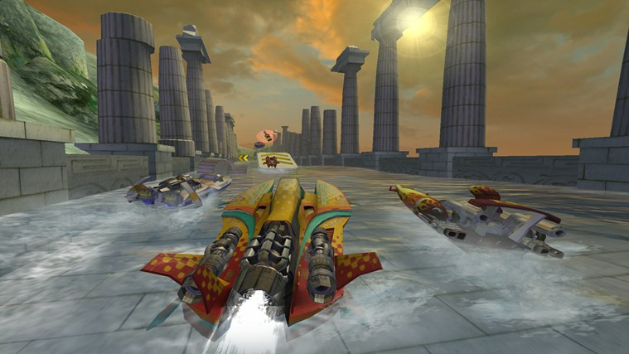

Slide 11
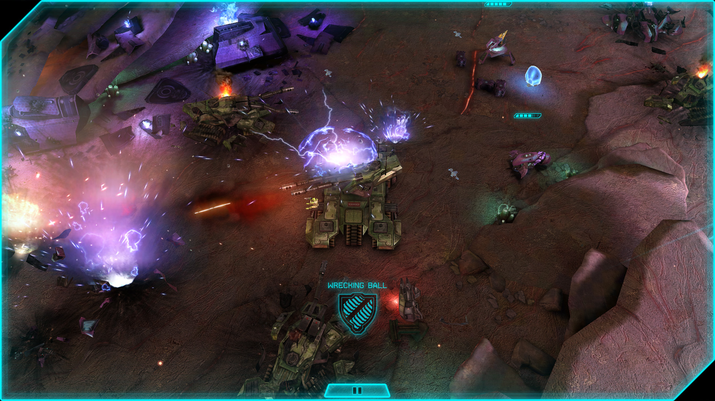
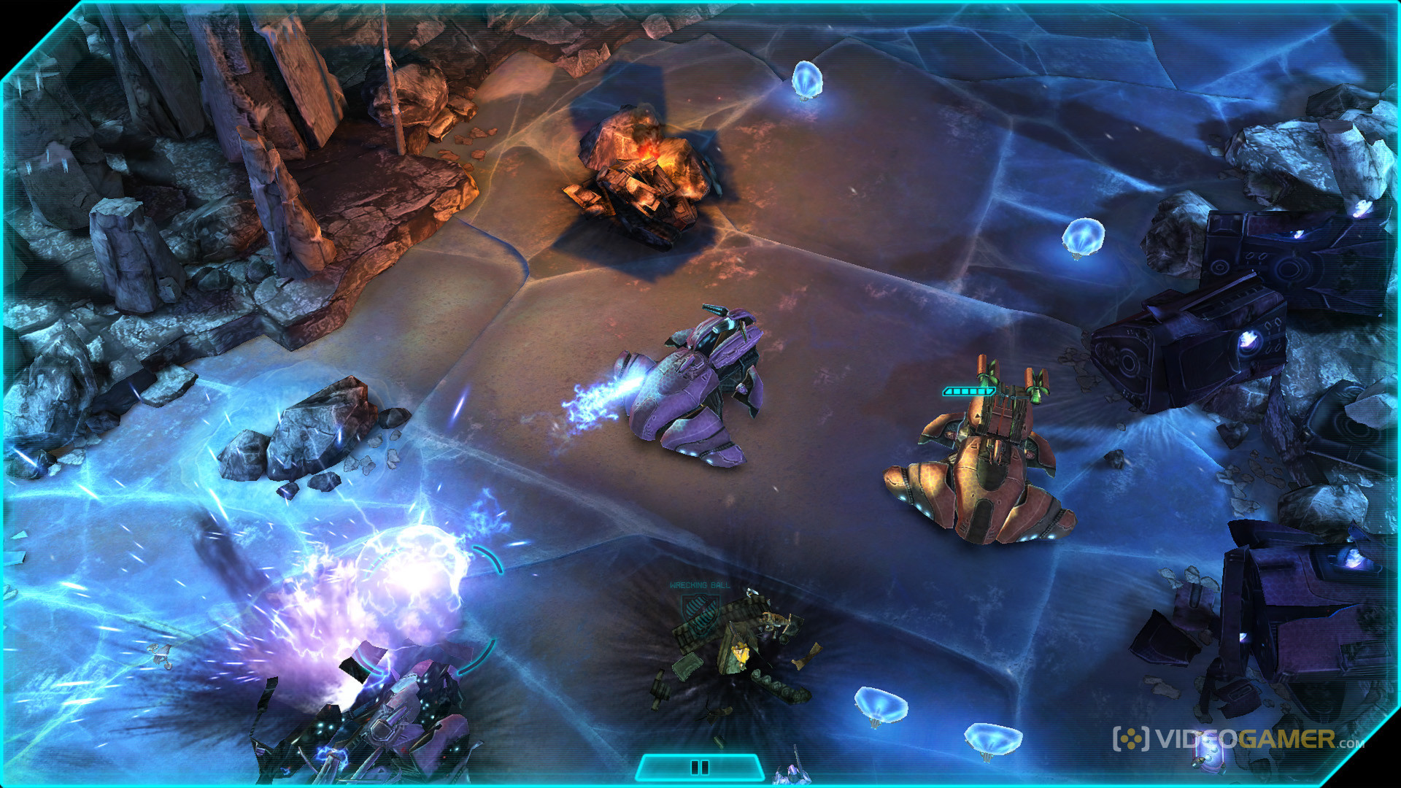
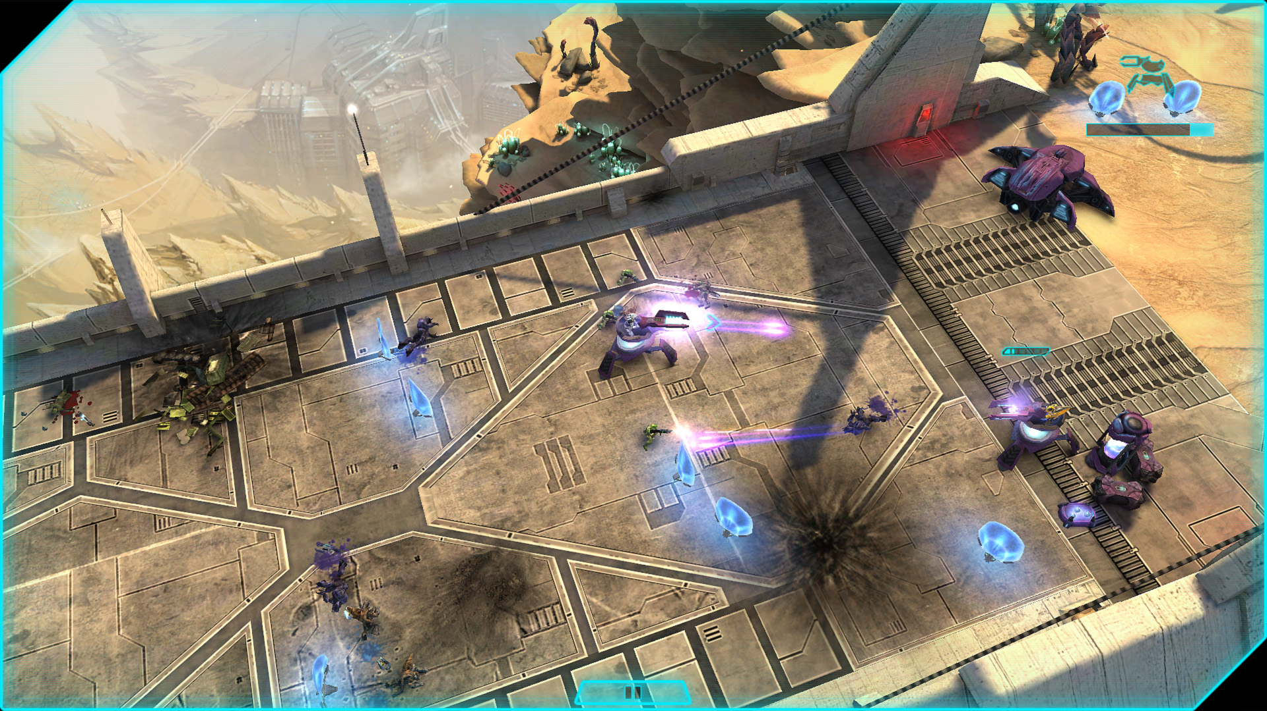
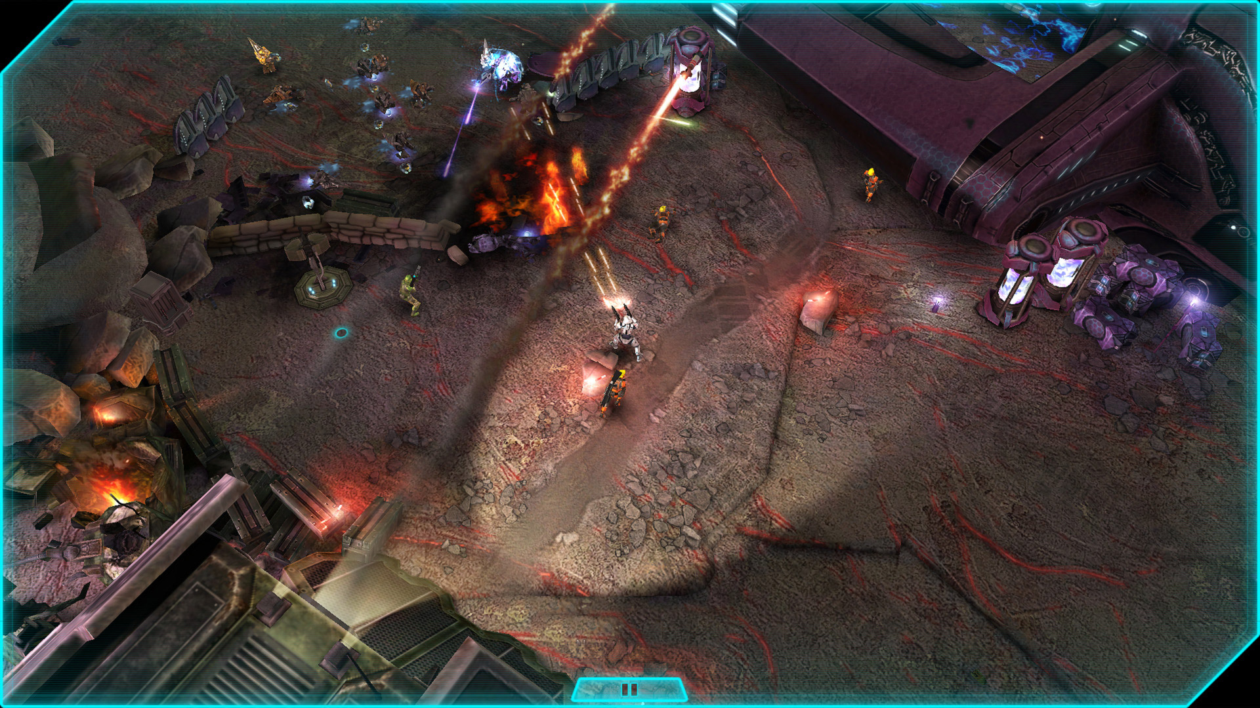

Slide 12
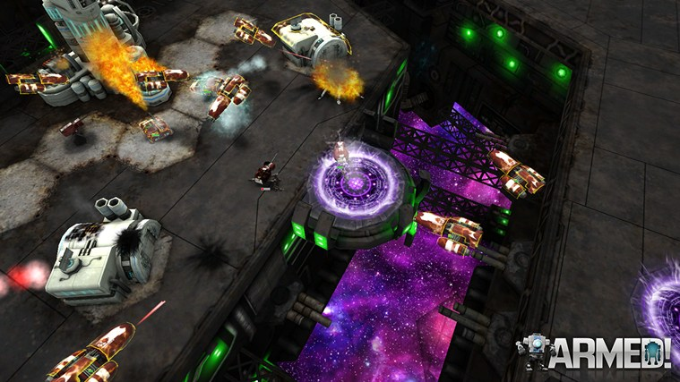
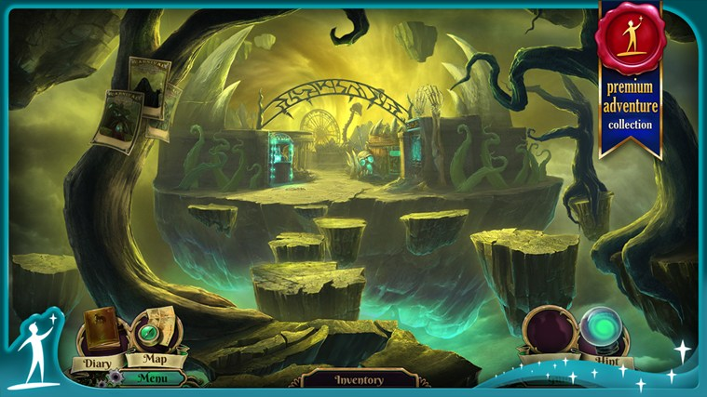
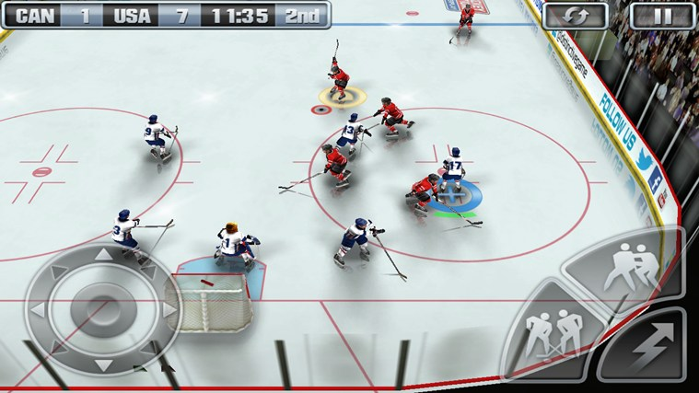
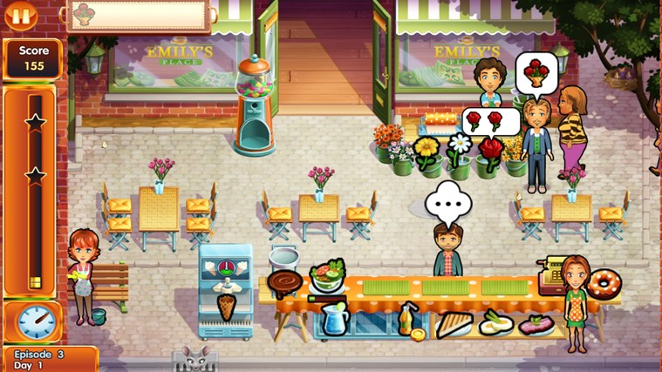
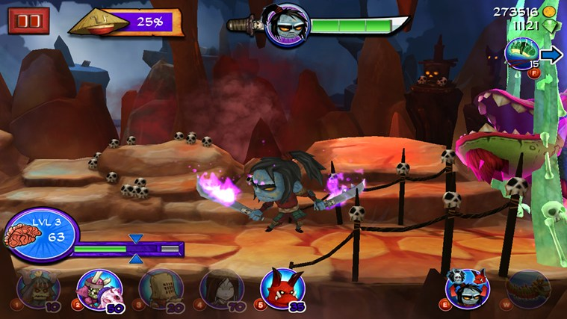
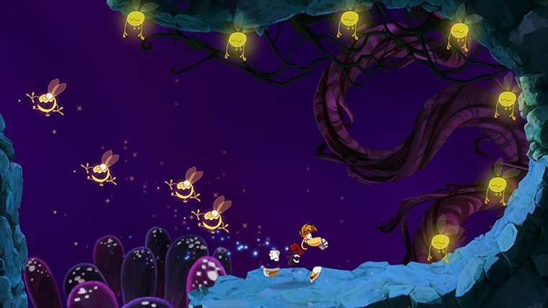
3rd party game screenshots

Slide 13
ANGLE
Box2D

Slide 14
Video: game developers

Slide 15
Feedback & learnings
Discovery, attach, and revenue
Engagement
Platform
Tools

Slide 16
Discovery, attach, and revenue
New Store UI design

Slide 17
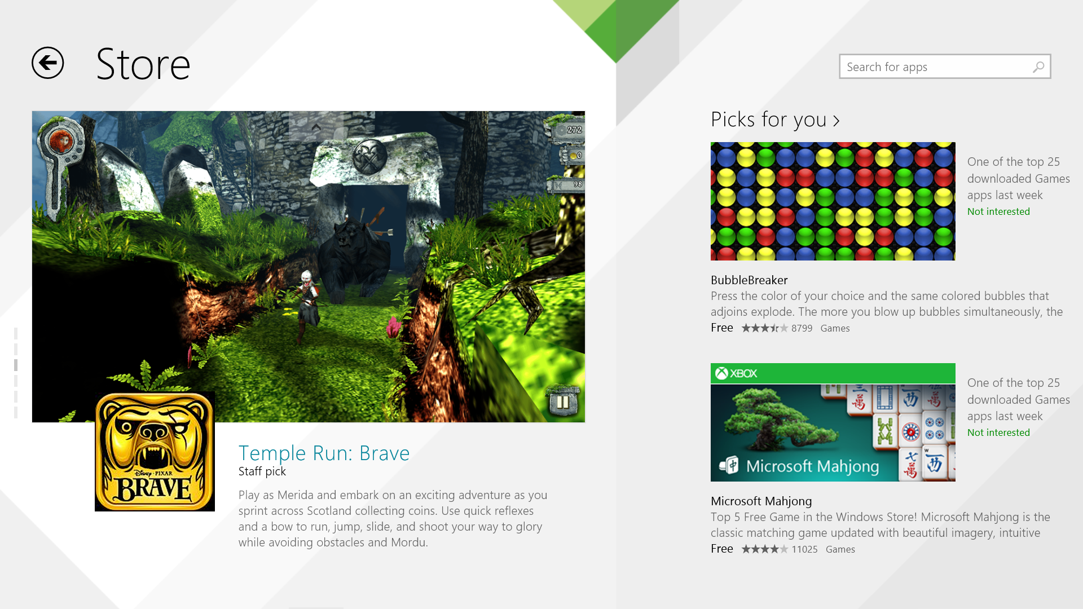

Slide 18
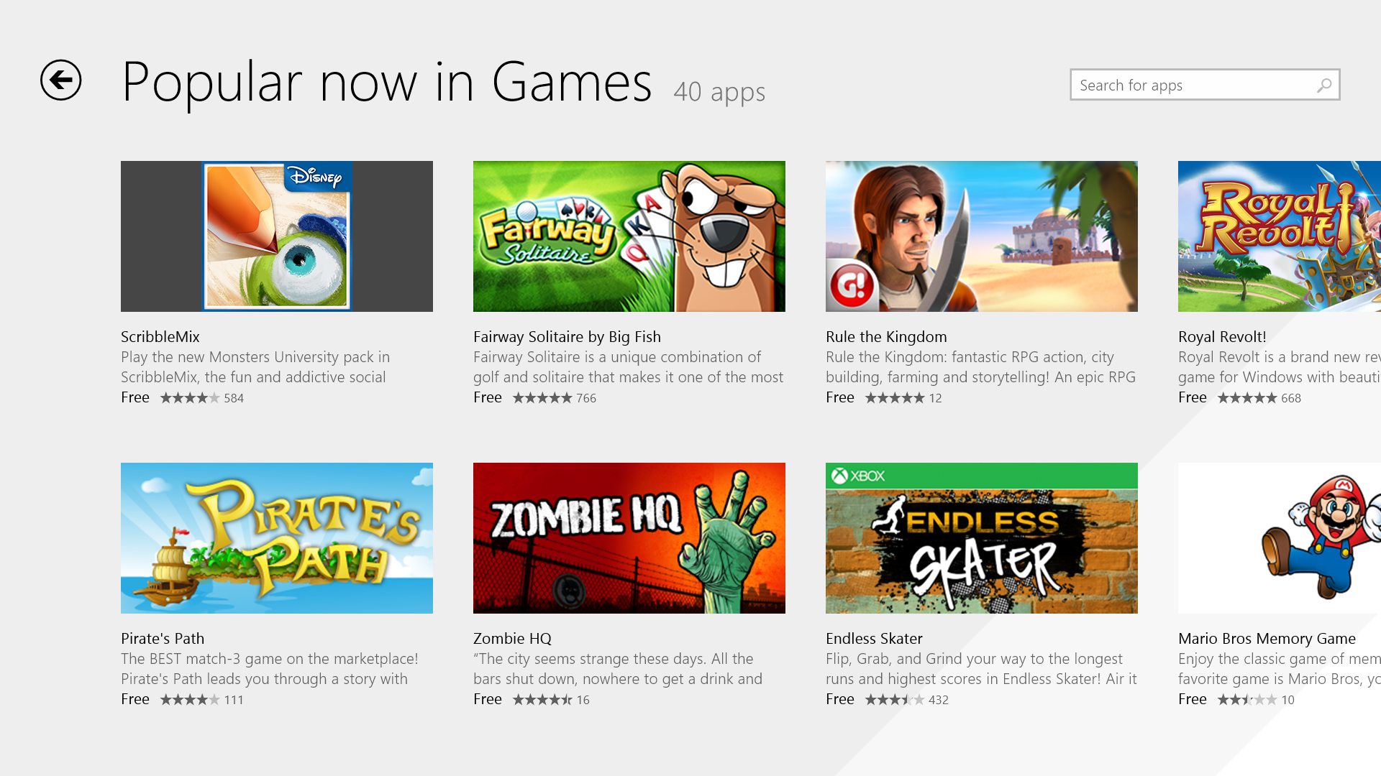
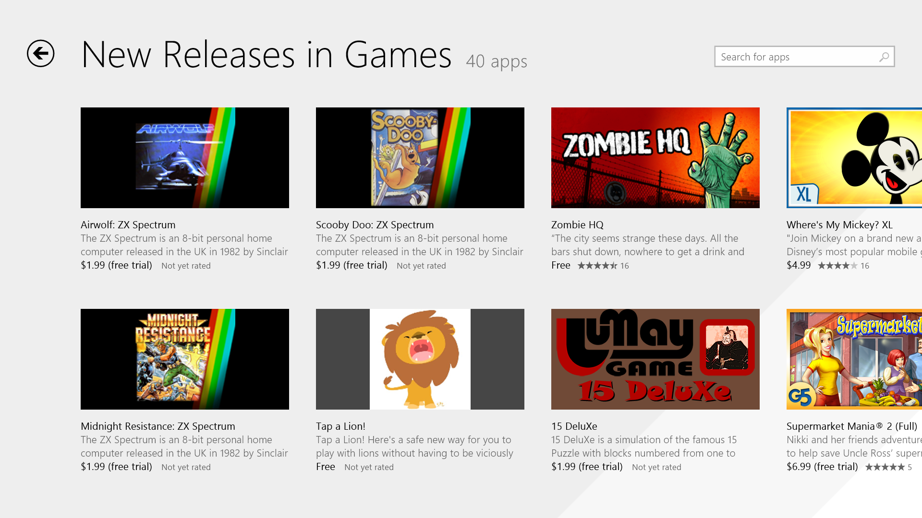
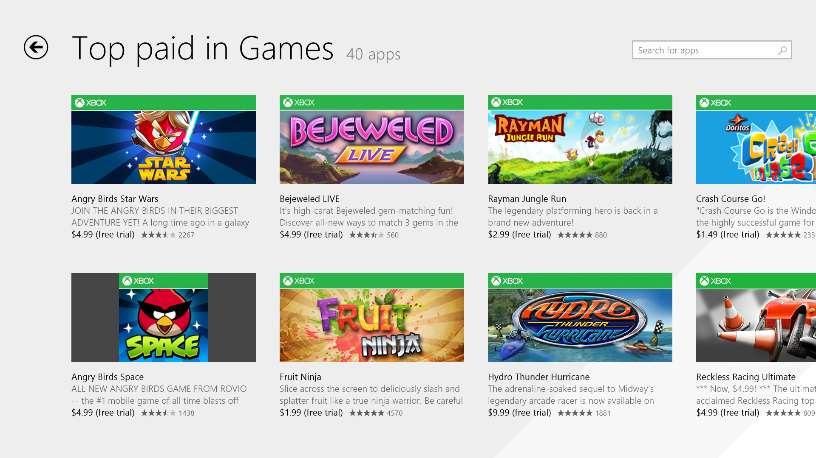

Slide 19
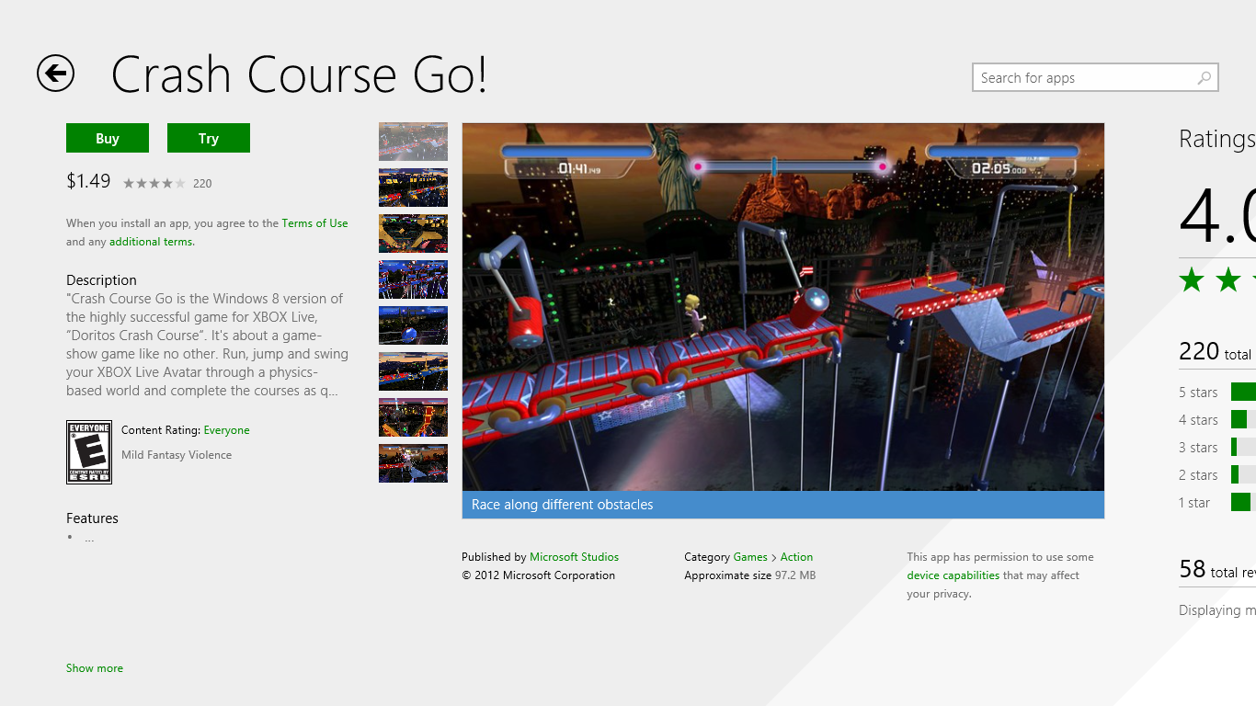
Store Demo

Slide 20
Discovery, attach, and revenue
New Store UI design
Consumables
Protocol launch falls back to store

Slide 21
Engagement
New Start screen tile sizes

Slide 22
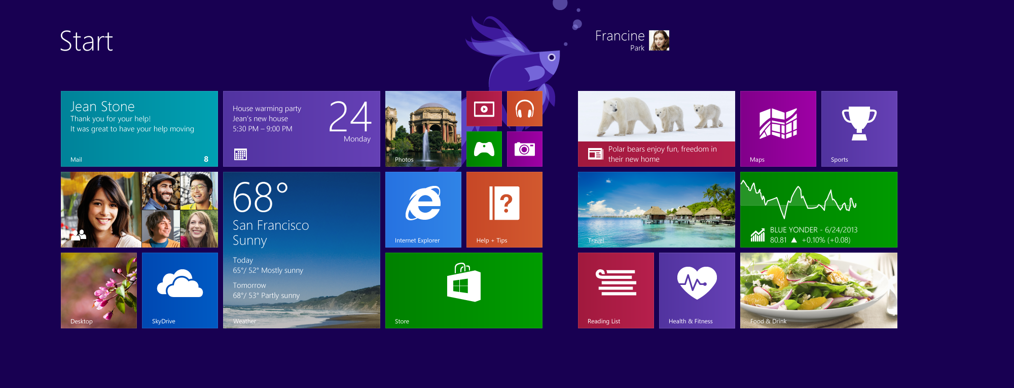

Slide 23
Engagement
New Start screen tile sizes
New window sizes

Slide 24
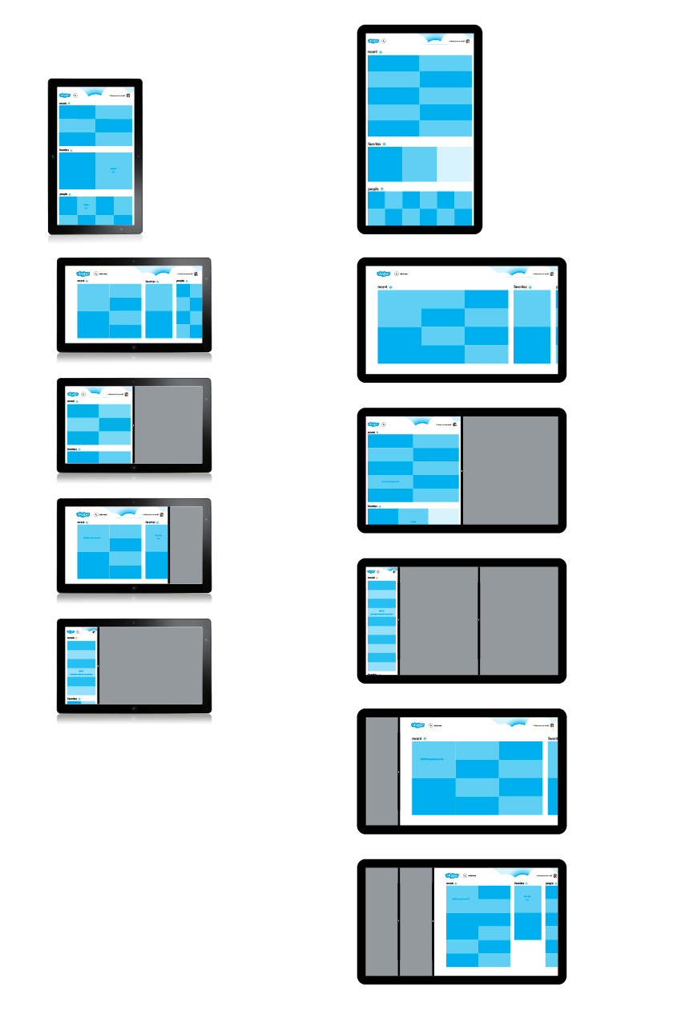
New window sizes
You can keep playing…
…while you’re on a Skype call
…while you’re waiting for a reply
…while your download finishes
…while your code compiles

Slide 25
Engagement
New Start screen tile sizes
New window sizes
Share contract

Slide 26
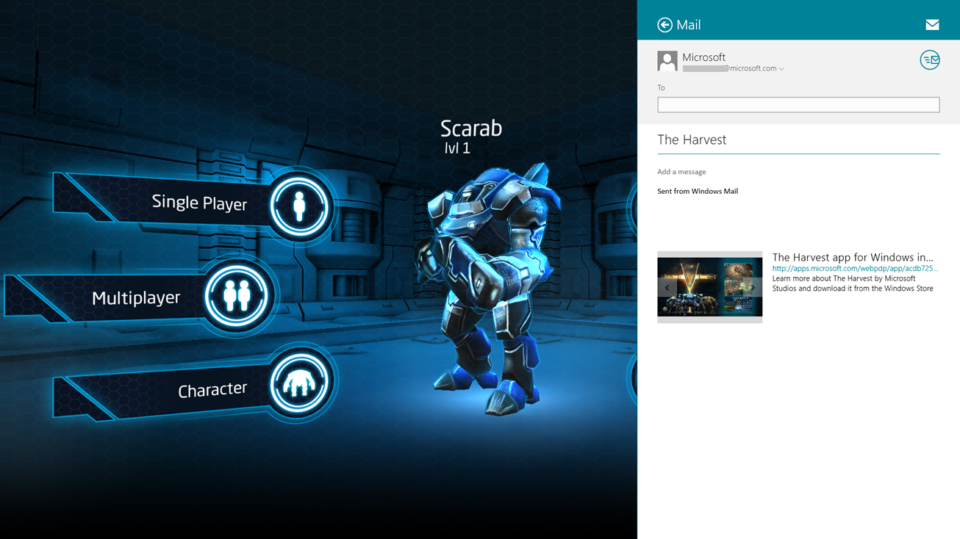

Slide 27
Deployment platform
Automatic updates
Resource packs
DX feature level
DPI
Language
Bigger games - up to 24GB!

Slide 28
Graphics hardware innovation

Slide 29
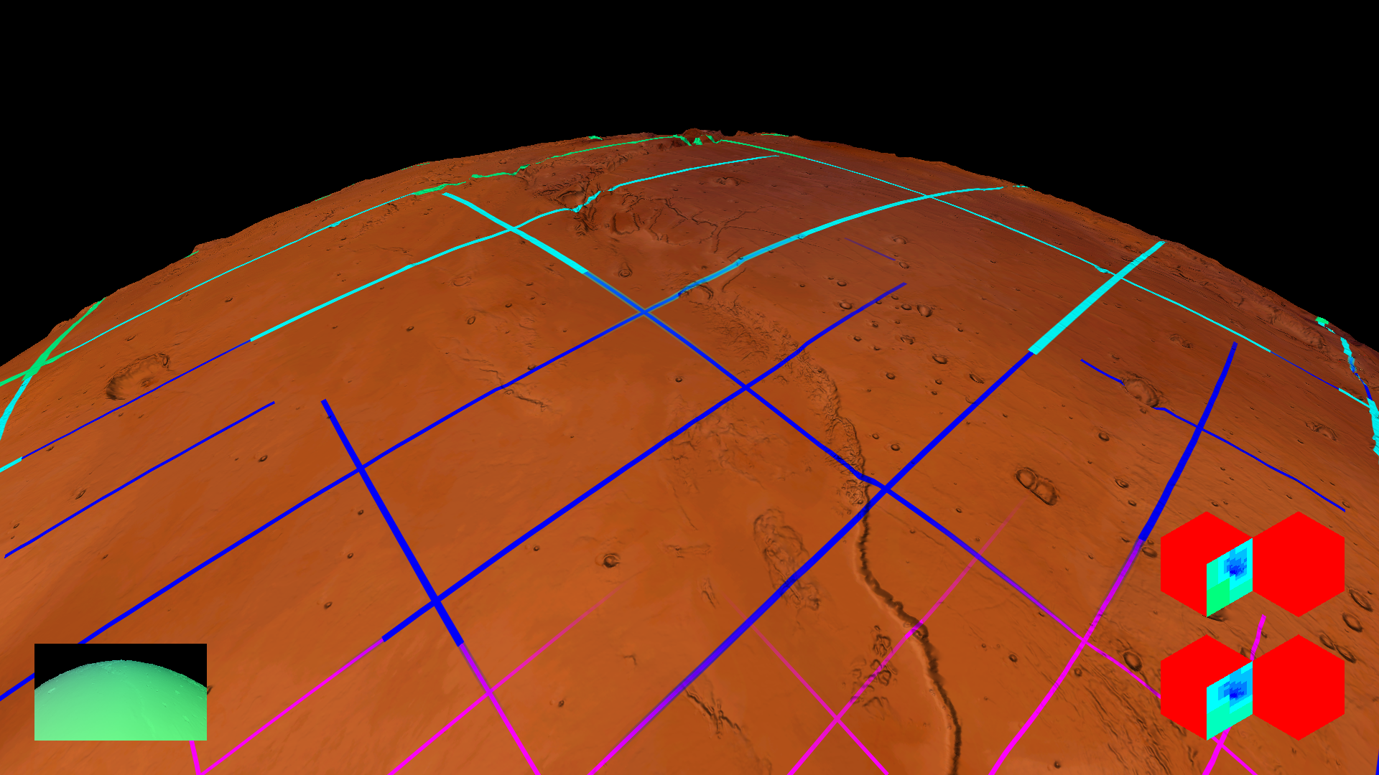
Cutting edge 3D graphics: Tiled Resources
Brand new rendering feature in Direct3D 11.1
Enables games to efficiently use gigabytes of textures
Works on millions of existing Windows PCs

Slide 30
Demo: Tiled Resources Matt Sandy Program Manager Direct3D

Slide 31
Demo: Overlay Bennett Sorbo Program Manager Direct3D

Slide 32
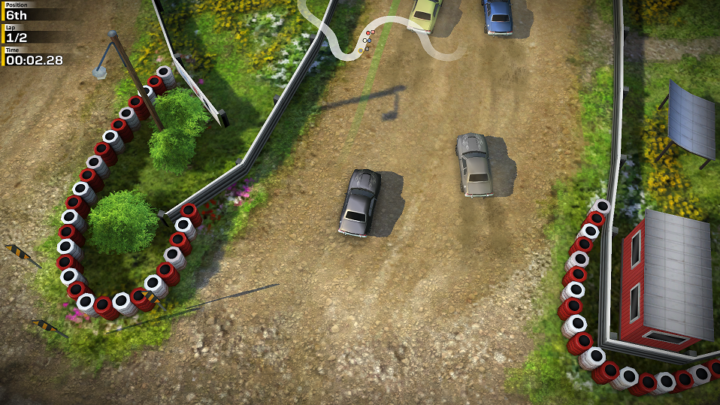
Hardware overlay support
Usage is scalable:
Static scaling
Dynamic scaling
Change scale factor during run time
Swap chain composition
Render scene & heads-up display separately
Compose for free
Display
Display
Swap Chain 1
Display
Swap Chain 2

Slide 33
More flexibility with HLSL
Introducing HLSL Shader Linking
Compile libraries offline, link together at runtime
Runtime compilation of HLSL
Makes desktop code easier to reuse in Store

Slide 34
Using DirectX and XAML together
XAML
DX
XAML
Great for integrating UI and Video
SwapChainPanel - New for 8.1!
Airspace limitations removed!
Independent input
Improves latency for touch, pen, and mouse

Slide 35
Graphics platform tools
Improved performance & reliability
Remote graphics debugging for ARM
Capture/playback on different hardware
Available in Visual Studio Express 2013 for Windows 8.1

Slide 36
Recap
The platform is ready!
Keep the great feedback coming
The elevator doors are still open

Slide 37
Bring your game!

Slide 38
Additional resources
Developing Games on Windows Dev Center
http://msdn.microsoft.com/library/windows/apps/hh452744
Title | Session ID
What’s new in Direct3D 11.2 | 3-062
Massive virtual textures for games: Direct3D and Tiled Resources | 4-063
DirectX Graphics Debugging Tools | 3-141
Bringing Desktop PC Games to the Windows Store | 3-190
Tales from the Trenches: Developing “The Harvest” and “Gunpowder” with Unity | 3-044
Accelerating Windows Store Game Development with Middleware | 3-187
Bringing Halo: Spartan Assault to Windows tablets and mobile devices | 2-049
From Android or iOS: Bringing Your OpenGL ES Game to the Windows Store | 3-189
Cutting Edge Games on Windows Tablets | 3-043
Play Together! Leaderboards with Windows Azure and Multiplayer with WiFi Direct | 3-051
Innovations in High Performance 2D Graphics with DirectX | 3-191
Monetization opportunities for Windows Store apps in Windows 8.1 | 3-121
Unlocking the power of DirectX in apps that use XAML | 4-065

Slide 39
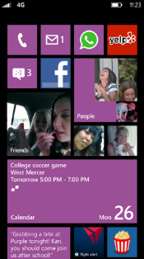
Evaluate this session
Required Slide
*delete this box when your slide is finalized
Your MS Tag will be inserted here during the final scrub.
Scan this QR code to evaluate this session and be automatically entered in a drawing to win a prize!

