Slide 2
Lessons from building Alarms and Calculator in Windows 8.1
Steven Abrahams
Program Manager, Lead
2-060

Slide 3
DEMO
Alarms
Calculator

Slide 4
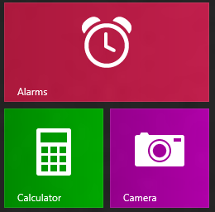
The paradox of “simple” apps
If I had more time I would've written a shorter letter – Mark Twain

Slide 5
Achieving depth of execution
Picking a “Canonical” scenario.
Employing craftsmanship techniques.
Using platform acumen.

Slide 6
The “Canonical” scenario
Use brainstorming and other techniques to find a core scenario that differentiates your app and gives you focus.

Slide 7
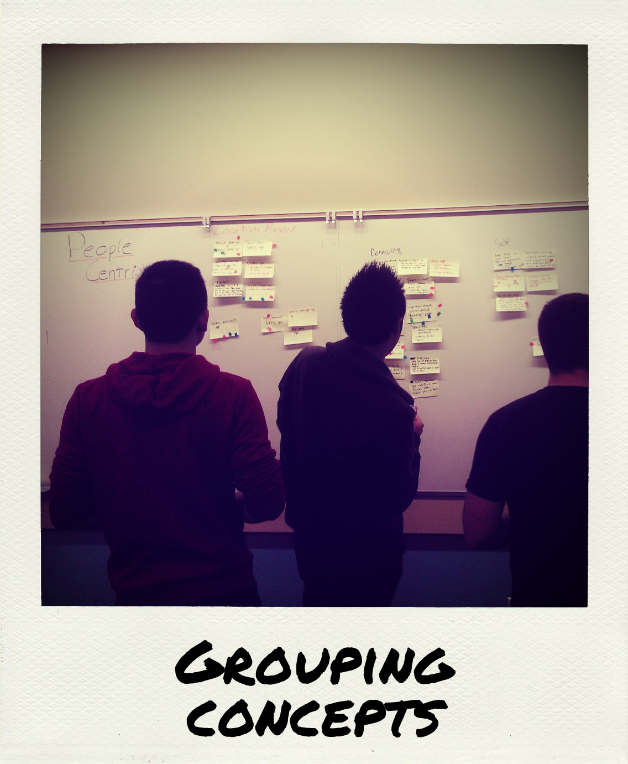
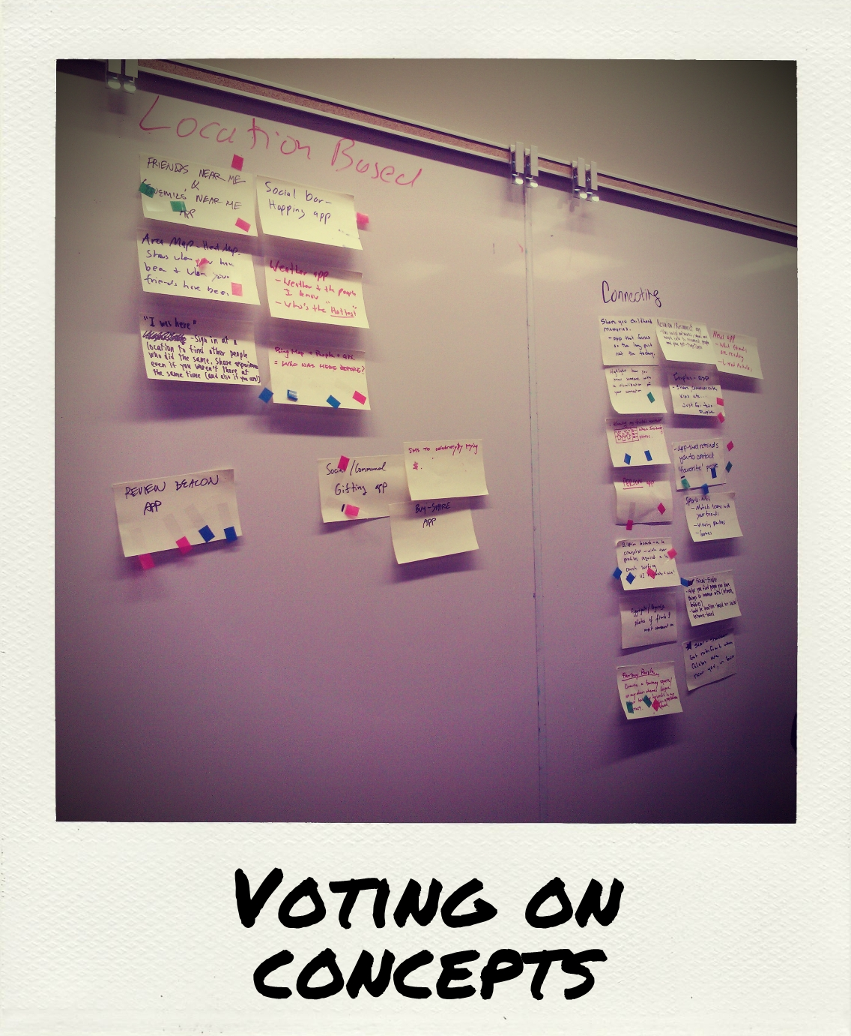
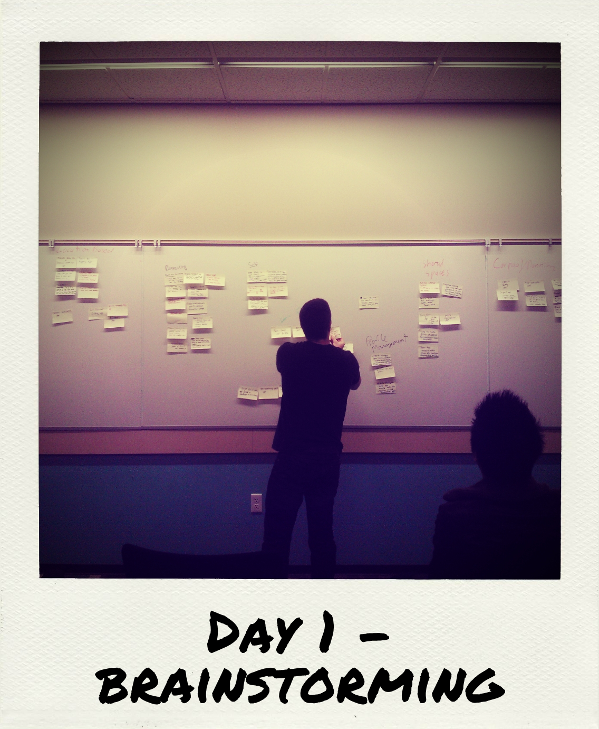
Kickstarting our ideas

Slide 8
What will the app be great at?
Confidence
I know that the timers are accurate
Core needs
An app that wakes me up even if my device is asleep.
Delighters
It should only take a second to set an alarm

Slide 9
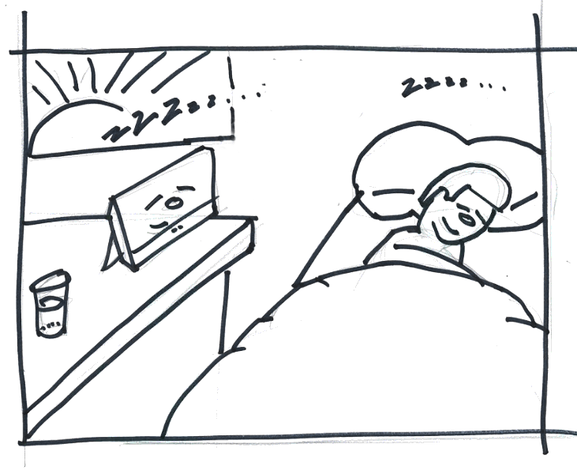
Alarm app core requirements
Precisely timed notifications.
Screen must turn on to display notification when device is in connected standby.
Audible even if device is muted.
User can snooze the alarm from the notification.

Slide 10
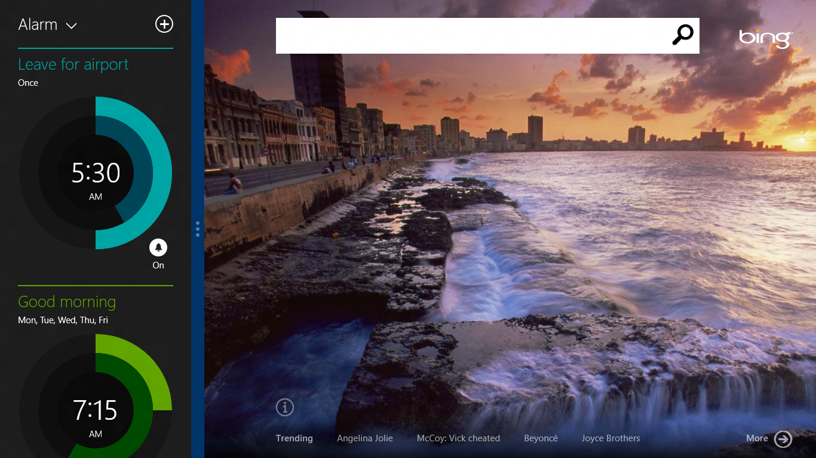
An Alarm app for everyday tasks
Basic features
Customizable alarms
Precise timers
Performance attributes
Multiple countdown timers
Stopwatch with laps/splits
Fun and delightful
Great touch-first experience

Slide 11
Key takeaways for selecting a scenario
Brainstorm concepts.
Select criteria to narrow ideas down.
Group scenarios into a single experience.
Consider user expectations, desirable features, performance attributes.
Write down goals for your app will be great.

Slide 12
Depth of execution
The “Canonical” scenario.
App craftsmanship.
Platform acumen.

Slide 13
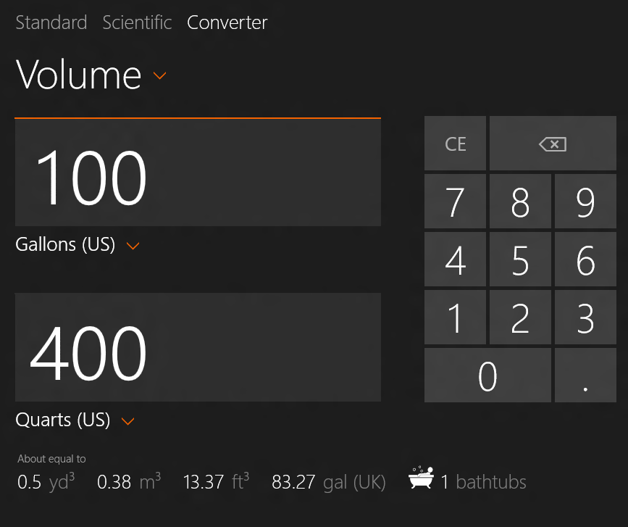
A calculator for everyday math
Basic features.
Basic mathematics.
Everyday conversions.
Performance attributes.
Scientific mode.
Side by side (companion app).
Fun and delightful.
Provides additional, fun unit conversions using everyday items like bathtubs and elephants.

Slide 14
Our design goals for Calculator
Parallel the Windows desktop calculator behavior in a fresh, modern experience.
Localize in all Windows languages and regions.
Be great at all sizes.

Slide 15
New device form factors. Various screen resolutions. Portrait and landscape.
📺 Video: Adaptive scaling for Calculator using XAML

Slide 16
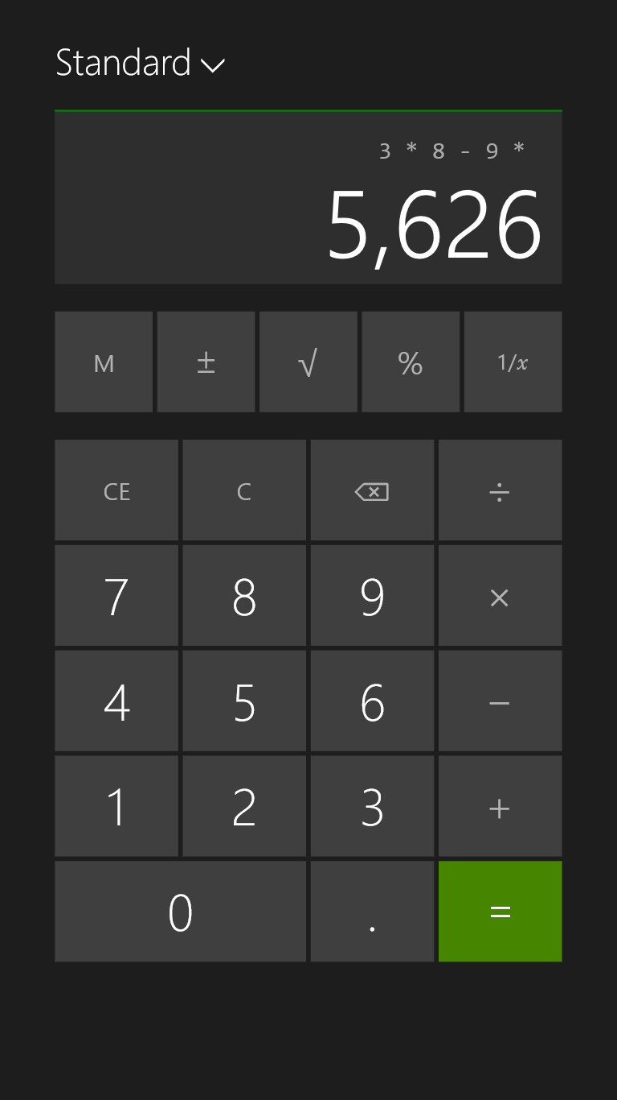
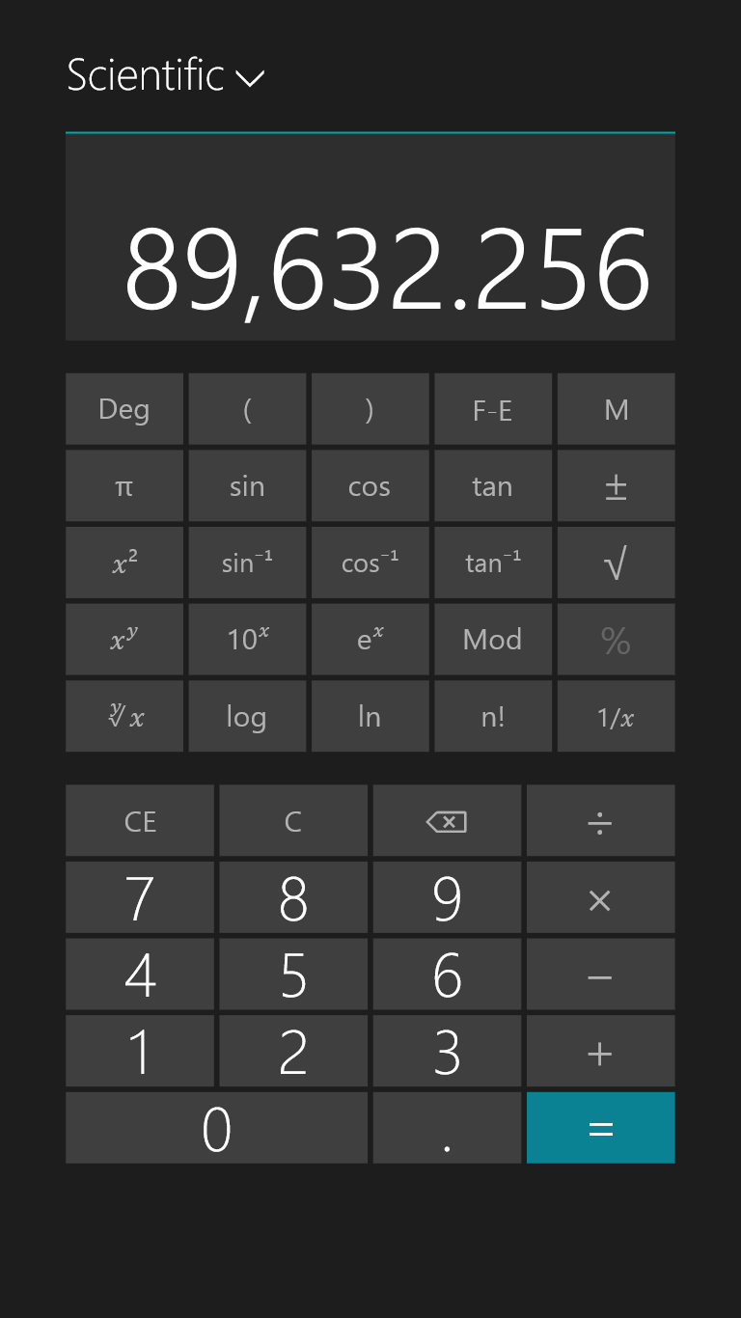
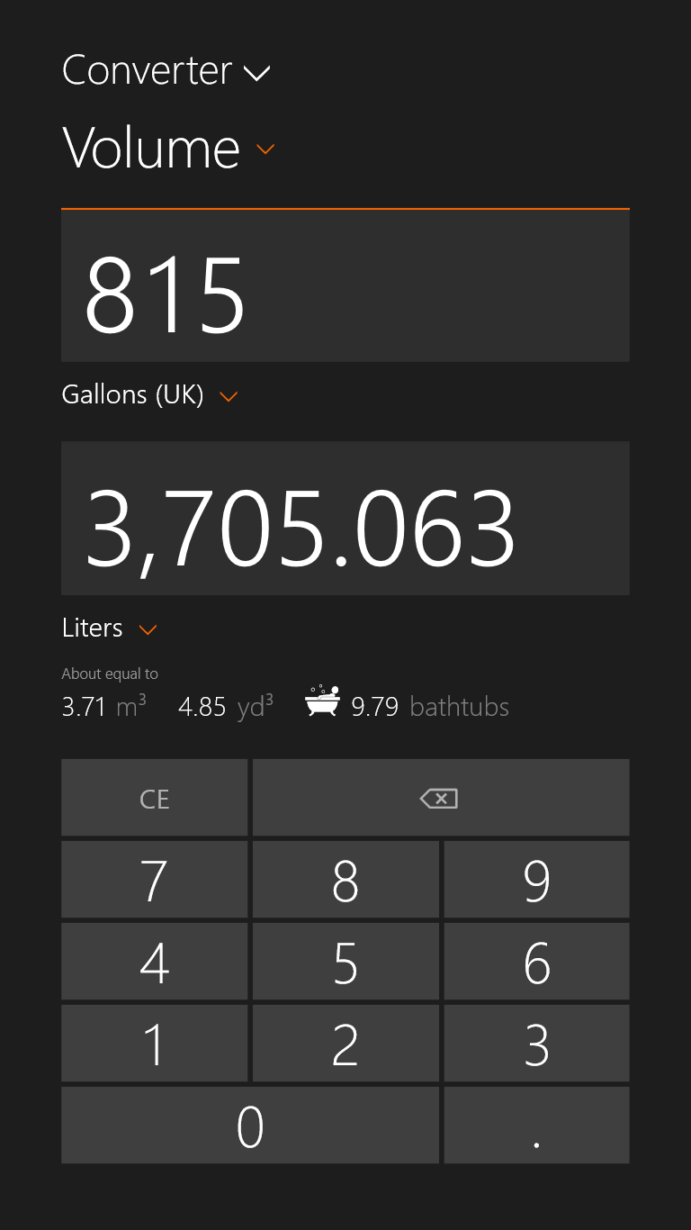

Slide 17
Tweaking typography
Calculator keypad typography took several rounds of tweaking to get right.

Slide 18
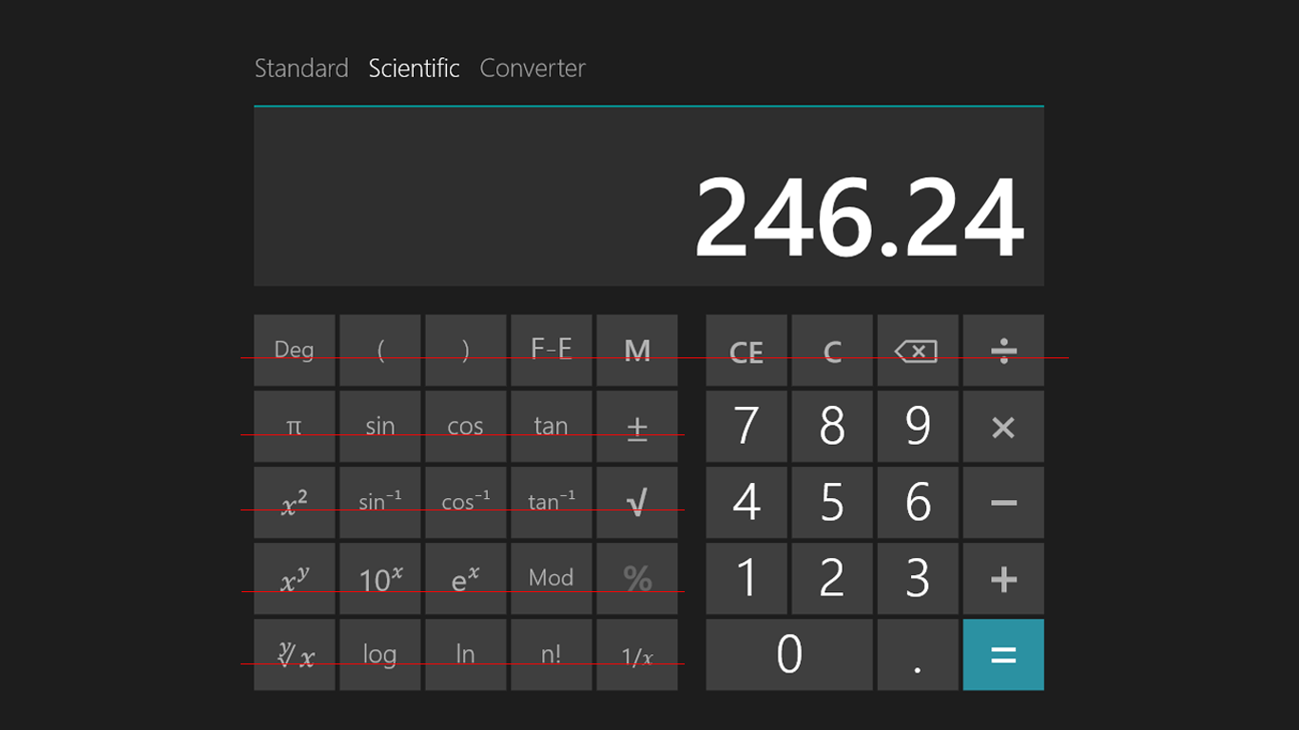

Slide 19
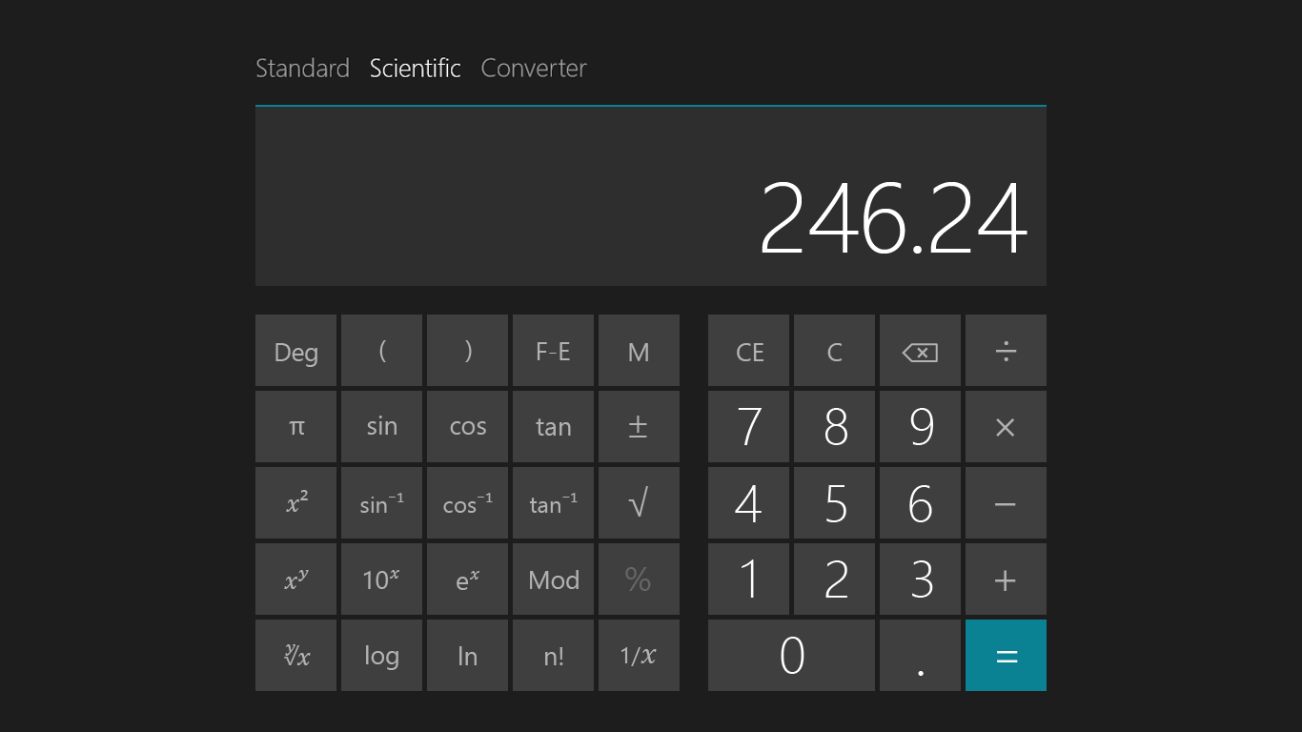
± U+00B1 | 30pt | Semilight
√ U+221A | 32pt | Semilight
% U+0025 | 26pt | Regular
1/𝑥 | 18pt/24pt | Regular/Symbol
Sin-1 cos-1 tan-1 | 18pt | Regular
The rest | 20pt | Regular

Slide 20
Margin adjustments

Slide 21
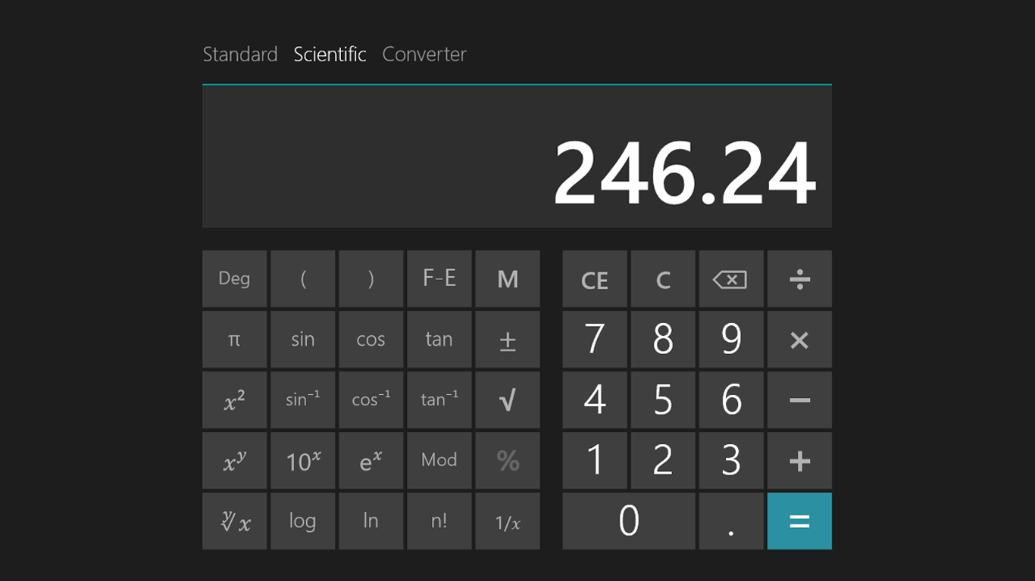
Before

Slide 22
After

Slide 23
Before

Slide 24
After

Slide 25
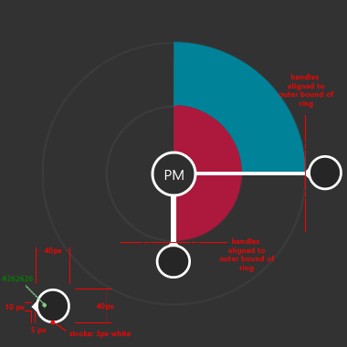
Alarms design goal. One control to set and read time.

Slide 26
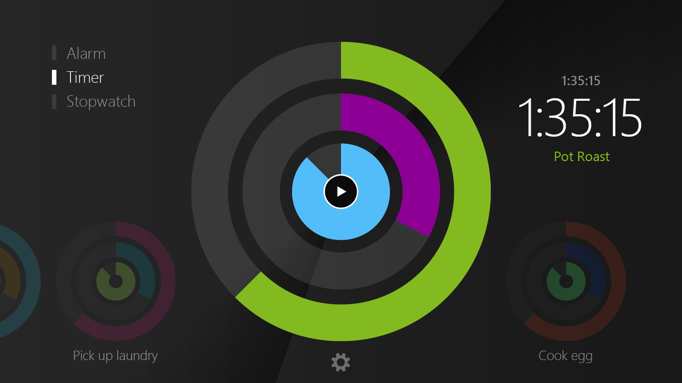
Information design
Making time both beautiful AND human readable took several design passes.

Slide 27
8.1 Design language
Direct manipulation
Delight moments
📺 Video: Designing the Alarm dial control

Slide 28
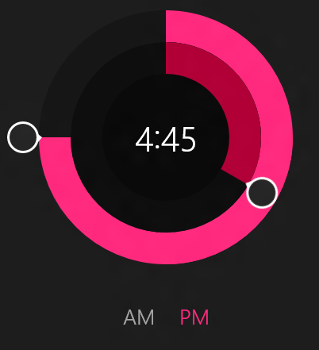
The Dial Control is the primary visual and interaction metaphor for the Alarms app.

Slide 29
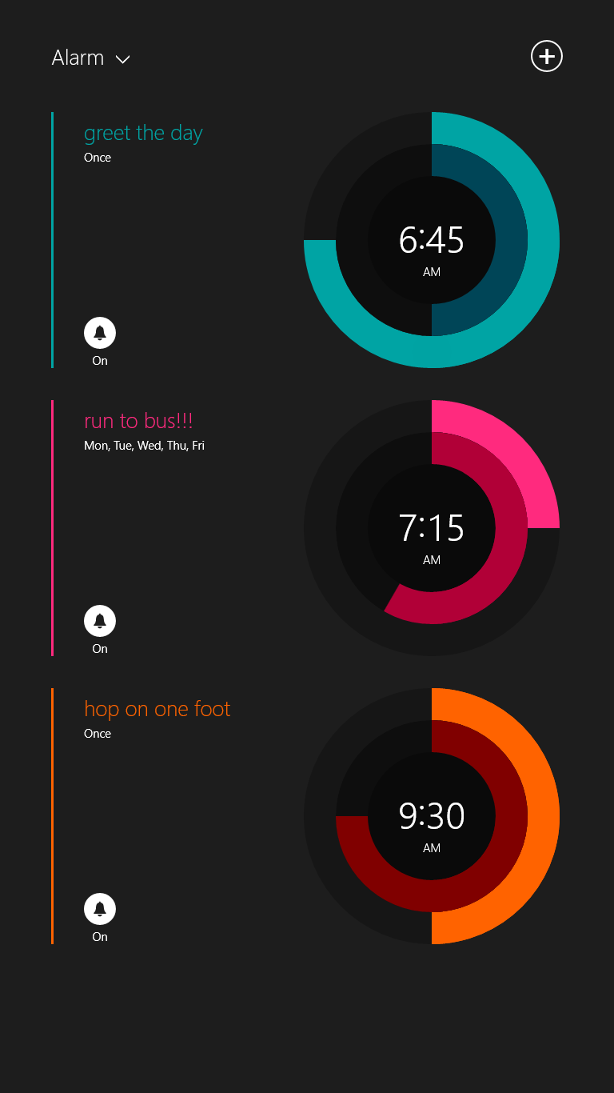
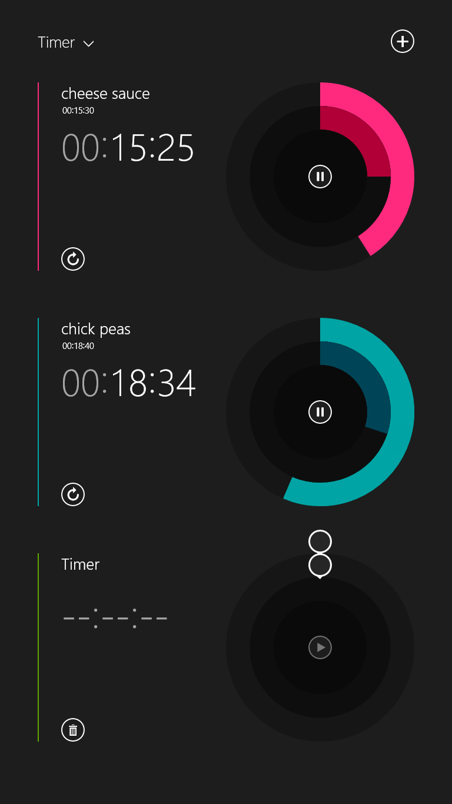
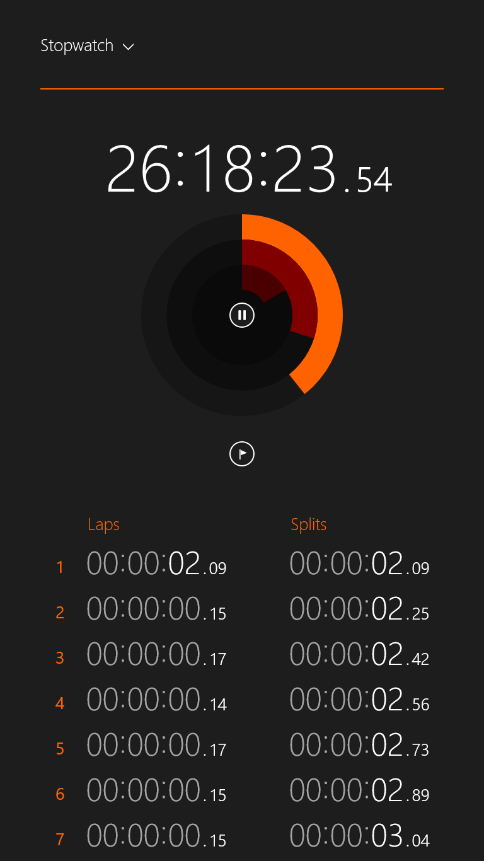

Slide 30
Lessons from building a custom control
Think about whether you need a custom control and whether you will reuse it somewhere else.
Consider using derivatives of common controls to exploit the power of the XAML framework, yet give you flexibility at the presentation layer.
Plan to spend time on getting controls, animations, typography, and layout right for all of the usage scenarios you expect.

Slide 31
Platform acumen
Leverage the Windows platform to give you the power, flexibility and time you need to innovate on your app.

Slide 32
Technology/platform goals
Desire to jumpstart creativity.
Leverage prior experience.
Build fast and fluid apps.

Slide 33
Use derivatives of common controls to exploit the power of the XAML framework, yet give you flexibility at the presentation layer.
📺 Video: Selecting and Stylizing XAML Controls

Slide 34
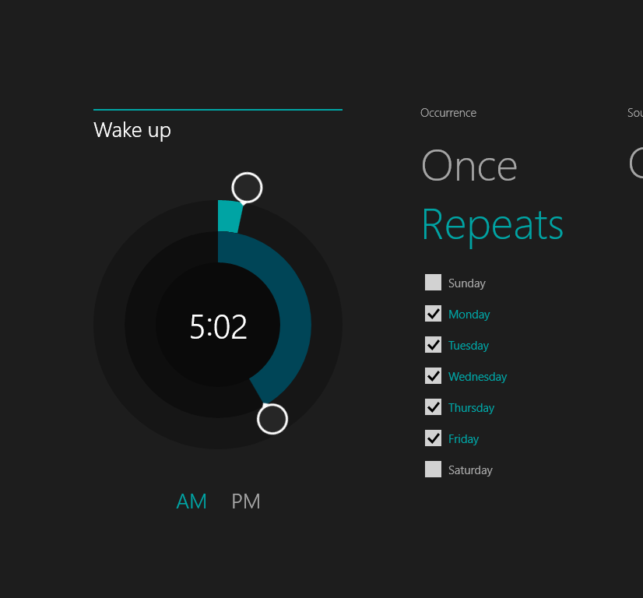
Great regional time formatting
24 or 12 hour clocks.
Regional formatting for time and date.
First day of the week.

Slide 35
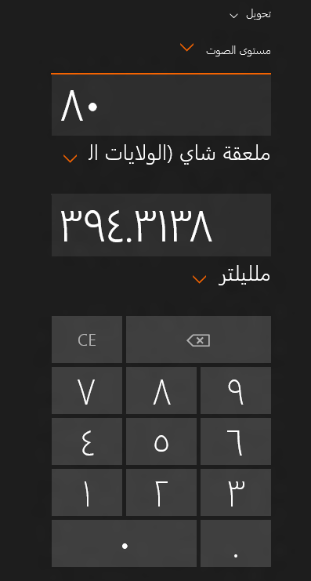
Great data presentation
Regional formatting for numbers.
Native digits (contextual or national).
Decimal symbol.
Digit grouping (100000 or 100,000).
Digit grouping symbols (“ , ” or “ . “).

Slide 36
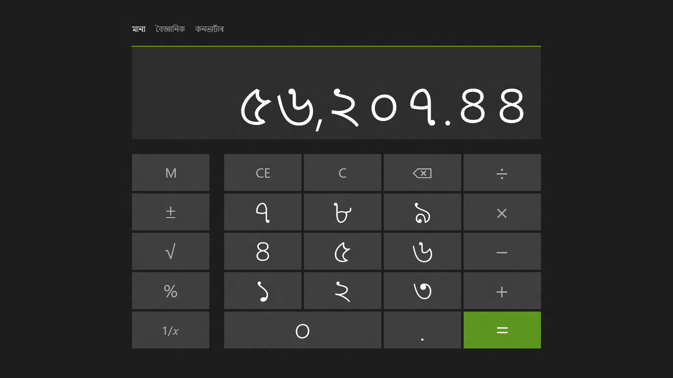

Slide 37
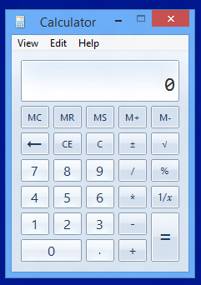
Modeling our views
Calculator Main Page
(View)
Calculator
(View Model)
Model-View-ViewModel
(MVVM)
APP Object
PLM
Calc Manager
(Model)
derivative

Slide 38
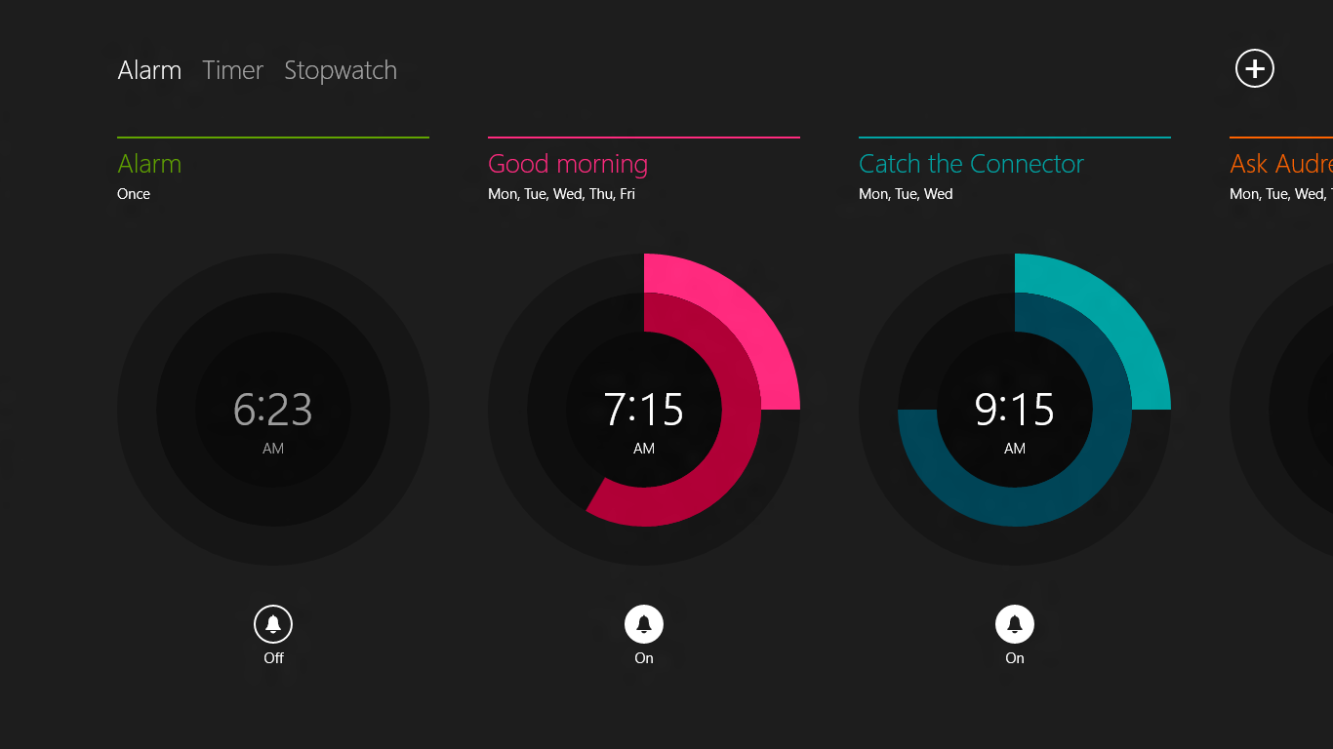
XAML Controls are optimized for performance
6000 ms
Worst case:
Highest Load
Low-end machine
2000 ms
Version 8.0
StackPanel
Version 8.1
ItemStackPanel

Slide 39
Leveraging the platform
Windows 8.1 XAML controls have been optimized for performance on low-end devices and are accessible out of the box, saving you time and giving you greater reach.
Windows globalization APIs for time and numbers both provide a locale contextual experience and obey user customization.
MVVM can be a good way to abstract out underlying logic from your presentation layer and provide you some flexibility.

Slide 40
Achieving depth of execution
Pick a “Canonical” scenario.
Employ craftsmanship techniques.
Leverage the platform.

Slide 41
Thank you!

Slide 42
Resources
Related build presentations:
#82: Creating your first app in XAML (Kannan).
#157: XAML performance fundamentals (Kumar).
#164: What’s new in XAML for Windows 8.1 (Heuer).

Slide 43
About me
Steven Abrahams
PM Lead – Windows In-box App Experience.
Started Microsoft in February 2005.
About my team
Collection of small feature crews.
Windows Store apps for Windows 8.1 (Reading List, Alarms, Calculator).
First time building both apps using native XAML/C++ and apps using JavaScript and HTML.

Slide 44
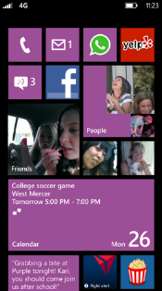
Evaluate this session
Required Slide
*delete this box when your slide is finalized
Your MS Tag will be inserted here during the final scrub.
Scan this QR code to evaluate this session and be automatically entered in a drawing to win a prize!

