Slide 2
Creating your first app using HTML/WinJS
Polita Paulus
Principal Program Manager, Windows
Ryan J. Salva
Senior Program Manager Lead, Visual Studio
2-081

Slide 3

We are covering today…
This is a basics talk!
2-165: What’s new in WinJS 2.0?

Slide 4

Agenda
What is a Windows Store app built using HTML?
What is WinJS?
Covering the basics
Let’s build a real app!

Slide 5
What is a Windows Store app built using HTML?
An app that runs natively on Windows using web technologies
Written in HTML, CSS, & JavaScript
Can use jQuery, Dojo & other libraries
Renders using Trident
Adds layers of security
Full access to the Windows Runtime
Designed for touch
Deployed via the Windows Store

Slide 6
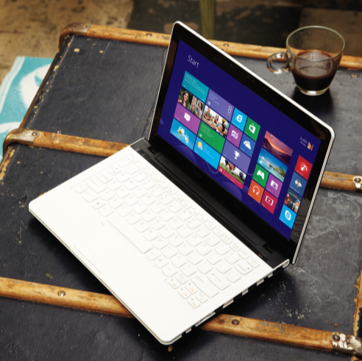
A taste of the apps built with HTML…
Calendar
People
Store
Reading List
Skype
Mail
Xbox Music
Xbox Video
Xbox Games
Travel
Finance
Sports
Weather
News

Slide 7
Windows Store app built using HTML architecture
Your app
HTML/CSS/JS
WinRT
WinJS
IE rendering engine “Trident”
Windows

Slide 8
Windows Library for JavaScript (WinJS)
A collection of toolkits to make building Windows Store apps fast and easy
Style sheets
Core (promises, class, namespace, etc.)
App model
Data binding
Controls
Animations
Utilities

Slide 9
Differences from web environment
All the advantages of HTML programming plus the power, personality, and security of Windows.
Styling changes
Windows Runtime access
Single page model
App sizes and orientations
Security context and innerHTML
Local and web context
IE11 DOCMODE
Network connectivity and offline experience

Slide 10
WinJS basics demo

Slide 11
Building our first app:
San Francisco Transportation

Slide 12
What we covered today…
What is a Windows Store app built using HTML?
How WinJS fits in and why you want to use it
Building our first app
Retrieving and binding to external data
Styling
Search
Geolocation
Local storage

Slide 13
Source code for the San Francisco Transportation app is now available on CodePlex at http://sanfranciscotransportation.codeplex.com/

Slide 14
Resources
Day 1
2-165: What’s new in WinJS 2.0?
2-192: Building a UI: What does it cost?
Day 2
2-168: Designing and Building User Interfaces for Windows
2-311: What’s new in Blend for HTML Developers

Slide 15
Please fill out a session evaluation!

