Slide 2
Creating your first app using XAML
Harini Kannan
Program Manager
Developer Experience – Windows
2-082

Slide 3
Agenda
XAML framework – an introduction
Concepts and nuances
Let’s build an app!

Slide 4
Characteristics of apps created using XAML
UI in XAML
Logic in C#/VB/C++
Interacts with Windows subsystems
Optimized for all input methods
Fast, fluid and responsive
Deployment and updates via Windows Store

Slide 5
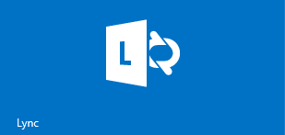
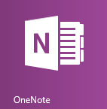
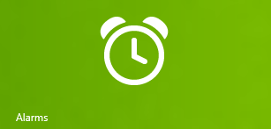
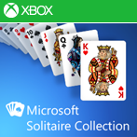
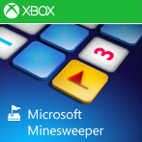
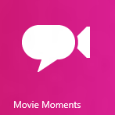
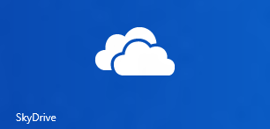
Types of apps and experiences using XAML
Core Experiences
PC Settings
Search
Contact/Calendar Card

Slide 6
High fidelity, high performance developer framework for any scenario!

Slide 7
Tooling support for building apps
Blend – User interface and visual design
Visual Studio – Development and debugging

Slide 8
Let’s build an app - “Build Conference Hub”

Slide 9
Recap from app building (1/2)
Application class
Creating UI
Working with XAML controls
Styling and themes
{ Binding }
Working with non-UI WinRT components

Slide 10
Recap from app building (2/2)
Adding non-XAML content
Working with Extension SDK, custom controls
Commanding patterns
Settings
Display diversity
Packaging concepts

Slide 11
And more to a Windows store app…
Accessibility
Globalization
More capabilities – Search, Share…
Maximize performance
WACK
etc.,

Slide 12
Have a great time building apps for the Windows store using XAML!

Slide 13
Relevant sessions
XAML specific sessions:
[2-164] What’s new in XAML
[3-157] XAML Performance fundamentals
[3-158] Dramatically increase performance when users interact with large amounts of data in GridView and ListView
[3-179] WebView – Bringing the web to your app
[4-065] Unlocking the power of DirectX in apps that use XAML
[3-321] What’s new in Visual Studio and Blend for XAML Developers

Slide 14
Relevant sessions
Broader Windows-wide sessions:
[3-077] Upgrading Windows 8 apps to Windows 8.1
[2-075] What’s new in WinRT for Windows 8.1
[2-001] How to build an accessible Windows 8.1 app
[2-150] Beautiful apps at any size on any screen
[3-144] Design and build a great search experience in your app
[2-095] First Impressions Matter: Delighting your user from the moment they click “Buy”
[2-130] The Wow factor: Making your Windows store app promotable

Slide 15
Resources
Design: http://design.windows.com/
Develop: http://msdn.microsoft.com/en-US/windows/apps/br229512
Samples: http://code.msdn.microsoft.com/windowsapps
Videos: http://channel9.msdn.com/Windows

Slide 16
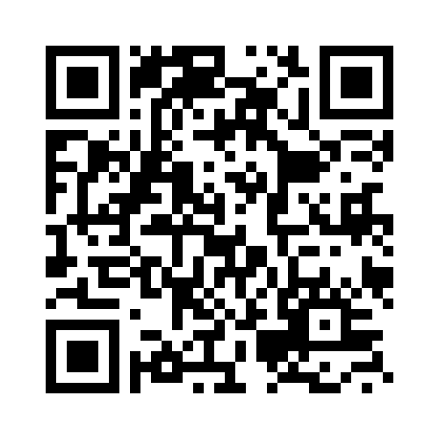
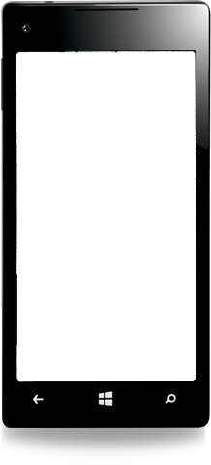
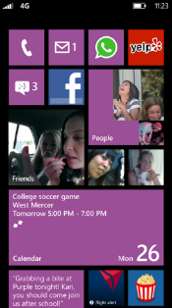
Evaluate this session
Required Slide
*delete this box when your slide is finalized
Your MS Tag will be inserted here during the final scrub.
Scan this QR code to evaluate this session and be automatically entered in a drawing to win a prize!

