Slide 2
What’s new for working with files
Marc Wautier
Program Manager 2-119

Slide 3
Agenda
Basics of working with files.
Understanding core concepts and guidelines.
API updates for local file access.
Unlocking new interactions with user files.
Handling SkyDrive files with Windows Runtime.
Learning best practices to update your app to work with any file.

Slide 4
With Windows 8.1, it’s never been easier for apps to use files across the PC, devices and SkyDrive.

Slide 5
A taxonomy of files
web
app-to-app picking
downloaded files
Files come from a variety of places, each with its own access model.
In Windows 8.1, user files now can include files from SkyDrive.
devices & network
removable storage
network shares
the PC+SkyDrive
user content
app data
local state
user-created app content

Slide 6
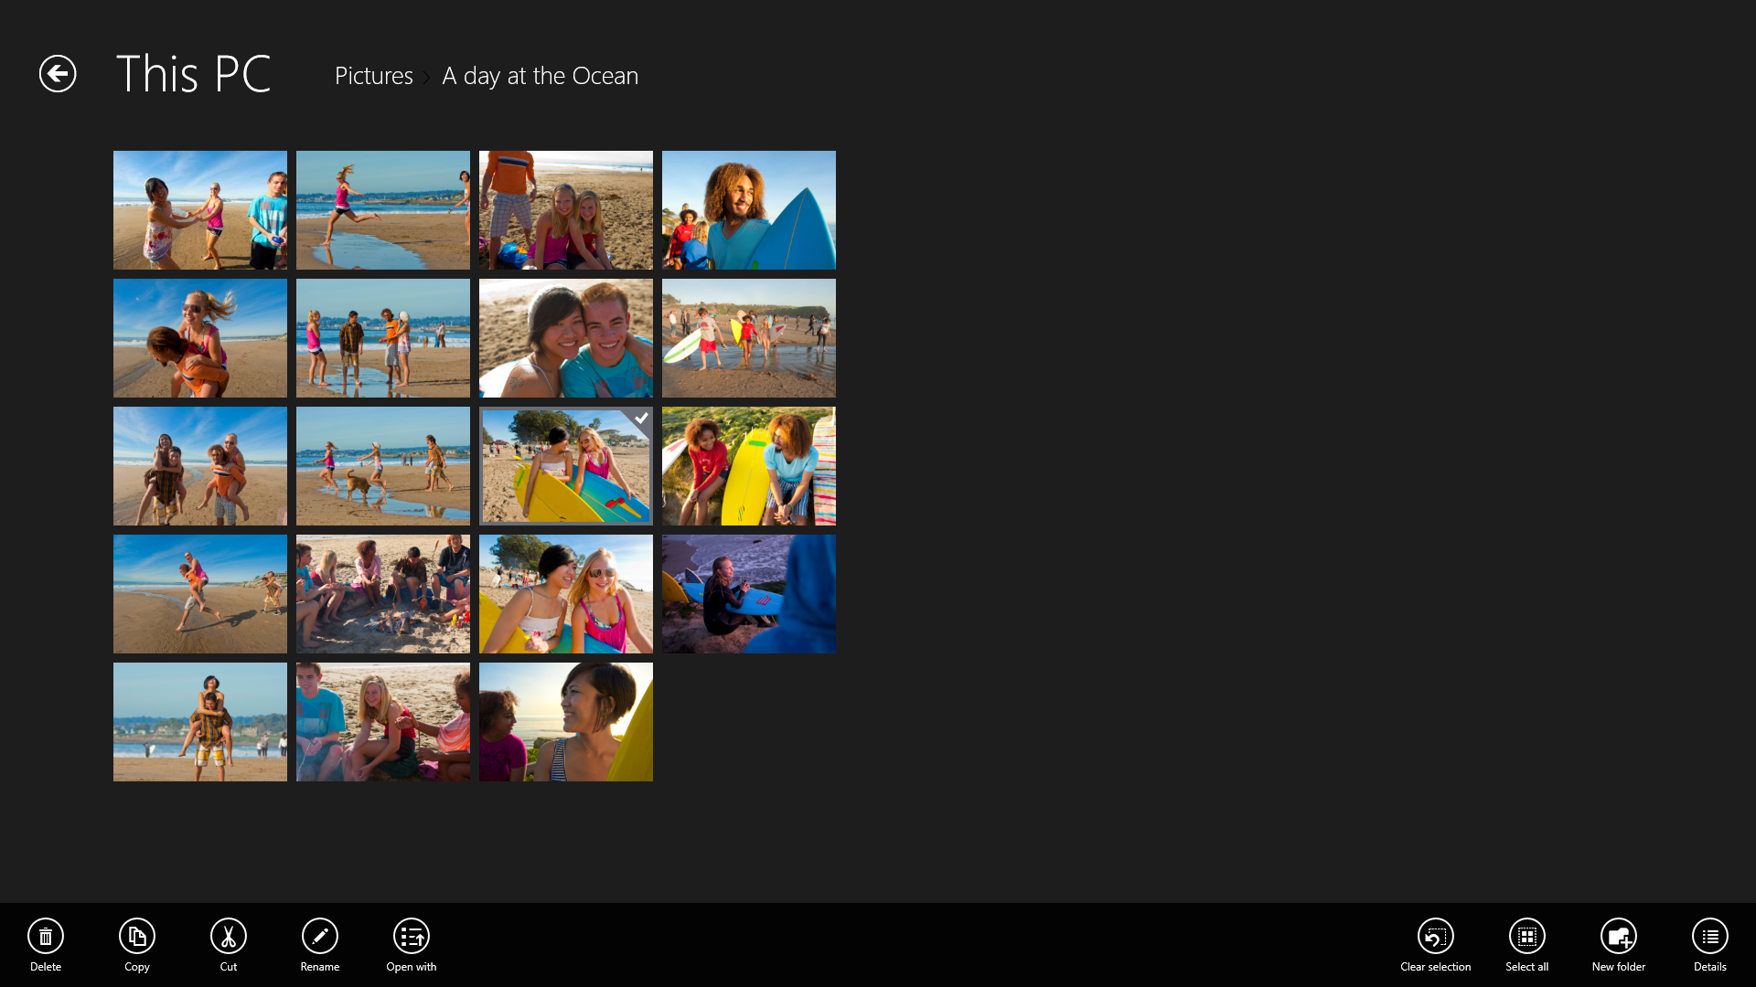

Slide 7
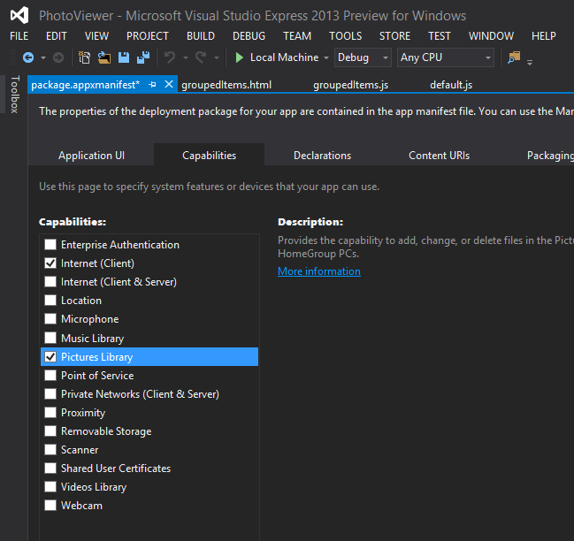
Gaining access to files
Apps can gain access to files through the file picker or with capabilities.
The file picker is a user-driven way to open from and save to the file system and apps.
Capabilities can grant programmatic access to specific files and folders.

Slide 8
User principles
Control.
Usefulness.
Clarity.

Slide 9
Developer principles
Security.
Usability.
Customizability.

Slide 10
Using files and folders
Windows Store app
Metadata
Thumbnails
Queries
File operations
File and folder Windows Runtime APIs
File system and Windows indexer

Slide 11
Key concepts
StorageItem
Retrieve basic properties.
Get thumbnails, perform rename, or delete operations.
StorageFile
Open the file as a stream.
Retrieve extended properties.
Move, copy.
Create files and folders.
Enumerate contents.
Retrieve StorageItem(s) within a folder by name.
StorageFolder

Slide 12
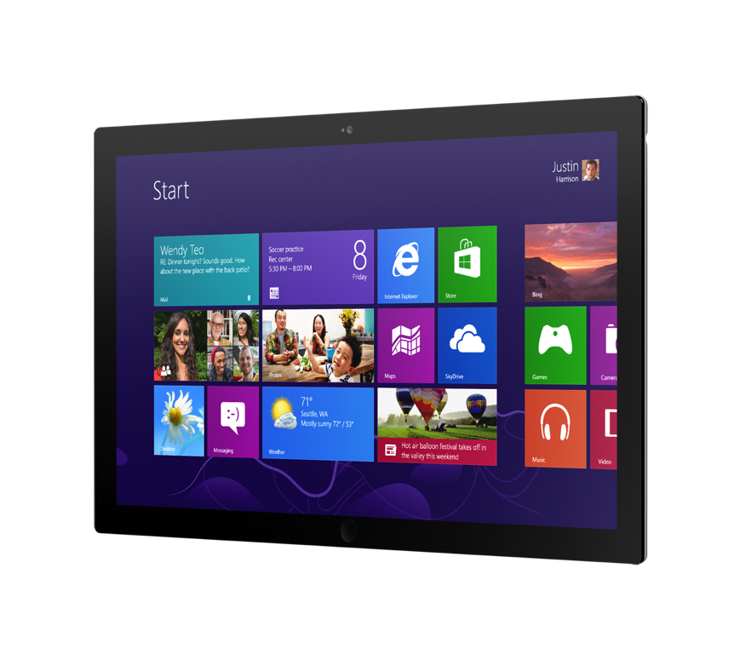
Demo:
Updating the Windows 8 HiloJS app.

Slide 13
New functionality to better interact with the file system
Improve navigation between files using NeighboringFilesQuery.
Add content to the user’s Libraries using StorageLibrary.
Easily navigate the namespace and simplify error handling using new helper APIs.

Slide 14
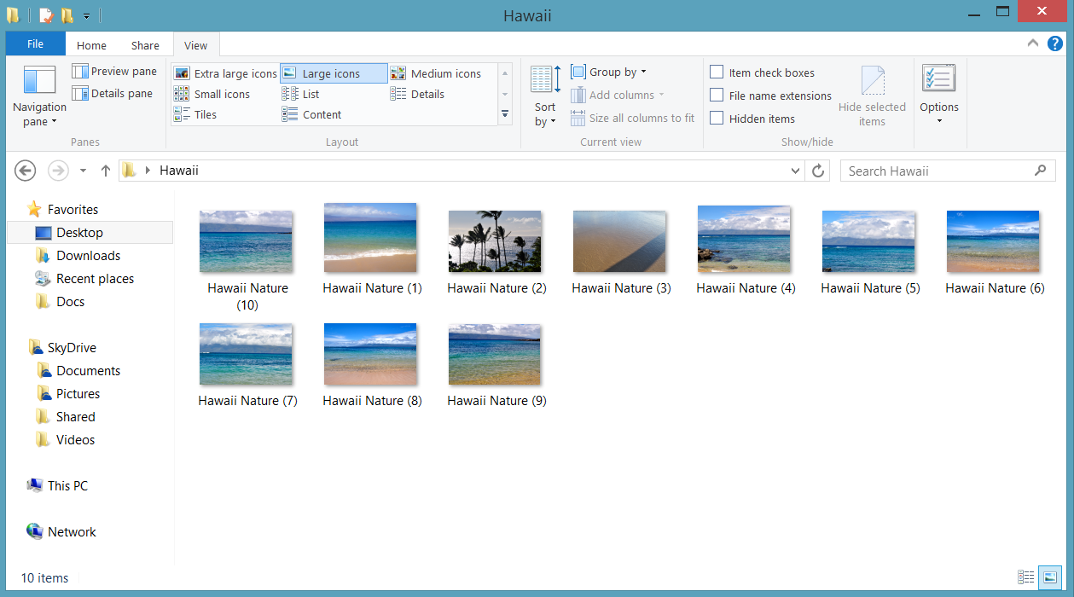
Provide better navigation between files
When your app is activated via a file association, you can now let the user navigate to the next and previous file in the view.
FileActivatedEventArgs.NeighboringFilesQuery
Works with folders, search results views, file queries.
Maps your app’s declared capabilities.

Slide 15
Using neighboring files
app.addEventListener("activated", function (args) {
if (args.detail.kind === activation.ActivationKind.file) {
var query = args.detail.neighboringFilesQuery;
var launchFile = args.detail.files.getAt(0);
if (query) { // Object null when no neighboring files exist
var startIndex = query.findStartIndexAsync(firstFile);
...
}
}
});

Slide 16
Give users a way to add content to your app
When users store their content in various locations that your app can’t access (external drives, disk partitions etc.), they can point your app to them easily.
Windows.Storage.StorageLibrary
Lets users point apps to more content.
Provides Library management directly from your app.
Notifies your app when the Library changes.
App
Picker
App
App
Library
App

Slide 17
Adding content to libraries
var picturesLibraryId = Windows.Storage.KnownLibraryId.pictures;
Windows.Storage.StorageLibrary.getLibraryAsync(picturesLibraryId).done(function (library) {
library.requestAddFolderAsync();
});

Slide 18
Easily navigate the namespace
Three new APIs give you simple, but useful functionality to be
more efficient when dealing with files.
GetParentFolderAsync
You can use this to access the parent folder of a file, if you have access to it.
IsEqual
In some cases, you may want to compare two files to ensure they are different. This is now a single API call.
TryGetItemAsync
Dealing with file system errors can be a pain, especially in C#. You can now choose to simply get a null result if the file couldn’t be retrieved.

Slide 19
Demo:
Update HiloJS
Use NeighboringFilesQuery.
Provide add to Library command.

Slide 20
SkyDrive in Windows 8.1
SkyDrive is built into Windows.
Users can store files on SkyDrive just like a file system folder.
SkyDrive files are synced and can be managed by users regardless of connectivity.

Slide 21
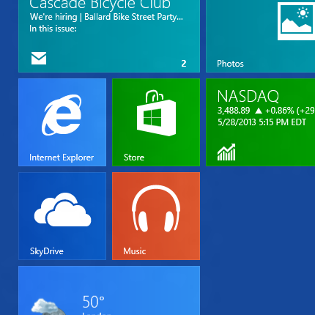
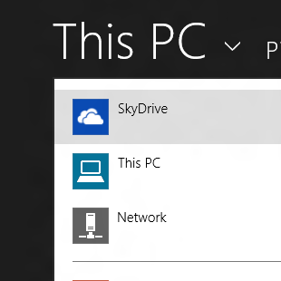
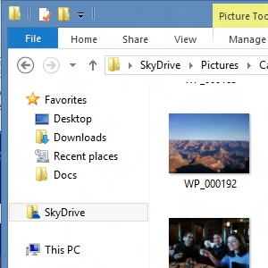
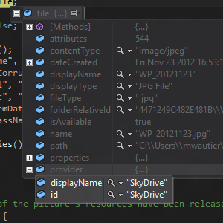

Slide 22
SkyDrive files are just files
All files are StorageFile objects, whether they come from the PC, SkyDrive, network or other apps.
In Windows 8, it is possible for your app to receive a stream-backed file from the file picker.
These files look similar to normal file system items.
API calls may be slow while their contents are downloaded.
Windows 8.1 extends this model to SkyDrive files.
Users will be able to easily pick files from their SkyDrive.
Content from SkyDrive can be included in Libraries.
SkyDrive files may be non-local “placeholder files”.

Slide 23
Placeholder files
Enable users to view and manage files regardless of connectivity.
Represent the SkyDrive namespace, even when files are not cached locally.
Contain file metadata and thumbnails for photos.
To end-users and developers, they look and feel almost the same as the local files.

Slide 24
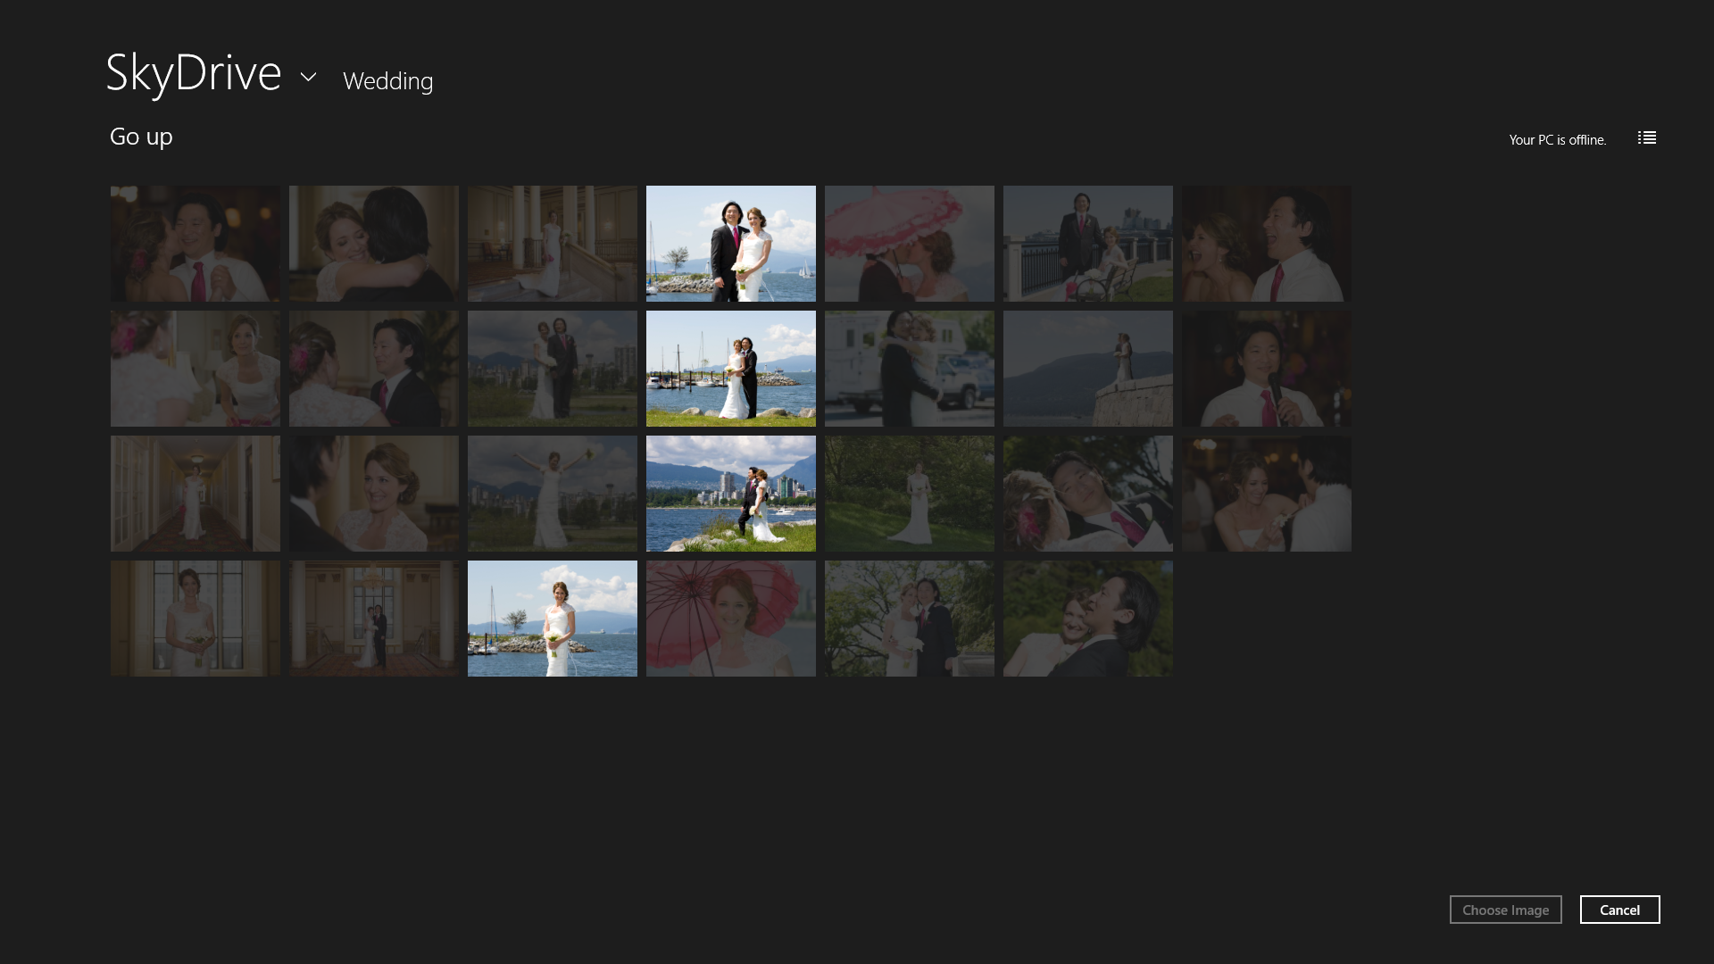

Slide 25
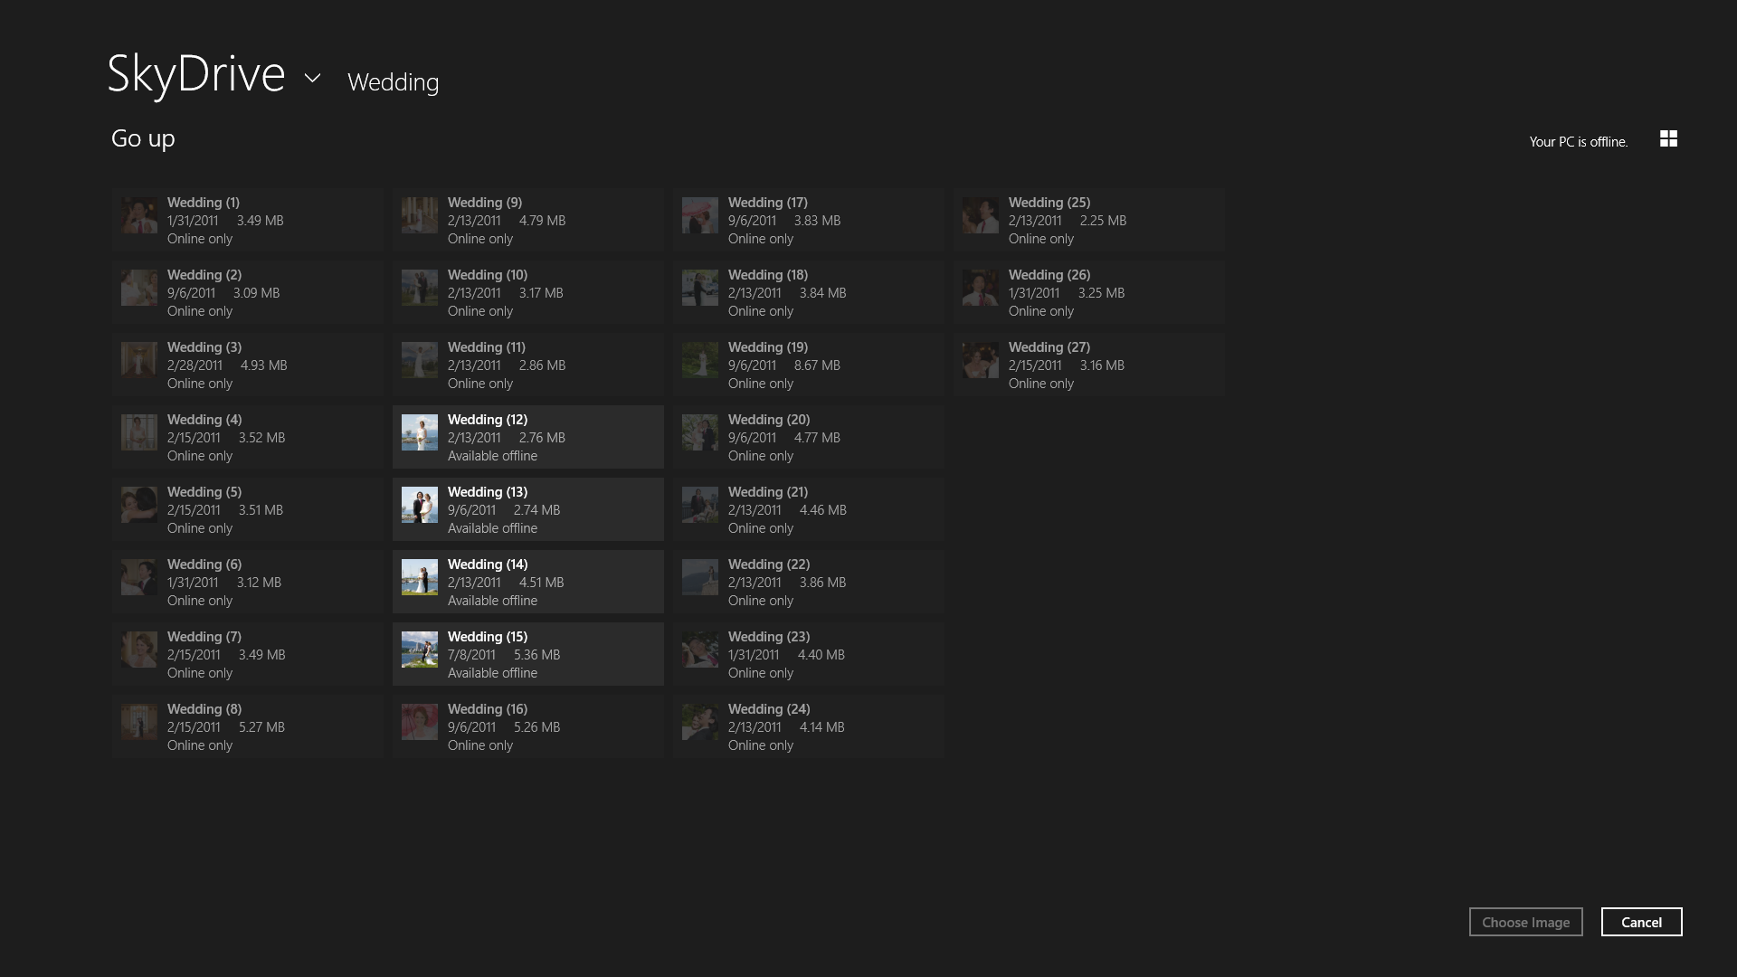

Slide 26
Guidelines for SkyDrive files
Check for availability.
Many common operations can be done just the same on local or SkyDrive files, regardless of connectivity.
Opening a file, or editing its metadata can only be done if the file is available offline or can be downloaded.
Use thumbnails for images.
The Windows thumbnail API can get thumbnails directly from the cloud and avoid costly file downloads.

Slide 27
Check for availability
The new IsAvailable property lets you know if a file can be opened at any given time.
StorageFile.IsAvailable
Whenever you want to open a file, or edit its metadata, check if it is available.
The property is true if it’s safe to treat a file like a local file.
Once opened, a file becomes marked available offline.
Value of IsAvailable | Online | Metered network | Offline
Local file | True | True | True
SkyDrive file marked available offline | True | True | True
SkyDrive placeholder file | True | Based on user setting | False
Network file | True

Slide 28
Checking availability for a file
// Query the Pictures Library.
var query = Windows.Storage.KnownFolders.picturesLibrary.createFileQuery();
query.getFilesAsync().done(function (files) {
// Get each file’s availability.
files.forEach(function (file) {
if (file.isAvailable) {
// Treat file as a normal file
} else {
// Treat file as disabled in UI
}
});
});

Slide 29
Reflecting availability in your UX
If you show a file view, differentiate files that are not available.
Use transparency to ghost unavailable items, and disable any interactions that would open the file.
When opening a file, show indeterminate progress.
This will indicate that your app is still responsive, even if the file needs to be downloaded over a slow network.
Allow users to cancel file operations.
Unlike local files, cancellation is useful for operations like opening a file on SkyDrive, in case network connectivity is slow.

Slide 30
Use thumbnails for images
The updated thumbnail API lets you obtain thumbnails without downloading full files from the cloud.
StorageItem.GetScaledImageAsThumbnailAsync
Is the best way to display images in your app.
Can return thumbnails at any size.
Can be used with all files, including placeholder files.
App
Thumbnail API
Local cache
Embedded thumbnail
Cloud cache

Slide 31
Using thumbnails
openpicker.pickSingleFileAsync().done(function (file) {
if (file) {
file.getScaledImageAsThumbnailAsync(
thumbnailMode,
requestedSize,
thumbnailOptions).done(function (thumbnail) {
if (thumbnail) {
// Display the image
}
}, function (error) {
// Handle error
});
}
});

Slide 32
Demo:
Update HiloJS
Use the IsAvailable property.
Leverage the new thumbnail API.

Slide 33
To summarize
Understanding core concepts and guidelines.
Let users export files with the file picker.
Unlocking new interactions with user files.
Take advantage of file activation and Libraries.
Learning best practices to update your app to work with any file.
Check for file availability and show it in UX.
Use thumbnails to improve performance.

Slide 34
Resources
[WCL-118] The story of the state – Channel 9
Using the file picker
Using Library capabilities
The File Activation extension
File access SDK sample
Folder enumeration SDK sample
HiloJS sample app
MSDN Windows.Storage documentation

Slide 35
Q&A

Slide 36
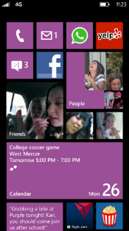
Evaluate this session
Required Slide
*delete this box when your slide is finalized
Your MS Tag will be inserted here during the final scrub.
Scan this QR code to evaluate this session and be automatically entered in a drawing to win a prize!

