Slide 2
The Wow Factor Making your Windows Store Apps promotable
Pete Brown | @pete_brown
Technical Evangelist – Client & Devices
2-130

Slide 3
What we’ll cover
What it means to be promotable
App goals & scenarios
Layout & content
Commands & navigation
Contracts & charms
App submission and your listing

Slide 4
We promote compelling high-quality apps in the Windows Store, through ads, and more.

Slide 5
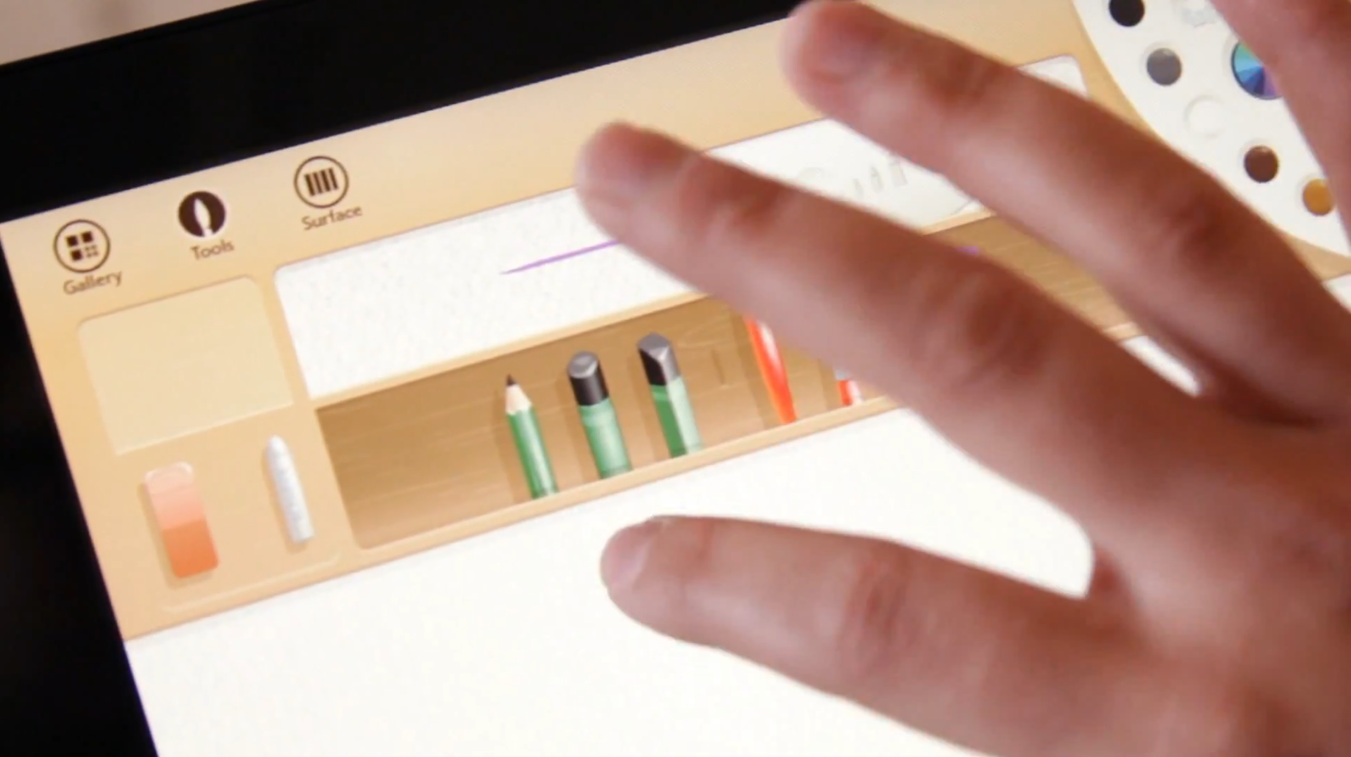

Slide 7
Planning for quality

Slide 8
The app needs to be “best at” something.

Slide 9
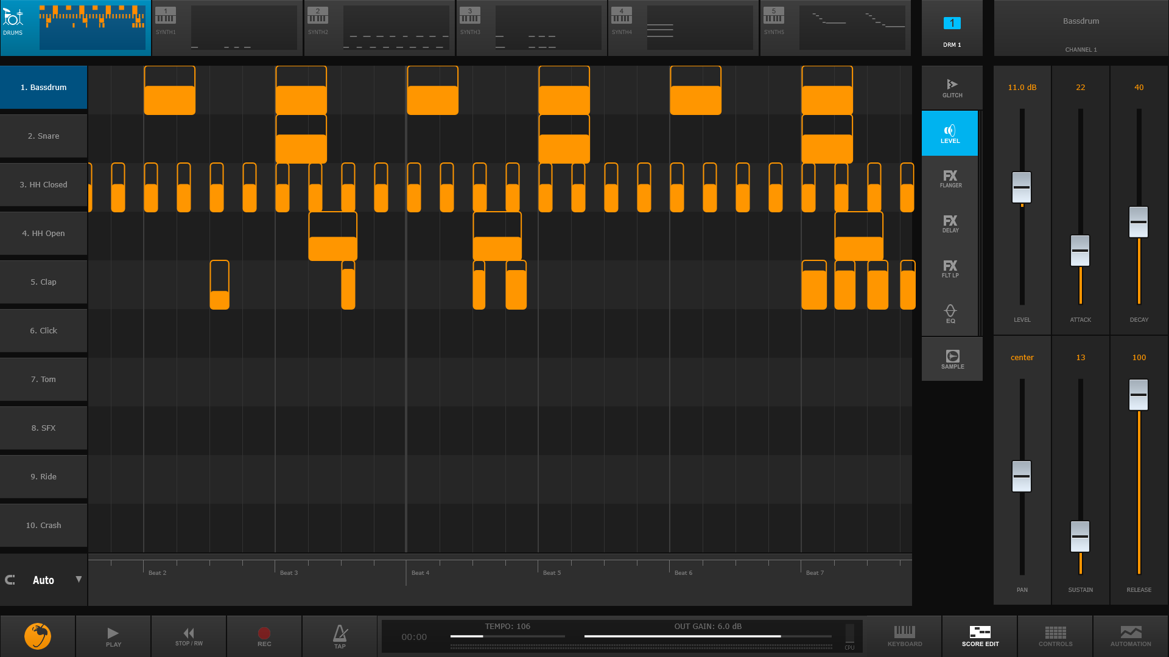
Deliver end-to-end user scenarios
List what the user will be able to do with your app
Those scenarios directly support the “best at” statement
This app enables users to create music starting from beats and bass lines all the way through recording a performance and publishing on social networks through the share charm.

Slide 10
Designing for quality

Slide 11
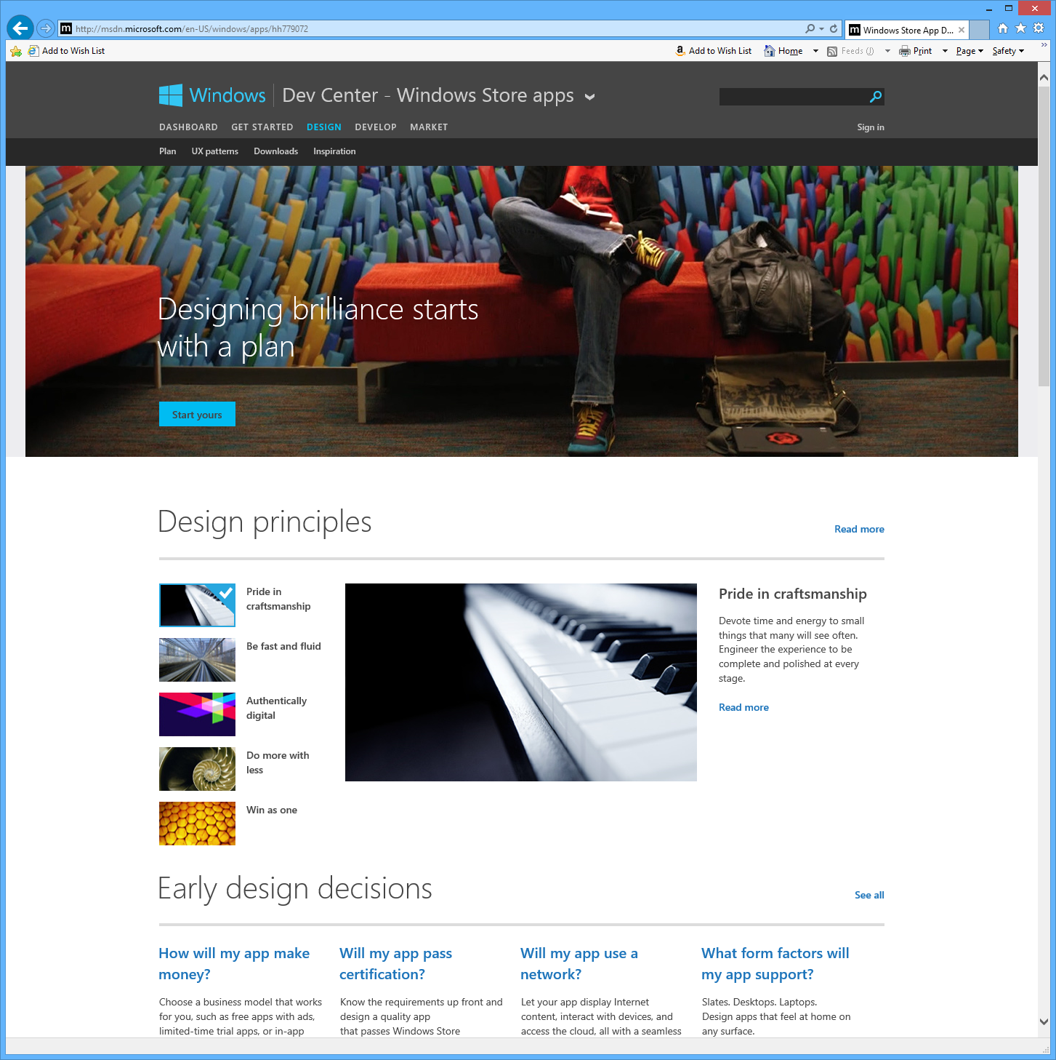
Design and User Experience guidelines
Guidelines available on http://design.windows.com
Design inspiration, UX checklists, and case studies also on the same site

Slide 12
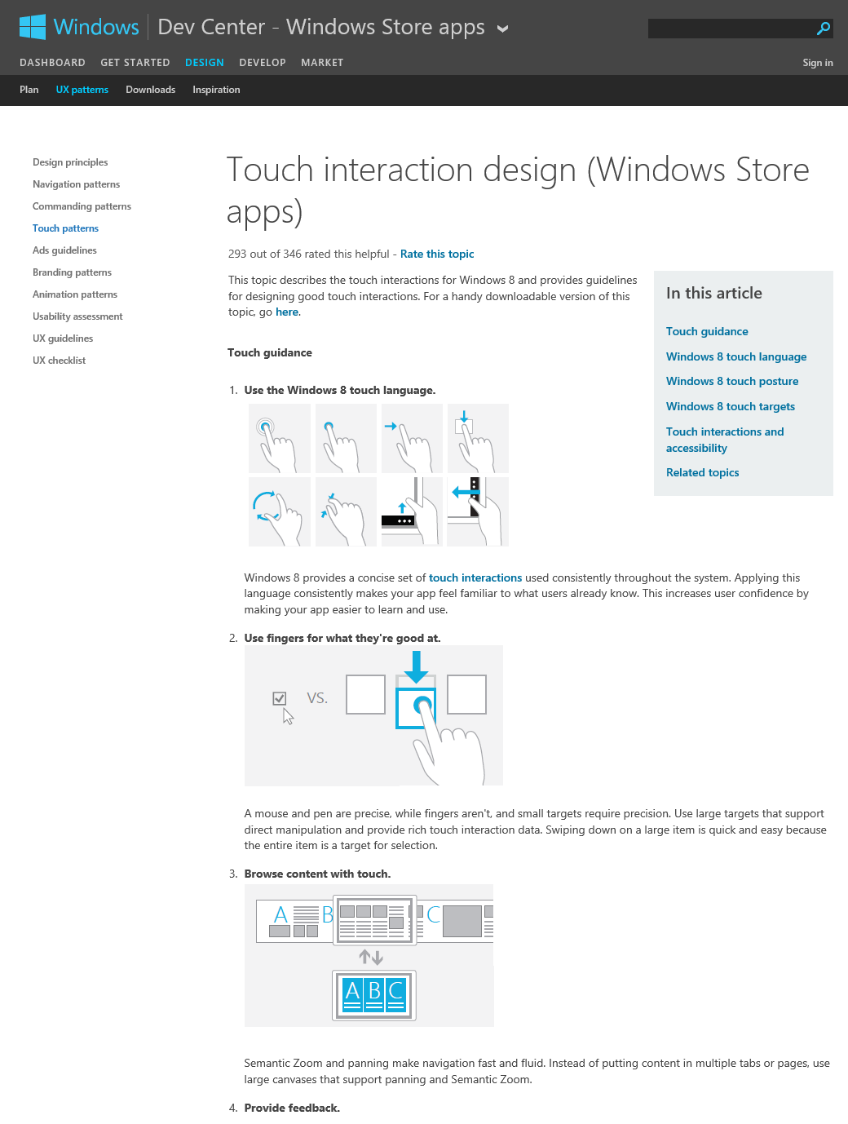
The app needs to follow Windows User Experience guidelines

Slide 13
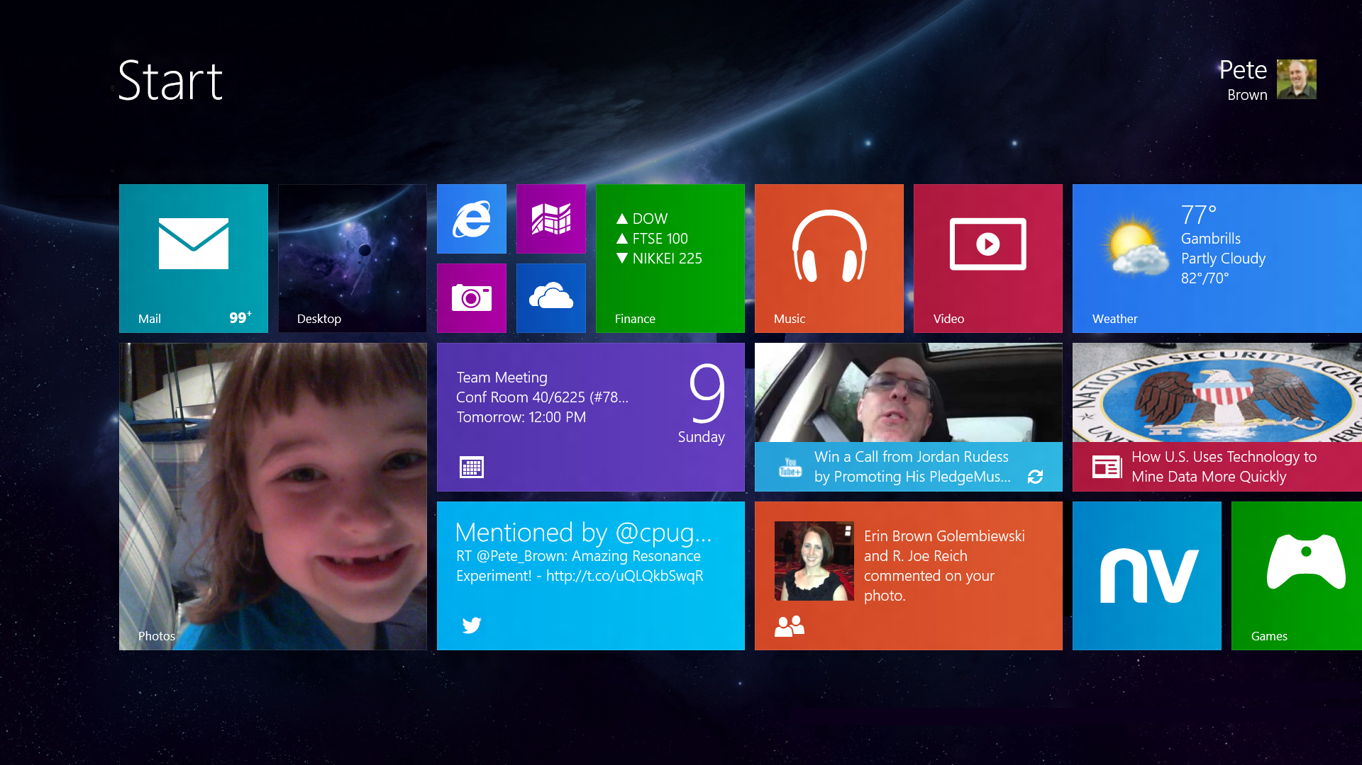
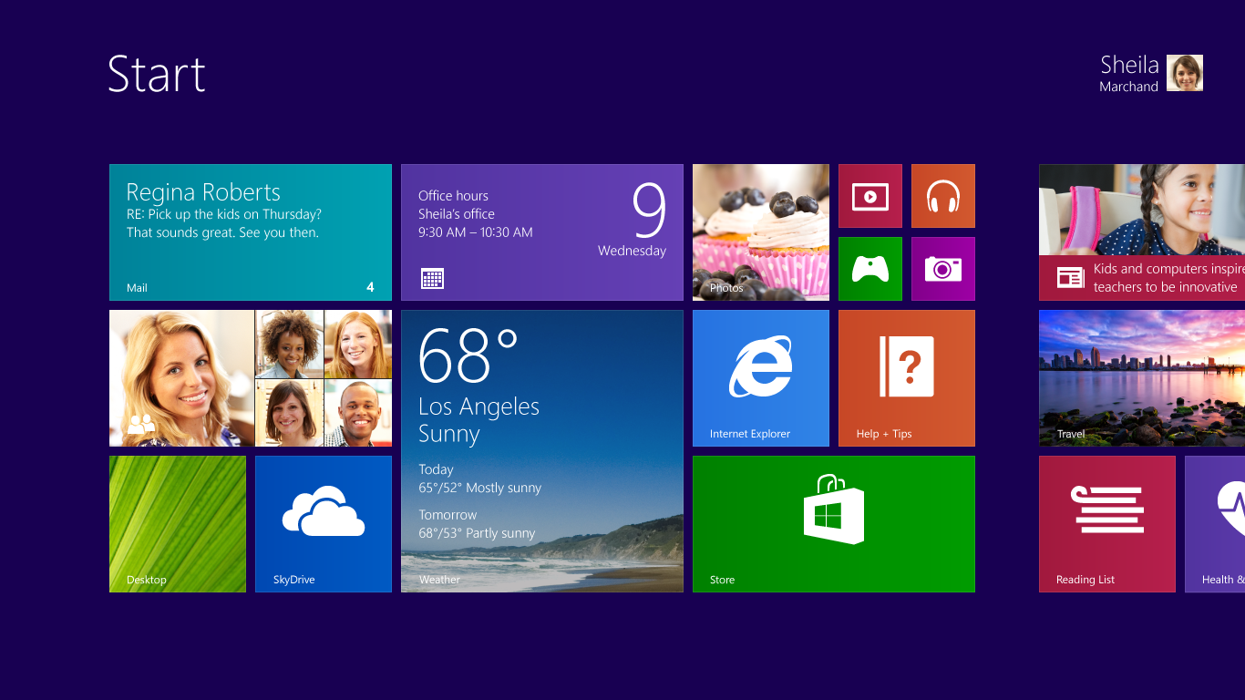

Slide 14
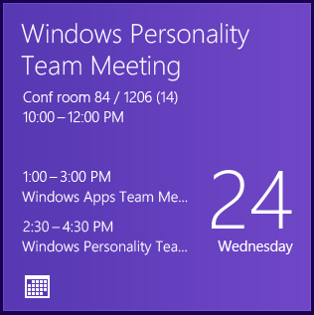
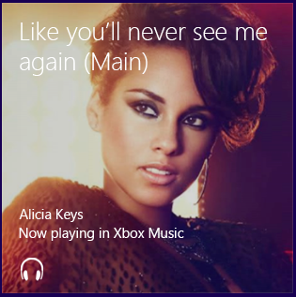
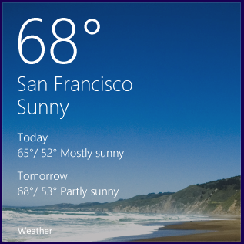
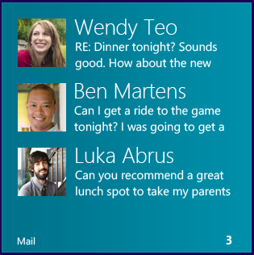
New large tile offers more opportunities for information on the Start screen

Slide 15
Use crisp tiles and images
Use built-in automatic image selection based on DPI.
Provide images in all supported DPI settings.
Tiles as well as internal app images whenever possible
Imagename.scale-100.png

Slide 16
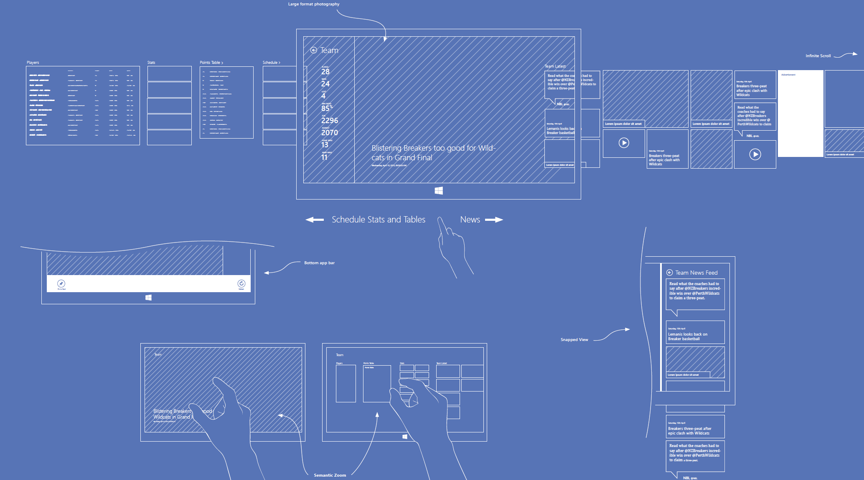

Slide 17
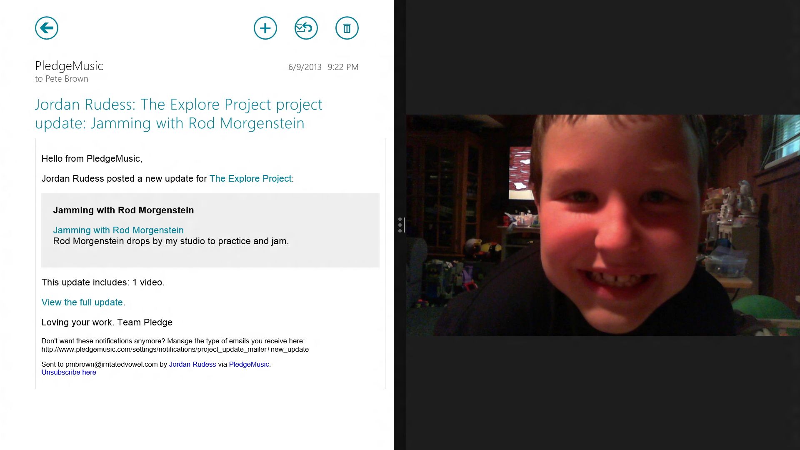
Support windowing
Support the new windowing model in Windows 8.1.
Declare and support a minimum size of 500x768 or 320x768 “taller than wide” layout with your primary experiences.
Optionally, support narrow windows 320px to 499px.

Slide 18
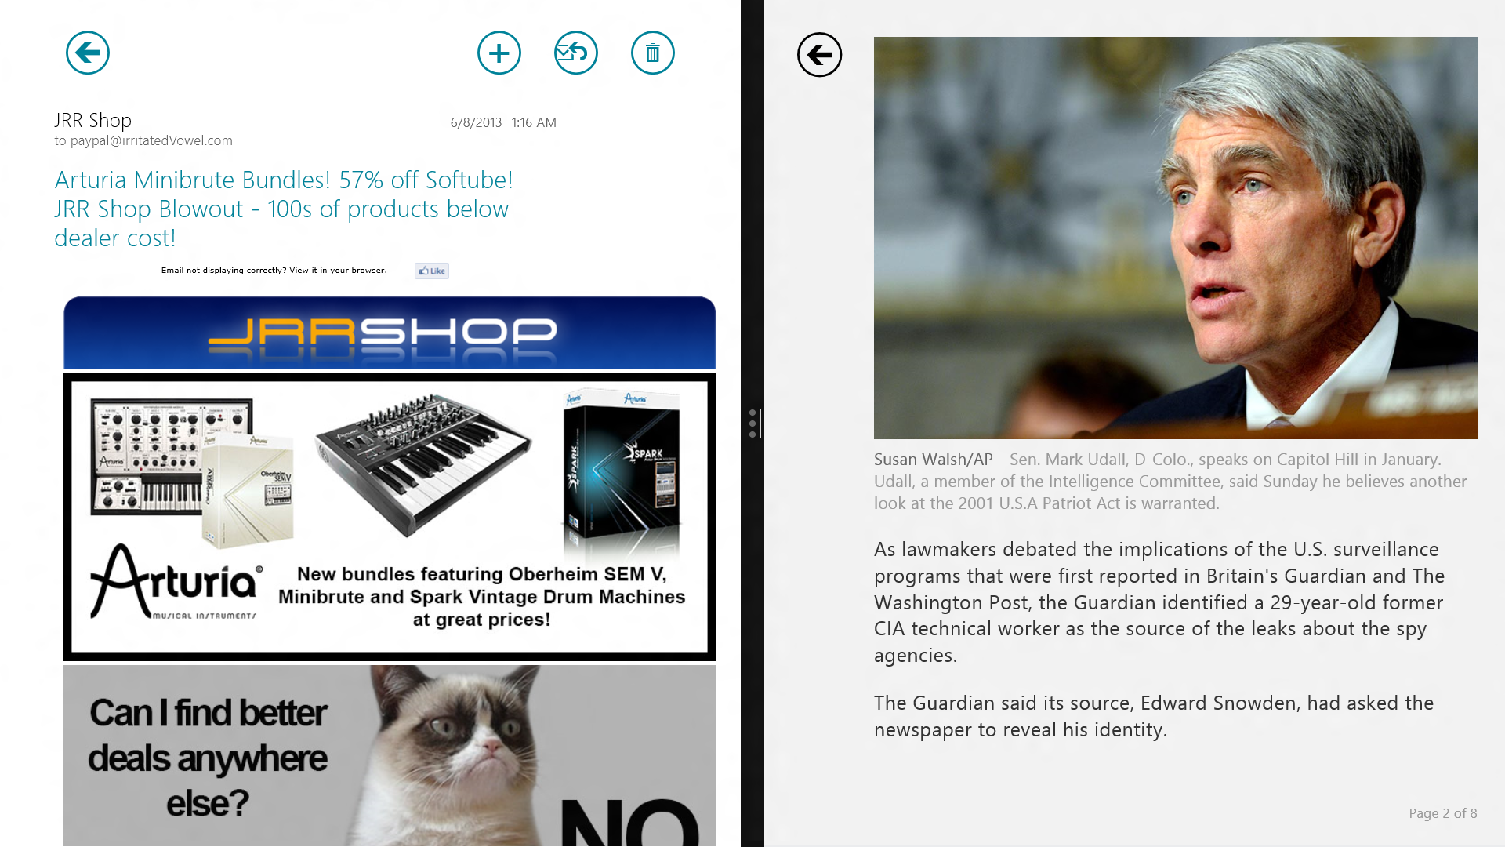
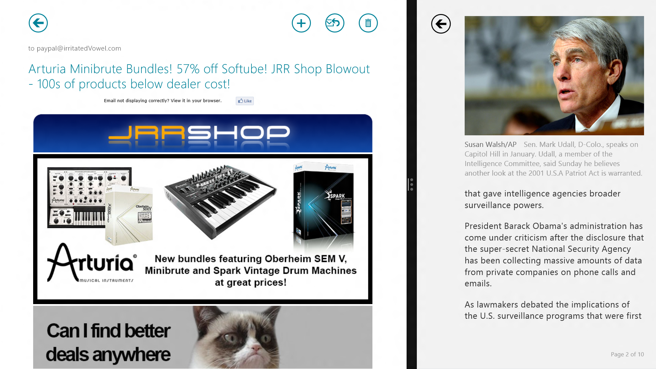
Reflow content when the window is resized.
Maintain location, selection state, focus, and panning position after reflowing.

Slide 19
Navigation bar vs. bottom app bar
Use the navigation bar for top-level navigation
Destinations within your app, back button
Bottom app bar is for commands.
Refresh, New, Add, Cancel, Pin to Start, etc.

Slide 20
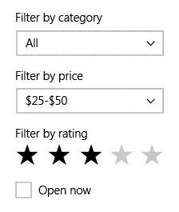
Position flyouts near command
Don’t use full-height from-the-side flyout panes except for settings from the settings charm.





List view
Map view
Sort
Filter
New plan

Slide 21
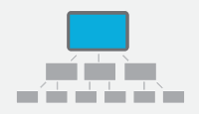
Provide a consistent navigation pattern
Use hierarchical system for apps with large collections
Use semantic zoom to move quickly through big lists
Hierarchical system
Flat system

Slide 22
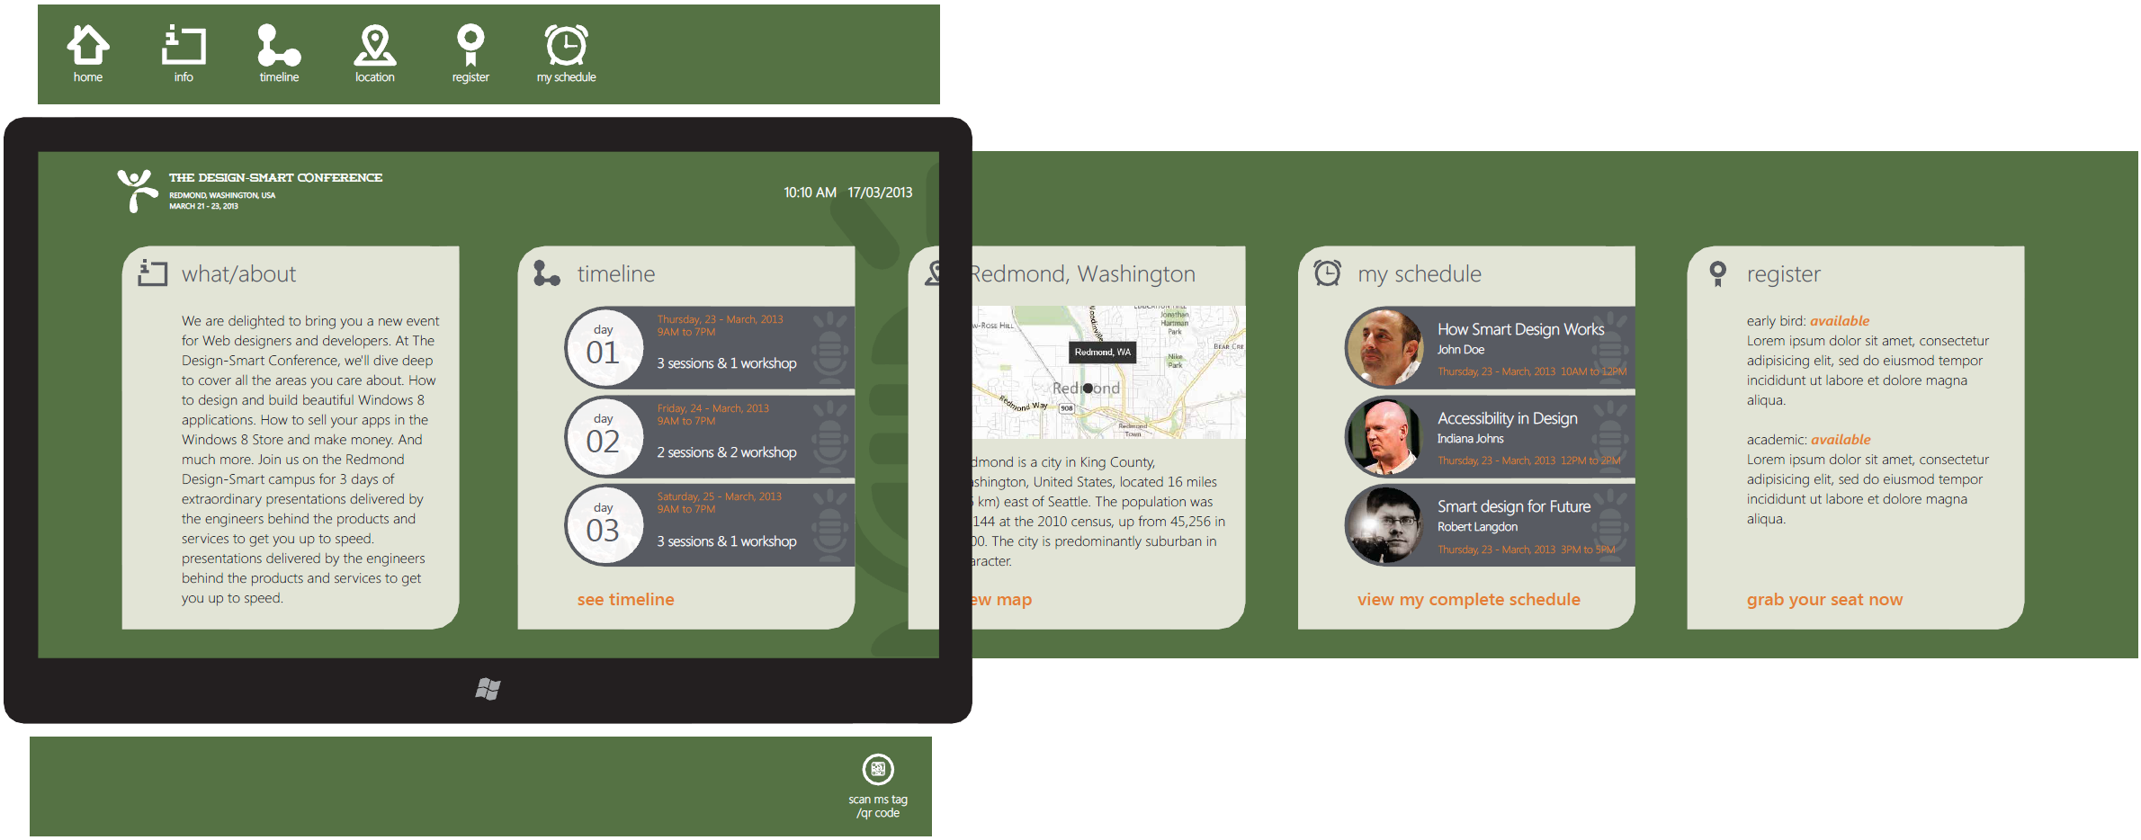

Slide 23
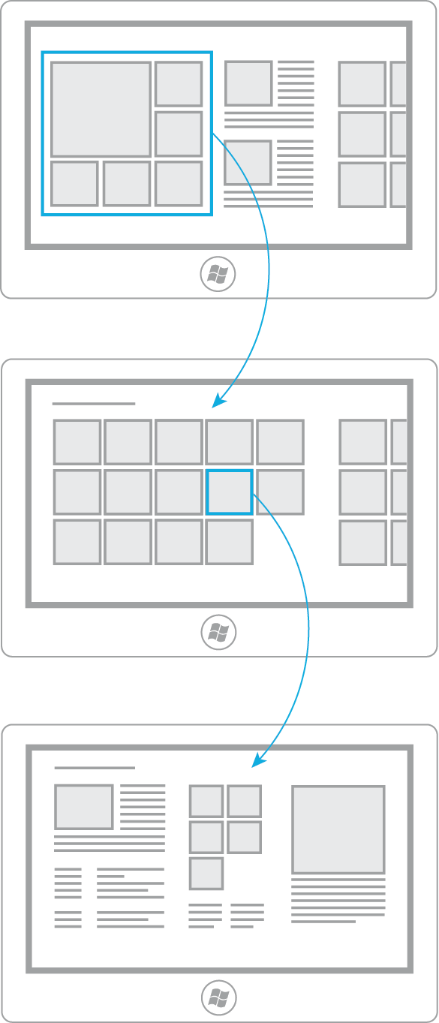
Entry point to app
Consists of different categories
Content maps to Section pages
Curated view of content
Main page
Exhaustive view of individual items within a category
Take advantage of grouping
Section
Display of an individual item
Detail

Slide 24
Back button
Be consistent in size and location across all pages in your app.
Hide if inactive (empty back stack), do not “gray out” or disable.

Slide 25
Be part of the bigger picture
Other apps
Windows
Your app
Shares to
Searches
File pickers
Opens / Saves via

Slide 26
Apps which use contracts help make the whole PC more useful.

Slide 27
Submitting with quality

Slide 28
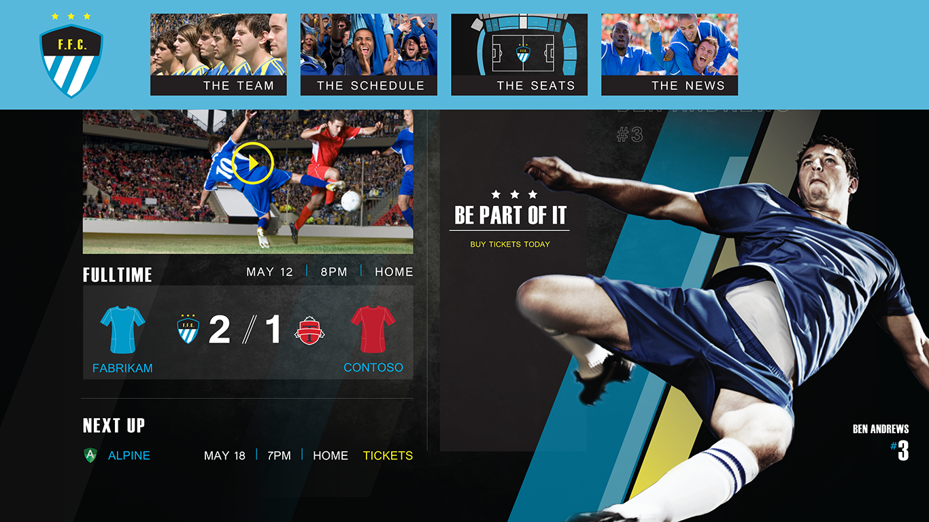
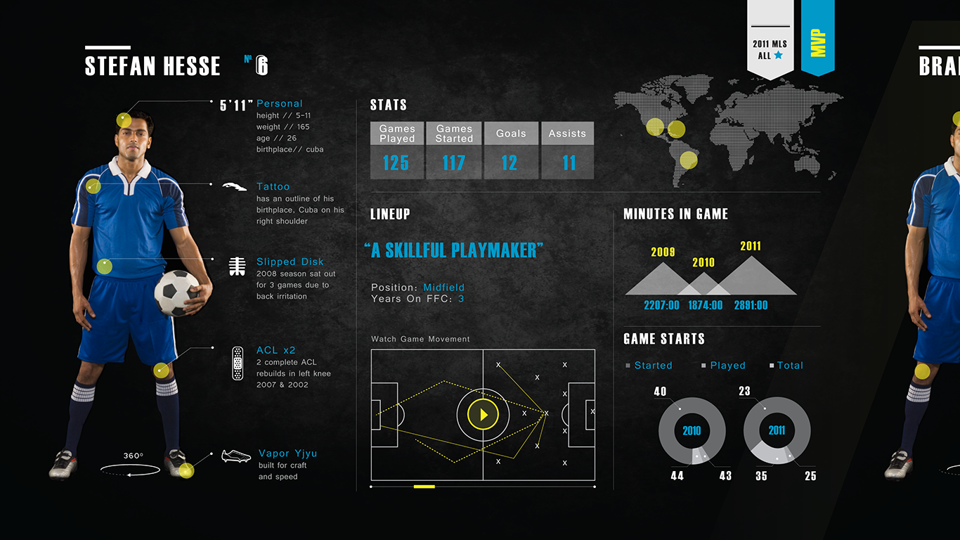
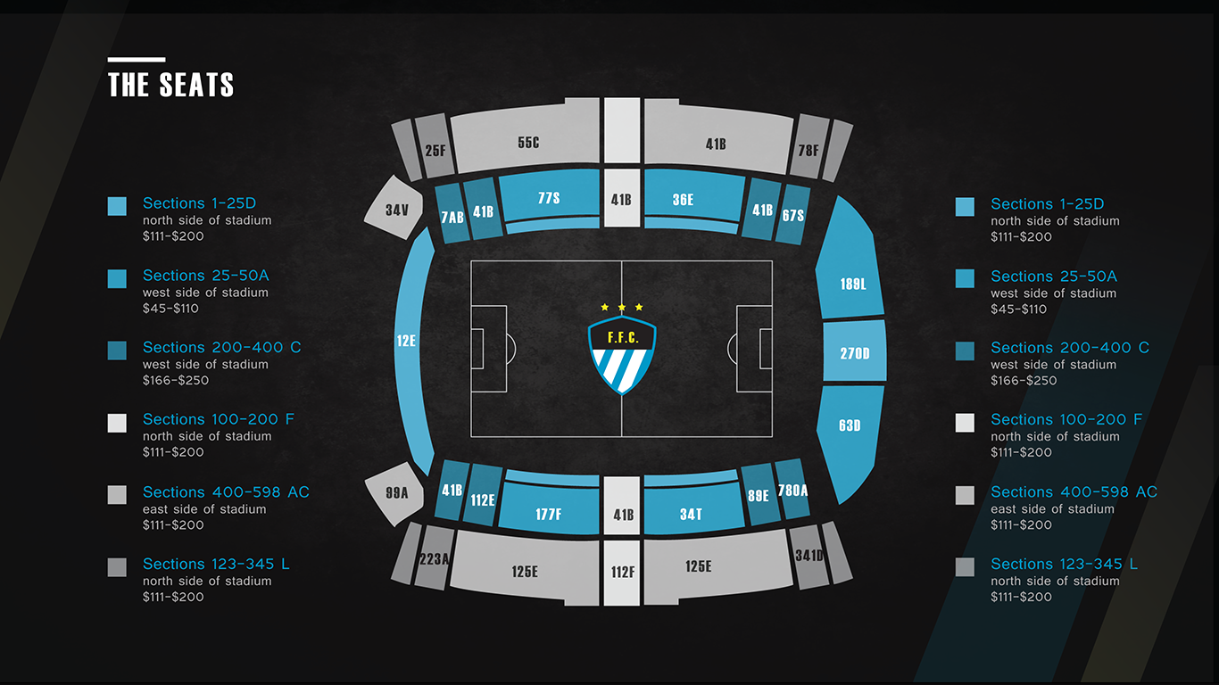
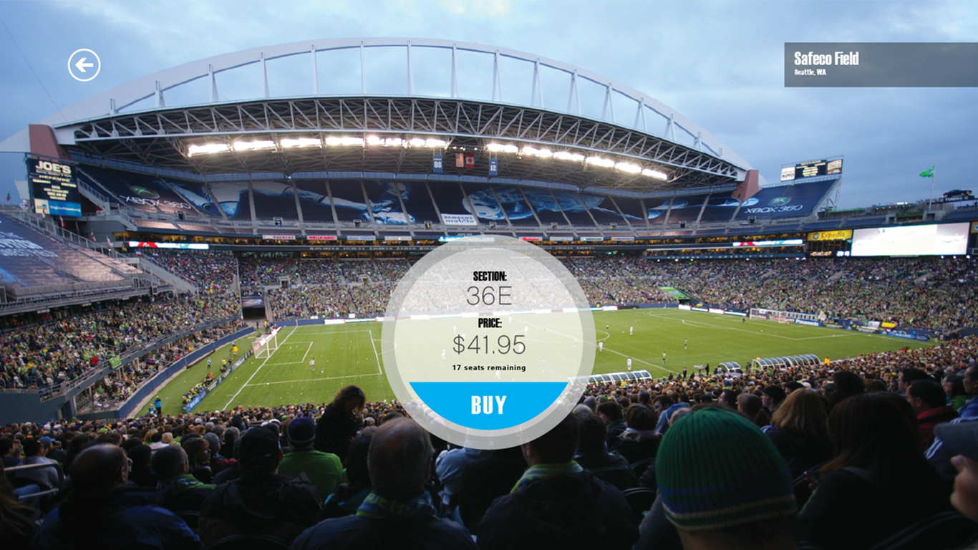
Submit awesome screenshots
The first piece of artwork is one we may use to promote your app and can include your logo or other artwork related to your app (a detail of a screenshot, or a composite of images). If you don’t want to create promo artwork, then put your best screenshot first in your submission.
Subsequent screenshots can showcase the finer details, features, and functionality of the app.
Learn more

Slide 29
Promotion assets
Always upload the promotion assets with app submission
414 x 180 (if you can do only one, make it this one)
414 x 468 (this is used more frequently in 8.1)
558 x 756
846 x 468
There is no change in promotion asset sizes from Windows 8 to Windows 8.1.

Slide 30
Promotion app tile guidelines
Small and medium size app tiles that quickly communicate your app’s brand at-a-glance work best. Clean, bold versions of your brand are easy to read and stand out well for users.
Learn more

Slide 31
Promotion assets and Live Tiles
The Windows 8.1 Store now supports a small tile plus 3 Live Tile sizes:
2 x 2 (new for Windows 8.1)
2 x 1
1 x 1
½ x ½ (static content, new in Windows 8.1)

Slide 32
Write a great description
Grab attention in the first sentences
Use lists and short paragraphs
Avoid dry language
Use a length that is just right
Be clear about trial periods and in-app purchases
Get ideas by reviewing descriptions of similar apps in the store
Don't forget to check the spelling and grammar
Avoid special characters (e.g. ****), all caps, etc. as these don’t help the user understand your app
Learn more

Slide 33
App description text examples
Jetpack Joyride
Suit up with a selection of the coolest jetpacks ever made and take to the skies as Barry…
Netflix
Netflix is the world’s leading subscription service for watching TV episodes and movies.
Learn more

Slide 34
Listing screen shots and description
Have amazing screen shots that show the app’s primary and most exciting functions.
First screen shot is most important and should ideally incorporate the screen shot, branding elements and more.

Slide 35
Support every architecture
Always provide apps which support all three architectures:
ARM
x86
x64

Slide 36
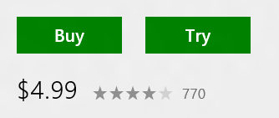
Support trial mode
Use supported trial properties and APIs, not separate “trial” and “full” apps.
In the app, consider taking the extra steps to increase conversion.

Slide 37
Be age appropriate
Apps that connect to Internet must
Include privacy policy in Settings and description
Typically set age rating to 12+ (see certification requirements)
Set content filters
If your app contains 16+ content, enable content filters in Settings and turned on by default to filter out 16+ content
Don’t include 16+ content in screen shots and promotional images

Slide 38
Help us help you
Create great apps that customers will love
Make the apps and their submissions promotion-ready

Slide 39
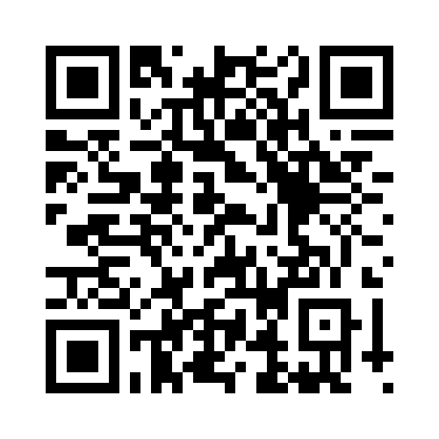
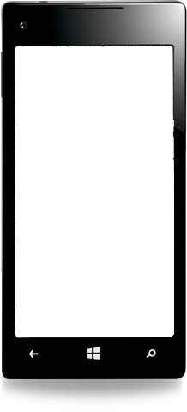
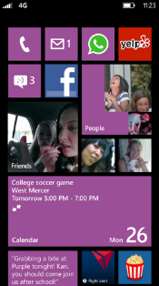
Evaluate this session
Required Slide
*delete this box when your slide is finalized
Your MS Tag will be inserted here during the final scrub.
Scan this QR code to evaluate this session and be automatically entered in a drawing to win a prize!

