Slide 2
Make your Store apps talk
Sriram Subramanian
Senior Program Manager Lead
2-171

Slide 3
Agenda
Text to speech capabilities.
Using the API.
Design and integration.

Slide 4
Evolving user experiences

Slide 5
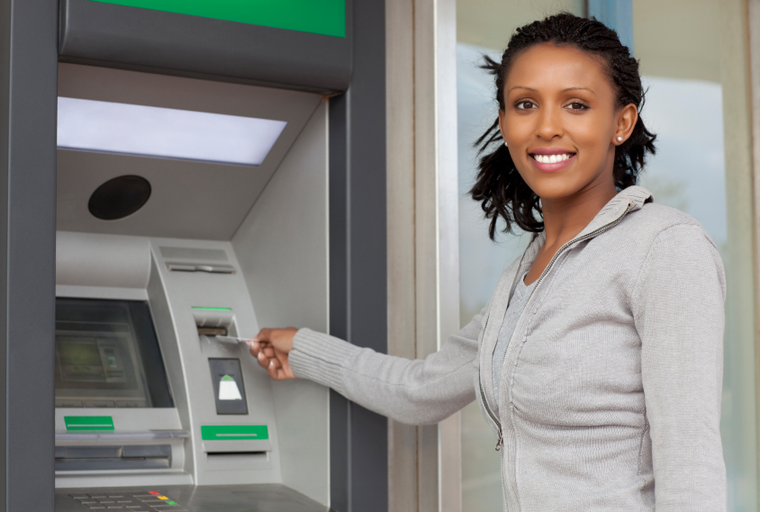
Evolving user experiences

Slide 6
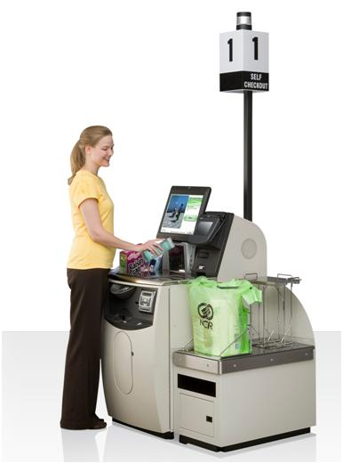
Evolving user experiences

Slide 7
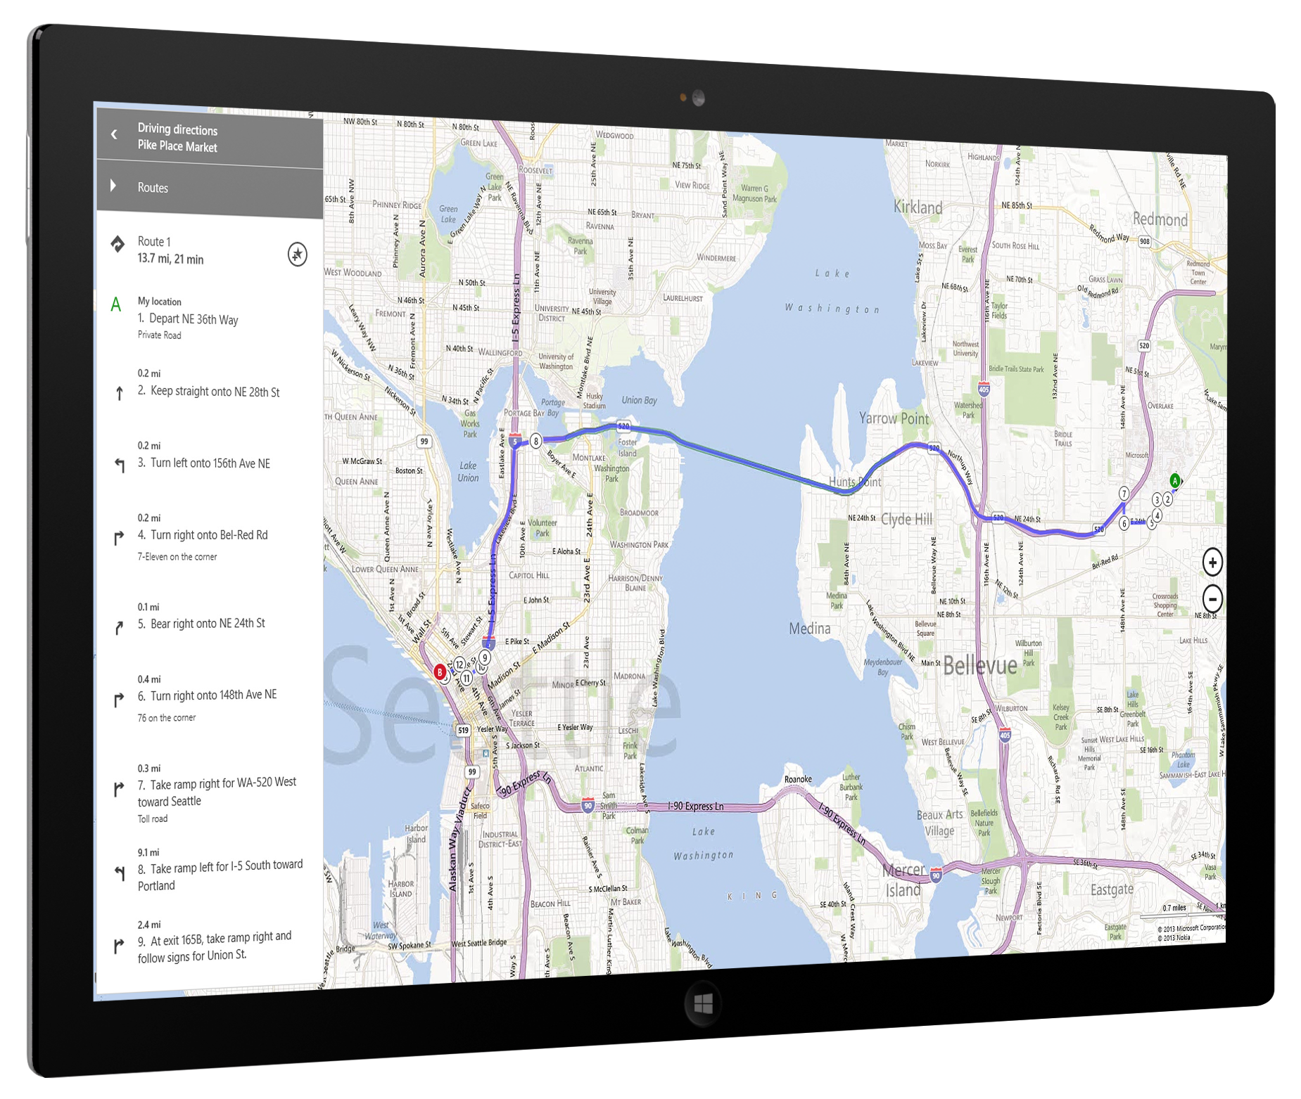
Evolving user experiences
Voice first experiences.
Eyes free experiences.
Training apps.
Background notifications.

Slide 8
Introducing text to speech in Windows 8.1

Slide 9
Text to speech demo

Slide 10
Text to speech platform features
Voice synthesis to read out text.
High quality voices with global reach.
Enhancement of the voice with rhythm, stress, and intonation.
Bookmarks and markers for control.

Slide 11
Text to speech (TTS) core API objects
SpeechSynthesizer.
SpeechSynthesisStream.
Voices.
SpeechSynthesizer
Media Element (<Audio/>)
SpeechSynthesisStream
Text
Voices

Slide 12
Speech synthesis code walkthrough

Slide 13
Fine tuning with SSML

Slide 14
When is tuning required?
Adjust prosody.
Intonation, rhythm, and speaking rate.
Pause at natural points in larger text content.
Flexibility to adjust pronunciations for app scenarios.
Date vs. fraction.
Abbreviations.

Slide 15
Using SSML to tune voice
W3C standard.
Attributes to control pronunciation, pitch, rate, etc.
Process SSML tagged text using SpeechSynthesizer.
SpeechSynthesizer.SynthesizeSsmlToStreamAsync.

Slide 16
Code walkthrough with SSML

Slide 17
Languages and voices

Slide 18
17 voices
16 locales

Slide 19
Spanish demo

Slide 20
Markers

Slide 21
Markers
Used to reference a specific location in the text sequence.
Enables interactive experiences.
Logical or user-set bookmarks.
Highlight sentences as they are read.

Slide 22
How to use markers
Use SSML <mark> element to define them in the input text.
SpeechSynthesizer generates the audio stream with markers.
Audio element fires an event when marker is reached.

Slide 23
Put the user always in control
Design guidelines for voice experiences
Use System Media playback controls.
Use the AppBar to expose the additional controls.
Use different voices when appropriate.

Slide 24
Final thoughts

Slide 25
Enable voice in your apps
Consider using voice
Use TTS APIs and platform
Reach global audience

Slide 26
Resources
TTS API reference:
http://msdn.microsoft.com/en-us/library/windows/apps/windows.media.speechsynthesis.aspx
Speech synthesis sample: http://go.microsoft.com/fwlink/?LinkID=306721&clcid=0x409

Slide 27
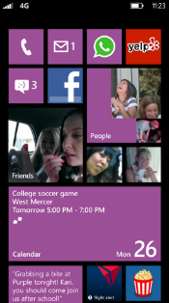
Evaluate this session
Required Slide
*delete this box when your slide is finalized
Your MS Tag will be inserted here during the final scrub.
Scan this QR code to evaluate this session and be automatically entered in a drawing to win a prize!

