Slide 2
C++ in Windows Phone Apps
Tim Laverty
timlav@microsoft.com
@timlaverty
Program Manager, Developer Platform
2-211

Slide 3
Platform Momentum Since Launch
Apps
160k+
More Downloads
155%
Store available in 50 languages and 191 markets
More Revenue
124%
Increase in monthly app download volume
More developers
Increase in monthly paid app revenue volume
102k+
More apps
52k+
New registered developers
New apps submitted with Windows Phone 8 SDK
As of 6/21/13
Source: Windows Phone Store. Period: 10/30/12 – 5/31/13
Source: Windows Phone Store. Period: 10/30/12 - 1/31/13

Slide 4
We Have a Full Featured App Platform
App to App Communication
Background Audio
Design Principles
XAML
Pages & Navigation
VoIP
Files and Storage
Video
Native Code Reuse
HTTP Networking
Sockets
C#
Compass
Camera
App Model
Bluetooth
Application Lifecycle
Background Agents
Lenses
Location
Maps
Proximity
File Associations
Wallet
Speech
Live Tiles
VB.NET
Launchers & Choosers
Lock Screen Wallpaper
In-App Purchase
Data
Lock Screen and Notifications
Push Notifications
Hubs
DirectX Interop
Trial
Controls
Enterprise
WebBrowser
DevCenter

Slide 5
We Have a Full Featured App Platform
App to App Communication
Background Audio
Design Principles
XAML
Pages & Navigation
VoIP
Files and Storage
Video
Native Code Reuse
HTTP Networking
Sockets
C#
C++
Compass
Camera
App Model
Bluetooth
Application Lifecycle
Background Agents
Lenses
Location
Maps
Proximity
File Associations
Wallet
Speech
Live Tiles
VB.NET
Launchers & Choosers
Lock Screen Wallpaper
In-App Purchase
Data
Lock Screen and Notifications
Push Notifications
Hubs
DirectX Interop
Trial
Controls
Enterprise
WebBrowser
DevCenter

Slide 6
C++ Support

Slide 7
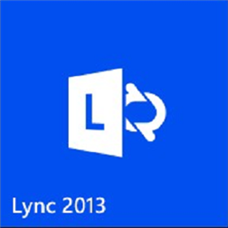
Top Apps and games that use C++

Slide 8
Welcome back to C++!

Slide 9
Agenda
How & Where C++ is supported
When and why to use C++
Introduction to the Windows (Phone) Runtime
Sharing C++ code across platforms

Slide 10
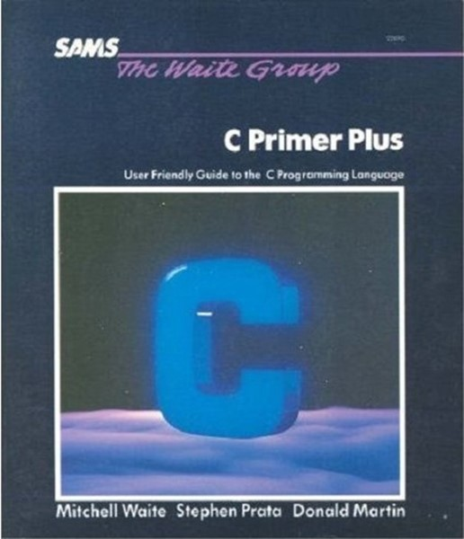
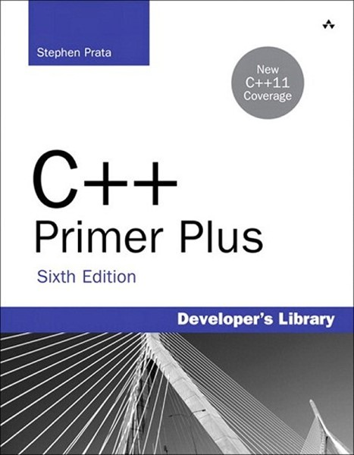
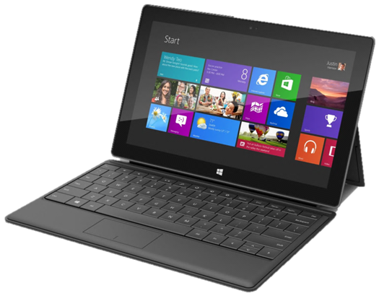
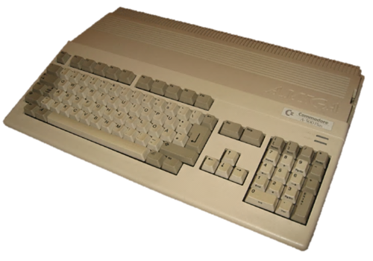

Slide 11
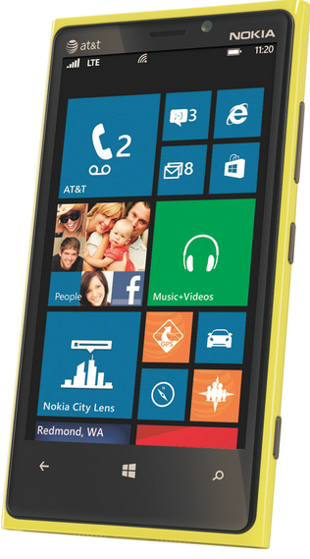
How: Windows Phone C++ Support
Can be used in any Windows Phone App
Visual Studio Express 2012 for Windows Phone
Same C++ compiler & CRT used in Windows 8
Subset of C++ 11 standard features

Slide 12
Sampling of C++ 11 Standard Features
RValue references | Forward declared enums | Bidirectional fences
static_assert | Alignment | Data-dependency ordering
Auto | Standard-layout and trivial types | exception_ptr
Trailing return types | Extended friend declarations | Thread-local storage
Lambdas | Local and unnamed types as template arguments | __func__
Decltype | Range-based for-loop | C99 preprocessor
Right angle brackets | override and final | long long
extern templates | Minimal GC support | Strongly typed enums
nullptr | Atomics
http://blogs.msdn.com/b/vcblog/archive/2011/09/12/10209291.aspx

Slide 13
Quick tour of C++ features

Slide 14
Where you can use C++
All Windows Phone 8 apps can use native code…
Pure native D3D apps/games
XAML apps mixed with D3D and WinRT
C++ libraries: Dynamic Link Libraries, Static Libs
WinRT C++ Components
...not all apps need to use native code

Slide 15
Why use C++
1
Portability
2
Reusability
3
Performance

Slide 16
Introduction to the Windows Phone Runtime
Why learn about WinRT?
WinRT is used in the application model
C++ code called from XAML uses WinRT
Phone Platform APIs are built using WinRT

Slide 17
What is the Windows Runtime?
Infrastructure:
Core plumbing
Common type system
Standard programming model
APIs:
Windows Phone Platform APIs
Libraries you write and license
Projected to C++ and C# / VB

Slide 18
WinRT In Action

Slide 19
Sharing C++ code across Platforms
With Windows 8
Windows Runtime
Win32 DLLs and Static Libs
With iOS and Android:
Standard C and C++
OSS and other Common libraries
Gaming and Middleware providers
Unity, Havok, Cocos2D, Marmalade, FMOD, Wwise, …

Slide 20
Using SQLite

Slide 21
Key takeaways
All Windows Phone 8 apps can use C++
C++ enables portability, code reuse, and best in class performance
Download the SDK and build native apps!

Slide 22
 | Wednesday |  |  |  | Thursday |  | Friday
09:00 | Keynote |  |  |  | Keynote |  | PH 2-222 WP Networking Peter Torr North 134
09:30
10:00
10:30 |  |  |  |  |  |  | PH 2-211 Using Native in your apps Tim Laverty South 102 | PH 2-216 WP Dev Best Practices Stefan Wick North 134
11:00
11:30 | PH 2-201 Intro to WP Dev Sam George North 134 |  | PH 2-202 WP Design for Dev Corrina Black North 135 |  | PH 2-206 WP Tiles, Lock, Notifications Thomas Fennel North 134
12:00 |  |  |  |  |  |  | PH 2-205 WP: MVVM in Practice Matthias Shapiro North 134
12:30
13:00
13:30
14:00 | PH 2-204 WP App Foundation Thomas Fennel North 134 |  |  |  | PH 2-215 Build for Both Win 8 and WP8 Matt Hidinger North 134 |  | PH 2-212 WP Cross App Comms Sean McKenna South 222 | PH 2-220 WP Map Apps Mike O’Malley North 134
14:30
15:00
15:30 | PH 2-210 WP Camera app Berthier Lemieux North 134 |  | PH 2-213 Maximize Revenue Bernardo Zamora North 135 |  | PH 2-219 Story of Nokia Music from WP to Win 8 Matthew Cooper North 134
16:00
16:30
17:00 | PH 2-207 WP Game Basics Joao Raza South 304 | PH 2-208 WP UI in XAML Shawn Oster North 134 |  | PH 2-208 WP Middleware JC Cimetiere North 132 | PH 2-221 WP Low Memory Andrew Whitechapel North 135 | PH 2-218 WP Contest Panel Panel North 123
17:30

Slide 23
Developer resources
MSDN DOCS
Design | http://aka.ms/wp8devdesign
Develop | http://aka.ms/wp8devdoc
Test | http://aka.ms/wp8testing
Publish | http://aka.ms/wp8publishing
Samples | http://aka.ms/wp8samples
NEWS & UPDATES
Portal | http://dev.windowsphone.com
Blog | http://wpdev.ms/developerblog
Channel 9 | http://wpdev.ms/insidewp
Twitter | http:/twitter.com/wpdev
TRAINING CONTENT
Absolute Beginners | http://wpdev.ms/beginvids
Jump Start | http://aka.ms/wp8js
Design Boot Camp | http://aka.ms/wp8designbootcamp
Training Kit | http://aka.ms/wp8hol

