Slide 2
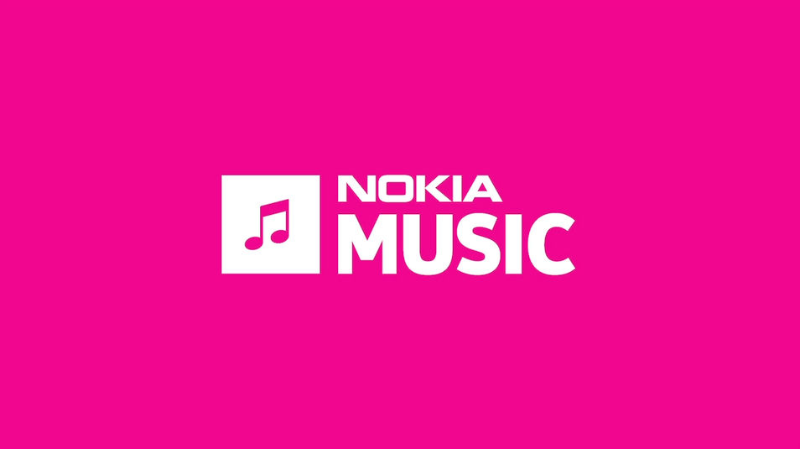

Slide 3
Nokia Music is, like, awesome

Slide 4
The Story of Bringing Nokia Music to Big Windows
Matt Cooper, Ben Buttigieg, Craig Pugsley
Senior Architect, Senior Code Monkey, Principle Pixel Pusher
Nokia Music, Bristol, UK
2-219

Slide 5

Agenda
Where we started
Design approach
Architecture approach
Development challenges
Design tips and tricks

Slide 6
Nokia Music for Windows Phone demo

Slide 7
Windows Phone design

Slide 8
Information Architecture
Central application hub with home page menu

Slide 9
Information Architecture for Nokia Music

Slide 10
Information Architecture for Nokia Music

Slide 11
Original architecture

Slide 12
Windows Phone Application Architecture
Windows Phone 7 Application
Windows Phone 8 Application
Views
Views
View Models
View Models
Models
Models
Shared Libraries (WP7)
API Wrapper
Utilities and Business Logic
Nokia Music REST API

Slide 13
Target architecture

Slide 14
Target Architecture
Windows Phone 7 Application
Windows Phone 8 Application
Windows 8 Application
Views
Views
Views
Platform Specifics
Platform Specifics
Platform Specific
Shared Libraries (PCL)
View Models
Models
API Wrapper
Utilities and Business Logic
Platform Abstraction Interfaces
Nokia Music REST API

Slide 15
REST API and C# APIs
WP7 API
WP8 API
Win 8 API
Shared Libraries (PCL)
API Wrapper
Public API wrapper
Public API wrapper
Public API wrapper
Nokia Music REST API
Public REST API

Slide 16
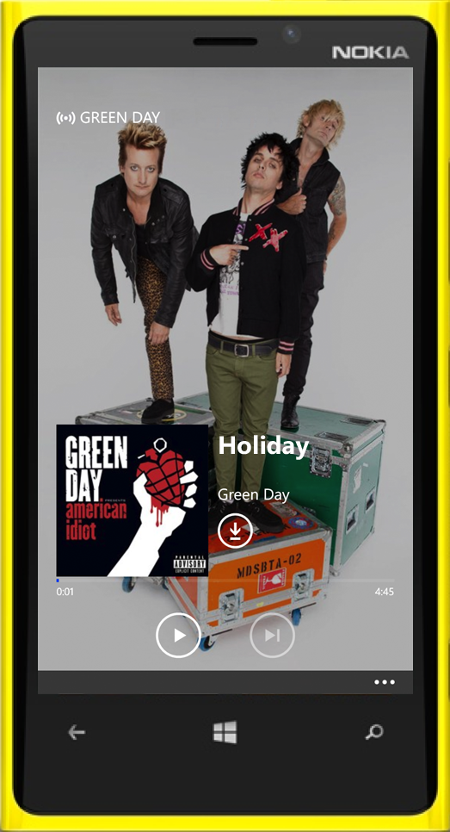
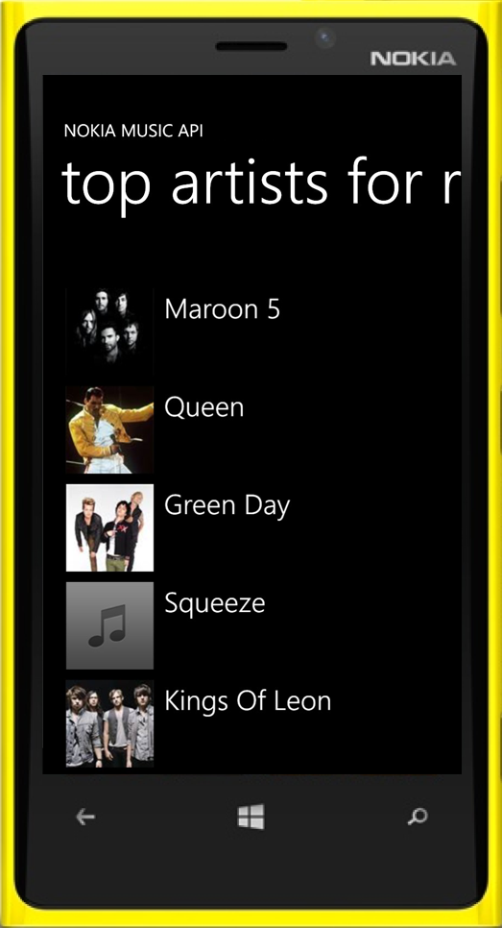
Nokia Music C# API
Makes it easy for you to integrate music data into your app.
MusicClient api = new MusicClient(AppId);
var artists = await api.GetTopArtistsAsync();
list.ItemsSource = artists.Result;
// when user selects artist...
artist.PlayMix();

Slide 17
Initial design approach

Slide 18
Design Principles
Know what’s important.
It helps when making design decisions.
SIMPLE
Supreme ease of use from FTU onwards
No registration. Click: play
DELIGHTFUL
Content is king
Personally relevant
EFFORTLESS
Focus on the casual user
LOVE THE PLATFORM

Slide 19
Know HOW you’re going to be used

Slide 20
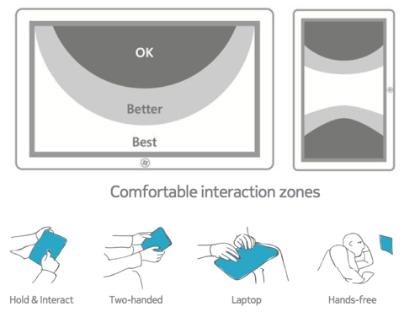
Ergonomics & Gestures
Microsoft have lots of information on this in their design guidelines.

Slide 21
Know WHERE you’re going to be used

Slide 22
Know WHO will be using your app

Slide 23
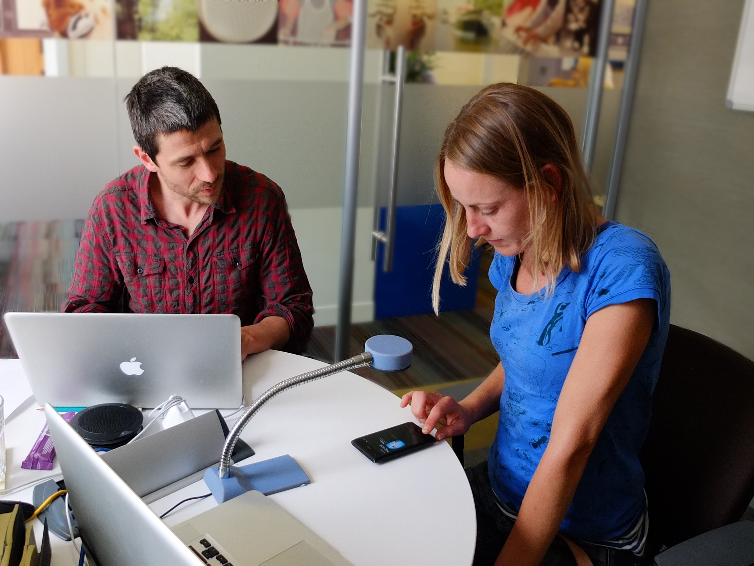

Slide 24
“If you want a great site, you’ve got to test. After you’ve worked on a site for even a few weeks, you can’t see it freshly anymore. You know too much. The only way to find out if it really works is to test it.”
- Steve Krug Krug, Don't Make Think: A Common Sense Approach to Web Usability

Slide 25
What we did first

Slide 26
Cut-out-and-stick IA demo

Slide 27
WP8 <> W8 demo

Slide 28
The harsh reality…

Slide 29
Original Windows 8 application architecture
Nokia Music REST API
Windows Phone 7 Application
Windows Phone 8 Application
Windows 8 Application
Views
Views
Views
View Models
View Models
View Models
Models
Models
Models
Shared Libraries (WP7)
Windows 8 Libraries
API Wrapper
API Wrapper
Utilities & Business Logic
Utilities & Business Logic

Slide 30
Current application architecture
Nokia Music REST API
Windows Phone 7 Application
Windows Phone 8 Application
Windows 8 Application
Views
Views
Views
View Models
View Models
View Models
Models
Models
Models
Shared Libraries (WP7)
Portable Libraries
API Wrapper
API Wrapper
Utilities & Business Logic
Utilities & Business Logic

Slide 31

Ben Buttigieg
(Senior code monkey)

Slide 32
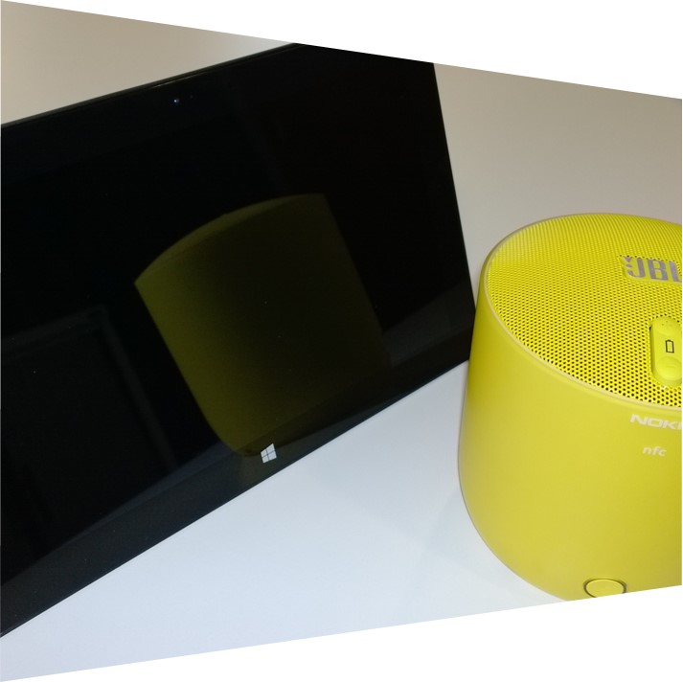
Connected Standby
What is it?
What was the problem?
What was the solution?

Slide 33
Connected Standby Flow
Screen ON
Screen OFF
Screen ON
Network ON
Network ON
Network ON
Low Power Audio Platform State
Low Power Audio Platform State
Song 1
Song 2
Device enters connected standby. Screen shuts off, device enters lowest power mode that supports audio playback.
MediaElement opens network connection and starts buffering Song 2.
We use this is our opportunity to request next set of tracks to stream.
MediaElements indicates that it no longer requires network connection so device re enters low power audio playback mode and drops network connection. Any requests made after this point is likely to cause the app to be terminated.
Device exits connected standby. Screen turns on and network is brough out of it’s low power state.

Slide 34
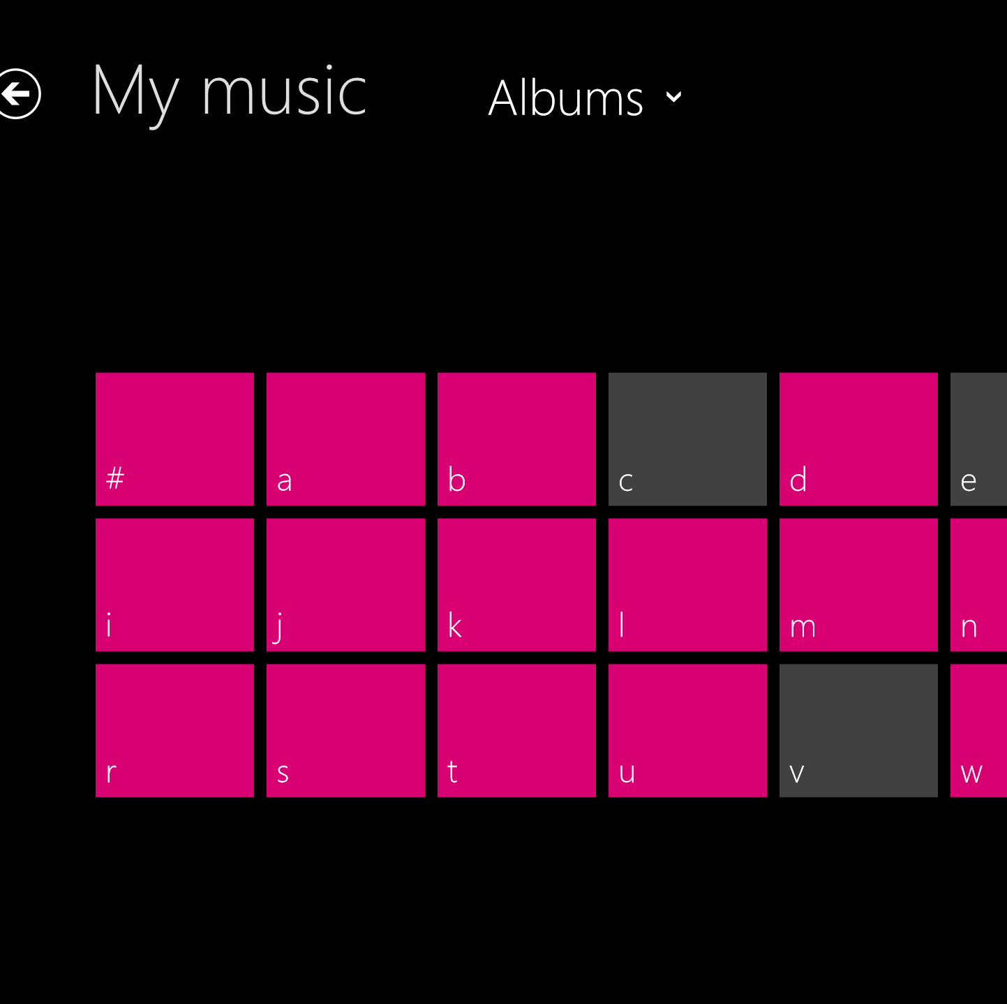
Semantic Zoom
What is it?
What was the problem?
What was the solution?

Slide 35
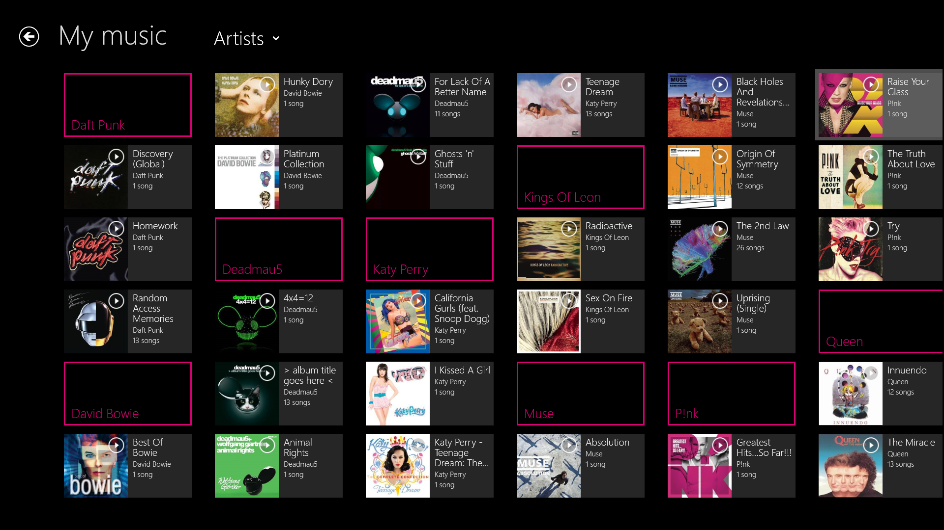

Slide 36
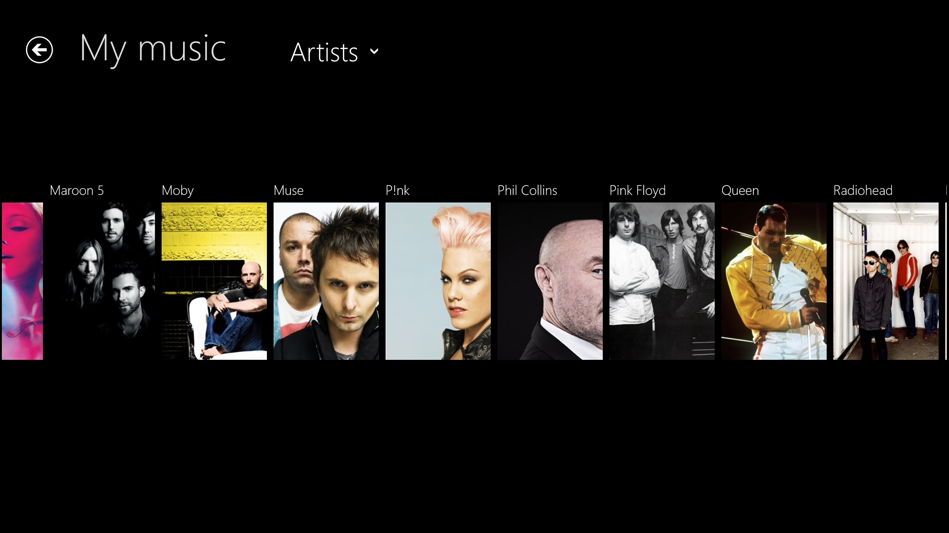

Slide 37
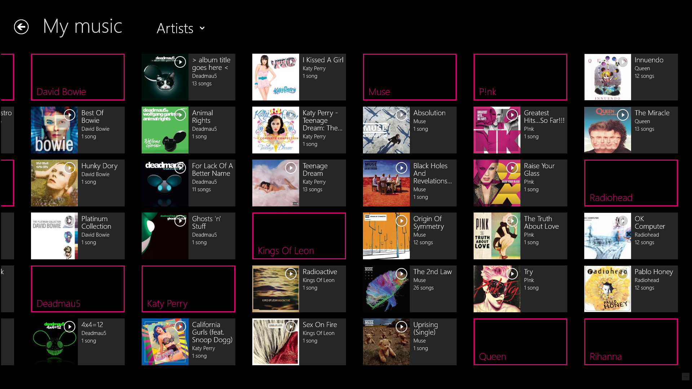

Slide 38
Typical Semantic Zoom Implementation
XAML
SemanticZoom views bound to CollectionViewSource used to perform the sorting and grouping. Automatically synchronizes scroll position when switching between the two views.
SemanticZoom Control
Zoomed In View
Zoomed Out View
CollectionViewSource
Model
Database

Slide 39
Our Semantic Zoom Implementation
XAML
Dedicated virtualized collections with no grouping and bound to each view independently.
Ensures virtualisation can still be enabled. But requires scroll position to be manually synchronised between views.
SemanticZoom Control
Zoomed In View
Zoomed Out View
Albums Virtualized Vector
Task<int> GetCountAsync();
Task<T> GetItemAsync(int index);
int GetIndexOf(T item);
Artists Virtualized Vector
Task<int> GetCountAsync();
Task<T> GetItemAsync(int index);
int GetIndexOf(T item);
Database

Slide 40
Top 10 design tips & tricks

Slide 41
Top 10 design tips & tricks
Make some principles
Make your app consistent

Slide 42
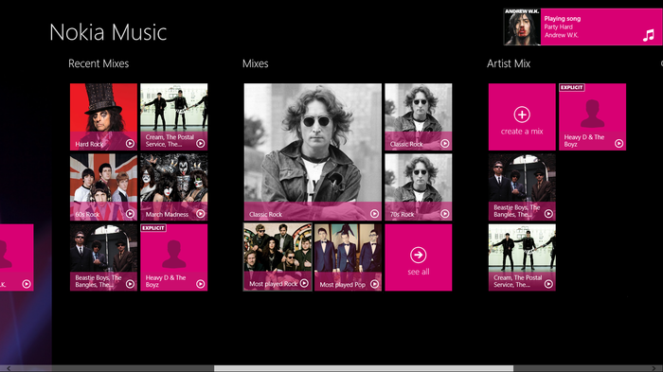
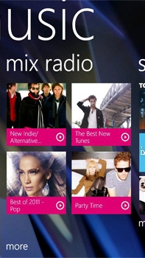
Consistent Brand Experience
Share:
visual styles
iconography
naming conventions
copy style

Slide 43
Top 10 design tips & tricks
Make some principles
Make your app consistent
READ THE GUIDELINES!

Slide 44
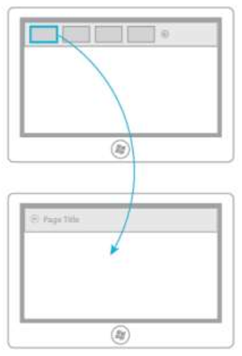
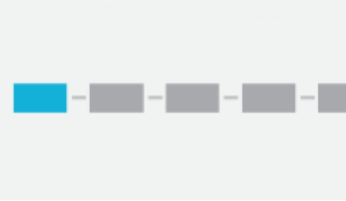
Understand Windows 8 Interaction Models
FLAT

Slide 45
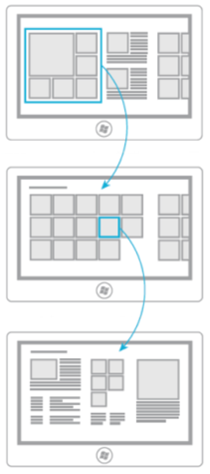
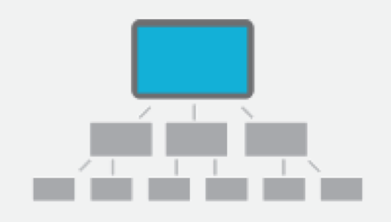
Understand Windows 8 Interaction Models
HEIRARCHICAL

Slide 46
Top 10 design tips & tricks
Make some principles
Make your app consistent
READ THE GUIDELINES!
Use the apps
Don’t fear long Hubs

Slide 47
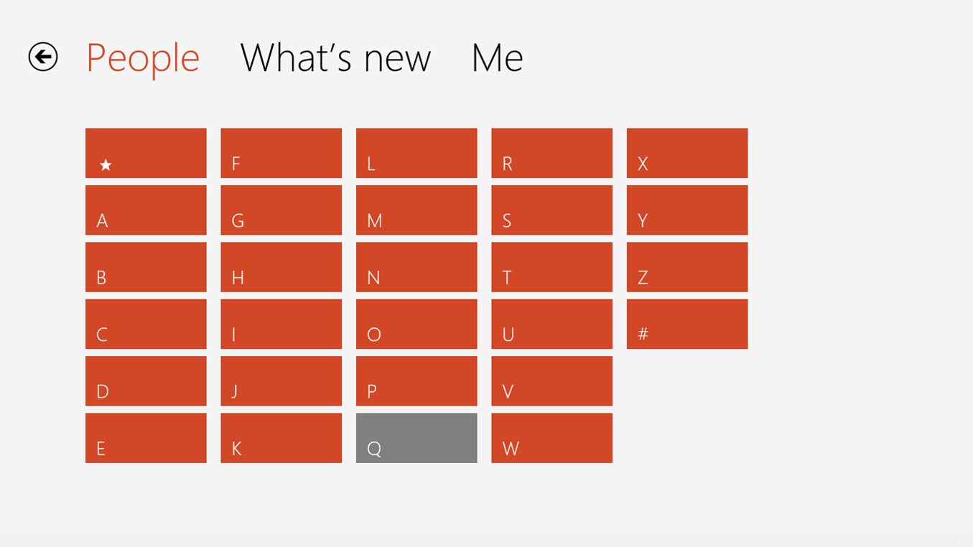

Slide 48
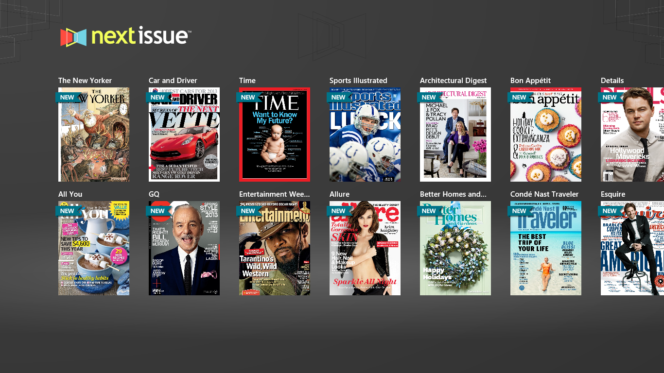

Slide 49
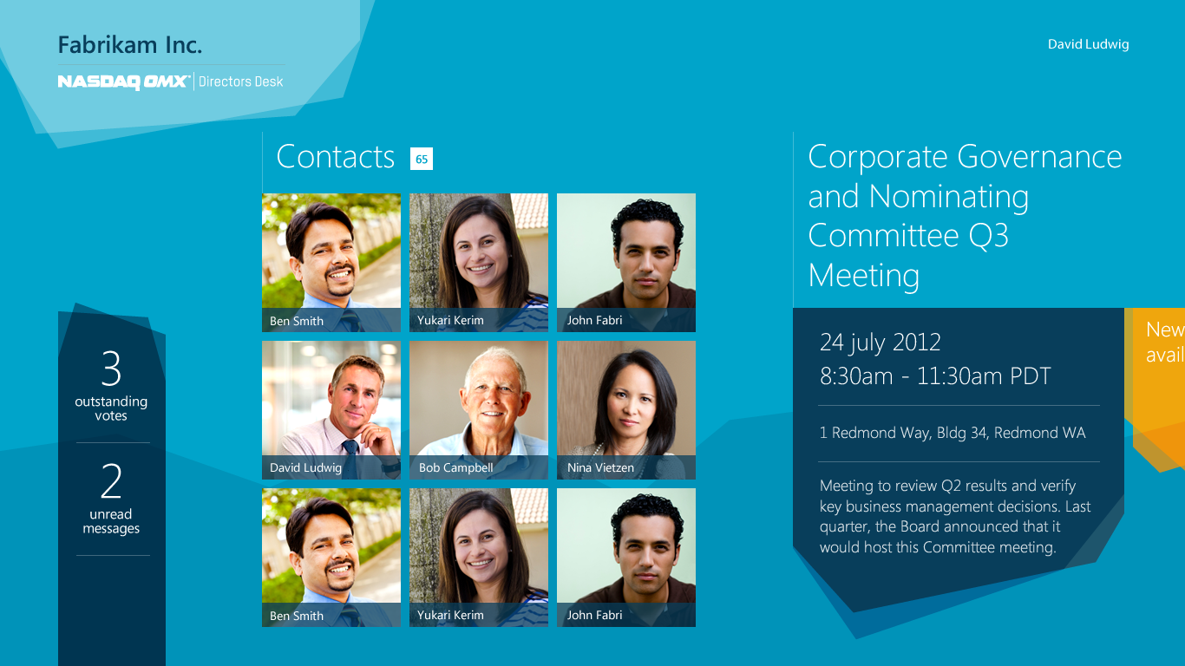

Slide 50
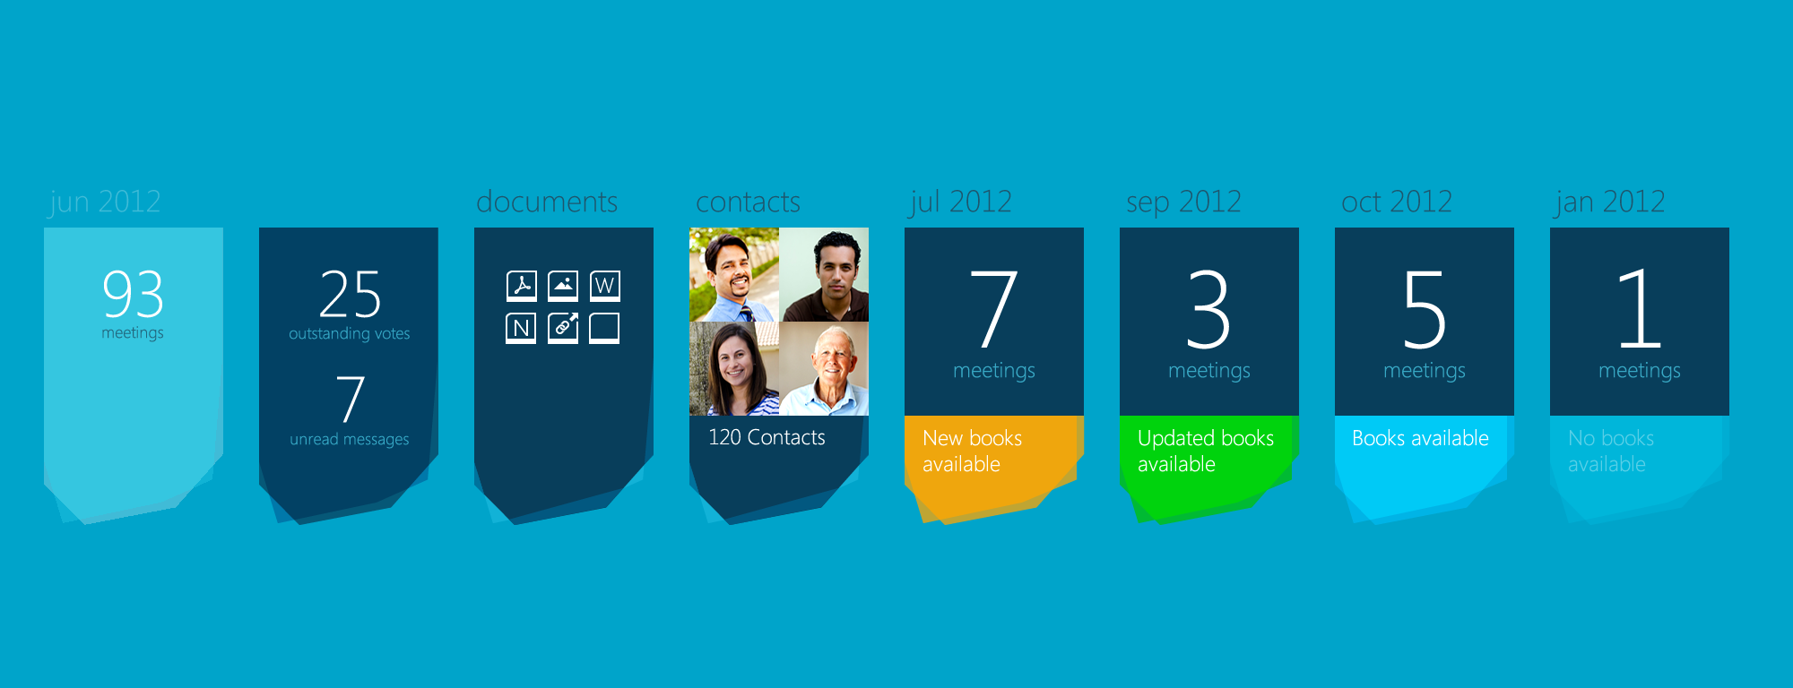

Slide 51
Top 10 design tips & tricks
6. Sweat the details
7. Know how components map
8. Flatten your IA
9. Be aware of resolution & scaling

Slide 52
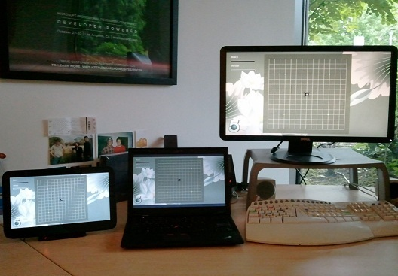

Slide 53
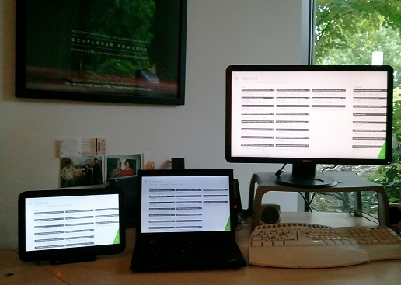

Slide 54
Top 10 design tips & tricks
6. Sweat the details
7. Know how components map
8. Flatten your IA
9. Be aware of resolution & scaling
10. Leave snap view to last

Slide 55
That’s it!

Slide 56
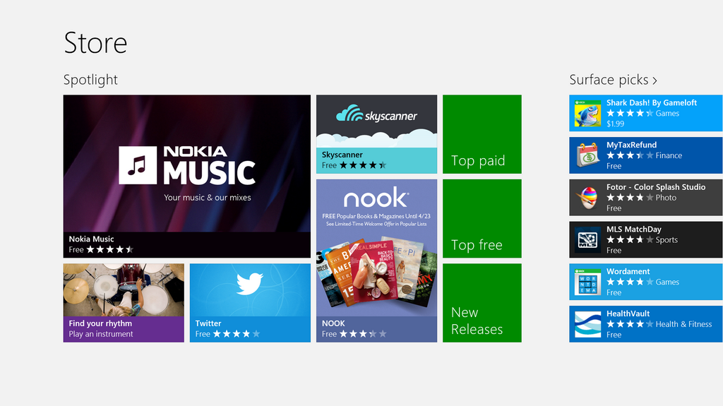

Slide 57
Q&A

Slide 58
Resources
Windows 8 Design Guidelines
http://msdn.microsoft.com/en-us/library/windows/apps/hh779072.aspx
Nokia Music API
http://nokia.ly/wpmusicapi
@craigpugsley
@benbtg
@mcooperg

Slide 59
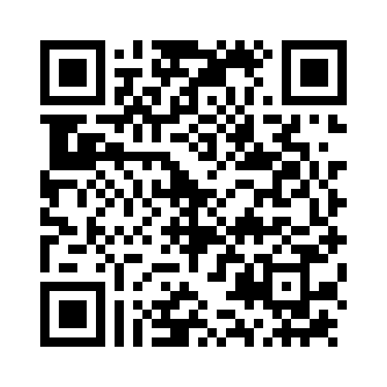
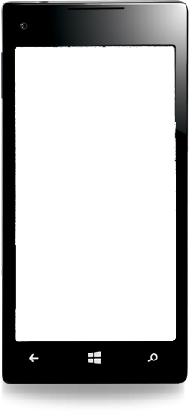

Evaluate this session
Required Slide
*delete this box when your slide is finalized
Your MS Tag will be inserted here during the final scrub.
Scan this QR code to evaluate this session and be automatically entered in a drawing to win a prize!

