Slide 2
Networking in Windows Phone 8
Peter Torr
Program Manager, Windows Phone Developer Platform
2-222

Slide 3
Agenda
HTTP
Sockets
Proximity
Tips and Tricks

Slide 4
Choosing the Right API

Slide 5
Windows 8.x
.NET HttpClient
Windows Phone 8 Platform
WinRT Sockets
Desktop .NET
WCF
.NET Sockets
Windows Phone 7.x
WebClient
HttpWebRequest
Legacy C++
IXmlHttpRequest2
WinSock

Slide 6
.NET
.NET HttpClient
Windows Phone 8 Platform
WinRT Sockets
C++
IXmlHttpRequest2
WinRT Sockets

Slide 7
Setting up your Development Machine

Slide 8
Step 1: Get your IPv4 address
From elevated command prompt
C:\>ipconfig
Windows IP Configuration
Ethernet adapter vEthernet (don't pick the Emulator):
[...]
IPv4 Address. . . . . . . . . . . : 192.168.0.123

Slide 9
Step 2: Add binding for IISExpress
Update the IISExpress config file
%userprofile%\Documents\IISExpress\config\applicationhost.config
<site name="TestApp" id="1">
<...>
<binding protocol="http"
bindingInformation="*:45678:localhost" />
<binding protocol="http"
bindingInformation="*:45678:192.168.0.123" />

Slide 10
Step 3: Add reservation for http.sys
From elevated command-prompt:
C:\>netsh http add urlacl url=http://192.168.0.123:45678/ user=everyone

Slide 11
Step 4: Enable traffic through firewall
From elevated command-prompt:
C:\>netsh advfirewall firewall add rule dir=in action=allow protocol=tcp localport=45678 remoteip=localsubnet profile=private,domain name=TestApp

Slide 12
HTTP APIs

Slide 13
.NET HttpClient
Simple, modern API based on async pattern
Built in to .NET 4.5 and Windows 8
NuGet package for Windows Phone 7.5 and 8
“Pipeline” model for filters, mocks, and more

Slide 14
IXmlHttpRequest2
Mature COM API
Built in to Windows 8 and Windows Phone 8
Only HTTP stack available to native

Slide 15
HTTP APIs
DEMO

Slide 16
Socket and Proximity APIs

Slide 17
WinRT Sockets
Simple, modern API based on async pattern
Built in to Windows 8 and Windows Phone 8
Stream- and Datagram- based (no WebSockets on Phone)
Support for client and server scenarios

Slide 18
StreamSocket
DEMO

Slide 19
Proximity
Abstraction over NFC, Bluetooth, and WiFi
Built in to Windows 8 and Windows Phone 8
Enables P2P gaming, transfers, etc. (NFC has other uses)
Once connected, uses StreamSocket for communication

Slide 20
Proximity Demo
Cinemagraph by
Nokia

Slide 21
Proximity Flowchart - Host
Start
Look for
peers
Connect to peer
Connected StreamSocket
Browse for peers
Tap other phone
Magic
Happens
Tap + Play

Slide 22
Proximity Flowchart - Client
Start
Wait for
peer
Connect to peer
Connected StreamSocket
Browse for peers
Launched
via tap
Magic
Happens
Tap + Play

Slide 23
Proximity
DEMO

Slide 24
Tips and Tricks

Slide 25
Tips from today
Setup your dev machine for each new project
Use the pre-release version of WebAPI Client Libraries
Plan your proximity connection experience before you code
Hookup PeerFinder events before calling Start()

Slide 26
Tips from today
Remove <meta> tags for WebBrowser.NavigateToString
Copy the Windows SDK code for IXmlHttpRequest2
Always code your web sites in orange Comic Sans MS

Slide 27
Feed Reader by Sam Jarawan
HttpWebRequest works; use HttpClient if rebuilding today
Prefer Json .NET over built-in serializer for complex objects
Consider WebBrowser vs custom XAML UX trade-off

Slide 28
Engadget
Uses background agent to pre-load data
Great for jumping on an aeroplane or slow connections
Also just a great UX in general vs. basic web browser

Slide 29
Other Tips from Popular Apps
Build a priority queue for requests if you have lots going on
Use the new HttpClient.Compression NuGet package
Validate your URIs if dynamically generating them
Use network simulator in Visual Studio

Slide 30
Wrap-Up

Slide 31
Agenda
HTTP – HttpClient (managed); IXmlHttpRequest2 (native)
Sockets – WinRT Sockets
Proximity – Browse vs. Tap; PeerFinder & WinRT Sockets
Tips and Tricks – dev setup, JSON, compression, agents
and always use Comic Sans MS

Slide 32
Other Resources
2-211 Native Code: Tim Laverty - South 102 @ 10:30
2-212 App2App: Sean McKenna - South 222 @ 2:00
2-220 Maps: Mike O’Malley - Here (North 134) @ 2:00
2-215 Build for Both: Matt Hidinger - View online
3-548 Phone + Azure: Yvor Georgiev - View online
4-092 WinRT HttpClient: Peter Smith - View online
3-057 Networking: Tim Laverty (//Build/ 2012) - View online

Slide 33
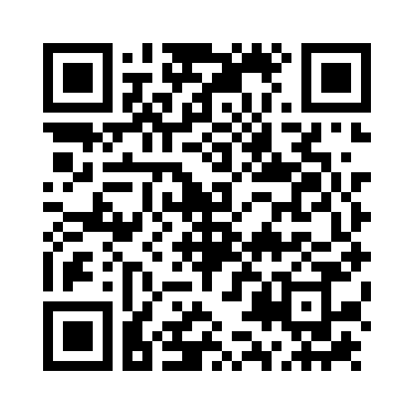
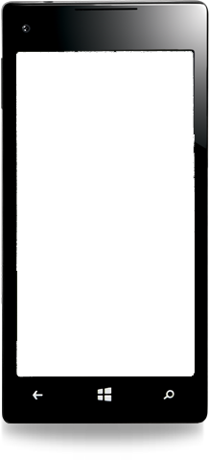
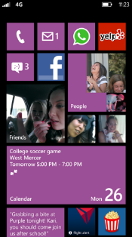
Evaluate this session
Required Slide
*delete this box when your slide is finalized
Your MS Tag will be inserted here during the final scrub.
Scan this QR code to evaluate this session and be automatically entered in a drawing to win a prize!

