Slide 2
Getting Started with Team Foundation Service
Mario Rodriguez
Program Manager
2-345

Slide 3
mariorod@microsoft.com
@mariorod1

Slide 5
i want to begin by telling you a story

Slide 6
about our transition from server to services

Slide 7
because having context about the past

Slide 8
about our culture

Slide 9
will help you understand not only

Slide 10
our present but also our future

Slide 11
it starts with a series of planning meetings

Slide 12
around “areas of darkness”

Slide 13
a promise to take “one”

Slide 15
and evolve it into many

Slide 17
circa 2010

Slide 18
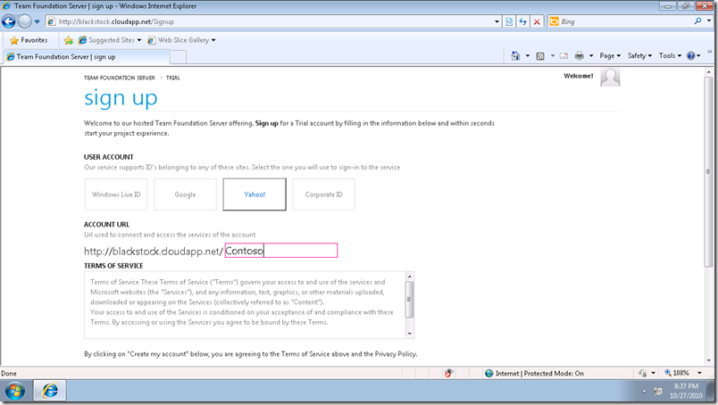

Slide 19
but architecture is not enough

Slide 20
we must rethink everything

Slide 21
how we plan

Slide 22
how we code

Slide 23
how we test

Slide 24
how we ship

Slide 25
to truly embrace services

Slide 26
Development Content
Measure
Build
Development Process
Learn

Slide 27
it requires inspiration …

Slide 28
“Gentlemen, we will chase perfection,
and we will chase it relentlessly,
knowing all the while we can never attain it.
But along the way,
we shall catch excellence.” - Vince Lombardi

Slide 29
staying true to your identity

Slide 30
and hard work

Slide 31
to reach the goal

Slide 32
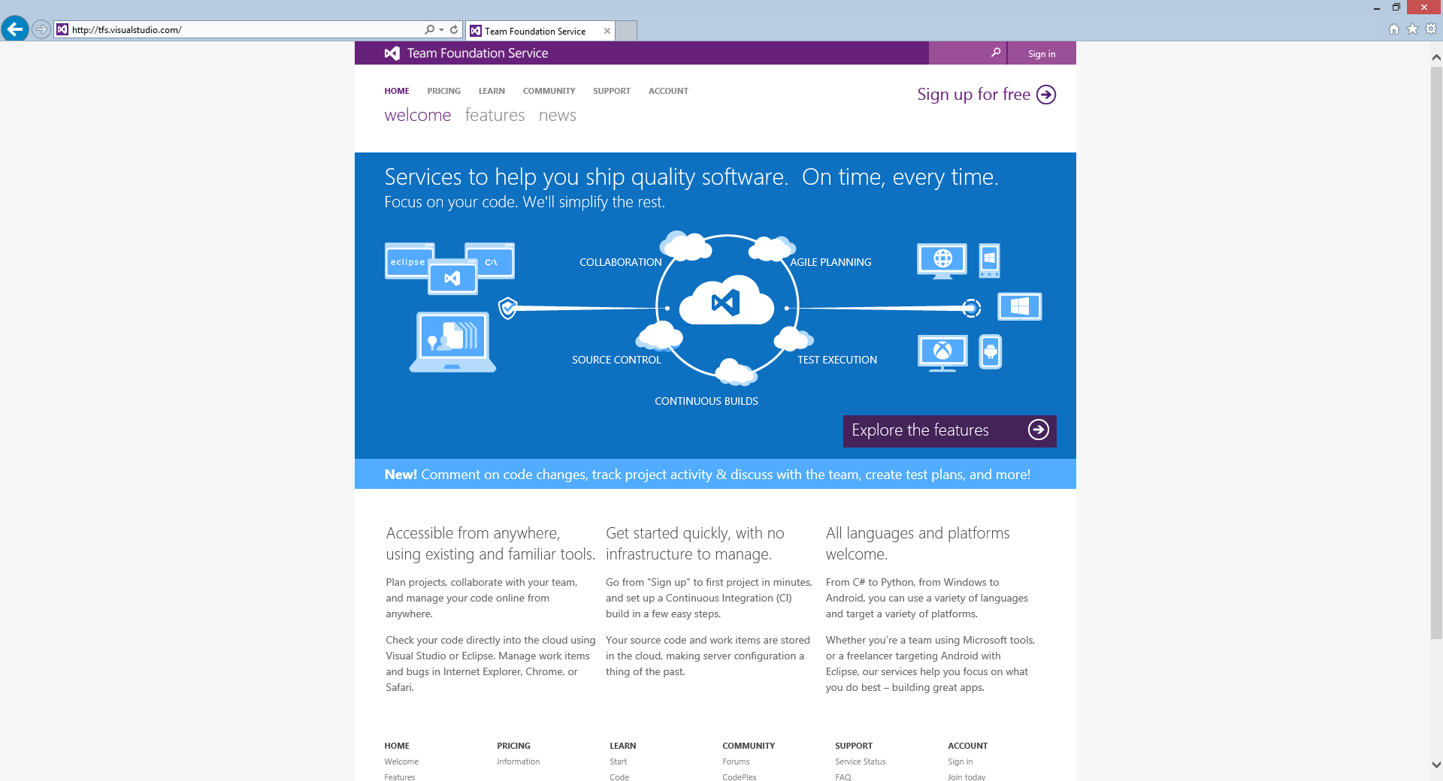

Slide 33
Define
Customer connection
Ideation
Product backlog
Feedback
Actionable learning
Develop
Idea to working software
Adapt
Exposure control
Experimentation
Implement
Monitor
Deployment pipelines
Operate
Working software in production
Value realization

Slide 34
Demos
Getting Started
Work Item Tracking
Team Room
Visual Studio 2013
Web experiences

Slide 35
Team Foundation Service details
Free Plan for up to 5 users
Included for certain paid MSDN subscribers:
Version control (TFVC or Git)
Comment on changesets & commits
Work item tracking and tagging
Team rooms
Agile planning tools
Feedback Management
Agile Portfolio Management*
Build*
Web-based test case management*
Load testing*
New!
New!
New!
New!
Additional information at http://tfs.visualstudio.com
* Capability in preview – limits may apply. Authoring load tests requires Visual Studio Ultimate 2013 Preview.

Slide 36
On Premise differences
Customizations (WIT)
Reporting
Active Directory Federation

Slide 37
we are transforming our DNA

Slide 38
enterprise + cloud services

Slide 39
we feel IT’S TIME

Slide 40
2013

Slide 41
but we know

Slide 42
leadership will be achieved by those who innovate

Slide 43
security, reliability, engineering

Slide 44
new scenarios and experiences

Slide 45
we are EXCITED about services

Slide 46
FUTURE

Slide 47
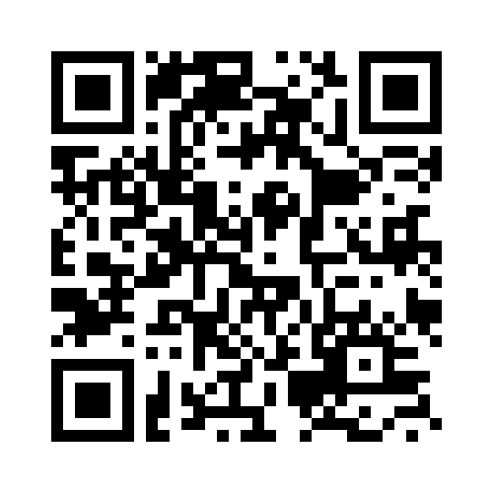
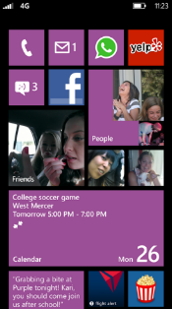
Evaluate this session
Required Slide
*delete this box when your slide is finalized
Your MS Tag will be inserted here during the final scrub.
Scan this QR code to evaluate this session and be automatically entered in a drawing to win a prize!

