Slide 1
Windows Azure Mobile Services soup to nuts
Josh Twist
@joshtwist
2-542

Slide 2
Thanks

Slide 3
Agenda
INTRO
DEMO

Slide 4
since last build
GA – 99.9% SLA
Free 20MB Database
CLI
Scheduler
Custom API
Source Control
Shared Code
NPM
Android SDK
HTML + JS SDK
WP7.x support

Slide 5
Mobile Services at Build
2-542 Mobile Services – Soup to Nuts
Josh Twist – Thursday 2pm
3-545 Cross-Platform w/ Mobile Services
Chris Risner – Thursday 4pm
3-543 Protips for Mobile Services
Chris Risner – Thursday 5pm
3-548 Connected Win Phone Apps
Yavor Georgiev – Friday 9am
3-511 Going Live and Beyond
Kirill and Paul – Friday 10:30am
3-116 Developing Windows Apps
Nick Harris – Friday 2pm
3-544 Who’s that user?
Dinesh Kulkarni – Friday 2pm
Check out the Hackathon

Slide 6
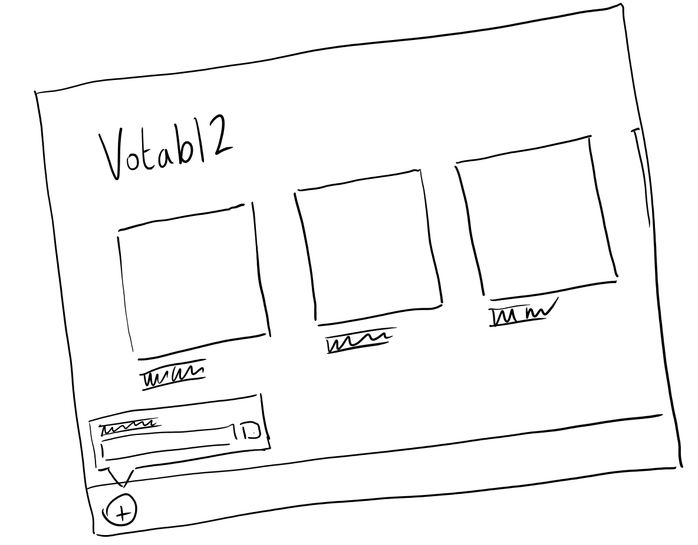
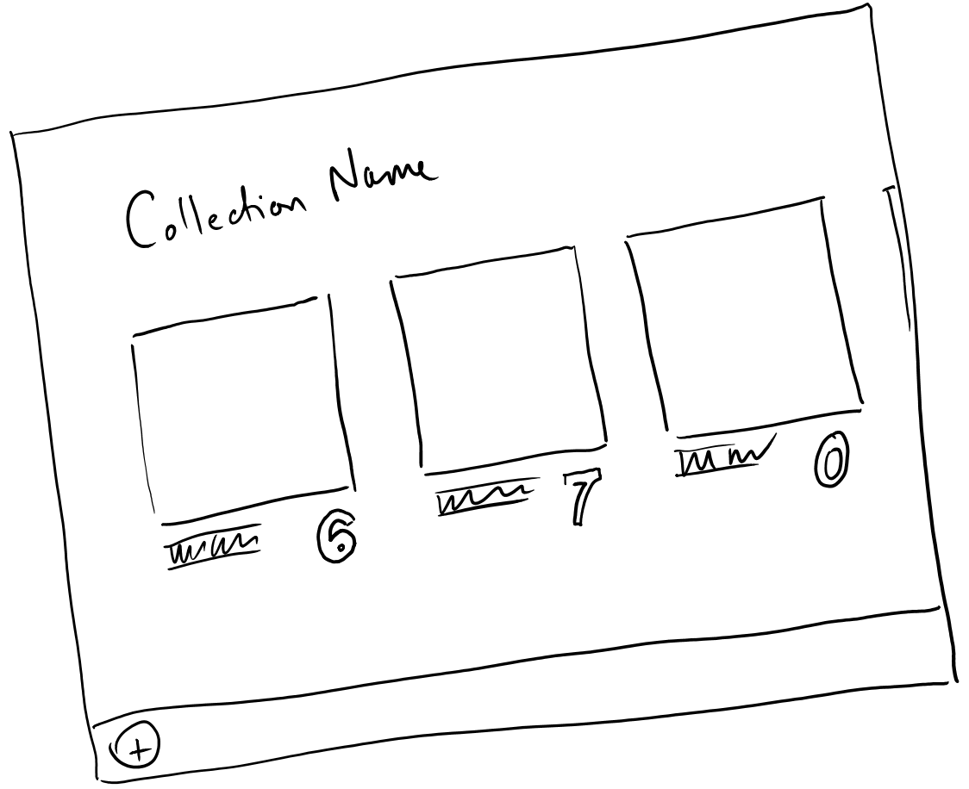
Votabl2

Slide 7
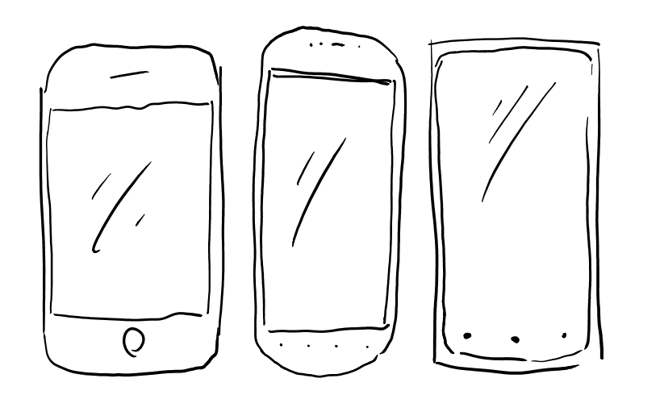
Voting
Z

