Slide 2
How to use point of sale devices in your app
Mike Hall
Principal Software Architect, Windows Embedded
3-029

Slide 3
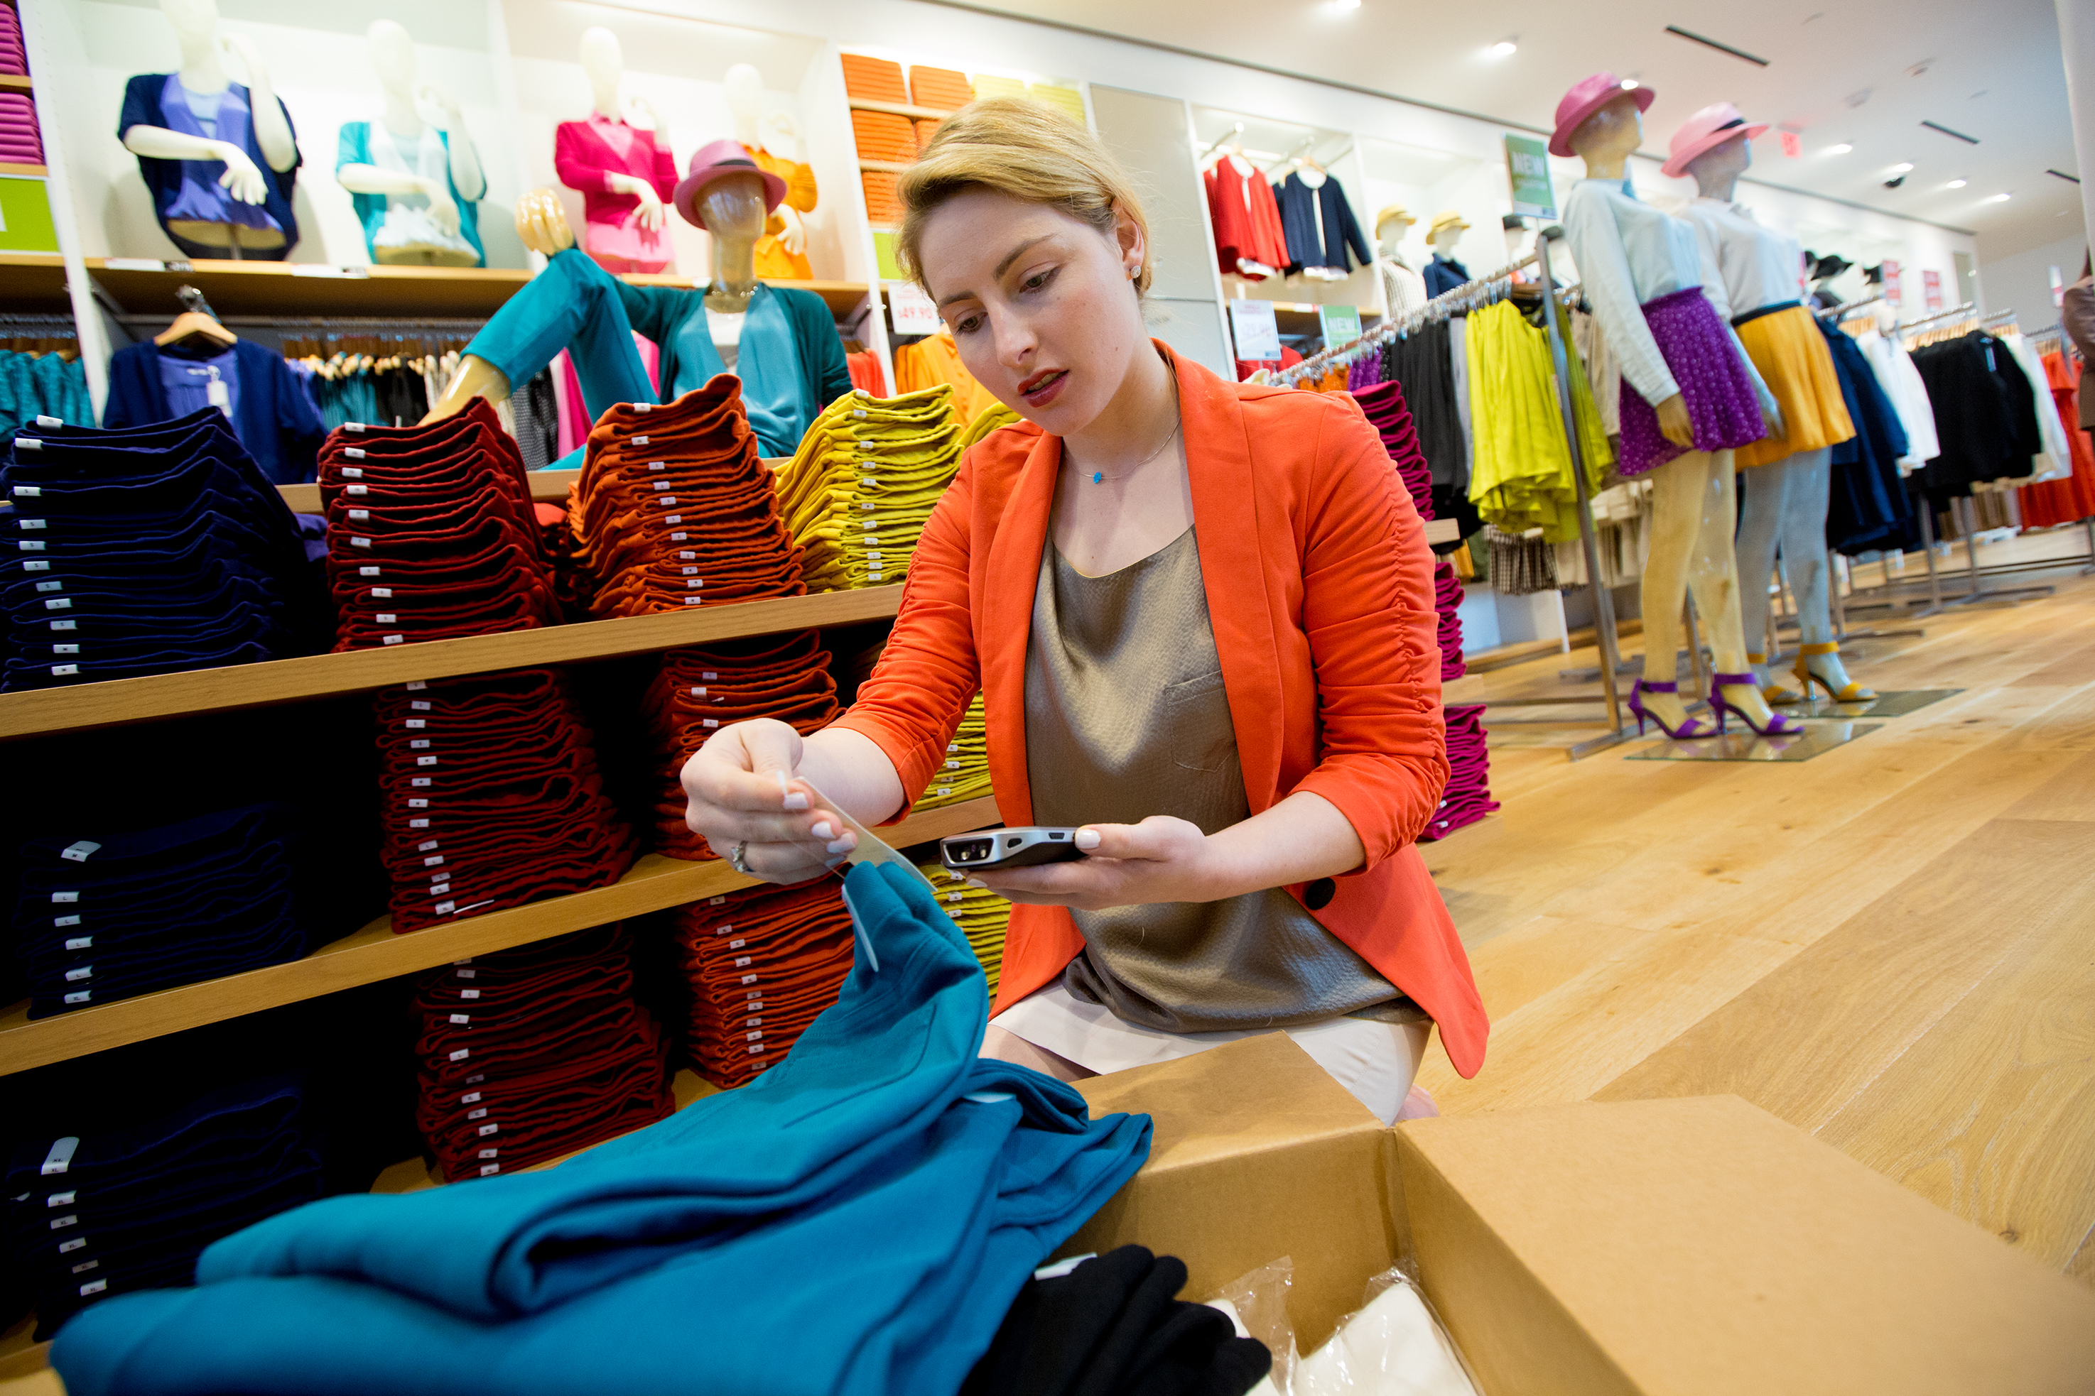
Agenda
Introduction:
Mobile POS Architecture
Typical POS Application Code Flow
Coding Demo
Application Demos

Slide 4
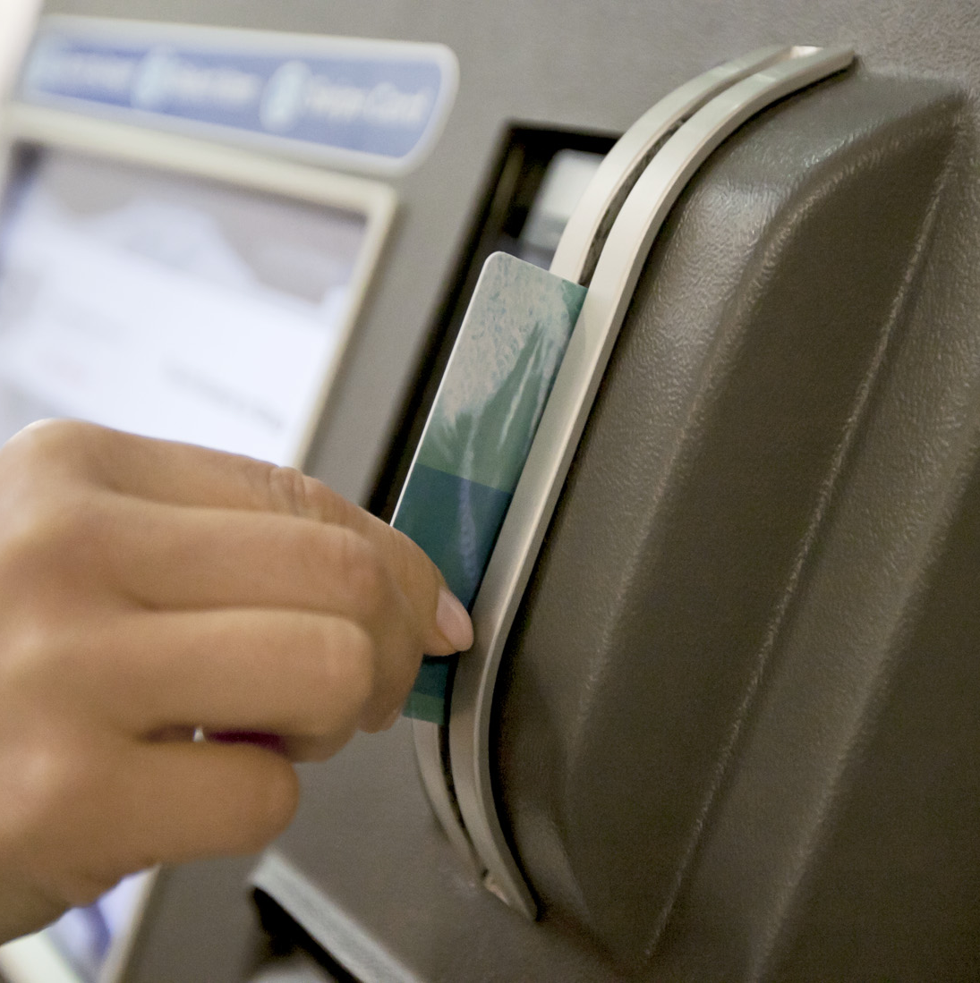
Point of Service (POS) Examples
Magnetic Stripe Reader (MSR)
Barcode Scanners

Slide 5
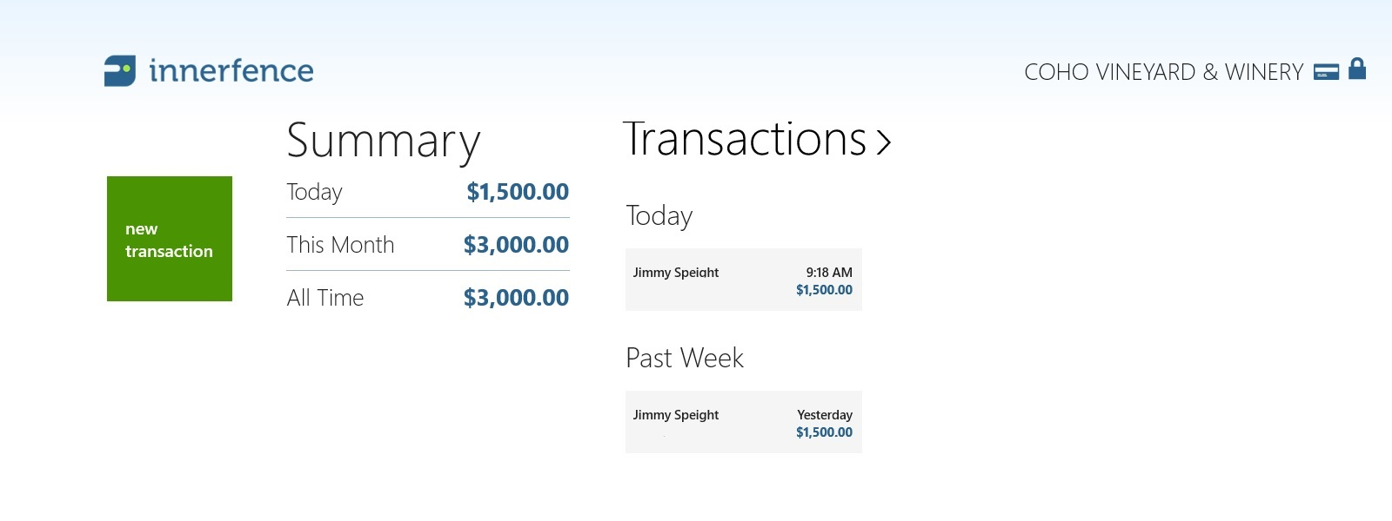
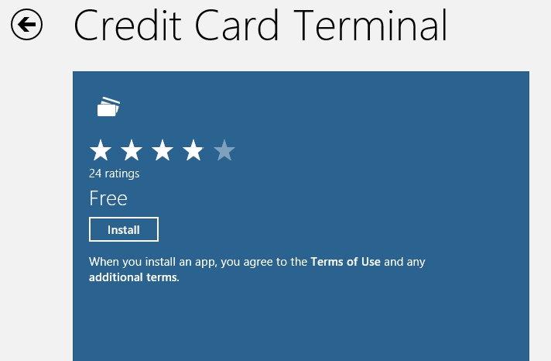
Demo: Inner Fence
Credit Card Transaction using POS.RT APIs

Slide 6
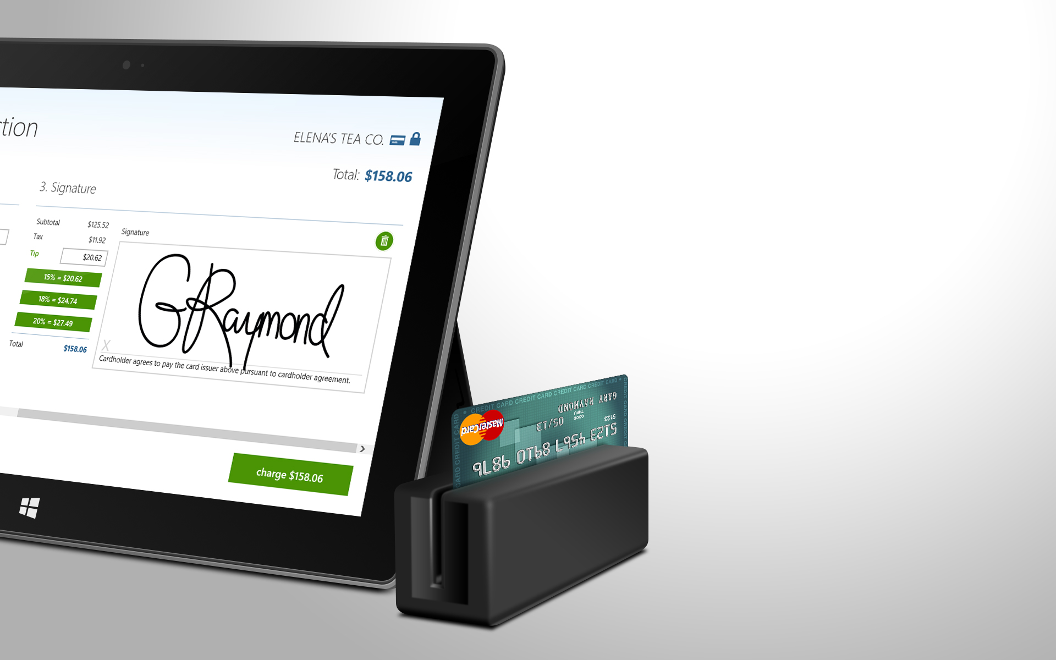
Credit Card Terminal
By Inner Fence
Swipe credit cards
Capture customer signatures and tips
Calculate location-based sales tax
Map transactions
Send customer receipts

Slide 7
Introduction to POS

Slide 8
Introduction: UnifiedPOS
Unified POS:
Common peripheral device platform for Retail solutions
International standard driven by National Retail Federation
Examples: Barcode Scanner, Magnetic Stripe Reader, Receipt Printer
Defines properties, methods, and events for POS peripherals Including common locking infrastructure

Slide 9
POS.NET
.NET Desktop Applications
    Not supported on ARM
POS .NET - based on UPOS 1.12
Supports typical POS device classes
Supports Device Extensibility
    Service Object Model (.NET Library)
    Device Drivers
  Extensibility “above the O/S”
Application
POS.NET API
POS.NET Service Object
.NET Framework
Windows O/S
HW Driver/Physical Hardware

Slide 10
Benefits of POS.RT APIs
Windows Store Applications
Supported on all processor architectures (x86, x64, ARM)
App/POS hardware abstraction
Simple WinRT-based API
Callable from WinRT & Desktop

Slide 11
Windows 8.1 – POS.RT API
Supported devices
    Barcode Scanner
    Magnetic Stripe Reader
  Connectivity: USB HID
  Support through inbox drivers
    Scanner Class Driver
    MSR Inbox Drivers
  Additional devices through Device Protocol APIs
    Bluetooth Receipt Printer etc…
Windows Store POS app
Windows Runtime (WinRT.POS)
USB HID POS Scanner Class Driver
USB HID POS MSR Vendor Class Driver

Slide 12
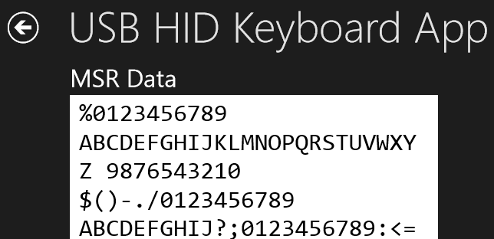
USB HID Keyboard vs. POS.RT API
  Note: USB HID Keyboard mode
    Requires the appropriate UX control to have focus
    No parsing of content through API
    No exclusive “Locking” of device to application
    Only text based data

Slide 13
Code and Demos!

Slide 14
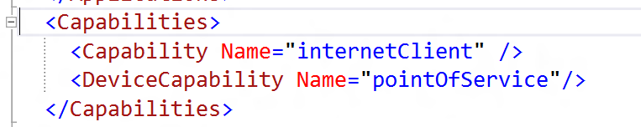
Device Capabilities
internetClient, Print and Sensors enabled by default
Other devices require the capability to be set:
pointOfService, location, proximity, webcam etc…

Slide 15
POS.RT Usage Pattern
Device Enumeration (Windows.Devices.Enumeration)
    Or, <Device>.GetDefaultAsync, or DeviceWatcher
Device Claim/Release Model
Claim<Device>Async, RetainDevice
    Claiming an already held device
Common Properties, Methods, Events
Status and Error States
Handling application suspend/resume

Slide 16
Barcode Scanner
Windows.Devices.Enumeration/Scanner.GetDeviceSelector
GetDefaultAsync and FromIdAsync
ClaimScannerAsync
Enable/Disable
Events
    DataReceived
        BarcodeScannerDataReceivedEventArgs
    ErrorOccurred

Slide 17
Magnetic Stripe Reader
Windows.Devices.Enumeration/GetDeviceSelector
GetDefaultAsync and FromIdAsync
ClaimMagneticStripeReaderAsync
Enable/Disable
Raw Track Data (Track 1-4)
Three Supported Card Types (Three Data Events)
    AAMVA (Motor Vehicle Card), Bank Card, Vendor Specific Card
ErrorOccurred

Slide 18
BarcodeScanner and MSR – Claim Model
Scanner/MSR require app-exclusive lock
For a multi-app environment we also need cooperative lock
// Setup the Barcode Scanner
claimedScanner = await scanner.ClaimScannerAsync( );
claimedScanner.DataReceived += claimedScanner_DataReceived;
claimedScanner.ReleaseDeviceRequested += claimedScanner_ReleaseDeviceRequested;
// Handle Release Requests
async void claimedScanner_ReleaseDeviceRequested(object sender, ClaimedBarcodeScanner e)
{
await Dispatcher.RunAsync(Windows.UI.Core.CoreDispatcherPriority.Normal, () =>
{
// keep claim and carry on.
e.RetainDevice();
});
}

Slide 19
Demo – Build a simple POS app show cooperative lock

Slide 20
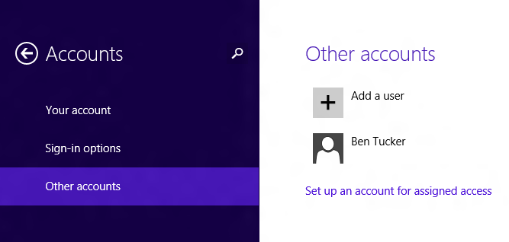
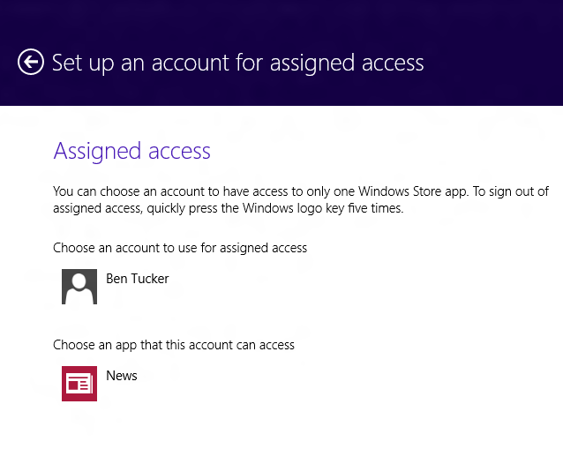
Assigned Access
Enable a single Windows Store application experience on the device.
Blocks other actions so the user only experiences the specified application and is unable to access system files and other applications.

Slide 21
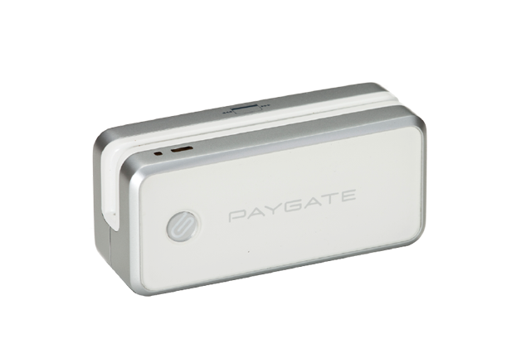
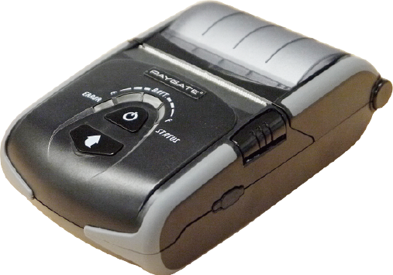
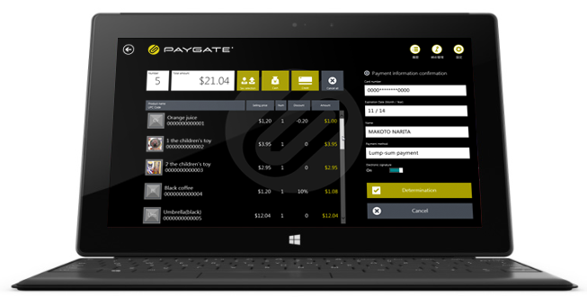
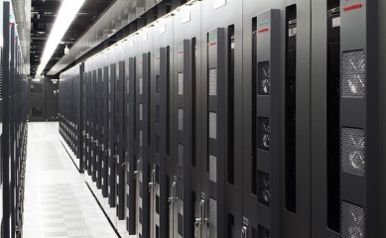

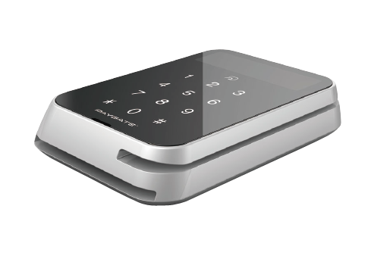
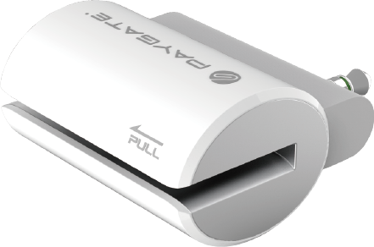
Demo: ROYAL GATE INC
Using Windows APIs to build a simple POS application
Bluetooth Receipt Printer Mobile POS Solution
PAYGATE provides all technologies surrounding applications, server systems, security and devices for payment solutions.
Card reader & Printer
Application
Centre
Security
We provide a one-stop solution

Slide 22
Windows 8.1 Solution & PAYGATE
Mobile POS Solution by PAYGATE
  Bluetooth Barcode Reader
PAYGATE Barcode Reader PG-BC01
Bluetooth Magnetic Stripe Reader
  PAYGATE card reader PG-MG01
  Triple DES encryption with DUKPT key management
  Bluetooth Printer
  PAYGATE Printer PG-PR01
  Secure Backend Payment processing by PAYGATE

Slide 23
Windows 8.1 Bluetooth Device Coding
Enumerate Devices
Create and connect to socket
Format Data to send to device
Fill buffer with data, and send to device
Windows.Devices.Bluetooth.Rfcomm.RfcommDeviceService.fromIdAsync(printer. id).then(function (_bluetoothdevice) {...
var socket = new Windows.Networking.Sockets.StreamSocket();
try {
socket.connectAsync(_bluetoothdevice.connectionHostName,
_bluetoothdevice.connectionServiceName).then(...

Slide 24
Key Takeaways
Easily and quickly build store applications for Point of Sale/Service scenarios
Windows Store Applications for broad reach and exposure
Supported across ARM, x86 and x64

Slide 25
Resources
Related Sessions
    [WCL_23] Building apps that connect with devices
    [WCR_24a] Apps for USB devices
    [WCR_24b] Apps for HID devices
    [WCL_28] Apps for Bluetooth Smart devices
UPOS: Association for Retail Technology Standards
http://www.nrf-arts.org/
ISO/IEC 7813 : Financial transaction cards (Credit/Debit etc.)
http://www.iso.org/iso/iso_catalogue/catalogue_tc/catalogue_detail.htm?csnumber=43317
United States motor vehicle/ID cards
http://www.aamva.org/DL-ID-Card-Design-Standard

Slide 26
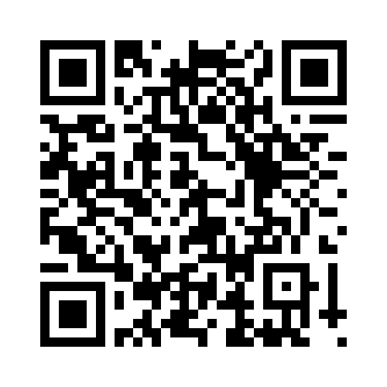
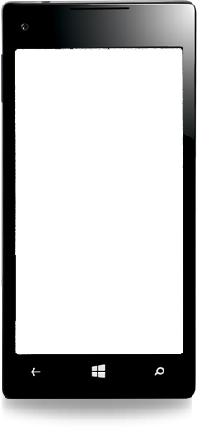

Evaluate this session
Required Slide
*delete this box when your slide is finalized
Your MS Tag will be inserted here during the final scrub.
Scan this QR code to evaluate this session and be automatically entered in a drawing to win a prize!

