Slide 2
What’s new in Direct3D 11.2
Bennett Sorbo
Program Manger
3-062

Slide 3
Agenda
Overview.
Core improvements.
Leveraging new features.
Summary / further resources.

Slide 4
Direct3D overview
High-performance graphics API.
Targets extremely wide variety of hardware.
Works across phone, desktop and Store apps.

Slide 5
What’s new in Direct3D?
Focus for release: performance and efficiency.
New 11.2 features/APIs across variety of scenarios/hardware.
Compatible with all existing apps.

Slide 6
Core improvements

Slide 7
Core improvements
On new drivers, everyday operations faster.
Instancing now optional for 9_1.
Frame latency reductions.

Slide 8
Core improvements
New IDXGIDevice3: Trim API.
Frees internal driver allocations.
No further action necessary from app.
Better for app, also required.

Slide 9
Leveraging new features

Slide 10
New features overview
Key
Hardware overlay support.
HLSL Shader Linking.
Mappable Default buffers.
Low-latency presentation API.
Tiled resources.
Guaranteed Support
Check for Support
Feature not Available

Slide 11
1. Hardware overlay support
Frame-rate is king.
Lowering resolution is a solution, but it has drawbacks:
GPU overhead.
Loss of fidelity.
New APIs in Windows 8.1 allow for efficient, targeted scaling.
FL9_1
FL10_0
FL11_0

Slide 12
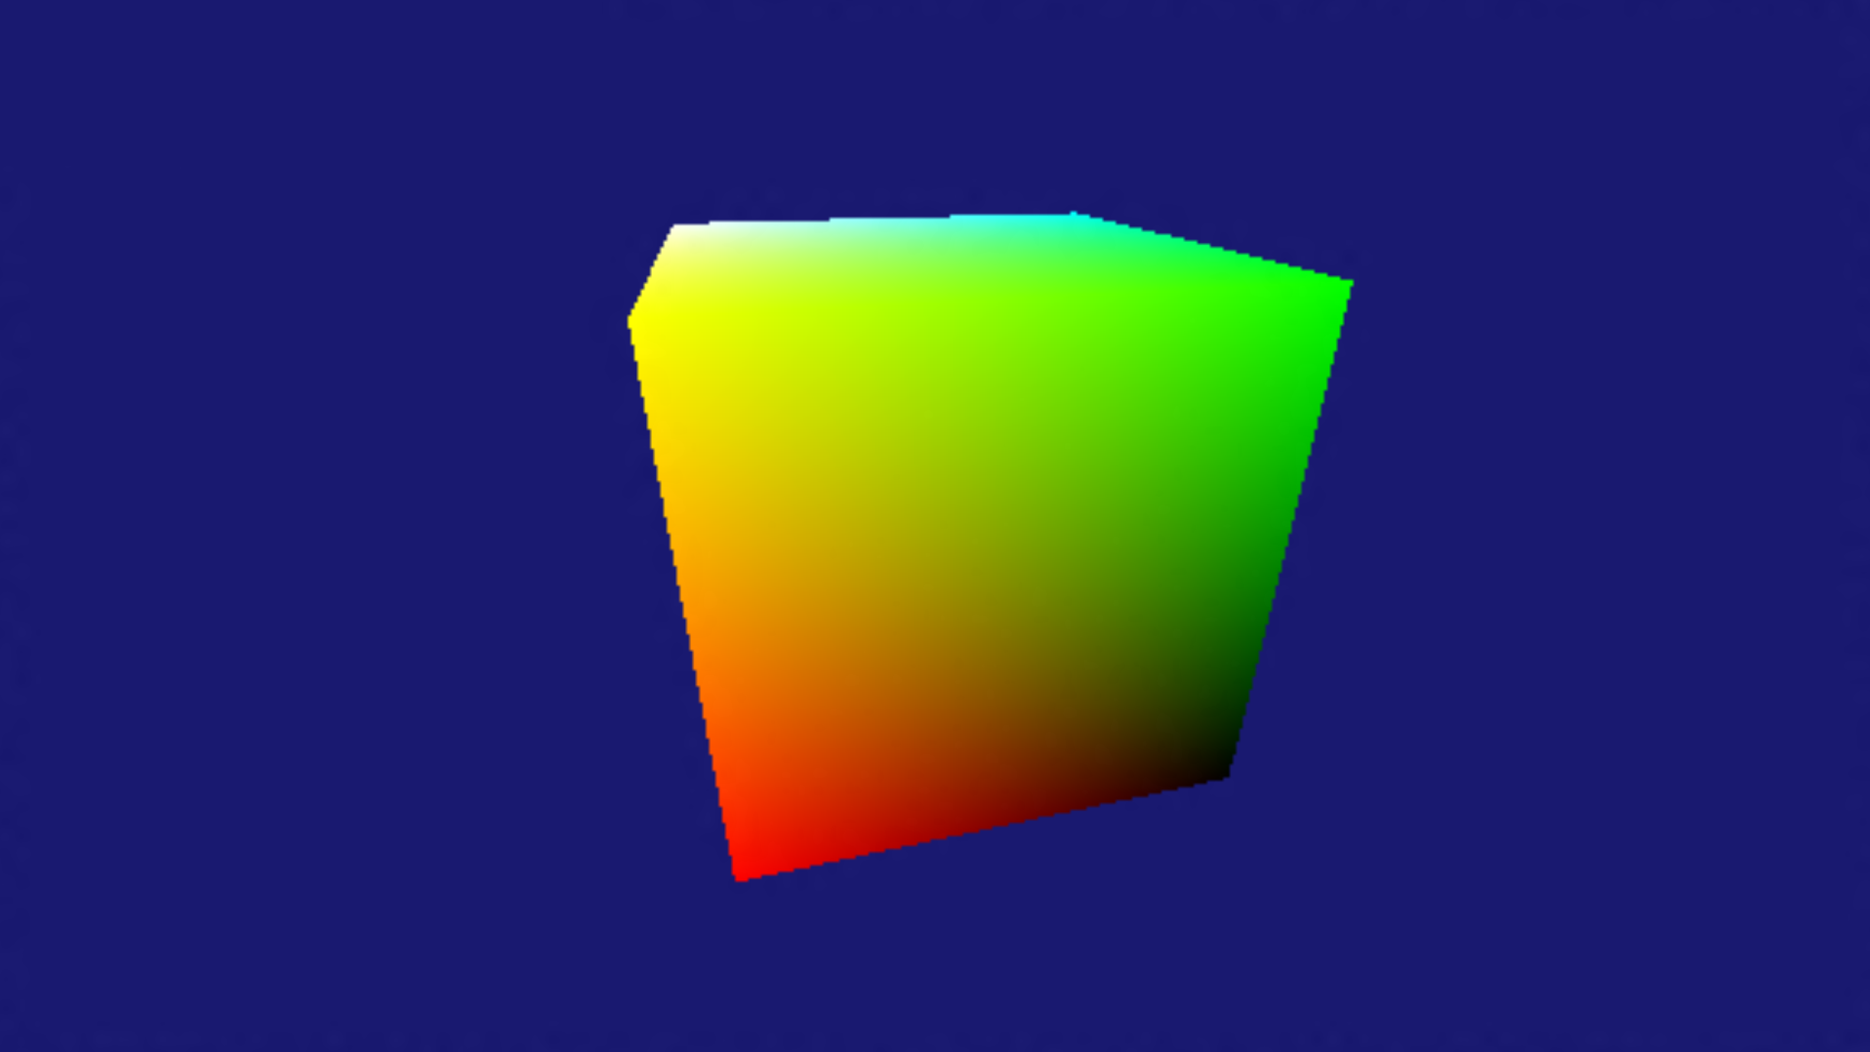
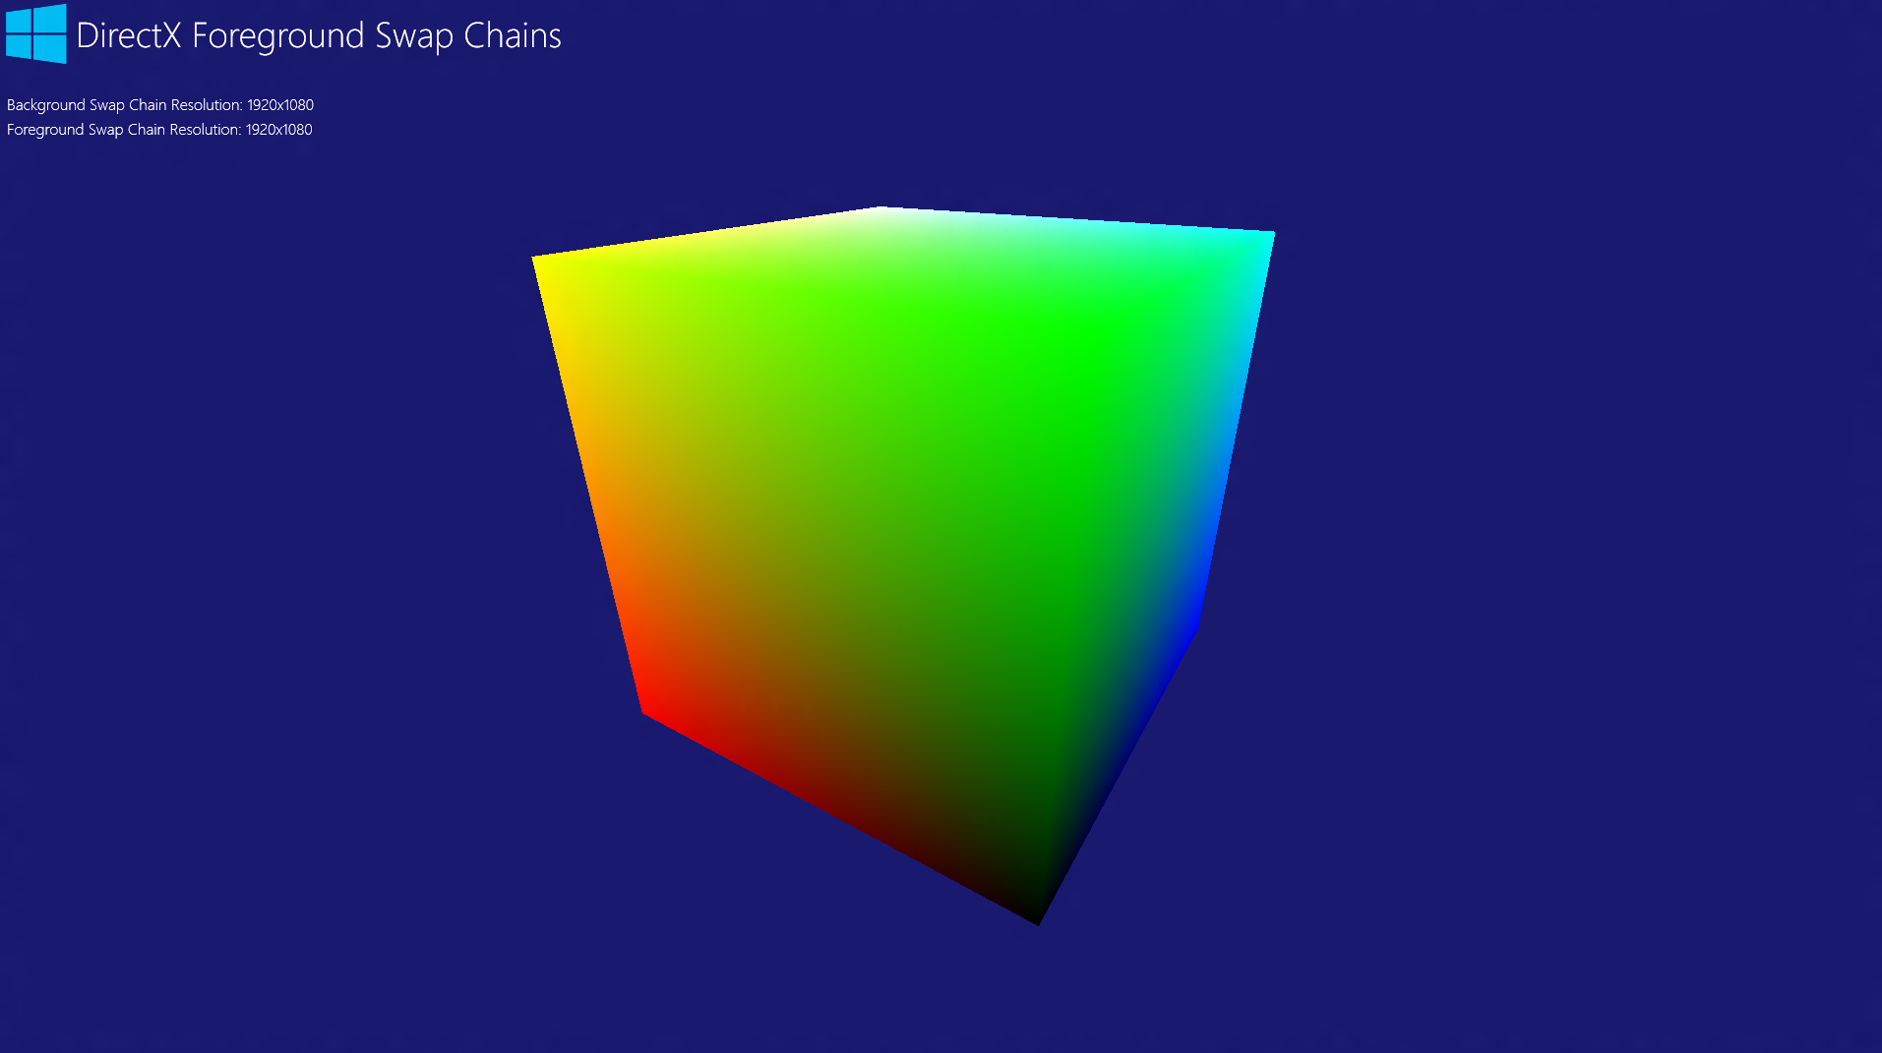
Hardware overlay support
Scaling
Composition

Slide 13
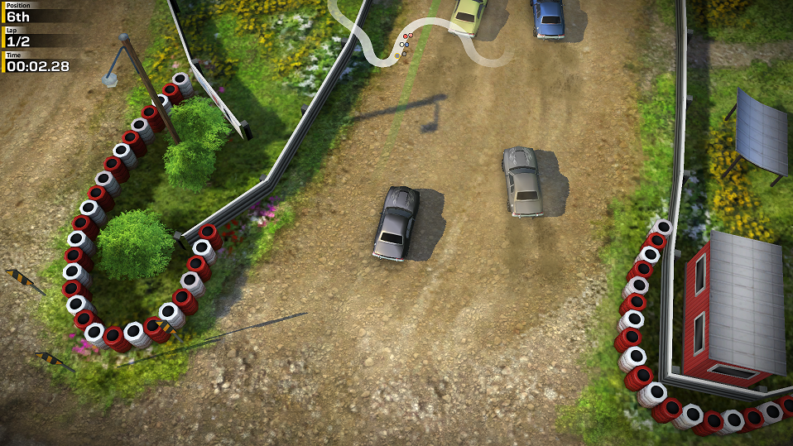
Hardware overlay support
Usage is scalable:
Static scaling
Simplest if scale factor will be fixed
Display
Swap Chain
FL9_1
FL10_0
FL11_0

Slide 14
Hardware overlay support: static scaling
Great if scale factor known up front, and will not be changing.
Scale factor set at swap chain creation time (use flag DXGI_SCALING_STRETCH).
If overlays are absent, automatically fall back to GPU linear scaling.
Swap Chain
(1280x720)
Display
(1920x1080)
FL9_1
FL10_0
FL11_0

Slide 15
Static scaling sample code
DXGI_SWAP_CHAIN_DESC1 swapChainDesc = {0}; swapChainDesc.Width = screenWidth / 1.5f; swapChainDesc.Height = screenHeight / 1.5f; swapChainDesc.Scaling = DXGI_SCALING_STRETCH; // Scale content to entire window
...
dxgiFactory->CreateSwapChainForCoreWindow( m_d3dDevice.Get(), reinterpret_cast<IUnknown*>(m_window.Get()), &swapChainDesc, nullptr, &swapChain );

Slide 16
Hardware overlay support
Display
Usage is scalable:
Static scaling.
Simplest if scale factor will be fixed.
Dynamic scaling.
Change scale factor during run time without IDXGISwapChain::ResizeBuffers.
Swap Chain
Swap Chain
Display
FL9_1
FL10_0
FL11_0

Slide 17
Hardware overlay support: dynamic scaling
Swap Chain
(1920x1080)
Game Content
(1280x720)
Allows apps to vary the resolution at which they render, on-the-fly.
Useful for dynamic workloads, when maintaining a fluid frame rate is critical.
IDXGISwapChain2::SetSourceSize API changes portion of swap chain from which you present data.
Display
(1920x1080)
FL9_1
FL10_0
FL11_0

Slide 18
Dynamic scaling sample code
DXGI_SWAP_CHAIN_DESC1 swapChainDesc = {0};
swapChainDesc.Width = screenWidth; swapChainDesc.Height = screenHeight; swapChainDesc.Scaling = DXGI_SCALING_STRETCH;
dxgiFactory->CreateSwapChainForCoreWindow( ... );
...
if (fps_low == true) {
swapChain->SetSourceSize(screenWidth * 0.8f, screenHeight * 0.8f);
}
// Render to sub-rect of swap chain.
...
swapChain->Present(1, 0);

Slide 19
Dynamic scaling
Demo

Slide 20
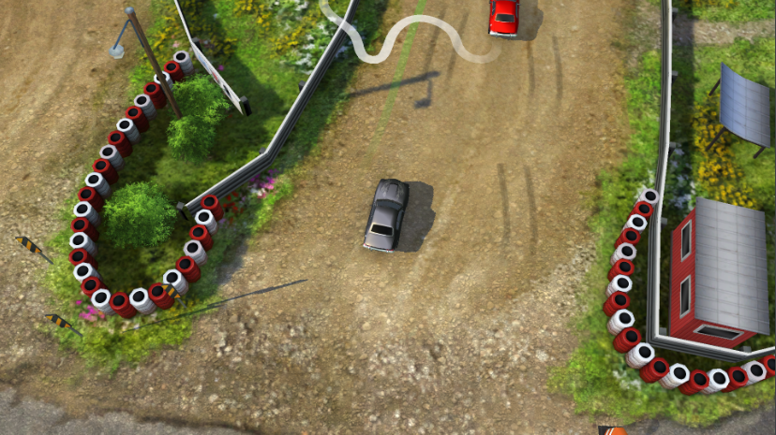
Hardware overlay support
Display
Usage is scalable:
Static scaling.
Simplest if scale factor will be fixed.
Dynamic scaling.
Change scale factor during run time without IDXGISwapChain::ResizeBuffers.
Swap chain composition.
Render to separate swap chains, compose them for free.
Can render some content at low-res, other at native-res.
Swap Chain
Swap Chain
Display
Swap Chain 1
Display
Swap Chain 2
FL9_1
FL10_0
FL11_0

Slide 21
Overlays: swap chain composition
With lower-resolution swap chains, all content scaled down.
With swap chain composition, can create separate swap chain for HUD.
Blended using pre-multiplied alpha: RGB_{Out} = RGB_{Top} + RGB_{Bottom} * (1 – A_{Top}).
HUD swap chain
(1920x1080)
3D swap chain
(1280x720)
Display
(1920x1080)
FL9_1
FL10_0
FL11_0

Slide 22
Swap chain composition sample code
DXGI_SWAP_CHAIN_DESC1 bottomSwapChainDesc = {0}; bottomSwapChainDesc.Width = screenWidth; bottomSwapChainDesc.Height = screenHeight; bottomSwapChainDesc.Scaling = DXGI_SCALING_STRETCH; dxgiFactory->CreateSwapChainForCoreWindow( ... );
if (m_dxgiOutput->SupportsOverlays()) { DXGI_SWAP_CHAIN_DESC1 topSwapChainDesc = {0}; topSwapChainDesc.Width = screenWidth; topSwapChainDesc.Height = screenHeight; topSwapChainDesc.Scaling = DXGI_SCALING_NONE; topSwapChainDesc.Flags = DXGI_SWAP_CHAIN_FOREGROUND_LAYER; topSwapChainDesc.AlphaMode = DXGI_ALPHA_MODE_PREMULTIPLIED; dxgiFactory->CreateSwapChainForCoreWindow( ... ); }
... bottomSwapChain->Present(1, 0); if (topSwapChain) topSwapChain->Present(1, 0);

Slide 23
Swap chain composition
Demo

Slide 24
Swap chain composition best practices
With overlays, scaling and composition is ‘free’.
When overlays are not available, OS falls back to GPU.
Not as performant – use IDXGIOutput2::SupportsOverlays to decide.
If false, use single swap chain.
HUD swap chain
(1920x1080)
3D swap chain
(1280x720)
Display
(1920x1080)
FL9_1
FL10_0
FL11_0

Slide 25
Swap chain composition advanced usage
Lots of power here: swap chains can be presented independently.
Either swap chain can be dynamically scaled.
Core Windows Store apps only
Opens up new rendering scenarios to achieve best possible performance (dual-device).
HUD swap chain
(1920x1080)
3D swap chain
(1280x720)
Display
(1920x1080)
FL9_1
FL10_0
FL11_0

Slide 26
2. Runtime shader modification
Changing shader behavior at runtime is important.
Optimize-out the inapplicable code paths.
Combine multiple shaders into single pass.
HLSL compiler now available to Store apps.
But, compilation is slow. Can we go further?
FL9_1
FL10_0
FL11_0

Slide 27
HLSL shader linking
Introducing HLSL shader linking.
Compile libraries offline, link together at runtime.
Useful for changing shader behavior at runtime, or for library-style shader-usage.
Works on all hardware at all feature levels.
FL9_1
FL10_0
FL11_0

Slide 28
HLSL shader linking
Demo

Slide 29
HLSL shader linking usage overview
New HLSL compiler target: ‘lib_5_0’.
D3DCreateFunctionLinkingGraph to create shader graph
ID3D11FunctionLinkingGraph::CallFunction to call shader method
ID3D11FunctionLinkingGraph::PassValue to pass parameters between shaders
D3DCreateLinker to generate shader blob
HLSL Compiler
Compiled Shader Library
CallFunction
PassValue
Shader Graph
Shader Linker
Shader Blob
FL9_1
FL10_0
FL11_0

Slide 30
3. Mappable default buffers
Default-to-Staging copy
In Windows 8, reading data back on CPU requires default-to-staging copy.
Redundant copy is performance issue for compute shaders.
Windows 8.1 allows default buffers to be directly mapped – “mappable default buffers”.
Default
Compute Shader
Default
App CPU
Staging
Staging
App CPU
Mappable Default Buffers
Default
Compute Shader
Default
App CPU
App CPU
FL9_1
FL10_0
FL11_0

Slide 31
Mappable default buffers
Default-to-Staging copy
Use existing CPU_ACCESS flags.
Buffers only, no Texture1D/2D/3D
Available with new drivers, use CheckFeatureSupport to determine support.
Simple fallback path.
Default
Compute Shader
Default
App CPU
Staging
Staging
App CPU
Mappable Default Buffers
Default
Compute Shader
Default
App CPU
App CPU
FL9_1
FL10_0
FL11_0

Slide 32
Mappable default buffers
D3D11_FEATURE_DATA_D3D11_OPTIONS1 featureOptions; m_deviceResources->GetD3DDevice()->CheckFeatureSupport( D3D11_FEATURE_D3D11_OPTIONS1, &featureOptions, sizeof(featureOptions) );
...
If (featureOptions.MapDefaultBuffers) {
deviceContext->Map(defaultBuffer, ...);
} else {
deviceContext->CopyResource(stagingBuffer, defaultBuffer); deviceContext->Map(stagingBuffer, ...);
}

Slide 33
4. Low-latency presentation API
Latency: time between user input and result on-screen.
Low latency is key for user satisfaction.
Especially important on touch devices.
Challenge—difficult to know when to render to achieve lowest-possible latency.
FL9_1
FL10_0
FL11_0

Slide 34
Low-latency presentation API (cont’d)
Solution – new low-level API: IDXGISwapChain2::GetFrameLatencyWaitableObject.
To use, new flag: DXGI_SWAP_CHAIN_FLAG_FRAME_LATENCY_ WAITABLE_OBJECT .
HANDLE is signaled when app should perform rendering operations.
More flexible, block where you want.
WaitForSingleObjectEx
Process latency-sensitive events
Render scene
Present
FL9_1
FL10_0
FL11_0

Slide 35
Low-latency presentation
Demo

Slide 36
Low-latency presentation sample code
DXGI_SWAP_CHAIN_DESC1 swapChainDesc = {0};
... swapChainDesc.Flags = DXGI_SWAP_CHAIN_FLAG_FRAME_LATENCY_WAITABLE_OBJECT;
dxgiFactory->CreateSwapChainForCoreWindow( ... );
HANDLE frameLatencyWaitableObject = swapChain->GetFrameLatencyWaitableObject();
while (m_windowVisible) { WaitForSingleObjectEx( frameLatencyWaitableObject, INFINITE, true );
Render(); swapChain->Present(1, 0); }

Slide 37
5. Tiled Resources
Gamers want immersive, high-detail worlds.
Problem: managing resources at the texture granularity is wasteful.
Solution: partial resource residency.
Smaller overhead means more resources left for games.
FL9_1
FL10_0
FL11_0

Slide 38
Tiled resources
Physical memory
Texture filter unit
Tiled Texture2D
Hardware page table
FL9_1
FL10_0
FL11_0

Slide 39
Summary/further resources

Slide 40
New features
1. Hardware overlay support
2. HLSL shader linking
3. Mappable default buffers
4. Low-latency presentation API
5. Tiled resources
Key
Guaranteed Support
FL9_1
FL10_0
FL11_0
Check for Support
Feature not Available
FL9_1
FL10_0
FL11_0
FL9_1
FL10_0
FL11_0
FL9_1
FL10_0
FL11_0
FL9_1
FL10_0
FL11_0

Slide 41
New interfaces
ID3D11Device2, ID3D11DeviceContext2
Tiled Resources, CheckFeatureSupport
ID3D11FunctionLinkingGraph
Shader Linking
IDXGISwapChain2
SetSourceSize, GetFrameLatencySemaphore
IDXGIOutput2
SupportsOverlays
IDXGIDevice3
Trim

Slide 42
SDK Samples
Overlays http://code.msdn.microsoft.com/windowsapps/DirectX-Foreground-Swap-bbb8432a
HLSL shader linking
http://code.msdn.microsoft.com/windowsapps/DirectX-dynamic-shader-b8160dff
Mappable default buffers
http://code.msdn.microsoft.com/windowsapps/DirectX-Mappable-Default-34b03cfe
Low-latency presentation API
http://code.msdn.microsoft.com/windowsapps/Modern-Style-Sample-ddf92f23
Tiled resources
http://code.msdn.microsoft.com/windowsapps/Direct3D-tiled-resources-db7bb4c3

Slide 43
Summary
Great improvements in D3D runtime.
New APIs take performance even further.
Use new features to make your app as performant/responsive as possible.

Slide 44
Further resources - related BUILD talks
Title | Session ID
DirectX tiled resources | 4-063
Building games for Windows 8.1 | 2-047
DirectX graphics debugging tools | 3-141
Bringing PC games to the Windows Store | 3-190
Tales from the trenches: developing “the harvest” and “gunpowder” with unity | 3-044
Accelerating Windows Store app development with middleware | 2-187
Bringing Halo: Spartan Assault to Windows tablets at mobile devices | 2-049
From Android or iOS: bringing your OpenGL ES game to the Windows Store | 3-189
Cutting edge games on Windows tablets | 3-043
Play together! Leaderboards with Windows Azure and multiplayer with Wi-Fi direct | 3-051
Innovations in high performance 2D graphics with DirectX | 3-191
BUILD 2012 – performance tips for Windows Store apps using DirectX and C++ | Link

Slide 45
Questions

Slide 46
Evaluate this session
Required Slide
*delete this box when your slide is finalized
Your MS Tag will be inserted here during the final scrub.
Scan this QR code to evaluate this session and be automatically entered in a drawing to win a prize!

