Slide 2
Building apps that use the camera
Mehmet Kucukgoz
Senior Program Manager
3-088

Slide 3
Agenda
Never miss a moment!
Photosequence in Windows 8.1 Preview.
Building an app using Capture APIs.
Camera controls in Windows 8.1 Preview.
Adding custom components.
Controlling audio capture pipeline.
Additional tips for camera apps.

Slide 4
Easy-to-use Capture APIs help you build innovative apps that use camera

Slide 5
Using camera in apps increases user engagement and personal connection

Slide 6
What’s new In Windows 8.1 Preview Never miss a moment – Photosequence

Slide 8
OK, jump!

Slide 11
Photosequence
Take multiple pictures in rapid fashion.
Not just a burst picture mode.
Pictures before trigger time.
More on how, later…

Slide 12
Photosequence demo

Slide 13
Photosequence
User trigger
Timeline
Intended
Actual
1
2
3
4
5
6
7
8
9
…
…
Pre-trigger photos
Trigger photo
Post-trigger photos

Slide 14
Building an app using Capture APIs

Slide 15
Windows.Media APIs
Capture
CameraCaptureUI
Capture.
Snap a picture, record video and audio.
Devices
MediaCapture API
Input and output audio devices such as Bluetooth.
Camera Capture UI.
Similar to ‘pick’ photos or videos from the file system.
Built-in camera control with pre-defined user workflow.
Media Capture API.
You control every pixel on screen.
Custom User Experience and workflow.
Playlists
Work with audio playlists.
Windows.Media.
PlayTo
Stream media to a television or audio system.
Protection
Use PlayReady or other content protection systems.
Transcoding
Convert music or video to other formats or resolutions, trim, or make effects permanent.
VideoEffects
Insert or remove well-known video effects.

Slide 16
Coding in Visual Studio

Slide 17
CameraCaptureUI What else can you do?
Specify ‘quality’ for photos and videos.
Limit time on returned video.
Fix aspect ratio or size for photos .
Users can:
Cycle through cameras.
Turn on a timer for capture.
Adjust camera settings.

Slide 18
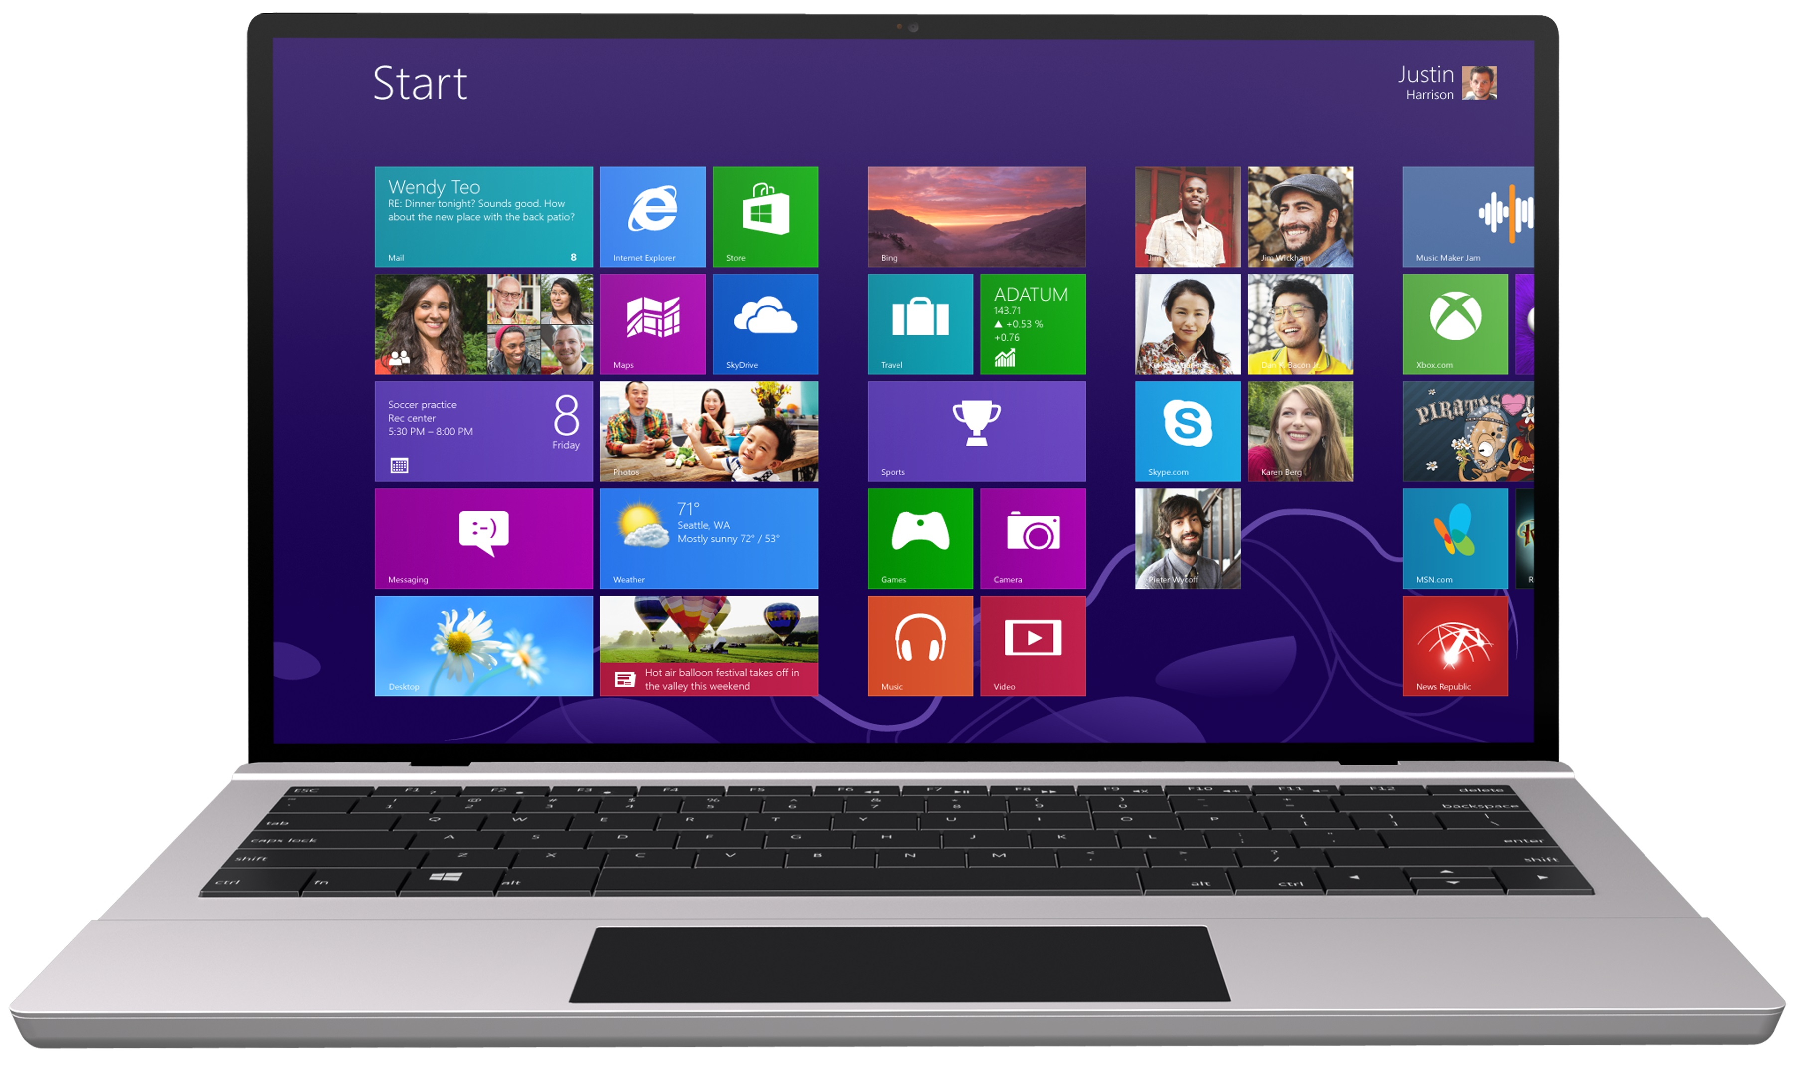
Slightly more advanced scenario

Slide 19
Coding in Visual Studio

Slide 20
Using microphone for audio only record
var mc = new Windows.Media.Capture.MediaCapture();
//Step 1: create an audio format profile
var encodingprofile = new Windows.Media.Capture.MediaEncodingProfile.createM4a(Windows.Media.Capture. AudioEncodingQuality.medium);
//Step 2: Create a file for the audio
return Windows.Storage.KnownFolders.musicLibrary.createFileAsync(“audio.m4a”)
.then(function (newFile) {
//Step 3: Start recording
mc.startRecordToStorageFileAsync(encodingprofile,newFile).then(
function (op) {
//recording started
});
});

Slide 21
MediaCapture API What else can you do?
Support various formats: MP4, WMV, M4A, MP3, WMA (Additional formats possible through extensions).
Prepare stage for images/videos.
Allow various encoding settings.
Programmatically control camera/mic settings: Brightness, Contrast, Hue, Volume, Mute, etc.
Enable custom scenarios through extensions.

Slide 22
Photosequence in code

Slide 24
Setting up the photo sequence mode
using Windows.Media.Capture;
MediaCapture mc = new MediaCapture();
LowLagPhotoSequenceCapture photoSequenceCapture;
//check support
if (mc.VideoDeviceController.LowLagPhotoSequence.Supported)
{
// Prepare capture
photoSequenceCapture = await
mc.PrepareLowLagPhotoSequenceCaptureAsync(
ImageEncodingProperties.CreateJpeg());
photoSequenceCapture.PhotoCaptured += PhotoCaptured;
// Start capture
await photoSequenceCapture.StartAsync();
}

Slide 25
Receiving the pictures
//handler function
private async void PhotoCaptured(LowLagPhotoSequenceCapture sender, PhotoCapturedEventArgs args)
{
// Save the photo
var file = await KnownFolders.PicturesLibrary.CreateFileAsync("photo.jpg", CreationCollisionOption.GenerateUniqueName);
var stream = await file.OpenAsync(FileAccessMode.ReadWrite);
await RandomAccessStream.CopyAndCloseAsync(args.Frame, stream);
}
//Finish photo sequence
await photoSequenceCapture.FinishAsync();
photoSequenceCapture.PhotoCaptured -= PhotoCaptured;

Slide 26
Receiving the pictures before trigger
// When preparing photo sequence, enable past photos
if (mc.VideoDeviceController.LowLagPhotoSequence.MaxPastPhotos >= 4)
{
mc.VideoDeviceController.LowLagPhotoSequence.PastPhotoLimit = 4;
}
// When handling PhotoCaptured event
bool isFutureFrame = (args.CaptureTimeOffset.Ticks > 0);

Slide 27
Using thumbnails
// Enable thumbnail
mc.VideoDeviceController.LowLagPhoto.ThumbnailEnabled = true;
mc.VideoDeviceController.LowLagPhoto.DesiredThumbnailSize = (uint)Image.Width;
// Prepare capture
var photoCapture = await mc.PrepareLowLagPhotoCaptureAsync(ImageEncodingProperties.CreateJpeg());
// Capture
var photo = await photoCapture.CaptureAsync();
// Display the thumbnail
var bitmap = new BitmapImage();
bitmap.SetSource(photo.Thumbnail);
Image.Source = bitmap;
// Save the photo
var file = await KnownFolders.PicturesLibrary.CreateFileAsync("photo.jpg");
var stream = await file.OpenAsync(FileAccessMode.ReadWrite);
await RandomAccessStream.CopyAndCloseAsync(photo.Frame, stream);
// Finish capture
await photoCapture.FinishAsync();

Slide 28
PhotoSequence
“Zero shutter lag” in photo taking!
Query frame rate under current light conditions.
Device/driver support needed.

Slide 29
What’s new in Windows 8.1 Preview Camera controls

Slide 30
New async camera controls
Scene Mode. Portrait, Sport, Snow, Night, Beach, Sunset etc.
Focus. Normal, Continuous, FullRange, Infinity, Macro, Hyperfocal.
Region of Interest. Rectangle with Focus, Exposure, White Balance lock.

Slide 31
New async camera controls
ISO. 50, 80, 100, 200, …, 25600.
Flash. On, Off, Auto, Red eye reduction.
Video Torch. On, Off.
Optimization Hint. Photo, Video.

Slide 32
In code
//Enable video torch
var control = mc.VideoDeviceController.TorchControl;
if (control.Supported)
{
control.Enabled = true;
}

Slide 33
Adding custom code to pipeline

Slide 34
Extensions What can you do with them?
Incorporate in your preview, video capture, image, audio streams as effects.
Analyze live camera stream to add overlays (e.g., virtual reality, games).
Build real time communication and collaboration apps.
Implement custom output formats.

Slide 35
Demo BallStrike

Slide 36
Analyze camera stream for object recognition
Windows Store app
App Code
Windows Runtime
Camera preview
Media Capture API
Camera
Your custom component (MFT)

Slide 37
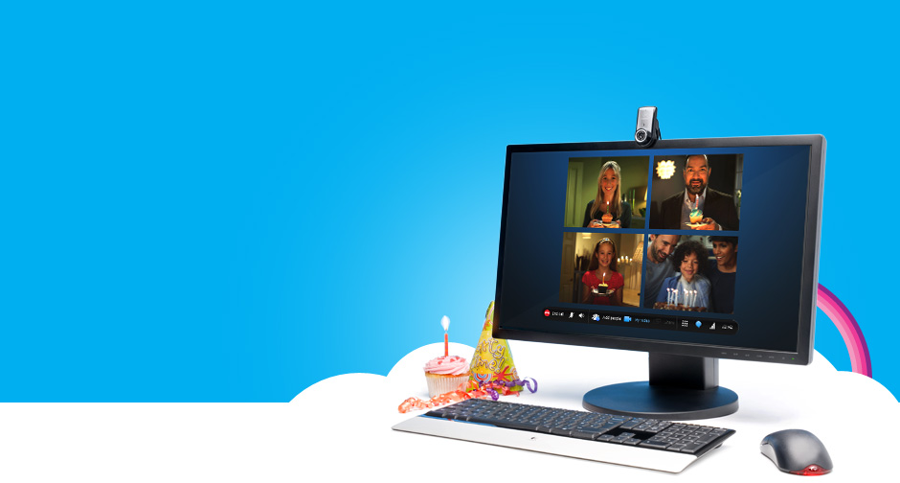

Slide 38
Build a real-time communication app
Windows Store app
App Code
Windows Runtime
Camera Preview
Media Capture API
Your Custom component
(MF Sink)
Camera

Slide 39
Accessing extensions
// Application manifest extensions required to access the plug-in
<Extension Category="windows.activatableClass.inProcessServer">
<InProcessServer>
<Path>bin\YourCustomMFT.dll</Path>
<ActivatableClass ActivatableClassId="Microsoft.Samples.YourCustomMFT" ThreadingModel="both" />
</InProcessServer>
</Extension>

Slide 40
Adding extensions
// Choose the stream type and the extension
mc.addEffectAsync(MediaStreamType.videoPreview, “Microsoft.Samples.YourCustomMFT”, null).then(
function (op) {
// effect added
});

Slide 41
Extensions
Native (C++/COM) Media Foundation components.
Packaged with your app.
Always local to your app.

Slide 42
Full control audio pipeline

Slide 43
Audio Effects API
Understand the active processing configuration.
Opt-out of default processing (to do in-app processing).
Use the default processing and monitoring active effect state.

Slide 44
Enumerating active effects
//create a manager to enumerate DSPs/effects
var WMDM = Windows.Media.Devices.MediaDevice;
Var WME = Windows.Media.Effects;
var captureEffectsManager = Windows.Media.Effects.AudioEffectsManager.createAudioCaptureEffectsManager(
WMDM.getDefaultAudioCaptureId(Windows.Media.Devices.AudioDeviceRole.Communications),
Windows.Media.Capture.MediaCategory.communications,
Windows.Media.AudioProcessing.default);
//check what’s in the default configuration
var effectsList = captureEffectsManager.getAudioCaptureEffects();
for (i = 0; i < effectsList.size; i++) {
switch (effectsList[i].audioEffectType) {
case WME.AudioEffectType.acousticEchoCancellation:
return "AcousticEchoCancellation";
case WME.AudioEffectType.noiseSuppression:
return "NoiseSuppression";
}
}

Slide 45
Creating the session
//if configuration is acceptable, proceed to create the capture session
var mc = new Windows.Media.Capture.MediaCapture();
captureInitSettings.mediaCategory = MediaCategory.Communications;
mc.initializeAsync(captureInitSettings).done(function (result) {
displayStatus("Device started"); }, errorHandler);

Slide 46
Opting out of the default processing
var propertiesToRetrieve = new Array();
propertiesToRetrieve.push("System.Devices.AudioDevice.RawProcessingSupported");
var DevInfo = Windows.Devices.Enumeration.DeviceInformation;
if (DevInfo) {
try {
DevInfo.createFromIdAsync(WMDM.getDefaultAudioCaptureId(
Windows.Media.Devices.AudioDeviceRole.Communications),
propertiesToRetrieve).then(function (device) {
var prop = device.properties;
if (prop["System.Devices.AudioDevice.RawProcessingSupported"]) {
captureInitSettings.audioProcessing = Windows.Media.AudioProcessing.raw;
}
});
}
}
catch (e) {
//display exception
}

Slide 47
App-side audio processing
Windows Store app
App Code
Windows Runtime
Camera Preview
<video >
Media Capture API
Your Custom component
(MF Sink)
Camera
Mic
Your custom component (MFT)

Slide 48
Monitoring active effect state
captureEffectsManager.addEventListener("audiocaptureeffectschanged", onCaptureEffectsChanged, true);
function onCaptureEffectsChanged(sender) {
var effectsList = captureEffectsManager.getAudioCaptureEffects();
for (i = 0; i < effectsList.size; i++) {
switch (effectsList[i].audioEffectType) {
case WME.AudioEffectType.acousticEchoCancellation:
return "AcousticEchoCancellation";
case WME.AudioEffectType.noiseSuppression:
return "NoiseSuppression";
}
}
// If the effects have changed and are no longer providing the processing
//targeted to your scenario you can close the stream and open a new in RAW mode.
}

Slide 49
Tips for camera functionality in apps

Slide 50
Handling your app going to background
Camera is an exclusive resource.
Need to re-initialize if you lose the camera.
Listen to Playback Manager events.
Privacy concern.
Exception, if you are a communication app.

Slide 51
More…
If specifying content resolution, match aspect ratio of preview and photo/video.
Dynamic resolution change support.
While handling Orientation, check for mirroring.
MediaDeviceCapabilities (read-only).
Photo during video.
Field of view.

Slide 52
Summary
Never miss a moment!
Photosequence in Windows 8.1 Preview.
Building an app using capture APIs.
Camera controls in Windows 8.1 Preview.
Adding custom components.
Controlling audio capture pipeline.
Additional tips for camera apps.

Slide 53
Other related sessions
2-087 Creating apps that use video and audio
2-075 What's New in Windows RunTime for Windows 8.1

Slide 54
Further reading
Capturing photos & video
Playing audio & video

Slide 55
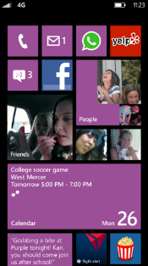
Evaluate this session
Required Slide
*delete this box when your slide is finalized
Your MS Tag will be inserted here during the final scrub.
Scan this QR code to evaluate this session and be automatically entered in a drawing to win a prize!

