Slide 2
Running in the background with background tasks
Hari Pulapaka Lead Program Manager
3-108

Slide 3
Agenda
Overview of the multitasking model
Background tasks architecture
Implementing a background task
Connected standby and background tasks
What’s new in Windows 8.1
Best practices

Slide 4
Multitasking model
Windows 8 app lifecycle designed to ensure consistent battery life and yet provide great user experience
Apps not on screen are suspended
However apps can provide real-time content even when suspended
Live tiles
Scheduled toasts and notifications
Background transfer
Background tasks

Slide 5
Background tasks introduction
Allow apps to run code in the background
Short running tasks that perform work quickly and go away
Run regardless of the state of app
Strict resource usage quotas

Slide 6
What can you do in a background task?
It runs in the same app container as the app, so it is app code
Most APIs are accessible
Audio and video are not accessible due to privacy concerns
No UI other than toasts, badges, and tile updates
E.g. incoming VOIP call, push email, RSS sync

Slide 7
Background task triggers
Background task trigger | Example scenario | Lock screen required?
ControlChannelTrigger | Incoming VOIP call | Yes
DeviceUseTrigger | Sync content with USB or Bluetooth device | No
DeviceServicingTrigger | Update the firmware on USB device | No
LocationTrigger | Create a geofence around a GPS location | Yes
MaintenanceTrigger | Perform maintenance work on AC power | No
PushNotificationTrigger | Incoming WNS push notification to initiate IM conversation | Yes
SystemTrigger | Run code when the user or the Internet is present | No*
TimeTrigger | Periodically download POP3 email every 15 minutes | Yes

Slide 8
Lock screen and resource model
Background tasks are designed for apps to have real-time content
Battery impact of these tasks can be high
Hence, only apps on the lock screen can use real-time background task triggers
All background tasks have resource constraints on CPU and network usage

Slide 9
Background tasks architecture
Windows Store app
Windows Runtime (WinRT)
Background tasks WinRT DLL
Media Foundation
System events service
Time trigger service
Windows Push Notification Services
Control channel service
Location service
Device service
Windows kernel services
Background tasks infrastructure

Slide 10
Writing a background task
Can be authored in any Windows Runtime language (C++, C#, JS, VB)
Must be manifested
App must run to register background tasks
They have one trigger and zero or more conditions
All background task registrations are persistent

Slide 11
Demo

Slide 12
Registering a background task
private void RegisterBackgroundTasks()
{
BackgroundTaskBuilder builder = new BackgroundTaskBuilder();
// Friendly string name identifying the background task
builder.Name = "Background Test Class";
// Class name
builder.TaskEntryPoint = "BackgroundTaskLibrary.TestClass";
IBackgroundTrigger trigger = new TimeTrigger(15, true);
builder.SetTrigger(trigger);
IBackgroundCondition condition = new SystemCondition(SystemConditionType.InternetAvailable);
builder.AddCondition(condition);
IBackgroundTaskRegistration task = builder.Register();
task.Progress += new BackgroundTaskProgressEventHandler(task_Progress);
task.Completed += new BackgroundTaskCompletedEventHandler(task_Completed);
}

Slide 13
Background task run implementation
namespace BackgroundTaskLibrary
{
public sealed class TestClass:IBackgroundTask
{
private int globalcount;
void IBackgroundTask.Run(IBackgroundTaskInstance taskInstance)
{
globalcount = 0;
taskInstance.Canceled += new BackgroundTaskCanceledEventHandler(OnCanceled);
for (int i = 0; i < 100000; ++i)
{
Interlocked.Increment(ref globalcount);
taskInstance.Progress = (uint)globalcount;
}
}
}
}

Slide 14
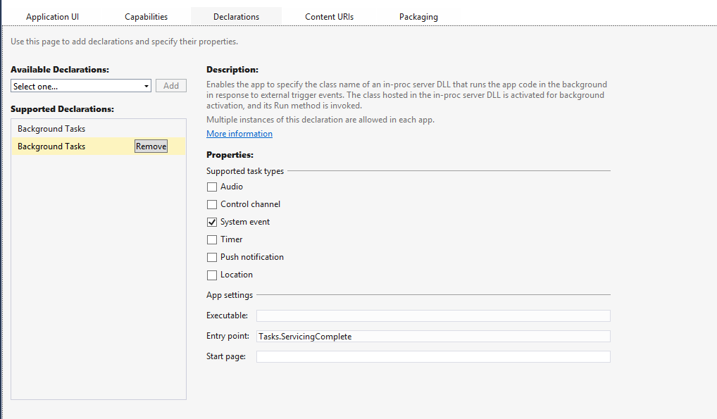

Slide 15
Debugging background tasks
Visual Studio can trigger background tasks
Look in Event Viewer for debugging clues if the task doesn’t start
Application and Services Logs -> Microsoft -> BackgroundTaskInfrastructure
PowerShell cmdlets provided to get more info
get-help AppBackgroundTasks

Slide 16
Demo

Slide 17
Common gotchas
Output type of class library is not Windows Runtime Component
Background task EntryPoint is not accurately described in the manifest
E.g. JS tasks in a sub-directory need to escape the directory separator ‘\’ in their registration
Forgetting to call close() in JavaScript – now a WACK failure
App not on the lock screen and hence background task is not triggered
Not using Visual Studio to trigger and test your background task

Slide 18
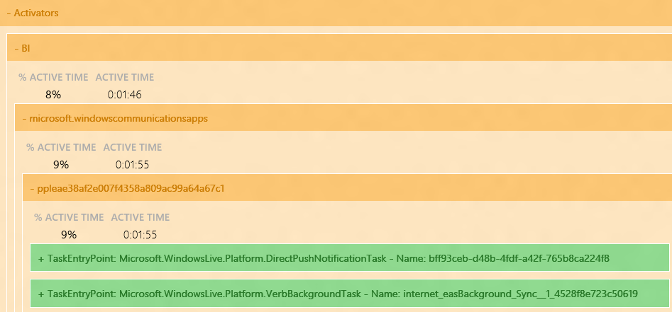
Connected standby
Get real-time email or VOIP calls
Only way to run code during connected standby
System is out of low power mode when tasks are running
powercfg.exe /sleepstudy lists active background tasks in connected standby

Slide 19
Power comes with responsibility
Lessons from telemetry collected on user machines
Developers forget to use InternetAvailable condition
Network is flaky, causing long wait periods
Hence system detects idle tasks and cancels them
However developers forget to add a cancelation handler

Slide 20
Idle task cancelation
System sends a cancelation, cancel all work and return immediately from the background task
public sealed class TestClass:IBackgroundTask
{
CancellationTokenSource cancelTokenSource = new CancellationTokenSource();
async void Run(IBackgroundTaskInstance taskInstance)
{
BackgroundTaskDeferral deferral = taskInstance.GetDeferral();
HostName server = new HostName("contoso.com");
StreamSocket sock = new StreamSocket();
// skipping other extraneous code
taskInstance.Canceled += new BackgroundTaskCanceledEventHandler(OnCanceled);
try
{
await sock.ConnectAsync(server, "http").AsTask(cancelTokenSource.Token); await sock.InputStream.ReadAsync(…).AsTask(cancelTokenSource.Token);
}
finally { deferral.Complete(); }
}
private void OnCanceled(IBackgroundTaskInstance sender, BackgroundTaskCancellationReason reason)
{
cancelTokenSource.Cancel();
}
}

Slide 21
Resource constraints
All background tasks have CPU and network usage quotas
Quotas are based on actual usage instead of wall clock time limits
Shared global pool where apps can request resources
VOIP (lock screen call capable) background tasks are critical
Critical background tasks receive the guaranteed resource quota

Slide 22
Resource quota values
Test with global pool disabled
set-AppBackgroundTaskResourcePolicy –Mode Conservative
Use PowerShell to see the resource usage of a background task
get-AppBackgroundTask -ResourceUsage
 | Refresh period | CPU quota | Network quota @1Mbps | Network quota @10Mbps
Lock screen app | 15 minutes | 2 CPU seconds | 0.469 MB | 4.69 MB
Non lock screen app | 2 hours | 1 CPU second | 0.625MB | 6.25 MB

Slide 23
What's new in Windows 8.1
Quiet hours
More background task triggers
Cancel on condition loss
More developer tools such as PowerShell cmdlets

Slide 24
Quiet hours
No toast notifications or background activity
Not enforced if user is using the device
Currently running background tasks are canceled on entry
Lock screen call capable apps are allowed to present VOIP toasts
Alarm toasts are raised during quiet hours

Slide 25
Other background task updates
New triggers
LocationTrigger
DeviceUseTrigger
DeviceServicingTrigger
BackgroundWorkCostChange
Cancel background task on condition changing
IBackgroundTaskBuilder.CancelOnConditionLoss

Slide 26
Dos and Don'ts
Design background tasks to be short lived
Design the lock screen user experience as described in the Guidelines and checklists for lock screen tiles
Decouple the background task from the main app
Use persistent storage to share data between the background task and the app
Register for a background task cancellation handler in the background task class
Do not display UI other than toast, tiles, or badges from a background task
Do not rely on user interaction in background tasks

Slide 27
Related sessions
3-159 – Alive with activity: Tiles, notifications, and background tasks
3-026 – Apps for Bluetooth, HID, and USB Devices
3-090 – Web content: Fast and Fresh apps
4-107 – Windows Runtime Internals: Understanding the threading model

Slide 28
Resources
Introduction to background tasks: http://www.microsoft.com/en-us/download/details.aspx?displaylang=en&id=27411
Background tasks sample project: http://code.msdn.microsoft.com/windowsapps/Background-Task-Sample-9209ade9
Background networking: http://www.microsoft.com/en-us/download/details.aspx?id=28999
Being productive in the background: http://blogs.msdn.com/b/windowsappdev/archive/2012/05/24/being-productive-in-the-background-background-tasks.aspx
Guidelines and checklists for lock screen tiles: http://msdn.microsoft.com/en-us/library/windows/apps/hh465403.aspx
Lock screen call capability sample project: http://code.msdn.microsoft.com/windowsapps/Lock-Screen-Call-SDK-Sample-fb701f9f

Slide 29
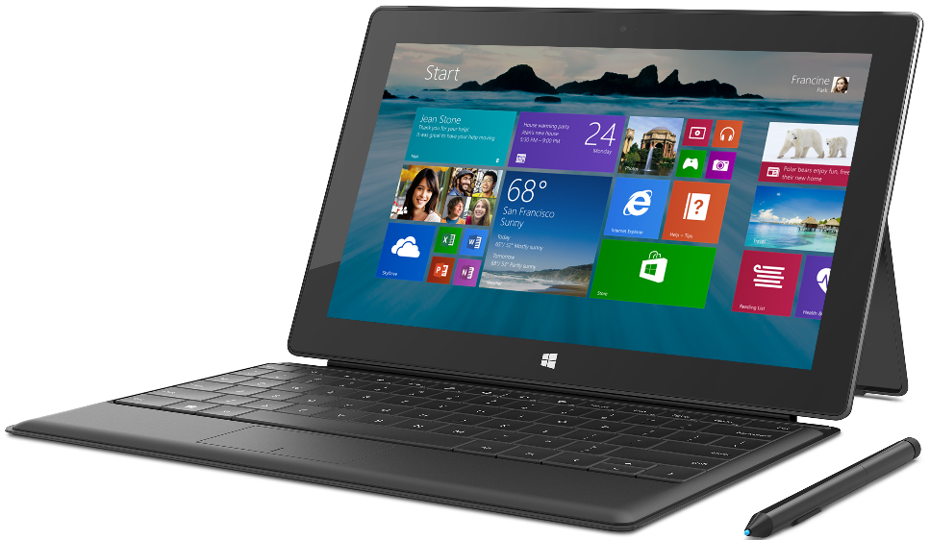
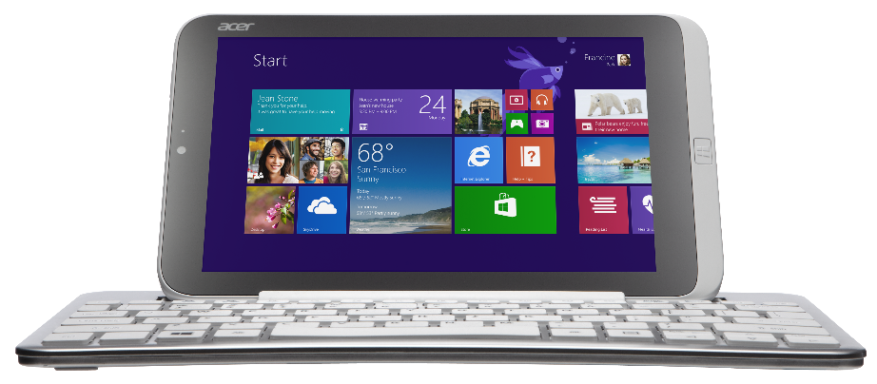
Acer Iconia W3, Surface Pro, and Surface Type Cover
Get your goodies
Device distribution starts after sessions conclude today (approximately 6:00pm) in the Big Room, Hall D.
If you choose not to pick up your devices tonight, distribution will continue for the duration of the conference at Registration in the North Lobby.

Slide 30
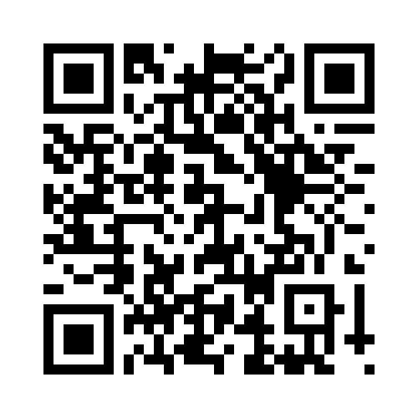
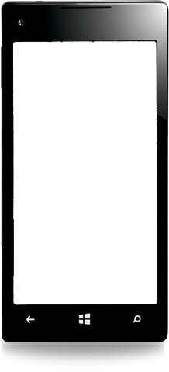
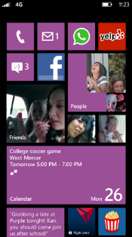
Evaluate this session
Required Slide
*delete this box when your slide is finalized
Your MS Tag will be inserted here during the final scrub.
Scan this QR code to evaluate this session and be automatically entered in a drawing to win a prize!

