Slide 2
Developing Windows 8.1 apps With Windows Azure Mobile Services
Nick Harris | @cloudnick
Sr Technical Evangelist
Microsoft Corporation
3-116

Slide 3
Agenda
Getting Started
Auth
Geolocation
Media
Notifications and Live Tiles

Slide 4
Getting Started
Connecting your Windows Store app

Slide 5
Auth
Authenticate users using Mobile Services
How do I restrict data access based on the authenticated user
Caching Credentials

Slide 6
Geolocation
Where am I?
Save a place of interest
Search for places nearby

Slide 7
Media
How do I capture Media
How can I securely upload my Media to Windows Azure Storage

Slide 8
Notifications and Live Tiles
Using Custom API for periodic notifications
Using WNS for Push Notifications

Slide 9
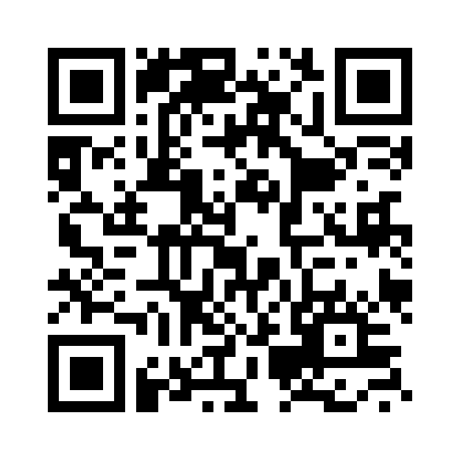
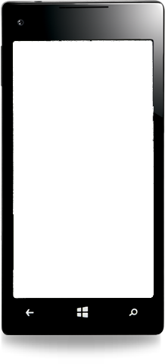
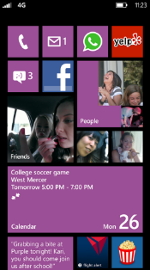
Evaluate this session
Required Slide
*delete this box when your slide is finalized
Your MS Tag will be inserted here during the final scrub.
Scan this QR code to evaluate this session and be automatically entered in a drawing to win a prize!

