Slide 2
Monetization opportunities for Windows Store apps in Windows 8.1
Arik Cohen
Principal Program Manager Lead
3-121

Slide 3
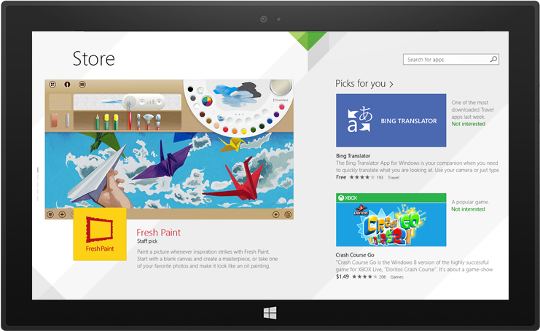
Agenda
Monetization options
New in Windows 8.1
Your choices
Finding the right sweet spot

Slide 4
Monetization options
Growth in advertising and post-download purchases
Industry trends on how monetization is being done
Source: VisionMobile, January 2013

Slide 5
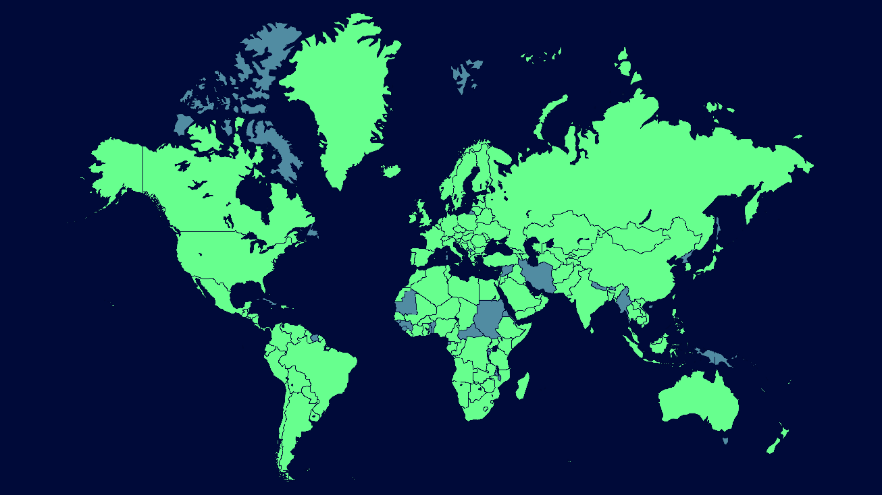
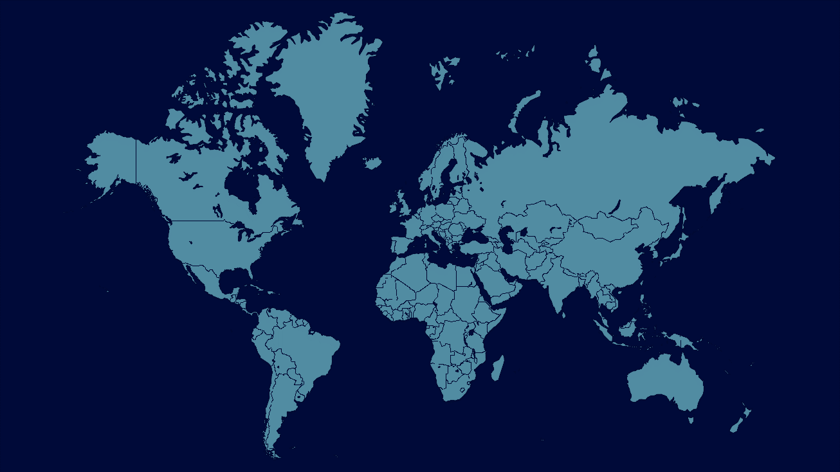
Global opportunity

Slide 6
What’s new in Windows 8.1
Alipay
Gift card
70+ new developer markets
Consumable in-app purchases
Managing your own in-app catalog
Additional types of in-app content
Auto-updating of your apps

Slide 7
Monetization options
Advertising
Pay for download
In-app purchases
Use
existing

Slide 8
Demo: Monetization options in action

Slide 9
Monetization options
Advertising
Pay for download
In-app purchases
Use
existing

Slide 10
Advertising Best practices
Update your app as your ad platform updates
Recent Microsoft Ads SDK update gives your app ad targeting and keeps your users in control
Use ad sizes that pay the most
250x250, 300x250, 160x600, 728x90, 300x600 (new)
Design ads into your app experience

Slide 11
Advertising
Choice of ad providers
Microsoft Ads SDK
Enables targeting
Ads SDK integrated into VS 2013

Slide 12
Demo: Microsoft Ads SDK 8.1

Slide 13
Monetization options
Advertising
Pay for download
In-app purchases
Use
existing

Slide 14
Pay for download Best practices - trials
12x download vs paid only
15x download when promoted
~70% of top paid apps have trials
95% of top grossing apps have trials

Slide 15
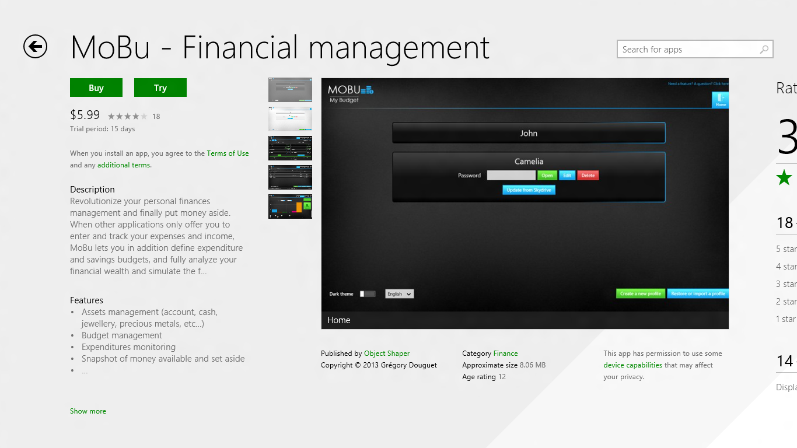

Slide 16
Pay for download
Time-based trials
Feature-differentiated trials

Slide 17
Implementation basics
Check the license
Get listing data to populate UX
Prompt for purchase

Slide 18
Check the license
// get access to the current app for testing
using Store = Windows.ApplicationModel.Store.CurrentAppSimulator;
// check to see if the user has an active non-trial license
if (Store.LicenseInformation.IsTrial) {
// user has trial version of the application
}
// get access to the current app
using Store = Windows.ApplicationModel.Store.CurrentApp;
// check to see if the user has an active non-trial license
if (Store.LicenseInformation.IsTrial) {
// user has trial version of the application
}

Slide 19
Get the listing data
try
{
StoreListingInfo = await Store.LoadListingInformationAsync()
}
catch
{
// handle offline case
}
string price = StoreListingInfo.FormattedPrice;
<ListingInformation>
<App>
<MarketData xml:lang="en-us">
<Name>Build my run</Name>
<Price>1.99</Price>
<CurrencySymbol>$</CurrencySymbol>
<CurrencyCode>USD</CurrencyCode>
</MarketData>
</App>
</ListingInformation>

Slide 20
Prompt for purchase
await Store.RequestAppPurchaseAsync(fRerequestReceipt);

Slide 21
Demo: Add feature-differentiated trial

Slide 22
Monetization options
Advertising
Pay for download
In-app purchases
Use
existing

Slide 23
In-app purchases Best practices
Psychology of a user
Where to offer upsell

Slide 24
In-app purchases
Durable purchases
Expiring durable purchases
Consumables
Manage your own catalog

Slide 25
Consumable basics
Initiate the purchase
Grant user the product
Report fulfillment
App builds purchase history
Must report fulfillment before it can be purchased again

Slide 26
Demo: Consumable purchases

Slide 27
Measuring performance

Slide 28
Find the right sweet spot
Example app 1
Paid app at $3.99
Added 7 day trial
Moved to feature differentiated trial
Changed price to $2.49
Example app 2
Free app with ads
Added new IAPs to provide additional functionality
Added 3 new IAPs to replace ads for different amounts of time
Added IAP to remove ads

Slide 29
Monetization options
Advertising
Pay for download
In-app purchases
Use
existing

Slide 30
More information
Microsoft Ads SDK update for Windows 8 apps available now
Updated samples and SDK content @ http://dev.windows.com
More talks
Thursday @ 5pm 3-125 The fast lane for certification
Friday @ 9am 3-126 Validating Windows Store purchases for your app
Friday @ 10:30am 2-130 The Wow Factor: Making your Windows Store app promotable
Use Microsoft Ads SDK as part of the Quickstart Challenge

Slide 31
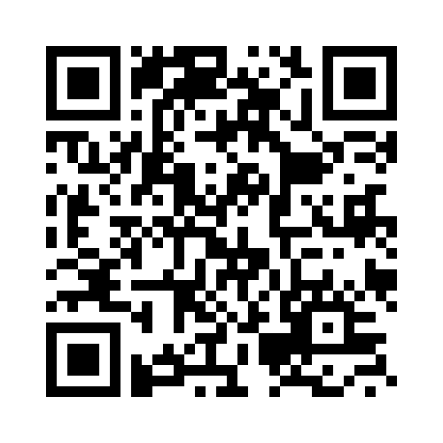
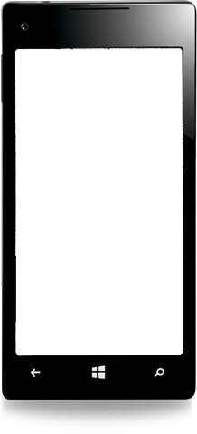
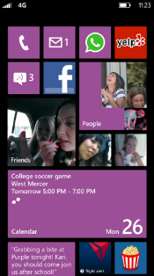
Evaluate this session
Required Slide
*delete this box when your slide is finalized
Your MS Tag will be inserted here during the final scrub.
Scan this QR code to evaluate this session and be automatically entered in a drawing to win a prize!

