Slide 2
Dramatically increase performance for large amounts of data in Xaml GridView and ListView
Chipalo Street
Program Manager II
3-158

Slide 3
Agenda
Panning
Item virtualization
Placeholder elements
Incremental update
Startup
Presenter elements
Customizing presenters

Slide 4
Panning

Slide 5
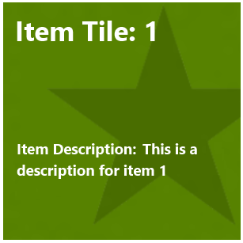
Data template vs. item container template

Slide 6
Data template vs. item container template

Slide 7
Data template vs. item container template

Slide 8
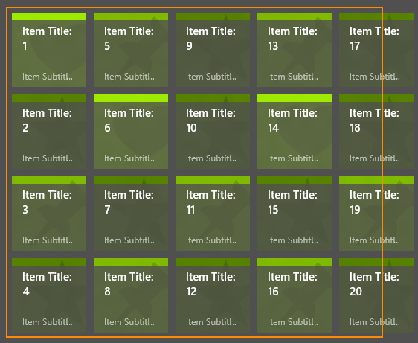
Panning perf overview

Slide 9
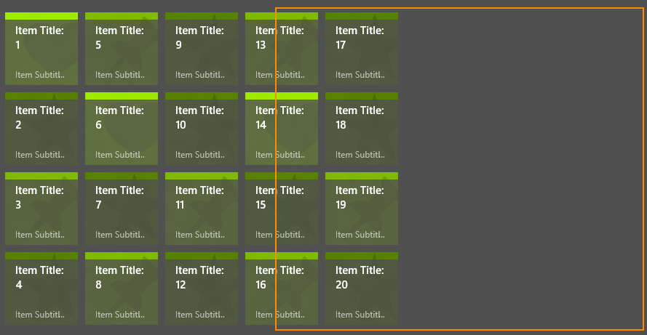
Panning perf overview

Slide 10
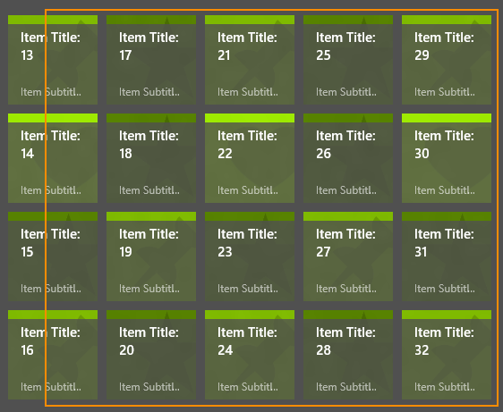
Panning perf overview

Slide 11
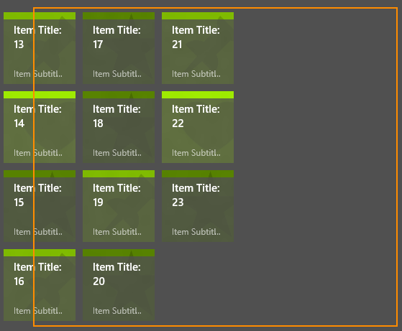
Panning perf overview

Slide 12
Panning perf overview – UI virtualization

Slide 13
Panning perf overview – UI virtualization

Slide 14
Use ItemsStackPanel or ItemsWrapGrid to get item virtualization. The framework automatically does this for all apps that use the default ItemsPanel.

Slide 15
Item virtualization improvements

Slide 16
Panning perf overview

Slide 17
Panning perf overview
UI thread work

Slide 18
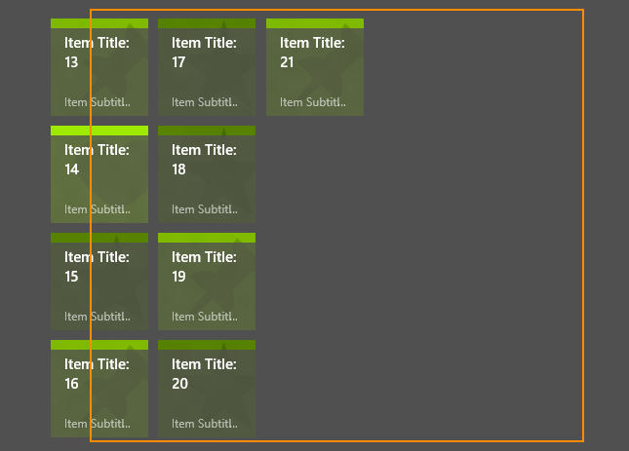
Panning perf overview
render item 21

Slide 19
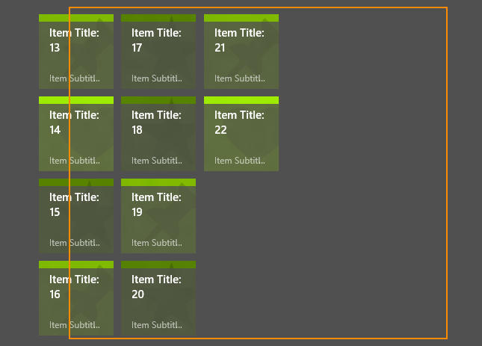
Panning perf overview
render item 22

Slide 20
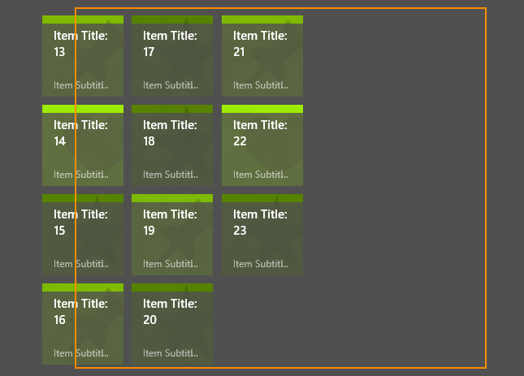
Panning perf overview
render item 23

Slide 21
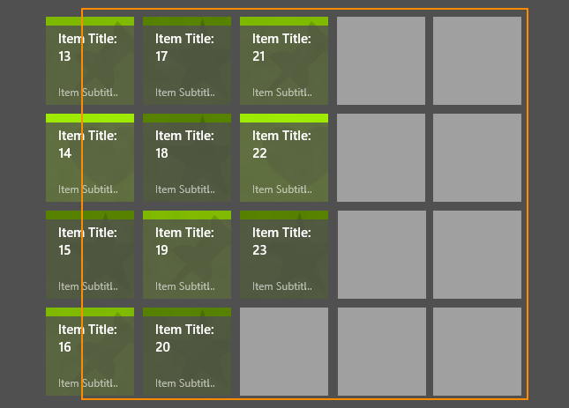
Placeholders increase perceived performance
<GridView ShowsScrollingPlaceholders="true“>

Slide 22
All apps running on Windows 8.1 get placeholders for free.

Slide 23
Perf improvement from placeholders

Slide 24
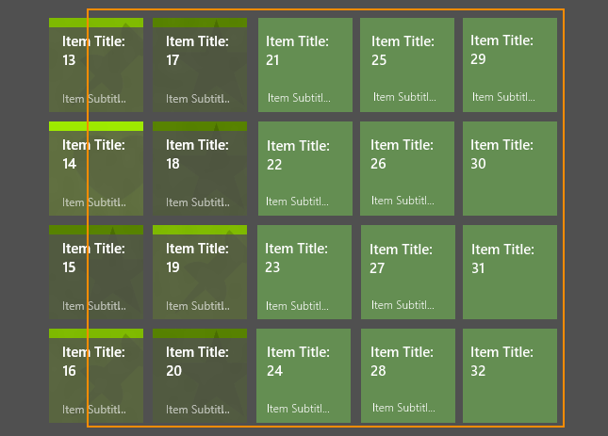
Incrementally updating the data template

Slide 25
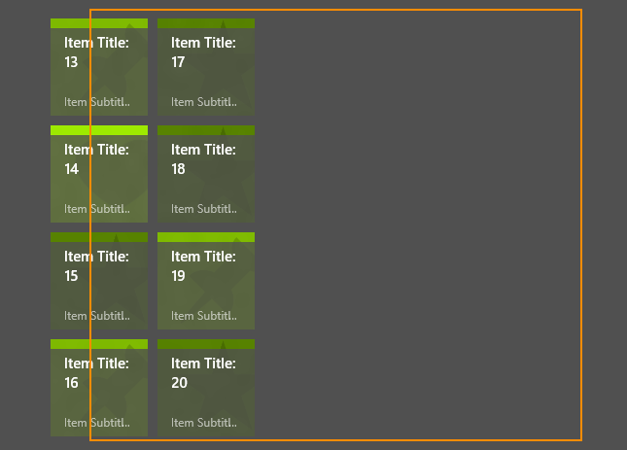
Incrementally updating the data template
UI thread work

Slide 26
Incrementally updating the data template
UI thread work

Slide 27
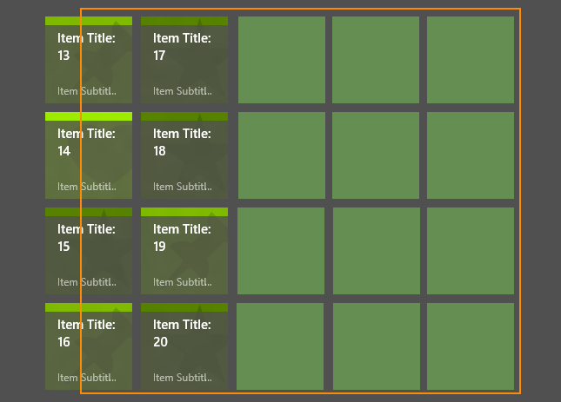
Incrementally updating the data template
phase 0

Slide 28
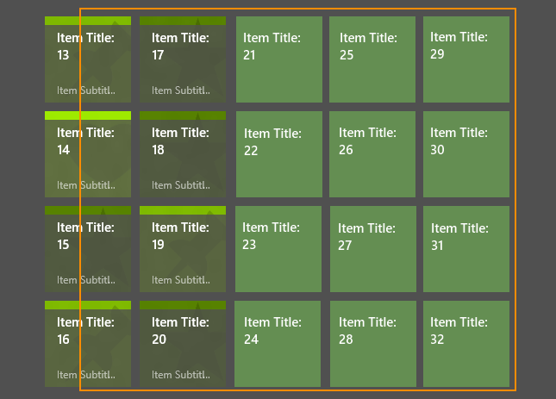
Incrementally updating the data template
phase 1

Slide 29
Incrementally updating the data template
phase 2

Slide 30
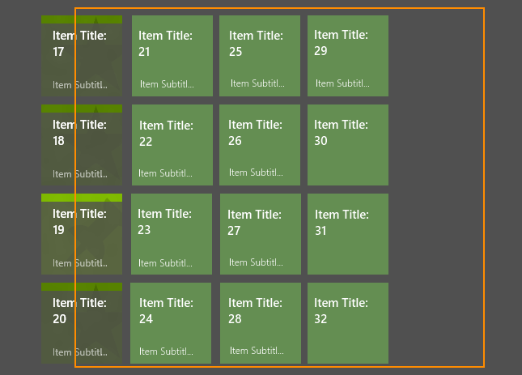
Incrementally updating the data template
UI thread work

Slide 31
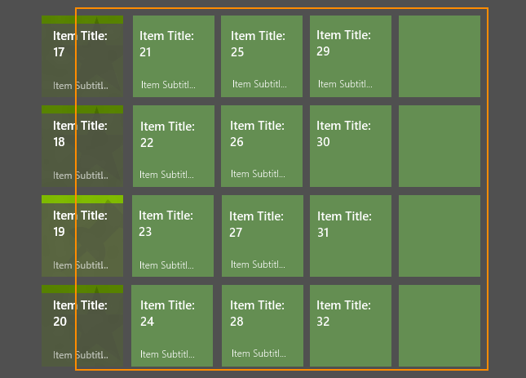
Incrementally updating the data template
phase 0

Slide 32
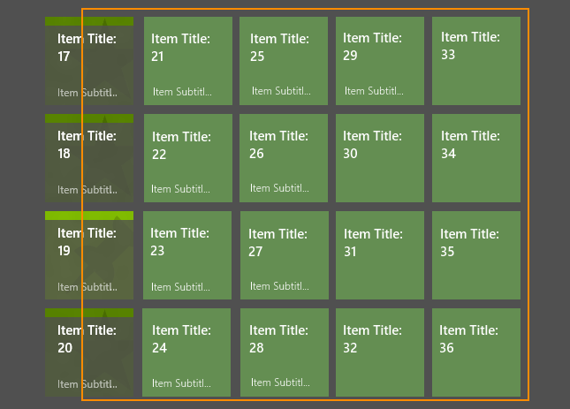
Incrementally updating the data template
phase 1

Slide 33
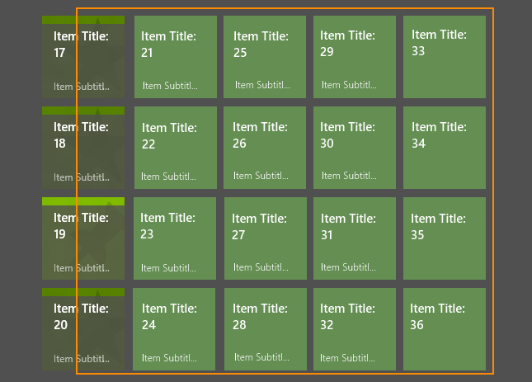
Incrementally updating the data template
phase 2

Slide 34
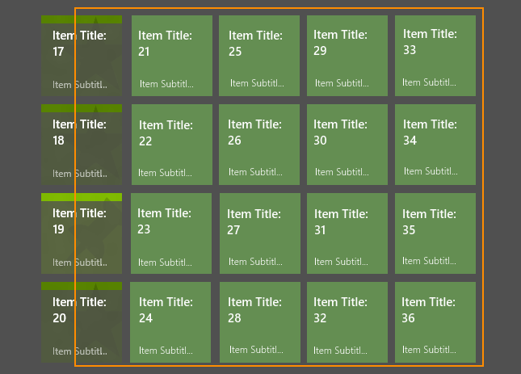
Incrementally updating the data template
phase 2

Slide 35
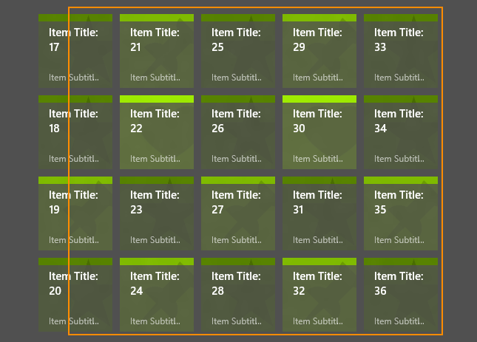
Incrementally updating the data template
phase 3

Slide 36
ContainerContentChanging
<GridView ContainerContentChanging=“YourCCCEventHandler“>
ContainerContentChanging args
Phase
RegisterUpdateCallback
Handled
ItemContainer
Item
InRecycleQueue
ItemIndex

Slide 37
Consider implementing incremental updating for scenarios when rendering items is expensive.

Slide 38
Using ContainerContentChanging to implement incremental updating

Slide 39
Startup

Slide 40
Data template vs. item container template

Slide 41
Data template vs. item container template

Slide 42
Data template vs. item container template

Slide 43
Win 8 item container templates are expensive

Slide 44
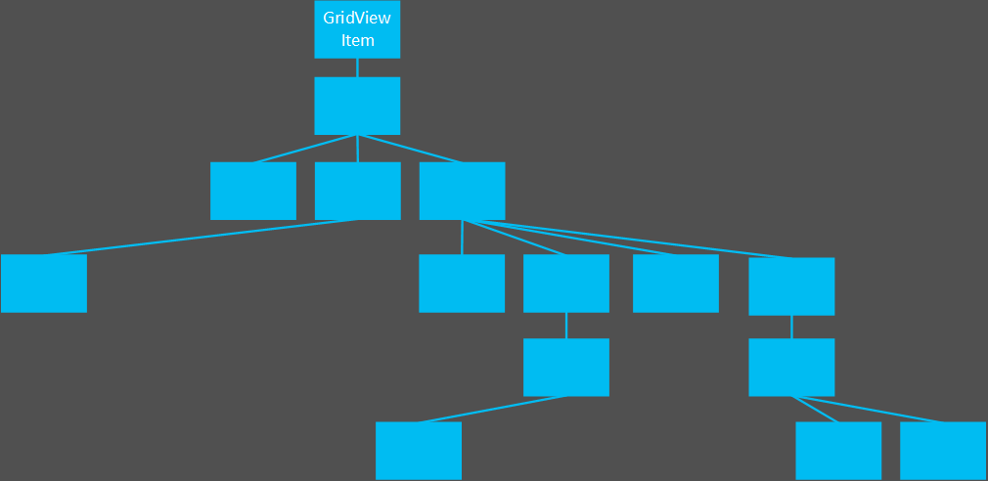
Win 8 item container templates are expensive

Slide 45
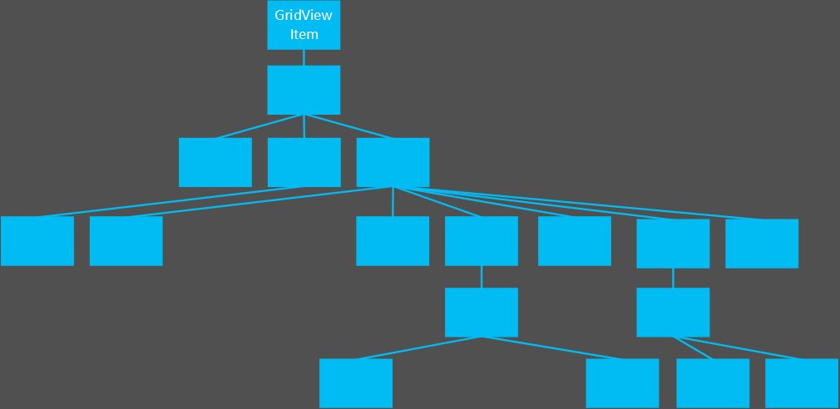
Win 8 item container templates are expensive

Slide 46
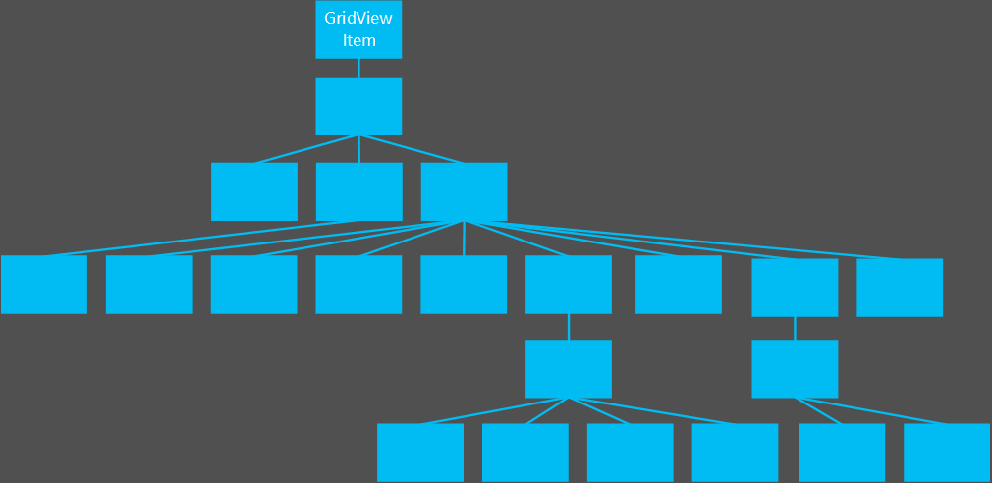
Win 8 item container templates are expensive

Slide 47
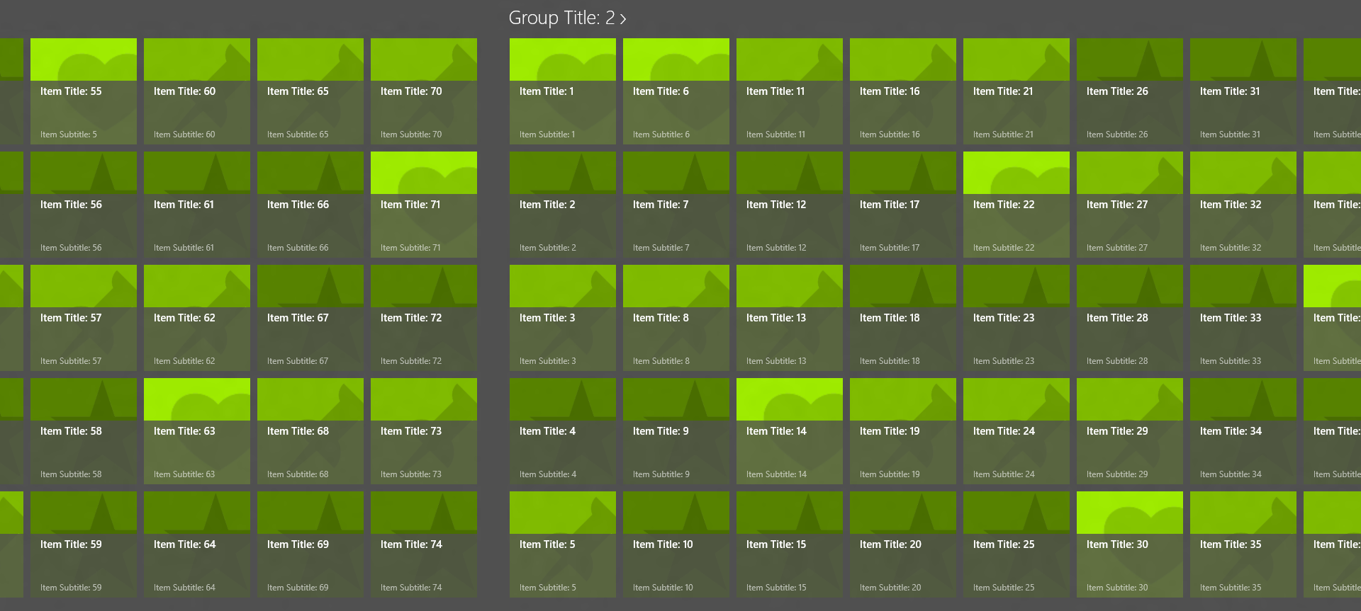
Many items exacerbate problem
1050 objects created for state alone!

Slide 48
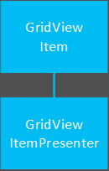
Item presenters
Windows 8
Windows 8.1

Slide 49
All apps that use default item container visuals start up to 26% faster when running on Windows 8.1

Slide 50
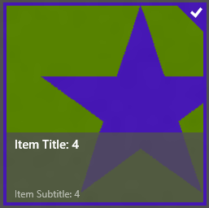
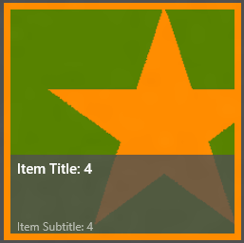
Use presenters in customized item container templates
+
<GridViewItemPresenter
SelectionChecMarkVisualEnabled=“False”
SelectionBackground=“#FFFF8c00”
SeletionBorderThickness=“5” />
=

Slide 51
Use presenters in customized item container templates to get start up improvements on Windows 8.1

Slide 52
Migrating to GridViewItemPresenter

Slide 53
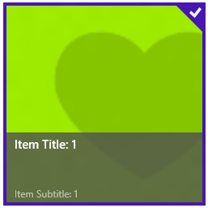
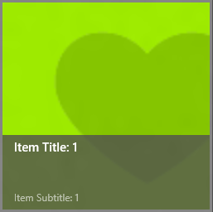
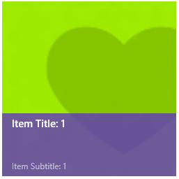
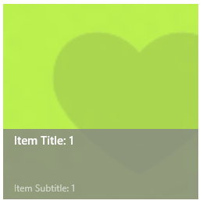
Structural item container template customization
$$\text{✘}$$
$$\text{✘}$$
Default
Customized

Slide 54
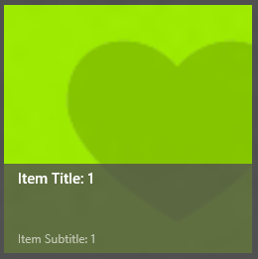
Build visual tree with GoToElementStateCore

Slide 55
Build visual tree with GoToElementStateCore

Slide 56
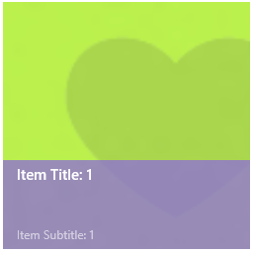
Build visual tree with GoToElementStateCore

Slide 57
Build visual tree with GoToElementStateCore

Slide 58
Build visual tree with GoToElementStateCore
Customization via GoToElementStateCore
Customization via Windows 8 template

Slide 59
Building a visual tree on demand of customized item container templates results in better startup performance and reduced memory overhead.

Slide 60
Review – Item virtualization
Faster startup and faster item presentation
 | Default ItemsPanel | Custom ItemsPanel
Windows 8 | Recompile app for 8.1 | Change to new panel
Windows 8.1 | FREE! | Change to new panel

Slide 61
Review – Placeholders
Improves perceived performance
Free for all apps!

Slide 62
Review – Incremental update
Incrementally update all items instead of fully rendering a few
Windows 8 – N/A
Windows 8.1 – Use ContainerContentChanging

Slide 63
Review – Presenters
$$✔$$
Improve startup by up to 26%
 | Default ItemContainer Style | Custom ItemContainer Style
Windows 8 | Recompile app for 8.1 | Change template to use presenters
Windows 8.1 | FREE! | Change template to use presenters
$$\text{✘}$$

Slide 64
Review – GoToElementStateCore
Improve startup by up to 26%
Windows 8 – N/A
Windows 8.1 – Use GoToElementStateCore

Slide 65
Resources
Notes in the slides!
3-157 Xaml Performance Fundamentals
3-403 App Performance: The Mental Model for Interacting with the Platform
3-099 App Performance: From UX to API for 5 Key Scenarios
2-100 App Performance: The Windows Performance Toolkit
2-098 App Performance: Planning Costs Less Than Architecting
http://aka.ms.fastxaml

Slide 66
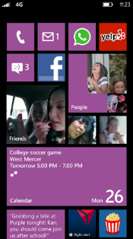
Evaluate this session
Required Slide
*delete this box when your slide is finalized
Your MS Tag will be inserted here during the final scrub.
Scan this QR code to evaluate this session and be automatically entered in a drawing to win a prize!

