Slide 2
WebView: Bringing the web to your app
John Hazen
Program Manager
3-179

Slide 3
Agenda
Web + Windows
Introduction to WebView
Demos and Code

Slide 5
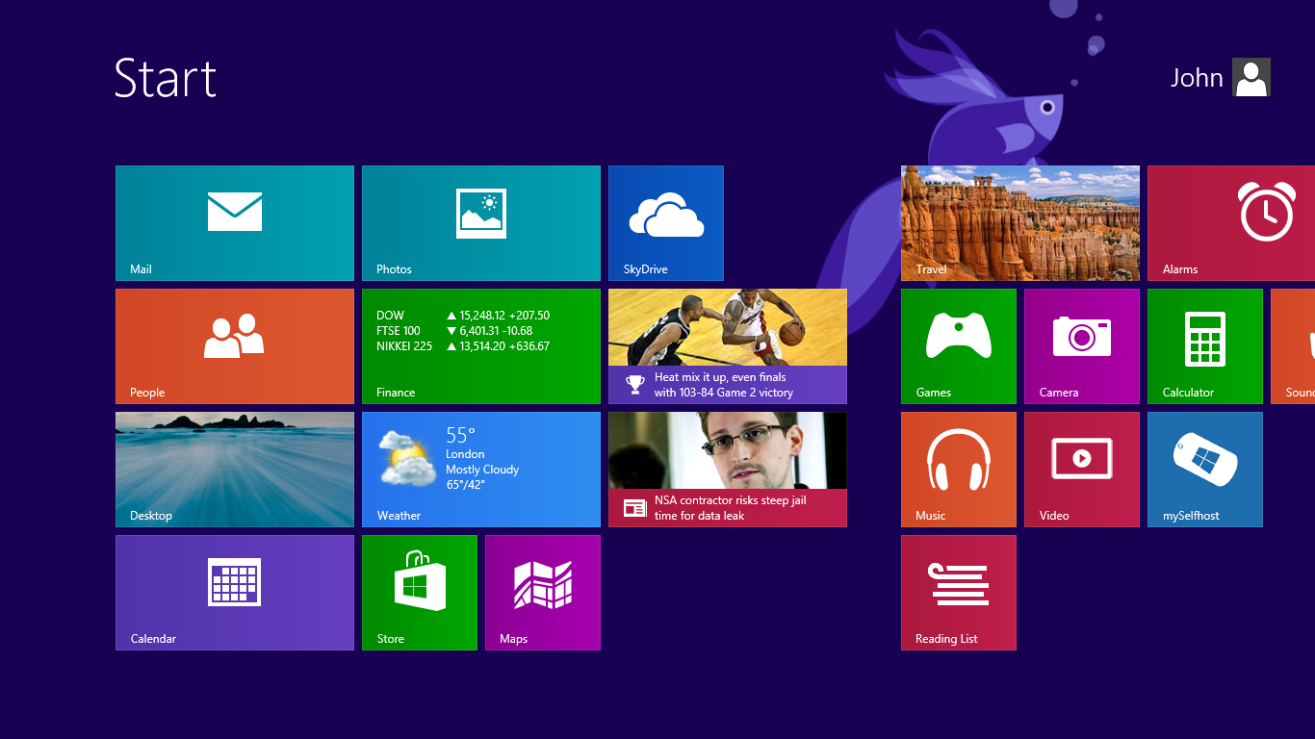

Slide 6
Continuum of Support
IE with live tiles, notifications, and contracts
Building Windows Store apps using familiar web technologies
Web sites integrated into Windows Store apps

Slide 7
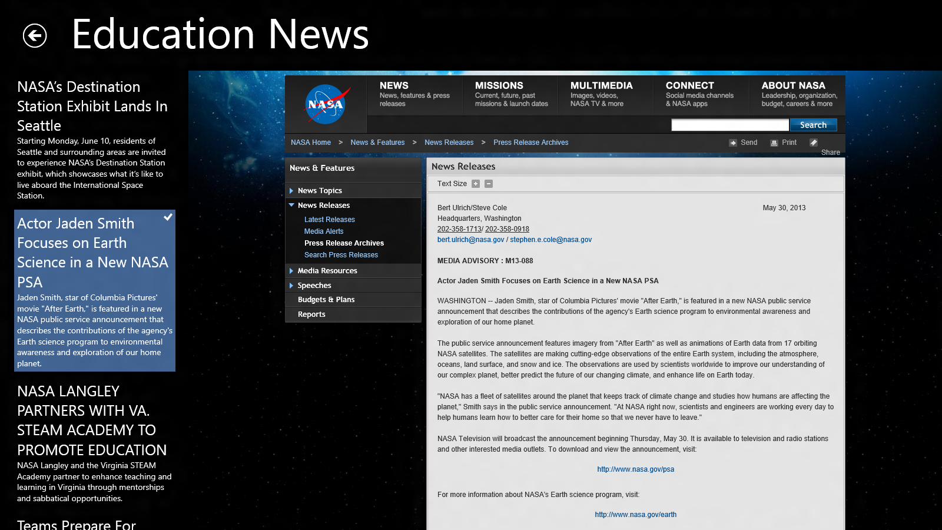
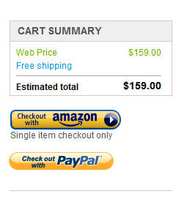
Windows Store apps and the Web
Display a web page
The Internet
Provide a native experience
for a cloud based app
Integrate a web
component or service

Slide 8
Displaying Web Content in Windows 8
<iframe id=“myIframe” src=“http://example.com”></iframe>
Familiar mechanism for HTML developers
<WebView x:Name="myWebView" Source="http://example.com" />
Familiar mechanism for XAML developers
Both have limitations…

Slide 9
WebView control for Windows 8.1
Integrated WebView into display tree!
Complete set of navigation events and methods
Navigate to local content
Integrated with SmartScreen to block phishing attacks
Single great control available to XAML and HTML developers

Slide 10
Key WebView events
Navigation events
Navigation starting
Content loading
DOMContentLoaded
Navigation completed
Content events
Unviewable content
Potentially unsafe content
Script
Script executing

Slide 11
Key WebView methods
Navigation
Navigate / Stop / Refresh
CanGoForward & GoForward
CanGoBack & GoBack
Content
Capture preview
Capture selection
Communication
InvokeScriptAsync & ScriptNotify

Slide 12
Protecting your app and customer data
SmartScreen in WebView
Intentional and Trustworthy Communication
Manifest and SSL is critical for app and data integrity
Impact for iframes
WebView and ScriptNotify

Slide 13
DEMO: Intro to WebView

Slide 14
DEMO: WebView in HTML

Slide 15
WebView local navigation support
Navigation to ms-appdata://
http:// - navigate to internet content
ms-appx-web:// - navigate to content in app package
ms-appdata:// - navigate to local app state directory
Nativation to ms-local-stream://
myWebView.NavigateToLocalStreamUri( initialUri, resolver );
BuildLocalStreamUri – constructs initial ms-local-stream:// URI
IUriToStreamResolver – returns Windows.Storage.Streams.IInputStream

Slide 16
DEMO: WebView on XAML

Slide 17
Summary
Dramatically improved WebView
Use WebView where possible
Move to SSL to protect your code and your customer

Slide 18
Resources
WebView API reference (XAML)
WebView API reference (WinJS)
Windows 8.1 Preview Samples
Windows 8.1 Preview: New APIs and features for developers

Slide 19
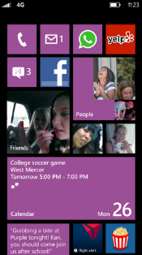
Evaluate this session
Required Slide
*delete this box when your slide is finalized
Your MS Tag will be inserted here during the final scrub.
Scan this QR code to evaluate this session and be automatically entered in a drawing to win a prize!

