Slide 2
Building .NET Apps for Devices and Services
Habib Heydarian (habibh@microsoft.com)
Program Manager, .NET
3-304: Building .NET Applications for Devices and Services

Slide 3
Let’s a start with a quick demo!

Slide 4
The evolution of application into experience
What used to be:
Has evolved into:
“I type http://www.netflix.com in my browser to watch a movie”
“My friend mentions the TV series Breaking Bad over a coffee. I use my phone to find it and add it to my Netflix queue. I start watching it on the bus on my tablet. I then continue watching it at home on my TV.”

Slide 5
What is an application?
In the 80s & most of 90s
An app is an exe on my machine
In the ~1st decade of 2000
An app is an exe on my machine or a website
Today
An app is something that runs on a phone or tablet or PC or console or car or ?. Is connected. Could also be a website or service, or ???

Slide 6
Application Modernization
Modern Times!

Slide 7
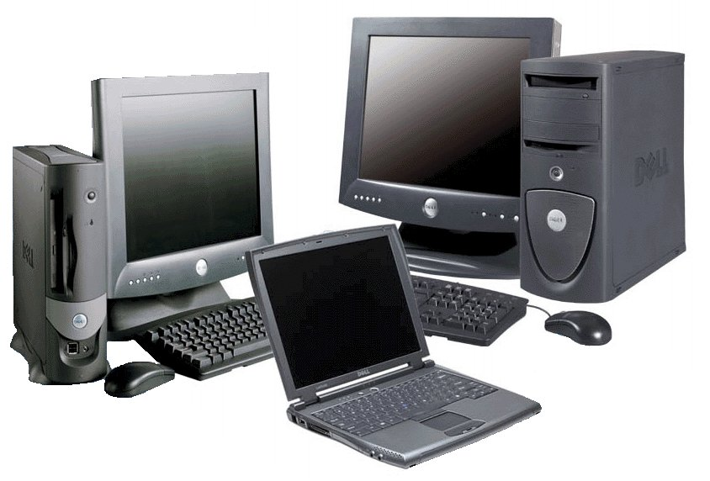
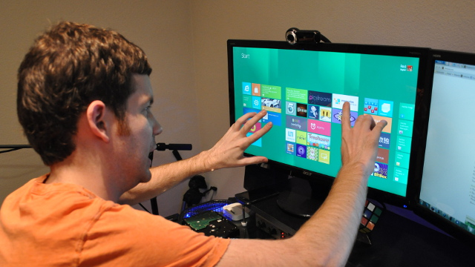
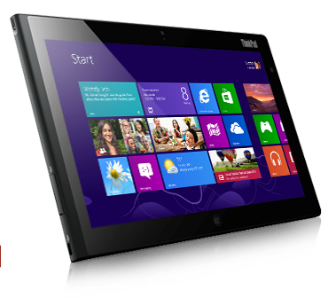
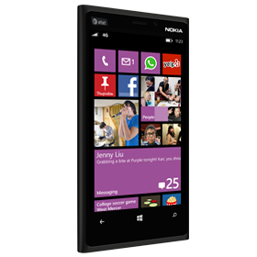
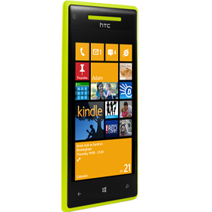
Development targets are evolving

Slide 8
Application patterns evolution
+
Client
Devices
+
Servers
Services
Established patterns
Emerging patterns

Slide 9
.NET Application Modernization
WEB APPLICATIONS
Web-PC form factor
Web tablet / phone form-factors
NATIVE APPLICATIONS
Desktop-only
Windows Store
Windows Phone
Non-Microsoft native apps
SERVICES
On-premises only
Hybrid
Cloud

Slide 10
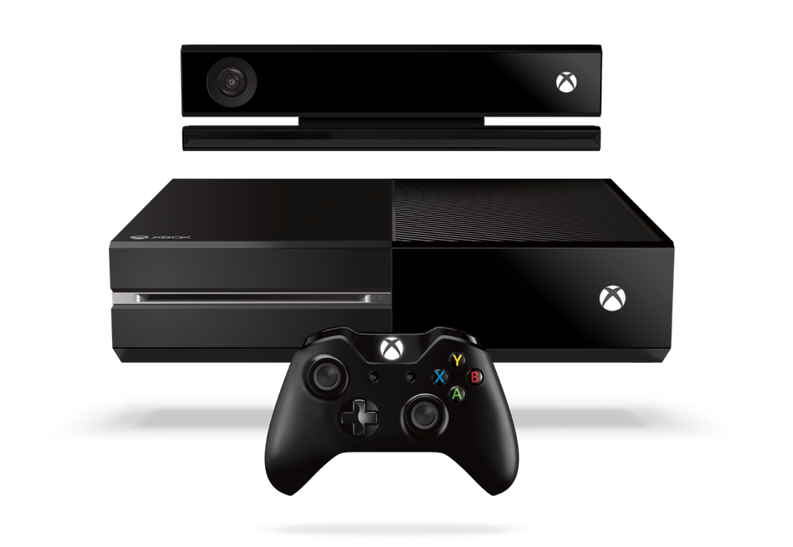
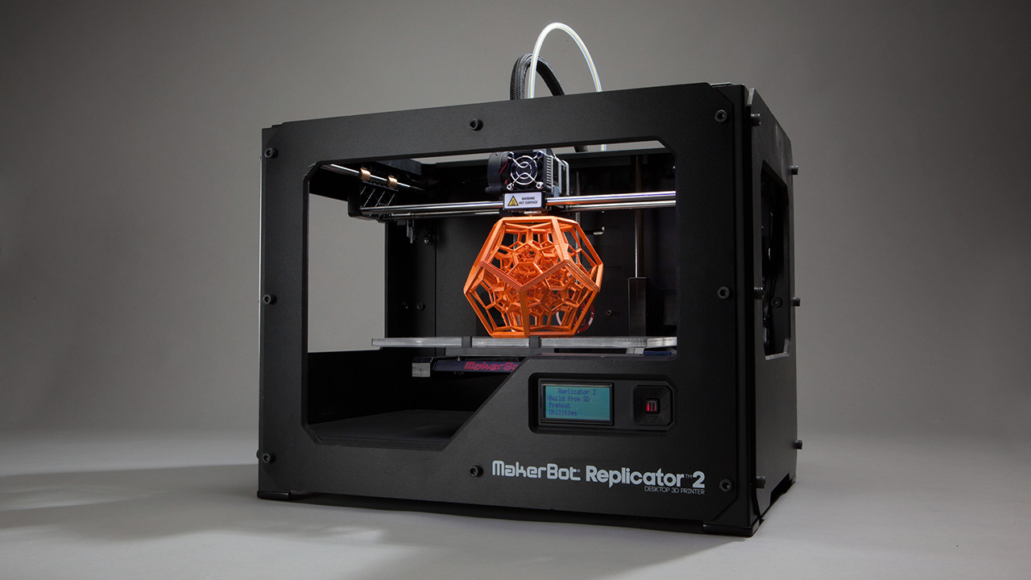
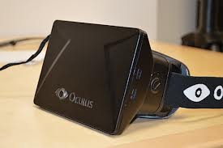
Two Inexorable Trends
1. Devices will continue to proliferate at an astonishing rate
Form factors that we can’t imagine today
2. The Cloud movement is just beginning

Slide 11
Developer Expectations
Easy to reuse source code and binaries across devices
New devices do not constitute a reset

Slide 12
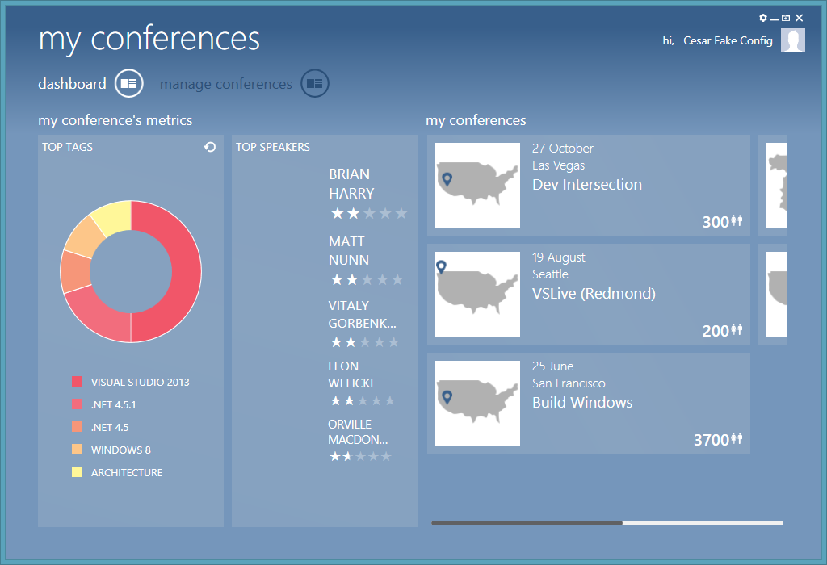
An Example: Existing WPF Application
Rich UI
On-Prem DB

Slide 13
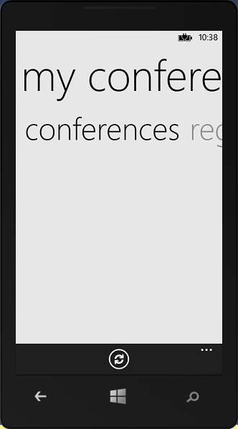
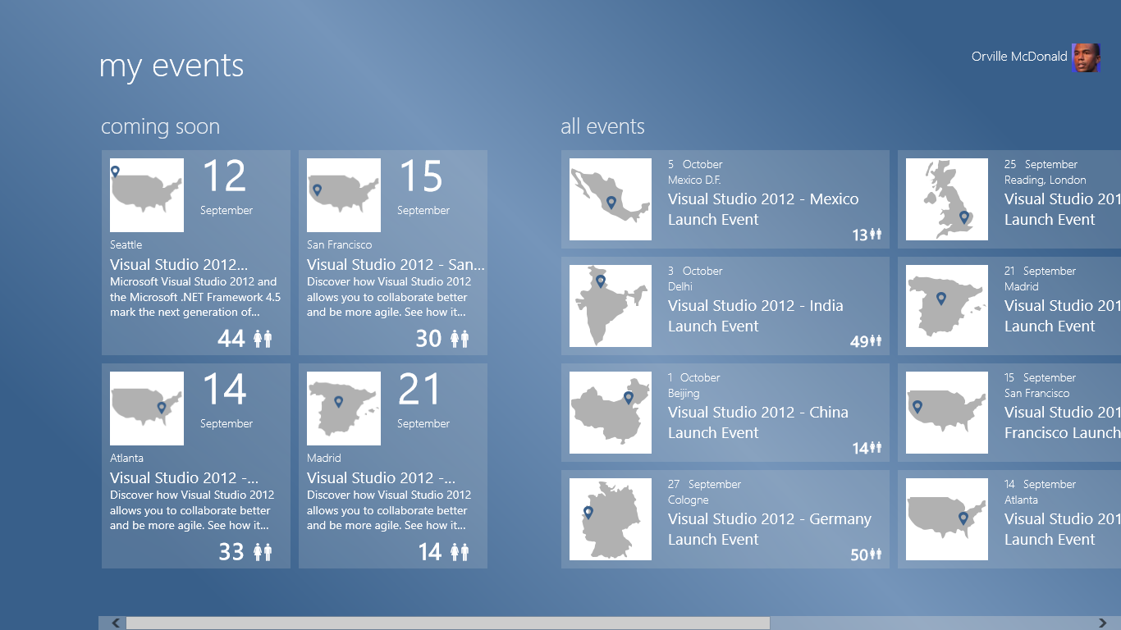
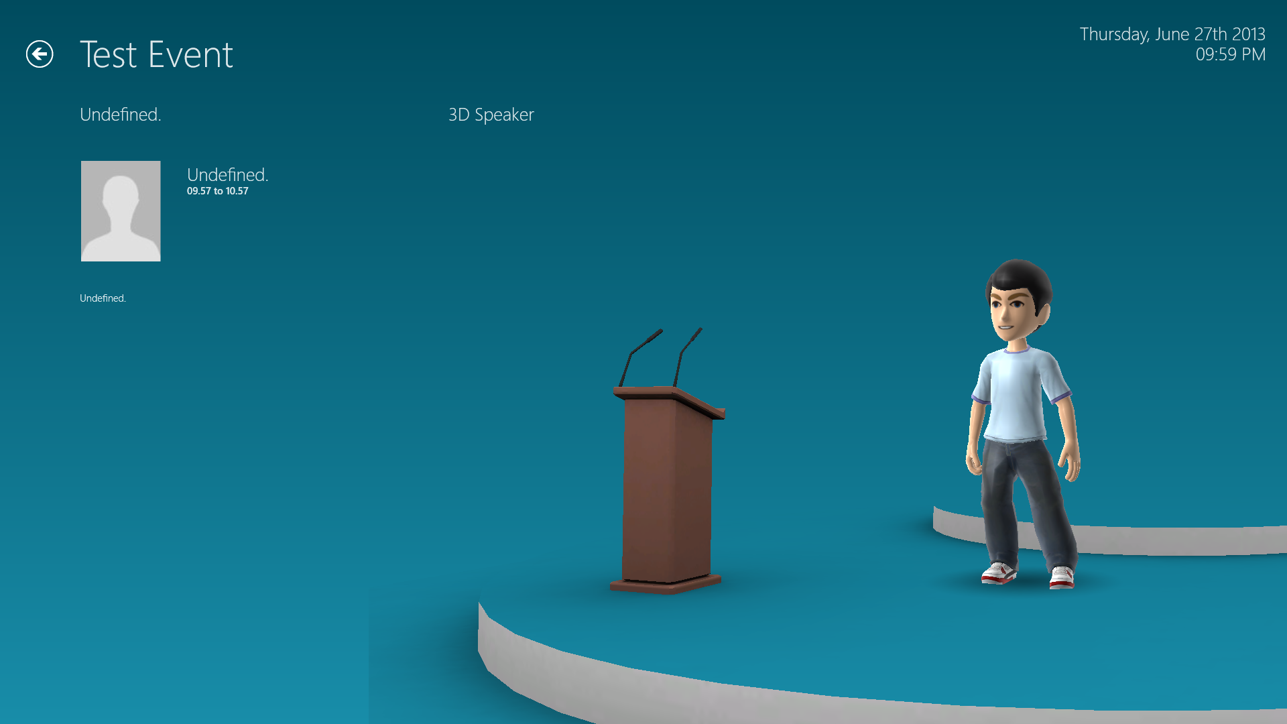
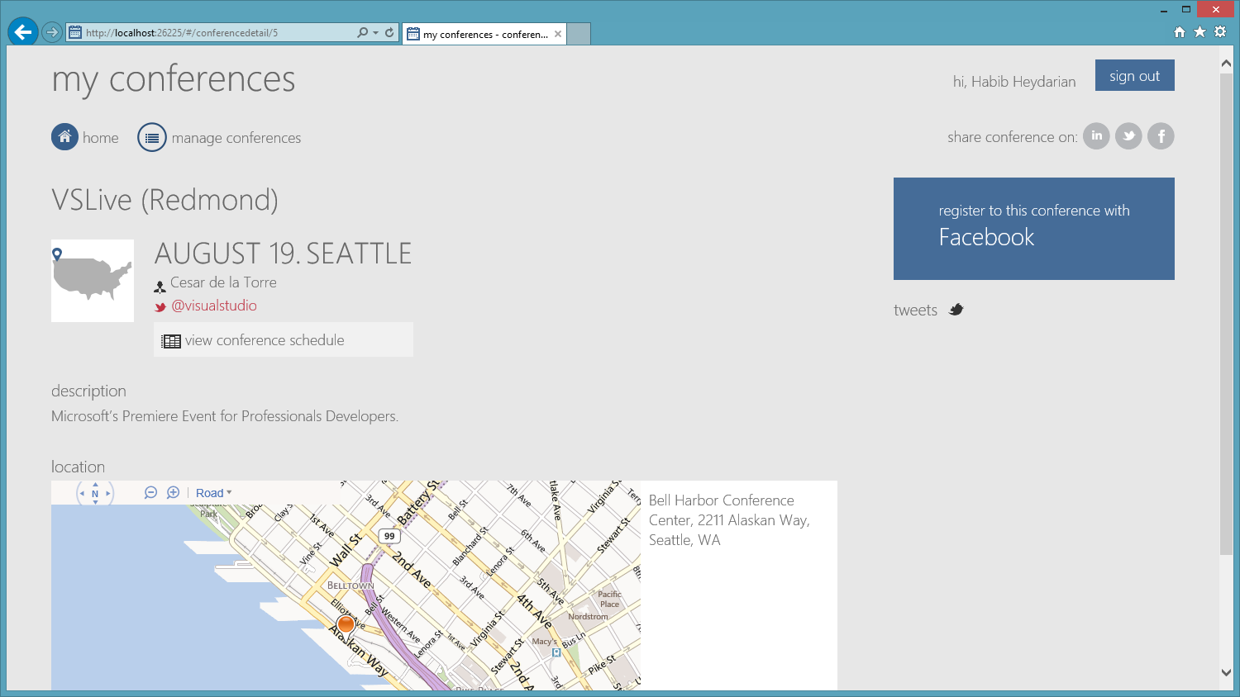
The “Experience Continuum”
Tablet (Mobile)
Phone (Ultra Mobile)
Desktop (Rich)
Cloud (The Connective Tissue)
NUI
Web (Reach)

Slide 14
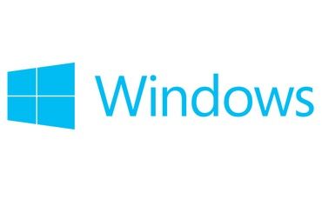
.NET is part of many Microsoft platforms
(Redistributes)

Slide 15
.NET (A *Very* Simplified View)
Runtime
Libraries
.NET
Languages
Tools
General & platform specific capabilities

Slide 16
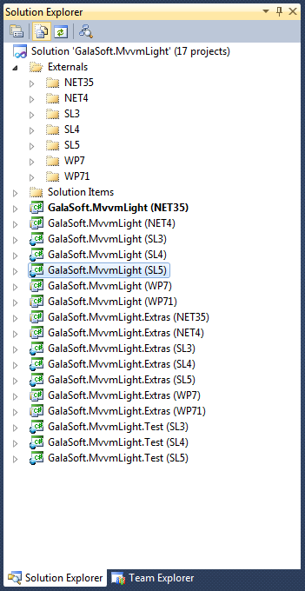
Project proliferation

Slide 17
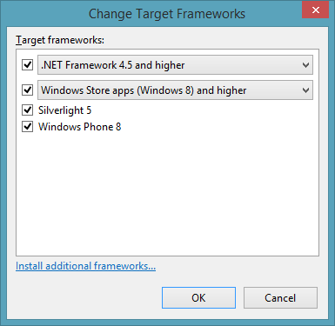
Portable Class Libraries
One source
One project
One binary
Multiple platforms!

Slide 18
Feature | .NET Framework | Windows Store | Silverlight | Windows Phone
Core | √ | √ | √ | √
LINQ | √ | √ | √ | √
IQueryable | √ | √ | √ | 7.5 and higher
Dynamic keyword | 4.5 and higher | √ | √
Managed Extensibility Framework (MEF) | √ | √ | √
Network Class Library (NCL) | √ | √ | √ | √
Serialization | √ | √ | √ | √
Windows Communication Foundation (WCF) | √ | √ | √ | √
Model-View-View Model (MVVM) | 4.5 and higher | √ | √ | √
Data annotations | 4.0.3 and 4.5+ | √ | √
XLINQ | 4.0.3 and 4.5+ | √ | √ | √
System.Numerics | √ | √ | √
What can I use and where?

Slide 19
Model-View-ViewModel (MVVM)
Views
How to display information
Written in XAML
View Models
What information to display
Flow of interaction
Models
Data objects
Business logic
Etc.
View
Platform-specific
Databinds
View Model
References
Portable
Model

Slide 20
Cross Platform App Architecture
Windows Store App
Windows Phone App
Startup
Startup
Views
Views
Platform specific functionality
Platform specific functionality
Portable Class Library
Reference
View Models
Reference
Models
Platform functionality abstractions

Slide 21
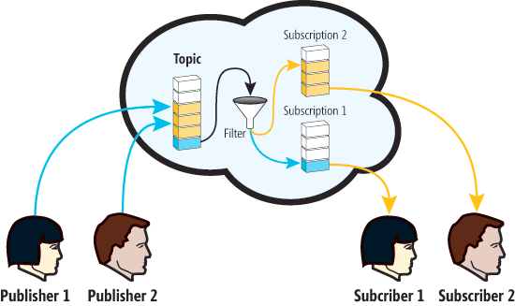
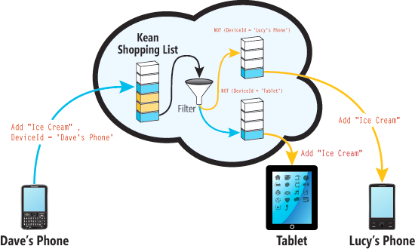
Azure service bus
MSDN Magazine:
Create a Continuous Client Using Portable Class Libraries

Slide 22
Cross Platform Code Reuse
Share code across platforms with Portable Class Libraries
Use the MVVM pattern to write cross platform apps
Put models and view models in portable libraries
Create platform-specific views
Create portable abstractions for non-portable functionality
Implement the abstractions for each platform you target

Slide 23
NuGet Packages
During .NET 4.5 we released two components via NuGet:
MEF (Microsoft.Composition) for web and Windows Store apps
TPL Dataflow (Microsoft.Tpl.Dataflow)
These (and new packages) are treated as any other .NET 4.5 component, i.e. are fully supported
System
Composition
TPL Dataflow
Http Client
Async
Immutable Collections
.NET (“in box”)

Slide 24
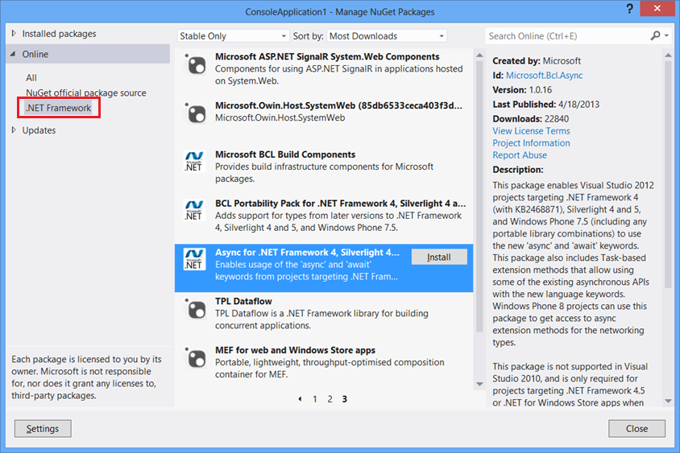
.NET Framework NuGet Packages
One-stop shopping for all of your .NET Framework NuGet packages released by Microsoft
In Visual Studio 20[10,12,13]
On the Web

Slide 25
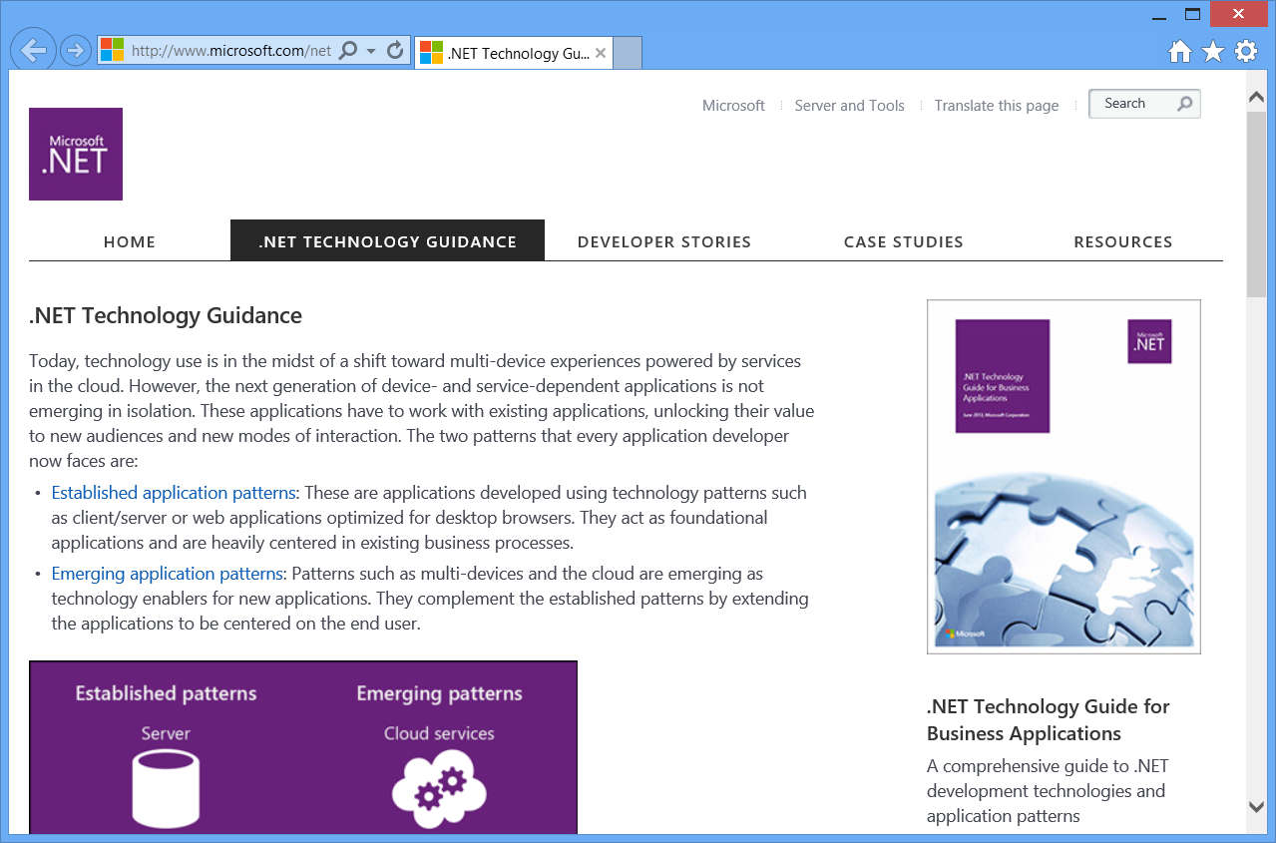
.NET Technology Guidance
Brand new set of .NET developer guidance released this week
Provides a roadmap for multiple scenarios
Visit .NET Technology Guidance

Slide 26
We would love to hear from you!
Blog
E-mail
dotnet
@dotnet
MSDN Forums
UserVoice

