Slide 2
Diagnosing Issues in JavaScript Windows Store Apps with Visual Studio
Andrew Hall
Program Manager
3-312

Slide 3
Agenda
New features in Visual Studio 2013
Recap of useful functionality
Performance and Diagnostics Hub

Slide 4
New Debugging Features
Async Debugging
JavaScript Attach
Improved Console and DOM Explorer
JavaScript/C++ Interop

Slide 5
Features worth reviewing
First chance exceptions
Tracepoints and conditional breakpoints
Code Map
Pinning DataTips
Debugging suspend and resume
Debugging background tasks and contracts

Slide 6
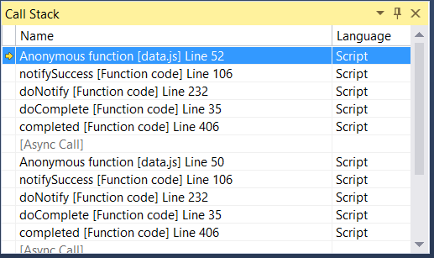
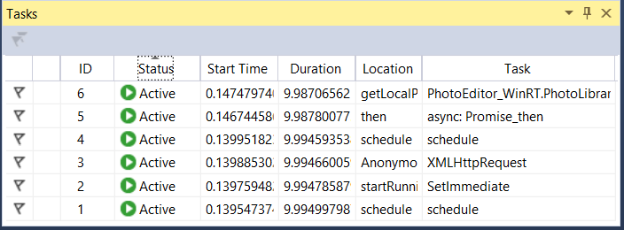
Async Debugging
Answers the questions
Why am I here?
What is going on right now?
Enhancements to the Call Stack and Tasks window
Supports Window Store, Web, and Desktop apps
Requires Windows 8.1

Slide 7
Demo
Async debugging
JavaScript Attach
First chance exceptions
Tracepoints

Slide 8
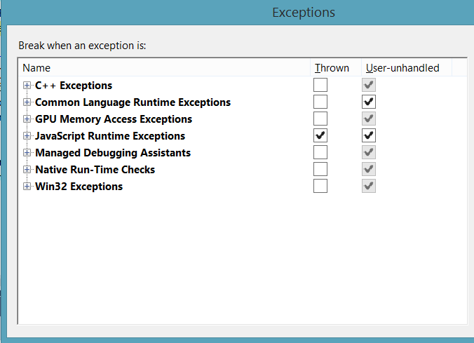
First Chance Exceptions & Tracepoints
Debug -> Exceptions
Break whenever an exception is thrown
Diagnose “silent failures”
Tracepoint
Breakpoint: “When Hit…”

Slide 9
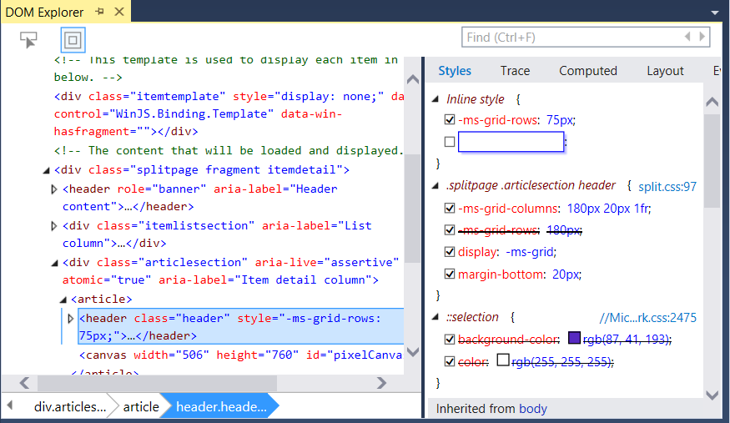
DOM Explorer Improvements
IntelliSense
Drag and Drop
Edit as HTML

Slide 10
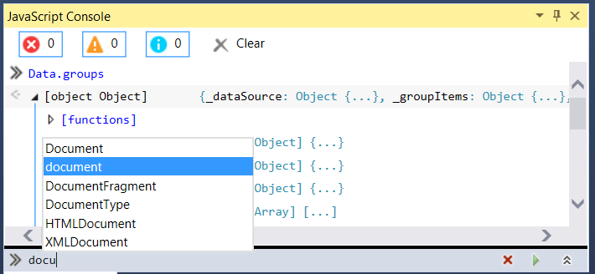
JavaScript Console Improvements
console.group
console.time
filter/clear
IntelliSense
Auto complete

Slide 11
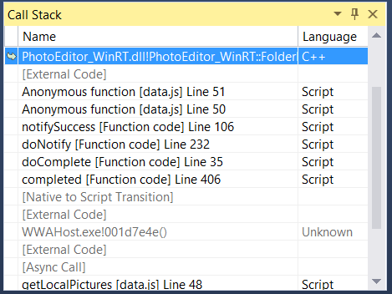
JavaScript/C++ Interop Debugging
Break in the debugger in either C++ or in
JavaScript code
Breakpoint
Exception
Async Break (pause icon)
Inspect Locals, Call Stack, etc
Enable by choosing “Script with Native” in the Project Properties

Slide 12
Demo
DOM Explorer
JavaScript C++ Interop
JavaScript Console Improvements
Code Map, Pinning DataTips

Slide 13
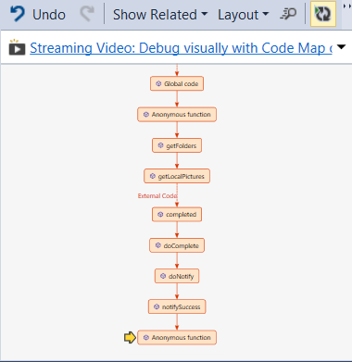
Code Map and Pinning DataTips
Show Call Stack on Code Map
Graphical representation of the call stack
Make notes
Save file
Visual Studio Ultimate Edition
Use “pin” icon to stick DataTips to editor
Take notes in the comments section
See values from last debug session

Slide 14
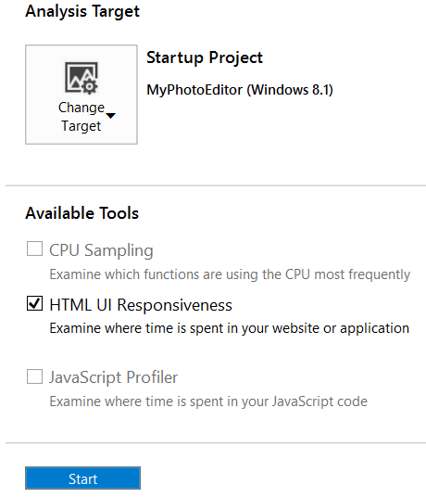
Performance and Diagnostics Hub
Single point of entry for all performance tools
JavaScript Memory
JavaScript Function Timing
HTML UI Responsiveness
Energy Profiler (new)
CPU Profiling (C++/.NET reference only)
XAML UI Responsiveness (new, C++/.NET only)
Debug -> Performance and Diagnostics

Slide 15
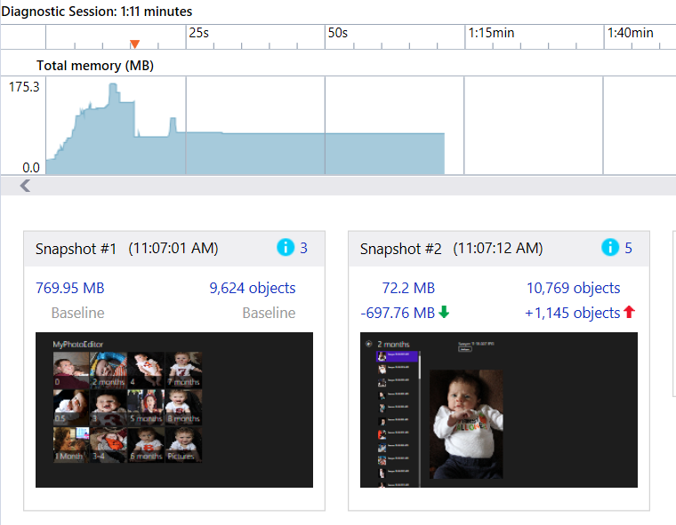
JavaScript Memory
Identify unintentionally retained memory and inefficient use of memory
Shows
JavaScript
DOM elements
WinRT Objects
Review

Slide 16
Demo Performance and Diagnostics Hub JavaScript Memory

Slide 17
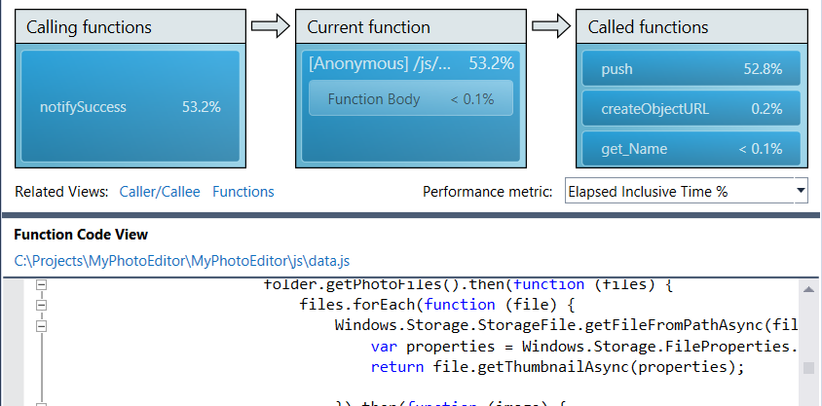
JavaScript Function Timing
Instrumentation-based profiling
Records how long every method takes to execute
Records exact counts of method calls
Only shows JavaScript execution time
Not work done by other systems, e.g. rendering

Slide 18
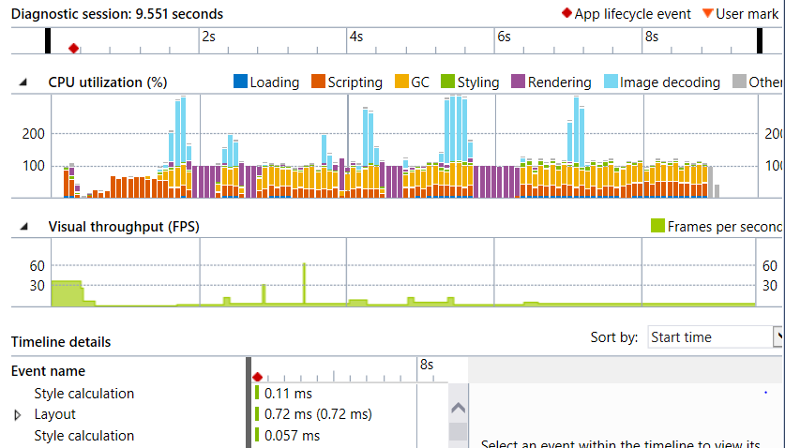
HTML UI Responsiveness
Helps to identify app startup performance and low frames per second
Content loading
Layouts/CSS calculation
Script execution/garbage collection
Network latency
Overdrawing
Review

Slide 19
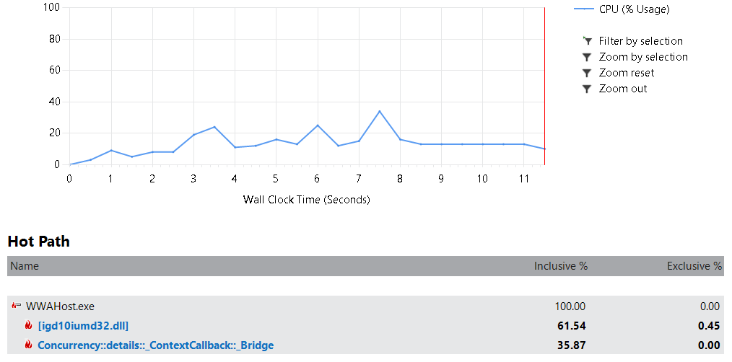
CPU Sampling
Records which functions are using the CPU most frequently
Takes a call stack from the CPU every millisecond
Shows aggregate report
Only C++/.NET functions
Review

Slide 20
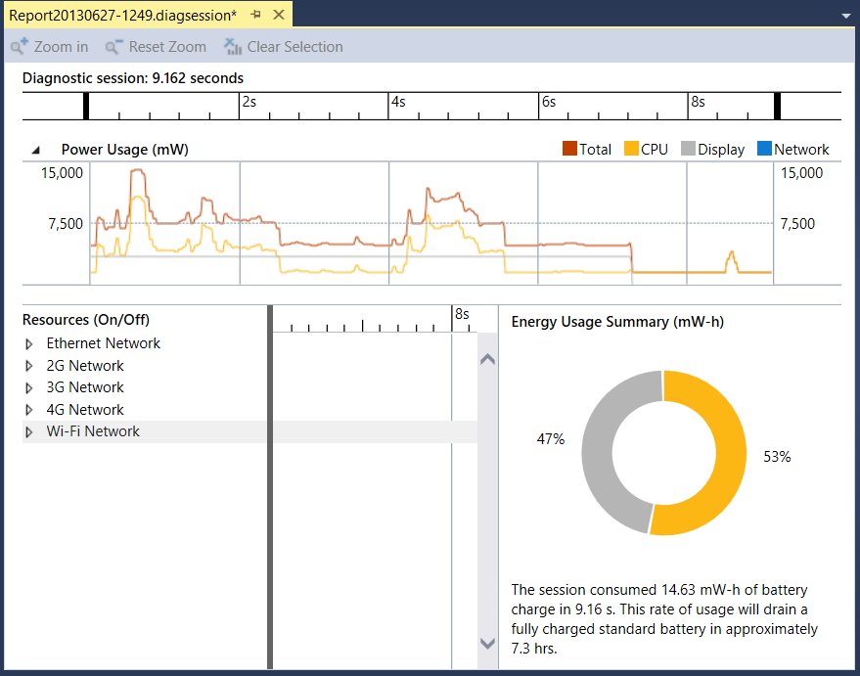
Energy Profiler
Without tooling it is very difficult to understand power consumption
The Energy Profiler tool estimates power consumption due to app’s use of
CPU
Network
Display

Slide 21
Demo Energy Profiler

Slide 22
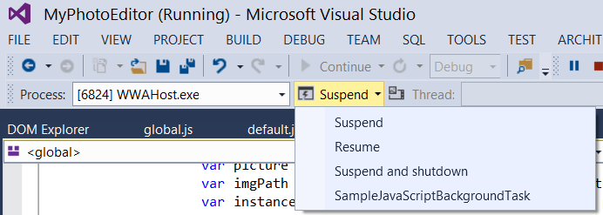
Debugging suspend and resume
Debug Location toolbar
Suspend
Resume
Suspend and shutdown
Review

Slide 23
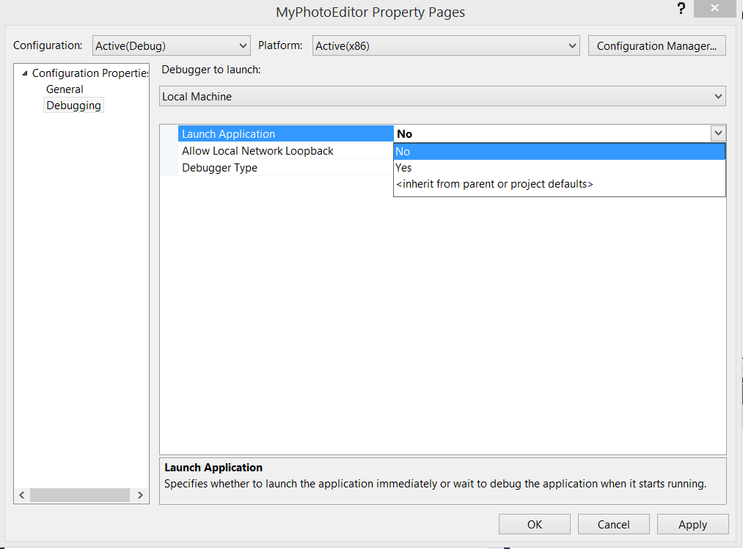
Debug Background Tasks and Contracts
Project properties
Launch Application: No
Debugging will start when code is invoked
Invoke background task from debug location toolbar
Manually trigger event (e.g. share)
Review

Slide 24
Resources
Diagnostics Blog
http://blogs.msdn.com/b/visualstudioalm/archive/tags/diagnostics/
Diagnostics Forum
http://social.msdn.microsoft.com/Forums/vstudio/en-US/home?forum=vsdebug
Related Diagnostics Sessions at //build
Thu 11:30am 2-066 New Internet Explorer Developer Tools
Thu 5:00pm 4-073 Inspecting & Debugging Using the New F12 Developer Tools in IE
Fri 9:00am 3-316 Developing High Performance Websites and Modern Apps with JavaScript Performance Tools
Fri 10:30am 3-322 Visual Studio 2013 Diagnostics Tools for XAML-Based Windows Store Apps

Slide 25
Give us your feedback!
What?
Talk to a Microsoft Visual Studio team member about your experience building enterprise apps
When & Where?
Schedule a time with Karl in the back of the room or contact vsdr@microsoft.com
Room 254 South Moscone, West Mezzanine Level
Why?
Your input and feedback will influence future Microsoft Visual Studio tools

Slide 26
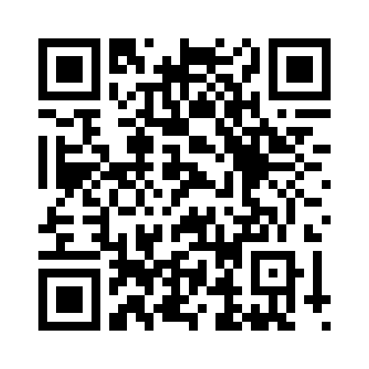
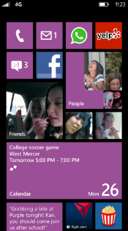
Evaluate this session
Required Slide
*delete this box when your slide is finalized
Your MS Tag will be inserted here during the final scrub.
Scan this QR code to evaluate this session and be automatically entered in a drawing to win a prize!

