Slide 2
TypeScript: Application scale JavaScript
Anders Hejlsberg
Technical Fellow
3-314

Slide 3
Application scale JavaScript development is hard.

Slide 4
TypeScript: A language for application scale JavaScript development.

Slide 5
TypeScript: A typed superset of JavaScript that compiles to plain JavaScript.

Slide 6
Any browser. Any host. Any OS.

Slide 7
Open Source.

Slide 8
TypeScript
An Open Source language for application scale JavaScript development.
Starts with JavaScript
All JavaScript code is TypeScript code, simply copy and paste
All JavaScript libraries work with TypeScript
Optional Static Types, Classes, Modules
Enable scalable application development and excellent tooling
Zero cost: Static types completely disappear at run-time
Ends with JavaScript
Compiles to idiomatic JavaScript
Runs in any browser or host, on any OS

Slide 9
Demo: TypeScript in Action

Slide 10
Type System
TypeScript’s static compile-time type system accurately models the dynamic run-time type system of JavaScript
Type inference and structural typing
In practice very few type annotations are necessary
Generics
Enables more accurate expression of flow of types
Works with existing JavaScript libraries
Declaration files can be written and maintained separately
Types enable tooling
Provide verification and assistance, but not hard guarantees

Slide 11
Classes and Modules
TypeScript’s static compile-time type system accurately models the dynamic run-time type system of JavaScript
Scalable application structuring
Classes, Modules, Interfaces enable clear contracts between components
Aligned with emerging standards
Class, Module, Lambda syntax aligns with ECMAScript 6 proposals
Supports popular module systems
CommonJS and AMD modules in any ECMAScript 3 environment

Slide 12
TypeScript 0.9
This release represents the largest update to TypeScript to date, bringing significant changes to the language, compiler and tools.
Language
Generic classes, interfaces, and methods
Overloading on constants
Enum types
‘export =‘
Function/class/module merging
Methods in object literals
Compiler
Incremental parser
Pull-model type checker
Scaling to 100K+ line projects

Slide 13
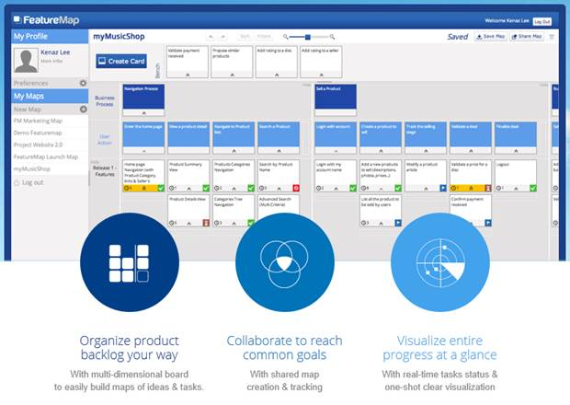
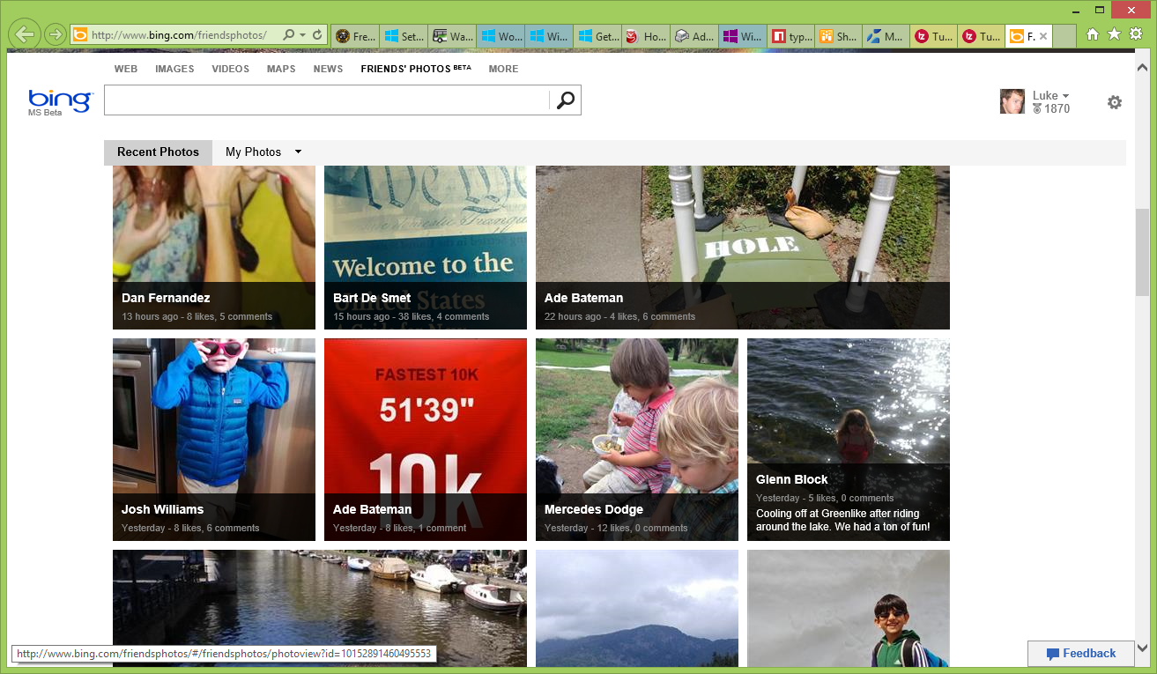
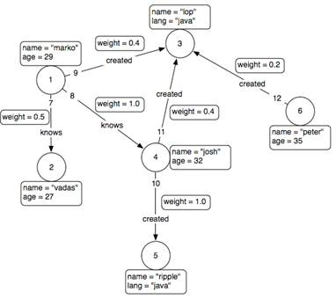
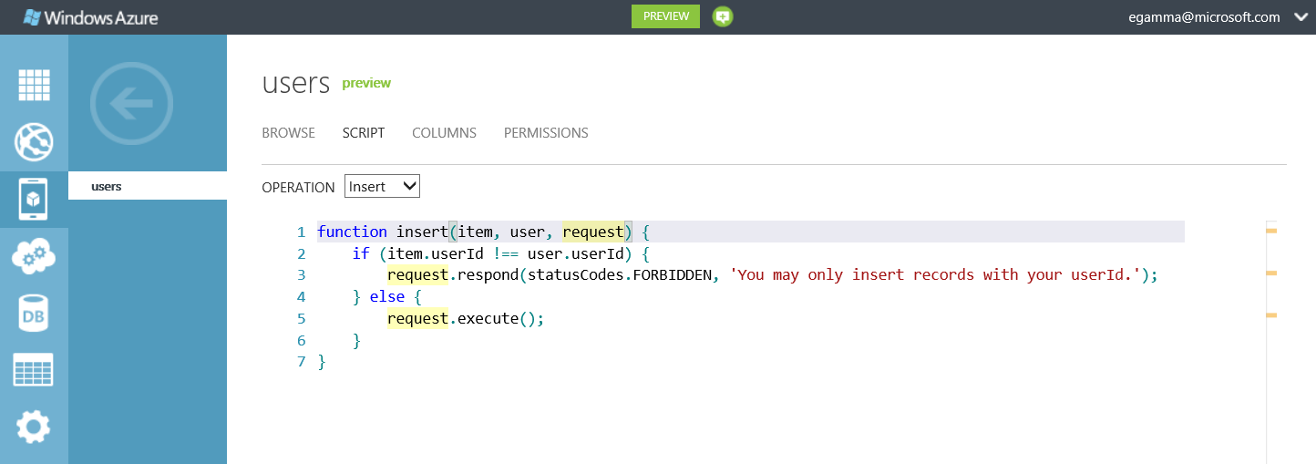
TypeScript Adoption

Slide 14
Xbox Music and TypeScript

Slide 15
TypeScript Ecosystem
“TypeScript is quite a good piece of work for Visual Studio users, and smartly aligned with ES6.”
- Brendan Eich
Frameworks
Definitely Typed has 150+ community curated library typings
Over 90% of top 20 JavaScript frameworks covered
Tools
Rich IDEs: Visual Studio, WebStorm, Cloud9, Brackets
Text Editors: SublimeText, vi, Emacs, JSBin
Build Integration: ASP.NET, node.js, compile-in-client, Ruby, grunt
Process
Active Open Source development on CodePlex
Thousands of discussion posts and tracked issues

Slide 16
http://typescriptlang.org

Slide 17
Resources
Use this slide to list resources, white papers, videos and links.

Slide 18
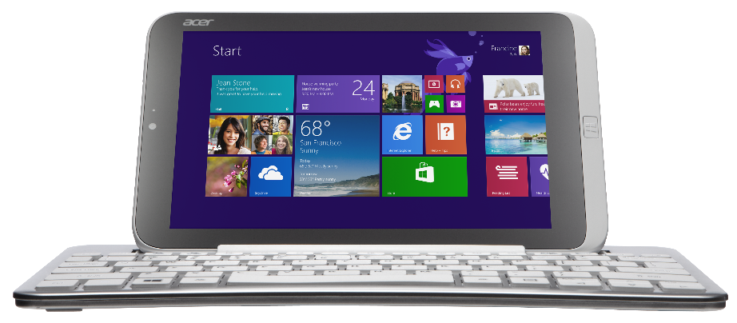
Acer Iconia W3, Surface Pro, and Surface Type Cover
Get your goodies
Device distribution starts after sessions conclude today (approximately 6:00pm) in the Big Room, Hall D.
If you choose not to pick up your devices tonight, distribution will continue for the duration of the conference at Registration in the North Lobby.

Slide 19
Evaluate this session
Required Slide
*delete this box when your slide is finalized
Your MS Tag will be inserted here during the final scrub.
Scan this QR code to evaluate this session and be automatically entered in a drawing to win a prize!

