Slide 2
Developing high performance websites and modern apps with JavaScript performance tools
Jonathan Carter
Program Manager
3-316

Slide 3
Agenda
Why is performance important (or at
least interesting)?
What are some high-priority
performance scenarios?
How can you diagnose these scenarios using Visual Studio 2013 and IE11?

Slide 4
Why is performance important?
(source: http://www.businessnewsdaily.com)

Slide 5
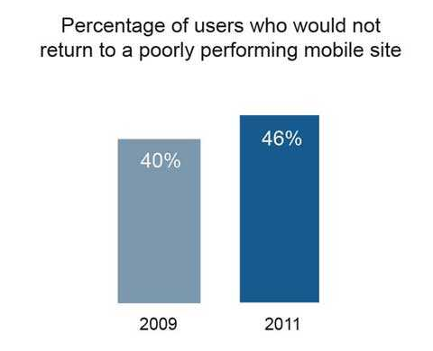
It isn’t just important for apps…
“People will visit a Web site less often if it is slower than a close competitor by more than 250 milliseconds”
(source: http://www.nytimes.com)
(source: http://www.webperformancetoday.com)

Slide 6
Consumer expectations & expanding device ecosystem make performance more important than ever

Slide 7
Which are some (of many) high-priority performance scenarios?
Page/app load time
“Decreasing page load time can drastically increase conversions”
(source: http://blog.kissmetrics.com)
“The frustration of waiting for large pages to load can cost the enterprise valuable potential visitors.”
(source: Gartner Inc.)
UI responsiveness/input lag
“Research in human-computer interaction points to around 100 ms as the maximum acceptable response time to simulate instantaneous behavior”
(source: http://www.informit.com)
Fluid scrolling/panning/animations
“Low FPS does not give the illusion of motion effectively”
(source: http://www.wikipedia.com)
Long-term stability
Resuming use of an app should feel like it has always been running
Running an app/site for days shouldn’t result in a degradation of usability

Slide 8
Fast, fluid and efficient

Slide 9
IE Pipeline
DMANIP
Hit Testing
Data
&State
Input
DOM
Tree
Display Tree
1
1
Networking
Parsers
2
7
Formatting
Layout
2
7
Painting
Compositing
3
4
8
9
3
4
8
9
5
6
5
6
DOM API
& Capabilities
Chakra

Slide 10
Questions to ask when investigating performance?
Can I eliminate work entirely?
Can I optimize existing work?
Can I defer work, or perform it in parallel?

Slide 11
Diagnosing page load/UI responsiveness

Slide 12
Memory Scenarios to Watch For
Memory bloat
Memory leaks
Object churn

Slide 13
JavaScript/DOM Object Graph
Global
$
window
document
<html>
Your Object
<head>
<body>
location
<div>
<section>
<p>

Slide 14
JavaScript/DOM Object Graph
Global
$
window
document
<html>
Your Object
<head>
<body>
location
<div>
<section>
<p>

Slide 15
JavaScript/DOM Object Graph
Global
$
window
document
<html>
Your Object
<head>
<body>
location
<div>
<section>
GC Runs….
<p>

Slide 16
JavaScript/DOM Object Graph
Global
$
window
document
<html>
Your Object
<head>
<body>
location
<div>
<section>
<p>
GC Frees Memory

Slide 17
JavaScript/DOM Object Graph
Global
$
window
document
<html>
<head>
<body>
location
<div>
<section>
<p>

Slide 18
Object Retained Size
Global
$
window
document
<html>
Retains all of its children
<head>
<body>
location
<div>
<section>
<p>

Slide 19
Object Retained Size
Global
$
window
document
<html>
Retains the <body> only
<head>
<body>
location
<div>
<section>
<p>

Slide 20
Diagnosing memory usage

Slide 21
Summary
Performance is extremely important (and fun!)
Visual Studio 2013 and IE11 provide tooling for diagnosing issues related to…
Page load/resource loading costs
UI responsiveness
Frame rate
Memory efficiency
Please try out the tools and send us feedback!

Slide 22
Evaluate this session
Required Slide
*delete this box when your slide is finalized
Your MS Tag will be inserted here during the final scrub.
Scan this QR code to evaluate this session and be automatically entered in a drawing to win a prize!

