Slide 2
Securing Windows Store applications and REST services with Active Directory
Vittorio Bertocci - @vibronet
Principal Program Manager
3-518

Slide 3
Building a Modern Business App
Resource
Resource
App

Slide 4
Checklist
Tackle those, and you’ve got yourself a nice business app.
Access resources outside of the corporate network.
Handle authentication and session mechanics.
Apply access policies on non-domain joined devices.

Slide 5
Access resources outside of the corporate network

Slide 6
REST, OAuth2
authorization server
authorization
endpoint
token
endpoint
A
4
App
A
R
Resource

Slide 7
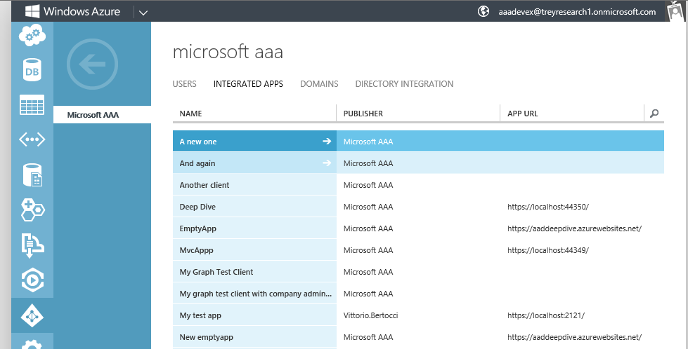
Windows Azure Active Directory
Windows Azure Active Directory
Management Portal
OAuth2
SAML-P
WS-Federation
Graph API
Contoso’s tenant
Metadata
Dir Sync
M
A
Contoso’s On-Premises Directory

Slide 8
Clients and Resources in Windows Azure AD
Registration
Today - via Graph Explorer
Soon - via Windows Azure Portal
App
Resource
App
Resource

Slide 9
Demo

Slide 10
ADFS in Windows Server 2012 R2
New! OAuth2 code grant
Resources represented as classic Relying Party Trust entries
Clients registered via PowerShell
No permission table entry necessary
Support for JWT format
New! Registered devices authentication
More details later in the session

Slide 11
Demo

Slide 12
Checklist
Tackle those, and you’ve got yourself a nice business app.
Access resources outside of the corporate network.
Use OAuth2.
Register client app and resources in Active Directory
Get and use access tokens
Handle authentication and session mechanics.
Apply access policies on non-domain joined devices.

Slide 13
Handle authentication and session mechanics

Slide 14
Windows Azure Authentication Library (AAL)
Helps developers to add authentication capabilities to rich client apps
User authentication experience
Obtaining tokens
Token lifecycle management (caching, automatic token refresh, etc)
Assisted authority discovery
Works with both Windows Azure AD and Windows Server 2012 R2 ADFS
Ships out of band as NuGet package
.NET and Windows Store in developer preview
details here
download from VS2012 or here

Slide 15
Windows Azure Authentication Library
AAL is a Windows Runtime Component
C# Windows Store App
JS/HTML5 Windows Store App
Application
AAL for Windows Store .WINMD
Windows Runtime (WinRT)
System
OS

Slide 16
Essential AAL Usage (C#)
Authenticate the user to get a token
AuthenticationContext aCtx = new AuthenticationContext("https://login.windows.net/contoso.onmicrosoft.com");
AuthenticationResult result =
await authorizationContext.AcquireTokenAsync("http://host.com/shipmentservice", clientID);
Use the token to invoke a REST service
HttpClient httpClient = new HttpClient();
httpClient.DefaultRequestHeaders.Authorization =
new AuthenticationHeaderValue("Bearer", result.AccessToken);
//...

Slide 17
Demo

Slide 18
Notes on User Experience
AAL wraps the WebAuthenticationBroker API in WinRT
New in Windows 8.1: built-in account selection experience
See Karanbir’s session later today (3-113)

Slide 19
Demo

Slide 20
AAL Cache
AAL for Windows Store offers a persistent token cache
Key
Value
Key
Value
Authority
Access Token
Authority
Access Token
ClientID
ClientID
Expiration
Resource
Expiration
Resource
Refresh Token
User
Refresh Token
User

Slide 21
AAL Cache
refresh token?
NO
prompt the user via WebAuthenticationBroker
[authority],
resource, clientid, user
YES
use the refresh token to refresh the access token
matching cache entry?
NO
success?
NO
success?
NO
YES
YES
YES
valid access token?
NO
cache access token, refresh token, validity
replace cache entry
YES
return cache entry
return error info

Slide 22
Checklist
Tackle those, and you’ve got yourself a nice business app.
Access resources outside of the corporate network.
Use OAuth2.
Register client app and resources in Active Directory
Get and use access tokens
Handle authentication and session mechanics.
Use the Windows Azure Authentication Library.
Apply access policies on non-domain joined devices.

Slide 23
Apply access policies on non-domain joined devices

Slide 24
Workplace-join in Windows 8.1
Especially useful for
user-owned devices
Devices incapable of joining a domain
Allows administrator to apply access control policies in a wide range of scenarios Workplace-join ability available directly in Windows 8.1

Slide 25
Workplace Join Mechanics
Users can enroll devices which configure the device for management with Windows Intune. The user can then use the Company Portal for easy access to corporate applications
Data from Windows Intune is sync with Configuration Manager which provides unified management across both on-premises and in the cloud
Active Authentication
Users can register BYO devices for single sign-on and access to corporate data with Workplace Join. As part of this, a certificate is installed on the device
Active Directory
Web Application Proxy
ADFS
IT can publish access to corporate resources with the Web Application Proxy based on device awareness and the users identity. Multi-factor authentication can be used through Windows Azure Active Authentication.
As part of the registration process, a new device object is created in Active Directory, establishing a link between the user and their device
25

Slide 26
Using Device Authentication Info to Drive Access
Some constraints about how authentication should take place to apply device-aware access policies
On the client
Ensure your app manifest has the right capabilities
WebAuthenticationBroker should be invoked in SSO mode In AAL: you should use the AcquireTokenAsync(resource, clientid) overload
In ADFS
Server-wide: enable device authentication
Per-RP: Add device-related issuance authorization rules

Slide 27
Demo

Slide 28
Checklist
Tackle those, and you’ve got yourself a nice business app.
Access resources outside of the corporate network.
Use OAuth2.
Register client app and resources in Active Directory
Get and use access tokens
Handle authentication and session mechanics.
Use the Windows Azure Authentication Library.
Apply access policies on non-domain joined devices.
Use Windows 8.1 Workplace-join and ADFS rules.

Slide 29
In summary

Slide 30
all you need to build great modern business app
Active Directory
Resource
App
Windows Azure Authentication Library
Active Directory

Slide 31
Resources
Windows Azure AD home
Window Server AD home
Windows Azure and Windows Server AD Team Blog
Windows azure AD Walkthroughs
Find me:
On twitter - @vibronet
On the web – www.cloudidentity.com

Slide 33
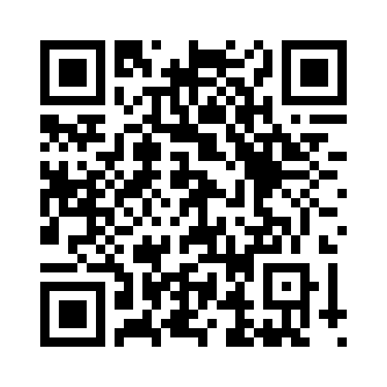
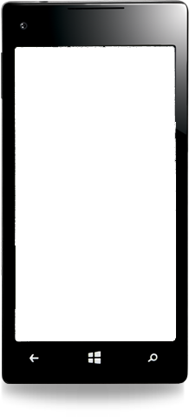
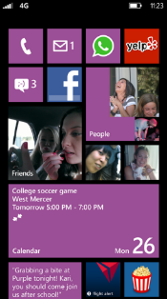
Evaluate this session
Required Slide
*delete this box when your slide is finalized
Your MS Tag will be inserted here during the final scrub.
Scan this QR code to evaluate this session and be automatically entered in a drawing to win a prize!

