Slide 2
Advanced Patterns using Windows Azure Web Sites for apps for Office and SharePoint
Donovan Follette & Brady Gaster
Technical Evangelists
Microsoft
3-604

Slide 3
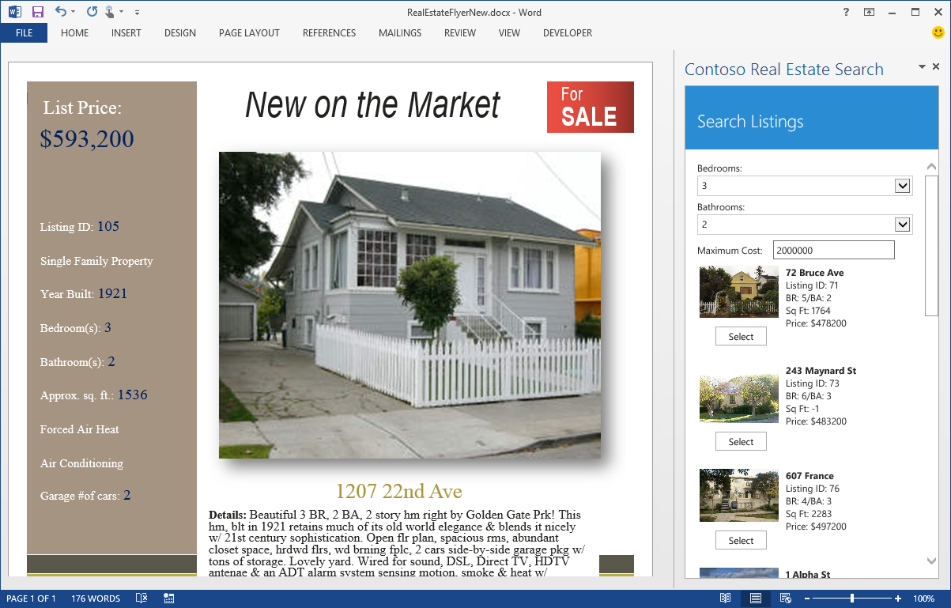
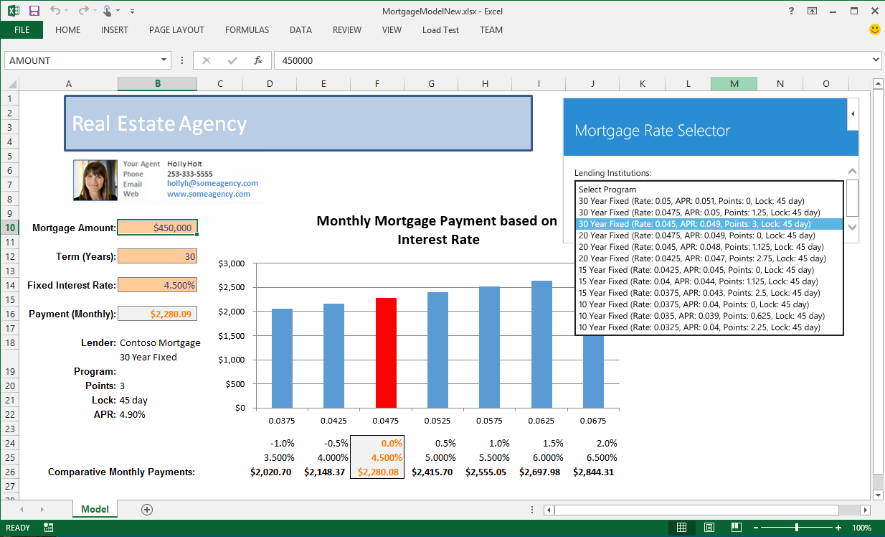
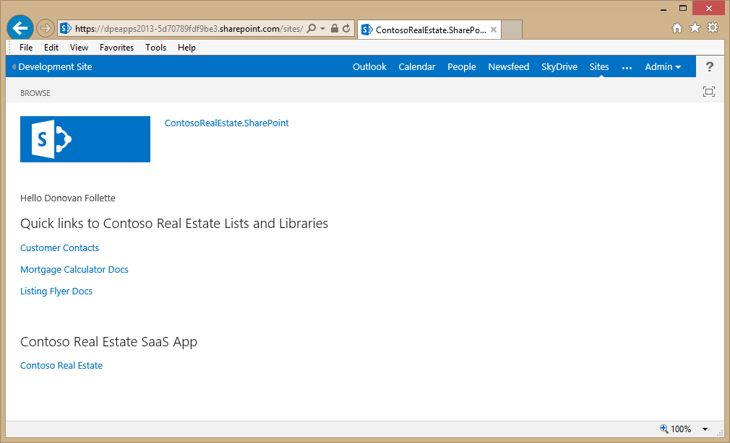
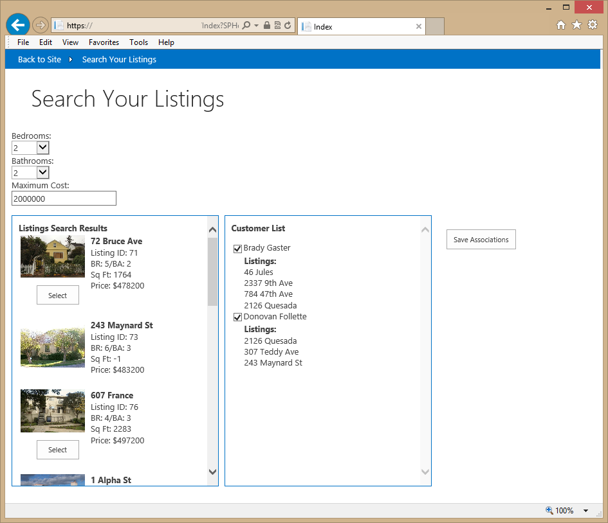
Agenda
Apps for Office & SharePoint, why @ scale?
Why Windows Azure & Web Sites?
SaaS Architecture drill-down & demos
What to keep top-of-mind

Slide 4
Business Perspective
Multi-tenant SaaS offering
User base could be multiple millions
Apps for Office & SharePoint
Companion Apps for Office
Office 365 App for SharePoint

Slide 5

Technical Perspective
Inactivity
Period
Compute
Compute
On and Off
t
Unpredictable Bursting
t
SaaS at Internet scale
Hosting platform?
Identity store?
Web site architecture?
Compute
Compute
t
Growing Fast
t
Predictable Bursting

Slide 6





Contoso Real Estate SaaS – Windows Azure
SaaS Requirements:
Relational data store
Image store
Scalable user store
Easily scalable web site
Web sites
Sql databases
ContosoRealEstate
ContosoRealEstate
storage
contosorealestate
Active directory
dpeospmicrosoft

Slide 7
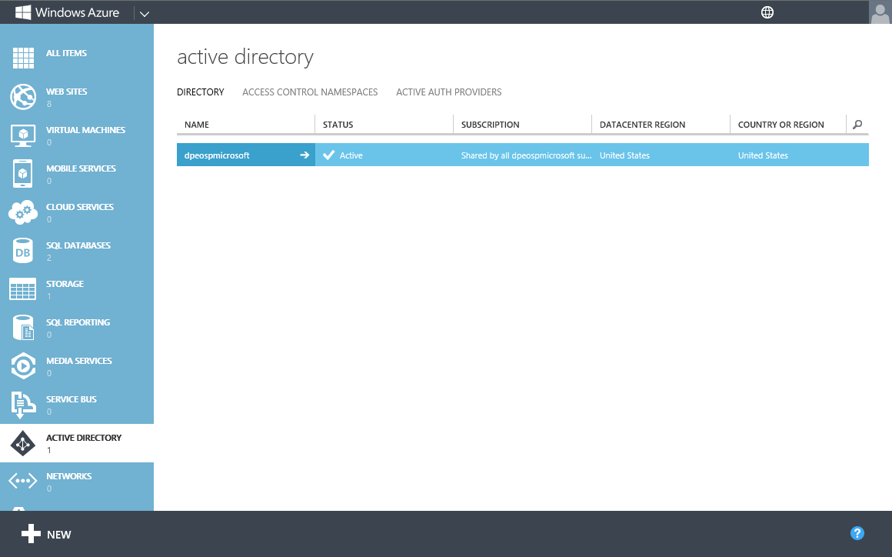
Demo
Windows Azure Services for SaaS

Slide 8
Contoso Real Estate – SaaS Web Site
ASP.NET MVC 4
JavaScript MVVM
Web API
Office 2013 JavaScript
Web sites
Sql databases
ContosoRealEstate
ContosoRealEstate
MVC4
ContosoRealEstate.Web
Views
Home
Account
Shared
RealEstateListings
storage
contosorealestate
Active directory
dpeospmicrosoft

Slide 9
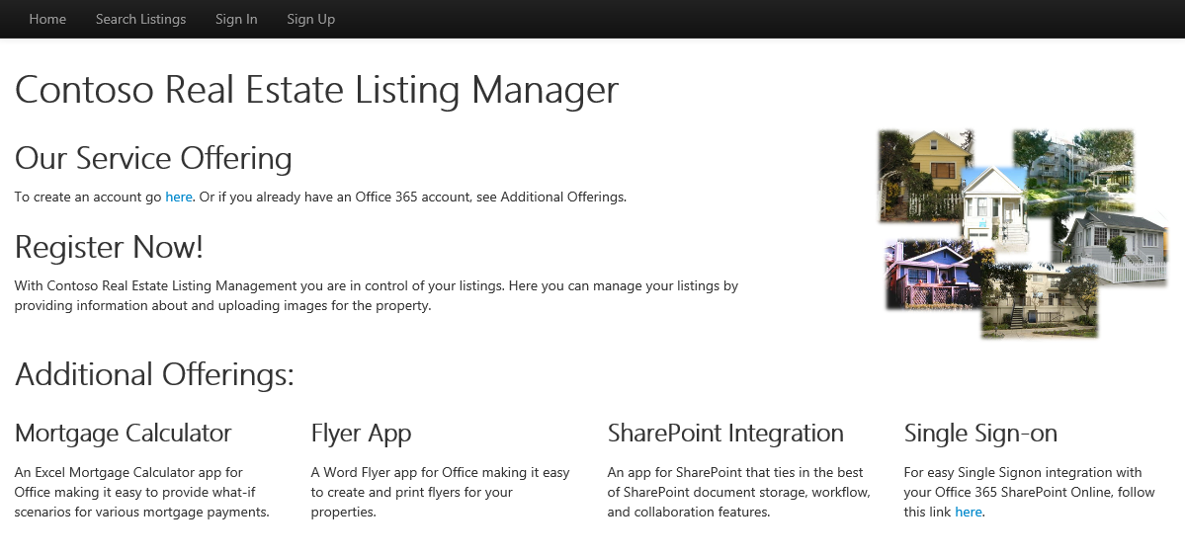
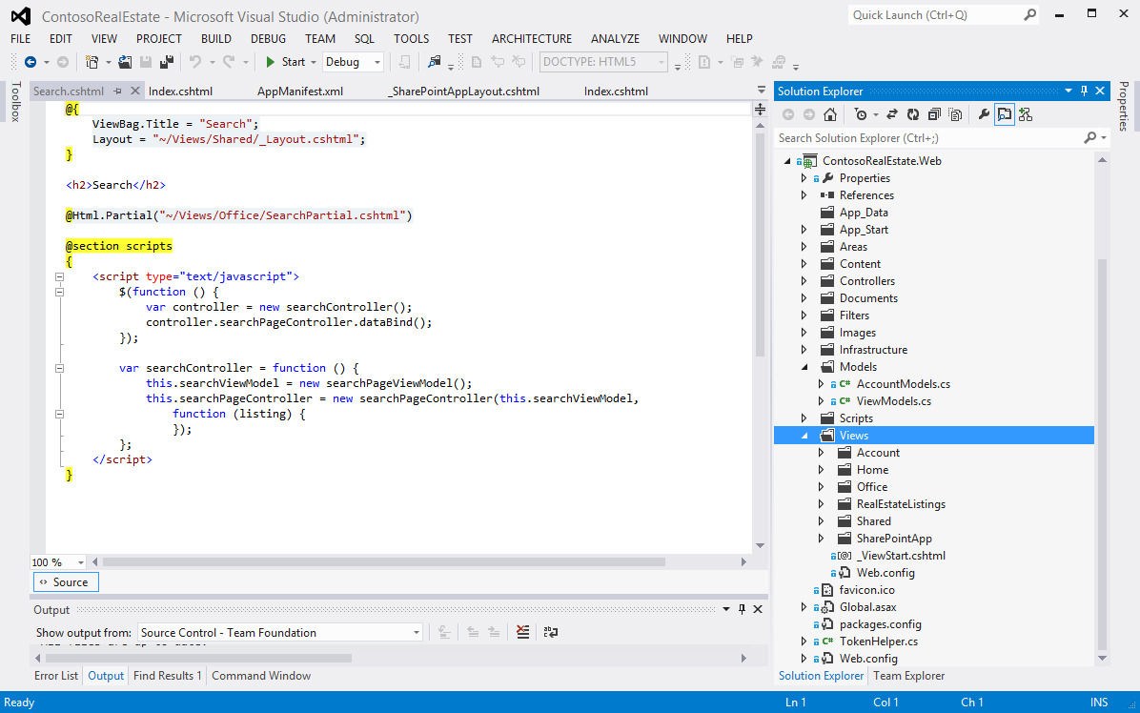
Demo
SaaS MVC4 Architecture and Code Drill-down

Slide 10



Contoso Real Estate – SaaS Apps for Office
Web sites
Sql databases
ContosoRealEstate
Apps for Office:
SaaS “companion” apps
Land data in Office
Doc template with app
ContosoRealEstate
MVC4
ContosoRealEstate.Web
Views
MortgageCalculator
SearchListings
_AppForOfficeLayout
storage
contosorealestate
Active directory
dpeospmicrosoft

Slide 11
Demo
SaaS Companion Apps for Office and Code Drill-down

Slide 12


Contoso Real Estate – SaaS App for SharePoint
App for SharePoint:
SaaS “companion” app
Web sites
Sql databases
ContosoRealEstate
ContosoRealEstate
MVC4
ContosoRealEstate.Web
Views
SharePointSearch
_SharePointAppLayout
SSO
storage
Customers List
contosorealestate
Mortgage Calc Document Library
Active directory
Real Estate Flyer Document Library
dpeospmicrosoft
Customer Selection List
OAuth
Listing Search Mash-up
Access control service

Slide 13
Demo
SaaS Companion App for SharePoint and Code Drill-down

Slide 14
Tips for building at Internet scale
Out of Proc session providers (SQL)
Static resources on CDN
Retry logic
Log streaming (VS/PowerShell/CLI)
What mode? free/shared/standard

Slide 15
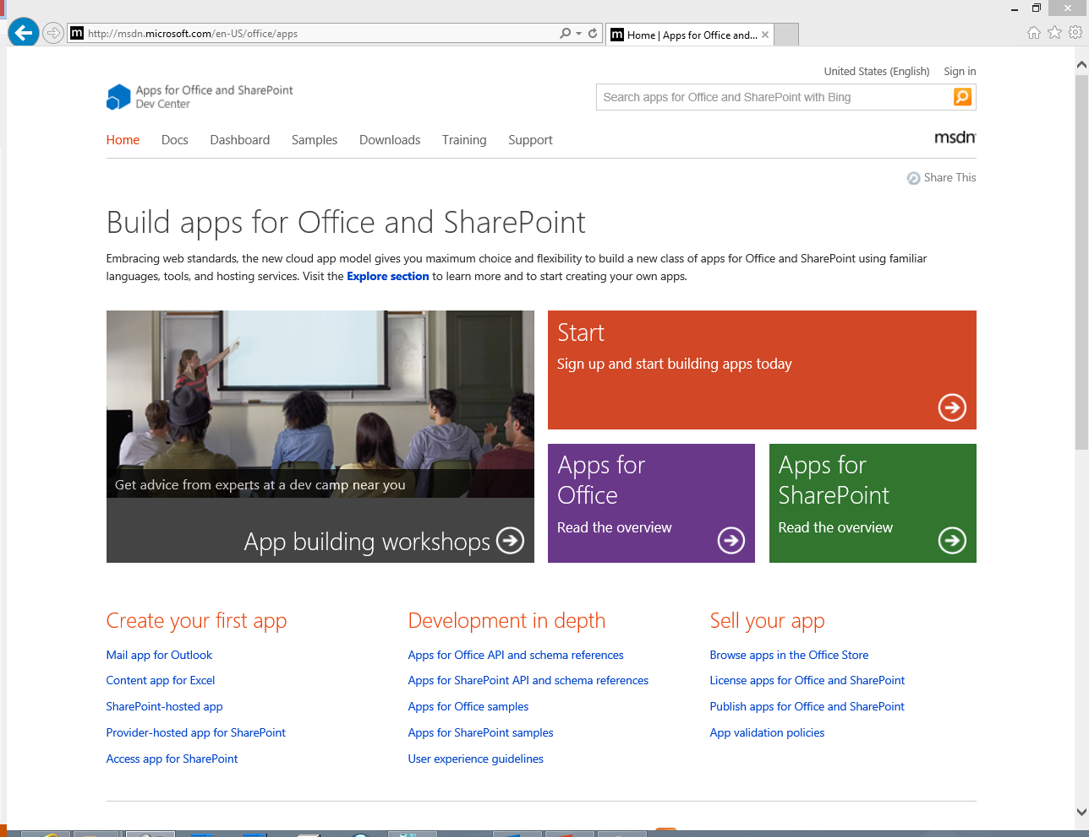
Resources
http://dev.office.com
http://blogs.msdn.com/officeapps/
http://social.msdn.microsoft.com/Forums/officeapps
http://blogs.msdn.com/donovanf
Office, SharePoint & Yammer Sessions
Wednesday
2:00-3:00, 3-602 0 to 60: Developing Apps for Microsoft SharePoint 2013
3:30-4:30, 3-603 Understanding Authentication and Permissions with Apps for SharePoint and Office
5:00-6:00, 3-319 Developing Apps for SharePoint 2013 with Visual Studio 2013
Thursday
2:00-3:00, 3-601 0 to 60: Developing Apps for Microsoft Office 2013
Friday
10:30-11:30, 3-604 Advanced Patterns Using Windows Azure Web Sites for Apps for Office and SharePoint
2:00-3:00, 3-605 Building Enterprise Web and Mobile Apps with the Yammer Platform

Slide 16
It’s a GREAT DAY to be a developer!
Go, build something new and innovative. Make someone’s day a bit better because they’ve used your software.
Thank you!

Slide 17
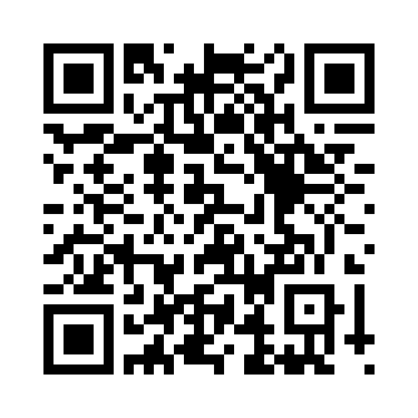


Evaluate this session
Required Slide
*delete this box when your slide is finalized
Your MS Tag will be inserted here during the final scrub.
Scan this QR code to evaluate this session and be automatically entered in a drawing to win a prize!

