Slide 2
Unlocking the power of DirectX in apps that use XAML
Bede Jordan, bedej@microsoft.com
Software Development Lead
4-065

Slide 3
Who am I?
Senior Development Lead, XAML
In Windows 8.1, I worked on graphics, media, and text in XAML
Previously: XAML, WPF, Silverlight, Desktop Window Manager, etc.
Outside of work?
Hail from Australia…
…but there are more mountains to climb in Washington!

Slide 4
XAML + DirectX interop
Why use DirectX in your XAML app?
How can I integrate DirectX in XAML?
SurfaceImageSource/VirtualSurfaceImageSource
SwapChainPanel/SwapChainBackgroundPanel
What is independent input, and how can I use it in my XAML app?

Slide 5
1. Why use DirectX in your XAML app?

Slide 6
XAML is the first Windows UI platform that includes fully integrated and high-performance DirectX interop

Slide 7
What is XAML for?
XAML is focused on building great UI
Provides a set of controls and drawing primitives, backed by a rich object model
From Rectangle primitives to complex GridViews
Accessible in XAML or code behind
Properties can be animated, databound
<StackPanel Background="Black">
<Border Width="100" Height="100" CornerRadius="5"
BorderThickness="10" BorderBrush="Red">
<Image Source="Assets/trees.jpg"
Stretch="UniformToFill"/>
</Border>
<Button Content="Click me!" HorizontalAlignment="Center"/>
</StackPanel>

Slide 8
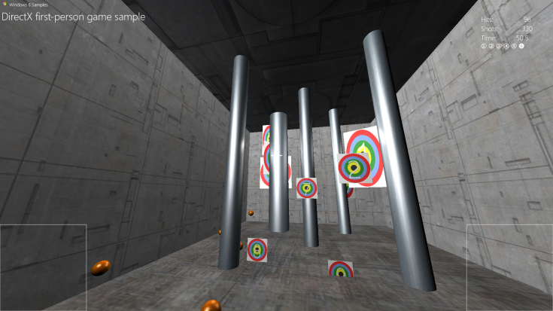
What is DirectX for?
DirectX provides a powerful set of graphics functionality
Flexibility, scalability, and high performance
Lowest-level graphics API for applications - “All the way to the metal”
Direct3D
Direct2D
WIC (Windows Imaging Component)
DirectWrite
DirectComposition
DirectManipulation
We built all of XAML on top of DirectX!
DirectComposiiton in Win 8.1

Slide 9
XAML + DirectX
Windows Store app using XAML (C++, C#, VB)
DirectX interop in XAML provides developers the best of both worlds
UI and controls? → Use XAML
Custom graphics, image editing, games? → Use DirectX
Windows Runtime / C++
C++
XAML Framework
Windows 8 subsystem
Direct3D
Direct2D
DirectWrite
Media
App
Theme & PVL
Input

Slide 10
Many great applications that you use are built with DirectX interop:
OneNote: custom display canvas
FreshPaint: custom-rendered painting
Bing Maps app
Reader (PDF)
Games!

Slide 11
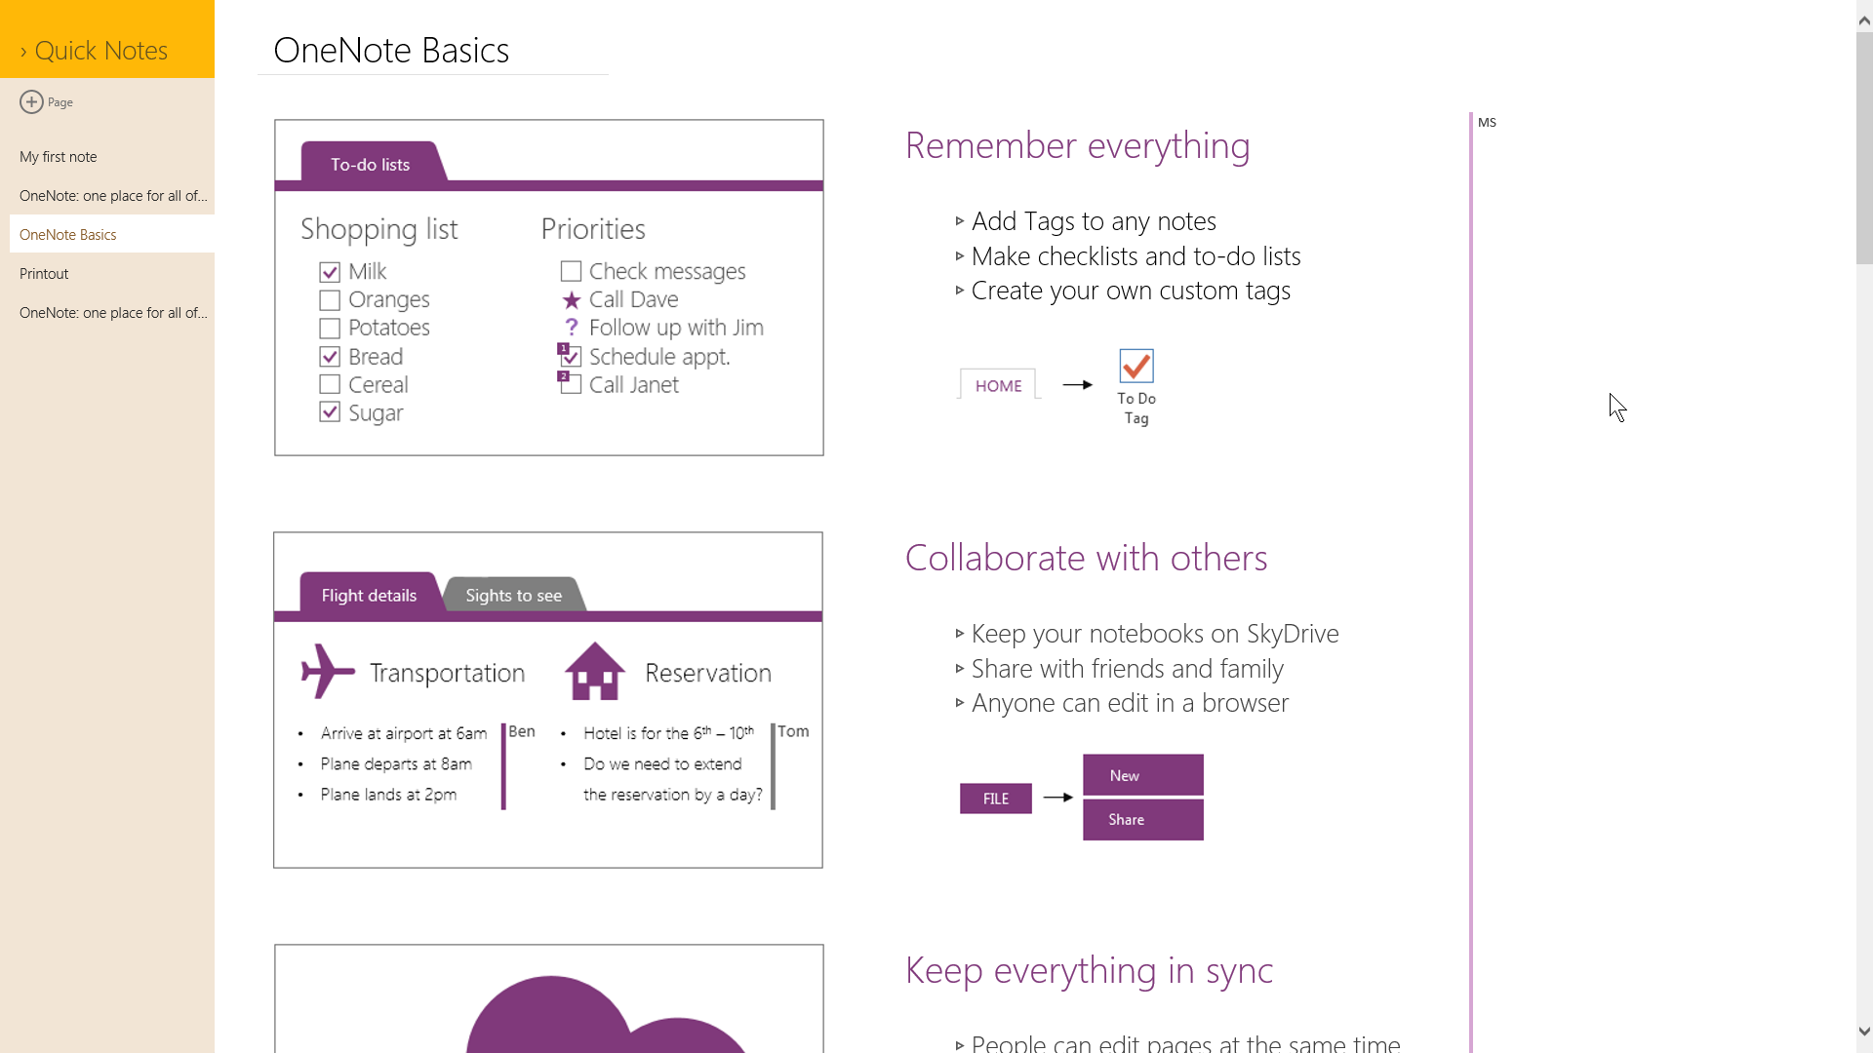
DirectX
XAML

Slide 12
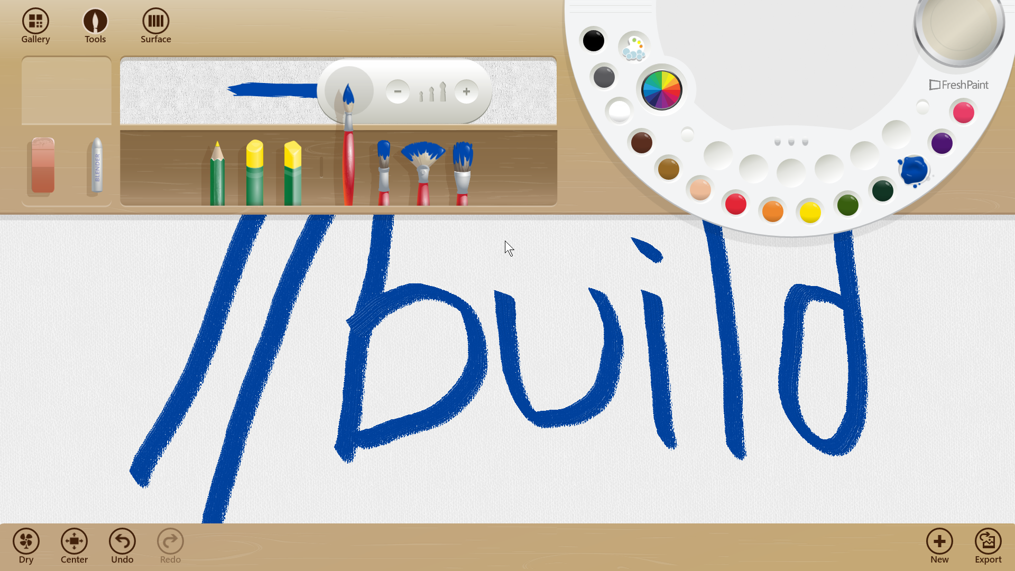
DirectX
XAML
DirectX

Slide 13
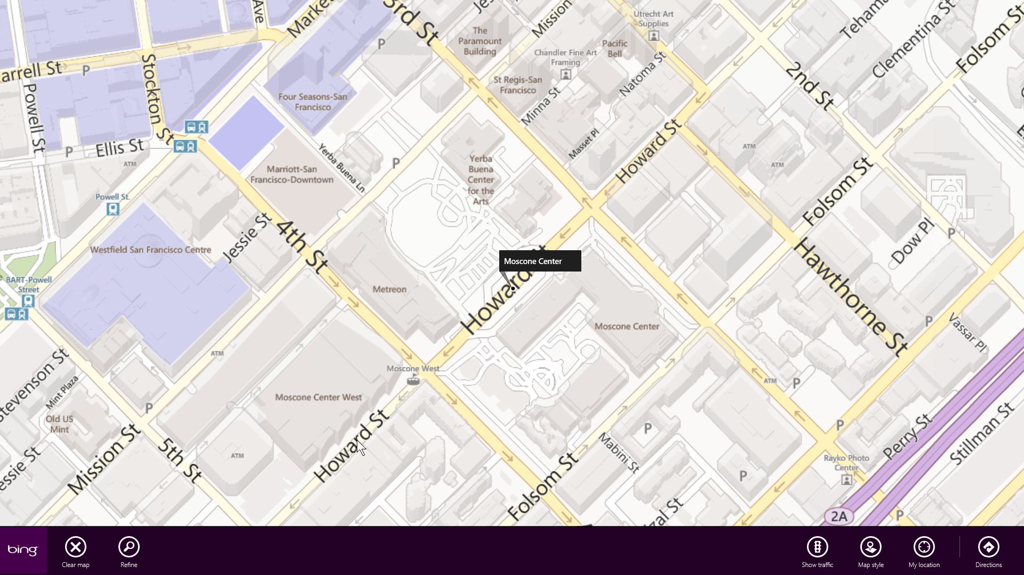
DirectX
XAML

Slide 14
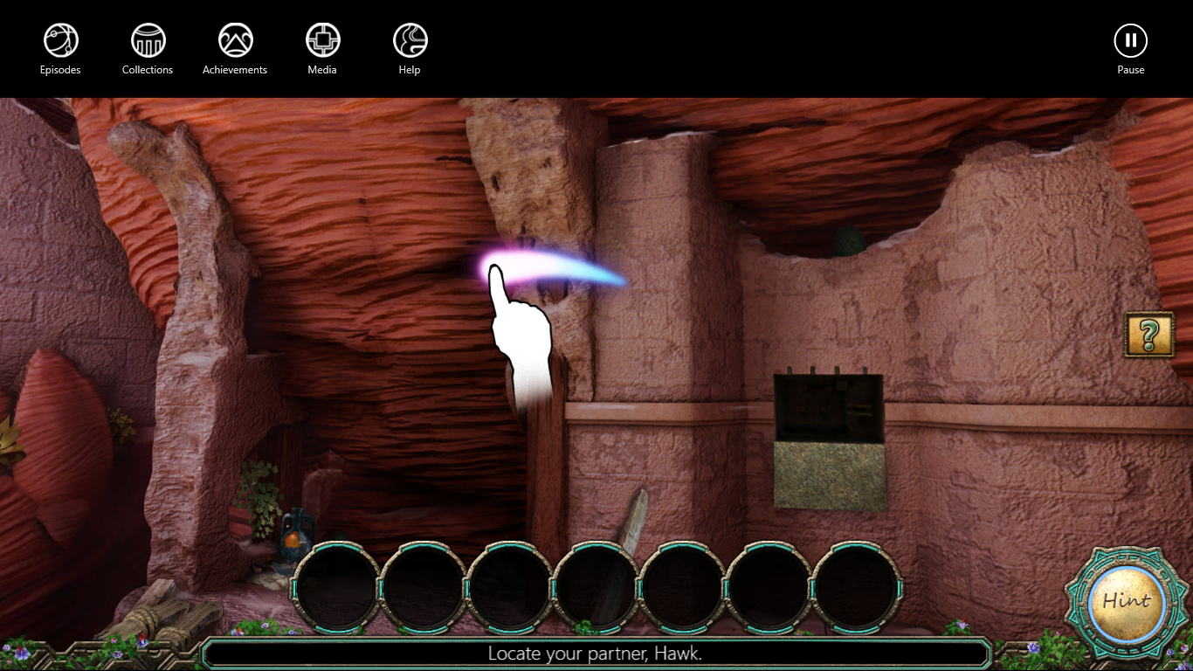
XAML
DirectX

Slide 15
2. DirectX interop options in XAML

Slide 16
DirectX interop options in XAML:
Use a DirectX surface as a XAML brush:
SurfaceImageSource
VirtualSurfaceImageSource
b) Tightly integrate into compositor, low latency presentation:
SwapChainPanel
SwapChainBackgroundPanel

Slide 17
DirectX interop options in XAML SurfaceImageSource and VirtualSurfaceImageSource

Slide 18
SurfaceImageSource
Object
DependencyObject
ImageSource
SurfaceImageSource
Derives from XAML ImageSource
Think of it as a dynamically updatable D2D/D3D bitmap
Just like a BitmapImage, it can fill any XAML element
Begin/Draw/End update model
Application provides D3D device
XAML provides a surface to draw to with D2D/D3D
XAML retains that surface in the tree
ImageBrush^ brush = ref new
ImageBrush();
brush->ImageSource = ref new
SurfaceImageSource(300, 300);
Ellipse1->Fill = brush;

Slide 19
SurfaceImageSource
: IUnknown
interface ISurfaceImageSourceNative
{
SetDevice(IDXGIDevice *pDevice);
BeginDraw(
RECT updateRect,
IDXGISurface** ppSurface,
POINT* pOffset
);
EndDraw();
};
These methods must be called from the XAML UI thread

Slide 20
How can I use SurfaceImageSource?
Create a SurfaceImageSource
Create a D3D device and set it on the SurfaceImageSource
Set the SurfaceImageSource on a XAML element’s ImageBrush
Call BeginDraw
Draw to the returned IDXGISurface with Direct2D or Direct3D
Call EndDraw when you’re done drawing

Slide 21
Demo SurfaceImageSource

Slide 22
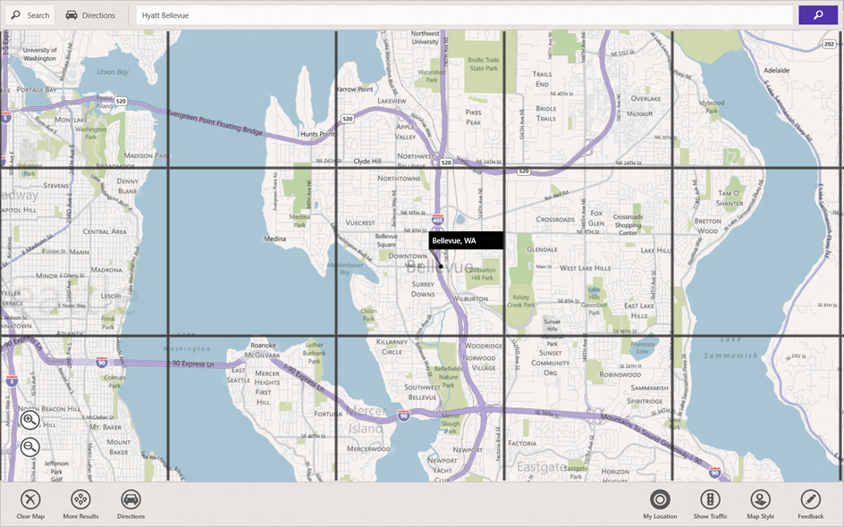
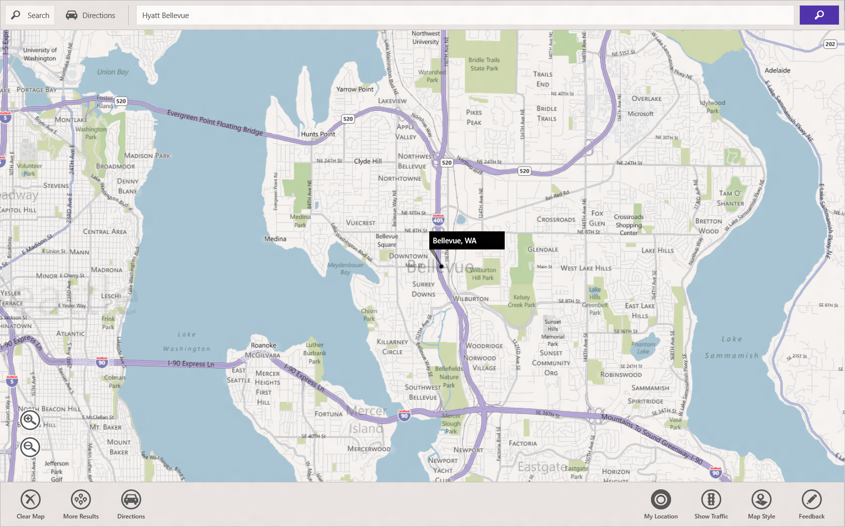
VirtualSurfaceImageSource
Object
DependencyObject
ImageSource
SurfaceImageSource
VirtualSurfaceImageSource
For very large surfaces that are too large to fit in video memory as a single texture
Larger than 1 screen size
Virtualization via tiles
Automatically manages tile cache
XAML requests tiles from the app when they come into view
Use for mapping scenarios, large document canvases
DirectX
XAML

Slide 23
VirtualSurfaceImageSource
interface IVirtualSurfaceImageSourceNative: ISurfaceImageSourceNative
{
RegisterForUpdatesNeeded(IVirtualSurfaceUpdatesCallbackNative *pCallback);
GetUpdateRects(RECT *pUpdates, DWORD count);
GetUpdateRectCount(DWORD *pCount);
Invalidate(RECT updateRect);
};
interface IVirtualSurfaceUpdatesCallbackNative: IUnknown
{
UpdatesNeeded();
};

Slide 24
How can I use VirtualSurfaceImageSource?
Implement IVirtualSurfaceImageSourceCallbackNative interface
Call RegisterForUpdatesNeeded on VSIS
In UpdatesNeeded callback, call GetUpdateRectCount and GetUpdateRects
Render the update rectangles (using BeginDraw/EndDraw method as per SurfaceImageSource)

Slide 25
New to SurfaceImageSource and VirtualSurfaceImageSource in 8.1
Faster Direct2D drawing
Multi-threaded drawing

Slide 26
New for SurfaceImageSource in 8.1
1. Faster Direct2D drawing
Draw with a Direct2D DeviceContext directly
Faster drawing to multiple SurfaceImageSource objects
Examples: thumbnail generation
No batching
With D2D device context/batching
App Draws Surface 1
App Draws Surface 2
App Draws Surface 3
App Draws Surface 1
App Draws Surface 2
App Draws Surface 3
D2D
Work
Flush
Work
Flush
Work
Flush
D2D
Work
Work
Work
Flush

Slide 27
SurfaceImageSource
interface ISurfaceImageSourceNativeWithD2D: IUnknown
{
SetDevice(IUnknown* device);
BeginDraw(RECT updateRect,
REFIID iid,
void **updateObject
POINT* offset);
EndDraw();
SuspendDraw();
ResumeDraw();
}
iid can be either:
For using D3D:
__uuidof(IDXGISurface)
→ *updateObject is IDXGISurface
For optimized D2D batching:
__uuidof(ID2D1DeviceContext)
→ *updateObject is ID2D1DeviceContext

Slide 28
New for 8.1 in SurfaceImageSource
2. Multi-threaded drawing
Single-threaded V/SIS drawing
Expensive DX drawing can bog down UI thread
Can delay input processing etc.
Multi-threaded V/SIS drawing
Expensive app rendering on another thread
Keeps UI thread responsive
UI Thread
Application rendering code
UI Thread
App rendering thread
Input processing
Input processing
Application rendering code
Layout, Render
Layout, Render
Cross thread communication

Slide 29
SurfaceImageSource
interface ISurfaceImageSourceNativeWithD2D: IUnknown
{
SetDevice(IUnknown* device);
BeginDraw(RECT updateRect,
REFIID iid,
void **updateObject
POINT* offset);
SuspendDraw();
ResumeDraw();
EndDraw();
}
These methods can be freely called from any thread

Slide 30
DirectX interop options in XAML SwapChainBackgroundPanel, SwapChainPanel

Slide 31
DirectX

Slide 32
SwapChainBackgroundPanel
Allows full screen DirectX content to be used as a background in a XAML app
Low latency presentation controlled by app
Games, FreshPaint
Can render a swap chain on a background thread for more fluid rendering
DX
XAML
Designed for a specific scenario
Must be background element
Must be full-window sized

Slide 33
New for 8.1 - SwapChainPanel
Benefits over SwapChainBackgroundPanel
Z-order limitations removed (same for WebView)!
Composable like any other XAML element
Any sized swap chain allowed
Can use more than one simultaneously
Size changed notification to redraw content crisply
XAML
DX
XAML

Slide 34
SwapChainPanel/SwapChainBackgroundPanel
interface ISwapChainBackgroundPanelNative: IUnknown
{
SetSwapChain(IDXGISwapChain *pSwapChain);
};
interface ISwapChainPanelNative: IUnknown
{
SetSwapChain(IDXGISwapChain *pSwapChain);
};
(Look familiar?)

Slide 35
Demo SwapChainPanel

Slide 36
When should I use DirectX interop APIs?
Use SurfaceImageSource or VirtualSurfaceImageSource when:
You want your content to integrate tightly with the XAML tree (e.g. ScrollViewer)
Your DirectX content isn’t being updated too frequently
Discrete updates, not continuous updates
The XAML framework can still manipulate its position etc.
Max update frequency is UI thread frame rate
Use SwapChainPanel or SwapChainBackgroundPanel when:
Your content is updating quickly (e.g. games, ink)
You want the lowest presentation latency possible

Slide 37
3. Independent Input

Slide 38
SwapChainPanel now exposes the ability to process touch, pen, and mouse input on a background thread, providing a path for high performance, low latency interactivity

Slide 39
SwapChainPanel with independent input
Dependent input
Input events in XAML apps arrive on the UI thread
Input processing competes with other messages and processing that occurs on the UI thread
Apps can feel unresponsive
Independent input
Allows touch input for SwapChain[Background]Panel to be sent to another thread
Enables input and output (rendering) to be fully independent of the XAML UI thread
Touch, pen, and mouse can be received
Allows developers to do custom independent input – this isn’t limited to panning any more

Slide 40
SwapChainPanel with UI thread input
UI Thread
XAML
DX
XAML
App rendering thread
Input processing
Render
Layout, Render
Cross thread communication
Other operations

Slide 41
SwapChainPanel with Independent Input
UI Thread
XAML
DX
XAML
App rendering thread
XAML input processing
Input processing
DX Input
Render
Layout, Render
Cross thread communication
Other operations

Slide 42
SwapChainPanel with independent input
Independent input
Allows touch input for SwapChain[Background]Panel to be sent to another thread
Enables input and output (rendering) fully independent of the XAML UI thread
Touch, pen, and mouse can be received
XAML
DX (SCP)
XAML
UI Thread
App rendering thread
XAML Input processing
SCP Input
Layout, Render
Render
Other operations
Cross thread communication
Present

Slide 43
SwapChainPanel
SwapChainPanel : Grid
{
// Can be called from any non-UI thread, to create a pipe to receive input on
CreateCoreIndependentInputSource(CoreInputDeviceTypes deviceTypes, CoreIndependentInputSource** source);
// Events
CompositionScaleChanged();
};

Slide 44
CoreIndependentInputSource
CoreIndependentInputSource
{
// Events
PointerPressed(…)
PointerReleased(…)
PointerMoved(…)
// Properties
Windows.Foundation.Point PointerPosition
/* ... */
};
CoreIndependentInputSource provides access to all pointer based events and state, when the input is routed to the SwapChainPanel

Slide 45
How can I use SwapChainPanel with CoreIndependentInputSource?
Create a SwapChainPanel, attach it to the XAML tree
Create an IDXGISwapChain, and set it on the SwapChainPanel
Call CreateCoreIndependentInputSource on a background thread
Setup background thread to process input messages and render in a loop
Profit!

Slide 46
Demo SwapChainPanel + independent input

Slide 47
Recap
You can use XAML and DirectX together to create great apps and games
Use both swap chain-style and surface-style interop, depending on application needs
XAML + DirectX + independent input allows for responsive, custom rendering in XAML apps

Slide 48
Resources
Sessions
Session Code | Speaker | Title
2-164 | Tim Heuer | What’s new in XAML?
3-157 | Kiran Kumar | XAML Performance Fundamentals
2-047 | Kam VedBrat | Building games for Windows
2-192 | Chris Anderson | Building a UI: What Does It Cost?
4-021 | Silvana Moncayo | DirectComposition: Smooth Composition and Animation for Desktop Applications
4-072 | Frank Olivier | Hyper-Fast Web Graphics with OpenGL

Slide 49
Resources
Samples
SwapChainPanel - http://code.msdn.microsoft.com/windowsapps/XAML-SwapChainPanel-00cb688b
SurfaceImageSource - http://code.msdn.microsoft.com/windowsapps/XAML-SurfaceImageSource-85773f74
DirectX and XAML Interop overview on MSDN:
http://msdn.microsoft.com/en-us/library/windows/apps/hh825871.aspx

Slide 50
Give us your feedback!
What?
Are you interested in having an impact on the future user experiences in Visual Studio? Come help us shape the future.
When & Where?
Schedule a time with us vsdr@microsoft.com
Room 254 South Moscone, West Mezzanine Level
Why?
Your input and feedback will influence future Microsoft Visual Studio tools

Slide 51
Questions?

Slide 52
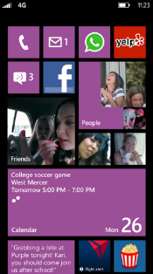
Evaluate this session
Required Slide
*delete this box when your slide is finalized
Your MS Tag will be inserted here during the final scrub.
Scan this QR code to evaluate this session and be automatically entered in a drawing to win a prize!

