Slide 2
Native Code Performance and Memory: The Elephant in the CPU
Eric Brumer
Compiler Developer
Session 4-329

Slide 3
Question: do less instructions yield faster code?

Slide 4
for (int i = 0; i < num_bodies; i++) {
X[i] = particles[i].pos.x;
Y[i] = particles[i].pos.y;
Z[i] = particles[i].pos.z;
}
for (int i = 0; i < numBodies; i+=8) {
__m256 netAccelx;
__m256 netAccely;
__m256 netAccelz;
netAccel.x = netAccel.y = netAccel.z = 0;
for (int j = 0; j < numBodies; j++) {
float_3 r;
r.x = X[j:j+7] - X[i];
r.y = Y[j:j+7] - Y[i];
r.z = Z[j:j+7] - Z[i];
float dst = sqrt(r.x*r.x + r.y*r.y + r.z*r.z);
float iDst = 1.0f / dst;
float deltaAccel = iDst * iDst * iDst * mass;
netAccelx += r.x * deltaAccel;
netAccely += r.y * deltaAccel;
netAccelz += r.z * deltaAccel;
}
particles[i].acc.x += netAccel.x;
particles[i].acc.y += netAccel.y;
particles[i].acc.z += netAccel.z;
}
for (int i = 0; i < numBodies; i++) {
float_3 netAccel;
netAccel.x = netAccel.y = netAccel.z = 0;
for (int j = 0; j < numBodies; j++) {
float_3 r;
r.x = X[j] - X[i];
r.y = Y[j] - Y[i];
r.z = Z[j] - Z[i];
float dst = sqrt(r.x*r.x + r.y*r.y + r.z*r.z);
float iDst = 1.0f / dst;
float deltaAccel = iDst * iDst * iDst * mass;
netAccel.x += r.x * deltaAccel;
netAccel.y += r.y * deltaAccel;
netAccel.z += r.z * deltaAccel;
}
particles[i].acc.x += netAccel.x;
particles[i].acc.y += netAccel.y;
particles[i].acc.z += netAccel.z;
}
for (int i = 0; i < num_bodies; i++) {
particles[i].pos.x = X[i];
particles[i].pos.y = Y[i];
particles[i].pos.z = Z[i];
}
3x more
instructions
for (int i = 0; i < numBodies; i++) {
float_3 netAccel;
netAccel.x = netAccel.y = netAccel.z = 0;
for (int j = 0; j < numBodies; j++) {
float_3 r;
r.x = particles[j].pos.x - particles[i].pos.x;
r.y = particles[j].pos.y - particles[i].pos.y;
r.z = particles[j].pos.z - particles[i].pos.z;
float dst = sqrt(r.x*r.x + r.y*r.y + r.z*r.z);
float iDst = 1.0f / dst;
float deltaAccel = iDst * iDst * iDst * mass;
netAccel.x += r.x * deltaAccel;
netAccel.y += r.y * deltaAccel;
netAccel.z += r.z * deltaAccel;
}
particles[i].acc.x += netAccel.x;
particles[i].acc.y += netAccel.y;
particles[i].acc.z += netAccel.z;
}
30% more
memory
5x faster

Slide 5
How can I achieve performance wins?
Less instructions is not the prescription for performance
Memory really matters
Working set
Caching
Spatial & temporal locality of accesses
Critical to performance
Sometimes in non-obvious ways

Slide 6
Memory in C/C++
As a programmer
malloc/calloc
new
make_shared
But there is more to it!

Slide 7
Mission: Deep dive into how performance of C/C++ is affected by memory.

Slide 8
Agenda
Cache overview
Data access pattern
Multi-core effects
Vector code
Alignment
Interesting edge cases
Recap & resources

Slide 9
Agenda
Cache overview
Data access pattern
Multi-core effects
Vector code
Alignment
Interesting edge cases
Recap & resources

Slide 10
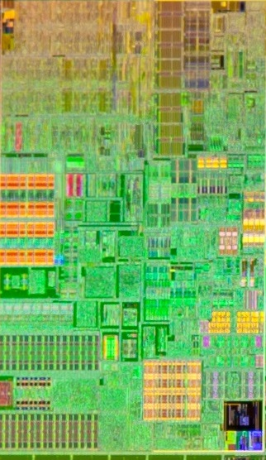
Intel Sandy Bridge
6 pipelines
6 instructions
per cycle
64kB L1 cache
256kB L2 cache
Courtesy of Intel

Slide 11
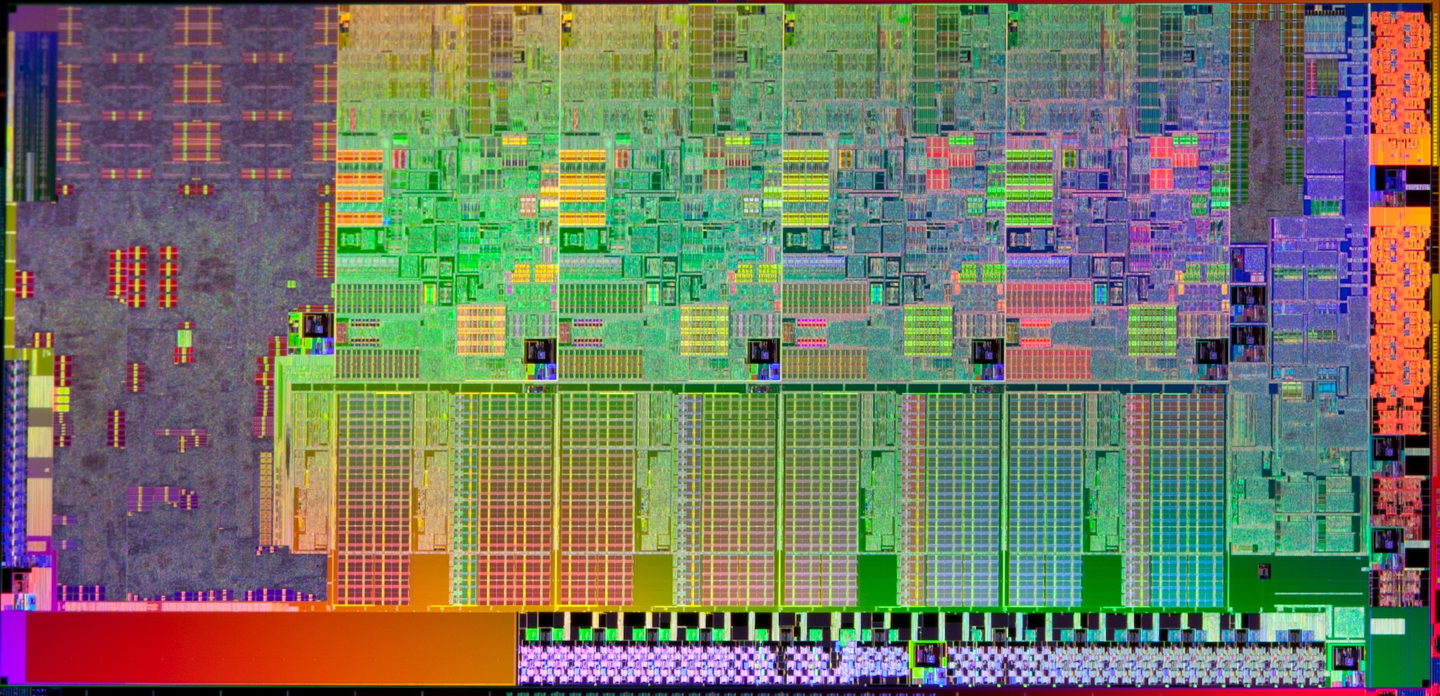
Intel Sandy Bridge
Execution pipelines
64kB L1
256kB L2
Execution pipelines
64kB L1
256kB L2
Execution pipelines
64kB L1
256kB L2
Execution pipelines
64kB L1
256kB L2
8-20MB L3 Cache
Courtesy of Intel

Slide 12
Coffee break!
Memory
4 cycles
(32-bit multiply)
12 cycles
(32-bit sqrt)
26 cycles
(2x 32-bit sqrt)
Execution Pipelines
L2 Cache
L3 Cache
L1 Cache
Execution Pipelines
L2 Cache
Execution Pipelines
L1 Cache
Execution Pipelines
L2 Cache
L1 Cache
Execution Pipelines
L2 Cache
L1 Cache

Slide 13
Performance Win: Keep your data close.

Slide 14
Agenda
Cache overview
Data access pattern
Multi-core effects
Vector code
Alignment
Interesting edge cases
Recap & resources

Slide 15
Matrix multiply
void mtx_mult() {
for (int i=0; i<N; i++)
for (int j=0; j<N; j++)
for (int k=0; k<N; k++)
C[i][j] += A[i][k] * B[k][j];
}
Poor spatial locality
Row 0
Row 1
Row 2
Row 3
… etc …
Array B:
B[0][5]
B[1][5]
B[2][5]
B[3][5]
Poor spatial locality = lots of
coffee breaks

Slide 16
Matrix multiply
void mtx_mult() {
for (int i=0; i<N; i++)
for (int k=0; k<N; k++)
for (int j=0; j<N; j++)
C[i][j] += A[i][k] * B[k][j];
}
Swap for perf boost
Row 0
Row 1
Row 2
Row 3
… etc …
Array B:
B[0][5],
B[0][6],
B[0][7],
B[0][8]
miss
Focusing on memory
10x speedup if N is large!
hits

Slide 17
Performance Win: Keep your data close
, and watch your access patterns.

Slide 18
Agenda
Cache overview
Data access pattern
Multi-core effects
Vector code
Alignment
Interesting edge cases
Recap & resources

Slide 19
Simple Parallelization
// add_arrays is called often
void add_arrays(float *A, float *B, float *C) {
for (int i=0; i<4000000; i++)
A[i] = B[i] + C[i];
}
Let’s go parallel on a 40-core machine

Slide 20
Simple Parallelization
// add_arrays is called often
void add_arrays(float *A, float *B, float *C) {
for (int i=0; i<4000000; i++)
A[i] = B[i] + C[i];
}
Number of Cores | Speedup
5 | 1.6x

Slide 21
Simple Parallelization
// add_arrays is called often
void add_arrays(float *A, float *B, float *C) {
for (int i=0; i<4000000; i++)
A[i] = B[i] + C[i];
}
Number of Cores | Speedup
5 | 1.6x
10 | 2.4x

Slide 22
Simple Parallelization
// add_arrays is called often
void add_arrays(float *A, float *B, float *C) {
for (int i=0; i<4000000; i++)
A[i] = B[i] + C[i];
}
Why does this suck so much?
Question: How much time is spent loading memory?

Slide 23
Memory
48 MB
30MB L3
30MB L3
30MB L3
30MB L3
Xeon Core
256kB L2
Xeon Core
256kB L2
Xeon Core
256kB L2
Xeon Core
256kB L2
Xeon Core
256kB L2
Xeon Core
256kB L2
Xeon Core
256kB L2
Xeon Core
256kB L2
Xeon Core
256kB L2
Xeon Core
256kB L2
Xeon Core
256kB L2
Xeon Core
256kB L2
Xeon Core
256kB L2
Xeon Core
256kB L2
Xeon Core
256kB L2
Xeon Core
256kB L2
Xeon Core
256kB L2
Xeon Core
256kB L2
Xeon Core
256kB L2
Xeon Core
256kB L2
Xeon Core
256kB L2
Xeon Core
256kB L2
Xeon Core
256kB L2
Xeon Core
256kB L2
Xeon Core
256kB L2
Xeon Core
256kB L2
Xeon Core
256kB L2
Xeon Core
256kB L2
Xeon Core
256kB L2
Xeon Core
256kB L2
Xeon Core
256kB L2
Xeon Core
256kB L2
Xeon Core
256kB L2
Xeon Core
256kB L2
Xeon Core
256kB L2
Xeon Core
256kB L2
Xeon Core
256kB L2
Xeon Core
256kB L2
Xeon Core
256kB L2
Xeon Core
256kB L2

Slide 24
Memory
48 MB
Not enough memory!
30MB L3
30MB L3
30MB L3
30MB L3
Xeon Core
256kB L2
Xeon Core
256kB L2
Xeon Core
256kB L2
Xeon Core
256kB L2
Xeon Core
256kB L2
Xeon Core
256kB L2
Xeon Core
256kB L2
Xeon Core
256kB L2
Xeon Core
256kB L2
Xeon Core
256kB L2
Xeon Core
256kB L2
Xeon Core
256kB L2
Xeon Core
256kB L2
Xeon Core
256kB L2
Xeon Core
256kB L2
Xeon Core
256kB L2
Xeon Core
256kB L2
Xeon Core
256kB L2
Xeon Core
256kB L2
Xeon Core
256kB L2
Xeon Core
256kB L2
Xeon Core
256kB L2
Xeon Core
256kB L2
Xeon Core
256kB L2
Xeon Core
256kB L2
Xeon Core
256kB L2
Xeon Core
256kB L2
Xeon Core
256kB L2
Xeon Core
256kB L2
Xeon Core
256kB L2
Xeon Core
256kB L2
Xeon Core
256kB L2
Xeon Core
256kB L2
Xeon Core
256kB L2
Xeon Core
256kB L2
Xeon Core
256kB L2
Xeon Core
256kB L2
Xeon Core
256kB L2
Xeon Core
256kB L2
Xeon Core
256kB L2

Slide 25
Memory
48 MB
Not enough memory!
30MB L3
30MB L3
30MB L3
30MB L3
Xeon Core
256kB L2
Xeon Core
256kB L2
Xeon Core
256kB L2
Xeon Core
256kB L2
Xeon Core
256kB L2
Xeon Core
256kB L2
Xeon Core
256kB L2
Xeon Core
256kB L2
Xeon Core
256kB L2
Xeon Core
256kB L2
Xeon Core
256kB L2
Xeon Core
256kB L2
Xeon Core
256kB L2
Xeon Core
256kB L2
Xeon Core
256kB L2
Xeon Core
256kB L2
Xeon Core
256kB L2
Xeon Core
256kB L2
Xeon Core
256kB L2
Xeon Core
256kB L2
Xeon Core
256kB L2
Xeon Core
256kB L2
Xeon Core
256kB L2
Xeon Core
256kB L2
Xeon Core
256kB L2
Xeon Core
256kB L2
Xeon Core
256kB L2
Xeon Core
256kB L2
Xeon Core
256kB L2
Xeon Core
256kB L2
Xeon Core
256kB L2
Xeon Core
256kB L2
Xeon Core
256kB L2
Xeon Core
256kB L2
Xeon Core
256kB L2
Xeon Core
256kB L2
Xeon Core
256kB L2
Xeon Core
256kB L2
Xeon Core
256kB L2
Xeon Core
256kB L2

Slide 26
Memory
48 MB
YES!
30MB L3
30MB L3
30MB L3
30MB L3
Xeon Core
256kB L2
Xeon Core
256kB L2
Xeon Core
256kB L2
Xeon Core
256kB L2
Xeon Core
256kB L2
Xeon Core
256kB L2
Xeon Core
256kB L2
Xeon Core
256kB L2
Xeon Core
256kB L2
Xeon Core
256kB L2
Xeon Core
256kB L2
Xeon Core
256kB L2
Xeon Core
256kB L2
Xeon Core
256kB L2
Xeon Core
256kB L2
Xeon Core
256kB L2
Xeon Core
256kB L2
Xeon Core
256kB L2
Xeon Core
256kB L2
Xeon Core
256kB L2
Xeon Core
256kB L2
Xeon Core
256kB L2
Xeon Core
256kB L2
Xeon Core
256kB L2
Xeon Core
256kB L2
Xeon Core
256kB L2
Xeon Core
256kB L2
Xeon Core
256kB L2
Xeon Core
256kB L2
Xeon Core
256kB L2
Xeon Core
256kB L2
Xeon Core
256kB L2
Xeon Core
256kB L2
Xeon Core
256kB L2
Xeon Core
256kB L2
Xeon Core
256kB L2
Xeon Core
256kB L2
Xeon Core
256kB L2
Xeon Core
256kB L2
Xeon Core
256kB L2

Slide 27
Simple Parallelization
// add_arrays is called often
void add_arrays(float *A, float *B, float *C) {
for (int i=0; i<4000000; i++)
A[i] = B[i] + C[i];
}
Focusing on memory
Many-core speedup!
Number of Cores | L3 Cache Available | Speedup
5 | 30 MB | 1.6x
10 | 30 MB | 2.4x
20 | 60 MB | 18x

Slide 28
Performance Win: Keep your data close, and watch your access patterns.

Slide 29
Performance Win: Keep your data close, and watch your access patterns. Especially when multithreading I/O bound code

Slide 30
Agenda
Cache overview
Data access pattern
Multi-core effects
Vector code
Alignment
Interesting edge cases
Recap & resources

Slide 31
Nbody

Slide 32
$$\vec{F}=m_{1}\vec{A}=\frac{Gm_{1}m_{2}}{{\left|\vec{r_{12}}\right|}^{2}} \hat{r_{12}}$$
$$\vec{A}=\frac{mass}{{\left|\vec{r_{12}}\right|}^{3}} \vec{r_{12}}$$

Slide 33
struct Particle {
float_3 pos;
float_3 vel;
float_3 acc;
};
Particle particles[4096];
pos
vel
acc
x
y
z
x
y
z
x
y
z
Particles:
...

Slide 34
Nbody
for (int i = 0; i < numBodies; i++) {
float_3 netAccel;
netAccel.x = netAccel.y = netAccel.z = 0;
for (int j = 0; j < numBodies; j++) {
netAccel.x += ...
netAccel.y += ...
netAccel.z += ...
}
particles[i].acc.x += netAccel.x;
particles[i].acc.y += netAccel.y;
particles[i].acc.z += netAccel.z;
// ... move the particle ...
}
$$\vec{A}=\frac{mass}{{\left|\vec{r_{12}}\right|}^{3}} \vec{r_{12}}$$

Slide 35
Nbody
for (int i = 0; i < numBodies; i++) {
...
for (int j = 0; j < numBodies; j++) {
float_3 r;
r.x = particles[j].pos.x - particles[i].pos.x;
r.y = particles[j].pos.y - particles[i].pos.y;
r.z = particles[j].pos.z - particles[i].pos.z;
float dst = sqrt(r.x*r.x + r.y*r.y + r.z*r.z);
float iDst = 1.0f / dst;
float deltaAccel = iDst * iDst * iDst * mass;
netAccel.x += r.x * deltaAccel;
netAccel.y += r.y * deltaAccel;
netAccel.z += r.z * deltaAccel;
}
... }
$$\vec{A}=\frac{mass}{{\left|\vec{r_{12}}\right|}^{3}} \vec{r_{12}}$$

Slide 36
Nbody
for (int i = 0; i < numBodies; i++) {
...
for (int j = 0; j < numBodies; j++) {
float_3 r;
r.x = particles[j].pos.x - particles[i].pos.x;
r.y = particles[j].pos.y - particles[i].pos.y;
r.z = particles[j].pos.z - particles[i].pos.z;
float dst = sqrt(r.x*r.x + r.y*r.y + r.z*r.z);
float iDst = 1.0f / dst;
float deltaAccel = iDst * iDst * iDst * mass;
netAccel.x += r.x * deltaAccel;
netAccel.y += r.y * deltaAccel;
netAccel.z += r.z * deltaAccel;
}
... }
$$\vec{A}=\frac{mass}{{\left|\vec{r_{12}}\right|}^{3}} \vec{r_{12}}$$
Three loads

Slide 37
Nbody
for (int i = 0; i < numBodies; i++) {
...
for (int j = 0; j < numBodies; j++) {
float_3 r;
r.x = particles[j].pos.x - particles[i].pos.x;
r.y = particles[j].pos.y - particles[i].pos.y;
r.z = particles[j].pos.z - particles[i].pos.z;
float dst = sqrt(r.x*r.x + r.y*r.y + r.z*r.z);
float iDst = 1.0f / dst;
float deltaAccel = iDst * iDst * iDst * mass;
netAccel.x += r.x * deltaAccel;
netAccel.y += r.y * deltaAccel;
netAccel.z += r.z * deltaAccel;
}
... }
Hoisted
$$\vec{A}=\frac{mass}{{\left|\vec{r_{12}}\right|}^{3}} \vec{r_{12}}$$

Slide 38
Nbody
for (int i = 0; i < numBodies; i++) {
...
for (int j = 0; j < numBodies; j++) {
float_3 r;
r.x = particles[j].pos.x - particles[i].pos.x;
r.y = particles[j].pos.y - particles[i].pos.y;
r.z = particles[j].pos.z - particles[i].pos.z;
float dst = sqrt(r.x*r.x + r.y*r.y + r.z*r.z);
float iDst = 1.0f / dst;
float deltaAccel = iDst * iDst * iDst * mass;
netAccel.x += r.x * deltaAccel;
netAccel.y += r.y * deltaAccel;
netAccel.z += r.z * deltaAccel;
}
... }
Eight add/sub
$$\vec{A}=\frac{mass}{{\left|\vec{r_{12}}\right|}^{3}} \vec{r_{12}}$$

Slide 39
Nbody
for (int i = 0; i < numBodies; i++) {
...
for (int j = 0; j < numBodies; j++) {
float_3 r;
r.x = particles[j].pos.x - particles[i].pos.x;
r.y = particles[j].pos.y - particles[i].pos.y;
r.z = particles[j].pos.z - particles[i].pos.z;
float dst = sqrt(r.x*r.x + r.y*r.y + r.z*r.z);
float iDst = 1.0f / dst;
float deltaAccel = iDst * iDst * iDst * mass;
netAccel.x += r.x * deltaAccel;
netAccel.y += r.y * deltaAccel;
netAccel.z += r.z * deltaAccel;
}
... }
$$\vec{A}=\frac{mass}{{\left|\vec{r_{12}}\right|}^{3}} \vec{r_{12}}$$
Nine mult

Slide 40
Nbody
for (int i = 0; i < numBodies; i++) {
...
for (int j = 0; j < numBodies; j++) {
float_3 r;
r.x = particles[j].pos.x - particles[i].pos.x;
r.y = particles[j].pos.y - particles[i].pos.y;
r.z = particles[j].pos.z - particles[i].pos.z;
float dst = sqrt(r.x*r.x + r.y*r.y + r.z*r.z);
float iDst = 1.0f / dst;
float deltaAccel = iDst * iDst * iDst * mass;
netAccel.x += r.x * deltaAccel;
netAccel.y += r.y * deltaAccel;
netAccel.z += r.z * deltaAccel;
}
... }
$$\vec{A}=\frac{mass}{{\left|\vec{r_{12}}\right|}^{3}} \vec{r_{12}}$$
Divide & sqrt

Slide 41
Nbody Performance
What you get with
Visual C++
 | Scalar (32 bit) | SSE2 (128 bit)
Frames per second | 8 fps | 18 fps
# loop iterations | 4096 | 1024

Slide 42
Nbody Performance
 | Scalar (32 bit) | SSE2 (128 bit) | AVX (256 bit)
Frames per second | 8 fps | 18 fps | 23 fps
# loop iterations | 4096 | 1024 | 512
?

Slide 43
Nbody
for (int i = 0; i < numBodies; i++) {
...
for (int j = 0; j < numBodies; j++) {
float_3 r;
r.x = particles[j].pos.x - particles[i].pos.x;
r.y = particles[j].pos.y - particles[i].pos.y;
r.z = particles[j].pos.z - particles[i].pos.z;
float dst = sqrt(r.x*r.x + r.y*r.y + r.z*r.z);
float iDst = 1.0f / dst;
float deltaAccel = iDst * iDst * iDst * mass;
netAccel.x += r.x * deltaAccel;
netAccel.y += r.y * deltaAccel;
netAccel.z += r.z * deltaAccel;
}
... }
$$\vec{A}=\frac{mass}{{\left|\vec{r_{12}}\right|}^{3}} \vec{r_{12}}$$
Pop quiz:
what’s hot?
and why?

Slide 44
Non-contiguous vector loads
particles[j+1].pos.x
particles[j+1].pos.y
particles[j+1].pos.z
particles[j+3].pos.x
particles[j+3].pos.y
particles[j+3].pos.z
particles[j+5].pos.x
particles[j+5].pos.y
particles[j+5].pos.z
particles[j+7].pos.x
particles[j+7].pos.y
particles[j+7].pos.z
particles[j+6].pos.x
particles[j+6].pos.y
particles[j].pos.x
particles[j+6].pos.z
particles[j].pos.y
particles[j].pos.z
particles[j+2].pos.x
particles[j+2].pos.y
particles[j+2].pos.z
particles[j+4].pos.x
particles[j+4].pos.y
particles[j+4].pos.z
Particles:
2x vmovss
6x vinsertps
1x vinsertf128
ymm register (256 bits)
ymm register (256 bits)
2x vmovss
6x vinsertps
1x vinsertf128
ymm register (256 bits)
ymm register (256 bits)
2x vmovss
6x vinsertps
1x vinsertf128
ymm register (256 bits)
ymm register (256 bits)

Slide 45
How to make Nbody faster?
Time spent in non-contiguous memory operations
Not just loading, organizing, shuffling and merging
Question: What can we do about it?

Slide 46
Particles:
...
X:
...
Y:
...
Z:
...
Vectorized loop body

Slide 47
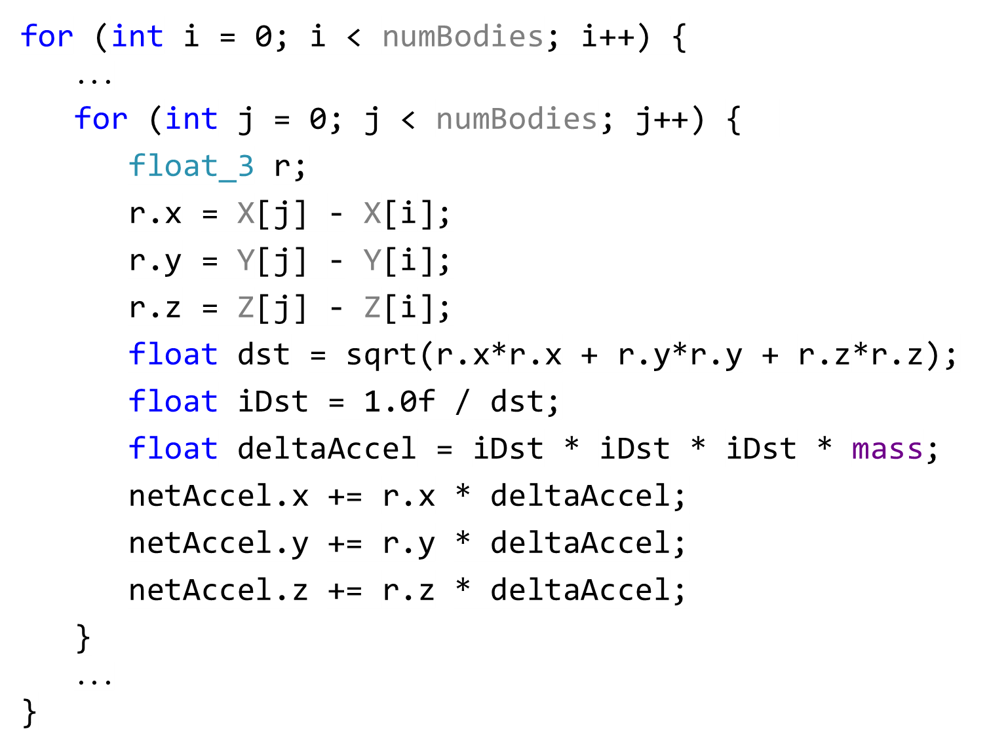
Nbody
Hot code
New (contiguous) arrays

Slide 48
Nbody
Hot code
for (int i = 0; i < num_bodies; i++) {
X[i] = particles[i].pos.x; Y[i] = particles[i].pos.y; Z[i] = particles[i].pos.z;
}
for (int i = 0; i < num_bodies; i++) {
particles[i].pos.x = X[i]; particles[i].pos.y = Y[i]; particles[i].pos.z = Z[i];
}
New code
New code

Slide 49
Nbody Performance
 | Scalar (32 bit) | SSE2 (128 bit) | AVX (256 bit)
Frames per second | 8 fps | 18 fps | 23 fps
# loop iterations | 4096 | 1024 | 512

Slide 50
Nbody Performance
 | Scalar (32 bit) | SSE2 (128 bit) | AVX (256 bit) | AVX Plus (256 bit)
Frames per second | 8 fps | 18 fps | 23 fps | 42 fps
# loop iterations | 4096 | 1024 | 512 | 512
Focusing on memory
2x speedup!

Slide 51
What’s the point?
Common knowledge: CPU performance is increasing faster than memory performance.
We are already there!

Slide 52
Performance Win: Be mindful of your data structures. How your data is accessed really matters.

Slide 53
Agenda
Cache overview
Data access pattern
Multi-core effects
Vector code
Alignment
Interesting edge cases
Recap & resources

Slide 54
Alignment Matters
L1 Cache
32B (256 bit)
aligned access
32B (256 bit)
aligned access
Alignment = good cache line density
64 Byte lines

Slide 55
Alignment Matters
32B (256 bit)
unaligned access
L1 Cache
Poor cache density
8% perf loss
on NBody
32B (256 bit)
unaligned access
64 Byte lines

Slide 56
Performance Win: Be mindful of your data structures. How your data is accessed really matters.
and cache line alignment!

Slide 57
Agenda
Cache overview
Data access pattern
Multi-core effects
Vector code
Alignment
Interesting edge cases
Recap & resources

Slide 58
Interesting Edge Cases
Focusing on working set is important
But: not always straightforward
Two examples

Slide 59
Example #1: Bitfield operations
struct S {
bool a;
bool b;
bool c;
bool d;
};
void set_c(S &s, bool v) {
s.c = v;
}
Size of S is 4 bytes
a
b
c
d
Code size of set_c’s function
body is 3 bytes
mov BYTE PTR [rcx+2], dl

Slide 60
Example #1: Bitfield operations
struct S {
int a : 1;
int b : 1;
int c : 1;
int d : 1;
};
void set_c(S &s, bool v) {
s.c = v;
}
Size of S is 1/2 byte
a
b
c
d
Code size of set_c’s function
body is 11 bytes
and DWORD PTR [rcx], -5
and edx, 1
shl edx, 2
or DWORD PTR [rcx], edx

Slide 61
Example #1: Bitfield operations
How much do you save?
Effects of inlining
/FAsc output of compiler

Slide 62
Example #2: Array-of-structs
struct MyDataType {
float a; float b; float c; float d;
float w; float x; float y; float z;
};
MyDataType myDataArray[100000];
Hot
Cold
myDataArray:
a
b
c
d
w
x
y
z
a
b
c
d
w
x
y
z
a
b
c
d
w
x
y
z
...

Slide 63
Access 4 bytes
Execution Pipelines
L2 Cache
256 kB
L1 Cache
Wasted cache space

Slide 64
Example #2: Array-of-structs
struct MyHotDataType { float a; float b; float c; float d; };
struct MyColdDataType { float w; float x; float y; float z; };
struct MyDataType {
MyHotDataType myHotData[100000];
MyColdDataType myColdData[100000];
};
MyDataType myData;
Focusing on memory
8% speedup!

Slide 65
Agenda
Cache overview
Data access pattern
Multi-core effects
Vector code
Alignment
Interesting edge cases
Recap & resources

Slide 66
Memory Performance Recap
Win: Watch your access patterns.
Win: Keep your data close to the execution units, especially when multithreading.
Win: Alignment matters, especially for vector code.
Win: Get cold data out of the way.
Caveat: It’s not always straightforward.

Slide 67
Compiler & Performance Resources
Profilers
Visual Studio Performance Analysis
Intel VTune Amplifier XE
AMD CodeXL
Tools
cl /FAsc Output assembly, including code bytes
link.exe /map View global data addresses
Undocumented switch: cl /d1reportSingleClassLayoutStructName
VMMap

Slide 68
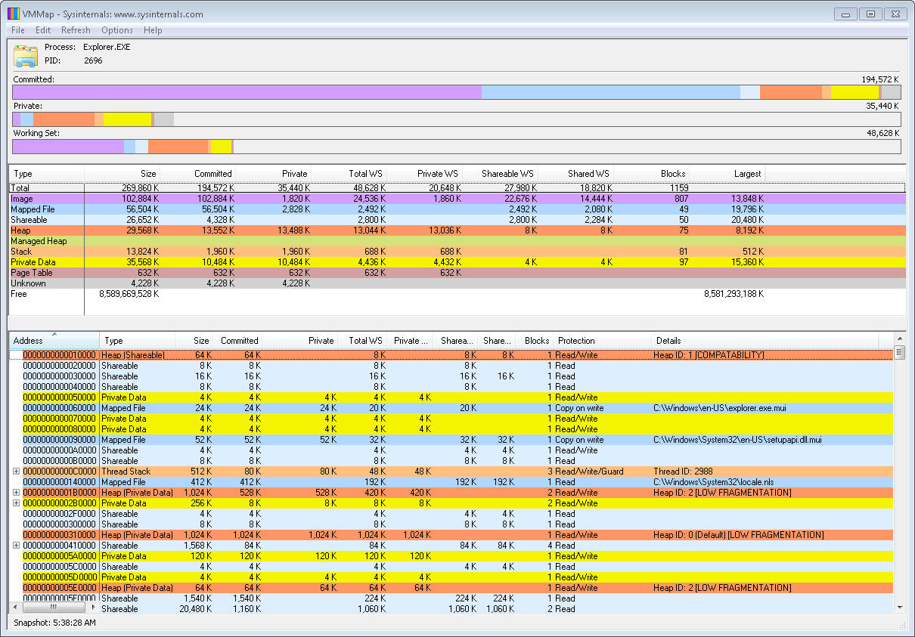
Compiler & Performance Resources
VMMap http://technet.microsoft.com/en-us/sysinternals/dd535533.aspx

Slide 69
Compiler & Performance Resources
Compiler switches
http://msdn.microsoft.com
Automatic vectorization blog & cookbook http://blogs.msdn.com/b/nativeconcurrency
Visual C++ blog
http://blogs.msdn.com/b/vcblog/
Channel 9 Going Native http://channel9.msdn.com/Shows/C9-GoingNative

Slide 70
Give us your feedback!
What?
Are you interested in having an impact on the future user experiences in Visual Studio? Come help us shape the future.
When & Where?
Schedule a time with us vsdr@microsoft.com
Room 254 South Moscone, West Mezzanine Level
Why?
Your input and feedback will influence future Microsoft Visual Studio tools

Slide 71
Evaluate this session
Required Slide
*delete this box when your slide is finalized
Your MS Tag will be inserted here during the final scrub.
Scan this QR code to evaluate this session and be automatically entered in a drawing to win a prize!

Slide 73
Backup slides

Slide 74
Omit frame pointers: /Oy
X86 (32-bit) only
Try not to construct stack frames
Frees up ‘ebp’ as a general purpose register
Off by default – debugging considerations

Slide 75
Whole program optimizations: /GL
On by default
Gives compiler whole program view
Cross module inlining
Track register usage across functions
Track memory usage across functions

Slide 76
Floating point model: /fp:fast
/fp:precise (not /fp:fast!) on by default
Allows for:
Algebraic transformations
Rounding simpifications
Re-ordering of fp expressions

Slide 77
Automatic vectorization
On by default with /O2
Targeting SSE2 (x86, x64), NEON (ARM) instruction sets
Reporting switches: /Qvec-report:1 or /Qvec-report:2
Benefits from /fp:fast
Blog posts, cookbook: http://blogs.msdn.com/b/nativeconcurrency

Slide 78
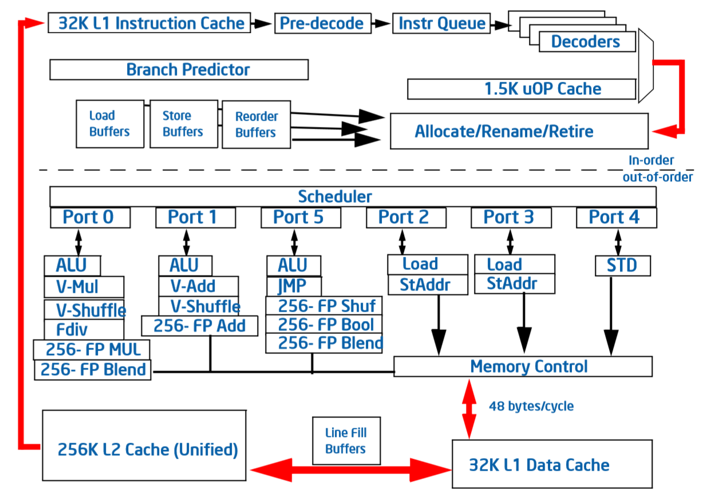
Branch Prediction Optimizations
Misprediction cost is 14 cycles on Sandy Bridge

Slide 79
Devirtualization
class Vehicle {
virtual void Drive(int miles) { ... }
};
class Car : public Vehicle {
void Drive(int miles) { ... }
};
void test(Vehicle *v) {
v->Drive(10);
}
Devirtualized call,
no prediction
Indirect call,
requires prediction
mov eax, DWORD PTR [ecx]
push 10
call DWORD PTR [eax]
push 10
call ?Drive@Car@@UAEXH@Z

Slide 80
Meet Sandy
Front-End
Execution Pipelines
Back-End
Courtesy of Intel

Slide 81
Instruction Latencies (Sandy Bridge)
1 cycle throughput
14 cycle throughput

Slide 82
Auto Vectorization
#include <intrin.h>
for (int i=0; i<100; i+=4) {
__m128 t1 = _mm_loadu_ps(&A[i]);
__m128 t2 = _mm_loadu_ps(&B[i]);
__m128 t3 = _mm_add_ps(t1, t2);
_mm_storeu_ps(&C[i], t3);
}

Slide 83
Auto Vectorization
Low latency
SIMD
Courtesy of Intel

Slide 84
Auto Vectorization
SCALAR
(1 operation)
VECTOR
(N operations)
r1
r2
v1
v2
+
+
r3
v3
vector
length
add r3, r1, r2
vadd v3, v1, v2

Slide 85
Auto Vectorization
for (int i=0; i<100; i++)
A[i] = B[i] + C[i];
Speedup!
128-bit operations
for (int i=0; i<100; i+=4) {
movups xmm1, [eax]
movups xmm2, [ebx]
addps xmm1, xmm2
movups [ecx], xmm1
}

Slide 86
#include <intrin.h>
for (int i=0; i<100; i+=4) {
__m128 t1 = _mm_loadu_ps(&A[i]);
__m128 t2 = _mm_loadu_ps(&B[i]);
__m128 t3 = _mm_add_ps(t1, t2);
_mm_storeu_ps(&C[i], t3);
}

Slide 87
Auto-vectorization
Auto-vectorization debut Visual C++ 2012
New in Visual C++ 2013:
More loops, operations, and data types
Statement-level vectorization
Dozens of significant improvements
SPEC2006: 50% more loops vectorized

Slide 88
Statement-level vectorization
128-bit operation identification
struct FourVector { // rgba, xyzw
float v[4];
};
FourVector scale(FourVector &A, float s) {
FourVector r;
r.v[0] = A.v[0] * s;
r.v[1] = A.v[1] * s;
r.v[2] = A.v[2] * s;
r.v[3] = A.v[3] * s;
return r;
}

Slide 89
Statement-level vectorization
128-bit operation identification
Vectorization!
struct FourVector { // rgba, xyzw
float v[4];
};
FourVector scale(FourVector &A, float s) {
movss xmm0, s$
shufps xmm0, xmm0, 0
movups xmm1, [ecx]
mulps xmm1, xmm0
movups [edx], xmm1
}
Performance win.
Code size win.
New in Visual C++ 2013

Slide 90
More Better Auto-Vectorization
float sdp(float *A, float *B, int *C) {
float s = 0.0f;
for (int i=0; i<100; i++)
s += *A++ * B[*C++];
return s;
}
Striding through A & C

Slide 91
More Better Auto-Vectorization
float sdp(float *A, float *B, int *C) {
float s = 0.0f;
for (int i=0; i<100; i++)
s += A[i] * B[C[i]];
return s;
}
movups
addps
3x Speedup!
New in Visual C++ 2013
mulps
Chained scalar load

