Slide 2
Developing apps using the common XAML UI framework
2-507
Tim Heuer
Program Manager

Slide 3
A common, familiar programming model for universal Windows apps
C / C++
XAML
C# / VB
HTML / CSS
JavaScript
Windows Runtime
Input, Interaction, & Manipulation
DirectX, Media, & Composition
Windows Kernel Services

Slide 4
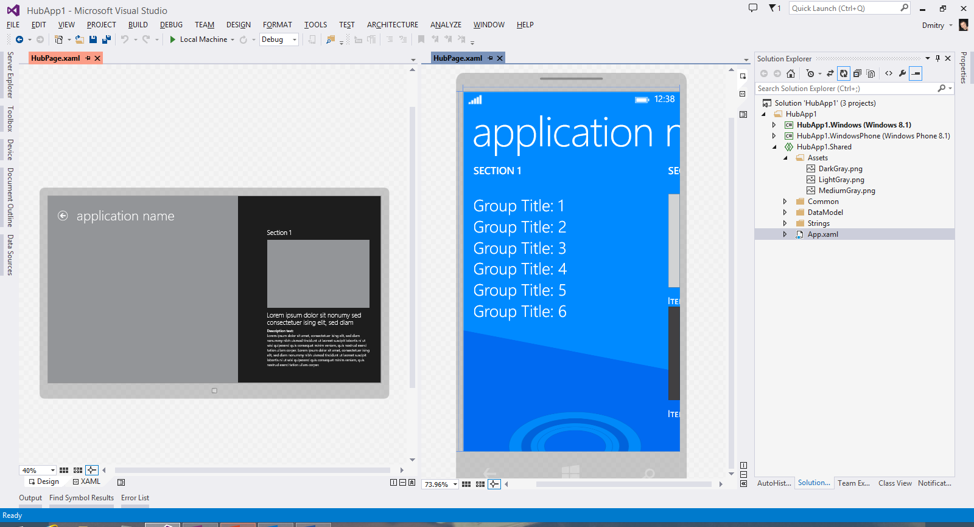
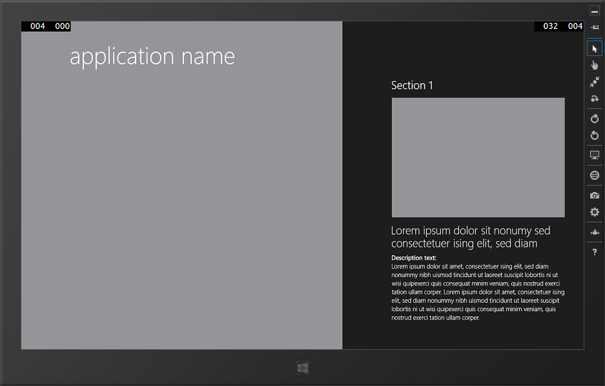
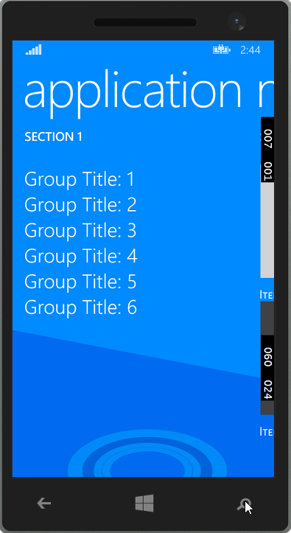
Visual Studio streamlines developing universal Windows apps
Share your XAML UI!
3-591: Using Visual Studio to build XAML universal apps (Navit Saxena)

Slide 5
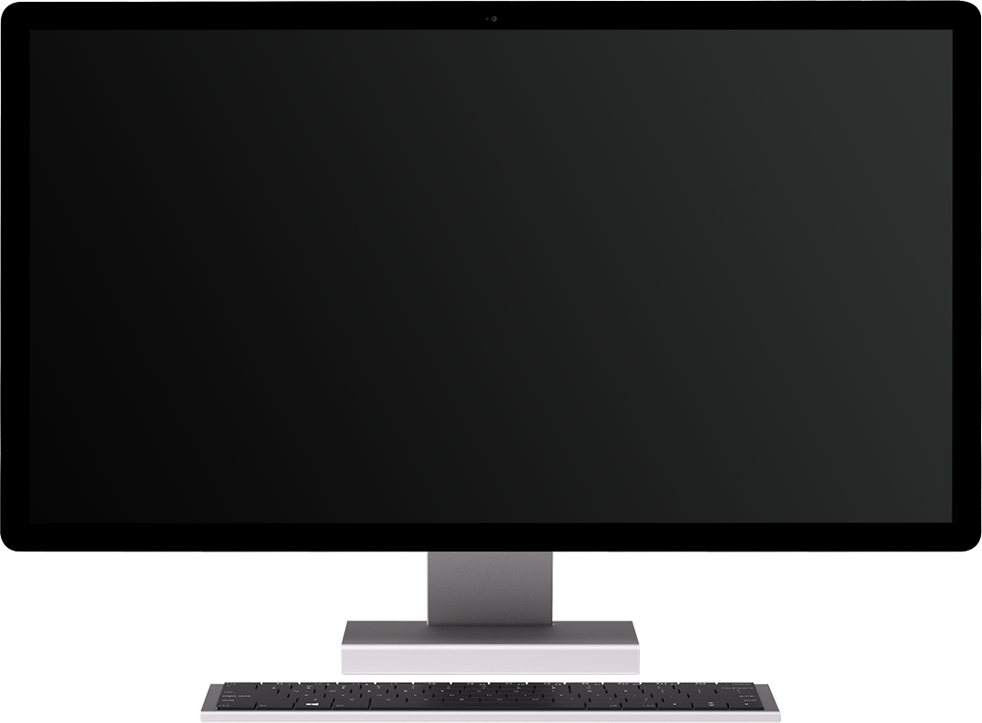
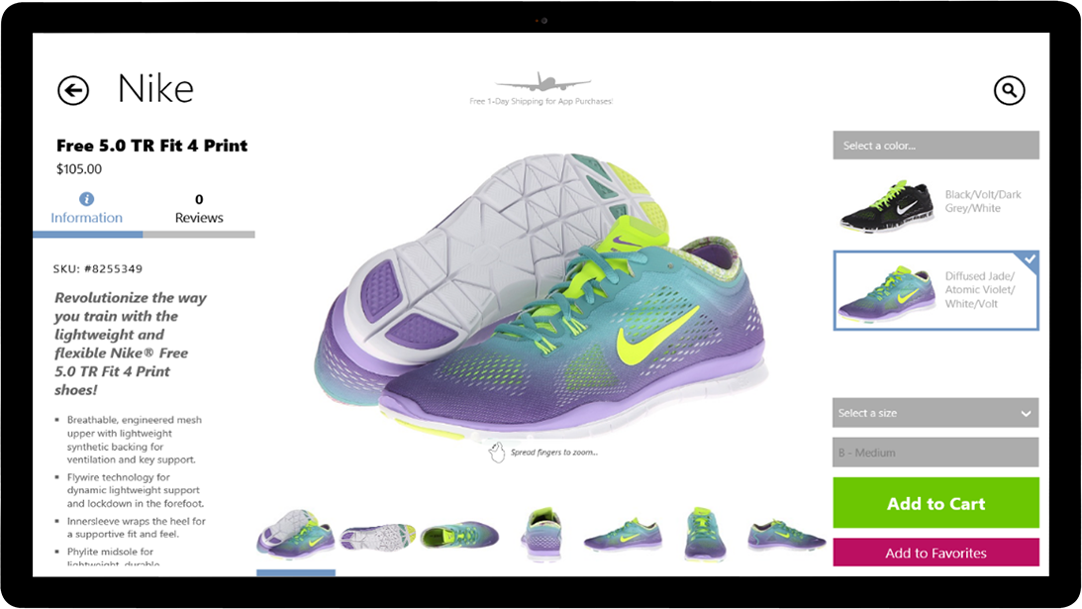
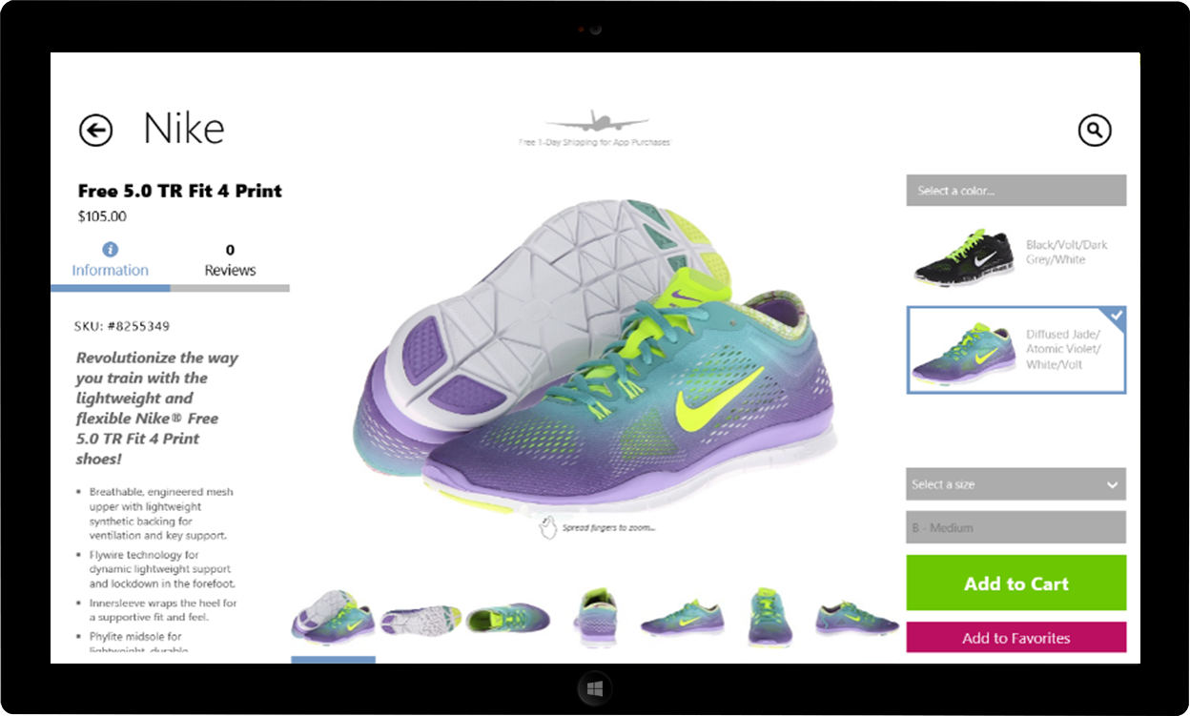
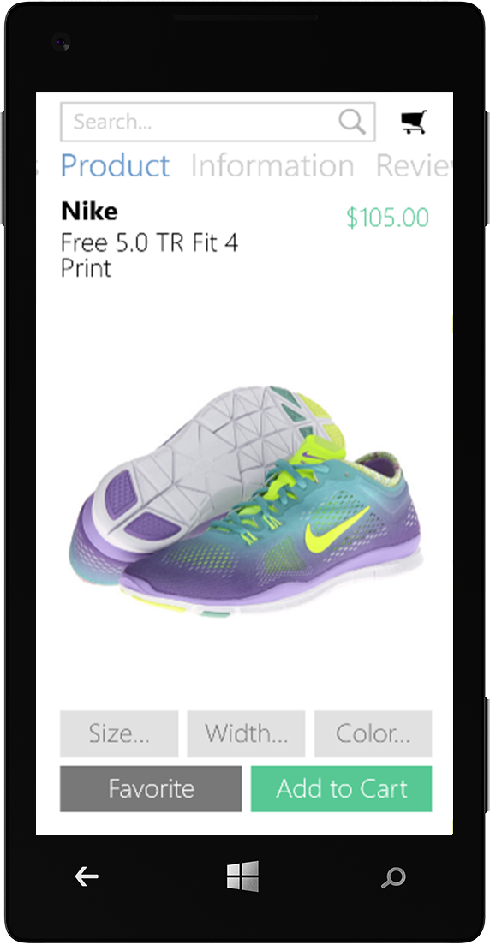
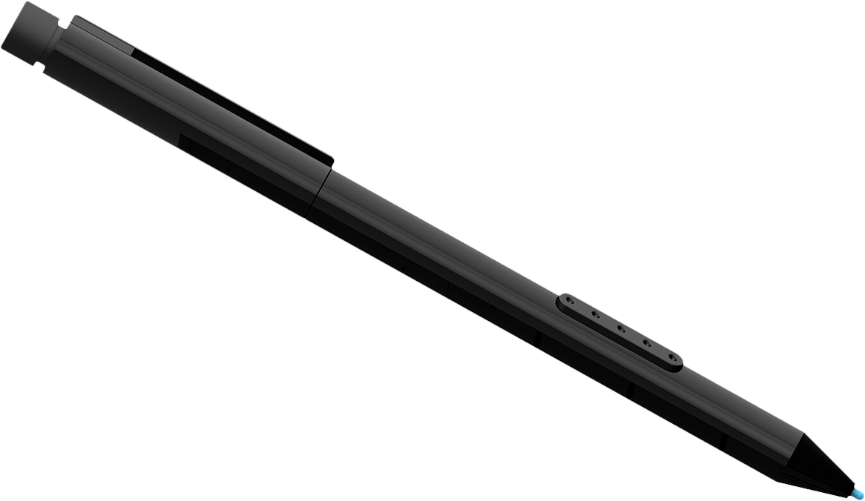
You can tailor the design to each device

Slide 6
Demo: Shared Projects in Visual Studio
3-591: Using Visual Studio to build XAML universal apps (Navit Saxena)

Slide 7
Windows
Phone
Windows

Slide 8
Don’t fool me with fancy Venn diagrams What is really common and what isn’t!
😒

Slide 9
Windows.UI.Xaml.*
 | Classes | Structs | Interfaces
Windows 8.1 SDK | 566 | 119 | 59
Windows Phone 8.1 SDK | 624 | 131 | 57
 | +58 | +12 | -2

Slide 10
What is Common?
API Same
API Same, tailored behavior
Device-specific APIs

Slide 11
Controls
2-516: Building Great UI in XAML (Shawn Oster)

Slide 12
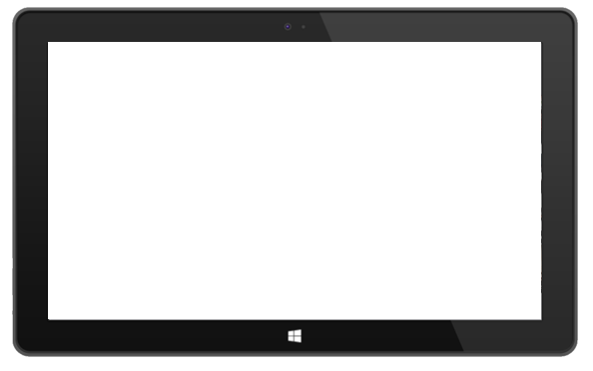
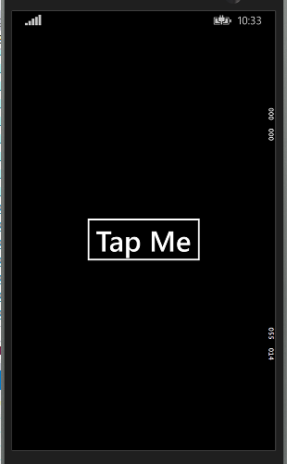

Slide 13
‘Primitives’ - same
Layout: Panel, StackPanel, Grid, Border
Buttons, Slider, ToggleSwitch, CheckBox, RadioButton, ProgressBar
TextBox/TextBlock
Shapes/Path

Slide 14
Demo: Same API/Behavior

Slide 15
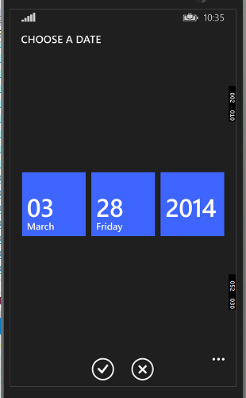
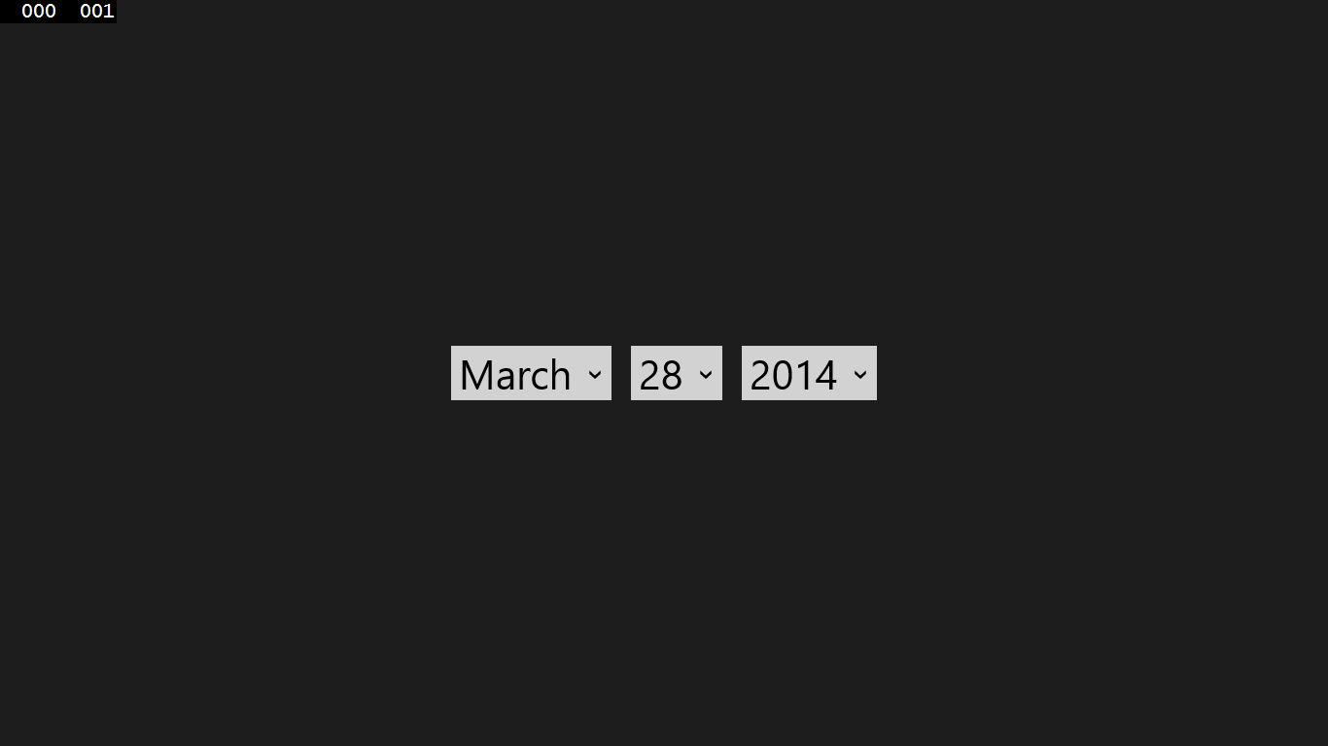

Slide 16
‘Primitives’ – same API, tailored behavior
Hub
AppBar/CommandBar
Date/Time Pickers and List Pickers
ListView
Multi-select; containers, swipe selection
Flyouts
Media
Ads SDK*

Slide 17
Demo: Same API Tailored Behavior

Slide 18
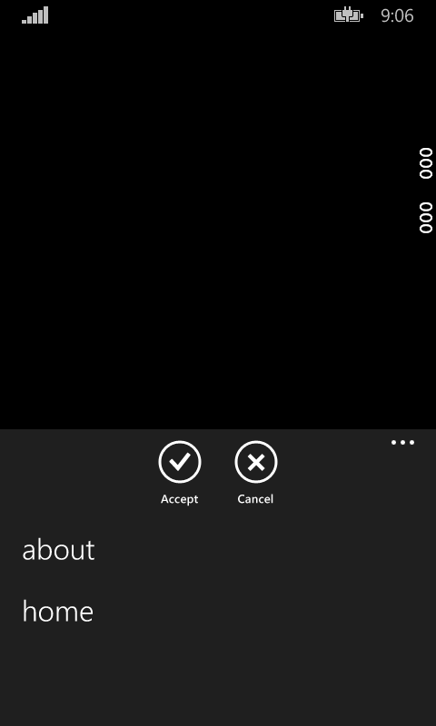
CommandBar
<Page.BottomAppBar>
<CommandBar>
<AppBarButton Icon="Accept" Label="Accept" />
<AppBarButton Icon="Cancel" Label="Cancel" />
<CommandBar.SecondaryCommands>
<AppBarButton x:Uid="AboutAppBarButton" Icon="Help" />
<AppBarButton x:Uid="HomeAppBarButton" Icon="Home" />
</CommandBar.SecondaryCommands>
</CommandBar>
</Page.BottomAppBar>

Slide 19
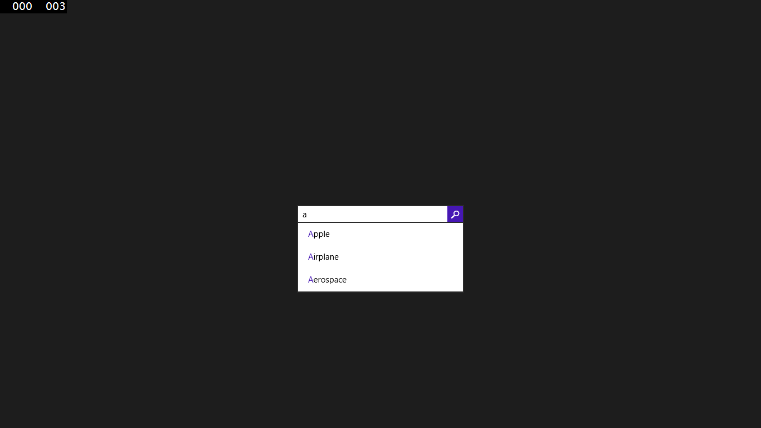
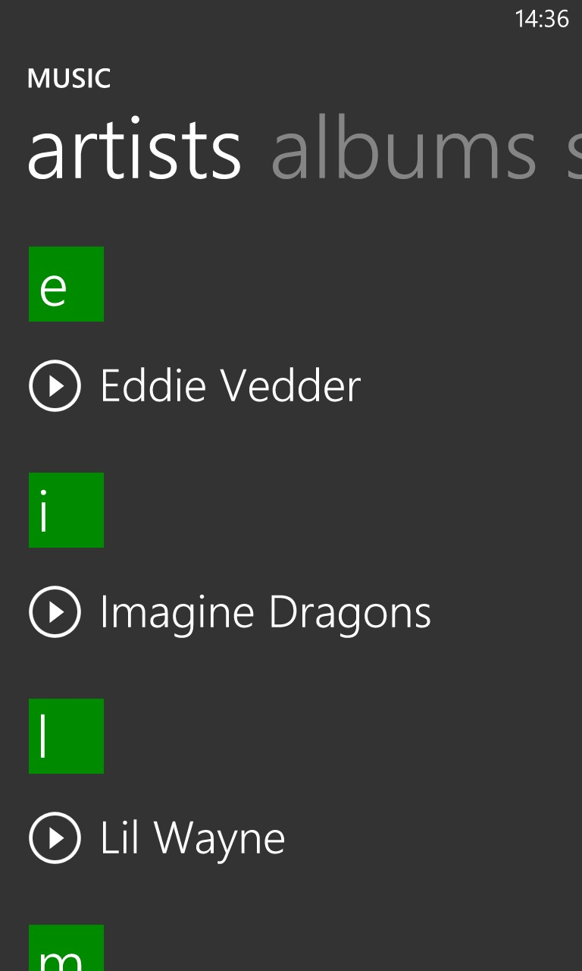

Slide 20
Device-specific APIs
Windows
SearchBox
SettingsFlyout
Windows Phone
Pivot
AutoSuggestBox
ContentDialog
Maps
System Chrome
Progress area, in-call UI

Slide 21
Demo: Device-specific APIs

Slide 22
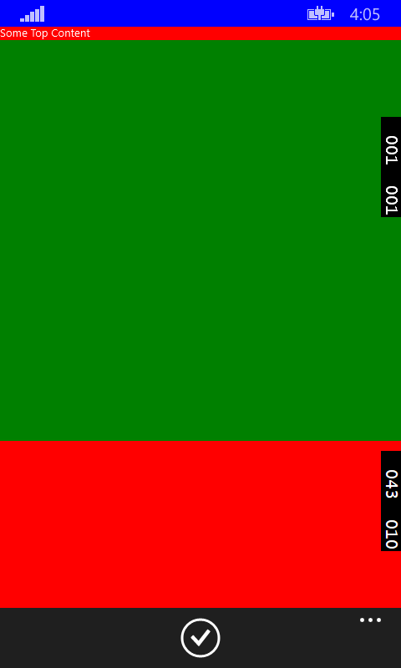
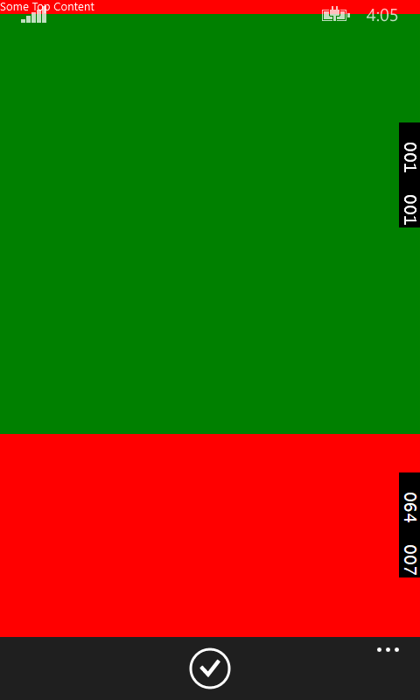
System Chrome
System Chrome (SystemTray, in-call progress, etc.)
SetDesiredBoundsMode(
ApplicationViewBoundsMode.UseCoreWindow);
App UI
System Chrome (CommandBar)

Slide 23
Session Referral
2-516: Building great UI in XAML Shawn Oster

Slide 24
Framework Areas (animation, text, navigation, background, scaling, styling)

Slide 25
Navigation Model
Navigation APIs Same
Phone Hardware Back Button
Windows in-app Back Button
#if WINDOWS_PHONE_APP
Windows.Phone.UI.Input.HardwareButtons.BackPressed += HardwareButtons_BackPressed;
#endif
2-537: Navigation Model for XAML Apps (Roberth Karman)

Slide 26
Animation
ThemeAnimations
ThemeTransitions
Navigation
“ReaderBoard”

Slide 27
Text
Typography.Caps
OpticalMarginAlignment
TextureBounds
TextWrapping
TextClipping
MaxLines
“Header” (Label) on input text controls

Slide 28
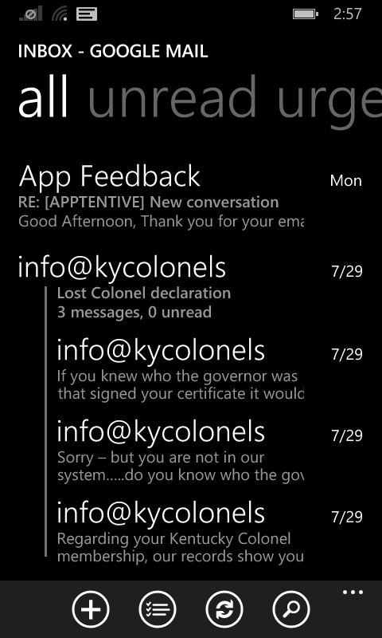
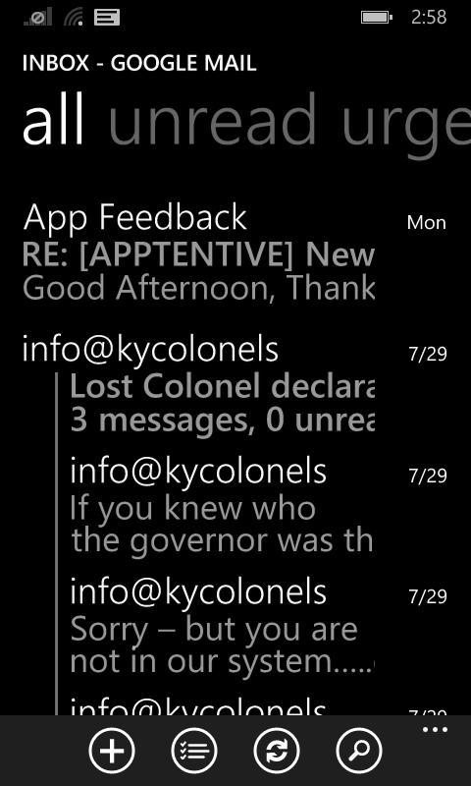
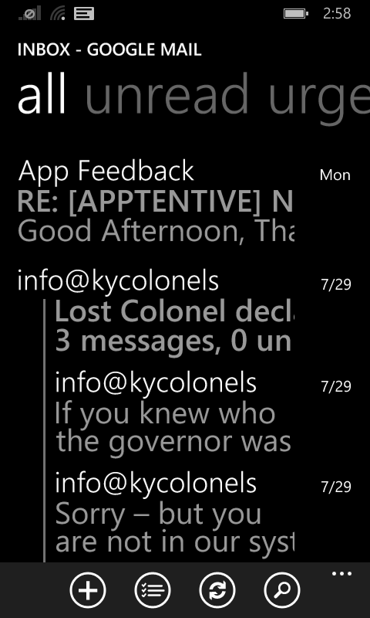
Text Enlargement

Slide 29
PasswordBox
Windows Phone
Delay character reveal
Show password checkbox
Windows
On-demand password reveal

Slide 30
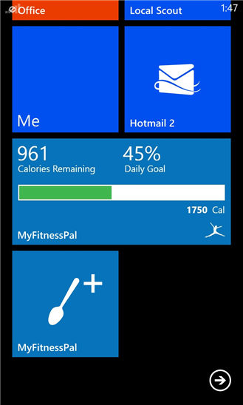
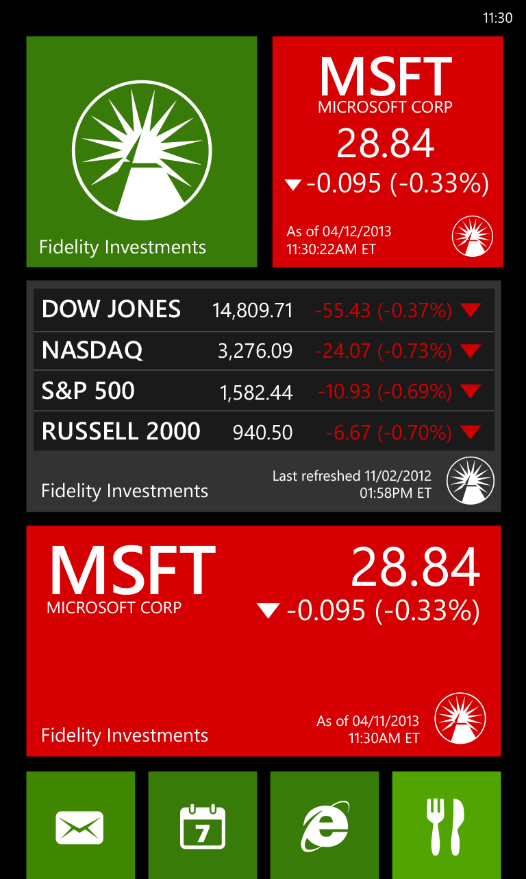
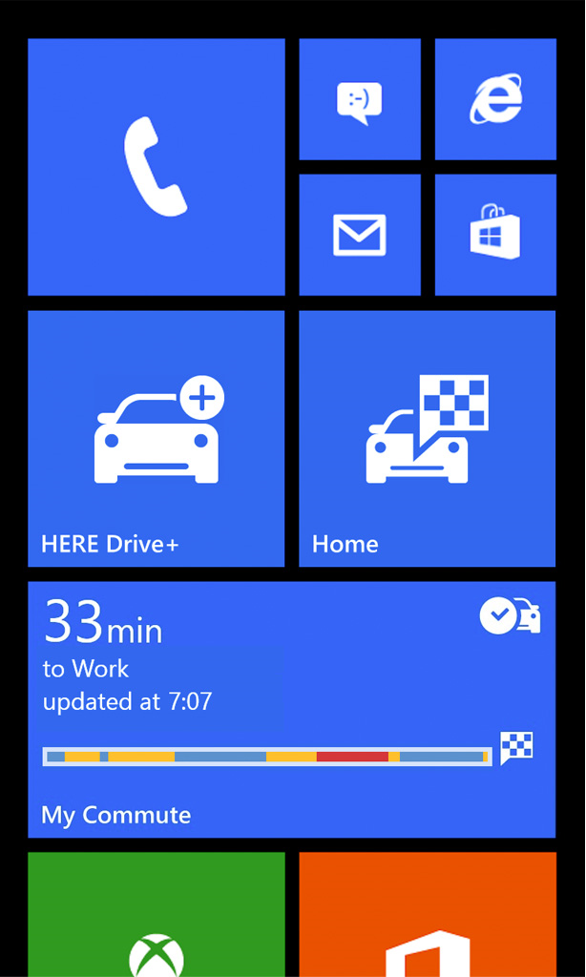
Custom Tiles
XamlRenderingBackgroundTask
2-253: Getting your app tapped (Matt Hidinger)

Slide 31
Scale Factors and Effective Resolution
384 x 683
450 x 800
2560 x 1440
1920 x 1080
1366 x 768
to scale
3-541: From 4 to 40 inches (Peter Torr)

Slide 32
Styling and Theming
Accent Color
SystemColorControlAccentColor/Brush
Text Styling
PhoneText*
Focus visuals
Do not exist on mobile
Theme overrides and High Contrast – same!

Slide 33
Other UI areas for XAML Developers
Control Developers
Needing 2 SDKs, what approach should you take
How to think about ‘adaptive’ in your own controls
3-591: Using Visual Studio to build XAML universal apps (Navit Saxena)
Interaction areas with shell (share/settings)
File pickers (Continuation Model)
Share – entry point differences
Settings – entry point differences, no SettingsFlyout on Phone

Slide 34
Resources and Sessions
http://dev.windows.com
2-516: Building great UI in XAML (Shawn Oster)
2-537: Navigation Model for Windows XAML Apps (Robert Karman)
X-XXX: Windows Desktop Development (Panel Q&A)
2-553: XAML Platform Leadership (Panel Q&A)
3-591: Using Visual Studio to build XAML universal apps (Navit Saxena)
2-550: Windows Runtime for Windows Phone Developers (Jerry Nixon & Doug Holland)
3-545: Quality & Performance for XAML apps (Stefan Wick)

Slide 35
Please fill out evaluation forms!
Your feedback is critical to help us (me!) improve
http://www.buildwindows.com/
Get the app for your phone, tablet, laptop, or PC:
http://aka.ms/buildapp

Slide 36
Questions
Tim Heuer
Program Manager
timheuer@microsoft.com
@timheuer

Slide 37
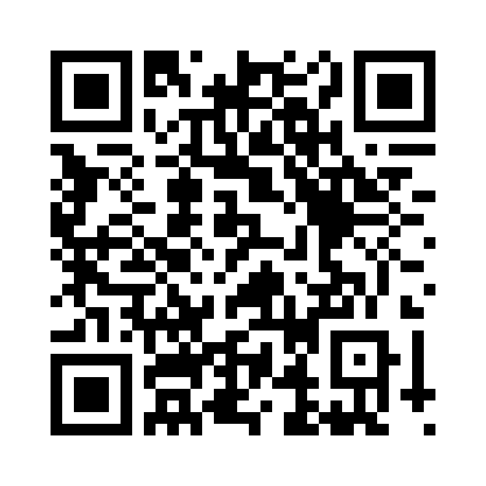
Your Feedback is Important
Fill out an evaluation of this session and help shape future events.
Scan the QR code to evaluate this session on your mobile device.
You’ll also be entered into a daily prize drawing!

Slide 38
© 2014 Microsoft Corporation. All rights reserved. Microsoft, Windows, Windows Vista and other product names are or may be registered trademarks and/or trademarks in the U.S. and/or other countries.
The information herein is for informational purposes only and represents the current view of Microsoft Corporation as of the date of this presentation. Because Microsoft must respond to changing market conditions, it should not be interpreted to be a commitment on the part of Microsoft, and Microsoft cannot guarantee the accuracy of any information provided after the date of this presentation. MICROSOFT MAKES NO WARRANTIES, EXPRESS, IMPLIED OR STATUTORY, AS TO THE INFORMATION IN THIS PRESENTATION.

