Slide 2
Store and Dev Center
Windows & Windows Phone
2-512
Mazhar Mohammed
Group Program Manager
Zac Woodall
Lead Program Manager

Slide 3










Expanding the Windows app ecosystem and portfolio
$
App momentum
More engaged users
Dev momentum
More sales
415K+
apps
14+ Million
daily downloads
410K
registered
developers
57
MO billing partners
help drive higher
monthly revenue
116%
YoY growth
114%
YoY growth
94%
YoY growth
197%
YoY gross sales growth
Recent Highlights
Top new apps
44M unique
Windows Phone users
purchased an app
Aug ‘13 – Feb ‘14
462% QoQ growth
in Windows registered developers due in part to lowering the Dev Center registration price
98% QoQ growth
in IAP revenue

Slide 4


Vision : One Store, One Dev Center with Multiple Storefronts
One big Store that sells more things to more people
Shell
Device Storefronts
Web Storefront
OS
One Catalog
Devices
Services
Software + Apps
Games
Entertainment
Content
Other digital content
One Dev Center
Discovery
Monetization
Low Friction

Slide 5
One Store - Blue
One developer registration
One set of policies, one cert team
One developer platform
Universal apps

Slide 6
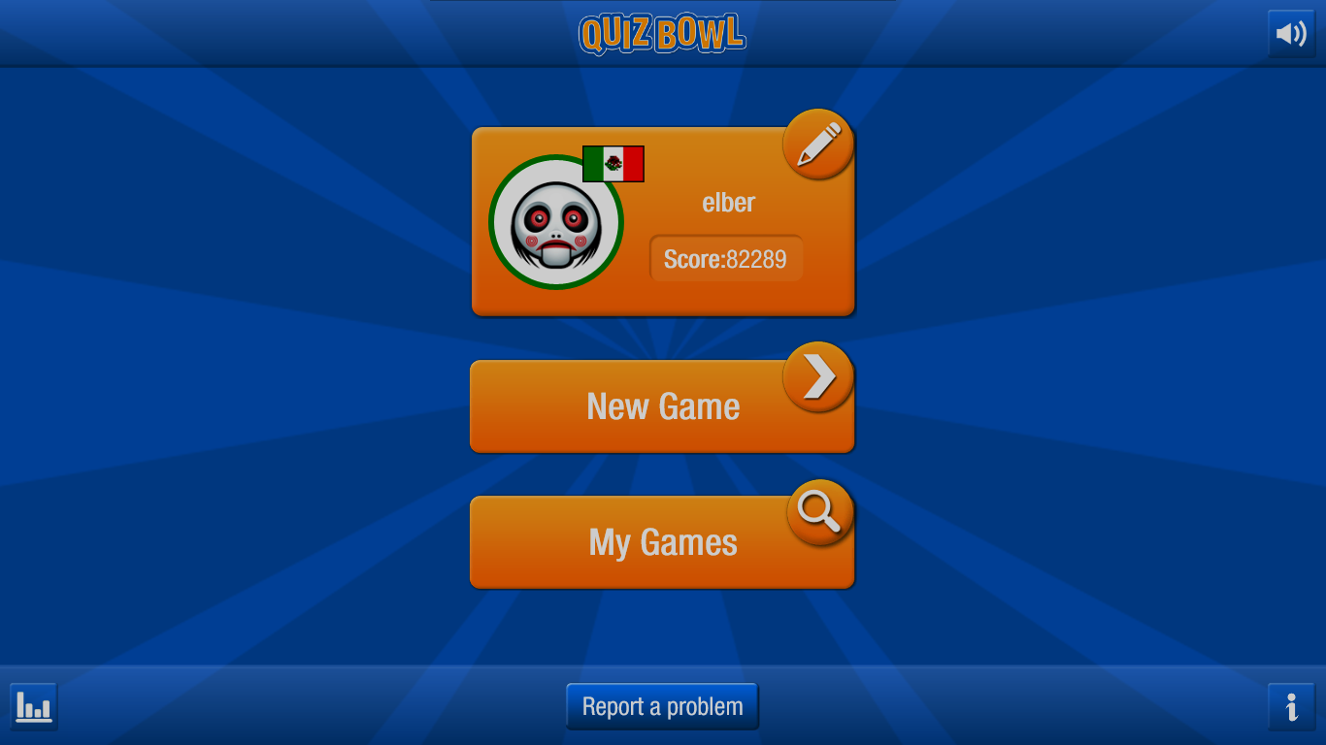
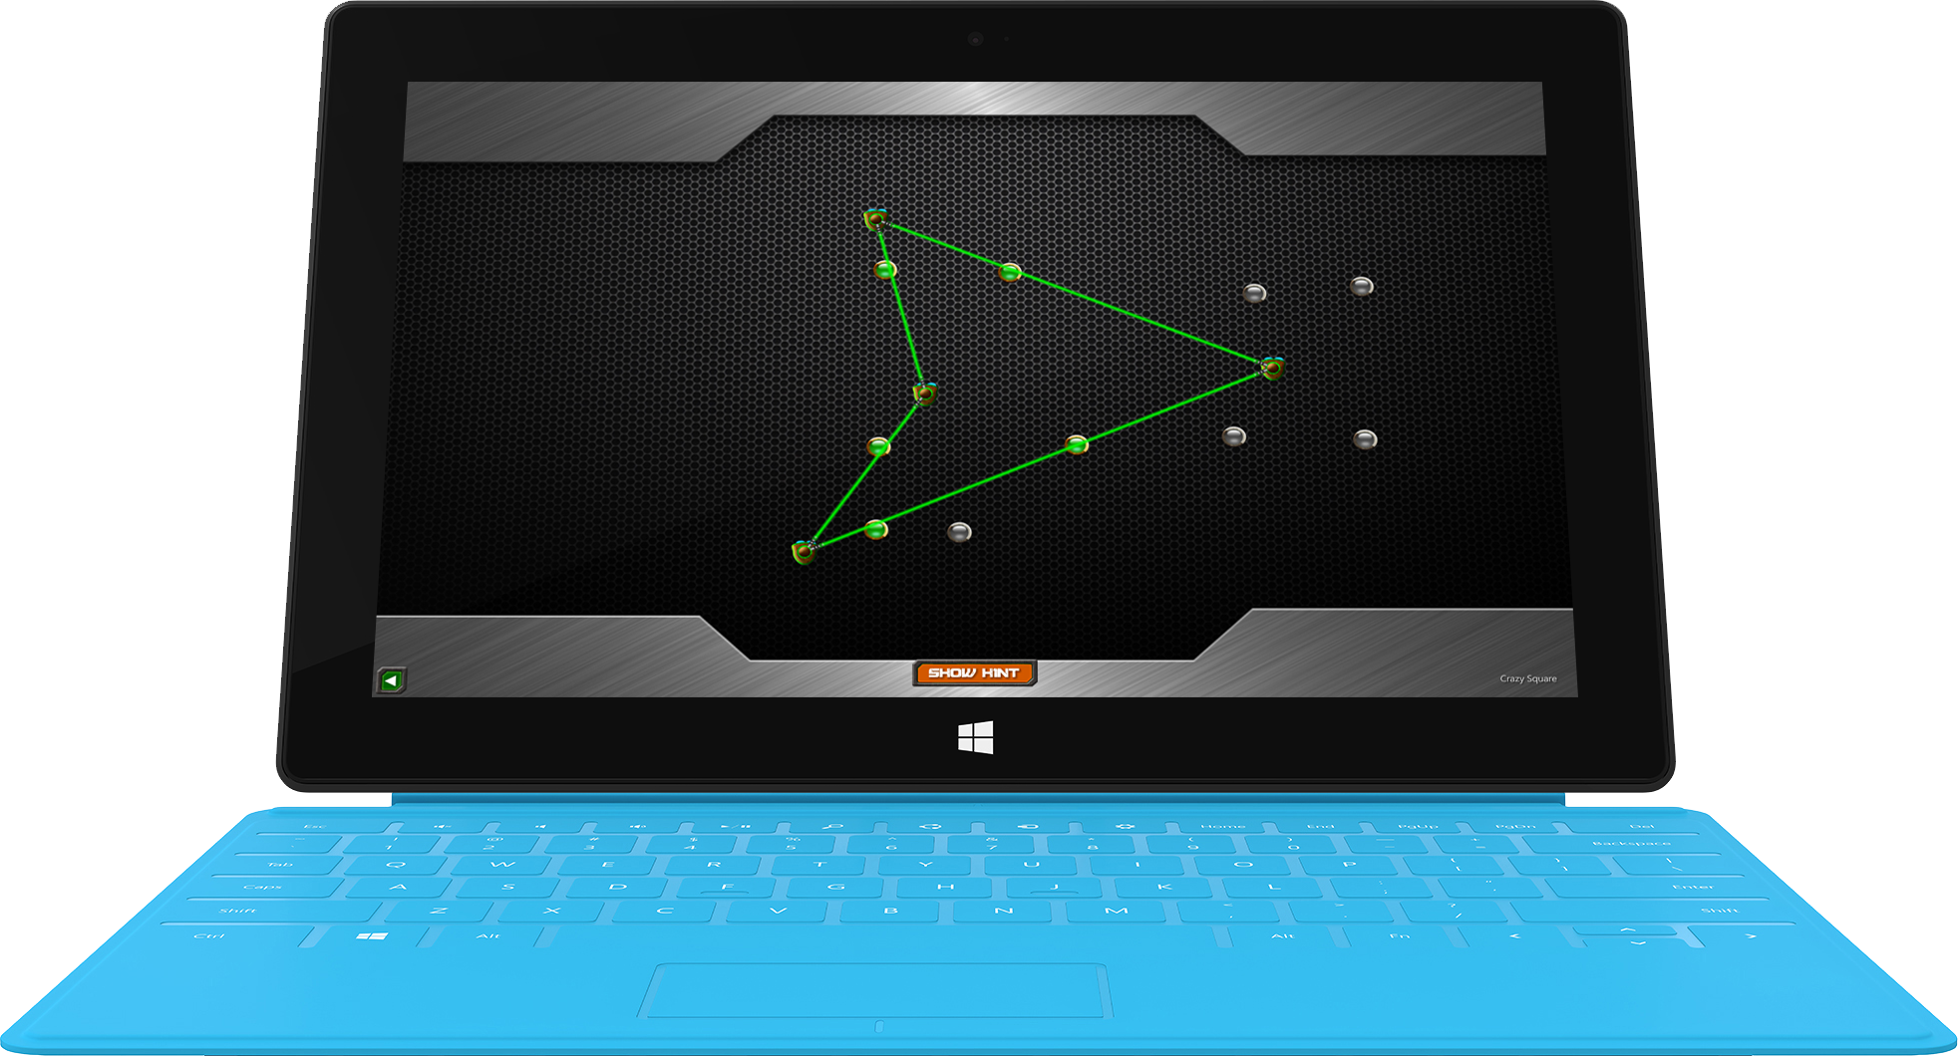
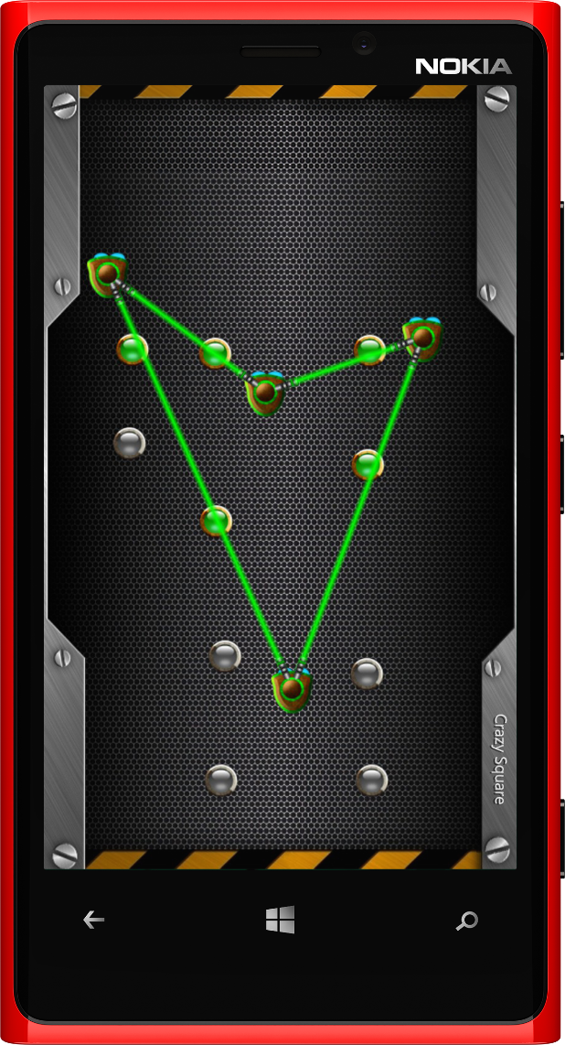
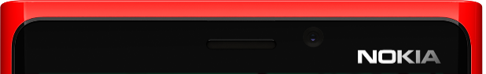
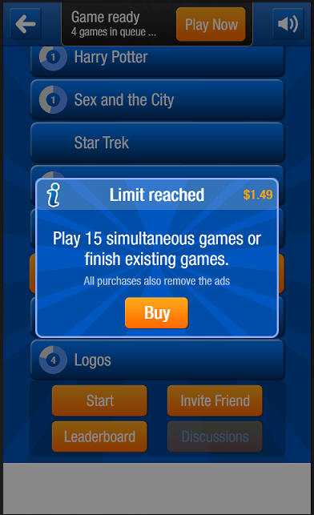
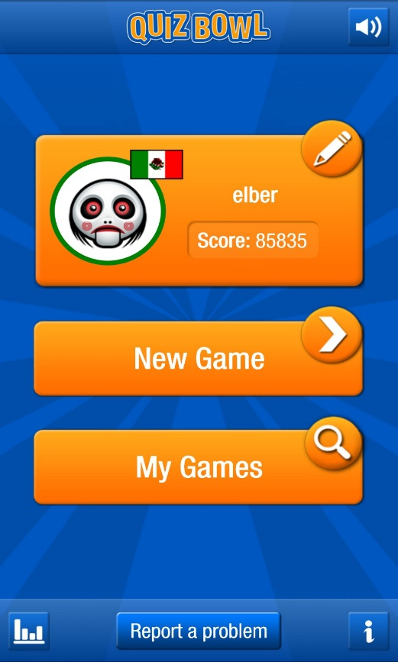

Slide 7

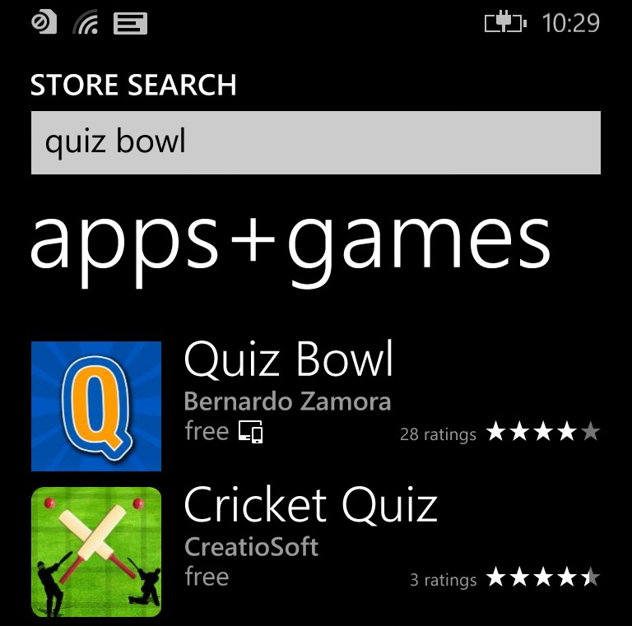
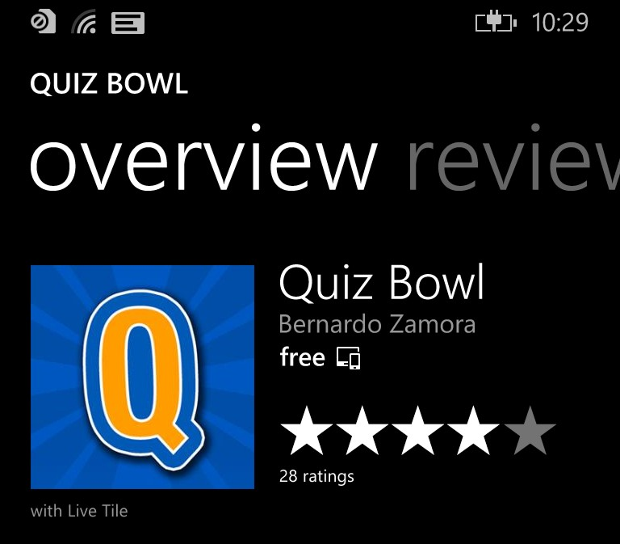
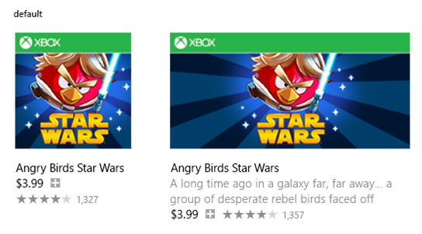


Universal apps for Windows
Share App & IAP entitlements across Windows & Phone
Roam your data across Windows & Phone
Single notification channel
You are still allowed to publish separate apps or IAPs
Not the same thing as universal project in Visual Studio
Quiz Bowl
Quiz Bowl
The next generation quiz game - compete real time with players worldwide.
Free
Free

Slide 8







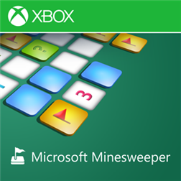
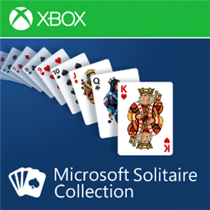


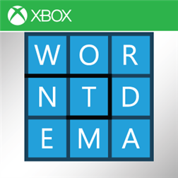

Universal Windows apps
NEW!
eBay
eBay, Inc.
Shazam
Shazam Entertainment Ltd
Citrix Receiver
Citrix
GoToMeeting
Citrix
DailyMotion
Dailymotion SA
Hexic
Microsoft Studios ™
Microsoft Minesweeper
Microsoft Studios ™
Microsoft Solitaire Collection
Microsoft Studios™
Halo: Spartan Assault
Microsoft Studios ™
Microsoft Mahjong
Microsoft Studios™
Wordament
Microsoft Studios™
Skulls of the Shogun
Microsoft Studios ™

Slide 9
App Certification

Slide 10
Certification time = 2-5 days
few hours*
* Some submissions will still take up to 2-5 business days
* Live on Windows Phone only. Windows – coming soon!

Slide 11
App Discovery

Slide 12
App Discovery Improvements in Blue
Store UX
Link your apps to search results
Cross promote your app in other apps using MS Ads

Slide 13
Store UX
Zac Woodall

Slide 14
What customers tell us they want in a store…
Easy to browse
Has a large variety of apps available
Has an easy to navigate interface
Has the specific apps I’m looking for
Makes it easy to transfer apps to my phone

Slide 15
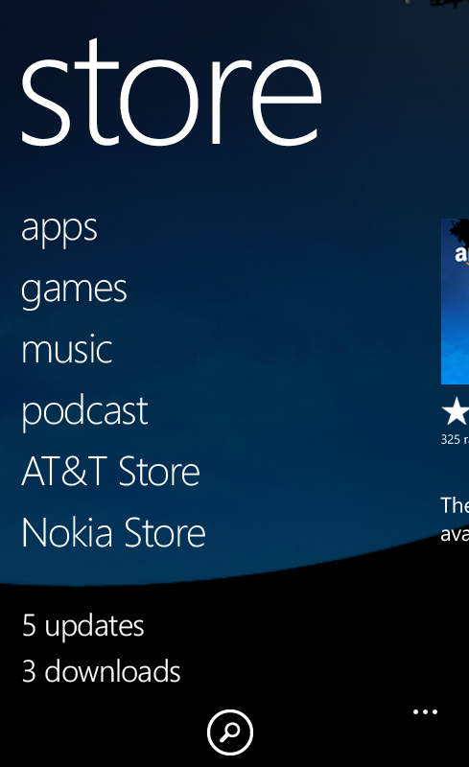

Slide 16
Store Experience Principles
Serendipity
Fresh, engaging, and personally relevant products greet you at the door
Consistent and predictable wayfinding for key tasks like search, top free games
Evolve by expanding concepts that work well and addressing top feedback
Way-finding
Tasks

Slide 17
Awareness
Storefront
Interest
Evaluation
App Details
Purchase
Referral

Slide 18
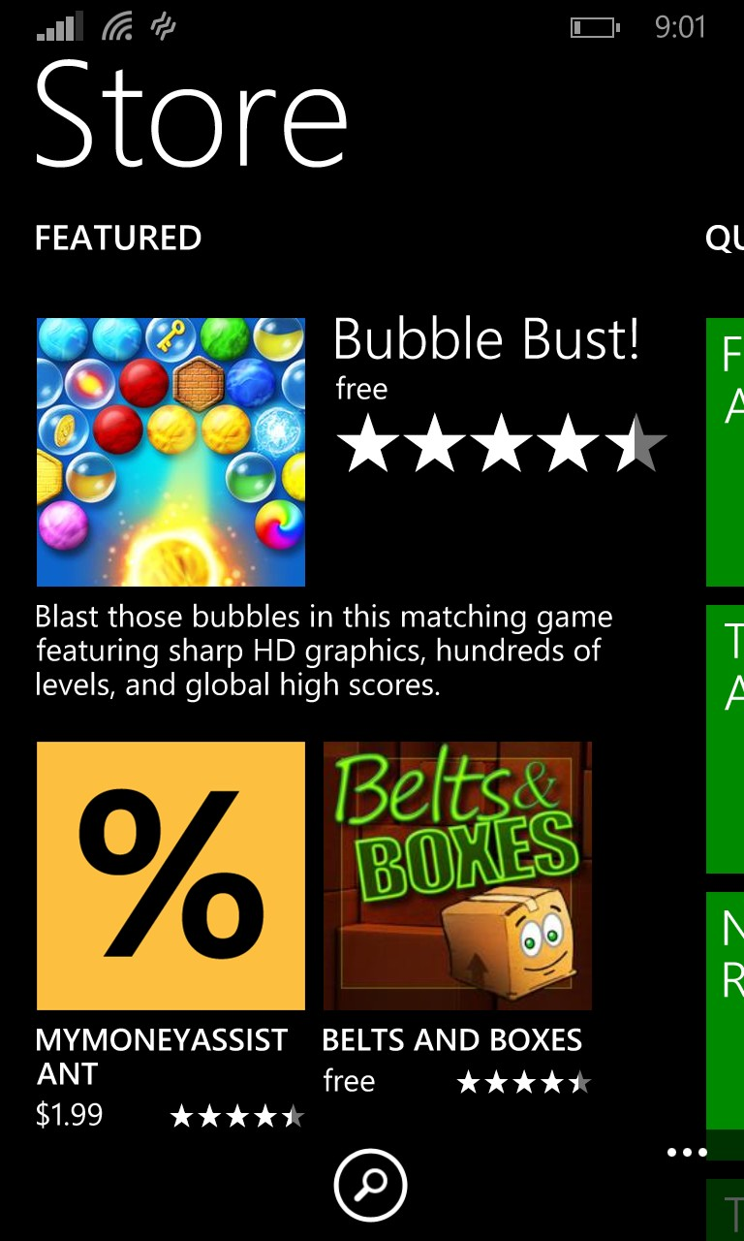
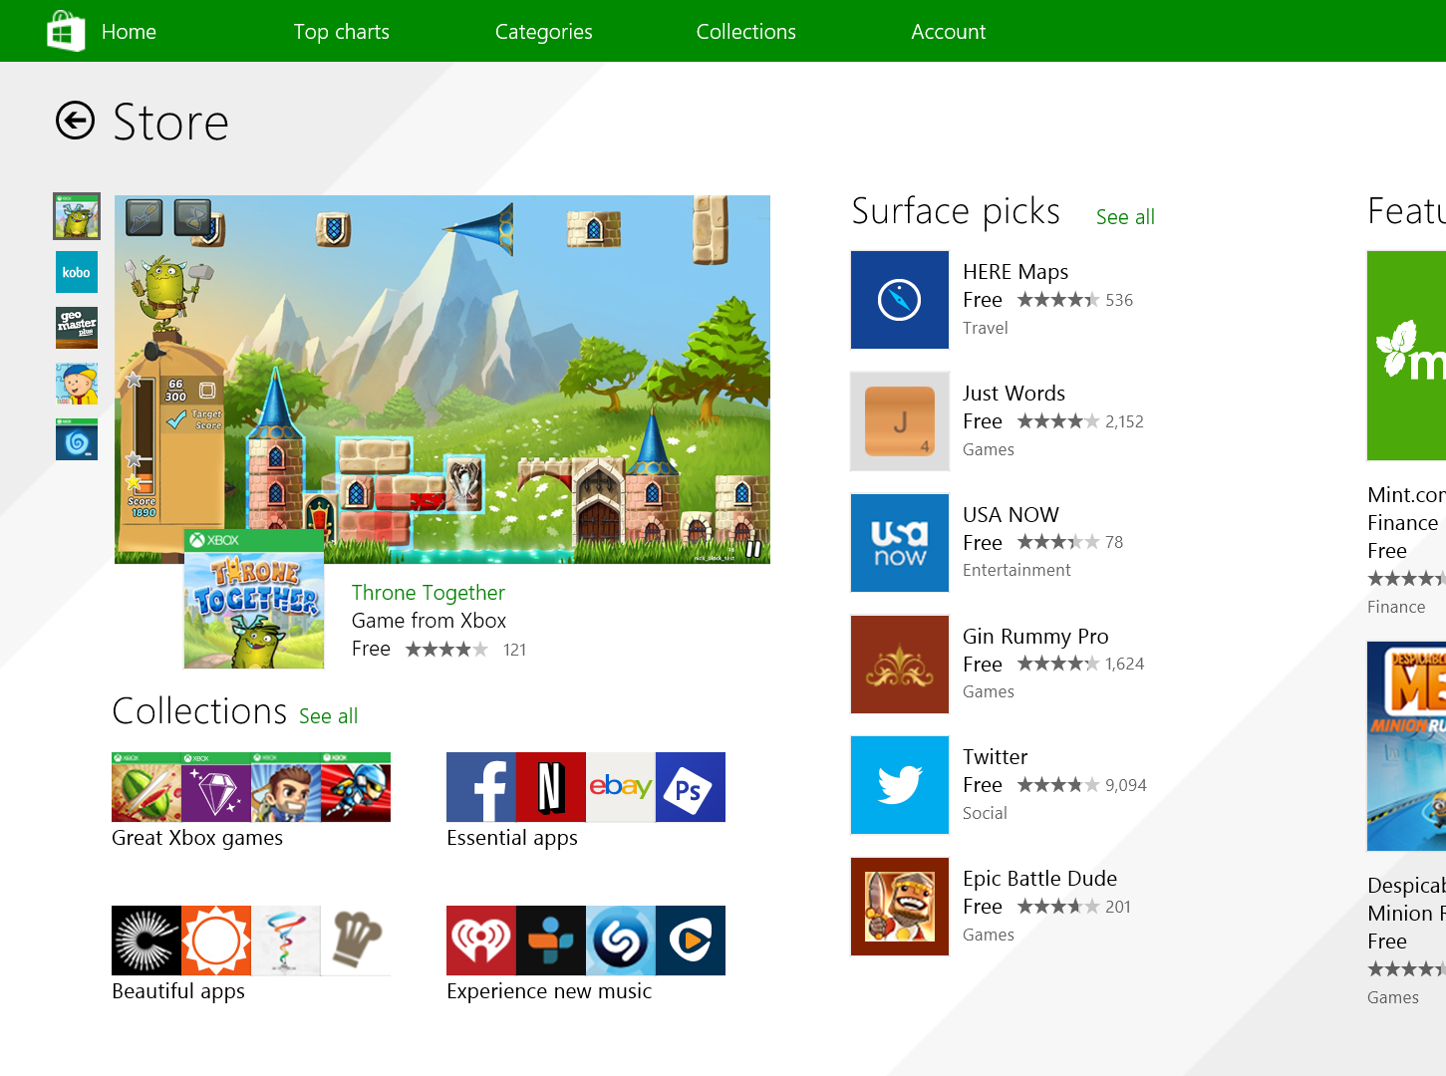
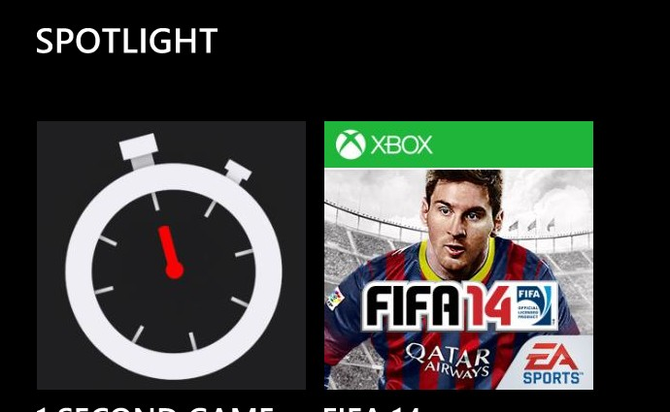
Demo: Storefronts

Slide 19
Awareness
Storefront
Interest
Evaluation
App Details
Purchase
Referral

Slide 20
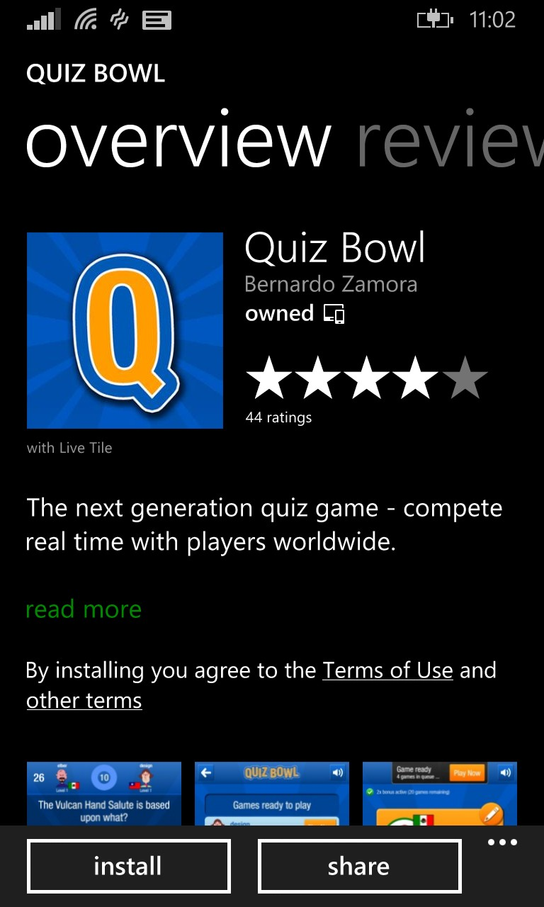
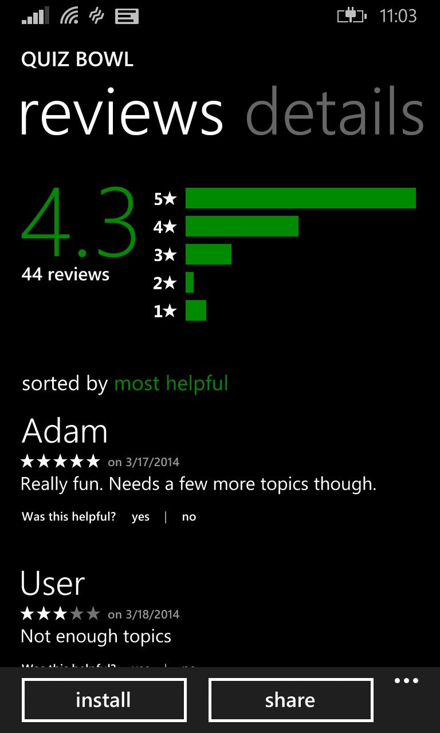
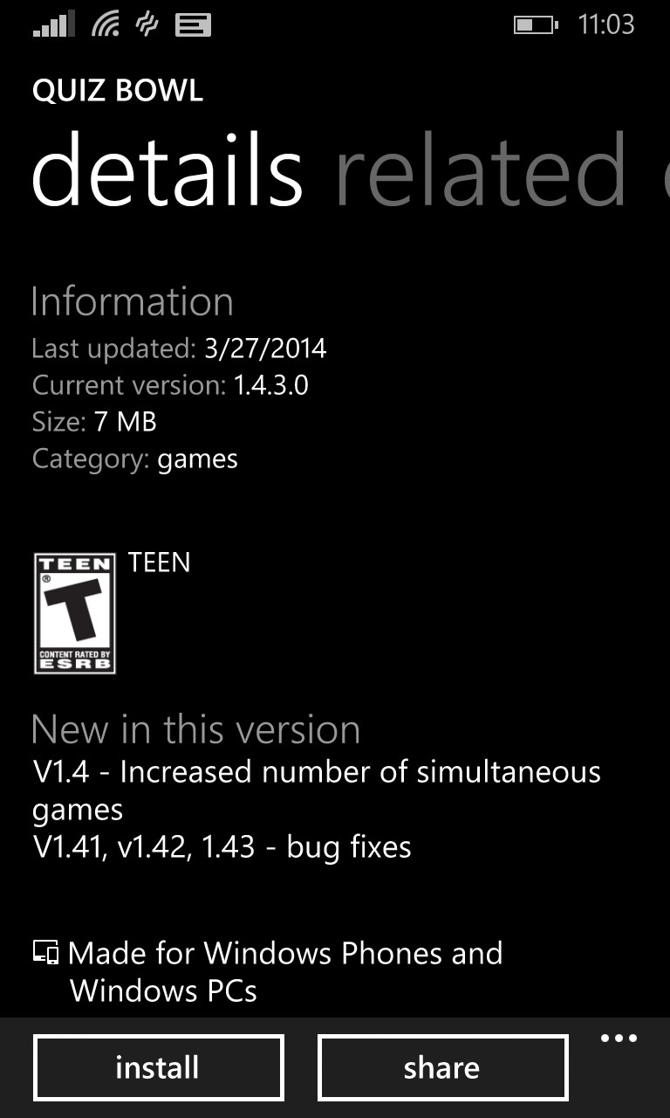
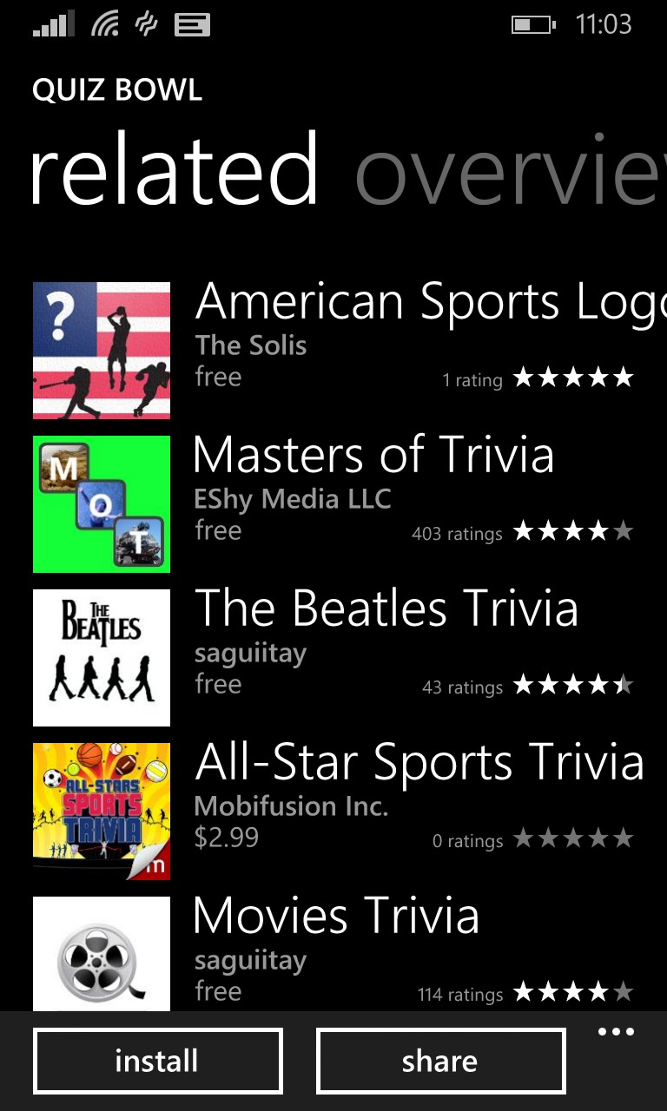
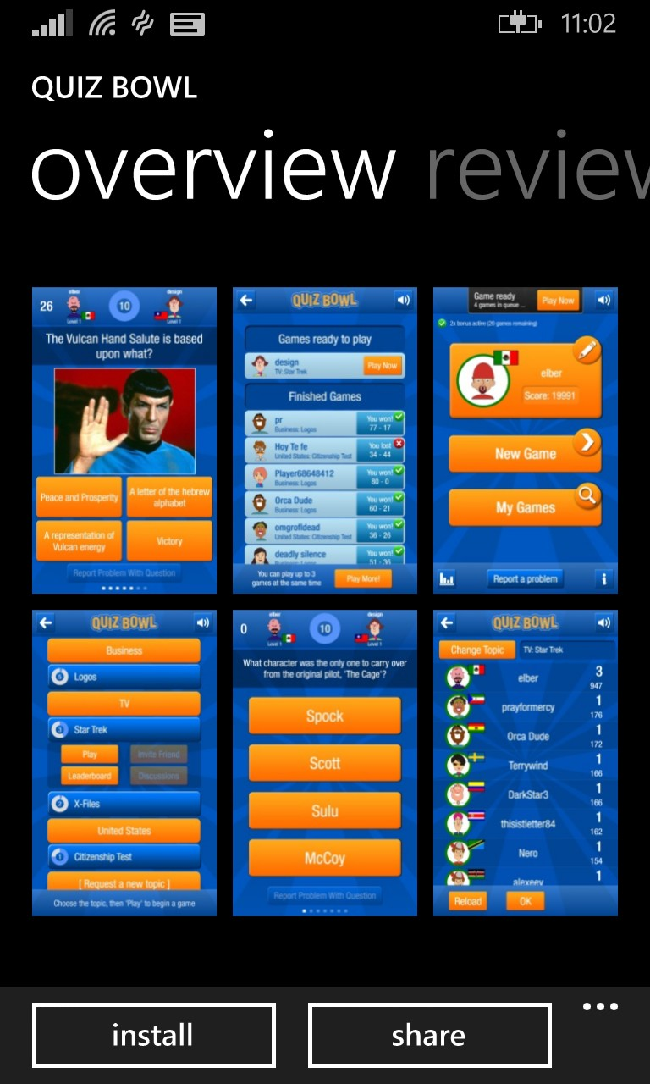
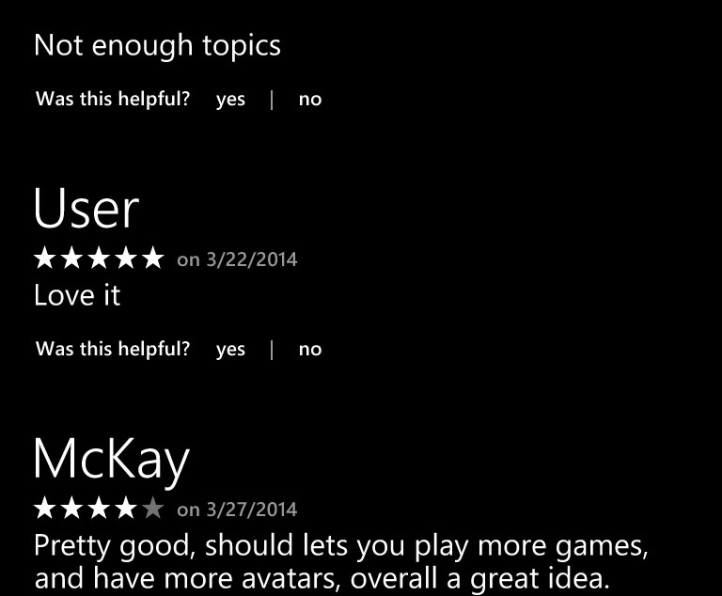
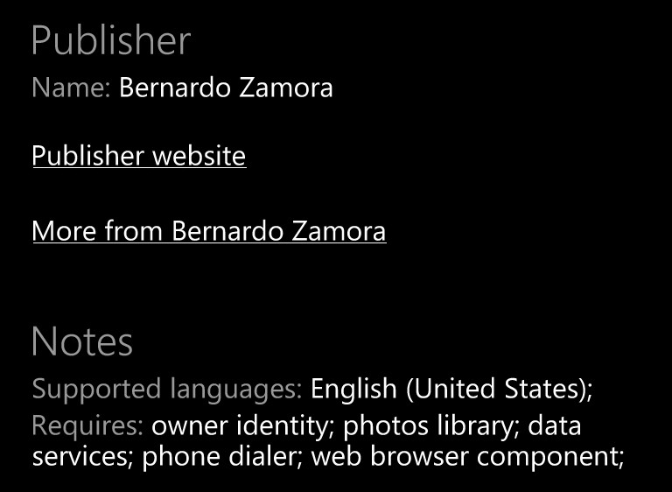
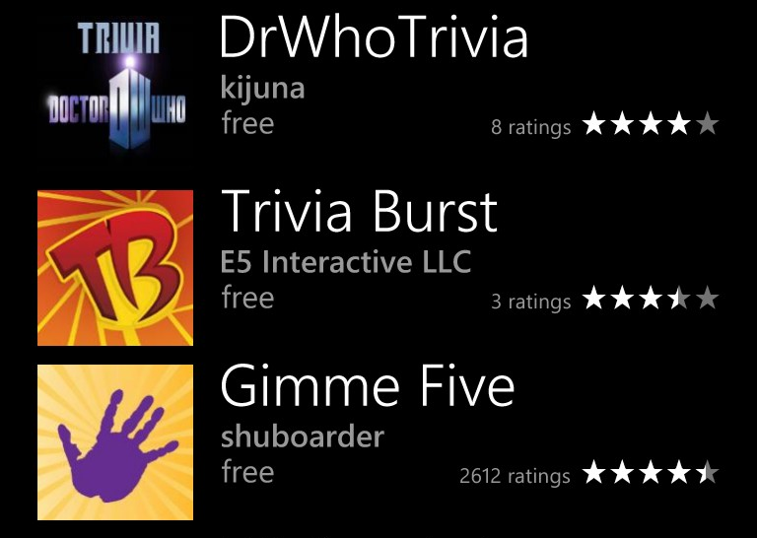
Demo: Details

Slide 21
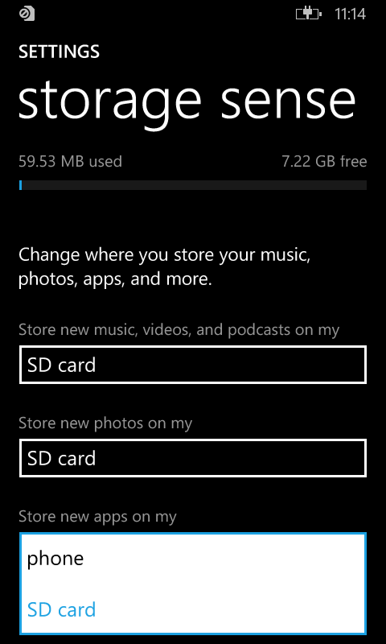
1. Apps on SD
Critical to 4GB devices
Phone storage settings
Low storage notification
Manifest opt-out
per app

Slide 22
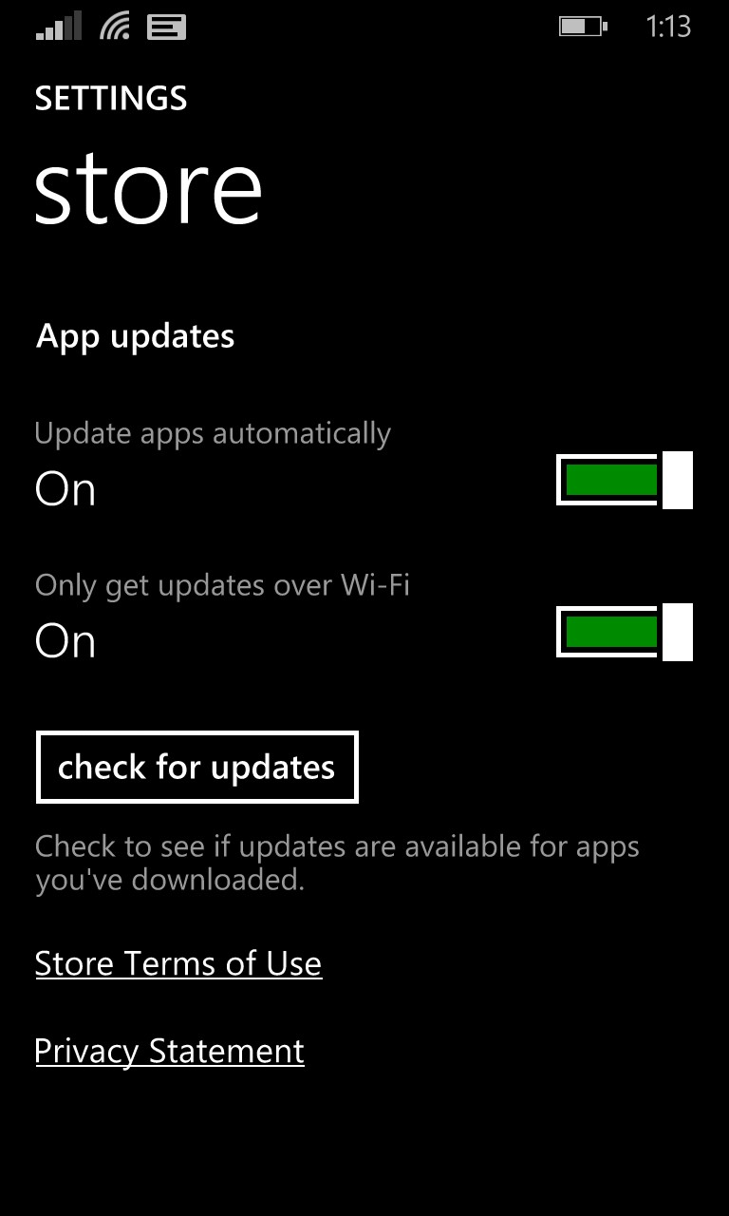
2. App Auto-Updates
On for those who choose
‘recommended’ settings
Defaults to Wifi only
(‘get it now’ option)
Update notifications and
download history
Pending/stuck update
notifications
Force update check

Slide 23
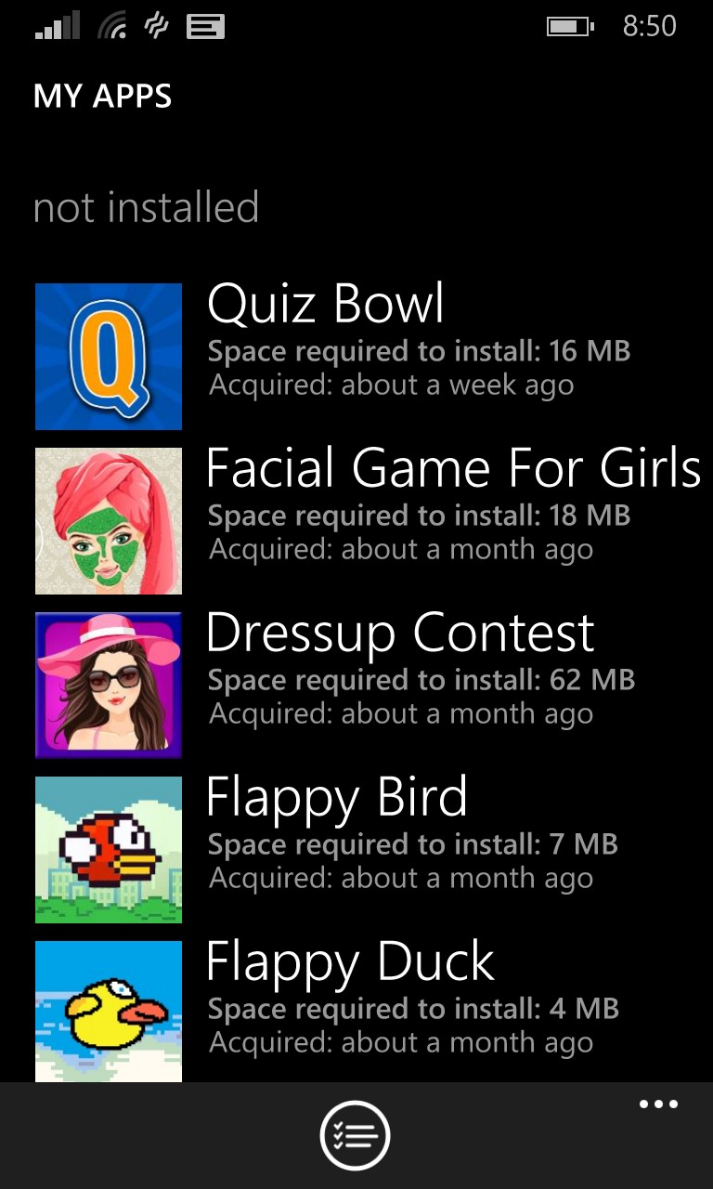
3. My Apps
View and reinstall
past purchases
Includes Windows store
purchases
‘owned’ in lists
‘install’ instead of ‘buy’
for owned apps
Do not feature apps
you own

Slide 24
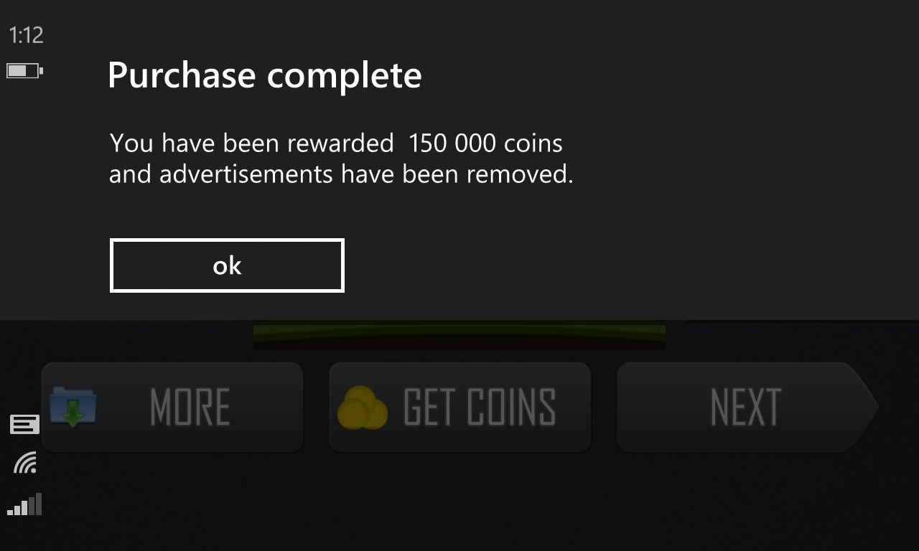
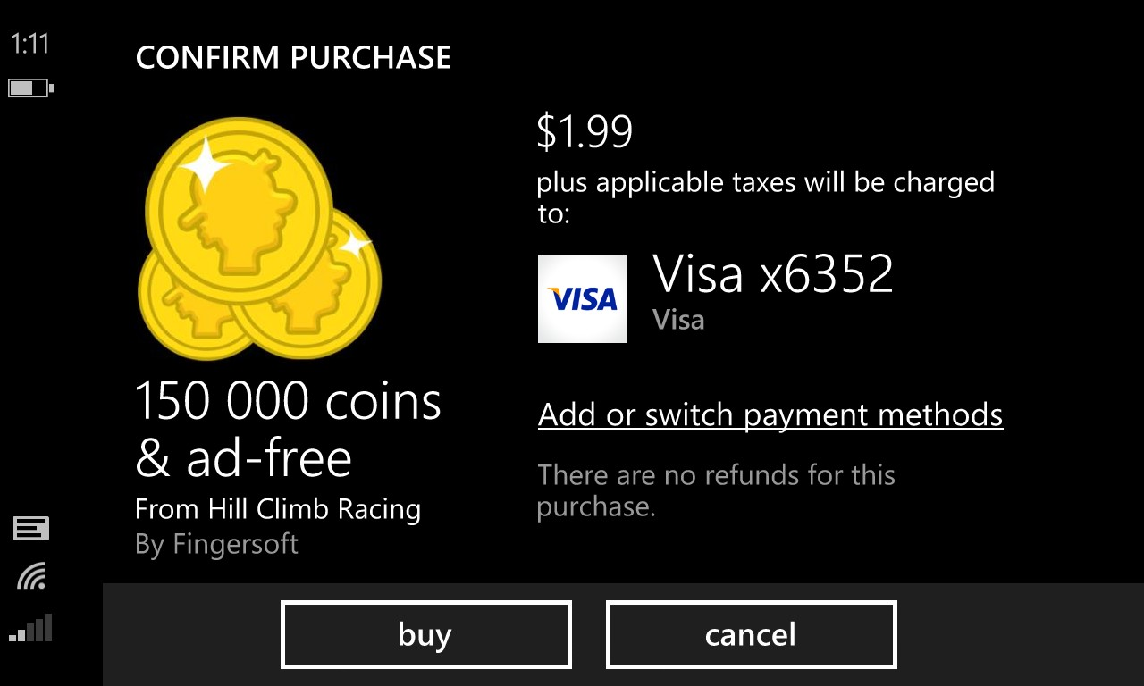
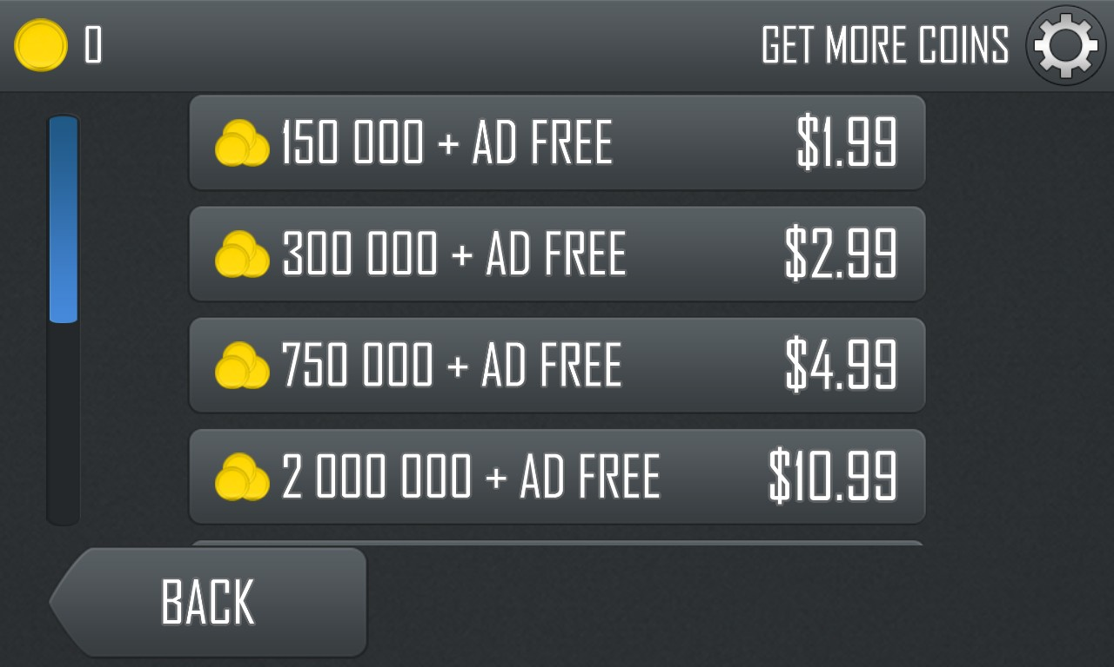
4. Landscape in-app-purchase

Slide 25
App Discovery Improvements in Blue
Store UX
Link your apps to search results
Cross promote your app in other apps using MS Ads

Slide 26

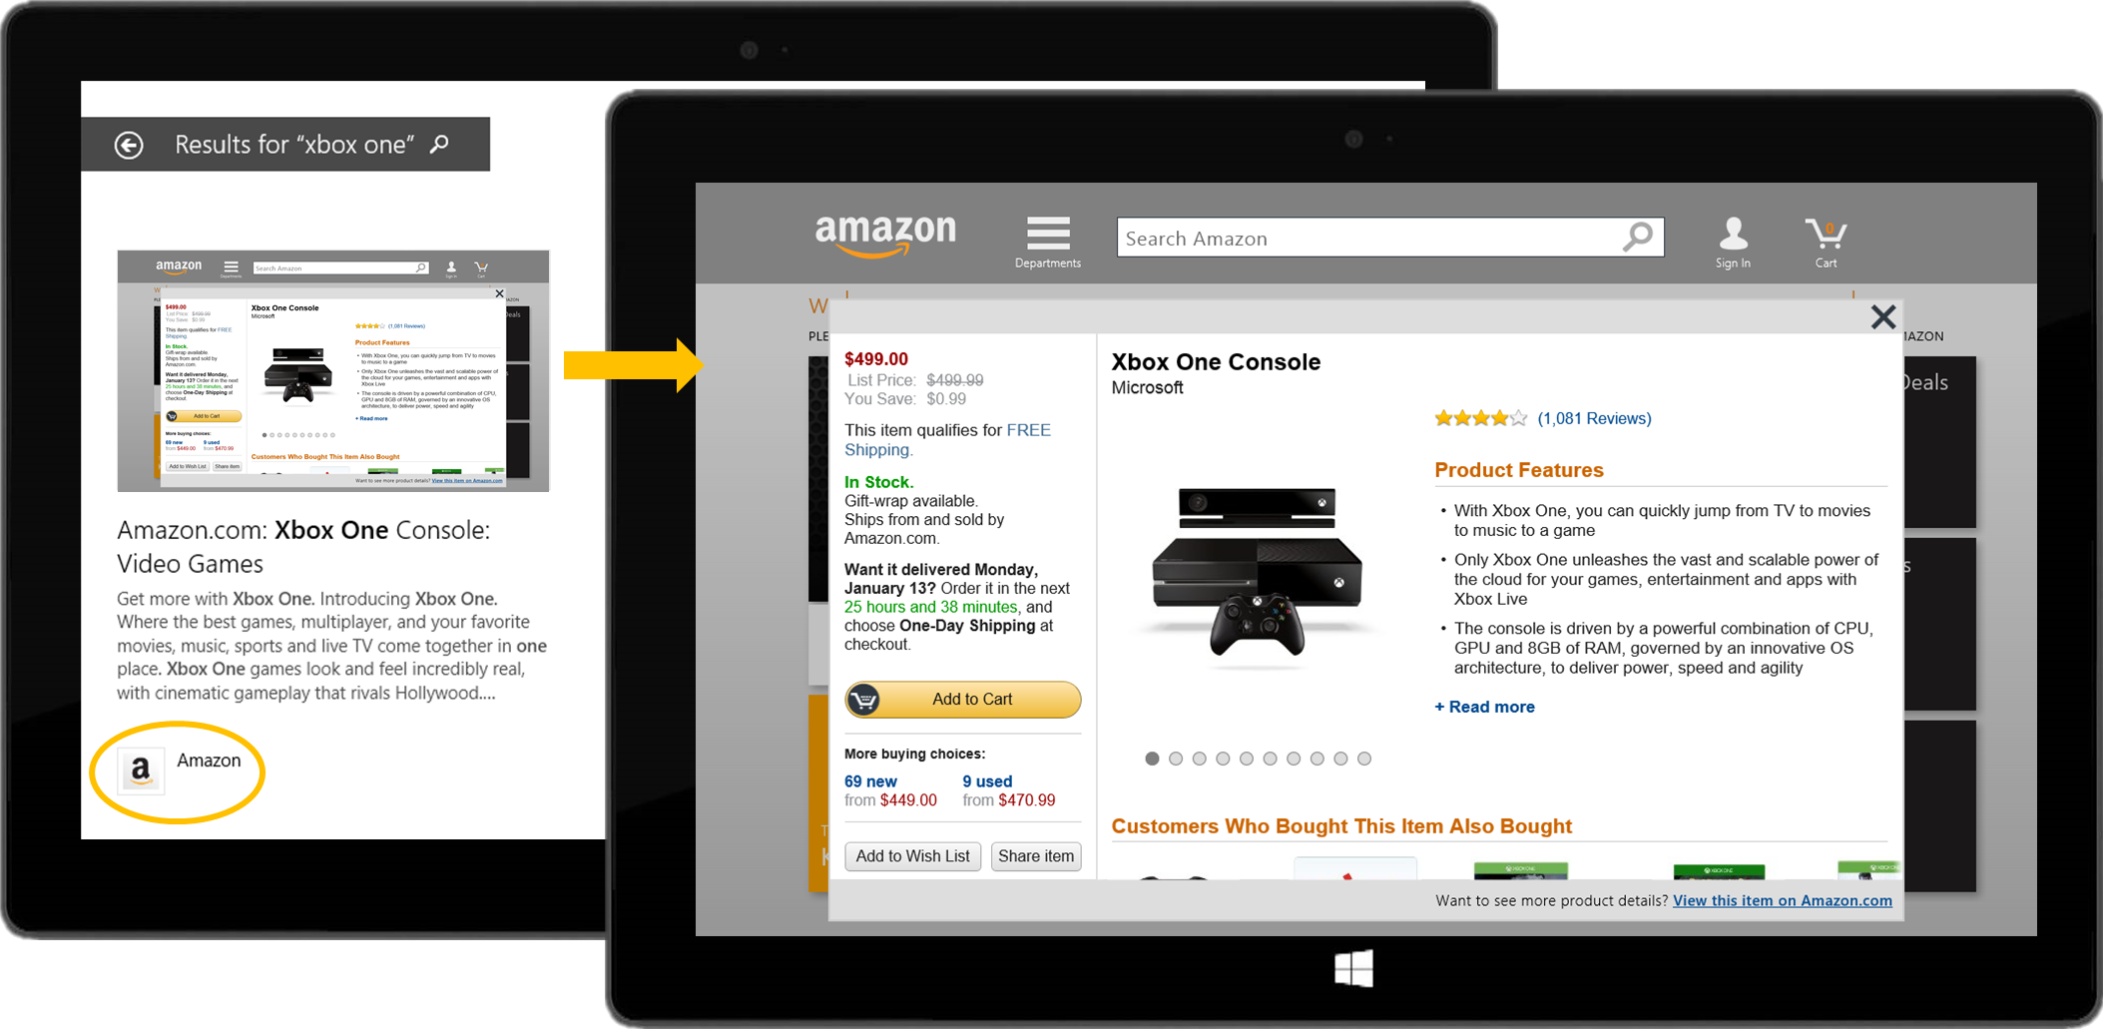
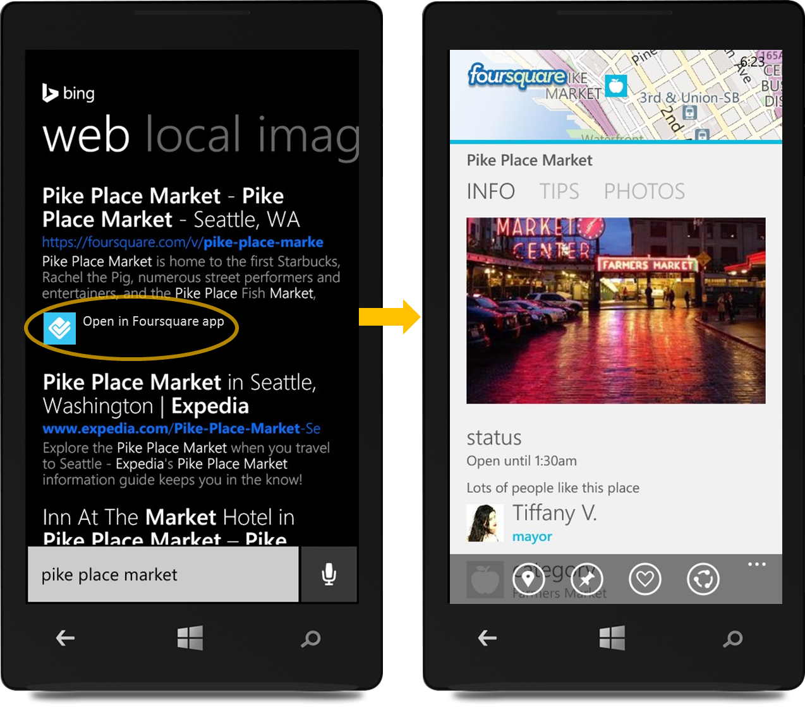
Bing App Linking
Link your app to search results.
More discoverable.
Get more people to discover and install your app by linking it to search results on Windows and Windows Phone.
Deeper engagement.
From search results, users can deep link to content in your app for a richer
user experience.
Easy and free.
Just follow simple self-serve steps to link your Windows and Windows Phone apps
to search results.

Slide 27
Bing App Linking
How it Works
Link your website to your app.
Go to the Bing webmaster portal and connect your app to your website.
Markup webpages.
Add markup to webpages that you want app deep links for.
Enable your app for deep linking.
Implement deep linking support in your app and submit it to the Store.
Register your app.
Return to the Bing webmaster portal to register your app for deep linking.
1
App
contoso.com
1
3
4
2
contoso.com/A
contoso.com/B
3
<app ID>
<pkg name>
<launch arg A>
<app ID>
<pkg name>
<launch arg B>
2
4
Get started at Bing.com/AppLink

Slide 28
App Discovery Improvements in Blue
Store UX
Link your apps to search results
Cross promote your app in other apps using MS Ads

Slide 29
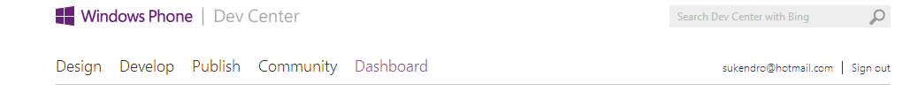
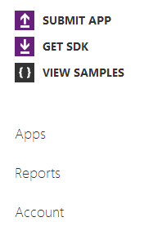

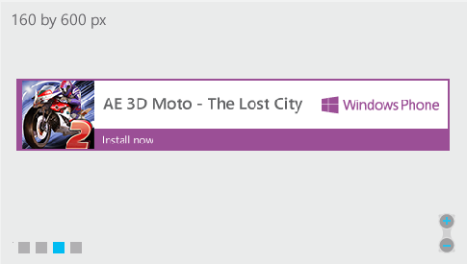
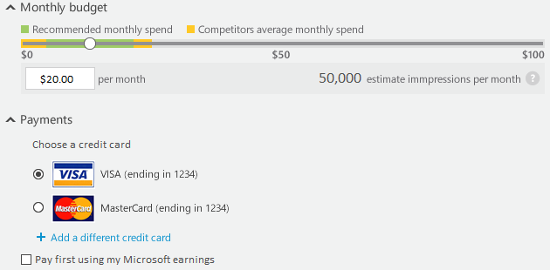
AE 3D Moto – The Lost City [App Name]
Get the word out about your app, and promote it in the Windows Phone Store.
Select an Image
Ad Preview
Apps
Ad Campaigns
Accounts
Campaign Name
Monthly Campaign Budget
Save
Cancel

Slide 30
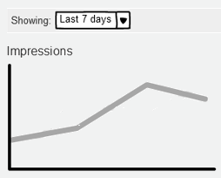
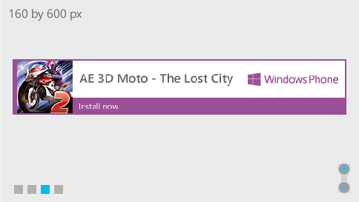
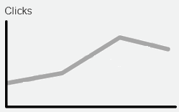
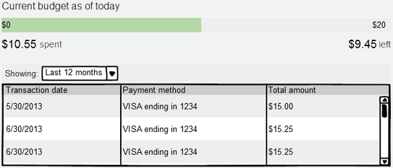
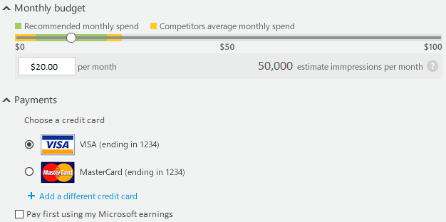
AE 3D Moto – The Lost City [Campaign Name]
Detailed stats to help you get the most out of your ad dollars.
Campaign Report
Banner Preview
Apps
Ad Campaigns
Accounts
This month’s budget
Change monthly budget
Save
Delete

Slide 31
Replying to reviews

Slide 32
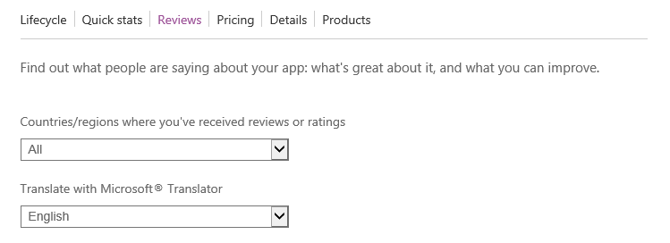
It’s fun, but can take a little time to get used to. My only complaint is that the songs in the game are low quality midis. Would be great to get better music to go with the game play!
Justin
5/23/2013
Hi Justin,
Thanks so much for your feedback on my app! I've worked on your comment and updated to higher quality music in the latest version. Please update the app and let me know your thoughts on my music choices! -John
Send
The game was great when it worked, but kept crashing in the middle of my game.
Lara
5/22/2013
Respond
Awesome game! Can’t wait for the next level to come out. It would also be really cool if I could see how my top score compares to my friends.
Lara
5/22/2013
Respond
The game was great when it worked, but kept crashing in the middle of my game.
Lara
5/22/2013
Respond

Slide 33
It’s fun, but can take a little time to get used to. My only complaint is that the songs in the game are low quality midis. Would be great to get better music to go with the game play!
Justin
5/23/2013
Hi Justin,
Thanks so much for your feedback on my app! I've worked on your comment and updated to higher quality music in the latest version. Please update the app and let me know your thoughts on my music choices! -John
Responded on 5/24/2013
The game was great when it worked, but kept crashing in the middle of my game.
Lara
5/22/2013
Respond
Awesome game! Can’t wait for the next level to come out. It would also be really cool if I could see how my top score compares to my friends.
Lara
5/22/2013
Respond
The game was great when it worked, but kept crashing in the middle of my game.
Lara
5/22/2013
Respond

Slide 34


Hi there,
The developer for the app Menu Revu has responded to the review you posted on 5/23/2013.
It’s fun, but can take a little time to get used to. My only complaint is that the songs in the game are low quality midis. Would be great to get better music to go with the game play!
By Justin
Hi Justin,
Thanks so much for your feedback on my app! I've worked on your comment and updated to higher quality music in the latest version. Please update the app and let me know your thoughts on my music choices! -John
John Silverman Productions
Would you like to respond? You can update your review, or reply directly to the developer by sending an email to support@jsproductions.com.
Thank you for helping to make our apps better.
The Windows Phone team
Opt out of developer responses to your reviews.
Report a concern to Microsoft.
Microsoft respects your privacy. To learn more, read Privacy and Cookies.
Microsoft Corporation | One Microsoft Way | Redmond, WA 98052

Slide 35
And a few more things…
Removal of credit card requirement during registration
Pay for your registration using PayPal

Slide 36
Summary
We are unifying our Stores and took a big first step in Blue
We continue to strive to:
  Provide more avenues for users to find your apps
  Provide more monetization options
  Expand the addressable market
  Reduce friction

Slide 37
Thank you!
Don’t miss the other Store sessions
  2-504 : Maximizing Revenue for Phone, Tablet and PC Apps in the Windows Store - Bernardo Zamora
  2-562 : Windows Store, Dev Center, Monetization and Ads: A Panel Discussion
  2-561 : Windows Dev Center and App Submission Deep Dive: Abhijat Kanade
  2-655 : Promote Your App in Search Results - Evan Lew, Eric Aleshire
My email – mazharm@microsoft.com

Slide 38
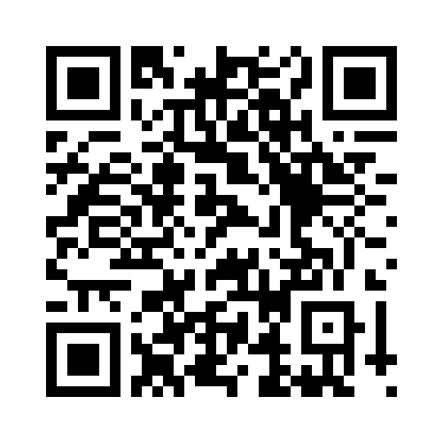
Your Feedback is Important
Fill out an evaluation of this session
and help shape future events.
Scan the QR code to evaluate
this session on your mobile device.
You’ll also be entered into
a daily prize drawing!

Slide 39

© 2014 Microsoft Corporation. All rights reserved. Microsoft, Windows, Windows Vista and other product names are or may be registered trademarks and/or trademarks in the U.S. and/or other countries.
The information herein is for informational purposes only and represents the current view of Microsoft Corporation as of the date of this presentation. Because Microsoft must respond to changing market conditions, it should not be interpreted to be a commitment on the part of Microsoft, and Microsoft cannot guarantee the accuracy of any information provided after the date of this presentation. MICROSOFT MAKES NO WARRANTIES, EXPRESS, IMPLIED OR STATUTORY, AS TO THE INFORMATION IN THIS PRESENTATION.

