Slide 2
Multitasking and Triggered Background Processing
2-518
Shawn Henry
Program Manager – Windows Application Model
Multitasking and Background Processing

Slide 3
Multi-whosit? Triggered-what-the?

Slide 4
Where did we come from?

Slide 5
Mobile multitasking model
Apps not on screen are suspended
However apps can provide real-time content even when suspended
Live tiles or toasts
Scheduled toasts and notifications
OS brokered tasks
Background tasks and agents

Slide 6
Background Execution in WP8
Scheduled Task
PeriodicTask, ResourceIntensiveTask
Background Transfer Service
Background Location Tracking
VOIP and Audio Agents

Slide 7
Where are we going?

Slide 8
Background Execution in WinRT
Centered around BackgroundTasks
Hosted in a separate process
Responds to Triggers and Conditions
One trigger per task, multiple conditions
Applications must request access to run in the background

Slide 9
Basic Triggers
Trigger | Usage
System Trigger UserPresent , UserAway, SessionConnected, TimeZoneChange, NetworkStateChange, InternetAvailable, ServicingComplete | Run code on system events
TimeTrigger | Data synchronization
MaintenanceTrigger | Perform maintenance work on AC power

Slide 10
DEMO
Background Tasks in Windows Store Applications

Slide 11
What’s new?

Slide 12
Windows Phone Silverlight 8.1 Apps
Native Background Task functionality is available from Silverlight 8.1 applications
Background Agents are hosted on top of WinRT Background infrastructure

Slide 13
Bluetooth and Sensors
Bluetooth RFComm, Bluetooth LE and Sensors while not in foreground
Based on existing and new WinRT Bluetooth APIs
New Triggers:
GattCharacteristicNotificationTrigger
DeviceChangeTrigger
DeviceUpdateTrigger
RfcommConnectionTrigger

Slide 14
DEMO
Bluetooth Background Triggers in Silverlight 8.1 + JS

Slide 15
Geofencing
Geofence notifications can be received in the background by a background task
Add a Geofence
Geocircle circle = new Geocircle(circleCenter, radius: 25.5);
Geofence geofence = new Geofence("LinconSquareStore", circle);
GeofenceMonitor.Current.Geofences.Add(geofence);
Register a background Task
BackgroundTaskBuilder builder = new BackgroundTaskBuilder(); builder.SetTrigger(new LocationTrigger(LocationTriggerType.Geofence));

Slide 16
Push Triggers
Associate a Background Task with WNS channel
RAW push notifications directly activate the Task

Slide 17
DEMO
PushNotificationTrigger

Slide 18
XAML Rendering in BackgroundTask
Render a Tile from your BackgroundTask!
New class XamlRenderingBackgroundTask
BackgroundTask + XAML Visual Tree
Use RenderTargetBitmap to render XAML visual tree

Slide 19
DEMO
XAML Rendering in BackgroundTask

Slide 20
Background Transfer
Windows.Networking.BackgroundTransfer
No file size restriction
Support for multi-part mime (for large transfers)
Additional verbs (PUT, RETR, STOR) and also FTP
In-progress stream access
Data-Sense and Battery Saver aware

Slide 21
DEMO
Background Transfer

Slide 22
What’s different?

Slide 23
Not available on Windows Phone
OnlineIdConnectedStateChange
LockScreenApplicationAdded
LockScreenApplicationRemoved
ControlChannelTrigger

Slide 24
Not available for Windows XAML applications
Continuous Background Location
Runs-Under-Lock
VoIP Agents
Wallet Agents

Slide 25
Battery Saver and Resource Management

Slide 26
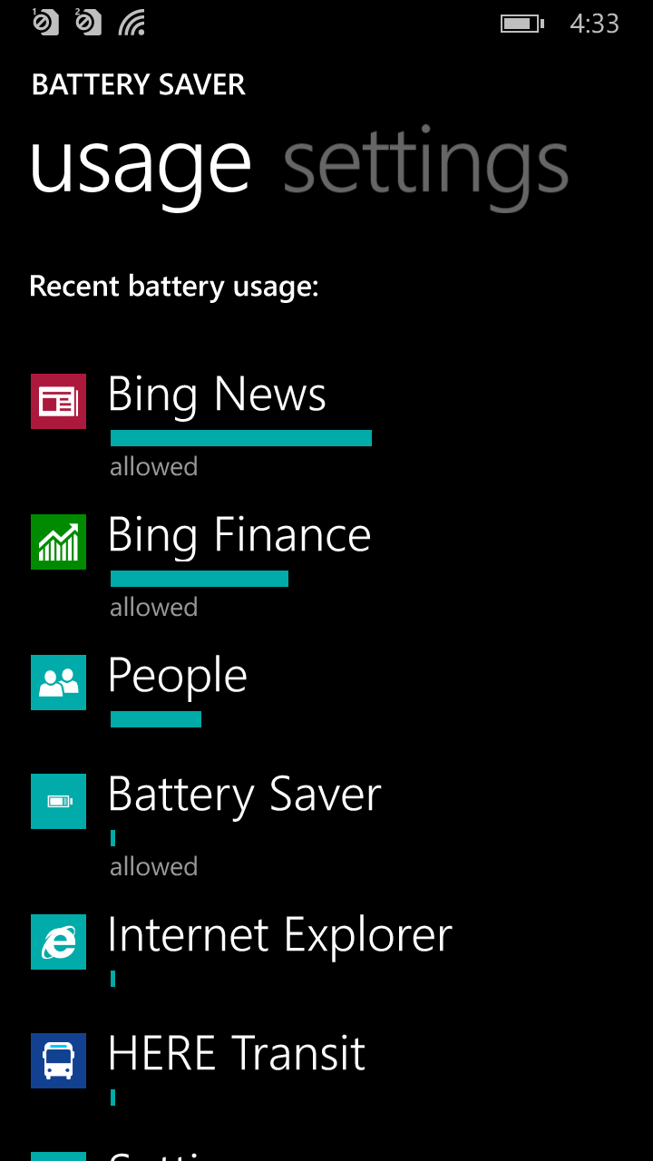
Battery Saver
New in Windows Phone 8.1
Sort and manage which apps can execute in the background
Controls number of apps that can run in the background

Slide 27
Demo
Battery Saver

Slide 28
Resource constraints
All background tasks have CPU, memory and network quotas
Quotas are based on actual CPU usage instead of wall clock time limits only
Wall-clock CPU quota will also be enforced (at least 30 secs)
Memory quota scales based on device capabilities
TimeTrigger will have a 30 min floor on Phone
Call RequestAccessAsync() to get your full quota!

Slide 29
Wrap up
Background processing is converged with Windows
There are lots of new things you can do
But resources are still limited

Slide 30
Other Sessions
2-521 Notification Platform Development for Windows Wednesday 5:30 - 6:30
2-526 Building Geo-Aware Apps with Maps and Geofencing
Thursday 2:30 – 3:30
2-523 Live Tiles Enhancements
Thursday 2:30 – 3:30
2-519 Building Great Bluetooth Apps for Windows Phone
Friday 9:00 - 10:00
3-542 Managing Resource Constraints on Windows Phone
Friday 10:00 – 11:00

Slide 31
Q&A

Slide 32
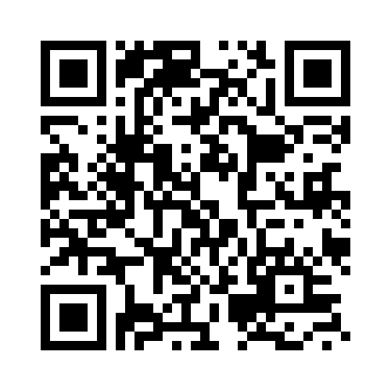
Your Feedback is Important
Fill out an evaluation of this session and help shape future events.
Scan the QR code to evaluate this session on your mobile device.
You’ll also be entered into a daily prize drawing!

Slide 33
© 2014 Microsoft Corporation. All rights reserved. Microsoft, Windows, Windows Vista and other product names are or may be registered trademarks and/or trademarks in the U.S. and/or other countries.
The information herein is for informational purposes only and represents the current view of Microsoft Corporation as of the date of this presentation. Because Microsoft must respond to changing market conditions, it should not be interpreted to be a commitment on the part of Microsoft, and Microsoft cannot guarantee the accuracy of any information provided after the date of this presentation. MICROSOFT MAKES NO WARRANTIES, EXPRESS, IMPLIED OR STATUTORY, AS TO THE INFORMATION IN THIS PRESENTATION.

