Slide 2
Deploying and Managing Enterprise Apps
Cliff Strom, Principal Program Manager
John Vintzel, Senior Program Manager
2-524

Slide 3
Enterprise Apps on Windows & WP
Windows
Windows Phone
Wrap Up

Slide 4
App deployment in an enterprise
Common app deployment workflows and features
Windows and Windows Phone share a common workflow and set of enterprise features
Conceptually the same, mechanically different
Convergence across platforms is driving a convergence of enterprise features across Windows and Windows Phone, but we aren't there yet

Slide 5
Enterprise Apps on Windows & WP

Slide 6
End to end workflow
Building and Testing
Readying for Deployment
Deploying
Managing

Slide 7
Notification Services for LOB apps
Engage in real-time with your users for a delightful app experience
App Type/ Service | Windows Notification Service (WNS) | Microsoft Push Notification (MPN)
Windows Runtime App (AppX)* | 8.1 | not supported
Windows Phone Silverlight App (XAP) | 8.1 | 8.0/8.1
Windows Runtime Phone App (AppX on WP)* | not supported | not supported
*Note: Appx files signed with a Symantec cert cannot use WNS

Slide 8
Readying apps for deployment
App ingestion is owned by the enterprise
The company is responsible for the quality of their apps and the impact to the user
LOB Apps offer increased developer flexibility
Enterprise line of business apps are not enforced by store policies (i.e. API checks) and give the developer more flexibility
Available Kits are an important step to evaluate the apps
WACK & MPTK can be downloaded and perform similar checks that the Store would perform

Slide 9
Readying clients for deployment
Enroll users for management
Use OMA-DM to manage all versions of Windows 8.1 or Windows Phone 8.0 and 8.1
Use management tools to configure device
OMA-DM management tools can push policies, required keys and necessary certificates to the device

Slide 10
Windows apps delivery in enterprise
Install from Windows Store
Distribute LOB apps internally
Internal LOB W8 Apps
Public W8 Apps
Install from Windows Phone Store
Company Portal
Management Server
Public WP8 Apps
Internal LOB WP8 Apps

Slide 11
Deploying Apps using Windows Intune

Slide 12
Managing app policies and restriction
Control access to the Store and Internet Explorer
Built-in device management policies can control access to the Store and restrict Internet Explorer
App policies can control access to apps
Use app policies to control access to which apps a user can run

Slide 13
Windows Client

Slide 14
Increased Developer Flexibility
Interact with the desktop
Windows 8.1 Update allows sideloaded apps to interact with the desktop through network loopback or through a brokered WinRT component
App Container
App Container
Windows Runtime App
Windows Runtime App
Broker
Local Service
Desktop .NET Framework Win32
Desktop .NET Framework Win32
Managed WinRT Component
Brokered WinRT Component
Local Loopback

Slide 15
Readying client for deployment
Install the appropriate certificate root
A certificate root for the certificate used to sign your apps needs to be in the devices Trusted Root Certification Authority
Device needs to be enabled for sideloading
Domain joined and policy setting enabled or
Activated by license key
New changes to sideloading keys
Key availability is now more flexible!
Keys not required for any domain joined device running Windows 8.1 Update!!

Slide 16
Deployment methods
Use built-in Windows commands
PowerShell are available to manage app deployments
Apps can be installed per user or for all users
Apps can be provisioned into a custom Windows image
Use inbox management capabilities
OMA-DM client is available in all editions of Windows 8.1 and works with most management software

Slide 17
Servicing of pre-installed Windows apps
Service pre-installed apps when the store is disabled
Update pre-install Windows Store Apps (Mail, Reader, etc..) within your enterprise without access to the Windows Store
Servicing uses typical enterprise tools
Updates will be available as an a downloadable MSI or published through WSUS for Windows 8 and 8.1
Coming soon: One-time updates for all the pre-installed apps in Windows 8

Slide 18
Enterprise Application Content URI Rules
Use apps from the Store without custom packaging
Extend the URI list of apps acquired from the Windows Store to include URIs within your enterprise
IT Pro controls the URI list for the enterprise
IT Pros can manage a list of URI specific for the enterprise and target clients using group policy or other management tools.

Slide 19
Enterprise Mode Internet Explorer
Enterprise Mode Icon
Customers can benefit from a modern browser, while reducing upgrade costs and preserving existing web app investments.
F12 Developer Tools

Slide 20
Windows Phone

Slide 21
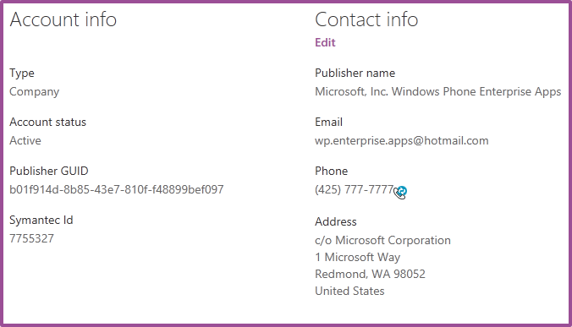
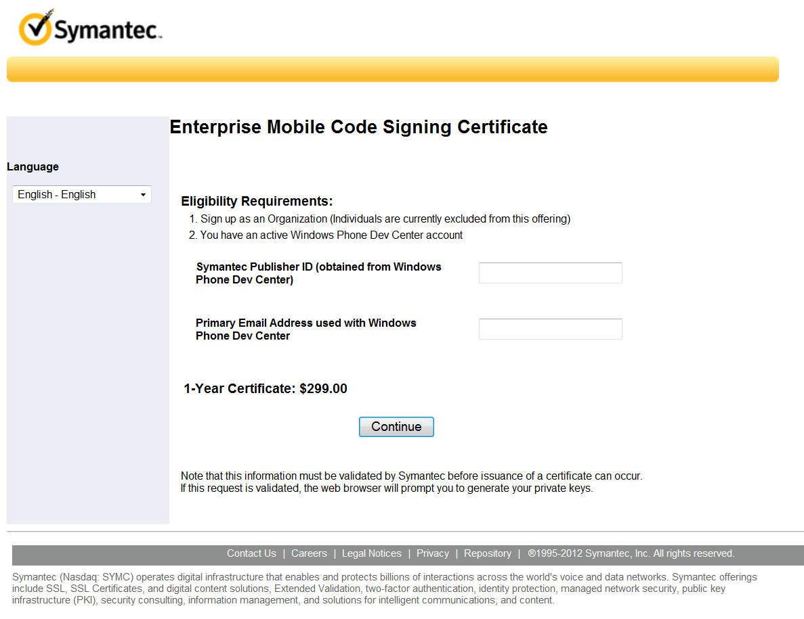
Acquiring a certificate
Must be a Company account
Publisher name displayed on phone
Company approval required
Private key, CSR, cert are local to PC

Slide 22
Managed and unmanaged enrollment
Feature | Managed | Unmanaged
Enrollment method | Workplace app + MDM | Email/browser
Number of enrollments | Limited to 1 | Unlimited
Policy management | Yes | No
App install method | MDM/company hub | Email/browser/company hub
App inventory | MDM/company hub | Company hub
Push app install | MDM | No
Push app uninstall | MDM | No
Push app updates | MDM | No
Unenroll | Remote and local | Local
NEW
NEW
NEW
For more information on managed enrollments, watch session 2-513, Windows Phone Enterprise Management

Slide 23
App enrollment
AET
App enrollment token (AET) is generated once per year
Delivered to the phone over an authenticated channel via email, browser, or MDM
Validated for signature and expiration
1
Publisher
ID
2
Windows Phone 8
Enterprise Service
Email/Browser/MDM
2
3

Slide 24
Company hub APIs
API feature | WP 8 | WP 8.1
Enumerate apps | Yes | Yes
Launch apps | Yes | Yes
Install enterprise signed apps | Yes | Yes
Get enterprise metadata | No | Yes
Renew an enterprise enrollment | No | Yes
Unenroll from the current enterprise | No | Yes
Trigger enterprise phone home | No | Yes
NEW
NEW
NEW
NEW
Company hubs must be Silverlight apps
Create a Windows Phone 8 Company Hub App
MSDN article by Tony Champion - http://aka.ms/E7c6xc

Slide 25
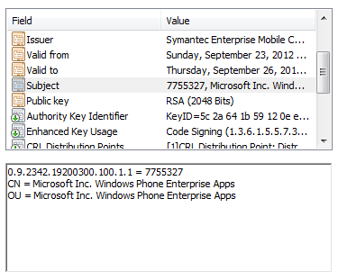
Manifest: Publisher
In order to sign WinRT apps, the manifest Publisher must match the certificate Subject
AppxManifest.xml
<Identity Name="Sample.Application"
Version="1.0.0.0"
Publisher="OID.0.9.2342.19200300.100.1.1=7755327,
CN=&quot;Microsoft Inc. Windows Phone Enterprise Apps&quot;,
OU=&quot;Microsoft Inc. Windows Phone Enterprise Apps&quot;" />

Slide 26
Manifest: PublisherID
In order to test Company Hub apps, the PublisherID in WMAppManifest and AppxManifest must match the certificate
WMAppManifest.xml
<App ProductID="{B316008A-141D-4A79-810F-8B764C4CFDFB}“
Title=“Sample.Application" RuntimeType="Silverlight" Version="1.0.0.0“
Genre="apps.normal" Author=“Sample author"
Description="Sample description" Publisher="Contoso Publisher"
PublisherID="{0076563F-0000-0000-0000-000000000000}">
AppxManifest.xml
<mp:PhoneIdentity PhoneProductID="{B316008A-141D-4A79-810F-8B764C4CFDFB}"
PublisherID="{0076563F-0000-0000-0000-000000000000}">

Slide 27
App deployment
App is packaged, signed, and published to the company’s store
Delivered to the phone over an authenticated channel via email, browser, MDM, or company hub
Validated for signature, an associated AET, and allowed capabilities
App
App
1
XAP
APPX
NEW
2
Windows Phone 8
Enterprise Service
Email/Browser/MDM/
Company Hub
2
3

Slide 28
App launch
User launches an enterprise app via the shell or an API
Publisher ID is extracted and used to find the associated AET
AET must be present and valid (not expired, revoked or disabled)
1
Windows Phone 8
Enterprise Service
Execution Manager
2
3

Slide 29
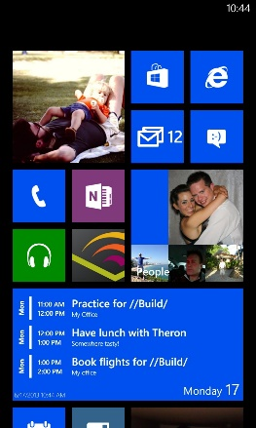
Phone home
Phone sends device ID, publisher IDs, and enterprise app IDs
Phone receives status for each enterprise
Apps of invalid enterprises are blocked from being installed or launched
Scheduled daily, plus each enrollment
After 7 consecutive failed attempts, the install of enterprise apps is blocked, but the launch of installed apps still works
Windows Phone Services
1
2

Slide 30
Wrap Up

Slide 31
Looking forward
Convergence for LOB app deployment
Certs, Enrollment, OMA-DM protocol, WNS, …
App management of Store apps
Better LOB app and data protection
Support more customer scenarios
More secure/isolated environments, flexible cert management, …
More policies/settings to push to LOB app

Slide 32
Related Sessions
2-513 – Windows Phone Enterprise Management
2-515 - Respecting Your Investments: How to Leverage Your Existing Code In a New Windows Runtime LOB App
2-559 - Better App Compat with Enterprise Mode for Internet Explorer 11
2-640 - App Packaging and Deployment for Windows Devices

Slide 33
Resources
Windows Client
Windows Sideloading: http://aka.ms/lanmep
AppLocker Step-by-Step Guide: http://aka.ms/X21isi
Notification Services: http://aka.ms/Iqqonk
Windows Phone
Company app distribution: http://aka.ms/wp8companyhub
Create a Company Hub App blog: http://aka.ms/E7c6xc
MDM whitepaper: http://aka.ms/V0h3v6

Slide 34
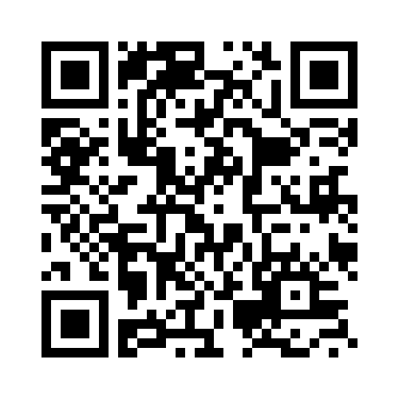
Your Feedback is Important
Fill out an evaluation of this session and help shape future events.
Scan the QR code to evaluate this session on your mobile device.
You’ll also be entered into a daily prize drawing!

Slide 35
© 2014 Microsoft Corporation. All rights reserved. Microsoft, Windows, Windows Vista and other product names are or may be registered trademarks and/or trademarks in the U.S. and/or other countries.
The information herein is for informational purposes only and represents the current view of Microsoft Corporation as of the date of this presentation. Because Microsoft must respond to changing market conditions, it should not be interpreted to be a commitment on the part of Microsoft, and Microsoft cannot guarantee the accuracy of any information provided after the date of this presentation. MICROSOFT MAKES NO WARRANTIES, EXPRESS, IMPLIED OR STATUTORY, AS TO THE INFORMATION IN THIS PRESENTATION.

