Slide 2
Building video and audio streaming apps
Gabe Frost
Principal Lead Program Manager
2-528

Slide 3
Agenda
Anatomy of a streaming app
API options for Store apps
Streaming app examples
Audio considerations
What you’ve told us

Slide 4
Anatomy of a streaming app
Media description & selection
Adaptive quality
Closed captions
Multiple languages
Video or audio ads
Analytics

Slide 5
API options for Store apps
Windows Runtime
W3C Media Source Extensions (MSE)
Media Stream Source (MSS)
Custom Media Foundation ByteStream
Supplementary SDKs
Smooth Streaming
For HTTP Live Streaming (HLS), contact hlsinfo@microsoft.com

Slide 6
WinRT streaming APIs are converged on phone, PC and tablet. Convergence is a priority.

Slide 7
Complexity vs. control

Slide 8
Video streaming app

Slide 9
Media Source Extensions (MSE)
W3C standard
Replacement for media plugins
Netflix, YouTube
Used with <video> and <audio>
Works with DRM

Slide 10
Media Source Extensions
App or site is responsible for retrieving samples
Takes MP4 fragments as input
Decoding and rendering by platform
DASH.js reference player is available at http://dashif.org
Multimedia platform
Windows Store app
Windows Store app or web site
JavaScript code
HTML5 video & audio tags,
XAML MediaElement
HTML5 video & audio tags, HTML5 MSE, and XAML MediaElement
Windows Runtime (WinRT)
Windows Runtime (WinRT)
Playback & preview
(IMFMediaEngine)
Playback & preview
(IMFMediaEngine)
Camera & mic capture
(IMFCaptureEngine)
Camera & mic capture
(IMFCaptureEngine)
Transcode & trim
(IMFTranscodeEngine)
Transcode & trim
(IMFTranscodeEngine)
Streaming to Xbox
(IMFMediaSharingEngine)
Cast to Xbox
(IMFMediaSharingEngine)
Media Foundation
Media Foundation
Audio/video reader (source)
Video
decoder
Video
decoder
Video
effect 1
Video
effect 1
Video
effect n
Video
effect n
Video
encoder
Video
encoder
Audio/video writer (sink)
Audio/video writer or render (sink)
Audio
decoder
Audio
decoder
Audio
effect 1
Audio
effect 1
Audio
effect n
Audio
effect n
Audio
encoder
Audio
encoder

Slide 11
Demo – Streaming with HTML5 http://ie.microsoft.com/testdrive/HTML5/eme/

Slide 12
Creating a media source
// Step 1: Create the media source
videoPlayer = document.getElementById("videoplayer");
mediaSource = new MediaSource();
// Step 2: When opening a media source, register event handlers.
mediaSource.addEventListener("sourceopen", function() {
videoPlayer.addEventListener("seeking", seekHandler, false);
videoPlayer.addEventListener("timeupdate", updateSourceBuffers, false); // Use playback
// timer callback
// Step 3: Create video and audio buffers for receiving data. // to monitor
vidSourceBuffer = mediaSource.addSourceBuffer("video/mp4"); // quality signals
audSourceBuffer = mediaSource.addSourceBuffer("audio/mp4"); // and append data
}, false);
// Step 4: Attach the media source to the video tag
videoPlayer.src = URL.createObjectURL(mediaSource);

Slide 13
Append data into source buffers
// Append video and audio segments
function updateSourceBuffers() {
/* This is where the magic happens.
Look at DASH.js (Dynamic Adaptive Streaming over HTTP) at
http://dashif.org
Use XMLHTTPRequest (XHR) to get video and audio segments to append.
Adapt quality based on buffer fullness, network, dropped frames, etc.
*/
}

Slide 14
Adapting quality – network conditions
// Of the multiple quality signals to
var totalSize = 0; // consider for switching streams, we’ll
var totalTimeMs = 0; // look at network and frame drops.
// Keep record of each segment size and download time
for (var i = 0; i < segmentDownloadRateRecords.length; i++) {
var record = segmentDownloadRateRecords[i]; // An optimization would be to
totalSize += record.size; // sample a sliding window
totalTimeMs += record.downloadTimeMs; // rather than every record.
}
// Determine the current bitrate
var bitrate = (totalSize * 8.0) / (totalTimeMs / 1000.0);

Slide 15
Adapting quality – frame drops
var now = new Date().getTime(); // As a rate limiter, only check
if ((now - lastQosCheck) < QOS_CHECK_PERIOD) { // media pipeline QoS every N seconds.
return;
}
lastQosCheck = now;
// Check for frame drops using W3C getVideoPlaybackQuality()
var videoQuality = videoPlayer.getVideoPlaybackQuality();
if ((videoQuality.droppedVideoFrames - lastFrameDrops) >= FRAME_DROP_THRESHOLD) {
// Too many frames have dropped, so switch to a lower bitrate source
limitMaxVideoQuality();
}
lastFrameDrops = videoQuality.droppedVideoFrames;
// We’re still ok on dropped frames, so proceed monitoring quality signals
switchToBestVideoBitrate();

Slide 16
Swap video elements for ads
// Create video element for the ad without built-in controls, initially hidden
<video id="adplayer" style="visibility: hidden; display: none"></video>
function playAd() {
adPlayer = document.getElementById("adplayer");
adPlayer.addEventListener("canplay", switchToAdPlayer, false); // signal when to play an ad
adPlayer.src = getAdUrl();
}
function switchToAdPlayer() {
videoplayer.pause(); // Pause the movie and hide it
showAdPlayer(true); // by making the ad visible over top.
adPlayer.addEventListener("ended", function() {
showAdPlayer(false); // Hide the ad when it’s over, and
videoPlayer.play(); // un-pause the movie.
}, false);
adPlayer.addEventListener("timeupdate", checkPercentPlayed, false); // To enable skip after (n) sec
adPlayer.play(); // Play the ad
}

Slide 17
Enable seek after some ad duration
// Enable seek control on the ad player if more than 50% of the ad has been played
function checkPercentPlayed() {
var pctPlayed = percentPlayed(adPlayer);
if (pctPlayed >= 50) {
adPlayer.removeEventListener("timeupdate", checkPercentPlayed, false);
adPlayer.controls = true;
}
}
// Determine the % of the ad that has been played
function percentPlayed(videoElement) {
var played = 0;
for (var i = 0; i < videoElement.played.length; i++) {
played += (videoElement.played.end(i) - videoElement.played.start(i));
}
return (played * 100.0) / videoElement.duration;
}

Slide 18
Closed Captions
<-- When TTML or WebVTT tracks are present, CC will light-up in standard media controls.
Web app or site may subscribe to caption events for creating custom controls.
-->
<video controls autoplay loop src='movie.mp4'>
<track kind='subtitles' srclang='en' label='English' src='captions.vtt' default>
<track kind='subtitles' srclang='de' label='German' src='de-captions.vtt'>
</video>

Slide 19
Custom streaming app

Slide 20
Media Stream Source (MSS)
Familiar to Silverlight developers
Works with XAML MediaElement and HTML5 <video> and <audio>
Works with DRM

Slide 21
Media Stream Source
App is responsible for retrieving samples and parsing file format
MSS takes elementary stream samples as input
Decoding and rendering by platform
Multimedia platform
Windows Store app
Get samples (e.g. HTTP or sockets) and parse file format
HTML5 video & audio tags, HTML5 MSE and XAML MediaElement
Windows Runtime (WinRT)
Windows.Media.Core.MediaStreamSource
Playback & preview
(IMFMediaEngine)
Camera & mic capture
(IMFCaptureEngine)
Transcode & trim
(IMFTranscodeEngine)
Cast to Xbox
(IMFMediaSharingEngine)
Media Foundation
Audio/video reader (source)
Video
decoder
Video
effect 1
Video
effect n
Video
encoder
Audio/video writer (sink)
Audio
decoder
Audio
effect 1
Audio
effect n
Audio
encoder

Slide 22
Dynamic D3D object as a video
MSS requests
uncompressed samples
Custom WinRT component generates uncompressed D3D samples
2D texture rendered in a MediaElement
Store app (JavaScript)
MediaStreamSource
WinRT Component C++/CX with DirectX
Opening
SampleRequest

Slide 23
Demo – Dynamic D3D object as a video

Slide 24
Describing the stream
var frameRateN = 30; // Unlike MSE which supports specific formats,
var frameRateD = 1; // MSS supports any format. So, the app must
var width = 1152; // explicitly specify what the video or audio is.
var height = 720;
// Define how the video source is encoded. Here, we’re using uncompressed 720p.
var videoEncProps = Windows.Media.MediaProperties.VideoEncodingProperties.createUncompressed(
MediaProperties.MediaEncodingSubtype.bgra8, width, height);
// Create a stream descriptor for initializing the media source.
var videoDesc = new Windows.Media.Core.VideoStreamDescriptor(videoEncProps);
videoDesc.encodingProperties.frameRate.numerator = frameRateN;
videoDesc.encodingProperties.frameRate.denominator = frameRateD;
videoDesc.encodingProperties.bitrate = frameRateN * frameRateD * width * height * 4;

Slide 25
Creating a stream source
// Step 3: Create a stream source using the stream descriptor
var streamSource = new Windows.Media.Core.MediaStreamSource(videoDesc); // Note: Switching
streamSource.bufferTime = 250; // streams for quality
// or an ad means
// Register handlers for initializing and getting samples. // updating the stream
streamsource.addEventListener(“starting”, streamSource_starting); // descriptor.
streamsource.addEventListener(“samplerequested”, streamSource_samplerequested);
// Attach the stream source to the video tag
var mediaPlayer = document.getElementById(“mediaplayer”);
mediaPlayer.autoplay = false;
mediaPlayer.src = URL.createObjectURL(streamSource);

Slide 26
Append data into source buffers
// A custom Media Extension projects a WinRT interface
var sampleGenerator = new DXSurfaceGenerator.SampleGenerator();
function streamSource_starting(e) {
sampleGenerator.initialize(streamSource, videoDesc);
e.request.setActualStartPosition(0);
}
function streamSource_samplerequested(e) {
sampleGenerator.generateSample(e.request);
// Like MSE, this is where the magic happens.
// Use XMLHTTPRequest (XHR) to get video and audio segments to append.
// Adapt quality based on buffer fullness, network, dropped frames, etc.
}

Slide 27
Using custom MF extensions
Native C++/COM MF components
Custom streaming, formats, processing, codecs
Packaged with your app
Can only be used by your app

Slide 28
Using a custom Media Foundation ByteStream
MSS is almost always a better streaming option
Register ByteStreamHandler to load extension on format & MIME type
Register SchemeHandler to load extension on src=myscheme://
Multimedia platform
Windows Store app
HTML5 video & audio tags, HTML5 MSE and XAML MediaElement
Windows Runtime (WinRT)
Playback & preview
(IMFMediaEngine)
Camera & mic capture
(IMFCaptureEngine)
Transcode & trim
(IMFTranscodeEngine)
Cast to Xbox
(IMFMediaSharingEngine)
Media Foundation
Audio/video reader (source)
Video
decoder
Video
effect 1
Video
effect n
Video
encoder
Audio/video writer (sink)
Audio
decoder
Audio
effect 1
Audio
effect n
Audio
encoder

Slide 29
Using a custom Media Foundation ByteStream
Step 1: Register DLL extension in app manifest
Multimedia platform
Windows Store app
HTML5 video & audio tags, HTML5 MSE and XAML MediaElement
Windows Runtime (WinRT)
Playback & preview
(IMFMediaEngine)
Camera & mic capture
(IMFCaptureEngine)
Transcode & trim
(IMFTranscodeEngine)
Cast to Xbox
(IMFMediaSharingEngine)
Media Foundation
Custom ByteStream (DLL)
Audio/video reader (source)
Video
decoder
Video
effect 1
Video
effect n
Video
encoder
Audio/video writer (sink)
1
Audio
decoder
Audio
effect 1
Audio
effect n
Audio
encoder

Slide 30
Example: Using Smooth Streaming SDK
<-- Step 1: Register your DLL in the extension section
of your app app manifest -->
<Extensions>
<Extension Category=“Windows.activatableClass.inProcessServer”>
<InProcessServer>
<Path>SSMFPluginM.dll</Path>
<ActivatableClass
ActivatableClassId=“Microsoft.IIS.SSMFByteStreamHandler”
ThreadingModel=“both” />
</InProcessServer>
</Extension>
</Extensions>

Slide 31
Using a custom Media Foundation ByteStream
Step 1: Register DLL extension in app manifest
Step 2: Register custom format with WinRT Media Extensibility Manager
Multimedia platform
Windows Store app
App media extension
2
HTML5 video & audio tags, HTML5 MSE and XAML MediaElement
Windows Runtime (WinRT)
Playback & preview
(IMFMediaEngine)
Camera & mic capture
(IMFCaptureEngine)
Transcode & trim
(IMFTranscodeEngine)
Cast to Xbox
(IMFMediaSharingEngine)
Media Foundation
Custom ByteStream (DLL)
Audio/video reader (source)
Video
decoder
Video
effect 1
Video
effect n
Video
encoder
Audio/video writer (sink)
1
Audio
decoder
Audio
effect 1
Audio
effect n
Audio
encoder

Slide 32
Example: Using Smooth Streaming SDK
/* Step 2: In your app, register your ByteStream handler */
/* for a certain file extension and MIME type */
var plugins = new Windows.Media.MediaExtensionManager();
try {
/* Register custom ByteStream handler */
plugins.registerByteStreamHandler(
“Microsoft.IIS.SSMFByteStreamHandler”, “.ism”, “text/xml”);
}
catch (e) {
log(e.message);
}

Slide 33
Using a custom Media Foundation ByteStream
Step 1: Register DLL extension in app manifest
Step 2: Register custom format with WinRT Media Extensibility Manager
Step 3: Set source URI to custom format
Multimedia platform
Windows Store app
App media extension
2
HTML5 video & audio tags, HTML5 MSE and XAML MediaElement
Windows Runtime (WinRT)
3
Playback & preview
(IMFMediaEngine)
Camera & mic capture
(IMFCaptureEngine)
Transcode & trim
(IMFTranscodeEngine)
Cast to Xbox
(IMFMediaSharingEngine)
Media Foundation
Custom ByteStream (DLL)
Audio/video reader (source)
Video
decoder
Video
effect 1
Video
effect n
Video
encoder
Audio/video writer (sink)
1
Audio
decoder
Audio
effect 1
Audio
effect n
Audio
encoder

Slide 34
Example: Using Smooth Streaming SDK
/* Step 3: Set the SRC attribute to a matching URI */
<video src=
“http://www.contoso.com/BigBuckBunny.ism/manifest(format=).ism”>

Slide 35
Audio considerations

Slide 36
System media transport controls are converged on phone, PC and tablet.

Slide 37
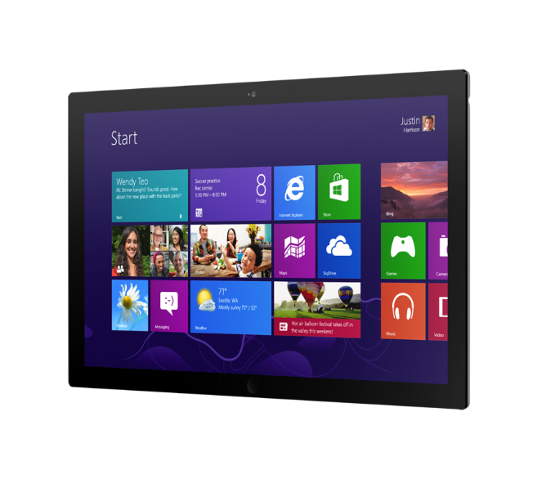
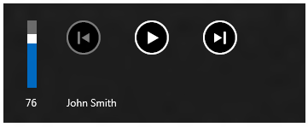
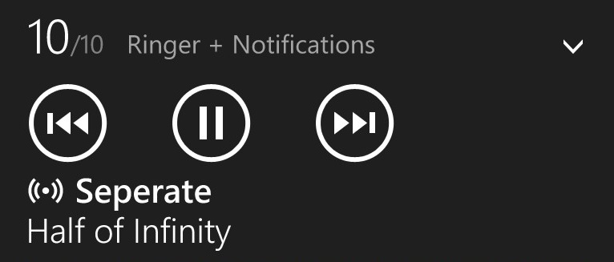
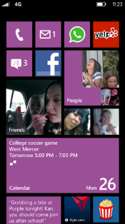
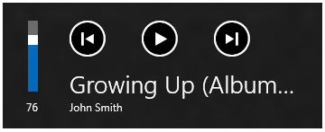

Slide 38
Background audio on PC & tablet is not yet converged with phone. Convergence is a priority.

Slide 39
Background audio capability in your manifest
<-- Background audio process is currently unique to Phone -->
<Extension Category=“Windows.backgroundTasks”
EntryPoint=“SampleBackgroundAudioTask.MyBackgroundAudioTask”>
<BackgroundTasks>
<Task Type=“audio” />
</BackgroundTasks>
</Extension>

Slide 40
Defining your background audio process
Namespace SampleBackgroundAudioTask // Playback controls must be
{ // Enabled and handled within
private Windows.Media.SystemMediaTransportControls transportcontrols; // your background audio process
private MyPlaylist Playlist;
public sealed class MyBackgroundAudioTask : IBackgroundTask // All your code that plays
{ // Entry point of the background task. // audio must be within your
public void Run(IBackgroundTaskInstance taskInstance) // background audio process.
{
transportcontrols = SystemMediaTransportControls.GetForCurrentView();
transportcontrols.ButtonPressed += playbackcontrols_ButtonPressed;
transportcontrols.IsEnabled = true; // Also set IsPauseEnabled, etc.
ValueSet message = new ValueSet(); // Messages are passed as key/value pairs between
message.Add(“BackgroundTaskStarted”, “”); // the foreground app and background process.
BackgroundMediaPlayer.SendMessageToForeground(message);
}

Slide 41
Getting transport commands from your app
// Inside your background audio process, handle foreground app button presses.
void BackgroundMediaPlayer_MessageReceivedFromForeground(object sender,
MediaPlayerDataReceivedEventArgs e) // Playback controls
{ // come from in-app
foreach (string key in e.Data.Keys) // buttons, and system
{ // buttons.
switch (Key.ToLower())
{ // Take action on playback commands from buttons in your foreground app
case “startplayback”: Playlist.StartTrack(e.Data[key]); break;
case “pauseplayback”: Playlist.PauseTrack(e.Data[key]); break;
}
}
}

Slide 42
Getting transport commands from system
// Inside your background audio process, handle SMTC button presses
// Same code as PC & tablet.
private void transportcontrols_ButtonPressed(SystemMediaTransportControls sender,
SystemMediaTransportControlsButtonPressedEventArgs args) // Playback controls
{ // come from in-app
switch (args.Button) // buttons, and system
{ // buttons.
// Take action on playback commands from system buttons // On a PC, these also
case SystemMediaTransportControlsButton.Play: // map to hardware
BackgroundMediaPlayer.Current.Play(); break; // buttons.
}
}

Slide 43
Update metadata in system transpot control
// Inside your background audio process, when the audio track changes,
// update metadata in the system playback control, and the foreground app.
void playlist_TrackChanged(MyPlaylist sender, object args)
{
transportcontrols.PlaybackStatus = Windows.Media.MediaPlaybackStatus.Playing;
transportcontrols.DisplayUpdater.Type = Windows.Media.MediaPlaybackType.Music;
transportcontrols.DisplayUpdater.MusicProperties.Title = …;
transportcontrols.DisplayUpdater.Update();
ValueSet message = new ValueSet(); // Inform your foreground
message.Add(Constants.Trackchanged, sender.CurrentTrackName); // app that the track
BackgroundMediaPlayer.SendMessageToForeground(message); // changed so you can update
} // now playing UI.

Slide 44
Start audio playback from your app
<audio id=“audioplayer" msAudioCategory=“BackgroundCapableMedia” />
// Accessing the current instance of the BackgroundMediaPlayer starts the background process.
var mediaPlayer = BackgroundMediaPlayer.Current;
// Send a message to the background process to start playback of a file
function startBackgroundAudioTask(filepath) {
var message = new Windows.Foundation.Collections.ValueSet();
message.insert(“StartPlayback”, filepath);
Windows.Media.Playback.BackgroundMediaPlayer.sendMessageToBackground(message);
}

Slide 45
Get status from the background process
// Handle messages from your background audio process
Windows.Media.BackgroundMediaPlayer.onmessagereceivedfrombackground = function(e) {
for (var i=0; i<e.detail.length; i++) {
for (var key in e.detail[i].data) {
switch (key) {
case “BackgroundTaskStarted”: …; break;
case “TrackChanged”: …; break;
}
}
}
}

Slide 46
What you’ve told us

Slide 47
We’re listening
Converge media APIs in WinRT
First class support for HLS
Simplify streaming (it’s too hard)
MSE – what about XAML apps?!
Go further with closed captions
Live content is fast approaching

Slide 48
Resources
Creating apps that use video and audio
Building web apps and sites without plug-ins
Media Stream Source sample code
Custom media extension sample code
Simple video captioning using standard controls
Dynamic video captioning for custom controls

Slide 49
Your Feedback is Important
Fill out an evaluation of this session and help shape future events.
Scan the QR code to evaluate this session on your mobile device.
You’ll also be entered into a daily prize drawing!

Slide 50
© 2014 Microsoft Corporation. All rights reserved. Microsoft, Windows, Windows Vista and other product names are or may be registered trademarks and/or trademarks in the U.S. and/or other countries.
The information herein is for informational purposes only and represents the current view of Microsoft Corporation as of the date of this presentation. Because Microsoft must respond to changing market conditions, it should not be interpreted to be a commitment on the part of Microsoft, and Microsoft cannot guarantee the accuracy of any information provided after the date of this presentation. MICROSOFT MAKES NO WARRANTIES, EXPRESS, IMPLIED OR STATUTORY, AS TO THE INFORMATION IN THIS PRESENTATION.

