Slide 2
Bringing Kinect Into Your Windows Store Apps
2-532
Kevin Kennedy
Senior Development Lead, Kinect Team, Microsoft

Slide 3
K4W News @ //build
Kinect for Windows v2 coming this summer
Create & publish Kinect apps to the Windows Store
Kinect Unity plugin for both desktop & store apps

Slide 4
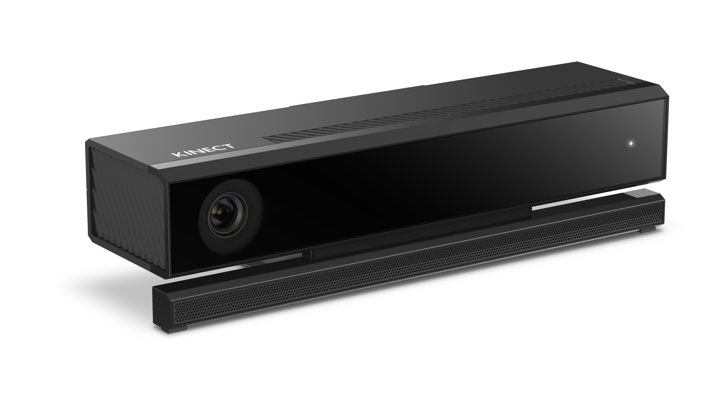
Agenda
Kinect Development Overview
Desktop and Windows Store
Kinect Data Sources
Color, Depth, Infrared, Body, BodyIndex
Other tools
Frame synchronization, coordinate mapping, processing body data
Notes:
At start of presentation:
Survey Audience:
Who went to The earlier "" talk by Chris White?
Who had used Kinect V1?

Slide 5
Kinect Overview

Slide 6
The data sources
Depth
Infrared
Color
Body
Body Masks
Audio, Speech,
Interactions
Notes:
Called “Streams” in V1
When talking about lean - present body as thumbstick. Tie in to design principles
Interactions and speech too

Slide 7
Demo: Data Sources
Notes:
Show detail of depth
Removal of other light sources from IR
Hand states

Slide 8
High-level architecture
Multiple Kinect enabled applications can run simultaneously
Native Apps
.Net
Apps
Windows Store Apps
C#, VB, JS, C++/CX
Native API
.Net
API
WinRT API
Kinect Runtime
Kinect Drivers
Physical Kinect Sensor
Notes:
One instance of the service per session
All the same – not lower-higher level
Talk to USB3, Windows 8, GPU requirement

Slide 9
Design Principles
Minimize per-frame allocations
Low latency – high throughput
Expose low level data and high level interpretations
Notes:
Talk to why these are important.
System is moving a lot of data constantly
Apps should “get-in, do it, and get out”
Deliver range of stuff from low to high level.
Working towards exposing higher level interpretations of lower level data – if you just want one specific goal
Hand state
Lean
Expressions,
Etc.

Slide 10
Creating a new store app using Kinect
In “New Project” create a new Windows Store app
Enable Microphone and Webcam capabilities
Add a reference to WindowsPreview.Kinect
Use the WindowsPreview.Kinect namespace in your code
Notes:
Everything is currently “WindowsPreview.Kinect” That, of course, will change before final RTM.

Slide 11
Accessing Kinect Data Sources

Slide 12
The KinectSensor class
Represents a single physical sensor
Always valid
If sensor is unplugged, app will not receive any frames.
App will start receiving frames when plugged back in
KinectSensor.IsAvailable tells you if the sensor is actually there
C#
JavaScript
this.sensor = KinectSensor.GetDefault(); this.sensor.Open(); // Make the world a better place with Kinect this.sensor.Close();
sensor = kinect.KinectSensor.getDefault(); sensor.open(); // Make the world a better place with Kinect sensor.close();
Sensor
Source
Reader
Frame Ref
Frame
Notes:
Improvement over V1 where app had to do more work to manage sensors coming and going
Talk to usage pattern

Slide 13
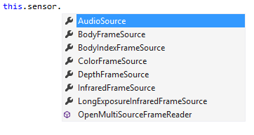
Sources
Expose metadata about the source and give access to readers
Sensors expose one source per data type
Use the source
Sensor
Source
Reader
Frame Ref
Frame
Notes:
Metadata – count of bodies, width and height of bitmap sources
We’ll talk about readers in the next slide

Slide 14
Readers
Give access to frames
Events
Polling
Multiple readers may be created on a single source
Allows better componentization
Readers can be paused
Sensor
Source
Reader
Frame Ref
Frame
Notes:
“Allow multiple pieces of your application independent access to the frames”
Pausable – explain benefits

Slide 15
Readers
InfraredFrameReader reader =
sensor.InfraredFrameSource.OpenReader();
reader.FrameArrived +=
InfraredReaderFrameArrived;
...
// see in the dark
...
reader.Dispose();
C#
reader = sensor.infraredFrameSource.openReader();
reader.onframearrived = function (args) { ... };
...
// see in the dark
...
reader.close();
JavaScript

Slide 16
Frame references
Sent in frame event args and give access to the actual frame via AcquireFrame
By the time the app calls AcquireFrame, the frame might already have expired
FrameReference.RelativeTime allow you to temporally correlate frames
Sensor
Source
Reader
Frame Ref
Frame
Notes:
Why will a frame expire
A newer frame has already taken its place
AcquireFrame returns null
Caller always needs to check
Goes back to optimizing for
Timestamp replaces V1 frame index
Compare hand location across two bodies to know how fast hand is moving. Coordinating skeleton over IR overlay

Slide 17
Frame references
using (InfraredFrame frame =
args.FrameReference.AcquireFrame())
{
if (frame != null)
{
// Get what you need from the frame
}
}
C#
var frame = args.frameReference.acquireFrame();
if(frame != null) {
// Get what you need from the frame
frame.close();
}
JavaScript
Notes:
If the frame is null, that frame has expired. Your app will quickly catch up to a valid frame.

Slide 18
Frames
Gives access to the frame data
Make a local copy or access the underlying buffer directly
Contains metadata for the frame
e.g. Color: format, width, height, etc.
Pro tip: Minimize how long you hold onto the frame
Not Disposing frames will cause you to not receive more frames
Sensor
Source
Reader
Frame Ref
Frame

Slide 19
Demo: Display an infrared frame in a Windows Store App
Notes:
Create a Windows Store App, display color frames. Practice the hell out of this.

Slide 20
Data source details

Slide 21
InfraredFrameSource
512 x 424 array of pixels
30 fps
2 bytes per pixel
16-bit IR intensity value
Ambient light removed
From the same physical sensor as depth
Notes:
Not heat – different frequency
People have used this for: night vision, computer vision applications that need consistent illumination like face recognition, retro reflective materials also show up very well

Slide 22
DepthFrameSource
512 x 424 array of depth pixels
30 fps
Range: 0.5 - 4.5 meters
Each depth pixel is a 16-bit distance in millimeters from the sensor’s focal plane

Slide 23
ColorFrameSource
1920 x 1080 array of color pixels
Different image sensor than depth
30 fps
Will maintain brightness and quality by dropping to 15 fps in low-light
Notes:
Different sensor means different pixel dimensions and aspect ratio. Also has wider field of view so there will be color pixels that don’t map to depth pixels.

Slide 24
BodyIndexFrameSource
512 x 424 array of body indexes
-1: No body at this pixel
0 to 5: Index of the corresponding body, as tracked by the body source
30 fps
Resolution is same as depth
Notes:
Could detect a body moved by comparing one frame to the next
Can be used directly for some background removal

Slide 25
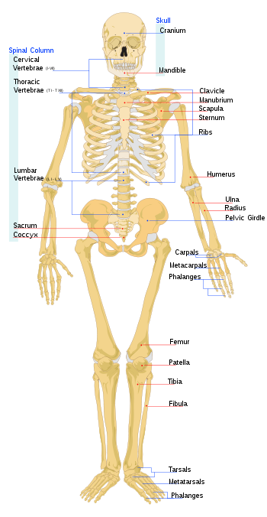
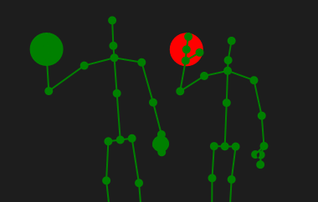
BodyFrameSource
Frame data is a collection of Body objects each with 25 joints
Each joint has position in 3D space and an orientation
Up to six simultaneous bodies
30fps
Hand State on 2 bodies
Lean
Notes:
Call out thumb and fingertip, hips, skeleton leaning

Slide 26
AudioFrameSource
Data is audio samples captured over a specific interval of time
Audio data is associated with an “audio beam”
A steerable “cone” of focus for audio
May be automatically or manually aimed

Slide 27
Other tools

Slide 28
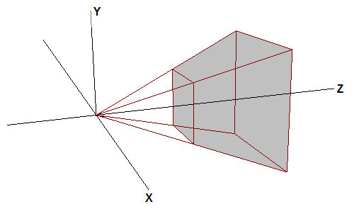
Coordinate mapping
Three coordinate systems
Coordinate mapper provides conversions between each system
Convert single or multiple points
Name | Applies to | Dimensions | Units | Range | Origin
ColorSpacePoint | Color | 2 | pixels | 1920x1080 | Top left corner
DepthSpacePoint | Depth, Infrared, Body index | 2 | pixels | 512x424 | Top left corner
CameraSpacePoint | Body | 3 | meters | – | Infrared/depth camera
Notes:
CameraSpacePoint was named SkeletonPoint in the V1 API. But it applies more generally, not only to Body joint positions, but to any point that is within the depth camera’s field of view. Hence, the new name.

Slide 29
MultiSourceFrameReader
Allows the app to get a matched set of frames from multiple sources on a single event
Caveat: Delivers frames at the lowest FPS of the selected sources
Notes:
Replaces AllFramesReady event in V1

Slide 30
Demo: Handle body frames and coordinate mapping

Slide 31
Processing body data
Every app is different in what it does with body data. However, some processing is almost always required
Smoothing
Selectively ignoring low-confidence data
Tracked vs. Inferred joints
Heuristics
Machine learning
…
Notes:
Guidance on using inferred joints

Slide 32
Other features
Activities, Appearance, Expression
EyeLeftClosed, EyeRightClosed, LookingAway, MouthMoved, MouthOpen, WearingGlasses, Happy expression, Neutral expression
Speech
HD Face
Unity
Fusion

Slide 33
Other Talks @ //build
Kinect 101: Introduction to Kinect for Windows
Wednesday, April 2nd 4-5pm, Room 3024
Building Windows, Windows Phone, and Xbox One Apps with HTML/JS/CSS & C++
Wednesday, April 2nd 1-2pm. Room 3024

Slide 34
Getting Started
Preorder v2 - Use your MS Store credit
Dev Center – http://aka.ms/k4wdev
More Info – http://kinectforwindows.com

Slide 35
Q & A

Slide 36
Your Feedback is Important
Fill out an evaluation of this session and help shape future events.
Scan the QR code to evaluate this session on your mobile device.
You’ll also be entered into a daily prize drawing!

Slide 37
© 2014 Microsoft Corporation. All rights reserved. Microsoft, Windows, Windows Vista and other product names are or may be registered trademarks and/or trademarks in the U.S. and/or other countries.
The information herein is for informational purposes only and represents the current view of Microsoft Corporation as of the date of this presentation. Because Microsoft must respond to changing market conditions, it should not be interpreted to be a commitment on the part of Microsoft, and Microsoft cannot guarantee the accuracy of any information provided after the date of this presentation. MICROSOFT MAKES NO WARRANTIES, EXPRESS, IMPLIED OR STATUTORY, AS TO THE INFORMATION IN THIS PRESENTATION.

