Slide 2
Windows Desktop Development Platform Advances
Steve Wright
Senior Program Manager
Windows Desktop Development Platform Advances

Slide 3
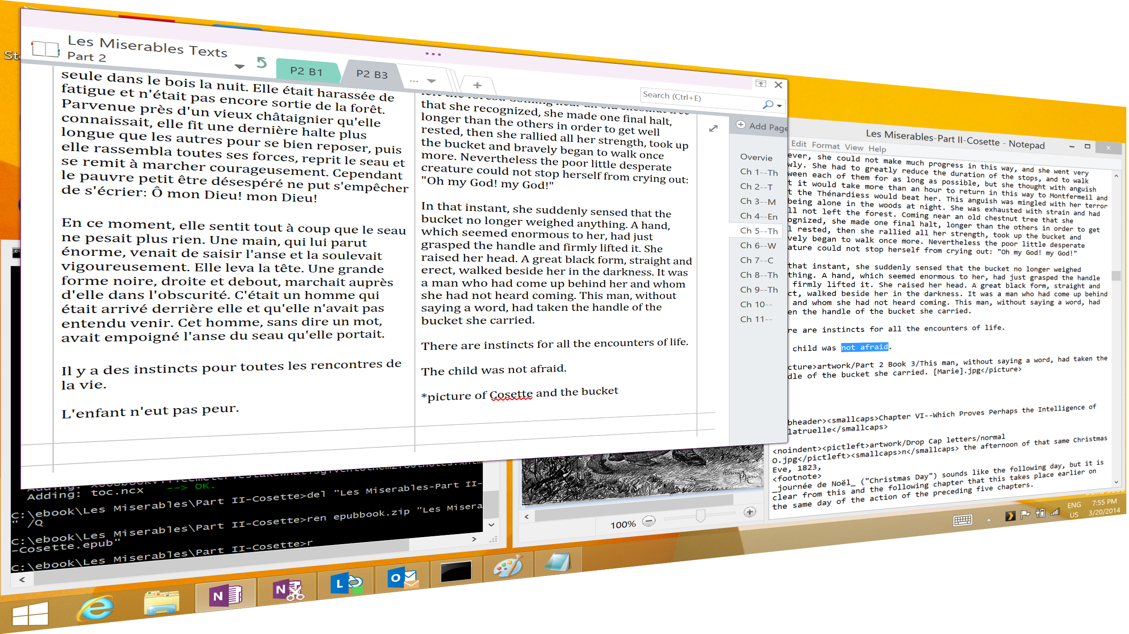
Agenda
Introduction
Windows platform
Form factors
Dense displays
Unified pointer events
Summary and other talks

Slide 4
Platform overviewp in a way that’s familiar
APIs
XAML
C / C++
XAML
HTML / CSS
HTML / CSS
C / C++
C# / VB
C# / VB
HTML
JS
C/C++
C#/VB
JavaScript
JavaScript
Windows Runtime
Windows Runtime
Windows Runtime
IE
WIN32
.NET /WPF/ SL
Input, Interaction, & Manipulation
DirectX, Media, & Composition
Windows Kernel Services
Windows Kernel Services

Slide 5
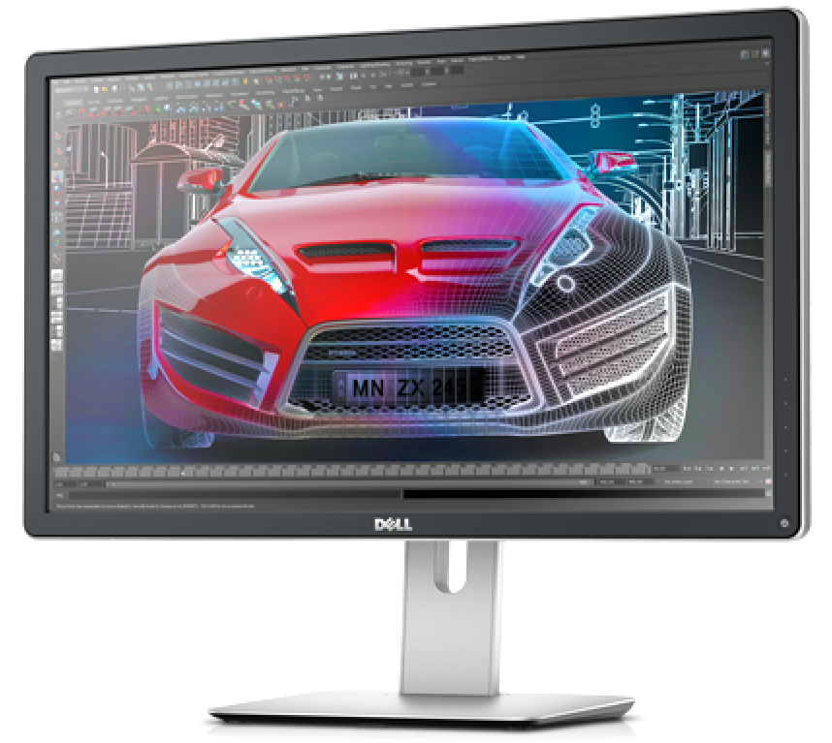
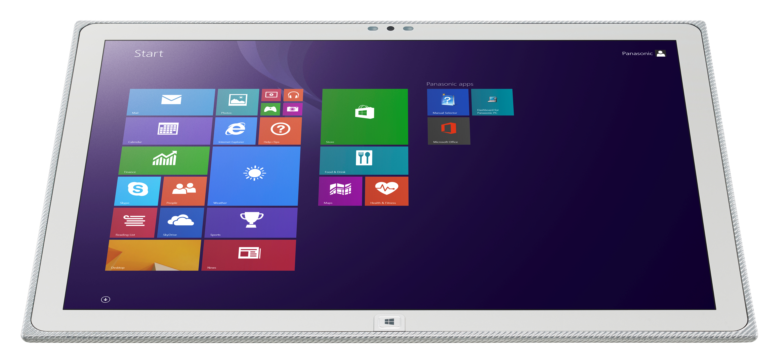
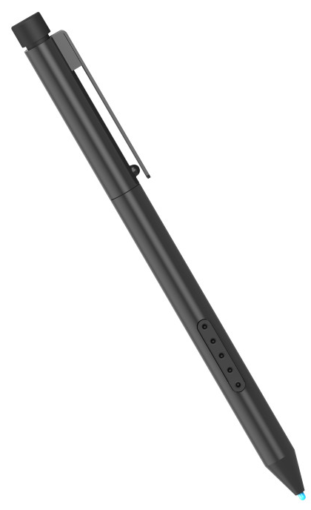
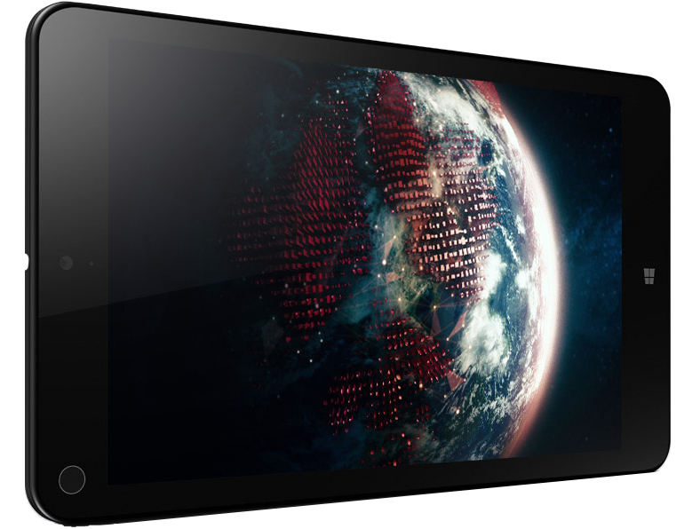
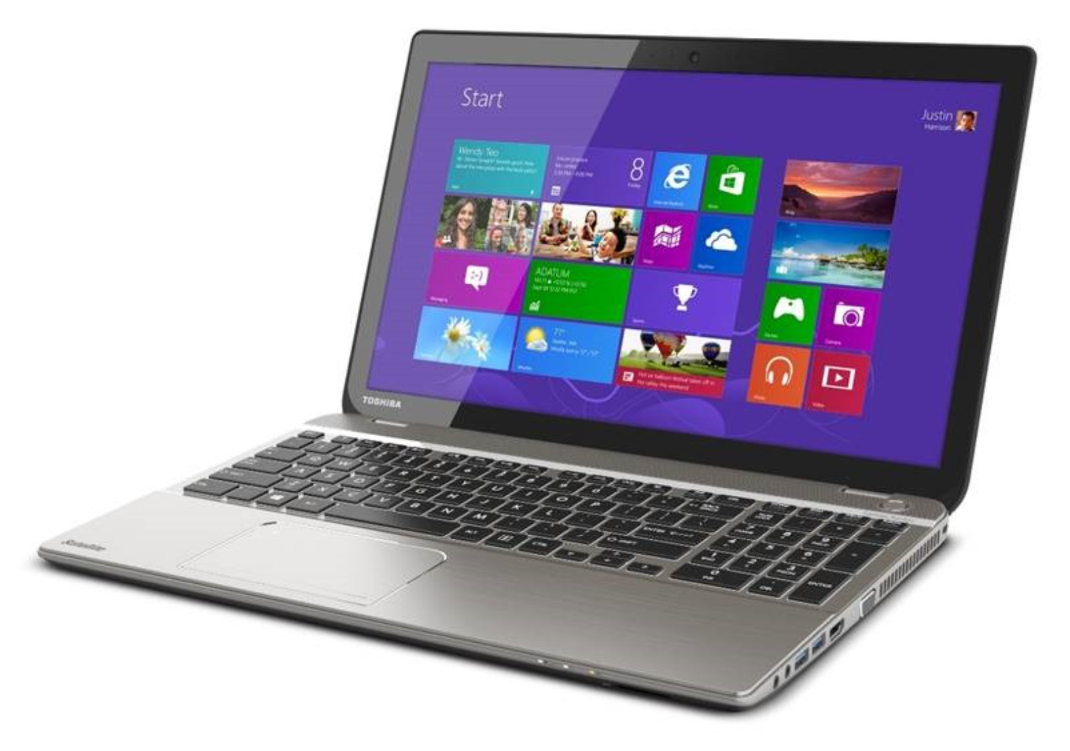
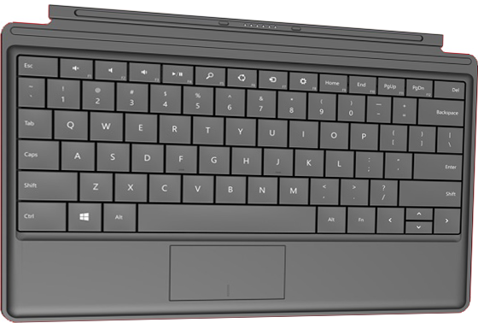
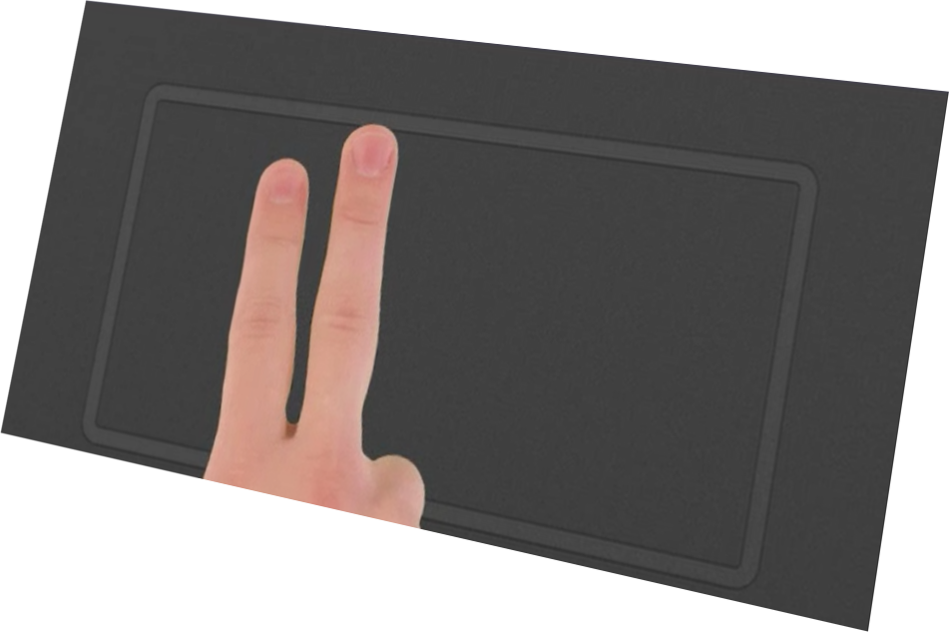
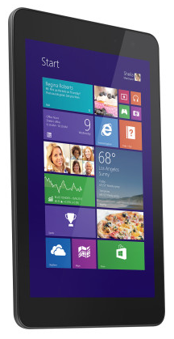
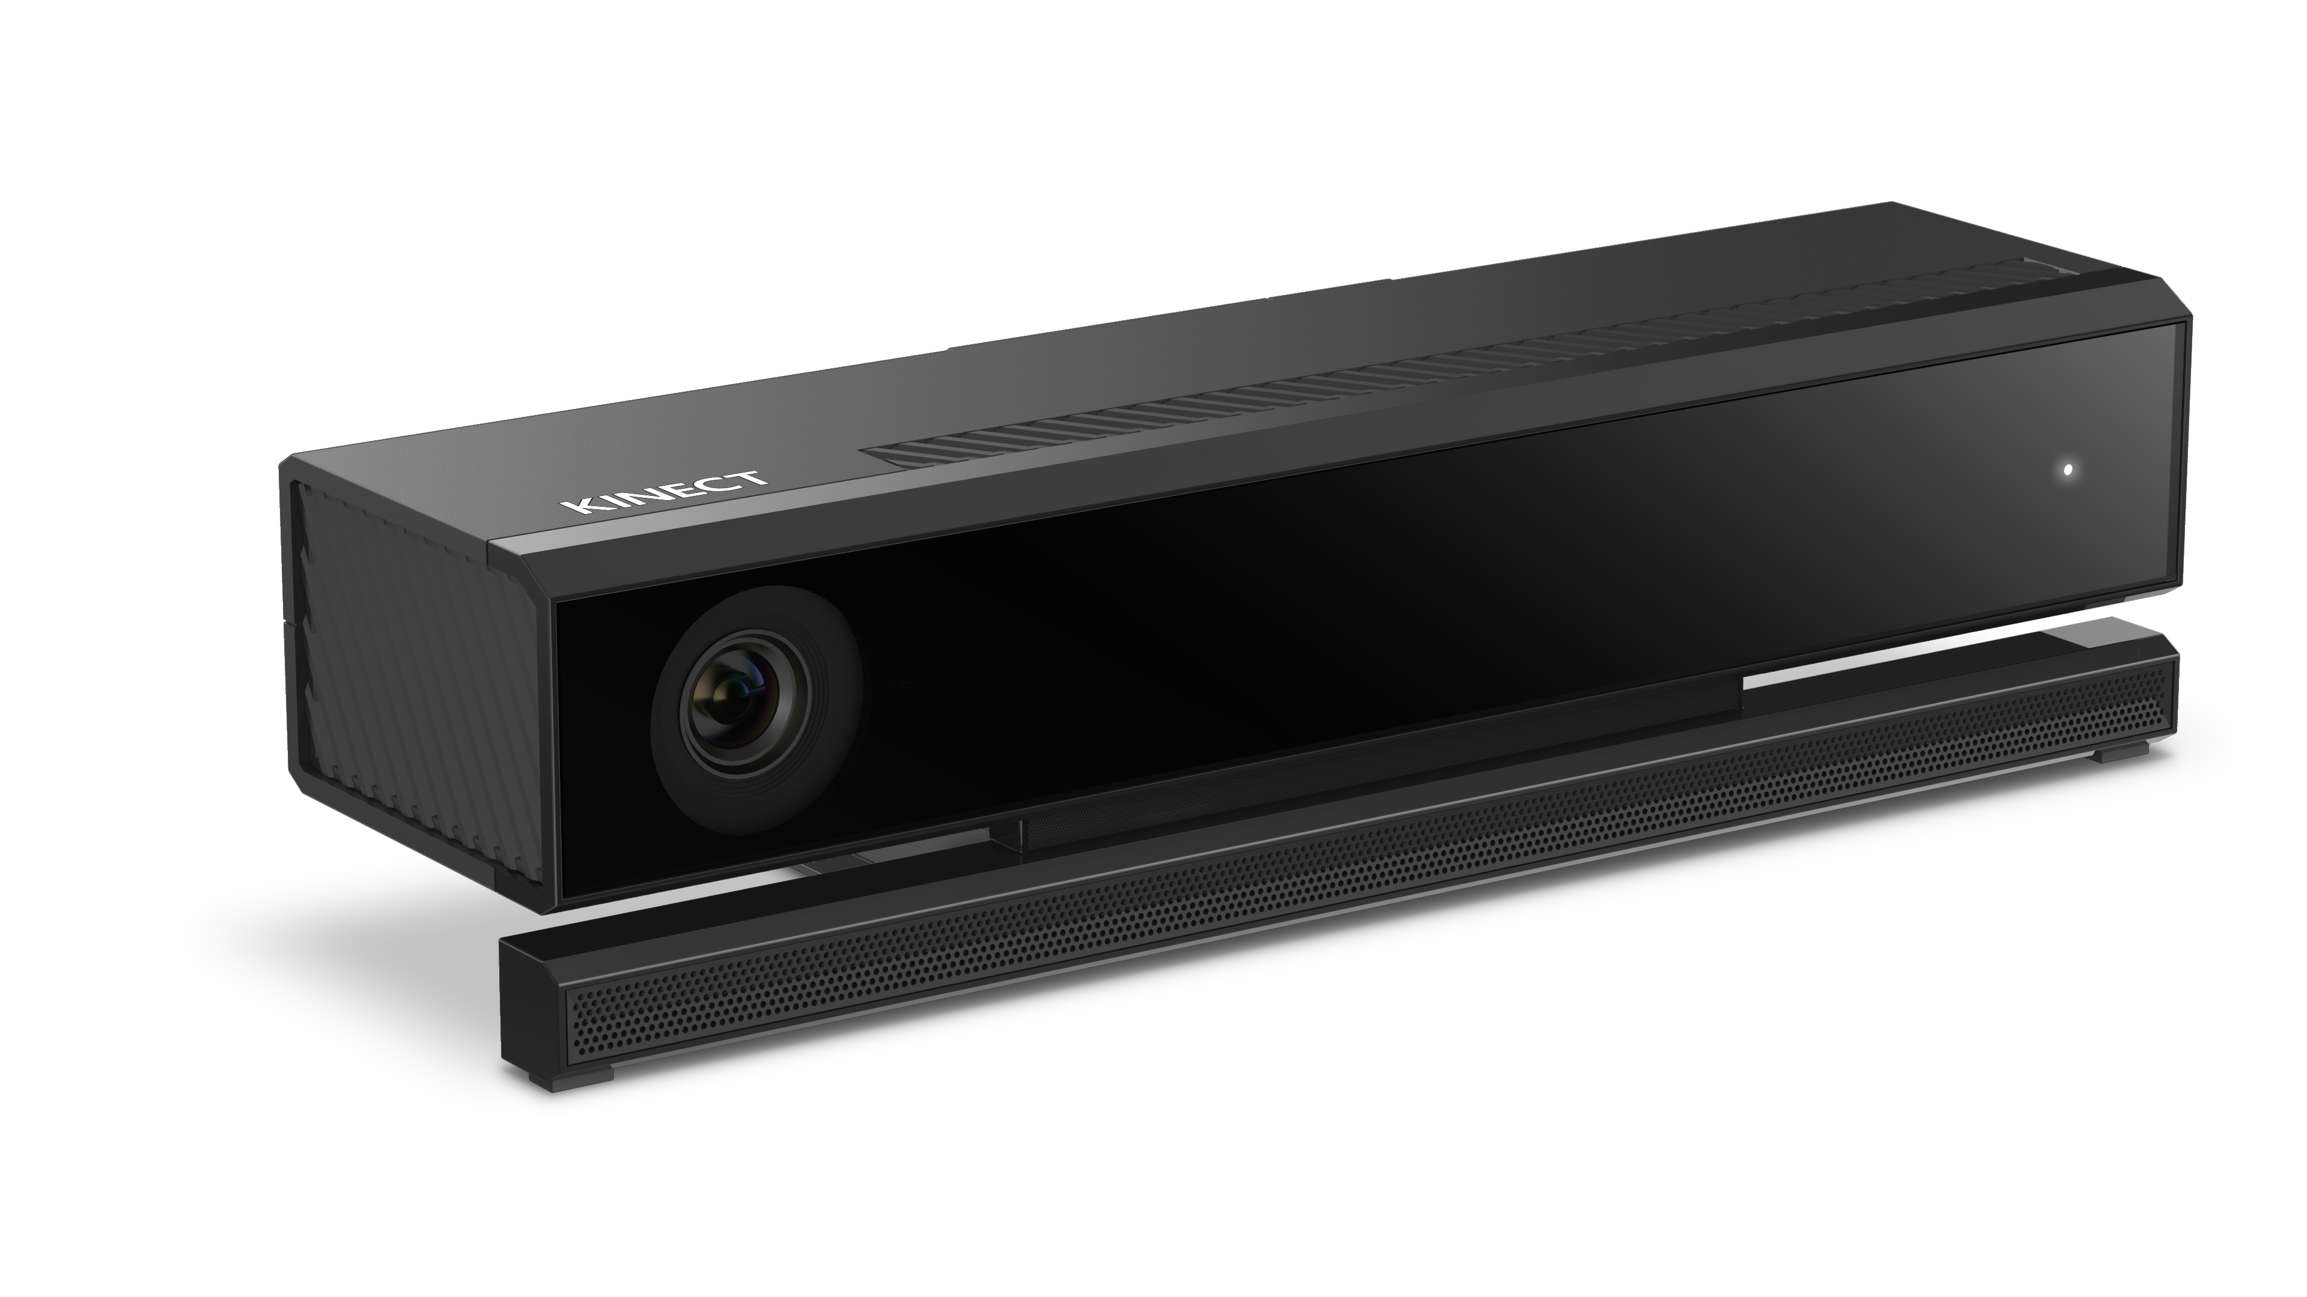
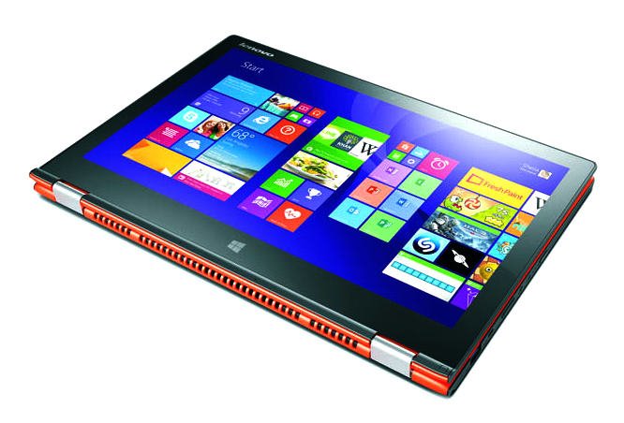
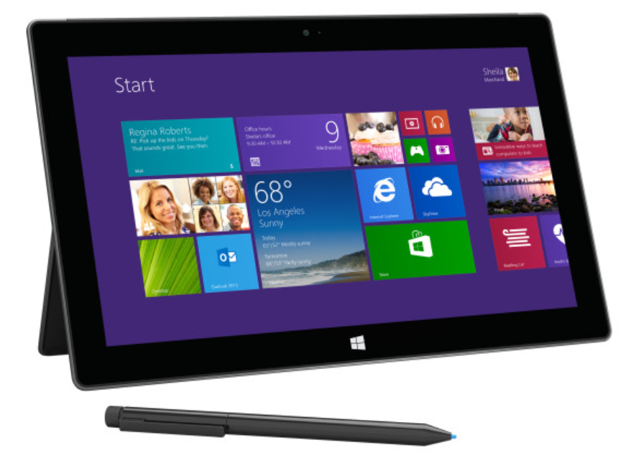
Form factors!

Slide 6
An exciting time to be developing desktop apps!
Write display-independent code that works at any display density
  And looks great on premium hardware
Write input-agnostic code that works well with any input device
  And takes advantage of the unique features of each class if of input
You can leverage or target all these new hardware options and form factors

Slide 7
Displays

Slide 8
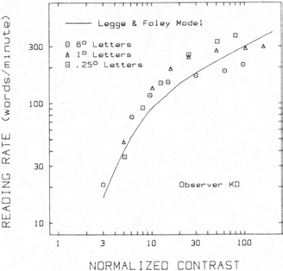


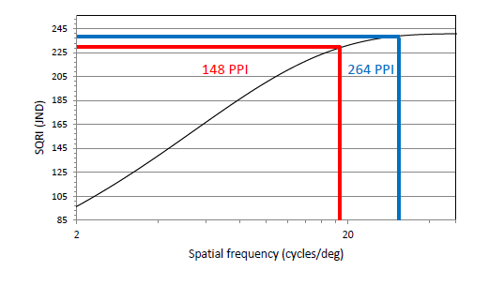
Contrast, vision, and productivity
DPI -> contrast
Contrast -> reading
Reading rate (words/minute)
Proxy for contrast
Proxy for pixel density
Proxy for contrast

Slide 9
Workstation in your pocket ...

Slide 10
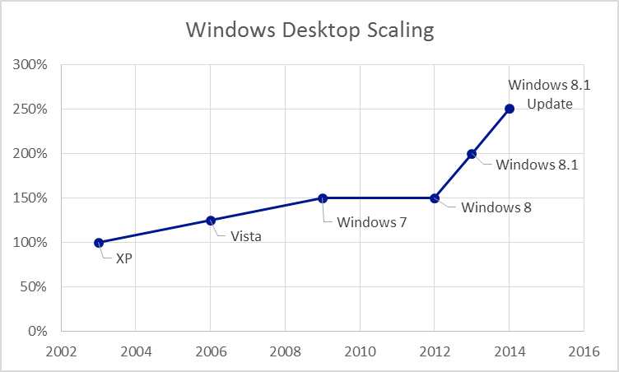
Accelerating pace of display scaling
Exciting times: rapid move towards much higher display densities

Slide 11
Displays will continue to move quickly
We – us, and you! – need to get ahead of the curve
150+% scaling: mainstream parts in 2015
4K (3840x2160): new wave of higher DPI parts:
8.1 + Update: 250% support for QHD+ & 4K
Display Size | DPI | Scaling
24” (Desktop) | 192 | 200%
15.6” (Laptop) | 296 | 250%
13.3” (Laptop) | 347 | TBD
10” (Laptop) | 461 | TBD

Slide 12
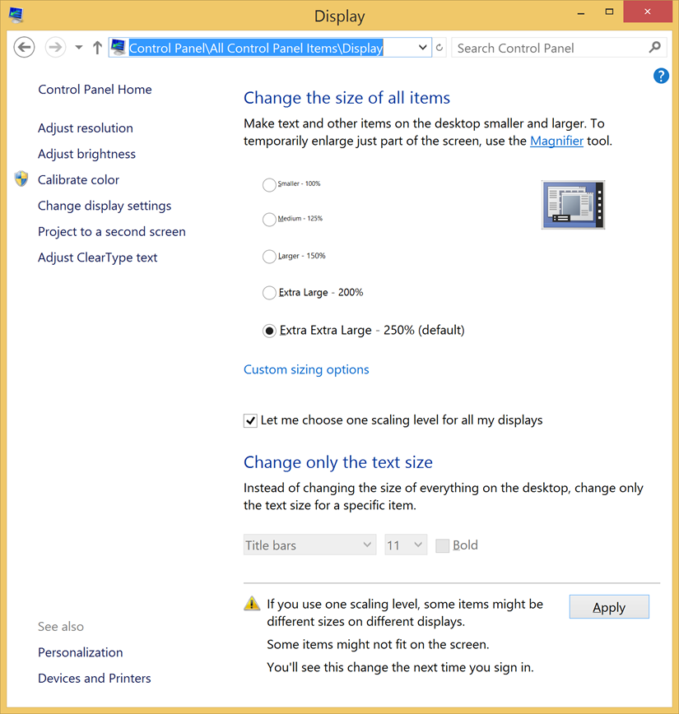
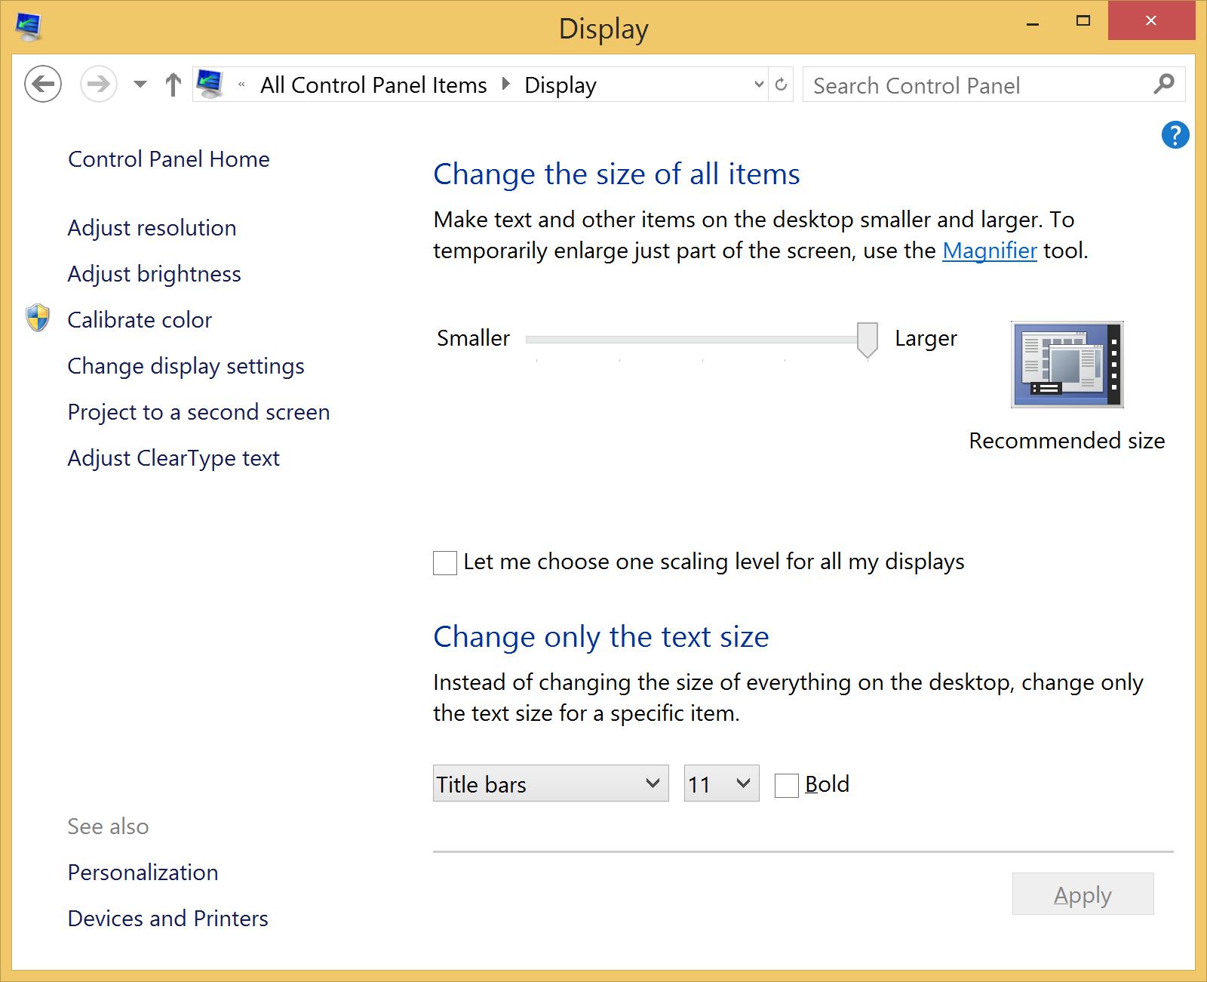
250% desktop scaling control in update

Slide 13
Challenges with desktop scaling
Assets
Scaleable UI
Testing
How can you design icons and other assets at various scale factors?
How do you write DPI aware code
How can you test at different DPI without a lot of hardware?

Slide 14
Writing DPI aware applications
Samples and tutorials at MSDN
Tell Windows your app scales itself
  Manifest setting: <dpiAware>Per monitor</dpiAware>
Ask Windows for scale factor
  GetDpiForMonitor(monitor, // per-monitor scaling MONITOR_DPI_TYPE::MDT_EFFECTIVE_DPI, &dpix,&dpiy);
Handle per-monitor scale changes
  WM_DPICHANGED // windows message

Slide 15
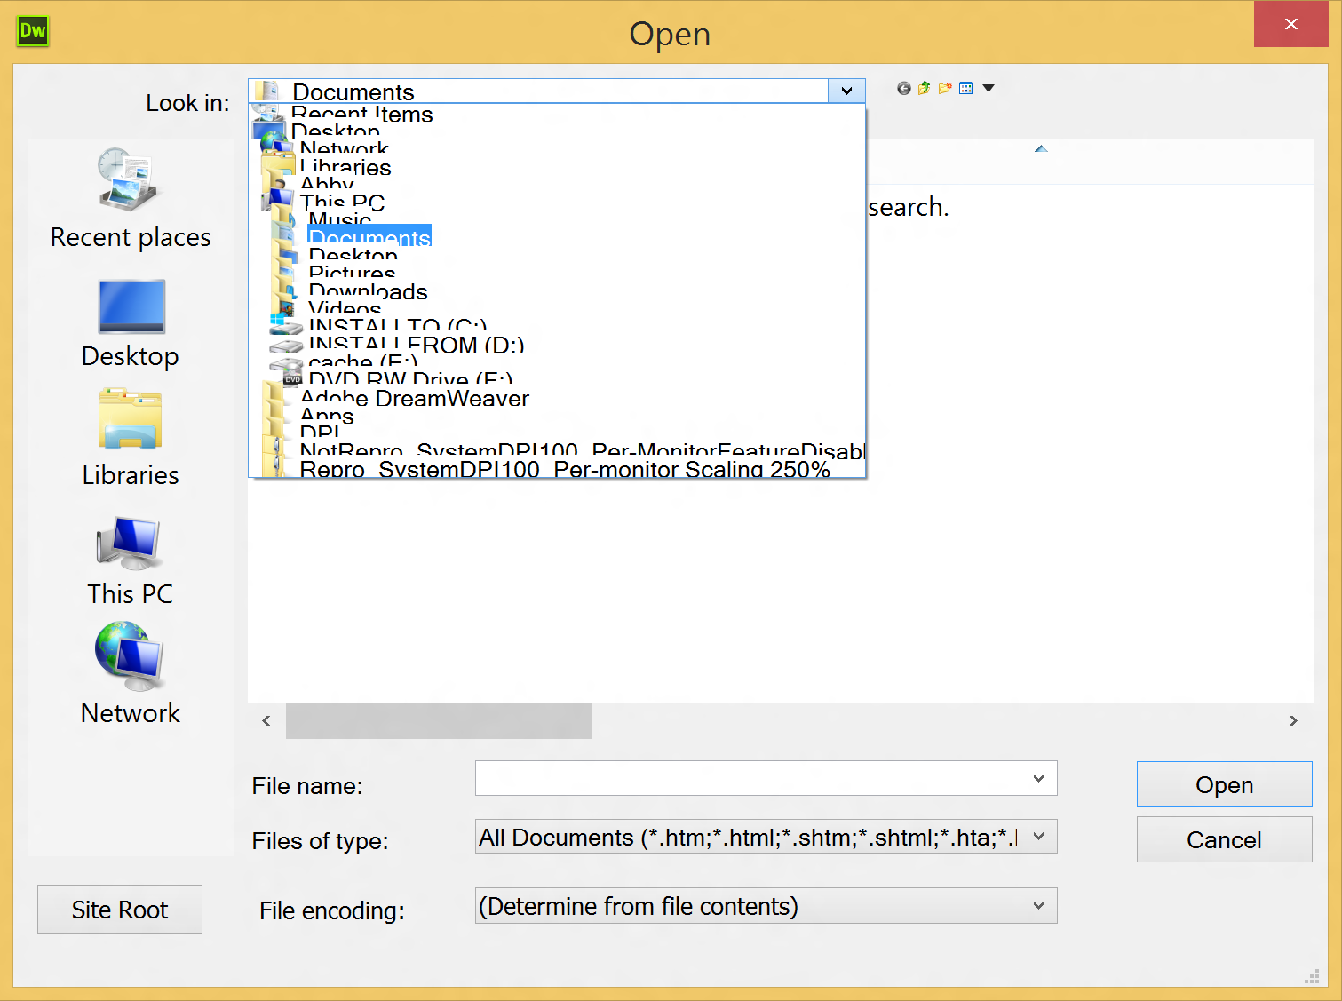
How can you test for the bugs?

Slide 16
How to test your app at high DPI
Everyone can validate their apps up to 500%!
Limited hardware? Remote desktop!
  Lets you set up a large virtual desktop that will support high DPI scaling
  Windows 8.1 RDP supports per-monitor scaling to the client machine
  We will be publishing a white paper with all the details
Call to action:
  When you add high DPI support, test it up to 500%
  Prioritize bugs at lower DPI, but fix well above 250% so your app doesn’t break if Windows needs to add higher scaling in the future!

Slide 17
Demo – RDP for testing scaling

Slide 18
How to have great assets at each scale factor
Vector graphics!
Color fonts!
Fixed assets
  Have to be tuned and tested for each scale level
  Doesn’t future proof the application against future possible scale levels
Consider vector assets as an alternative
  Color font glyphs make excellent containers for vector graphics
  Will look good at future plateaus
  Will look good at “in-between” scale factors
  Completes the scaling abstraction!

Slide 19
Demo – Color fonts

Slide 20
Importance of per-display scaling
Docking and multi-mon
Critical for best docking experience
  High DPI device docked to low DPI desktop display
Windows Runtime apps do this with framework scaling
  Vector scaling managed by framework on app’s behalf
  Desktop “Win32” apps have to scale themselves
WPF also provides framework support
  Updated sample showing how to get per-display scaling

Slide 21
Code peek – WPF scaling

Slide 22
Call to Action
Scale and test!
Display trends make high quality app scaling more and more urgent
  Competitive advantage if you get on board
  Disadvantage if you don’t and your competition does
  Support docking
  Test to very high DPI for future-proofing

Slide 23
Input

Slide 24
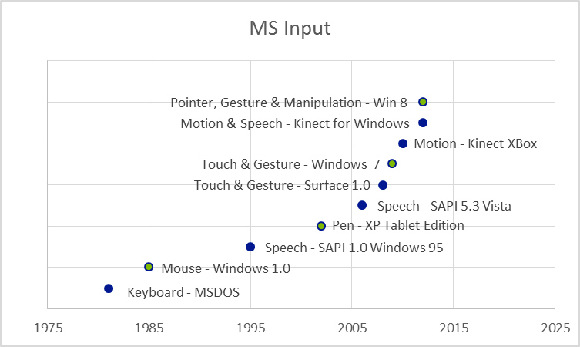
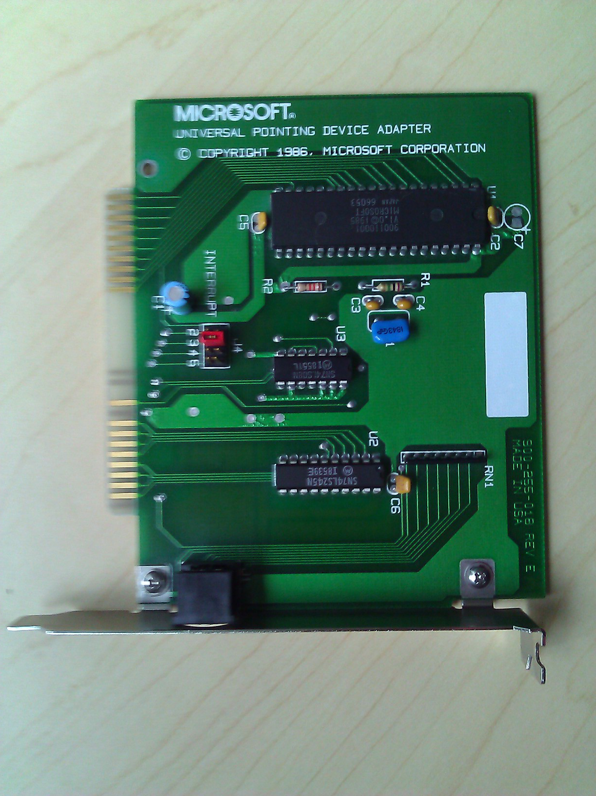
Accelerating pace of input innovation
Exciting times: acceleration of input modalities

Slide 25
Abstracting input modalities
Abstraction:
identifying common denominators and important differentiators
Start with the common denominator: a simple locator or pointer event
  Down, Move, Up – all these devices can generate these abstract events
  Exactly the support you need for most desktop apps!
Then go beyond common denominator
  Differentiators: pressure, tilt, contact, etc.
  Ways to move the user experience forward for specific form factors
  Apps that need them can get this data on demand
  Advanced pointer processing
  Multi-touch, gesture processing

Slide 26
Success stories for unified pointer
WinRT, XAML and HTML as pointer-first
New frameworks like XAML:
  pointer-only
Web is embracing pointer for DOM
  Win8/IE → W3C specification → Firefox, Chrome support
Major desktop apps moving to pointer
  Adobe Photoshop & Illustrator

Slide 27
“Using wm_pointer to paint is giving us ‘the best painting experience ever’ (internally referred to as ‘as smooth as butter’).”

Slide 28
Default desktop app input flow in 8 & 8.1
Default window message processing turns unhandled pointer messages into mouse messages

Slide 29
Default WinRT input flow in 8 & 8.1
Same, but preemptively wrap mouse in pointer.
You can enable this for desktop apps, too!

Slide 30
Code dive: migrating a simple app from mouse to pointer

Slide 31
Where does precision touchpad fit in?
Appears as mouse and input to DManip today
For traditional mouse interactions
  Generates mouse messages, or ...
  Pointer messages if you call EnableMouseinPointer() I
For pan and zoom
  Can drive DirectManipulation if your app consumes it
    Understand how input drives DManip in general: http://msdn.microsoft.com/en-us/library/windows/desktop/dn423905(v=vs.85).aspx
    Implement RegisterHitTestTarget method: http://msdn.microsoft.com/en-us/library/windows/desktop/Hh768905(v=vs.85).aspx
  Otherwise, Windows falls back on scrollwheel messages

Slide 32
How does Kinect fit in?
You got a coupon! How can you use it?
Ongoing investments in touch-free experiences in Kinect
  All these investments are exposed to desktop developers through Kinect for Windows
  See related sessions in this conference
  Kinect 101: Introduction to Kinect for Windows 4/2 4PM
  Kinect for Windows Session #2 4/3 4PM

Slide 33
Call to Action
Adopt pointer
Pointer: strategic forward direction
  Take control of your input handling
  Future proof your app against future hw innovations
  Reduce input latency for perf-critical interactions
  EnableMouseInPointer()

Slide 34
Resources
General desktop scaling:
  http://msdn.microsoft.com/en-us/library/windows/desktop/dn469266(v=vs.85).aspx
  http://msdn.microsoft.com/en-us/library/windows/desktop/dd464659(v=vs.85).aspx
  http://code.msdn.microsoft.com/DPI-Tutorial-sample-64134744
Updated WPF per-monitor scaling:
  Article: http://msdn.microsoft.com/en-us/library/windows/desktop/ee308410(v=vs.85).aspx
  Sample: http://code.msdn.microsoft.com/windowsdesktop/Per-Monitor-Aware-WPF-e43cde33
W3C unified pointer info:
  http://www.w3.org/TR/pointerevents/
Dell Venue 8 Pro driving four monitors video:
  https://www.youtube.com/watch?v=jPPY4m8iY0k
WinRT APIs for desktop developers:
  http://msdn.microsoft.com/en-us/library/windows/apps/windows.foundation.metadata.dualapipartitionattribute.aspx

Slide 35
Other BUILD 2014 talks with desktop dev content
Windows Desktop Development: A Panel Discussion - 4/3 12-12:40 2005
2-534: 3D Printing With Windows - Kris Iverson, Steve Olsson - 4/2 2:30-3:30PM 2005
2-514: Kinect 101: Introduction to Kinect for Windows - Chris White - 4/2 4-5PM 3024
3-541: From 4 to 40 Inches: Developing Windows Applications Across Multiple Form Factors - Peter Torr - 4/2 4-5PM 2018
2-501: Internet Explorer as a Web Application Platform - Joshn Holmes - 4/2 5:30-6:30PM 2018
3-510: Innovations in High Performance 2D Graphics with DirectX Across Windows and Windows Phone - Dan MacLachlan - 4/2 5:30-6:30PM 2014
3-580: Internet Explorer's Developer Tools, F12 Just Got Nicer (Again) - Andry Sterland - 4/3 2:30-3:30 3022
2-532: Kinect for Windows Session #2 - Kevin Kennedy 4/3 4-5PM 2004

Slide 36
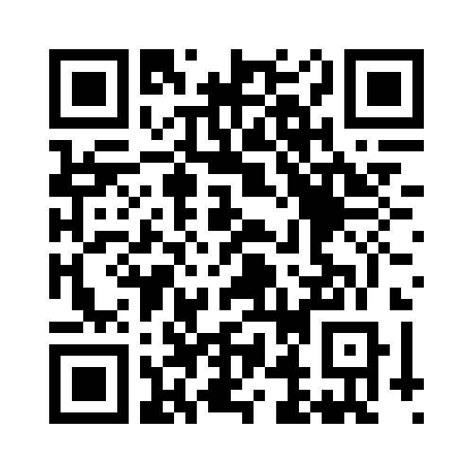
Your Feedback is Important
Fill out an evaluation of this session
and help shape future events.
Scan the QR code to evaluate
this session on your mobile device.
You’ll also be entered into
a daily prize drawing!

Slide 37

© 2014 Microsoft Corporation. All rights reserved. Microsoft, Windows, Windows Vista and other product names are or may be registered trademarks and/or trademarks in the U.S. and/or other countries.
The information herein is for informational purposes only and represents the current view of Microsoft Corporation as of the date of this presentation. Because Microsoft must respond to changing market conditions, it should not be interpreted to be a commitment on the part of Microsoft, and Microsoft cannot guarantee the accuracy of any information provided after the date of this presentation. MICROSOFT MAKES NO WARRANTIES, EXPRESS, IMPLIED OR STATUTORY, AS TO THE INFORMATION IN THIS PRESENTATION.

