Slide 2
Build for Both Building a Converged Phone and PC App using HTML and JavaScript
2-540
Josh Williams, Engineer
Ryan J. Salva, Program Manager

Slide 3
Why are we here?
Universal Projects
WinJS Controls
Tools
Write code!

Slide 4
Demographics

Slide 5
WinJS.Application Lifecycle

onactivated
Check ActivationKind to find out what is being activated
(e.g. launch, shareTarget, file, contactPicker)

oncheckpoint
Save WinJS.Application.sessionState before your app
suspends

onsettings
Populate the settings flyout with WinJS.UI.SettingsFlyout.populateSettings(e);

onerror
Capture unhandled exceptions

Slide 6
Take-aways
You can build apps for both
You can share most of your code
You can do it quickly
Its easy to customize for each platform

Slide 7
Resources
Other sessions
[2-506] What’s New in WinJS: The Road Ahead
[3-508] HTML5 Platform from Web Apps
[3-579] Diagnosing Issues with Windows Phone JS Apps Using Visual Studio
Today: https://2540.codeplex.com
WinJS: http://github.com/winjs/winjs

Slide 8
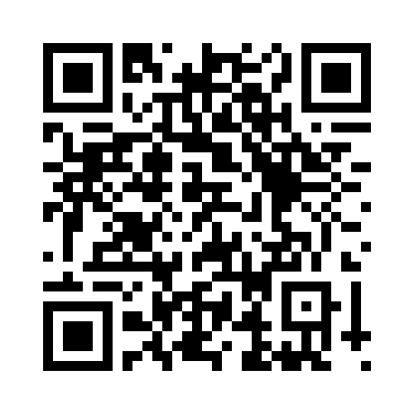
Your Feedback is Important
Fill out an evaluation of this session and help shape future events.
Scan the QR code to evaluate this session on your mobile device.
You’ll also be entered into a daily prize drawing!

Slide 9
© 2014 Microsoft Corporation. All rights reserved. Microsoft, Windows, Windows Vista and other product names are or may be registered trademarks and/or trademarks in the U.S. and/or other countries.
The information herein is for informational purposes only and represents the current view of Microsoft Corporation as of the date of this presentation. Because Microsoft must respond to changing market conditions, it should not be interpreted to be a commitment on the part of Microsoft, and Microsoft cannot guarantee the accuracy of any information provided after the date of this presentation. MICROSOFT MAKES NO WARRANTIES, EXPRESS, IMPLIED OR STATUTORY, AS TO THE INFORMATION IN THIS PRESENTATION.

